Slide 1

Relationship between Sleep Deprivation and Risk of Cardiovascular Diseases:
– A Narrative Review
Presented by- Dr. Apurva Ahuja, PG/23/023
Faculty Mentor- Dr. Sukesh Bhardwaj
IIHMR, Delhi

Slide 2
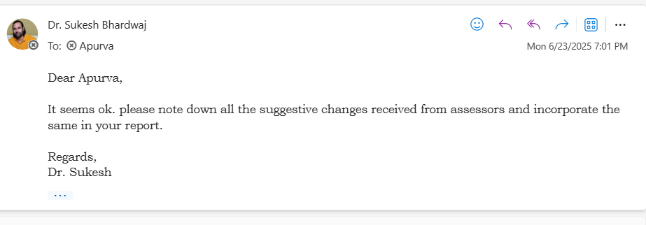
Mentor Approval

Slide 3
Definitions of Sleep Deprivation
Source | Definition
American Academy of Sleep Medicine (AASM) | Sleep deprivation occurs when an individual fails to get enough sleep.
National Institutes of Health (NIH) | A condition that occurs if you don't get enough sleep. It is a component of the broader concept of "sleep deficiency," which also includes sleeping at the wrong time or having poor quality sleep.
Centers for Disease Control and Prevention (CDC) | Getting less sleep than needed. It leads to tiredness, sleepiness, and declines in brain functioning such as response rate, thinking, remembering, and concentration.
International Classification of Sleep Disorders (ICSD-3) | A curtailed sleep pattern that has persisted for at least three months for most days of the week, along with complaints of sleepiness during the day.

Slide 4
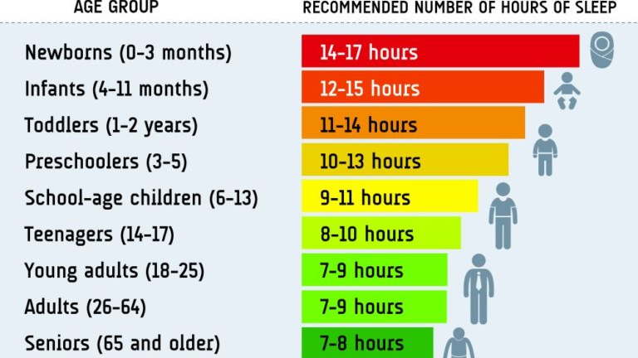
https://www.sleepfoundation.org/

Slide 5
Introduction
Sleep deprivation has emerged as a significant public health concern worldwide, with modern lifestyles, work demands, and social pressures contributing to a steady decline in average sleep duration.
According to the US Centers for Disease Control and Prevention, over one-third (35%) of adults in the United States report sleeping less than the recommended 7 hours per night, a trend mirrored globally. Large-scale studies, such as the UK Biobank project, have found that approximately 21.8% of participants were classified as sleep deprived, defined as obtaining less than 7 hours of sleep per night.
The prevalence of cardiovascular diseases (CVDs) is also alarmingly high, making them the leading cause of morbidity and mortality worldwide. Acc to WHO, An estimated 17.9 million people died from CVDs in 2019, representing 32% of all global deaths. Of these deaths, 85% were due to heart attack and stroke.
Cardiovascular disease (CVD) prevention traditionally focused on:
  Diet
  Physical activity
  Smoking cessation
  Managing hypertension & cholesterol
Sleep was historically seen as a passive process—not an active health determinant.

Slide 6
Recent evidence, however, has shifted this view, positioning sleep as a core pillar of cardiovascular health, equal in importance to other lifestyle factors.
In 2022, the American Heart Association updated its health metrics from "Life’s Simple 7" to "Life’s Essential 8", adding sleep duration.
Given the high prevalence of both sleep deprivation and cardiovascular diseases, and the accumulating evidence linking insufficient sleep with adverse cardiovascular outcomes, it is crucial to further investigate this association. Understanding the magnitude, mechanisms, and modifiable factors underlying this relationship will be essential for informing public health strategies and clinical interventions aimed at reducing the global burden of CVD.
This review synthesizes the evidence establishing sleep as an indispensable pillar of cardiovascular health, details the pathophysiological mechanisms linking sleep loss to vascular injury, and examines the clinical manifestations and modulating factors that influence this complex relationship.

Slide 7
Objectives of Your Study
Primary Objective:
To assess the association between sleep deprivation and the risk of developing cardiovascular diseases, based on current evidence.
Secondary Objectives:
To explore the role of specific sleep-related factors—such as sleep quality, duration, and disorders (e.g., insomnia, obstructive sleep apnea)—in contributing to cardiovascular risk.
To identify and analyze population-level modifiers (age, gender, occupation) and underlying biological mechanisms (autonomic, inflammatory, metabolic) influencing this relationship.

Slide 8
Methodology (1/2)
Study Design: Narrative Review
Search Strategy:
A term-based literature search was conducted in major databases including PubMed, and Google Scholar , with articles from 1990 to 2024 being considered.
The search focused on peer-reviewed journal articles, systematic reviews, and meta-analyses.
Keywords Used:
"sleep deprivation," "insufficient sleep," "insomnia," "obstructive sleep apnea," "cardiovascular disease," "hypertension," "coronary artery disease," "stroke."
Boolean operators (AND, OR) were utilized to refine searches.

Slide 9
Methodology (1/2)
Study Design: Narrative Review
Search Strategy:
  Databases Used: PubMed
  Keywords Used: "sleep deprivation," "insufficient sleep," "insomnia," "obstructive sleep apnea," "cardiovascular disease," "hypertension," "coronary artery disease," "stroke."
  Boolean operators (AND, OR) were utilized to refine searches.
Filters Applied:
  Publication years: Last 15 years
  Language: English
  Population: Human adults (18+)
  Article types:
    Meta-analyses
    Systematic reviews
    Randomized controlled trials (RCTs)
    Observational studies
    Scoping reviews

Slide 10
Methodology (2/2)
Selection Process:
The review prioritized studies involving adult human populations and focused on synthesizing evidence regarding the epidemiological associations, pathophysiological mechanisms, and clinical outcomes linking sleep health to cardiovascular status.
Relevant guidelines and scientific statements from organizations such as the American Heart Association (AHA) were also manually searched and incorporated to provide a current and authoritative perspective.
The process continued until saturation was achieved, where core findings and mechanisms were consistently repeated across the literature.

Slide 11
Methodology (2/2)
Article Selection Process
1. Initial Yield: ~1,000 articles identified through keyword search
2. Screening Process:
  Title screening → shortlisted 150 articles
  Abstract screening → selected 20 core articles
3. Inclusion Criteria:
Direct relevance to cardiovascular impact of sleep deprivation.
The review focused on synthesizing evidence regarding the epidemiological associations, pathophysiological mechanisms, and clinical outcomes linking sleep health to cardiovascular status.
Relevant guidelines and scientific statements from organizations such as the American Heart Association (AHA) were also manually searched and incorporated to provide a current and authoritative perspective.
4. Saturation Point: Further literature showed repetitive findings

Slide 12
Results (1/4)
The U-Shaped Risk Curve
Decades of epidemiological evidence reveal a consistent "U-shaped" relationship between sleep duration and cardiovascular risk.
Both extremes of sleep duration are associated with a significantly higher risk for cardiovascular disease (CVD) and mortality compared to those sleeping a moderate duration.
Optimal Duration: The lowest point of risk is consistently found in the range of 7 to 8 hours per night.
Quantified Risk (Cappuccio et al., 2011 Meta-Analysis):
  a. Short Sleep: Associated with a 48% greater risk of Coronary Heart Disease (CHD) and a 15% greater risk of stroke.
  b. Long Sleep: Associated with a 38% greater risk of CHD and a 65% greater risk of stroke.

Slide 13
Results (2/4)
The Conundrum of Long Sleep
While the link between long sleep (>9 hours) and adverse CVD outcomes is robust, its interpretation is a subject of considerable debate.
Prevailing Hypothesis: Long sleep is likely a marker of underlying, often undiagnosed, health problems rather than a direct cause of CVD.
Potential Confounding Factors:
  Underlying subclinical diseases (e.g., chronic inflammation, early-stage heart failure, cancer).
  Psychosocial factors like depression.
  Low socioeconomic status and physical inactivity.
Genetic Evidence: Mendelian randomization (MR) studies, which minimize confounding, support a causal link for short sleep and CVD but have consistently failed to find a similar causal link for long sleep.

Slide 14
Results (3/4)
Increased Risk of Specific Diseases
Hypertension: Habitual short sleep (<6 hours) is associated with a 20-60% increased risk of developing hypertension, an effect particularly pronounced in middle-aged adults and women.
Coronary Artery Disease (CAD): Individuals sleeping less than six hours per night have approximately a 48% higher risk of a CHD event. Poor sleep quality has also been identified as an independent risk factor.
Stroke: The risk generally follows a U-shaped curve, but some data suggest long sleep may confer an even greater relative risk for stroke than short sleep. The evidence remains complex and inconsistent.
Heart Failure (HF): The relationship is strongly bidirectional. Poor sleep (especially sleep-disordered breathing) is a potent risk factor for developing HF, and HF symptoms in turn severely disrupt sleep, creating a vicious cycle of decline.

Slide 15
Results (4/4)
How Sleep Loss Causes Vascular Injury
Sleep deprivation disrupts the body's state of cardiovascular rest and repair through three interconnected pathways:
Autonomic Nervous System (ANS) Dysfunction: Leads to "sympathetic overdrive" and disrupts the normal 10-20% drop in blood pressure during sleep (nocturnal "dipping"), a key protective mechanism.
Systemic Inflammation & Endothelial Dysfunction: Triggers a potent, low-grade inflammatory response (e.g., elevated hs-CRP). This inflammation damages the endothelium (the lining of blood vessels), which is considered the initiating event in atherosclerosis.
Metabolic & Endocrine Derangements: Causes insulin resistance (a temporary pre-diabetic state) and disrupts appetite-regulating hormones (decreased leptin, increased ghrelin), promoting obesity and type 2 diabetes.

Slide 16
Summary of a few key Studies Examining the Association Between Sleep and Cardiovascular Disease and its Risk Factors
Study (First Author, Year) | Design | Participants | Key Findings
Cappuccio et al. (2011) | Meta-analysis of prospective studies | 474,684 participants from 15 studies | Both short (≤5-6 h) and long (≥8-9 h) sleep durations were associated with a significantly greater risk of developing or dying from coronary heart disease and stroke, demonstrating a clear U-shaped relationship.
Meier-Ewert et al. (2004) | Experimental study | 20 healthy adults in two separate protocols | Both acute total sleep deprivation (88 hours) and chronic partial sleep restriction (4.2 h/night for 10 days) resulted in a significant, dose-dependent increase in high-sensitivity C-reactive protein (hs-CRP), a key inflammatory marker for cardiovascular risk.
Vgontzas et al. (2009) | Prospective cohort study (Penn State Cohort) | 1,741 men and women | Insomnia combined with objectively measured short sleep duration (<6 hours via polysomnography) was associated with a significantly higher risk of developing incident hypertension compared to normal sleepers.
Huang et al. (2020) | Prospective cohort study (Multi-Ethnic Study of Atherosclerosis) | 1,992 participants | Greater irregularity in sleep duration (>2 hours variation over a week) and sleep timing (>90 minutes variation) were independently associated with a higher risk of subsequent cardiovascular events over a 5-year follow-up.
McEvoy et al. (2016) | Randomized Controlled Trial (SAVE trial) | 2,717 patients with moderate-to-severe OSA and established cardiovascular disease | Treatment with continuous positive airway pressure (CPAP) did not significantly reduce the rate of major adverse cardiovascular events compared to usual care, though patient adherence to therapy was a noted limitation.

Slide 17
Discussion (1/2)
Clinical Nuances and the Treatment Paradox
A Critical Distinction: For clinical practice, it is vital to differentiate between behavioral sleep loss and primary sleep disorders, which have unique risk profiles and drivers.
  Behavioral Sleep Deprivation: Insufficient sleep due to lifestyle/work.
  Insomnia Disorder: Difficulty sleeping despite adequate opportunity; driven by 24-hour psychophysiological hyperarousal.
  Obstructive Sleep Apnea (OSA): A breathing disorder driven by intermittent hypoxia and large pressure swings. Key stat: About 80% of people with resistant hypertension have OSA — it’s that common and serious.
The Treatment Paradox:
  While treatments like CPAP for OSA are highly effective at correcting the underlying physiology, large clinical trials have yielded mixed results in reducing "hard" cardiovascular events like heart attacks or strokes.
  This may be due to poor patient adherence or because vascular damage is too advanced by the time of treatment, highlighting the critical need for earlier detection and primary prevention.

Slide 18
Discussion (2/2)
Heterogeneity of Risk & Vulnerable Populations
The cardiovascular risk from poor sleep is not uniform across the population.
Gender: Women may be more vulnerable to the inflammatory and hypertensive effects of sleep loss. Hormonal changes during pregnancy and menopause represent periods of heightened risk.
Lifespan:
  Adolescents: Face a "perfect storm" from a biological shift to a later sleep cycle clashing with early school start times, leading to chronic sleep debt and the early development of CVD risk factors.
  The Elderly: The association can become more complex and may weaken, possibly due to a "survivor effect" or the confounding influence of multiple other health conditions.
Shift Work: Serves as a real-world model of combined sleep loss and circadian disruption and is an independent risk factor for CVD, with studies suggesting a risk increase of up to 40%.

Slide 19
Conclusion
Synthesis & Future Directions
Synthesis: The cumulative evidence is unequivocal: sleep is a biological necessity and a fundamental pillar of cardiovascular health, co-equal with diet and exercise. Insufficient, poor-quality, or irregular sleep is a significant, modifiable risk factor for cardiovascular disease.
Critical Knowledge Gaps: Key unanswered questions remain regarding the causality of long sleep, the independent impact of sleep quality and regularity, and definitive proof from intervention trials that improving sleep prevents major cardiovascular events.
Future Research Agenda: Priorities include:
  Moving beyond duration to study multidimensional sleep health (quality, regularity, architecture).
  Test if improving sleep really lowers the risk of actual heart events
  Make sure research includes vulnerable populations who may face worse sleep and heart outcomes due to social, economic, or racial factors.
  Translating findings into actionable public health policy (e.g., Promoting sleep awareness in heart health programs, healthier shift work schedules).

Slide 20
References
I. Foundational Reviews & Core Epidemiology
Cappuccio FP, D'Elia L, Strazzullo P, Miller MA. Sleep duration and cardiovascular disease: a systematic review and meta-analysis of prospective studies. Eur Heart J. 2011;32(12):1484-92.
Lloyd-Jones DM, Allen NB, Anderson CAM, Black T, Brewer LC, Foraker RE, et al. Life's Essential 8: Updating and Enhancing the American Heart Association's Construct of Cardiovascular Health. Circulation. 2022;146(5):e18-e43.
Nagai M, Hoshide S, Kario K. Sleep Duration as a Risk Factor for Cardiovascular Disease- a Review of the Recent Literature. J Atheroscler Thromb. 2010;17(3):159-67.
Yin J, Jin X, Shan Z, Li S, Huang H, Li P, et al. Relationship of sleep duration with all-cause mortality and cardiovascular events: a systematic review and dose-response meta-analysis of prospective cohort studies. J Am Heart Assoc. 2017;6(9):e005947.
Huang T, Mariani S, Redline S. Sleep Irregularity and Risk of Cardiovascular Events: The Multi-Ethnic Study of Atherosclerosis. J Am Coll Cardiol. 2020;75(9):991-9.
Ikehara S, Iso H, Date C, Kikuchi S, Tamakoshi A; JACC Study Group. Association of Sleep Duration With Mortality From Cardiovascular Disease and Other Causes for Japanese Men and Women: The JACC Study. Sleep. 2009;32(3):295-301.
Ferrie JE, Shipley MJ, Cappuccio FP, Brunner E, Miller MA, Kumari M, et al. A psychobiological explanation for the social gradient in sleep: the Whitehall II study. Lancet. 2007;370(9587):609-11.

Slide 21
References
II. Pathophysiological Mechanisms
Mullington JM, Haack M, Toth M, Serrador JM, Meier-Ewert HK. Cardiovascular, inflammatory, and metabolic consequences of sleep deprivation. Prog Cardiovasc Dis. 2009;51(4):294-302.
Meier-Ewert HK, Ridker PM, Rifai N, Regan MM, Price NJ, Dinges DF, et al. Effect of sleep loss on C-reactive protein, an inflammatory marker of cardiovascular risk. J Am Coll Cardiol. 2004;43(4):678-83.
Spiegel K, Leproult R, Van Cauter E. Impact of sleep debt on metabolic and endocrine function. Lancet. 1999;354(9188):1435-9.
Kato M, Phillips BG, Sigurdsson G, Narkiewicz K, Pesek CA, Somers VK. Effects of sleep deprivation on nightly ambulatory blood pressure in healthy humans. Circulation. 2000;101(24):2961-7.
Knutson KL, Van Cauter E. Associations between sleep loss and increased risk of obesity and diabetes. Ann N Y Acad Sci. 2008;1129:287-304.
Irwin MR. Sleep and inflammation: partners in sickness and in health. Nat Rev Immunol. 2019;19(11):702-15.
Calvin AD, Covassin N, Krolo Jalusic K, Johnson G, Scott CG, Bukartyk J, et al. Experimental sleep restriction induces endothelial dysfunction in healthy adults. J Am Heart Assoc. 2013;2(3):e000104.

Slide 22
References
III. Specific Sleep Disorders & Clinical Outcomes
Vgontzas AN, Liao D, Bixler EO, Chrousos GP, Vela-Bueno A. Insomnia with objective short sleep duration is associated with a high risk for hypertension. Sleep. 2009;32(4):491-7.
Sofi F, Cesari F, Casini A, Macchi C, Abbate R, Gensini GF. Insomnia and risk of cardiovascular disease: a meta-analysis. Eur J Prev Cardiol. 2014;21(1):57-64.
Palagini L, Bruno RM, Gemignani A, Baglioni C, Ghiadoni L, Riemann D. Insomnia and cardiovascular disease: a systematic review. Sleep Med Rev. 2013;17(3):165-72.
Somers VK, White DP, Amin R, Abraham WT, Costa F, Culebras A, et al. Sleep apnea and cardiovascular disease: an American Heart Association/American College of Cardiology Foundation scientific statement from the American Heart Association Council for High Blood Pressure Research Professional Education Committee, Council on Clinical Cardiology, Stroke Council, and Council on Cardiovascular Nursing. Circulation. 2008;118(10):1080-111.
Javaheri S, Redline S. Insomnia and Obstructive Sleep Apnea. Chest. 2017;152(2):435-44.
Kou L, Liu S, Li Y, Wang Z, Zhang W. Association between sleep duration and risk of hypertension: a meta-analysis of prospective cohort studies. J Hum Hypertens. 2021;35(10):867-76.

Slide 23
References
IV. Vulnerable Populations & Special Topics
Vyas MV, Garg AX, Iansavichus AV, Costella J, Donner A, Laugsand LE, et al. Shift work and vascular events: systematic review and meta-analysis. BMJ. 2012;345:e4800.
Tobaldini E, Cogliati C, Fiorelli EM, Nunziata V, Wu MA, Montano N. The impact of shift work on cardiovascular health. Int J Cardiol. 2017;230:31-7.
Zhong X, He L, Chen G, Pang D, Zhang L. The effect of shift work on endothelial function in healthy subjects. J Occup Environ Med. 2005;47(9):905-9.
Ko Y, Shin S, Lee JH, Kim YJ. Sex-Specific Associations Between Sleep Duration and Hypertension. Hypertension. 2021;77(5):1656-65.
Baker FC, de Zambotti M, Colrain IM, Bei B. Sleep and cardiovascular disease in women. Sleep Med Rev. 2018;39:106-16.
Hall MH, Lee L, Matthews KA. The Impact of Weekday Sleep on Cardiovascular Health in Older Women. Sleep. 2019;42(10):zsz151.
Cespedes Feliciano EM, Rifas-Shiman SL, Quante M, Redline S, Oken E, Taveras EM. Sleep and cardiovascular disease in adolescents. Curr Atheroscler Rep. 2021;23(8):41.

Slide 24
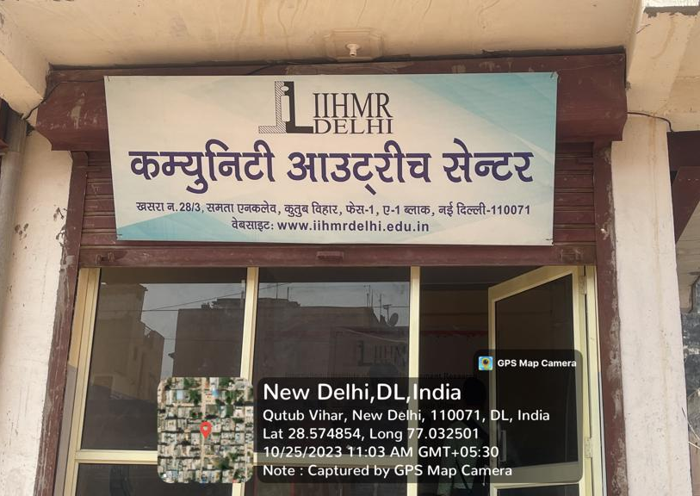
INVOLVEMENT IN COMMUNITY OUTREACH PROGRAMME ACTIVITIES
Total no. of visits done: 6
Day-wise activities done
Mapping and listing of the area.
Interaction with the community and frontline healthcare workers.
Observed field-level challenges

Slide 25
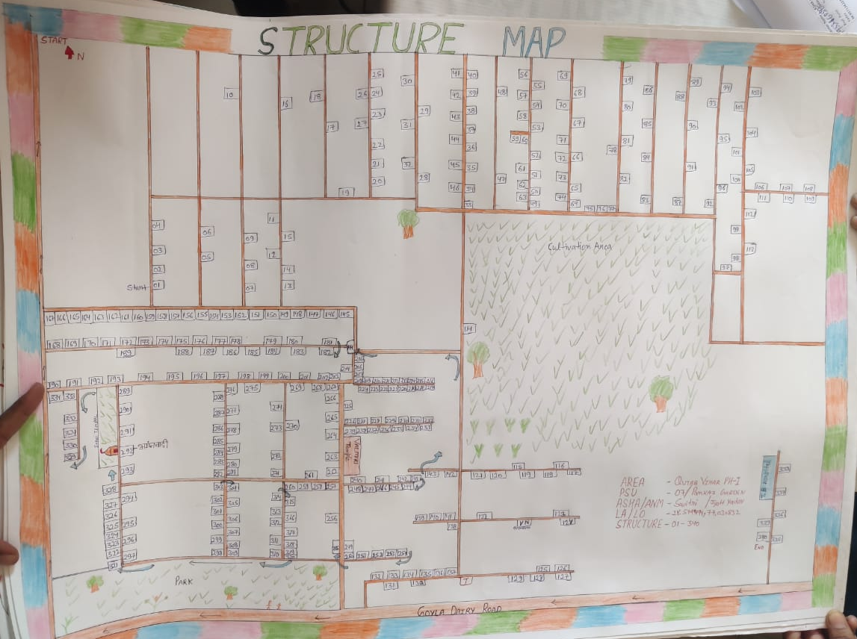

KEY LEARNING FROM COP ACTIVITIES
Community Insights: Understood local health beliefs, social structures, and demographic patterns.
Health Challenges Identified: Poor sanitation, waste disposal and water quality.
Field Skills Developed: Conducted household visits and health screenings(BP checks, BMI measurements).
IEC/BCC Exposure: Delivered health education using posters, group talks, and interactive sessions.
System Understanding: Observed role of frontline workers.
Professional Growth: Improved communication, empathy, and on-ground problem-solving.

Slide 26
Thank You
Any Questions

