Slide 1


UNRAVELLING THE ROOT CAUSES OF CYBERATTACKS ON INDIAN HEALTHCARE: A SCOPIC REVIEW
IIHMR DELHI
PRESENTED BY: HIMANSHI GOEL (PG/22/038)
MENTOR: DR. DIVYA AGGARWAL

Slide 2

MENTOR’S APPROVAL

Slide 3


INTRODUCTION
India has witnessed a significant surge in cyberattacks targeting healthcare institutions in recent years
According to a PhishLabs report, India ranked among the top ten countries targeted by phishing attacks in 2023
CERT-In reported a 13% increase in cyberattacks on the healthcare sector in 2022 compared to 2021.
Cyber attacks on Indian healthcare industry second highest in the world: CloudSEK
38% global increase in 2022 cyberattacks with healthcare as the most targeted industry in India: Check Point Research
3
Notes:
The digital revolution has transformed healthcare delivery, but with increased reliance on technology comes a new set of vulnerabilities: cyber-attacks. Cyberattacks are any malicious activities carried out through digital channels against computer systems, networks or data. Some forms these attacks may take include but are not limited to malware infections; phishing scams; ransomware; denial-of-service (DoS) attacks among others. Conversely, cyber security entails protecting such digital assets from being harmed by these types of ill-intended acts. The world we live in today is more than ever connected digitally hence many countries suffer greatly when there is an increase in the number and variety of cyber-attacks launched against individuals as well as organizations within them.

Slide 4

INTRODUCTION
At a time when digital technology dominates, the union of cyber security risks and health care system vulnerabilities has become a major global concern. Cyber-attacks have been affecting healthcare centers across the continents, from hacking into databases to highly organized ransom ware infiltration attempts, revealing weaknesses within virtual systems and corrupting patients’ confidential information. In this light, India’s healthcare industry becomes a center stage in grappling with surging cyber menaces that undermine not just privacy of medical records but also essential health services. Stepped up adoption of electronic health records (EHRs), telemedicine platforms and networked medical devices has increased the vulnerability of the Indian healthcare system against cyber threats necessitating robust data security measures.
Notes:
The cyber security challenges in Indian health care were worsened by the COVID-19 pandemic. The criminal hackers found a gold mine with an increased focus on telemedicine and booking appointments online. Reports indicated that phishing scams aimed at vulnerable patients looking for COVID-19 information or test results had surfaced. This added to the fact that institutions conducting vaccine research were also targeted by these malicious actors. Healthcare providers were under great pressure during this time which might have resulted in relaxation of security protocols thereby increasing the attack surface even more. This period brought out clearly the need for strong cyber defence measures within the health sector.

Slide 5
TYPES OF CYBER ATTACKS
Type of Attack | Description | Example (real life) | Link
Data Breaches | Unauthorized access compromises sensitive information, such as personal or financial data, through exploitation of vulnerabilities in systems or networks, leading to potential misuse or exposure. | On October 31, 2023, in a massive data breach, information of over 81.5 crore Indians with the ICMR were sold on the dark web. | https://www.financialexpress.com/healthcare/news-healthcare/questions-abound-but-icmr-still-silent-on-the-data-leak/3293107/
Malware Attacks | Malicious software infiltrates systems to disrupt, damage, or gain unauthorized access to data, often through viruses, worms, or trojans. | In August 2018, a malware attack on the Apollo Hospitals Group impacted patient data and caused disruptions to the group’s services. | https://icssindia.in/blog/healthcare-sector-is-the-biggest-target-for-cyber-attacks/
Phishing Attacks | Deceptive emails or messages trick users into revealing sensitive information or installing malware by posing as trustworthy entities. | In February 2019, the Indian Health Ministry reported that several government health organizations had been targeted by phishing emails. | https://icssindia.in/blog/healthcare-sector-is-the-biggest-target-for-cyber-attacks/
Distributed Denial-of-Service (DDoS) Attacks | Distributed Denial of Service floods a network or server with traffic, rendering it inaccessible to legitimate users by overwhelming its capacity. | In December 2018, a DDoS attack on the Medical Council of India (MCI) caused disruption to the MCI’s services. | https://icssindia.in/blog/healthcare-sector-is-the-biggest-target-for-cyber-attacks/
Ransomware Attacks | Malicious software encrypts files or systems, demanding payment for decryption, often exploiting vulnerabilities or social engineering to infiltrate and hold data hostage for financial gain. | Five servers of the All India Institute of Medical Sciences (AIIMS) had been hacked by ransomware. An estimated 1.3 terabytes of data was encrypted. The hackers had made it impossible for AIIMS to access its own data. | https://thewire.in/government/aiims-servers-cyberattack-ransomware-rajya-sabha
Insider Attacks | Trusted individuals exploit their access privileges to sabotage, steal, or manipulate data or systems, posing significant threats due to their intimate knowledge of organizational infrastructure and potential for undetected activity. | In January 2018, an insider attack on the Employees’ State Insurance Corporation (ESIC) resulted in the theft of patient data. | https://icssindia.in/blog/healthcare-sector-is-the-biggest-target-for-cyber-attacks/

Slide 6
INITIATIVE BY GOI
Legislation/Policy | Description | Applicability to Healthcare
Information Technology Act, 2000 (IT Act) | The primary law governing cybercrime and electronic commerce in India. Defines cyber offenses like hacking, data theft, and prescribes penalties. | Yes. The IT Act applies to all forms of electronic transactions, including those in healthcare. Provisions like data security and privacy are particularly relevant.
National Cyber Security Strategy (2013) | A high-level document outlining the government's vision for a secure cyberspace in India. | Yes. The strategy emphasizes protecting critical infrastructure, which includes healthcare.
CERT-In (Indian Computer Emergency Response Team) | A government body under the Ministry of Electronics and Information Technology (MeitY). It is responsible for handling cyber security threats and vulnerabilities. | Yes. CERT-In plays a crucial role in responding to cyber incidents in healthcare institutions. It issues advisories and coordinates with healthcare providers during attacks.
DISHA (Digital Information Security in Healthcare Act) | Not enacted yet. A proposed legislation that aims to specifically address cyber security in the healthcare sector. | Yes. If enacted, DISHA would establish a robust framework for data security and privacy in healthcare institutions.
National Cybersecurity Response Framework (NCRF) | A framework under development to provide a standardized approach for critical infrastructure sectors, including healthcare, to respond to cyber incidents. | Yes. NCRF will provide healthcare institutions with guidelines for incident response, recovery, and mitigation strategies.
Notes:
To respond to increasing threats against its cyber space, the Indian Government has taken steps aimed at making national infrastructure resilient enough before any risks can manifest themselves into realities.

Slide 7
RATIONALE
The advent of the COVID-19 pandemic catalyzed a dramatic transformation in healthcare systems globally, with Indian healthcare experiencing profound changes. As the pandemic necessitated social distancing and minimized physical interactions, it accelerated the adoption of digital technologies, including telemedicine, electronic health records (EHR), and remote patient monitoring systems. This digital shift, while enhancing healthcare delivery, has simultaneously exposed healthcare systems to a new array of cybersecurity threats.
The need for such a study is due to the increasing demands of the cybersecurity challenges facing the Indian healthcare industry after COVID. The more digital tools and platforms that are adopted, the greater the vulnerability of healthcare systems to cyber threats will be. This study thus seeks to improve cyber resilience in Indian healthcare through identifying and suggesting effective countermeasures on significant weak points like improper network segmentation, so that delivery of medical services in digital era can continue happening within safe environment.

Slide 8

OBJECTIVES
RESEARCH QUESTION
What are the root causes of the increasing cyberattacks on the Indian Healthcare sector, especially since the covid-19 outbreak?
To analyse the recent trends and patterns of cyberattacks on Indian healthcare institutions from previously published literature.
To identify the vulnerabilities within Indian healthcare systems that render them susceptible to cyber threats as per literature available.
To suggest effective countermeasures on effective weak points in the Indian Healthcare system as published by GOI .

Slide 9
RESEARCH METHODOLOGY
Study Design: Descriptive Secondary Research
Topic of Study: the study focuses on cyber attacks on the healthcare sector in India including incidents, vulnerabilities, and preventive measures within this domain.
Data Type: Literature-based Secondary data (Scholarly articles, news reports, statistical reports, CERT-In annual reports)
Duration of Study: Mar 2024 – May 2024
Study Population: These are cybersecurity articles which address cyber-attacks against the Indian health care department either by scholarly articles, news articles or reports.
Research Terms: cyberattacks, healthcare, India, cybersecurity, vulnerabilities, data breaches, patient privacy, preventive measures, root causes, statistical reports, cert-in, systematic review, ransomware, phishing, malware attacks

Slide 10
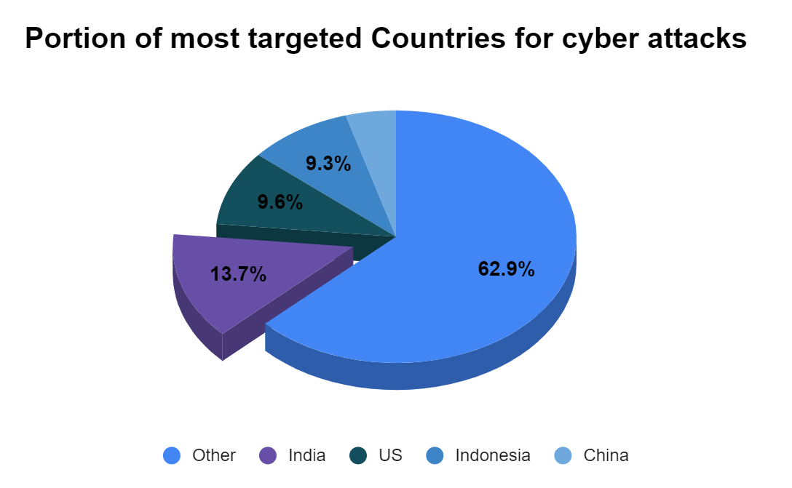
FINDINGS
179 million Indian Rupees!
That’s the average cost of data breach in India 2023. A record high for the report and an almost 28% rise from 2020.
It has been clearly represented that India has become one of the most targeted countries worldwide, accounting for 13.7% of all cyberattacks. With 9.6% of all attacks, the United States is the second most attacked nation. China and Indonesia come next, accounting for 4.5% and 9.3% of all attacks, respectively.
As India moves forward with its ambitions to digitize all areas of the economy, a widespread cyberattack outbreak has cost businesses a significant amount of money. Because of the complexity of cyberthreats and the growing financial consequences of data breaches, cybersecurity has become a top priority for board members.
Source: Cyfirmia Report 2023
1
Objective

Slide 11
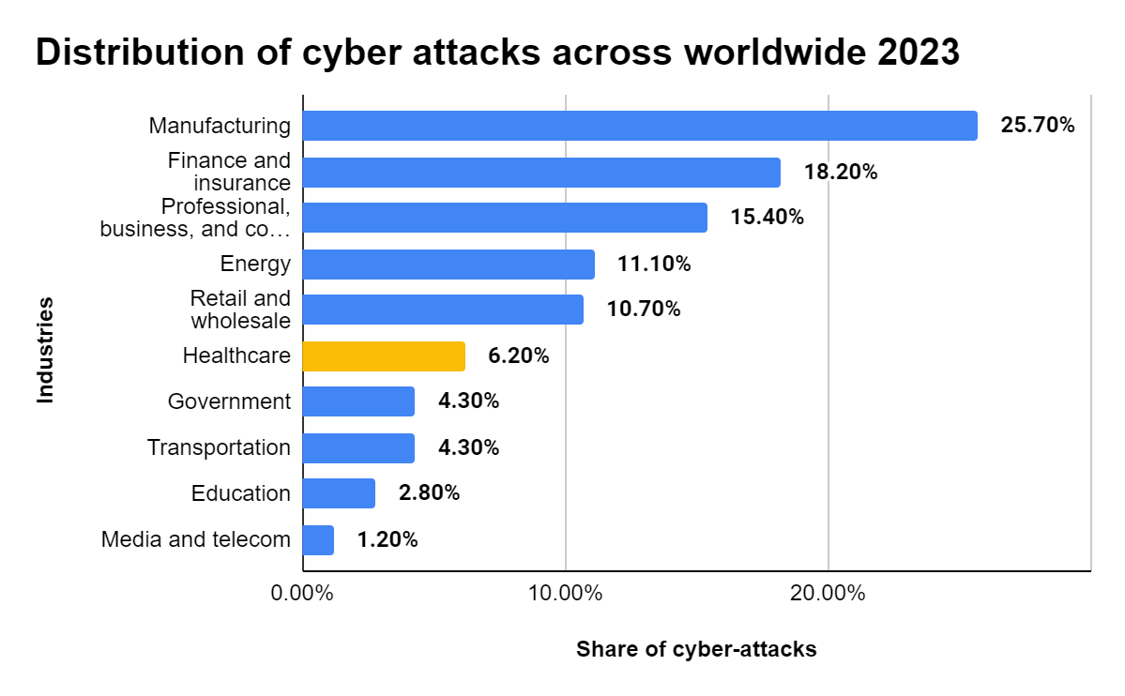
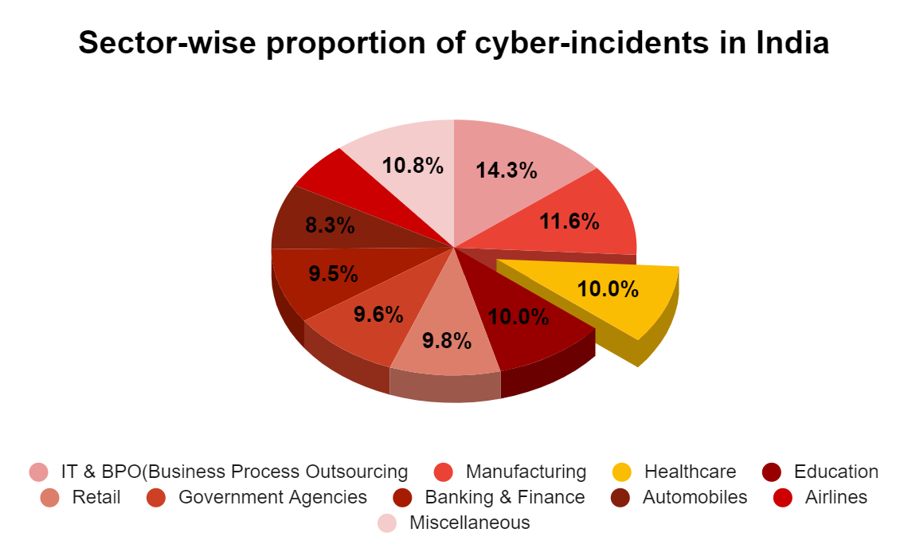
The healthcare industry is the sixth most vulnerable to cyberattacks worldwide accounting for around 6.2% of total cyberattacks happening.
Source: Statista Report 2023
The healthcare industry is the third most vulnerable to cyberattacks in India as per cyfirmia report 2023, accounting for almost 10% of total cyberattacks happening nationally.
Source: Cyfirmia Report 2023

Slide 12
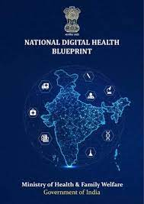
Weak points as per NDHM Blueprint
The Government of India (GOI) and the National Digital Health Mission (NDHM) Blueprint have identified several weak points in the Indian healthcare system's cybersecurity posture. This section proposes targeted countermeasures to address these vulnerabilities and strengthen cyber defenses.
Weak points
Outdated IT Infrastructure
Improper Network Segmentation
Limited Awareness and Training
Weak Cybersecurity Culture
Inadequate Legal Framework
2
Objective

Slide 13
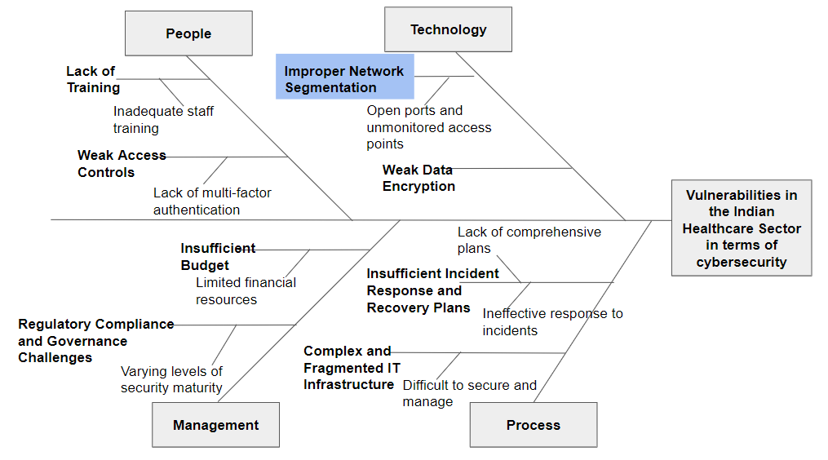
Security Measures
Unguarded network
Service provider
Illegal or compromised network
Inadequate Legal Framework

Slide 14
CERT-IN DATA 2019-2022
CERT-In Data | Total Incidents | Cyber threats and vulnerabilities
 |  | Security alerts | Advisories | Vulnerability Notes
2019 | 394499 | 204 | 38 | 202
2020 | 1158208 | 496 | 93 | 450
2021 | 1402809 | 618 | 52 | 390
2022 | 1391457 | 653 | 38 | 488
The table1 sheds light on the total number of incidents reported and cyber threats and vulnerabilities happened during 2019-2022, along with specifying the number of security alerts issued, advisories published and vulnerability notes published as reported by CERT-In.
Security Incidents | 2019 | 2020 | 2021 | 2022
Phishing | 472 | 280 | 523 | 1714
Unauthorized Network Scanning/Probing /Vulnerable Services | 305276 | 1028881 | 1160333 | 1200512
Virus/ Malicious Code | 62163 | 99986 | 209110 | 161757
Website Defacements | 24351 | 25969 | 27408 | 19793
Website Intrusion & Malware Propagation | 417 | 152 | 1489 | 2164
Others | 1820 | 2940 | 3946 | 5517
Table 1
The table2 shows the summary of security incidents reported by CERT-In during 2019-2022 such as phishing. Unauthorized network scanning, malicious code, website defacements, etc.
Table 2
Notes:
CERT-In (Indian Computer Emergency Response Team)
The Ministry of Electronics and Information Technology, Government of India, operates CERT-In, a functional organization whose goal is to secure Indian cyberspace. In addition to providing security quality management services, CERT-In offers incident prevention and response services.

Slide 15
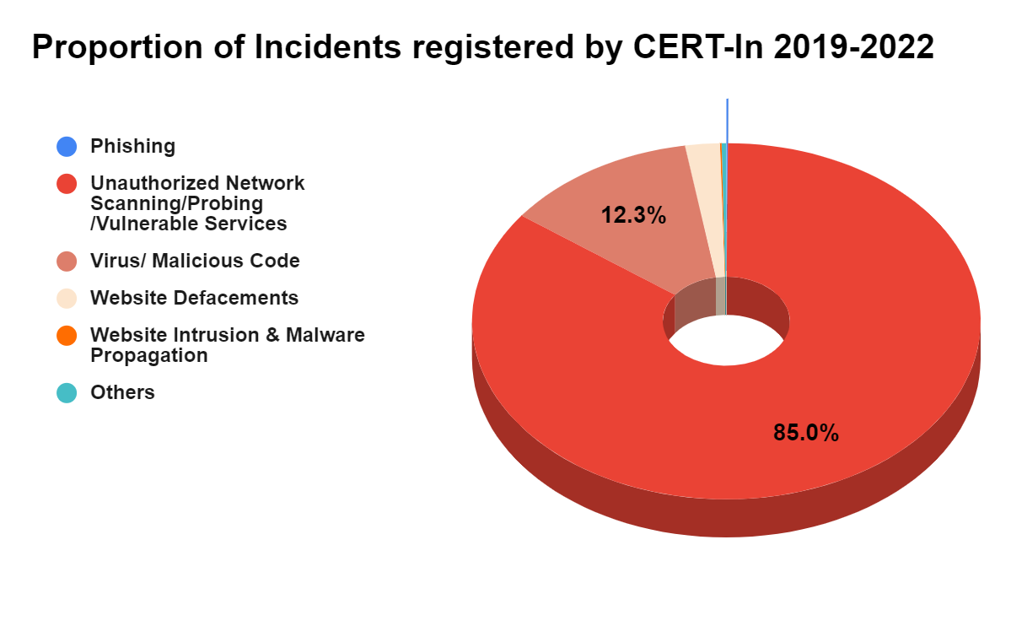
CERT-IN DATA 2019-2022
This makes it evident that, out of all the incidents that occurred between 2019 and 2022, the most common ones involved unauthorized network scanning, probing, and vulnerable services. These incidents accounted for 85% of all incidents. It may be observed that the majority of mishaps occur as a result of inadequate network security.
Source: CERT-In Data 2023

Slide 16
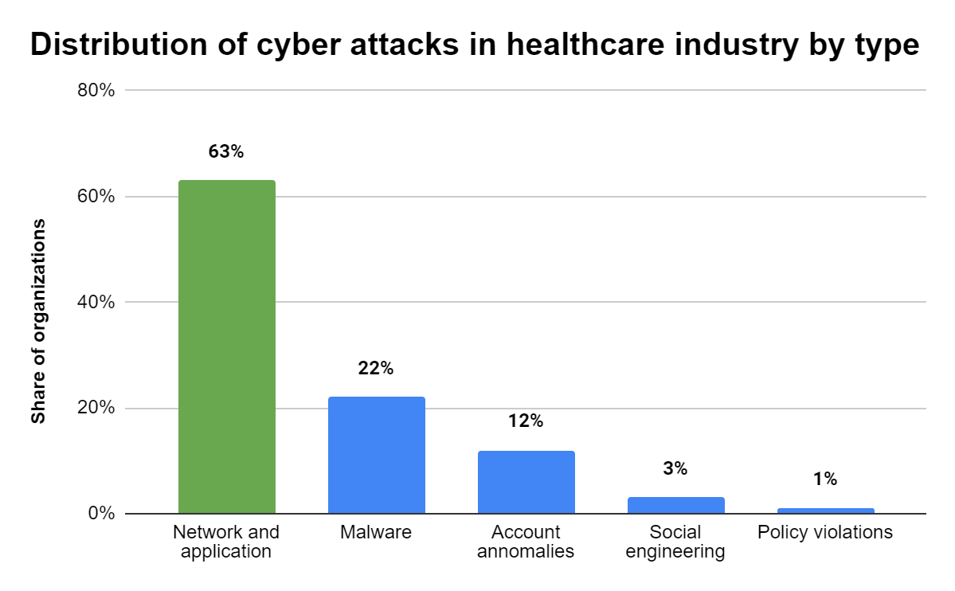
PATTERNS OF ATTACKS WITHIN THE HEALTHCARE INDUSTRY
One of the industry’s most susceptible to cybercrime is the healthcare sector. The companies in this industry saw a range of cyberattacks, with network and application anomalies accounting for about 63% of the total. Targeting 22% of the firms under examination, malware emerged as the second most prevalent form of attack vector.
Source: Statista Report 2023
Notes:
Network segmentation is a critical cybersecurity practice that involves dividing a network into smaller, isolated segments or subnetworks. This approach enhances security by controlling traffic flow and limiting access between segments, thereby reducing the attack surface and minimizing the potential impact of a breach.
Reduced Attack Surface
Enhanced Access Control
Improved Containment of Breaches
Increased Compliance and Data Protection
Better Network Performance and Management
Enhanced Monitoring and Detection
Protection Against Insider Threats
Facilitation of Zero Trust Architecture(Network segmentation is a fundamental component of a Zero Trust security model, which assumes that threats could exist both inside and outside the network. By segmenting the network, organizations can enforce strict verification and access controls at each segment boundary.)

Slide 17
Improper Network Segmentation and the Susceptibility of Indian Healthcare to Cyber Attacks (1/2)
Indian healthcare sector is faced with improper network segmentation which is a significant vulnerability leading to their susceptibility to cyberattacks as per the previously published reports. Network segmentation is the practice of dividing a network into smaller parts, each having its security controls. Properly segmented networks help to contain breaches, restrict unauthorized access and improve overall network security. Failing to effectively segment a network in the health care context could result in serious consequences.

Slide 18


Improper Network Segmentation and the Susceptibility of Indian Healthcare to Cyber Attacks(2/2)
In many cases, Indian healthcare organizations are using flat networking architectures where administrative systems, medical devices and patient data repositories are not properly segregated. For an attacker who has compromised any point on such a network, they can easily navigate throughout the entire network without much resistance accessing critical systems and sensitive data.
For instance, when a hacker uses an already compromised medical device to get access into EHR system or administrative database, it makes the attack’s scope even wider than it was at first.
Cyber attack: Oct 2023
Cause: Phishing attacks due to improper network access
Source: The Hindu.com
Cyber attack: 23 Nov 2022
Cause founded by CERT-In: Improper Network segmentation
Source: ET Healthworld.com

Slide 19
REGULATORY FRAMEWORK: GOVERNMENT MANDATES FOR CYBERSECURITY COMPLIANCE IN INDIA IN COMPARISON WITH OTHER COUNTRIES
3
Objective

Slide 20
Country | Law | Description | Year
United States | Federal Information Security Management Act (FISMA) | Requires federal agencies to develop and maintain a comprehensive information security program. | 2002
 | Health Insurance Portability and Accountability Act (HIPAA) | Protects sensitive patient data in the healthcare industry. | 1996
India | Information Technology Act (IT Act) | Defines cybercrimes and prescribes penalties. May need revisions for healthcare sector. | 2000
 | Digital Information Security in Healthcare Act (DISHA) | Proposed legislation specifically addressing cyber security in the healthcare sector (not yet enacted). | -
 | Personal Data Protection Bill (PDP Bill) | Upcoming legislation regulating the collection, storage, and use of personal data, including healthcare data. | -
Australia | Cybersecurity Act | Establishes a framework for protecting government and critical infrastructure from cyber attacks. | 2008
New Zealand | Cybersecurity Act | Focuses on information sharing and collaboration between government and industry to improve cyber resilience. | 2008
France | Network and Information Security Act (LMSI) | Requires operators of essential services to implement security measures and report cyber incidents. | 2004
Singapore | Cybersecurity Act | Comprehensive framework addressing cyber risks, including critical infrastructure protection, data breach notification, and computer misuse offences. | 2018
Germany | Information Security Act (BSIG) | Sets out requirements for the protection of information technology systems operated by critical infrastructure providers. | 2016
Japan | Act on the Protection of Information Assets | Aims to protect information assets important to national security and public safety. | 2016

Slide 21
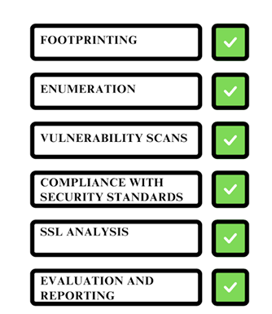
HIPAA Practices: A Model for Recommendations
Healthcare providers are required to comply with security laws, such as those mandated by the Health Insurance Portability and Accountability Act (HIPAA) in US countries (12). The major practices followed under HIPAA are shown in figure.

Slide 22
Countermeasures
Infrastructure Modernization: Healthcare institutions need to invest in modernizing their IT infrastructure with a focus on robust security features. This includes implementing firewalls, intrusion detection/prevention systems, and data encryption. (Source: NDHM Blueprint Standards and Regulations)
Network Segmentation Strategy: Implementing a well-defined network segmentation strategy is crucial. This involves dividing the network into smaller sub-networks, each with its own security controls and limited access to other segments. This can significantly hinder an attack's ability to spread laterally. (Source: Cybersecurity best practices from National Institute of Standards and Technology (NIST))
Comprehensive Security Awareness Training: Healthcare institutions must prioritize ongoing cybersecurity training programs for all staff members. These programs should educate them on cyber threats, social engineering tactics, data security best practices, and proper use of technology. (Source: NDHM Blueprint - Functional Principles - Educate and Empower)
Building a Strong Cybersecurity Culture: Leadership support is crucial for fostering a culture of cyber awareness within the healthcare organization. This involves integrating security considerations into daily operations, conducting regular security audits and vulnerability assessments, and prioritizing timely security updates. (Source: Healthcare Sector Cybersecurity Framework from Health Sector Cybersecurity Coordination Working Group (HSCWG))
Strengthening the Legal Framework: The swift enactment and effective implementation of the DISHA Act are critical steps towards a more robust legal framework for cyber security in healthcare. This act should clearly define data security responsibilities, outline incident reporting procedures, and establish appropriate penalties for cybercrimes targeting healthcare institutions. (Source: Discussion on Proposed DISHA Act in the research report)

Slide 23
CONCLUSION
The research reveals that network segmentation is very important for reducing the effects of cyber-attacks. In most healthcare institutions, no proper network segmentation exists resulting in a scenario where hacking one part can easily result in hacking of the entire system.
Securing the network through proper segmentation
Strengthening government laws and policies
Building a strong cybersecurity culture in India
Overall, the findings of this study states that cyber security for Indian healthcare is not a one-time solution but an ongoing process. A multi-faceted approach that involves increased awareness among healthcare institutions; modernizing infrastructure; securing applications; collaborating with stakeholders; and strengthening the legal framework is required here.

Slide 24
SUGGESTIONS
CYBER ATTACKS | KEY TERMS | CYBER SECURITY AREAS | BENEFITS | GOALS | PREVENTION TECHNIQUES
Denial of service | Make system unavailable to authorized users. | Network Security | Protects networking components from threats . | Integrity, Availability | Firewalls, Auditing and Logging
Cross scripting | Attacker inserts malicious code and exploits the service user. | Web Security | Protects website from threats | Confidentiality, Integrity | Malware Scanners.
Hacking | Gaining access to information in unauthorized manner. | Information Security | Protects digital and nondigital information from threats. | Integrity, Confidentiality | Firewalls, Access control and password security
Ransomware | Malware that locks victim computer. | Operational Security | Protects from various operations. | Integrity, Availability | Malware Scanners
Phishing | Sending fraudulent emails that appear to be from trusted sources. | Application Security | Protects applications from external threats | Integrity, Confidentiality | Firewalls, Access control and password security
Man-in the middle | Criminal enters a conversion between two parties and gain information. | Information Security | Protects digital and non digital information from threats. | Integrity, Confidentiality | Intrusion Prevention Systems
Notes:
By using these strategies, one may ensure that their information systems are safe from cybercrimes. In the case of healthcare information systems, in particular, it should be required to take all necessary precautions to safeguard the most valuable data ever.

Slide 25

REFERENCES
Churi P, Pawar A, Moreno-Guerrero AJ. A Comprehensive Survey on Data Utility and Privacy: Taking Indian Healthcare System as a Potential Case Study. Inventions. 2021 Sep;[cited 2024 May 17]. Available from: https://www.mdpi.com/2411-5134/6/3/45
Aravamudhan P, T K. A novel adaptive network intrusion detection system for internet of things. PLoS One. 2023 Apr 21;[cited 2024 May 17]18(4):e0283725. Available from: https://www.ncbi.nlm.nih.gov/pmc/articles/PMC10121003/
Prasuna A, Rachh A. A study on challenges of data security and data privacy in the healthcare sector: Swot analysis. Asia Pacific Journal of Health Management. 2023 Mar;[cited 2024 May 4]18(1):283–9. Available from: https://search.informit.org/doi/abs/10.3316/informit.014727326511420
Nirmala AP, Asha V, Ramesh BN, Chandana K, Chandana GR, Alam A. A Systematic Review on classification of Cyber Attacks and its Prevention techniques to improve Cyber Security. In: 2023 International Conference on Computer Communication and Informatics (ICCCI) [Internet]. 2023 [cited 2024 May 4]. p. 1–6. Available from: https://ieeexplore.ieee.org/abstract/document/10128642
Alawida M, Omolara AE, Abiodun OI, Al-Rajab M. A deeper look into cybersecurity issues in the wake of Covid-19: A survey. Journal of King Saud University - Computer and Information Sciences. 2022 Nov [cited 2024 May 4]1;34(10, Part A):8176–206. Available from: https://www.sciencedirect.com/science/article/pii/S1319157822002762
Vijarania M, Gupta S, Agrawal A, Misra S. Achieving Sustainable Development Goals in Cyber Security Using AIoT for Healthcare Application. In: Misra S, Siakas K, Lampropoulos G, editors. Artificial Intelligence of Things for Achieving Sustainable Development Goals [Internet]. Cham: Springer Nature Switzerland; 2024 [cited 2024 May 4]. p. 207–31. Available from: https://doi.org/10.1007/978-3-031-53433-1_11
IBM India News Room [Internet]. 2019 [cited 2024 May 17]. IBM Report: Average cost of a data breach in India touched INR 179 million in 2023. Available from: https://in.newsroom.ibm.com/IBM-Report-Average-cost-of-a-data-breach-in-India-touched-INR-179-million-in-2023
Data Security Council of India (DSCI) [Internet]. 2023 [cited 2024 May 17]. DSCI: India Cyber Threat Report. Available from: https://www.dsci.in/files/content/knowledge-centre/2023/India-Cyber-Threat-Report-2023_0.pdf
Statista [Internet]. [cited 2024 May 5]. India: estimated cybersecurity market size 2028. Available from: https://www.statista.com/statistics/1197074/india-estimated-cybersecurity-market-size/
Cybersecurity | Digital | McKinsey & Company [Internet]. [cited 2024 May 5]. Available from: https://www.mckinsey.com/capabilities/mckinsey-digital/mckinsey-technology/overview/cybersecurity

Slide 26
REFERENCES
Cert-In - Home Page [Internet]. [cited 2024 May 5]. Available from: https://www.cert-in.org.in/s2cMainServlet?pageid=PUBANULREPRT
cyber attacks: State-sponsored cyberattacks against India up 278% in three years - The Economic Times [Internet]. [cited 2024 May 5]. Available from: https://economictimes.indiatimes.com/tech/technology/india-most-targeted-country-by-cyber-attackers-report/articleshow/104989856.cms
Lohchab H. Cyberattacks on healthcare sector rising, 60% of organisations hit in a year: report. The Economic Times [Internet]. 2023 Nov 3 [cited 2024 May 5]; Available from: https://economictimes.indiatimes.com/tech/technology/cyberattacks-on-healthcare-sector-rising-60-of-organisations-hit-in-a-year-report/articleshow/104917689.cms?from=mdr
Digital India Act: Here’s how it should fix India’s cybersecurity weaknesses [Internet]. [cited 2024 May 5]. Available from: https://www.moneycontrol.com/news/opinion/digital-india-act-heres-how-it-should-fix-indias-cybersecurity-weaknesses-11038701.html
Business Today [Internet]. 2023 [cited 2024 May 5]. India is the 10th most affected country by cyberattacks in 2022 with healthcare sector most impacted: Report. Available from: https://www.businesstoday.in/technology/news/story/india-is-the-10th-most-affected-country-by-cyberattacks-in-2022-with-healthcare-sector-most-impacted-report-399963-2023-09-27
mint [Internet]. 2024 [cited 2024 May 5]. India witnesses 15% rise in cyber attack cases in 2023. Available from: https://www.livemint.com/news/india/india-witnesses-15-rise-in-cyber-attack-cases-in-2023-emerges-as-2nd-most-targeted-nation-11705939863447.html
Ahaskar A. mint. 2022 [cited 2024 May 5]. Indian healthcare sector suffers 1.9 million cyberattacks in 2022. Available from: https://www.livemint.com/technology/tech-news/indian-healthcare-sector-suffers-1-9-million-cyberattacks-in-2022-11669878864152.html
Standard B. Indian websites faced over 5 billion cyberattacks in 2023, shows data [Internet]. 2024 [cited 2024 May 5]. Available from: https://www.business-standard.com/india-news/indian-websites-faced-over-5-billion-cyberattacks-in-2023-shows-data-124021501548_1.html
Ford N. IT Governance UK Blog. 2024 [cited 2024 May 5]. List of Data Breaches and Cyber Attacks in 2023 – 8,214,886,660 records breached. Available from: https://www.itgovernance.co.uk/blog/list-of-data-breaches-and-cyber-attacks-in-2023
Ransomware is highest cyber threat in India: Report – India TV [Internet]. [cited 2024 May 5]. Available from: https://www.indiatvnews.com/technology/news/ransomware-is-highest-cyber-threat-in-india-report-2024-03-21-922569
The Latest Cyber Crime Statistics (updated May 2024) | AAG IT Support [Internet]. [cited 2024 May 5]. Available from: https://aag-it.com/the-latest-cyber-crime-statistics/

Slide 27


THANK YOU
HIMANSHI GOEL

