Slide 1

AI in Neuroimaging: Validating a Diagnostic Tool for Responsible and Beneficial Clinical Use
By: Swastik Mitra
PG/23/120
Under the Guidance of : Dr. Preetha GS

Slide 2
Introduction
AI in medical imaging significantly enhances diagnostic accuracy, speed, and workflow efficiency.
Brain CT is the frontline imaging tool in emergencies—used to detect trauma, strokes, hemorrhages, and tumors.
Radiologists often face heavy workloads, fatigue, and subtle findings, which may impact consistency.
AI solutions can:
  Automatically detect multiple pathologies, including various brain hemorrhages
  Flag urgent cases for early triage, aiding clinical decision-making
  Reduce interpretation delays, improving patient outcomes
Thus, AI plays a vital role in augmenting radiologists, especially in time-sensitive neuro cases.

Slide 3
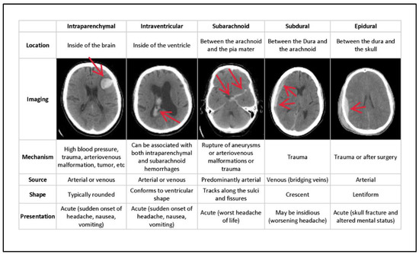
Rationale of Study
The rationale for this study is to ensure that any AI solution planned for onboarding or deployment undergoes rigorous validation.
CARPL.ai enables healthcare systems to evaluate and integrate third-party AI tools into their radiology workflow.
Our study:
  Focuses on a Brain CT AI model designed to detect six types of hemorrhages
  Uses a real-world dataset of 1261 annotated CT scans
  Aims to assess the reliability and clinical safety of the AI output by calculating Sensitivity, specificity , PPV, NPV, Accuracy and plotting ROC .
  Early validation is essential to safeguard patient care and ensure responsible, data-driven deployment of AI in neuroimaging.

Slide 4
Objective
To systematically assess the diagnostic performance of the AI solution in detecting multiple brain pathologies on CT scans against radiologist-verified ground truth performance before its integration into our platform and deployment to healthcare providers.

Slide 5
Methodology
Data Collection▸ 1261 CT brain scans (DICOM format) and corresponding radiologist reports (CSV) were obtained from a Brazilian healthcare partner.
Data Compilation
    ▸ Scans and reports were linked via unique Study IDs.
    ▸ CSV reports were structured for alignment with AI outputs.
3. AI Inferencing
    ▸ AI model processed 1094 out of 1261 cases on the CARPL platform
    ▸ Probability scores generated for 6 hemorrhagic findings:- ICH, EDH, SDH, SAH, IPH, IVH▸ Output exported in structured CSV format for analysis.
4. Ground Truth Creation
    ▸ Radiologist reports were manually reviewed.
    ▸ Each finding was labeled as '1' (present) or '0' (absent) to build the binary ground truth matrix.
5. Result Comparison & Evaluation
    ▸ AI outputs compared with GT labels per pathology and confusion matrices are created.
    ▸ Metrics computed: Sensitivity, Specificity, PPV, NPV, Accuracy, AUC. And ROC curves generated

Slide 6
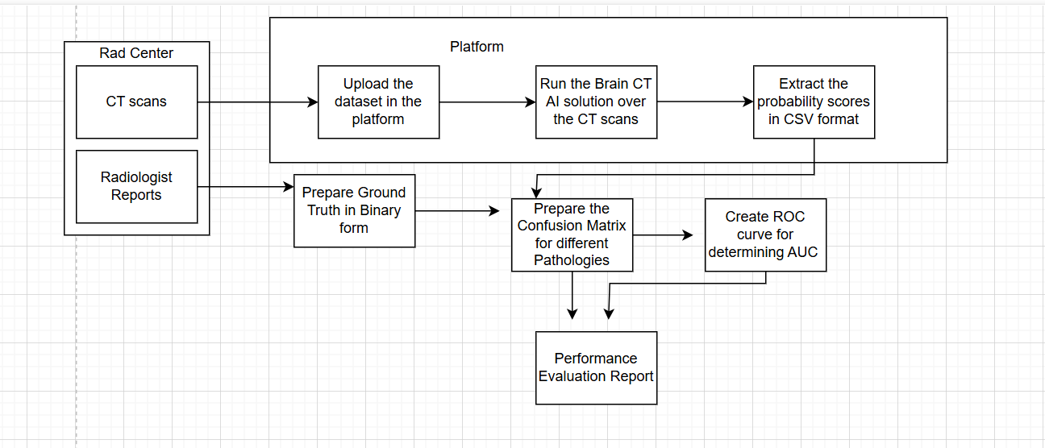
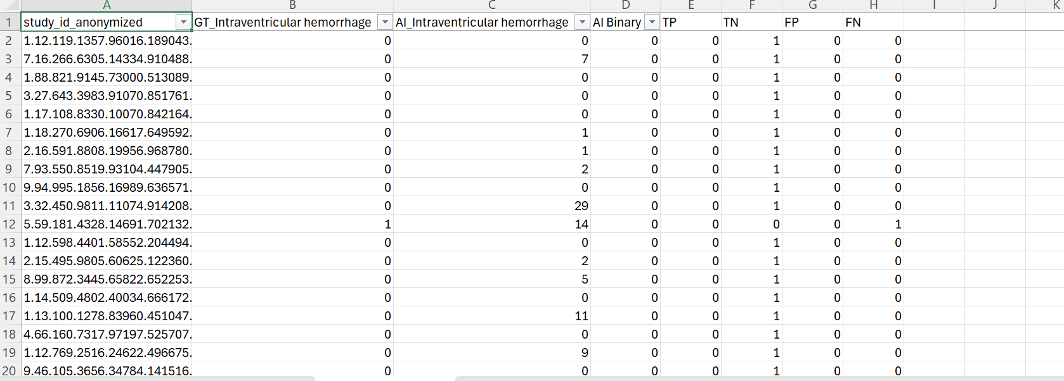
Methodology

Slide 7
Study Design
Study Population
The patients who were undergone CT scans from the radiological center.
Inclusion Criteria: The CT scans should be interpreted by the Radiologist and the scans are in DICOM format.
Exclusion Criteria: CT scans without Radiologists reports or incomplete verdicts and the scans whose quality as well as the standard(should be DICOM) is not supportable by the platform.
Sample Size and Sampling
Sample Size: Approximately 1261 CT scans.
Sampling Method:
Convenience Sampling – selected cases based on ease of access and availability.
Retrospective brain CT scans with radiologist reports sourced from partner radiology center.
Type: Cross-sectional, retrospective validation study.
Nature: Quantitative comparison of AI-generated predictions with radiologist-verified reports (ground truth)

Slide 8
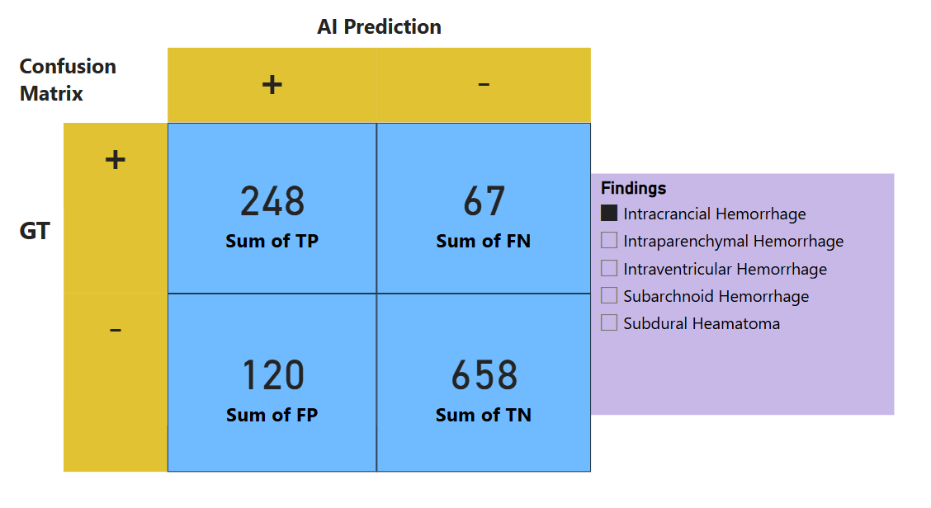
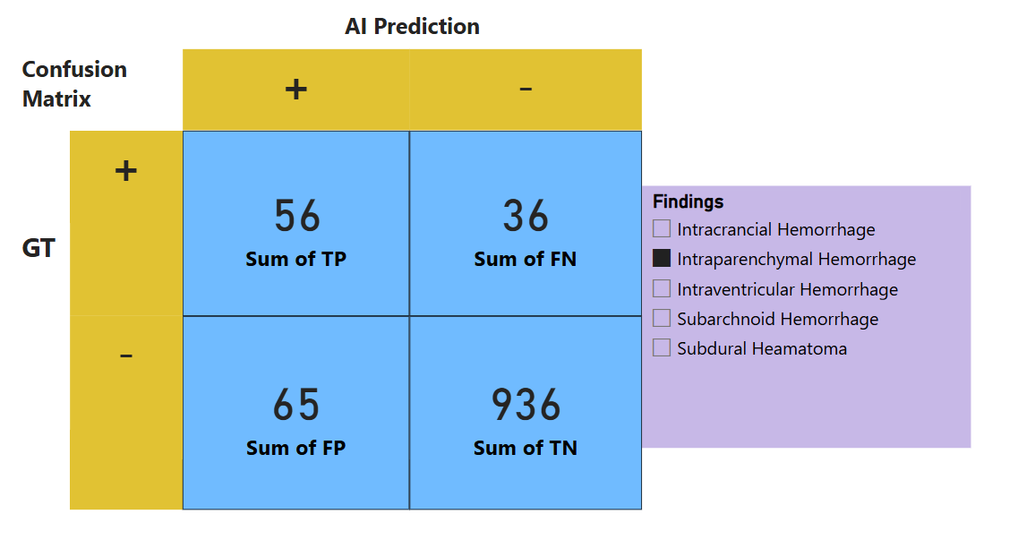
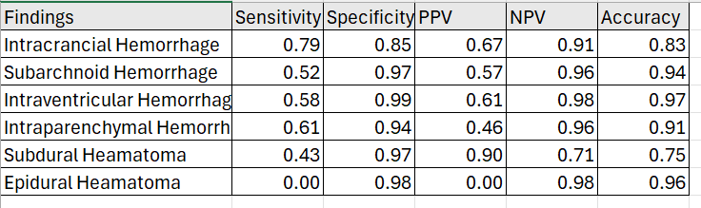
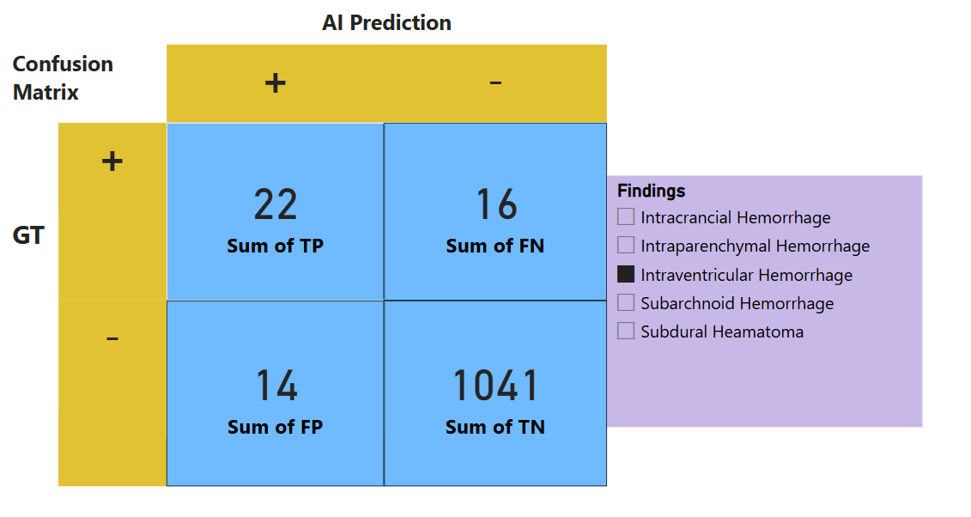
Data Analysis
- Construction of Confusion Matrix for each finding :
The GT and the AI inferenced probabilities for each six findings are present, so they are compared to develop the matrix using Power BI.
The confusion matrix is contains quadrants which shows the number of TP,FP,FN and TN.
- Calculation of other performance metrices:
The number of TP,TN,FP and FN are used to calculate the metrices like Sensitivity, Specificity,PPV,NPV and Accuracy for each findings.
The calculations are performed in Excel and represented in Power BI

Slide 9
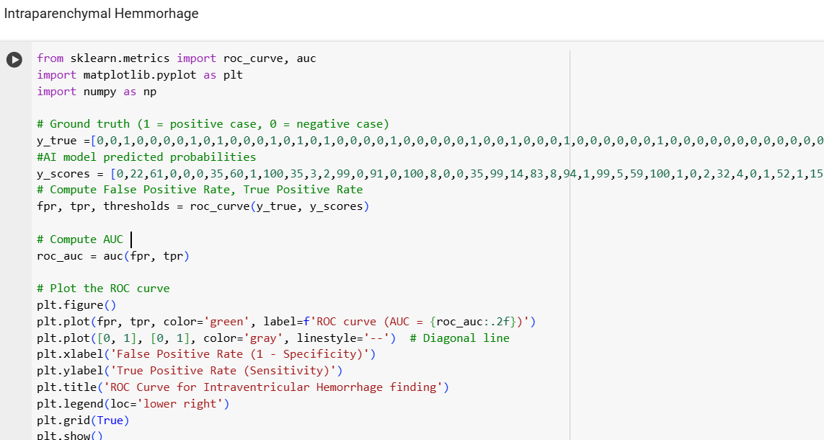
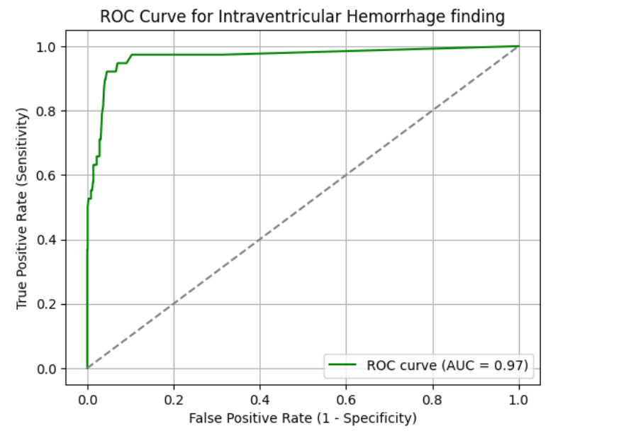
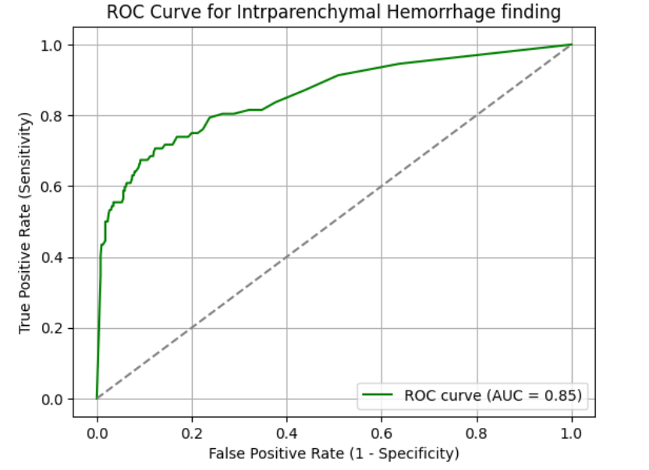
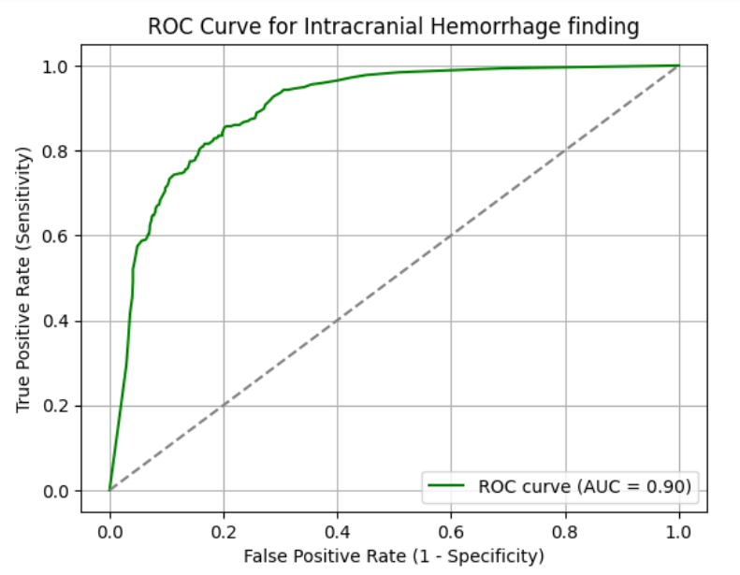
- ROC curve and AUC values
ROC curve helps to determine the performance of the AI for detecting different findings at different threshold levels and AUC determines how good the AI is in classifying findings as +ives and –ives.
We have used google colab to code in python for plotting the curve.
For creating ROC curve binarized GT and the AI probabilities are used.

Slide 10
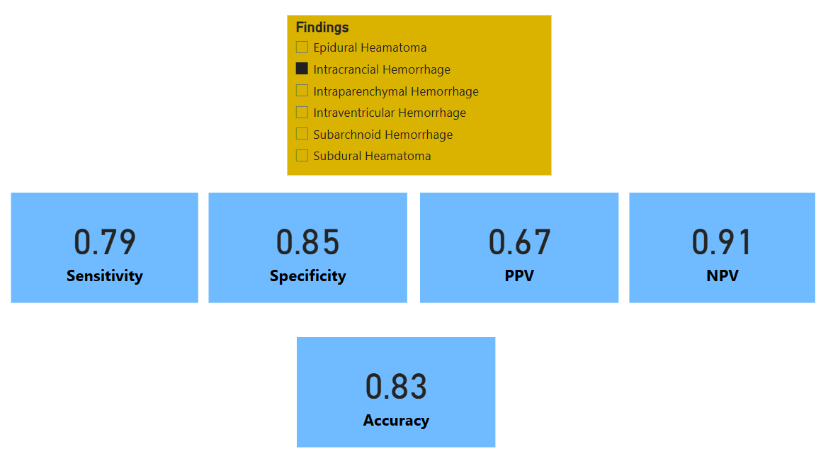
Result
Intracranial Hemorrhage
Sensitivity: 0.79
The AI correctly detected 79% of hemorrhagic cases, showing strong ability to identify true positives. This is crucial for urgent triage decisions.
Specificity: 0.85
Demonstrates reliable exclusion of normal cases. 85% of true negatives were identified correctly, reducing unnecessary follow-ups.
Positive Predictive Value (PPV): 0.67
About two-thirds of the AI-flagged positive cases were accurate. However, 33% were false positives, which could cause extra workload or patient anxiety.
Negative Predictive Value (NPV): 0.91
High NPV suggests strong confidence in negative predictions, making the AI a useful tool for ruling out hemorrhages quickly.
Accuracy: 0.83
Overall, 83% of total predictions (both positive and negative) were correct, indicating consistent model performance across the dataset.
Area Under Curve (AUC): 0.90
Excellent overall discrimination between positive and negative cases. A high AUC means the model performs well across different decision thresholds.

Slide 11
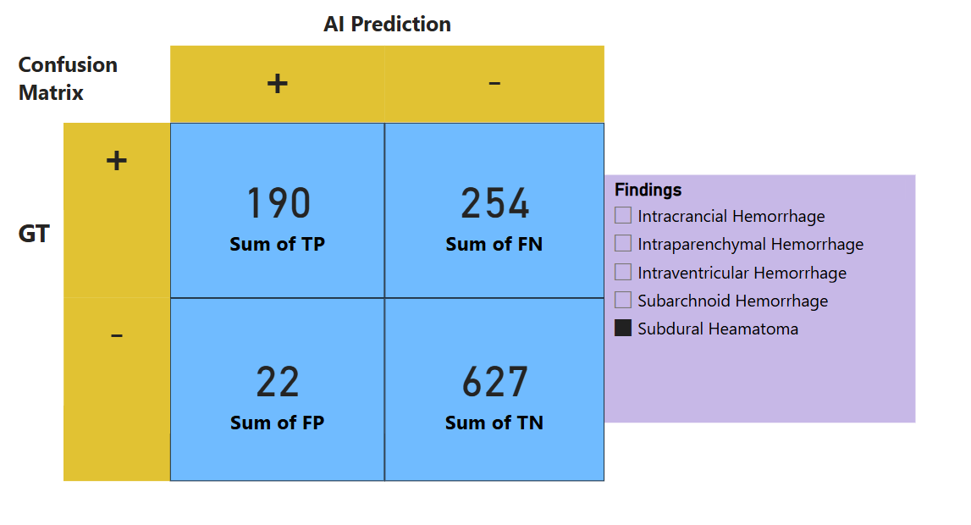
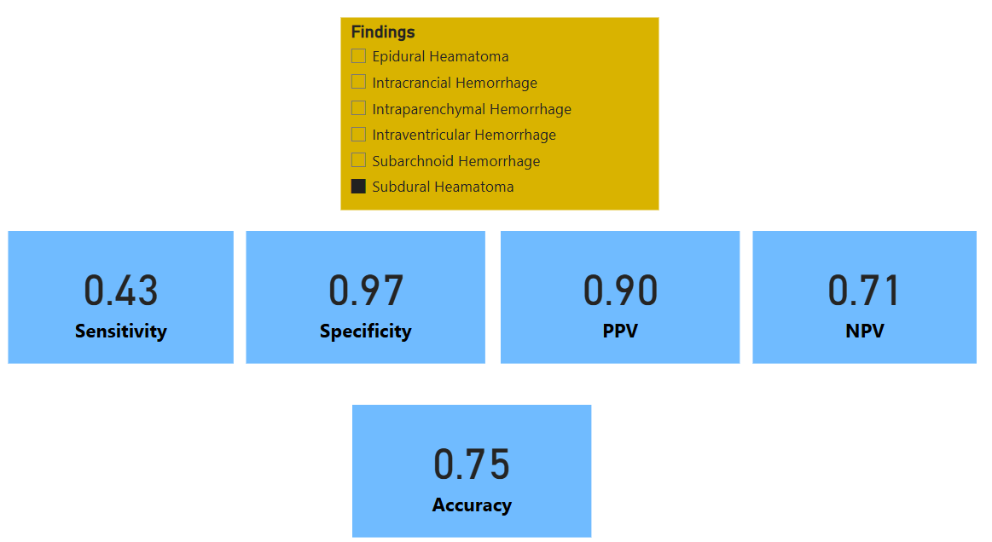
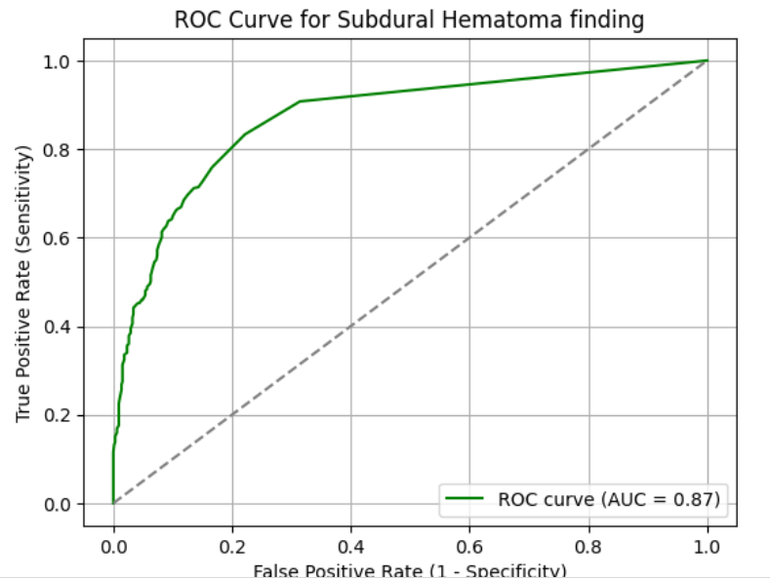
Subdural Hematoma
Sensitivity: 0.43
Low sensitivity indicates the AI detected less than half of actual SDH cases. High potential for false negatives could delay clinical intervention.
Specificity: 0.97
AI correctly identified most non-SDH cases, minimizing unnecessary escalations in the workflow.
Positive Predictive Value (PPV): 0.90
Most positive predictions were correct, indicating excellent precision and building clinician confidence when AI flags SDH.
Negative Predictive Value (NPV): 0.71
Moderate NPV suggests some false negatives, reinforcing the need for human review when AI predicts absence.
Accuracy: 0.75
The relatively lower accuracy highlights a performance gap, especially due to poor sensitivity.
Area Under Curve (AUC): 0.87
Good discrimination between classes, but overall performance limited by underdetection of positive cases.

Slide 12
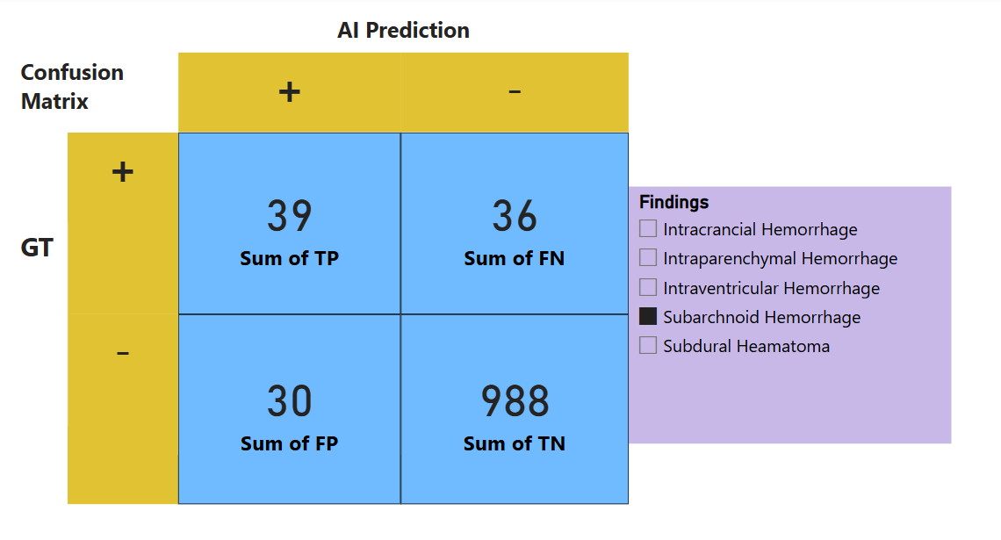
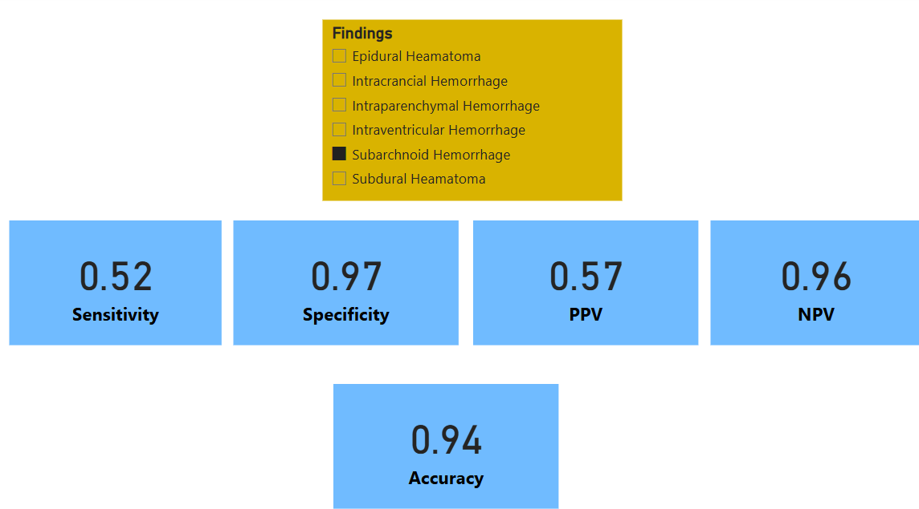
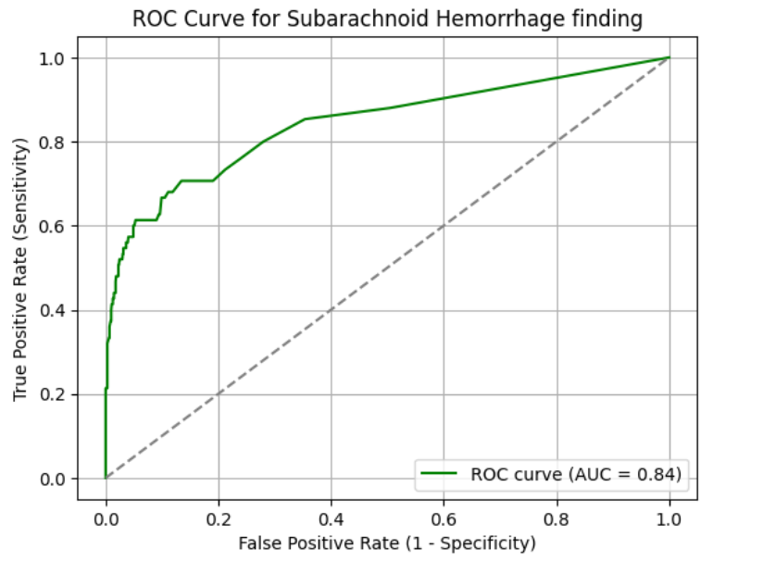
Subarachnoid Hemorrhage
Sensitivity: 0.52
The AI correctly identified only 52% of SAH cases. This relatively low detection rate is concerning for clinical safety, especially in emergency contexts where early diagnosis is critical.
Specificity: 0.97
Excellent specificity; the AI was effective in excluding non-SAH cases, reducing the risk of unnecessary follow-up for false alarms.
Positive Predictive Value (PPV): 0.57
Slightly better than chance — only 57% of flagged SAH cases were correct. This raises reliability concerns when acting on AI alerts alone.
Negative Predictive Value (NPV): 0.96
Strong NPV means AI is reliable when it predicts no SAH. It can be trusted to rule out SAH in most cases.
Accuracy: 0.94
High overall performance driven largely by correct identification of negatives. However, lower sensitivity impacts its ability to reliably confirm positive cases.
Area Under Curve (AUC): 0.84
Good, but not excellent, discriminative ability. Reflects moderate performance in distinguishing between SAH and non-SAH cases.

Slide 13
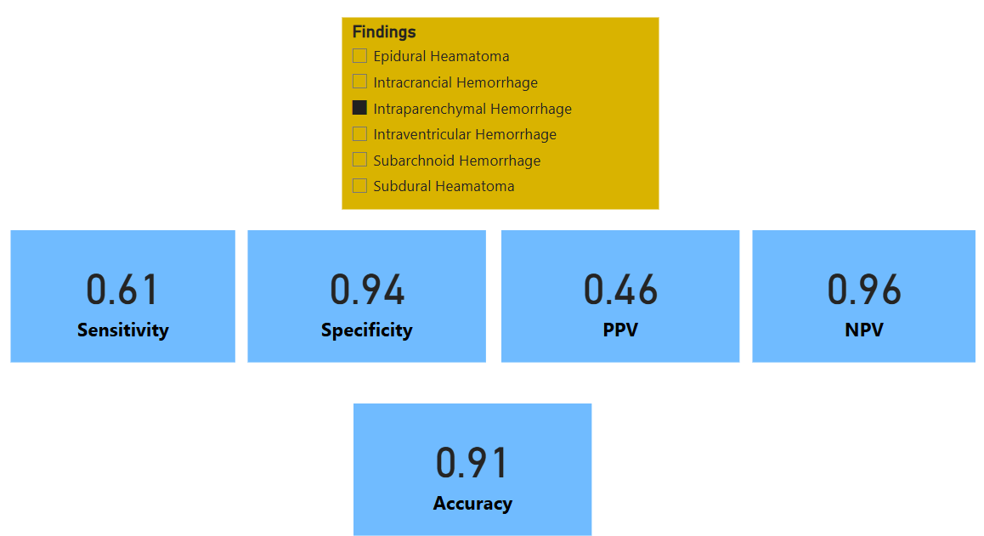
Intraparenchymal Hemorrhage
Sensitivity: 0.61
AI identified 61% of actual IPH cases, suggesting moderate detection ability. Nearly 40% of true IPH cases may be missed, a potential clinical risk.
Specificity: 0.94
High specificity indicates the AI is effective in identifying negative cases, limiting false positives in the clinical workflow.
Positive Predictive Value (PPV): 0.46
Less than half of flagged cases were accurate, highlighting a significant number of false positives that could erode clinician trust in the tool.
Negative Predictive Value (NPV): 0.96
Strong confidence in negative predictions; useful in screening and ruling out IPH.
Accuracy: 0.91
Overall, the model performs well across cases, but the moderate sensitivity requires cautious use in critical settings.
Area Under Curve (AUC): 0.85
Good discrimination between IPH and non-IPH cases, validating use as a support tool when combined with expert review.

Slide 14
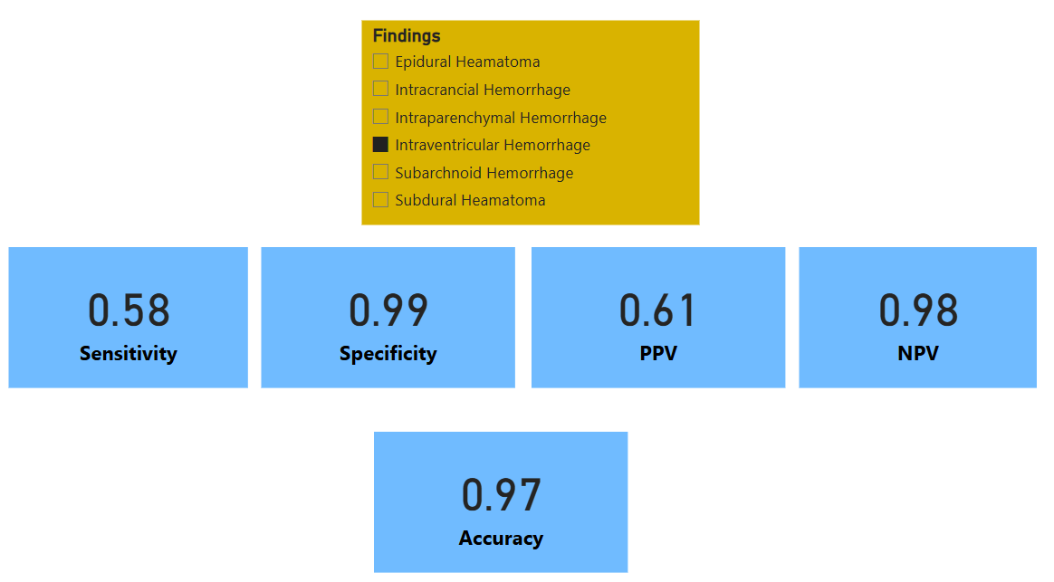
Intraventricular Hemorrhage
Sensitivity: 0.58
The AI detects 58% of IVH cases — slightly better than chance. This lower sensitivity raises concern for missed cases in acute care.
Specificity: 0.99
Very strong ability to exclude non-IVH cases, ensuring minimal false alarms and efficient triage.
Positive Predictive Value (PPV): 0.61
Just over half of the predicted IVH cases were correct. Clinician validation remains critical for decisions.
Negative Predictive Value (NPV): 0.98
High confidence in AI’s ability to rule out IVH. It can effectively filter non-critical cases in high-throughput environments.
Accuracy: 0.97
High overall accuracy — most predictions were correct. Yet, given the low sensitivity, positive cases might still be missed.
Area Under Curve (AUC): 0.97
Excellent discriminative performance. Despite moderate sensitivity, the model performs well across classification thresholds.

Slide 15
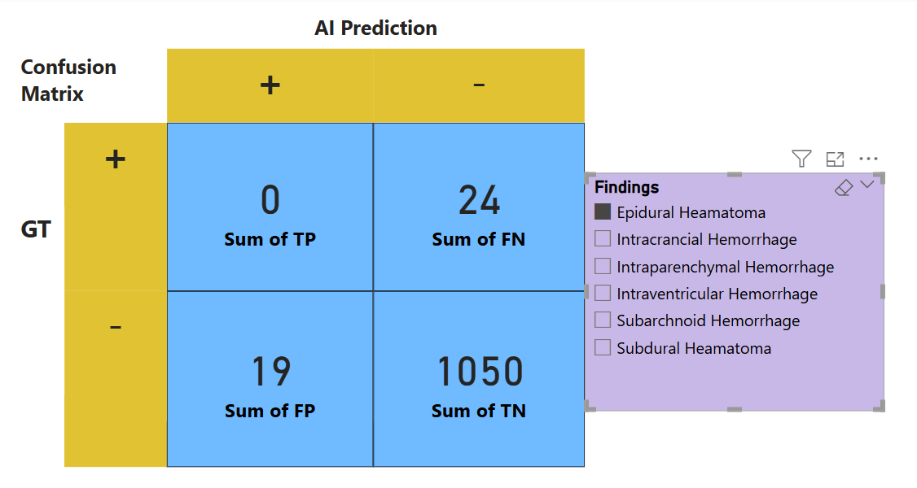
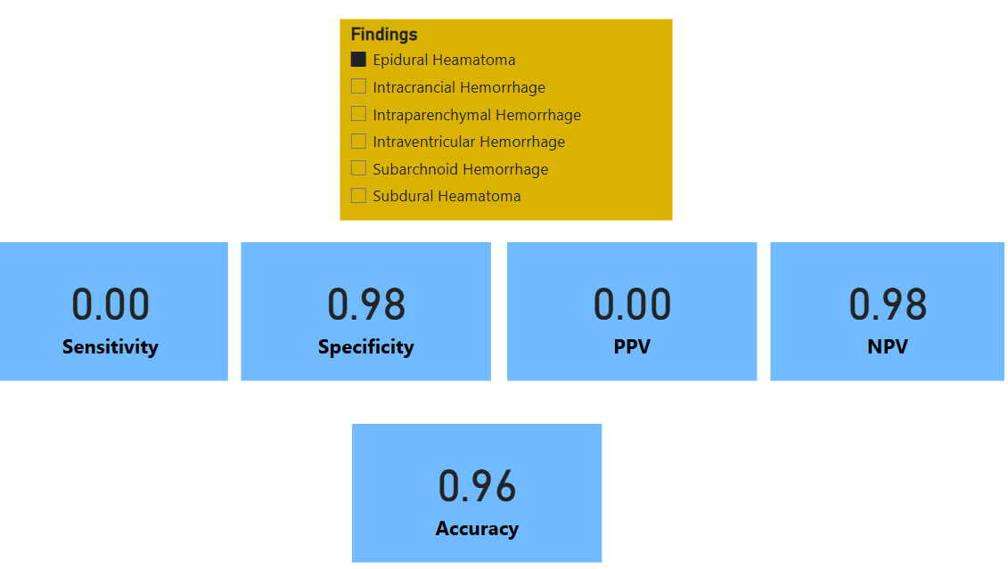
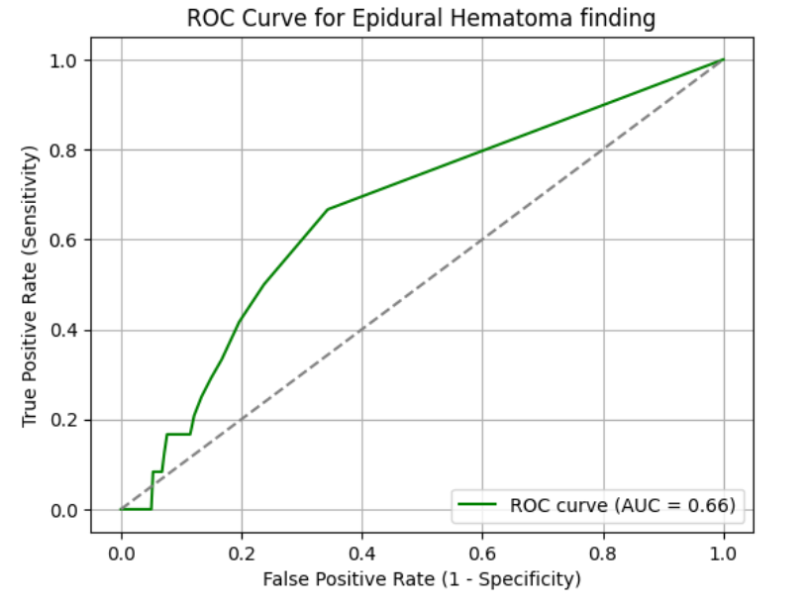
Epidural Hematoma
Sensitivity: 0.00
The AI failed to detect any true EDH cases. Complete absence of sensitivity is a major clinical limitation and indicates inability to identify this pathology.
Specificity: 0.98
High specificity shows strong performance in identifying non-EDH cases, avoiding unnecessary false alarms.
Positive Predictive Value (PPV): 0.00
All positive predictions were incorrect, pointing to a lack of utility in flagging EDH.
Negative Predictive Value (NPV): 0.98
Despite poor detection, the AI is still reliable when it rules out EDH — although this should not be solely relied upon in critical cases.
Accuracy: 0.96
High overall accuracy is misleading and primarily driven by correct classification of negative cases; not reflective of true detection ability.
Area Under Curve (AUC): 0.66
Subpar AUC underscores limited utility of the model in detecting EDH; highlights a clear area for model improvement.

Slide 16
Diagnostic Strength
AI showed strong classification capability with AUC > 0.84 for 5 out of 6 findings — confirming reliable discrimination between presence and absence of hemorrhage.
Overall Accuracy ranged from 75% to 97%, highlighting consistency across findings.
High-Performing Metrics
Subarachnoid Hemorrhage had the highest sensitivity (0.52) – strongest at identifying actual positives, valuable in emergency triage.
Intraventricular Hemorrhage (IVH) delivered excellent specificity (0.99) and NPV (0.98) – highly reliable when ruling out disease.
Subdural Hematoma (SDH) achieved highest PPV (0.90) – strong precision when predicting a positive.
Limitations & Risk Areas
Epidural Hemorrhage (EDH) recorded 0.00 sensitivity & PPV – failed to detect any cases, indicating poor model training or rare representation in data.
Intraparenchymal Hemorrhage (IPH) and SAH had moderate sensitivity and low PPV, reflecting a tendency to overcall non-hemorrhagic hyperdensities.
Low sensitivity across several findings suggests a risk of false negatives, which can lead to missed diagnoses in critical care.

Slide 17
Discussion
Diagnostic Accuracy & Subtype Analysis
AI showed strong performance for ICH (Sensitivity: 0.79, AUC: 0.90); SAH and IVH had acceptable accuracy, while EDH and IPH were weaker due to lower precision.
Unlike Mair et al. (2022), which provided overall hemorrhage validation, this study adds granular insights across subtypes, aiding clinical decision-making.
Pham et al. (2023) reported similar robustness using VeriScout™: Sensitivity 0.92, Specificity 0.96, even with artifacts and post-op cases
Pham et al.'s tool retained performance across noisy clinical cases .
False Positives & Overcalling
EDH and IVH overcalled due to misinterpretation of effusion, ossification, or post-surgical changes.
Similar concerns were reported by Bar et al. (2022), who also linked reduced AI accuracy to imaging protocol variability.
This study extends findings by identifying specific misinterpreted features contributing to false positives.

Slide 18
AI as a Workflow Tool
High NPV (e.g., 0.91 for ICH) supports AI use in triaging and ruling out negative cases in emergency settings.
Dyer et al. (2022) showed similar AI effectiveness in prioritizing normal scans; our study reinforces AI’s value in workload optimization, not full automation.
Real-World Validity
Dataset from a Brazilian hospital includes diverse clinical conditions, enhancing external validity and robustness testing.
Compared to Mair and Bar et al., this study offers greater context on imaging variability and clinical complexity.
Abrigo et al. (2023): For ICH in Hong Kong, model sensitivity improved from 73% to 93% with slice-level expert review which was a type of Change effect analysis, but our study focus on the cros-sectional performance
Benchmarking & Future Scope
Radiologist reports used as ground truth, similar to Bar et al. (2022).
Unlike Dyer et al., no direct AI vs. radiologist accuracy comparison—future work should explore discrepancy analysis to further evaluate AI reliability.

Slide 19
Conclusion
The study successfully validated the AI model’s performance across 1261 real-world brain CT scans, focusing on six major types of intracranial hemorrhages
Overall findings show the AI achieved strong sensitivity, specificity, and AUC for general ICH detection, with high NPV making it a reliable tool for ruling out critical cases.
Subtype-level analysis revealed areas of excellence (e.g., SAH, ICH) and limitations (e.g., EDH, IPH), providing clear direction for refinement before deployment.
The model demonstrated good generalizability across complex clinical cases, reinforcing its potential use in diverse radiology environments.
Based on the results, the AI model shows promising utility as a triage and decision-support tool. However, targeted improvements and continuous feedback loops are recommended before full clinical onboarding.

Slide 20
References
Mair G, Morris Z, Lindley RI, Tsang A, Curry M, Cheah C, et al. External validation of e-ASPECTS software for interpreting brain CT in stroke. Ann Neurol. 2022;91(4):462–72. doi:10.1002/ana.26354
Bar A, Saban M, Nagar H, Yehezkel G, Lichter I, Konen E, et al. Artificial intelligence model for stroke detection using non-contrast CT: multicenter external validation study. Insights Imaging. 2022;13:77. doi:10.1186/s13244-022-01188-y
Dyer T, Chawda S, Alkilani R, Naunton Morgan T, Hughes M, Rasalingham S. Validation of an artificial intelligence solution for acute triage and rule-out normal of non-contrast CT head scans. Neuroradiology. 2022;64(4):735–43. doi:10.1007/s00234-021-02826-4
Pham M, Quach V, Phan J, Shieh J, Gupta S, Sanghvi A, et al. Multicenter validation of an AI model for acute intracranial hemorrhage detection on non-contrast head CT. Front Neurol. 2023;14:1177723. doi:10.3389/fneur.2023.1177723.
Abrigo JM, He W, Cheung KY, Kwok ML, Chan CP, Mak DKY, et al. Diagnostic accuracy of artificial intelligence in identifying intracranial hemorrhage and large vessel occlusion on computed tomography. Hong Kong Med J. 2023;29(1):14–21.

Slide 21
INVOLVEMENT IN COMMUNITY OUTREACH PROGRAMME (COP) ACTIVITIES
In 52 districts across India Clinton Health Access Initiative(CHAI) collaborated with state governments, LAB India and CARPL to conduct TB screening program for the population who are residing in remote areas.
The TB screening is conducted using Portable handheld Xray machines and the RIS developed by CARPL, that helps in managing data which is being captured during the camp and screening as well as provides AI generated interpretations of scans detecting TB abnormalities.
The camps are conducted by the Radiographers and the TB officers of state so recently I have represented CARPL and provided training of the RIS and AI usage to Radiographers and officers of Haryana at State TB office of Haryana Panchkula.

Slide 22
Key Learnings
-
The on-camp staffs are well versed with their traditional approach of working and resist the change in the workflow due to lack of digital literacy so regular and engaging practical trainings are necessary for the adoption of technology.
For the better usage of the software a robust software support response mechanism needs to followed which helps the staffs to conduct the program.
The inclusion of Govt TB officers in planning and execution of the program plays an important role as the officials helps in conducting analysis and strategies to improve the program outcomes as well as can help in the refinement of the software functionalities.

Slide 23
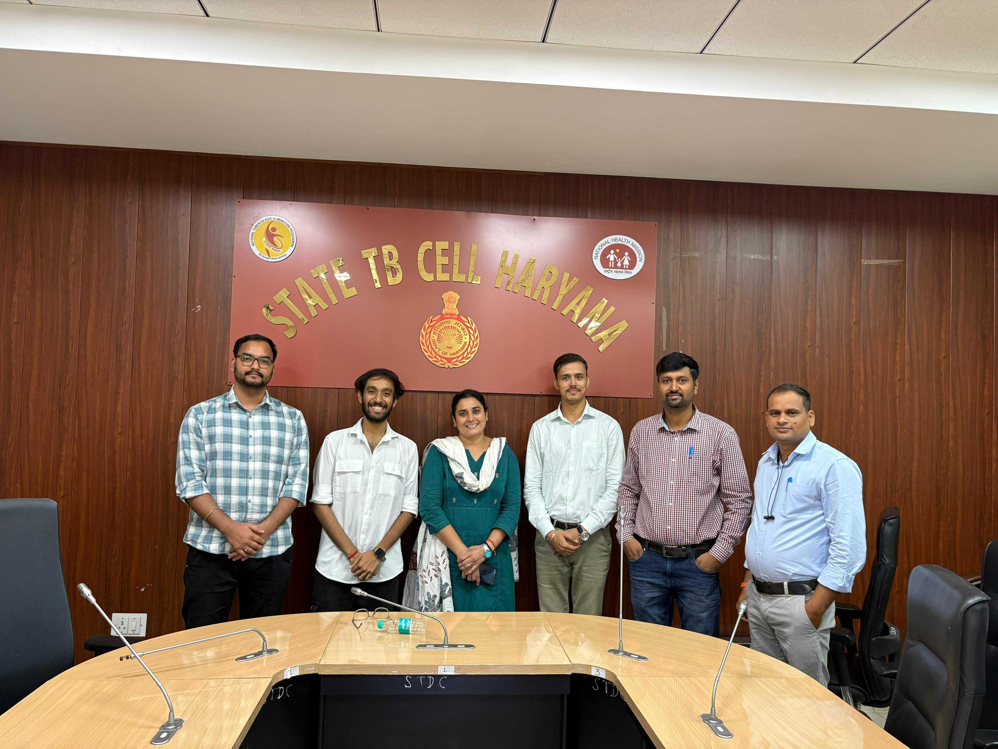
PICTORIAL JOURNEY
-

Slide 24
Thank You

