Slide 1

"Awareness, Perception, and Acceptability of Menstrual Cups Among Women in Delhi-NCR: A Survey
Faculty name - Dr.Divya Aggarwal
IIHMR Delhi
Presented by- Dr. Shreya Aggarwal
(PG/23/114)

Slide 2
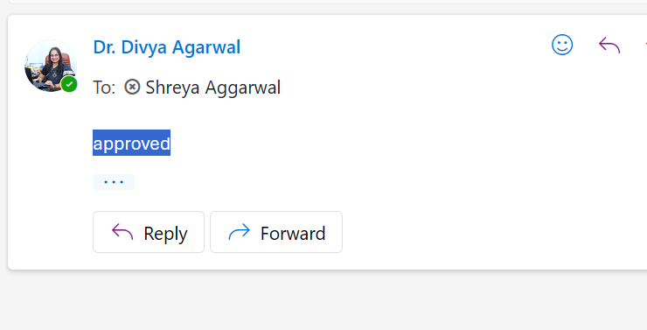
Mentor Approval

Slide 3
Introduction (1/2)
Menstrual Hygiene Landscape:
Women menstruate for 3-7 days, accumulating 6.25 years of periods in
a lifetime .
In India, a woman typically disposes over 10,000 tampons/pads in her menstrual
life cycle.
Environmental Impact of Traditional Products:
Sanitary pads can take 500 to 800 years to decompose due to plastic components
(e.g., polyethylene).
Emergence of Menstrual Cups:
Sustainable alternative offering cost-effectiveness, reduced environmental impact,
and increased convenience.
Research Gap:
Despite advantages, awareness, perception, and acceptability of menstrual cups
among women in Delhi-NCR remain under-researched.
This study aims to provide insights for public health initiatives and educational
campaigns.

Slide 4
Objectives of Your Study
“The study aimed to assess the level of awareness of menstrual cups among women in Delhi, NCR, and to identify both significant and non-significant associations between awareness and demographic factors like age, educational qualification, occupation, and monthly household income."
"We also aimed to explore the knowledge and perceptions regarding the usage of menstrual cups, and to determine the presence or absence of associations with demographic factors including age, educational qualification, occupation, and monthly household income."

Slide 5
Methodology (1/2)
Study Design-Cross-sectional survey.
Setting: Delhi, NCR, India.
Purpose: To assess knowledge, acceptance, perception, and usage of menstrual cups among women.
Study Population-Women aged 18 to 50 years with regular menstrual cycles.
Inclusion Criteria:
Women aged between 18 and 50 years.Reside in Delhi, NCR.
Experienced menstruation for at least one year prior to the study.
Willing to participate and provide informed consent.
Exclusion Criteria:
Medical conditions interfering with menstrual health (except PCOD and PCOS).
Unable to provide informed consent.
Sample Size: Approximately 384 participants.
Sampling Technique: Non-probability sampling.
Study Tool-Structured, close-ended questionnaire.
Sections:
Demographic Information: Age, educational qualification, occupation.
Knowledge and Awareness: Familiarity with menstrual cups, sources of information.
Perceptions and Attitudes: Beliefs, myths, cultural/personal barriers.
Acceptance and Usage: Willingness to use, past/current use, experiences.

Slide 6
Methodology (2/2)
Data Collection Procedure:
Modes: Both online and offline over a defined period.
Online: Google Forms distributed via email and social media (WhatsApp, Instagram, Facebook, LinkedIn).
Offline: Printed forms administered in person at selected community centers, colleges, and workplaces.
Consent: Participants informed about study purpose and confidentiality; informed consent obtained prior to participation.
Data Analysis:
Compilation: Microsoft Excel.
Software: Statistical software (e.g., https://www.socscistatistics.com/ R).
Methods:
Descriptive statistics (frequencies, percentages, means, standard deviations) for participant characteristics and responses.
Associations between variables and age analyzed using chi-square tests or other appropriate statistical methods.
Methodology - Ethical Considerations
Ethical Considerations:
Ethical Clearance: Obtained from the SRB Committee.
Voluntary Participation: Entirely voluntary.
Informed Consent: Participants provided with information about study objectives and their rights.
Confidentiality: No personal identifiers collected; data confidentiality strictly maintained.

Slide 7
Results (1/3)
Objective 1: Awareness of Menstrual Cups
Significant Associations Found:
Age: Significantly associated with having heard about menstrual cups (p=0.0402).
Educational Qualification: Significantly associated with having heard about menstrual cups (p=0.0013).
No Significant Associations Found:
Occupation: No significant association with awareness (p=0.2905).
Monthly Household Income: No significant association with awareness (p=0.5321).

Slide 8
Results (2/3)
Objective 2: Knowledge of Menstrual Cup Usage
Significant Associations Found:
Age: Significantly associated with knowing how a menstrual cup is used (p=0.0468).
Monthly Household Income: Significantly associated with knowing how a menstrual cup is used (p=0.0247).
No Significant Associations Found:
Educational Qualification: No significant association with knowledge of usage (p=0.0912).
Occupation: No significant association with knowledge of usage (p=0.0812).

Slide 9
Discussion (1/2)
This study investigated menstrual cup awareness, usage knowledge, and their demographic associations among women in Delhi-NCR. Findings offer crucial insights for promoting sustainable menstrual hygiene.
Awareness of Menstrual Cups
Awareness of menstrual cups was significantly associated with age and educational qualification. Older women and those with higher education demonstrated greater awareness, suggesting education's role in health literacy and information access. This aligns with existing literature [Cite relevant studies here]. Conversely, occupation and monthly household income showed no significant association with awareness. This indicates that awareness is more influenced by educational background and information exposure than by professional status or economic standing alone.
Knowledge of Menstrual Cup Usage
Knowledge regarding menstrual cup usage was significantly linked to age and monthly household income. Older women and those from higher-income households reported better knowledge of usage. This could reflect accumulated experience over time and greater access to resources (e.g., internet, healthcare) for practical learning. Notably, educational qualification and occupation were not significantly associated with usage knowledge. This suggests a gap: while education may increase general awareness, practical usage knowledge might require different, more hands-on learning channels, not necessarily provided through formal schooling or professional roles.
Acceptability of Menstrual Cups
While direct demographic associations with overall acceptability were not the primary focus of the Chi-square analysis, the findings on awareness and usage knowledge are foundational. Low awareness or lack of usage knowledge inherently limits acceptability. Further research is needed to fully delineate factors influencing menstrual cup adoption in Delhi-NCR.

Slide 10
Discussion (2/2)
Implications for Public Health
1)Targeted Education: Campaigns must target younger women and those with lower educational qualifications to boost awareness.
2) Practical Guidance: Focus on practical usage demonstrations and accessible instructions, especially for lower-income groups, to bridge the knowledge-usage gap.
3)Holistic Promotion: Emphasize environmental and economic benefits alongside health aspects to encourage broader adoption.
Limitations
Sampling: Non-probability sampling limits generalizability to the entire Delhi-NCR population.
Design: Cross-sectional design prevents causal inference or tracking changes over time.
Scope: Findings are specific to Delhi-NCR and may not apply elsewhere.
Future Research
Qualitative Studies: Explore nuanced perceptions, barriers, and experiences.
Intervention Studies: Evaluate educational programs for effectiveness in increasing awareness and practical knowledge.
Longitudinal Studies: Track changes in awareness, perception, and acceptability over time.
Broader Contexts: Expand research to diverse geographic and socio-economic settings.
Sustained Use: Investigate factors influencing continued menstrual cup use.
In conclusion, age, educational qualification, and monthly household income are key demographic factors influencing menstrual cup awareness and usage knowledge in Delhi-NCR. Addressing these factors through targeted, practical interventions is vital for promoting sustainable menstrual hygiene practices in the region.

Slide 11
References (Only Vancouver Style)
ResearchGate. Awareness, Acceptability, and Feasibility of the Menstrual Cup Among Working Women [Internet]. ResearchGate; 2025 Apr 25 [cited 2025 Jul 4]. Available from: https://www.researchgate.net/publication/390458925_Awareness_Acceptability_and_Feasibility_of_the_Menstrual_Cup_Among_Working_Women
Menstrual Hygiene Management. WaterAid India; [date unknown]. Available from: https://www.wateraid.org/in/sites/g/files/jkxoof336/files/informed-product-choice-and-disposal_1.pdf
Mildcares.com. Reusable vs. Disposable: The Environmental Impact of Menstrual Product - Mildcares.com [Internet]. Mildcares.com; 2025 Jan 18 [cited 2025 Jul 4]. Available from: https://mildcares.com/blogs/news/reusable-vs-disposable-the-environmental-impact-of-menstrual-products
American Chemical Society. Is food waste the key to sustainable, plastic-free diapers and sanitary pads? [Internet]. American Chemical Society; 2024 Mar 19 [cited 2025 Jul 4]. Available from:https://www.acs.org/pressroom/presspacs/2024/march/is-food-waste-the-key-to-sustainable-plastic-free-diapers-and-sanitary-pads.html
Nua. Why Menstrual Cups Are an Eco-Friendly, Cost-Effective, and Healthy Period Solution [Internet]. Nua; 2025 Apr 29 [cited 2025 Jul 4]. Available from: https://nuawoman.com/blog/why-menstrual-cups-are-an-eco-friendly-cost-effective-and-healthy-period-solution/
ResearchGate. Menstrual Cup Awareness and Future Usage Possibilities of Consumers: A Cross-sectional Study | Request PDF [Internet]. ResearchGate; 2025 May 24 [cited 2025 Jul 4]. Available from: https://www.researchgate.net/publication/376162438_Menstrual_Cup_Awareness_and_Future_Usage_Possibilities_of_Consumers_A_Cross-sectional_Study
PubMed Central. Bridging the Knowledge Gap: Awareness, Attitudes, and Practices Regarding Menstrual Cup Usage Among Medical Students in Chennai, India [Internet]. PubMed Central; 2025 Apr 22 [cited 2025 Jul 4]. Available from: https://pmc.ncbi.nlm.nih.gov/articles/PMC12096921/
PubMed Central. Awareness and acceptance of menstrual cups and the factors associated with it among healthcare professionals in Wolaita Zone, South Ethiopia [Internet]. PubMed Central; 2025 Jan 15 [cited 2025 Jul 4]. Available from: https://pmc.ncbi.nlm.nih.gov/articles/PMC11751893/

Slide 12
IIJLS. Knowledge Regarding Menstrual Cups and its Usage among Adolescent Girls [Internet]. IIJLS; 2023 Dec 23 [cited 2025 Jul 4]. Available from: https://iijls.com/currentissue/Knowledge_Menstrual_Cups_Usage_Adolescent_Girls.pdf
PubMed Central. Knowledge, Attitude and Practices Regarding Menstrual Cup Among Females in an Urban Setting of South Kerala [Internet]. PubMed Central; [date unknown] [cited 2025 Jul 4]. Available from: https://pmc.ncbi.nlm.nih.gov/articles/PMC10350547/
ResearchGate. Awareness and Adoption Rates of Menstrual Cups Among Adolescents and Young Women [Internet]. ResearchGate; 2025 Jun 20 [cited 2025 Jul 4]. Available from: https://www.researchgate.net/publication/392777105_Awareness_and_Adoption_Rates_of_Menstrual_Cups_Among_Adolescents_and_Young_Women
PubMed Central. Factors Associated with Exclusive Use of Hygienic Methods during Menstruation among Adolescent Girls (15–19 Years) in Urban India: Evidence from NFHS-5 [Internet]. PubMed Central; [date unknown] [cited 2025 Jul 4]. Available from: https://pmc.ncbi.nlm.nih.gov/articles/PMC11046189/
Storyboard18. World Menstrual Hygiene day: Tata Trusts' new campaign flips the narrative around menstruation [Internet]. Storyboard18; 2025 Jun 6 [cited 2025 Jul 4]. Available from: https://www.storyboard18.com/advertising/world-menstrual-hygiene-day-tata-trusts-new-campaign-flips-the-narrative-around-menstruation-69152.htm
MSJ Online. Effectiveness of structured teaching programme regarding knowledge about uses of menstrual cup among nursing students [Internet]. MSJ Online; 2024 Feb 9 [cited 2025 Jul 4]. Available from: https://www.msjonline.org/index.php/ijrms/article/download/13148/8556/60321
ICCRJNR. effectiveness of the menstrual cup education package on knowledge and attitude among college [Internet]. ICCRJNR; 2023 Apr 12 [cited 2025 Jul 4]. Available from: https://iccrjnr.com/downloads/ICCRJNR080102.pdf
ResearchGate. Acceptability and feasibility of using menstrual cups as an alternative menstrual hygiene product: a tertiary care-based prospective study [Internet]. ResearchGate; 2025 Jun 3 [cited 2025 Jul 4]. Available from: https://www.researchgate.net/publication/392271750_Acceptability_and_feasibility_of_using_menstrual_cups_as_an_alternative_menstrual_hygiene_product_a_tertiary_care-based_prospective_study
PubMed Central. Acceptability and feasibility of using vaginal menstrual cups among schoolgirls in rural Nepal: a qualitative pilot study [Internet]. PubMed Central; 2021 Jan 25 [cited 2025 Jul 4]. Available from: https://pmc.ncbi.nlm.nih.gov/articles/PMC7831234/
Journal of Chemical Health Risks. “A Qualitative Study – “This is Why Women reject to use a Menstrual Cup – Experiences of Non-Users” [Internet]. Journal of Chemical Health Risks; 2024 Feb 2 [cited 2025 Jul 4]. Available from: https://www.jchr.org/index.php/JCHR/article/view/2626

Slide 13
INVOLVEMENT IN COMMUNITY OUTREACH PROGRAMME (COP) ACTIVITIES
Total no. of visits done by the Student: 10
Day-wise activities done by the student:
Mapping and listing of the area.
Interaction with the community and frontline healthcare workers.
Conducted health profile survey

Slide 14
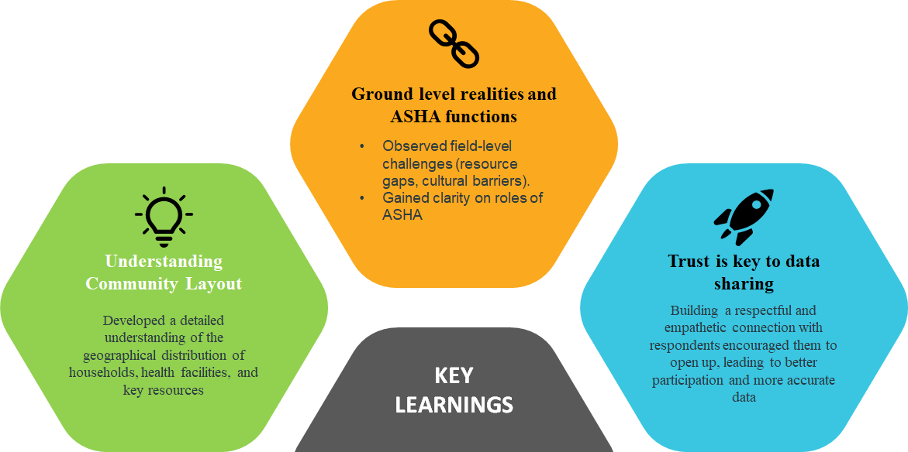
KEY LEARNING FROM COP ACTIVITIES

Slide 15
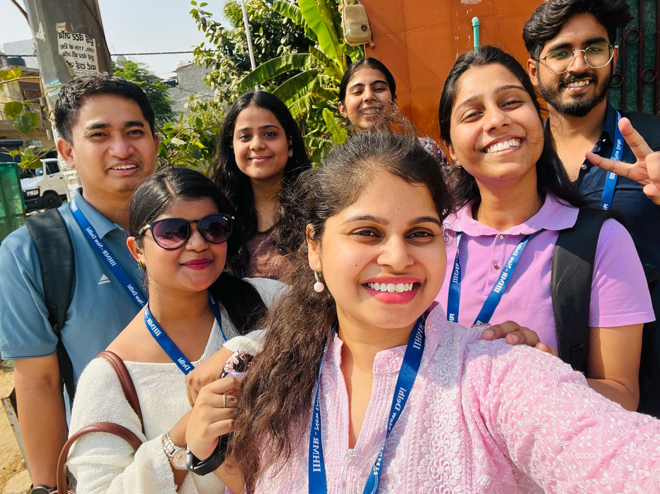
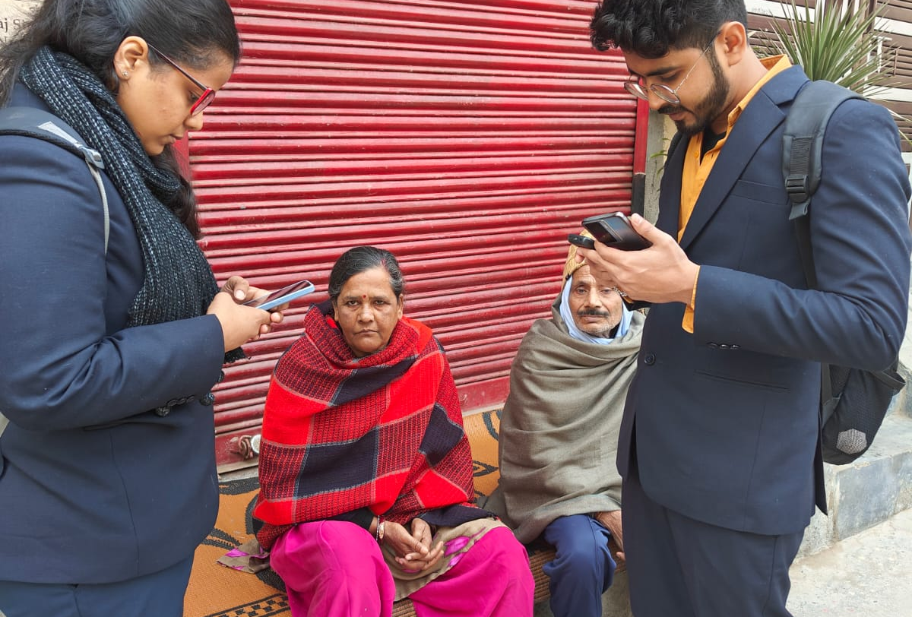
COP FIELD ACTIVITIES PHOTOGRAPHS

Slide 16
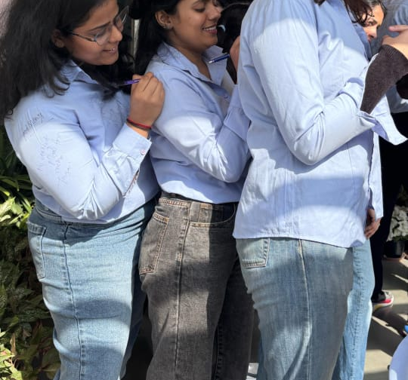
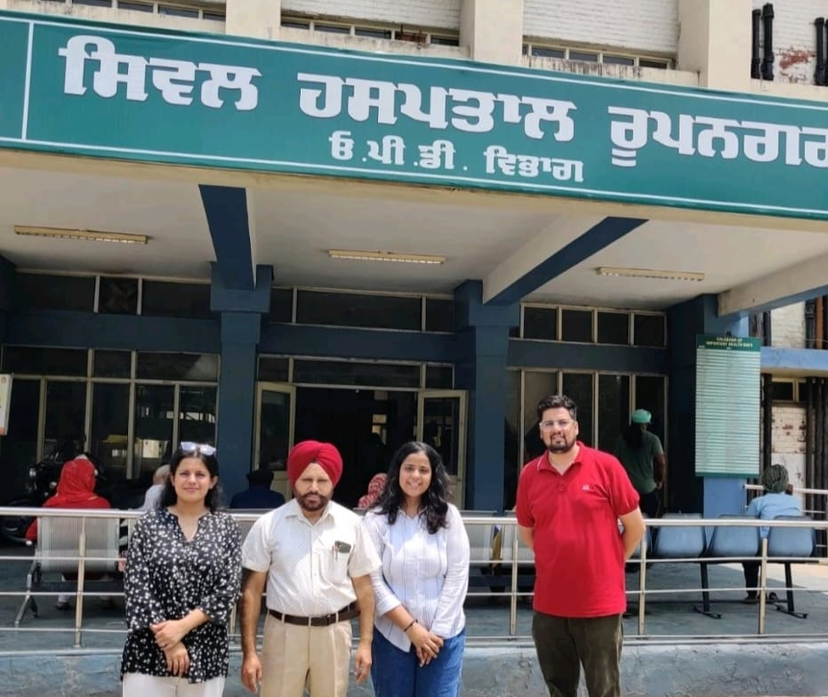
Pictorial Journey (1/2)

Slide 17
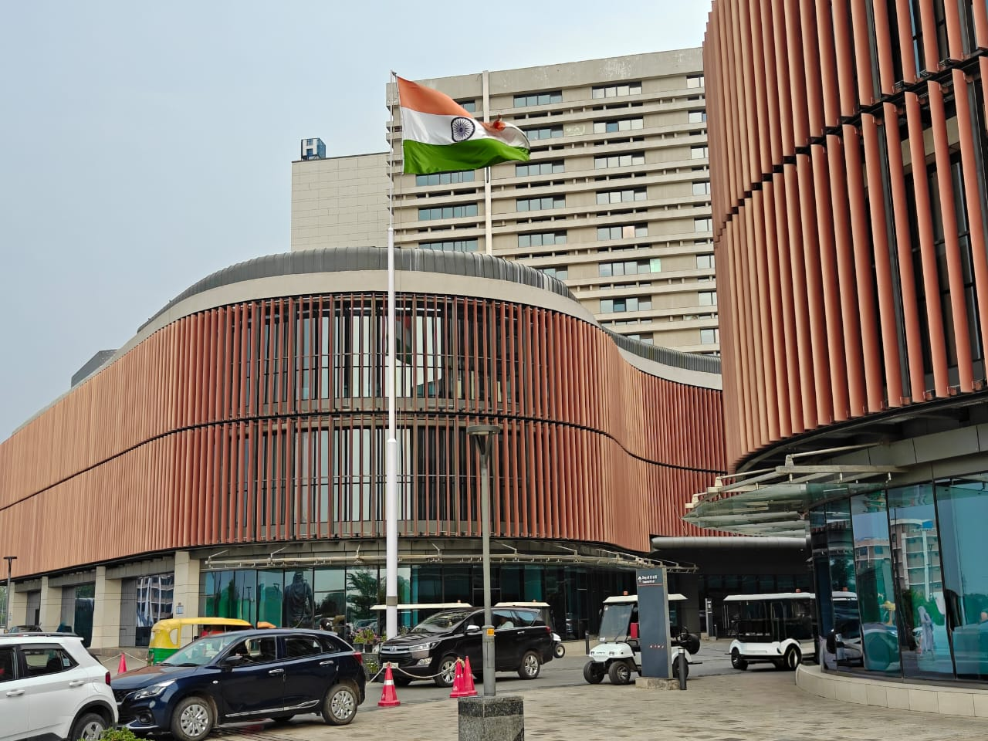
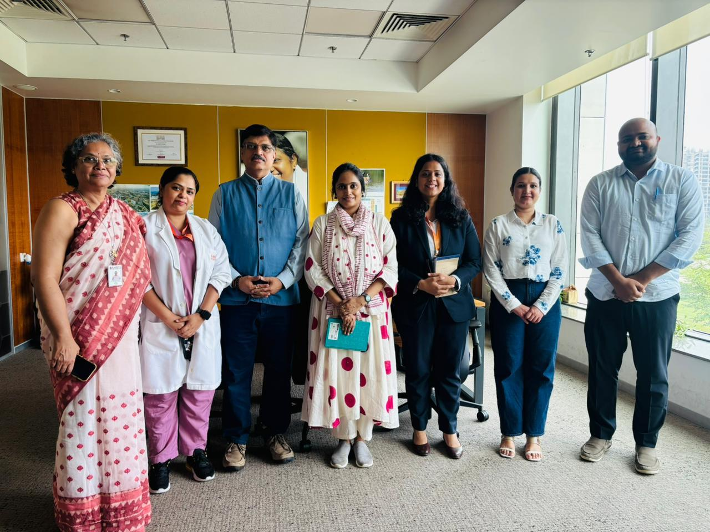
Pictorial Journey (2/2)

Slide 18
Thank You
Any Questions

