Slide 1
DISSERTATION
A Study To Assess the Availability & Quality of ANC services provided at village health and nutrition day in Budaun District Of Uttar Pradesh
Under the guidance of
Dr. B.S Singh, Associate Professor
By
Dr. Pardeep kumar
PG/15/053
Health Batch

Slide 2
Contents
Introduction
Research Question
Objectives
Methodology
Results
Conclusion
Recommendations
Reference

Slide 3
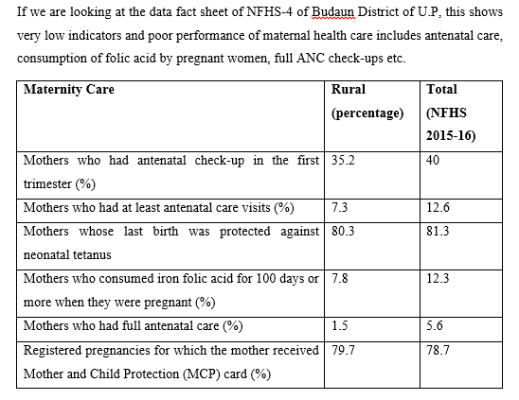
Introduction
“Healthy Mothers and Children’s are the real wealth of Societies.” (WHO)
The primary aim of antenatal care is to achieve, at the end of pregnancy, a healthy mother and healthy baby. The quality of care is more important than the quantity. Early diagnosis during pregnancy can prevent maternal ill-health, injury, maternal mortality, foetal death, infant mortality and morbidity

Slide 4
Research Question
What is the availability and quality of ANC services provided to Pregnant women at VHND session as per the guidelines, in Budaun Distict of U.P State?

Slide 5
Objectives
To assess the availability of prescribed services for Pregnant Women on VHND(Village Health Nutrition Day) as per the guideline .
To assess the quality of services provided to Pregnant women as per the guideline.

Slide 6
Indicators
For Availability
Percent of women who weighed during each visit
Percent of women whose blood pressure was measured at each visit
Percent of women whose urine sugar was being tested in each visit
Percent of women whose urine albumin was being tested in each ANC visit
Percent of women who received 2 doses of T.T./booster injection
Percent of women received ≥ 100 IFA tablets during ANC period

Slide 7
For Quality
Percent of women whose relevant history(obstetric/past/menstrual) was taken
Percent of VHND sessions where privacy was maintained.
Percent of VHND sessions where sphygmomanometer/digital B.P apparatus was functional
Percent of VHND session where Hb estimation was done using Sahli-Adams tube/Rapid diagnostic test kit
Percent of women whose abdominal palpation conducted & recorded.
Percent of women whose FHS measured and recorded in MCP card.
Percent of women who was counseled for danger signs.

Slide 8
Methodology
Study Design- Descriptive cross sectional study
Study Area- AWC, SC & School where VHND session conducted
Situated in Budaun district
Study Duration- February to April 2017
Sampling
Sampling Techniques- Non Probability- Convenient Sampling
Selection of Respondent-
Service Provider : ANM’s
Beneficiaries : ANC mother
(Willing and satisfying the criteria of study)

Slide 9
Sample Size- 64 ANC Pregnant women, 16ANMs, 8 Blocks, 16 VHND session
Inclusion Criteria-
Antenatal mothers willing to participate in the study
Antenatal mothers who are between the age group 19-45 year
Who are available at the time of data collection
Techniques- Face to Face Interview
Tools-Questionnaire (Semi structured)
Data Analysis Plan- MS Excel for further analysis.

Slide 10
Results and Data Analysis
Availability of Services on VHND Session

Slide 12
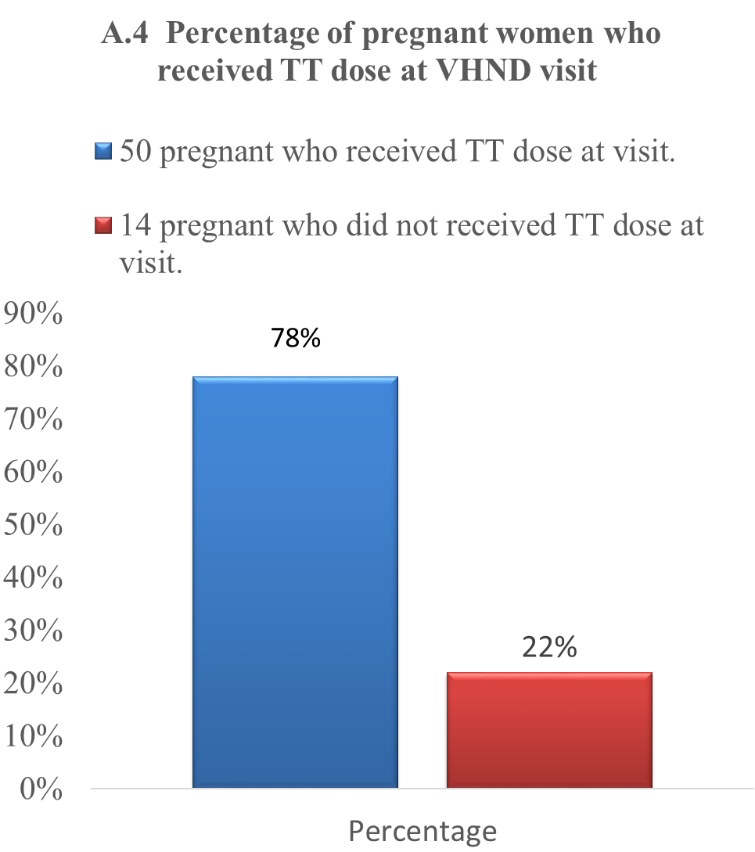

Slide 13
Quality of Services on VHND session

Slide 17
Conclusion
Present study found that utilization of ANC in the beneficiaries was comparatively low.
Major reasons of nonattendance was that ‘inconvenient timing of these sessions’ (towards the end of VHND in the afternoon) and ‘didn’t feel necessary’.
Presence of frontline health workers (ANM, ASHA) in any session was found lacking in knowledge on services providing like danger sign of pregnancy, abdominal examination, FHS etc.
Fig B.2 showed that12(75%) of the VHND session observed where privacy during examination was not maintained
Nutrition Health Education and Demonstration (NHED) sessions were not considered essential by beneficiaries as well as service providers. This gap in service delivery and utilization demands attention. (Gupshup pottely)
Fund of VHNSC was not utilized for it.
Main logistic supply problem was found that irregular supply of IFA, pregnancy test kit and uristix, TT vials & MCP card.
Whatever ANM had had like weighting machine, B.P apparatus were not working properly.

Slide 18
Recommendations
Continuous mentoring of ANMs to ensure better confidence in following skills:-
Measuring FHS by Foetoscope/Stethoscope
Abdominal examination
Dangerous signs during pregnancy
Local resources can be used for maintaining privacy during ANC check-ups.
Fund of VHNSC can be utilized for it.
Uninterrupted & Adequate supply of IFA, Uristix, MCP card, TT, OCP etc.
Convenient timing of these sessions should be there (not in the afternoon)
Monitoring and supervision need to be regularized for effective VHND.
NHED sessions would be done that will be essential for beneficiaries as well as service providers.
Greater community involvement is required to generate demand for essential services like antenatal care and nutrition and health education.
IEC and BCC can be a medium to create awareness. (Gupshup pottely)

Slide 19
References
Mamata Diwas Village Health & Nutrition Day Operational Guidelines
Impact of Antenatal Care on Maternal and Perinatal outcome: A Study at at Nepal Medical College Teaching Hospital By. Tuladhar H1, Dhakal N2 1Department of Obs/Gyn, KIST Medical College, Imadole, 2Nepal Medical College, Jorpati
Monthly village health nutrition day guidelines for awws/ashas/anms/pris
“Does antinatal care make a difference to safe delivery? A study in urban Uttar Pradesh, India by Shelah Bloom Theo Lippevold And David Wypij
“Antenatal Care” by Ornella Lincetto,Seipati Mothebesoane-Anoh,Patricia Gomez,Stephen Munjanja
Improving the Coverage and Quality of Village Health and Nutrition Days by USAID and VISTAAR
15. National Rural Health Mission.VHND monitoring in the month of April 2013. Assam. 2013 Sept [cited 2013 Sept 14]; Available from: URL:http://www.nrhmassam.in/pdf/ .../Report_on_VHND_Monitoring_Assam_2013
Vistaar Project. Improving the Coverage and Quality of Village Health and Nutrition Days: Technical brief. 2012 Oct [cited 2012 Oct 20]; Available from: URL:http:// www.intrahealth.org/.../improving-the-coverage-andquality-of-village-health.../
Maternal health Division Department of Family Welfare Ministry of Health & Family Welfare Government of India “Guidelines for Antenatal care” 2005 April (1-22)

Slide 20

Thank you

