Slide 1


Evaluating the Impact of a Digital Campaign on Healthcare Professionals:
A Pre- and Post-Survey Analysis
A Report on
By
Ms. Surbhi Kumari
Roll No: PG/23/119
Mentor: Dr. Preetha GS

Slide 2

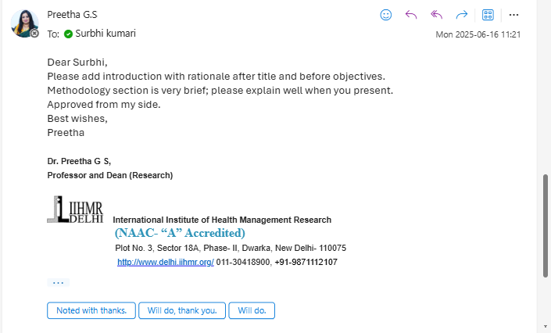
Mentor Approval

Slide 3
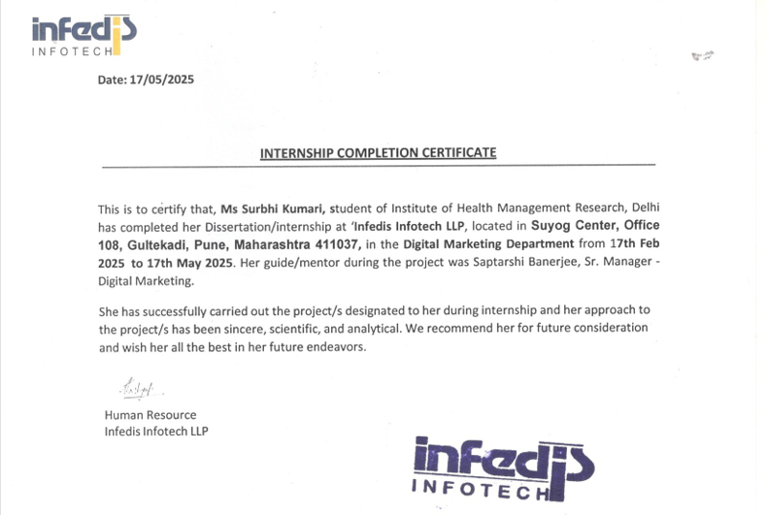
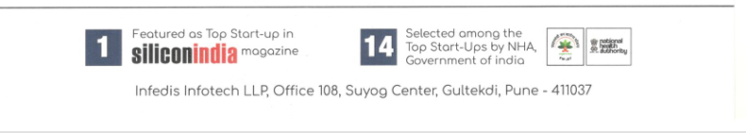
Certificate from HR Hidoc
Internship Completion Certificate from Hidoc Dr.

Slide 4
Organization Profile
Hidoc Dr. is a doctor networking platform (DNP) that serves as a global hub for
medical professionals to collaborate, consult, and exchange ideas. With over 1,065,322 doctors participating from across the globe, Hidoc Dr. harnesses the power of artificial intelligence to provide evidence-based medical second opinions and facilitate real-time case discussions. Remarkably, all these invaluable features are offered to doctors completely free of charge.
Parent Company: Infedis Infotech LLP
Founded: December, 2017
Team: 60 Associates
Location: Pune
Registered Users: 10,65,322
Active Users: 7,61,722
Brands Marketed: 1425
Hidoc Dr. unify 4.1+ million doctors from all over the world onto one medical education platform to foster collaboration, consultation and knowledge sharing. Powered by the state-of-the-art AI, Hidoc Dr. provides rapid access to evidence- based medical opinions and case discussions within no time.

Slide 5

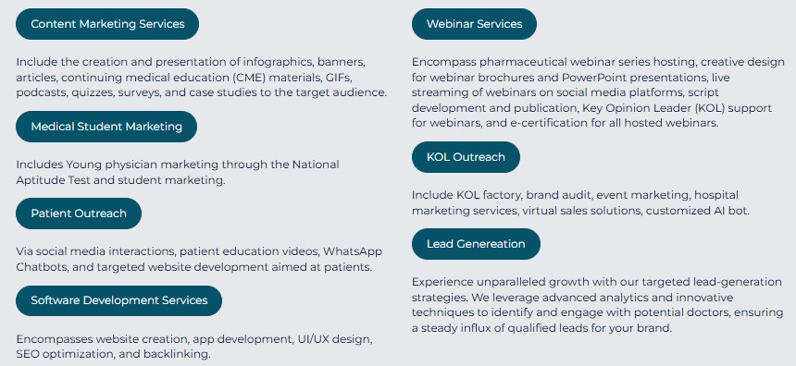
Products and Services

Slide 6
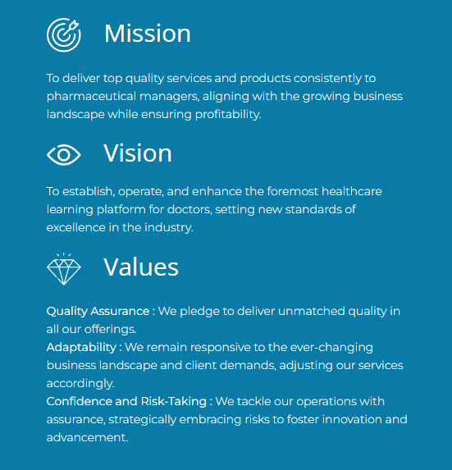
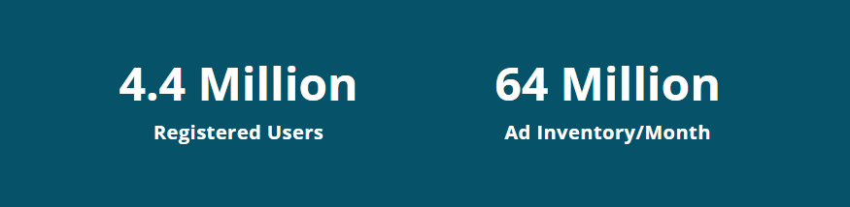
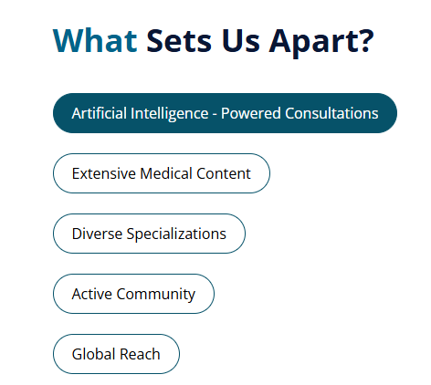

Slide 7
Job At A Glance
Pre Survey
Analyzing the pre survey
Launching the campaign
Post Survey
Comparison of both survey
Suggestions and Recommendations

Slide 8
Campaign Launch
Reach refers to the total number of unique individuals or accounts that have been exposed to your content or advertisement.
Reach
Impressions
Impressions refer to the total number of times your content or advertisement has been displayed, regardless of whether it was interacted with or not.
Engagements
Engagement refers to the interactions your content or
advertisement receives from your audience.

Slide 9
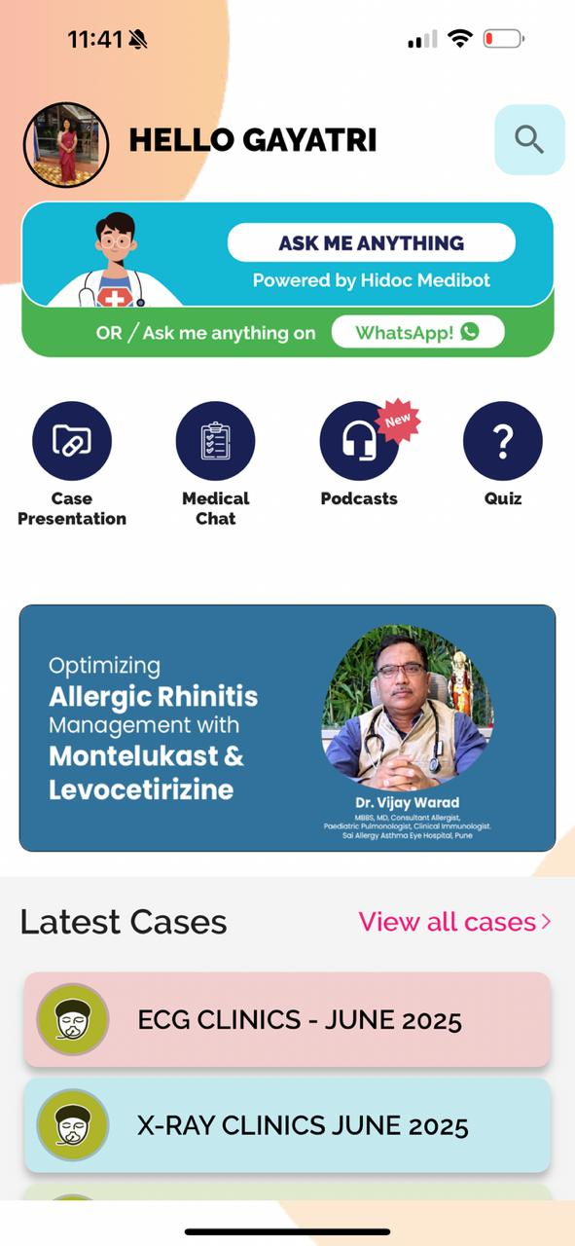
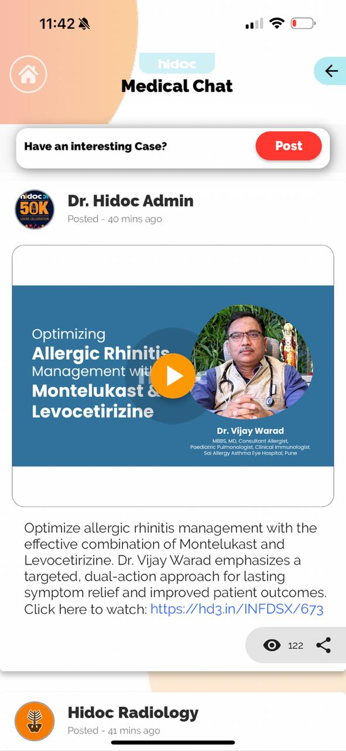
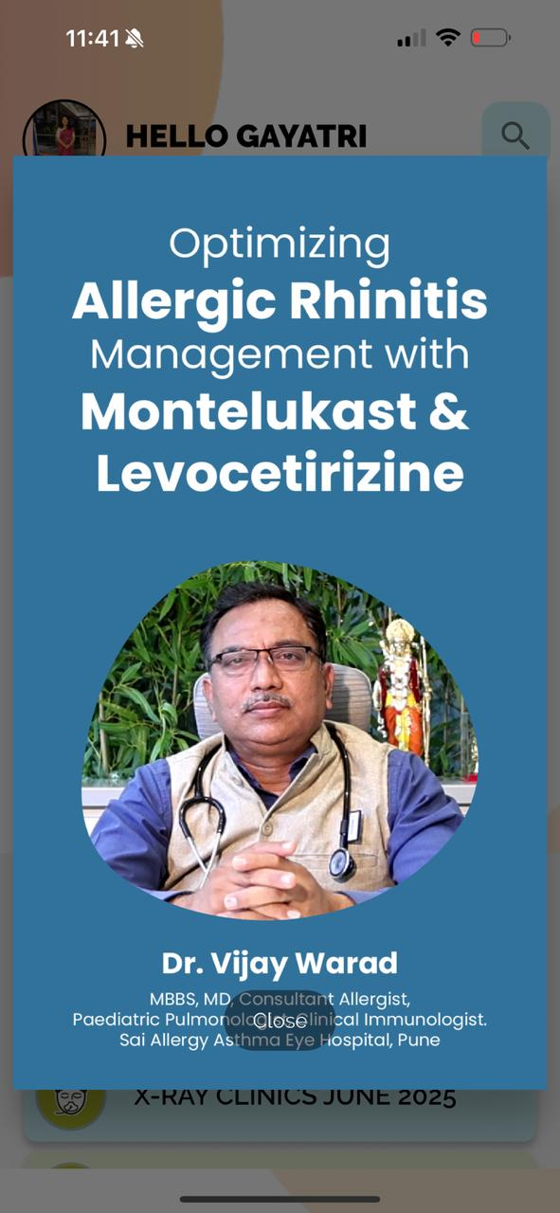
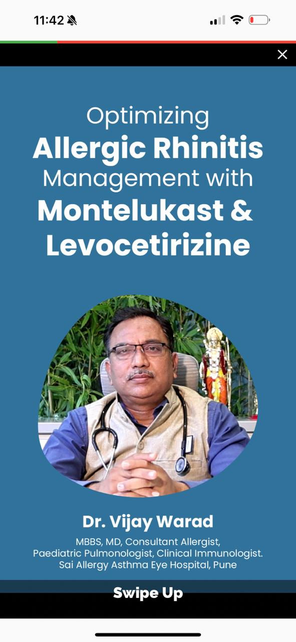
Scroller Cron Roadblock Story .

Slide 10
Evaluating the Impact of a Digital Campaign on Healthcare Professionals:
A Pre- and Post-Survey Analysis

Slide 11
Introduction
Rationale
Digital transformation has significantly reshaped healthcare marketing.
Pharmaceutical companies are increasingly relying on online platforms to reach doctors.
Hidoc Dr. is a major digital platform connecting pharma brands with HCPs.
Rising smartphone usage and internet access among doctors boosts digital campaign potential.
The study aims to analyze the effectiveness of digital strategies in reaching and engaging doctors.
To assess how digital marketing supports brand visibility, engagement, and decision-making in the pharma sector.

Slide 12
Objectives
Methodology
To assess the impact of digital marketing strategies on brand visibility and HCP engagement
To identify key metrics and performance indicators of successful digital campaigns
To generate data-driven insights and recommendations for optimizing future digital efforts
Study Period: March-May 2025
Study Design:Interventional Study
Methods of data collection: Primary data collected from the Hidoc Dr. Panel
Tools of data collection: Structured Google Forms
Sample Size: 35 Pre-survey participants & 35 post-survey
Data Analysis:Microsoft Excel for data entry & analysis

Slide 13

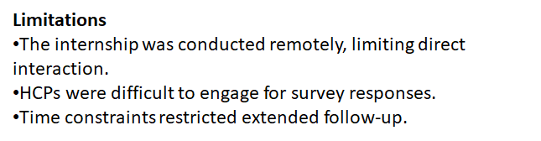
Calculation of sample size

Slide 14
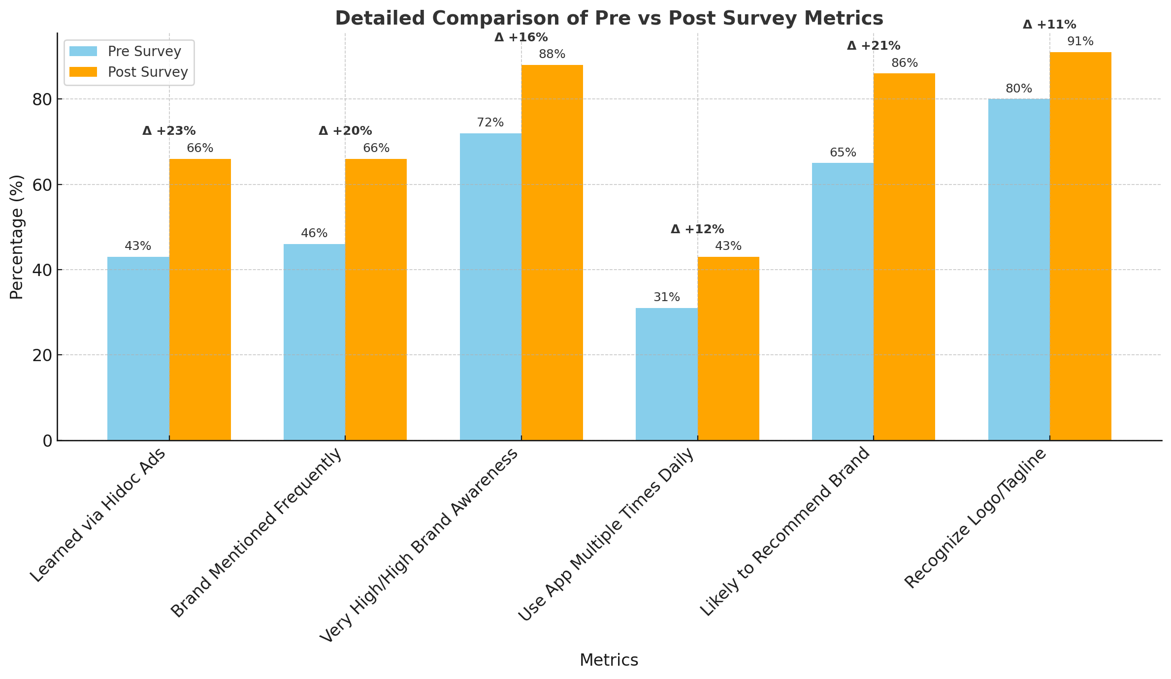
Based on the observation in pre versus post survey, there has been a positive shift towards the Recommended guidelines, Bridging in thrombectomy, Regulatory approval, Window period, Safety and Efficacy while determining the choice of thrombolytic agent in Acute Ischemic Stroke.
Based on the observation in pre versus post survey, there has been a negative shift towards the Cost, KOL influence and Work flow management while determining the choice of thrombolytic agent in Acute Ischemic Stroke.

Slide 15
Results: Pre Survey and Post Survey
Here's the bar graph comparing key metrics from the pre- and post-survey results. It visually shows the improvement in brand visibility, app usage, and recommendation likelihood after the digital campaign.

Slide 16
Key Findings
Scope of Improvement
Improved Brand Recognition
Positive Perception Shift
Enhanced Brand Trust
Increase in Engagement
Absence of Microsite/Landing Page Affects HCP Engagement
Inconsistant Content Updates Impact Engagement
Utilize Variety in Content Types for Campaign Promotion

Slide 17
Key Recommendations
Enhancing Campaign Impact with a customized Microsite Landing Page
Content creation
Lead Generation
Geographical Targeting
World Brain Tumor Day
Leveraging Successful WhatsApp Marketing Strategy

Slide 18
THANK YOU!

