Slide 1

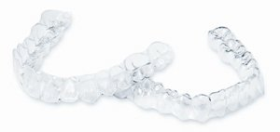
Introducing wireless
orthodontics for the
first time in
India

Slide 2
Aligner?
An aligner is a custom made clear plastic tray that moves teeth.
Aligners are removable, custom made appliances which SHOULD fit snugly on patient’s teeth.

Slide 3
CONTENTS
COMPANY PROFILE WITH MISSION
DELIVERABLES
INTRODUCTION
NEED FOR STUDY
OBJECTIVES OF THE STUDY
METHOD OF DATA COLLECTION
RESULTS
CONCLUSION
RECOMMENDATIONS
REFERENCES

Slide 4
COMPANY PROFILE

Slide 5
Clear Path was incorporated in 2008.
American Based Company
Business Operations In:
INDIA | SAUDI ARABIA | UAE | NETHERLANDS | GERMANY | BELGIUM | LUXEMBOURG | ALBANIA | MACEDONIA | JORDAN | LEBANON | EGYPT | SYRIA | KENYA | SOUTH AFRICA | UGANDA | R.O. AFRICA | SRI LANKA | MALAYSIA

Slide 6
2008, ClearPath
More than 7 years of experience.
Intensive R&D before commercial use.
It’s an advanced manufacturing service that makes a series of aligners.
2005, OrthoClear
The ClearPath process is an amalgamation of
Conventional dental laboratory procedures
Highly precise mechanical & software systems and
Digital technology
taking the best of three worlds.
Purpose is to make aligners available
globally at affordable prices !
1999, Align technology

Slide 7
MISSION.
Our mission is to deliver high quality, affordable, clear orthodontic aligner solutions to the global market

Slide 8
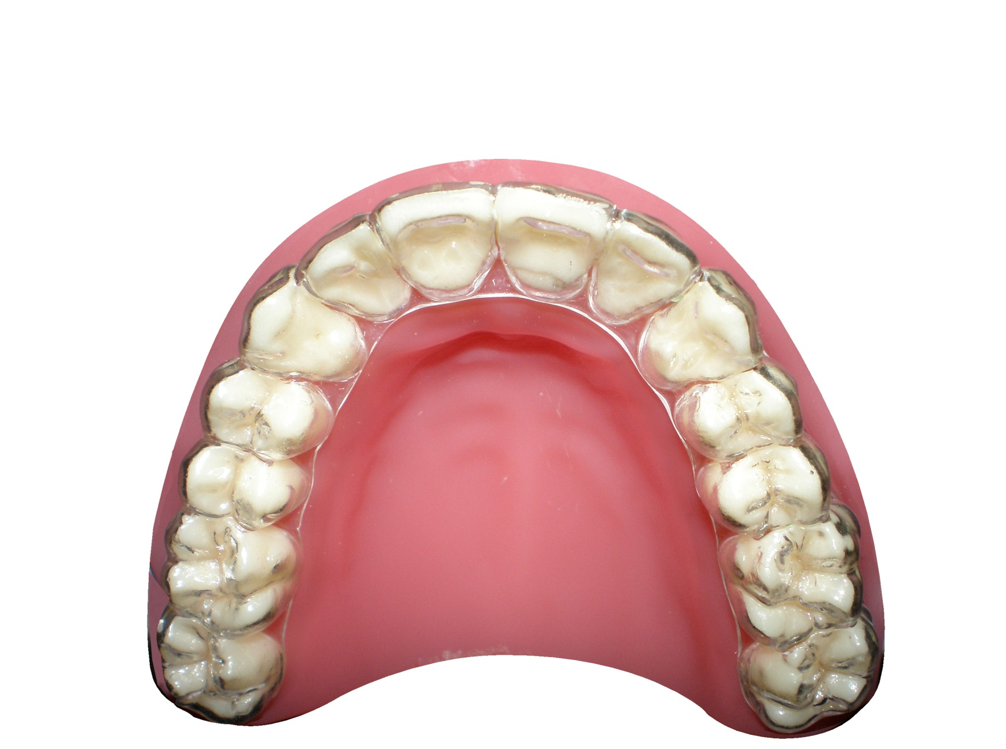

Slide 9
ClearPath Product types –3 PACKAGES TO OPT)
ClearPath-A (for double arch non-extraction cases) - Rs 80,000/to 1,00,000
ClearPath-B(for extraction indicated & complicated cases) - Rs 100,000/-1,20,000
ClearPath-S(for single arch non-extraction cases) - Rs 80,000/-90,000

Slide 10
DELIVERABLES
Acquisitions of new clients
Management of old clients
Boosting sales by distribution of brochures , posters and samples
Client relationship
Establishing market position of the product
Introduction of new concept

Slide 11
TITLE
A study on creating awareness about healthcare product among the dental surgeons of Delhi and thereby, increasing sales of the product.

Slide 12
INTRODUCTION
MARKETING: is the process of identifying, anticipating and then meeting the needs and requirements of consumers in order to make a profit. Marketing puts the needs of the customer first.
SELLING : involves persuading customers that your products or services provide the benefits that they are looking for.
The SALES PERSON is convinced that theirs is the best in the market. It is their job to then convince customers that this is the case.

Slide 13
Need for the study
The 4 P’s of marketing are taken into account.
Product, whose knowledge was increased by meeting new customers daily.
Pricing, whose knowledge was checked through interview and thereby, increased among the dental surgeons of New Delhi.
Place which included different areas visited, like West Delhi, Central Delhi and North Delhi by the manager.
Promotion, for which an advertisement was launched and its awareness was checked using interview technique.
To check the above and market awareness about the all of the above, this study was required to be conducted. It was a strategy designed to subsequently bring business and increase sales for the company.

Slide 14
Review of Literature
1)“How to find new customer and increase sales” :
To know the Target audience
Getting more revenue from existing clients
Generate new sales leads
2) “Proof That Online Search Ads Can Boost Offline Store Sales”
Online media is very effective to look for new clients
It becomes easier for buyer to know about product and is just two clicks away from buying .
3) “GE, General Electric”
Multiple strategies to achieve this growth in its healthcare business with a strong focus on research and innovation.
Maintaining the company’s competitive advantage and an expanding footprint in the developing regions particularly Asia-Pacific and Latin America, which has allowed the company to benefit from the rising healthcare spending from these regions.

Slide 15
Objectives of the study
GENERAL OBJECTIVES:
1) To find out the relation between creating awareness about a health care product and its subsequent increase in sales
SPECIFIC OBJECTIVES:
The following are the aims and objectives that will be examined during the research:
To find out the relation between creating awareness about clear aligners offered by the company Clearpath orthodontics and its subsequent increase in sales
To develop a market position and increasing awareness through advertising
To find out the extent of motivation by dental professionals to buy the product after being made aware about the product
4) To motivate the existing clients who are not satisfied with our services to keep buying the product and transform client dissatisfaction to client delightedness

Slide 16
Method of data collection
RESEARCH APPROACHES & DESIGN : Descriptive
SOURCE OF DATA : Database of 500 doctors
POPULATION : 500 dental surgeons with their name and address of the clinic given in the database
SAMPLE : 142 dental surgeons selected from the database according to the convenience of the researcher. 28.4% of the total population. Sample size was selected using Open epi.

Slide 17
SAMPLING TECHNIQUE : Convenience sampling technique was adopted
METHOD OF DATA COLLECTION : The study was carried out by using a structured “Questionnaires “and “Face –to –Face Interview”
SAMPLING CRITERIA : The sample was selected on the basis of convenient sampling method that was fulfilling the criteria according to convenience of the investigator

Slide 18
Inclusion criteria
142 dental surgeons from various areas in Delhi (such as paschim vihar, punjabhi bagh, pitampura, Rajendra place, Karol Bagh, Janak puri, Rajouri garden etc were selected)
Dental surgeons who have seen and know about clear aligners and dental surgeons who have no idea about clear aligners.
Dental Surgeons who are willing to know about clear aligners.
Dental surgeons who are willing to carry out orthodontic treatment at their clinic.
Dental surgeons who have adult patients willing to get orthodontic treatment done
Dental surgeons who have patients willing to pay that much amount of money for orthodontic treatment

Slide 19
Exclusion Criteria
Dental surgeons who do not have interest to participate in the study.
Dental surgeons who are not cooperative.
Dental surgeons who have patients willing to get orthodontic treatment done but are having mixed dentition and are <14 years old
Dental surgeons who have patients not willing to pay huge amounts of money( around 1 lakh ) for the orthodontic treatment
Dental surgeons who have patients with large skeletal deformities or orthognathic deformities

Slide 20
THE LEVEL OF EXISTING KNOWLEDGE AMONG DENTAL SURGEONS OF DELHI BEFORE AWARENESS

Slide 21
THE KNOWLEDGE ABOUT THE TYPE OF TREATMENT DONE USING ALIGNERS AMONG DENTAL SURGEONS OF DELHI

Slide 22
AWARENESS ABOUT ADVERTISEMENT OF CLEARPATH AMONG DENTAL SURGEONS OF DELHI

Slide 23
LEVEL OF MOTIVATION AMONG THE DENTAL SURGEONS OF DELHI TO USE CLEARPATH ALIGNER TECHNOLOGY AFTER AWARENESS

Slide 24
LEVEL OF MOTIVATION TO CONTINUE DOING CASES WITH CLEARPATH ALIGNERS AMONG EXISTING CLIENTS

Slide 25
Increase in sales in 2 months

Slide 26
Conclusion
52% of dental surgeons knew that aligner is a clear plastic tray
37% had this misconception that only mild cases could be treated using clear aligners and 30% thought that aligners cannot treat any malocclusion
73% didn’t know that there was an advertisement of clearpath on television and 18% had heard about invisalign but not clearpath

Slide 27
52% of the dental surgeons were highly motivated after awareness session and were willing to start a clearpath case,32% were somewhat motivated and wanted to ask their orthodontist or check on Google first, 16% were not at all motivated and didn’t want to do any case
65% of existing clients were willing to give more cases while 35% were not so much satisfied with the services
There was a 25% increase in sales.

Slide 28
Recommendations
WORKSHOP/CONFERENCE IN DELHI REGION BY A TRAINED PROFESSIONAL OR SENIOR PRACTITIONERS: This could be planned and organized in the coming months
CONTINUOUS MOTIVATION , AWARENESS AND WORKSHOPS AND SEMINARS FOR THE DENTAL SURGEONS: Dental surgeons believed that clear aligners can treat only mild to moderate malocclusion and can be used adjacent to fixed orthodontic treatment. This misconception can be removed.
AWARENESS CAN BE INCREASED BY ADVERTISING ABOUT THE PRODUCT IN LEADING TELEVISION CHANNELS: For those dental surgeons who had not seen any advertisement on television.

Slide 29
Recommendations
SALES TEAM INITIATIVE: Existing clients were not satisfied with services. This could be converted if sales team could meet them and change client dissatisfaction into client delightedness.
PATIENT EDUCATION AND AWARENESS
REDUCING COST OR MARKET PENETRATION BY DEVELOPING NEW STRATEGY: Dental surgeons were not willing to buy clear aligners in Dwarka Area.

Slide 30
Limitations of the study
1)Many dental surgeons in Delhi were not interested to participate in the study
2) The sales of the product was dependant on the patient as if patient will buy the product and services of the doctor , then only the doctor would buy the product and services by company.

Slide 31
References
Elizabeth Wasserman( Dec1, 2009) title “How to find new customer and increase sales”
Kirthi Kalyanam, Ph.d ( Published November, 2013) title “Proof That Online Search Ads Can Boost Offline Store Sales”, Retail management Institute, Santa Clara University.
James Manyika, Michael Chui, Brad Brown, Jacques Bughin, Richard Dobbs, Charles Roxburgh, Angela Hung Byers( May,2011) title “Big data: The next frontier for innovation, competition, and productivity” Report, Mckinsey Global Institute
George Eliades, Michael Retterath, Norbert Hueltenschmidt and Karan Singh( June 15,2012) title “ Healthcare 2020” Bain Beif company
Trefis Team ( May 16th, 2013) title “GE Healthcare Targets Growth Markets And New Technologies To Drive Sales”
Clearpath Bureau, Bangaluru(Friday, January 03, 2014, 14:00 Hrs [IST]) title “ClearPath Orthodontics grabs 15% sales a month from dental aligner market in Karnataka”
Dianne Ledingham,Mark Kovac, Michael Heric and François Montaville( January 16, 2013) ,title “ Is complexity killing your sales model?”

Slide 32
Boosting sales by
1)Installation of standees
2) Distribution of posters and brochures
3) Distribution of samples

Slide 33
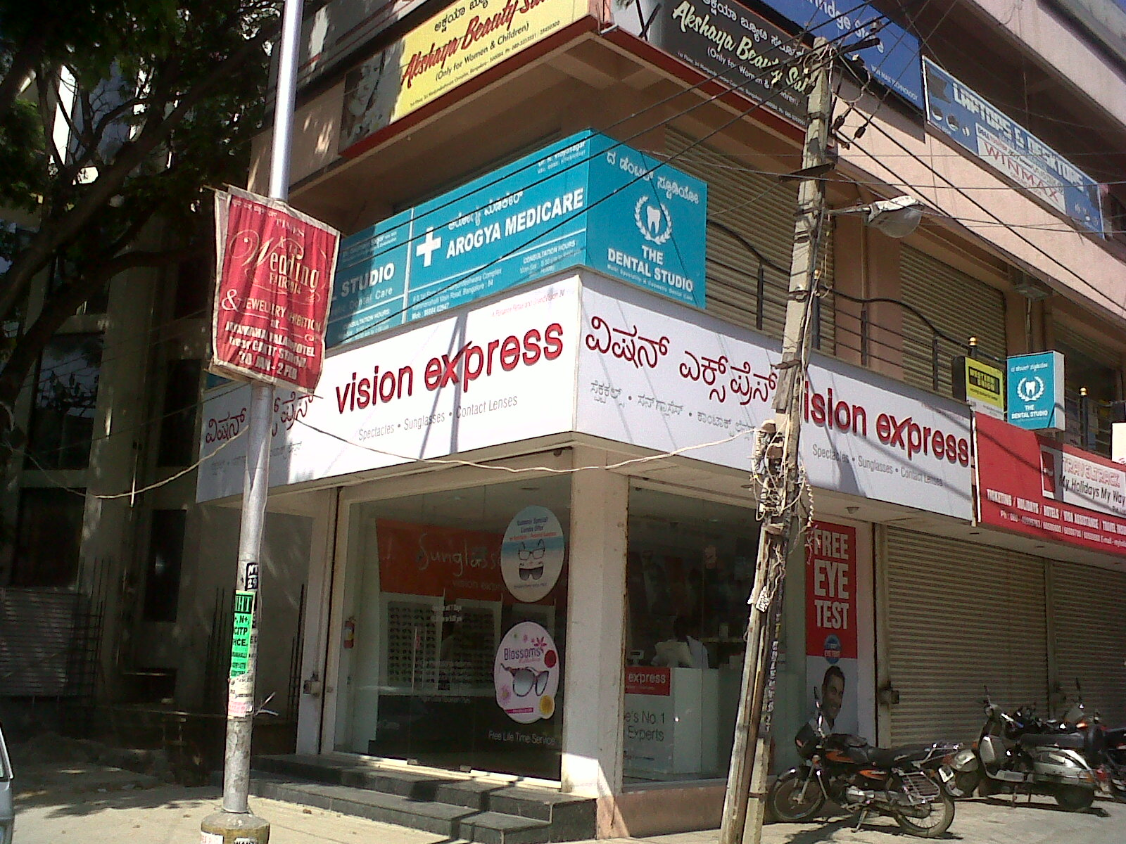

Slide 34
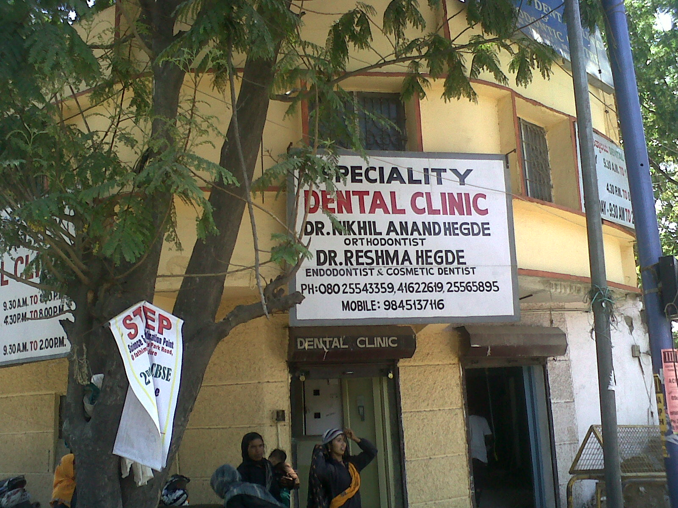

Slide 35
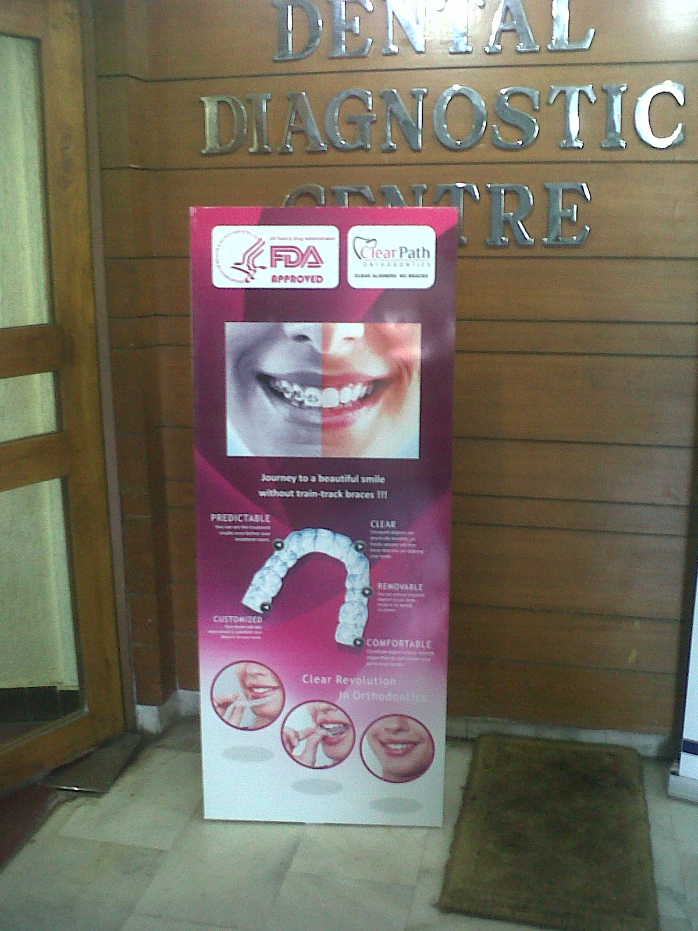
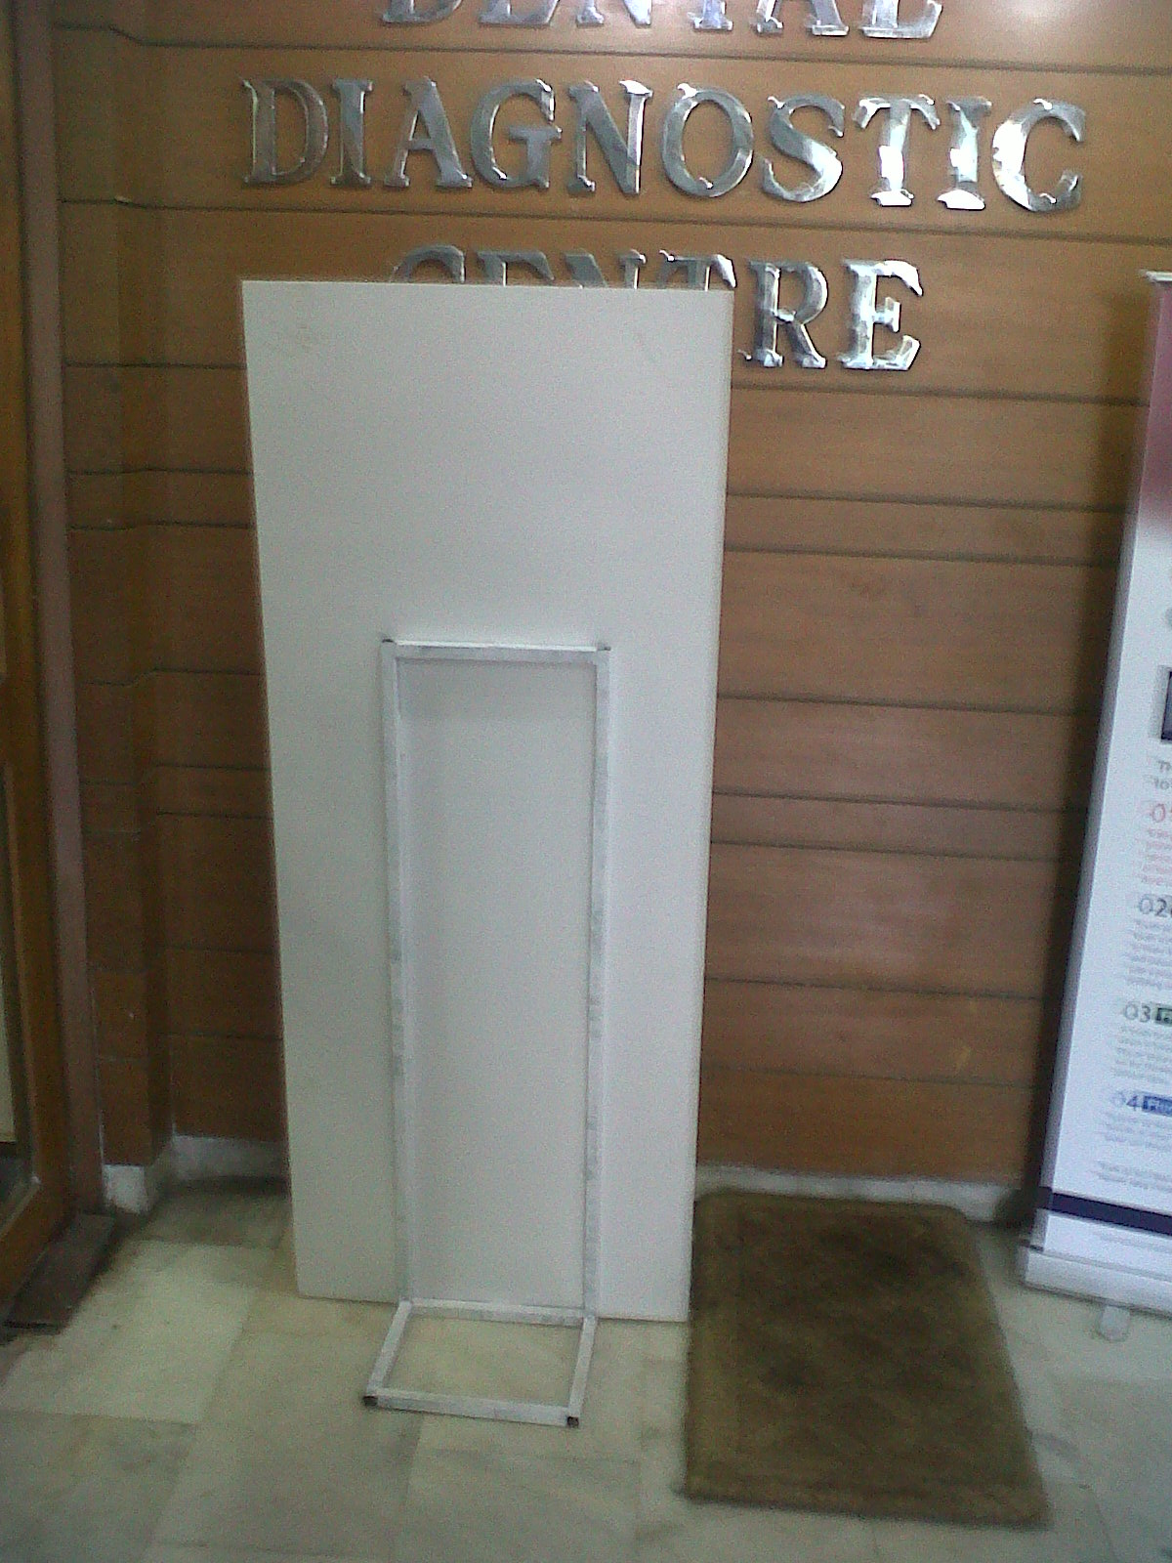

Slide 36
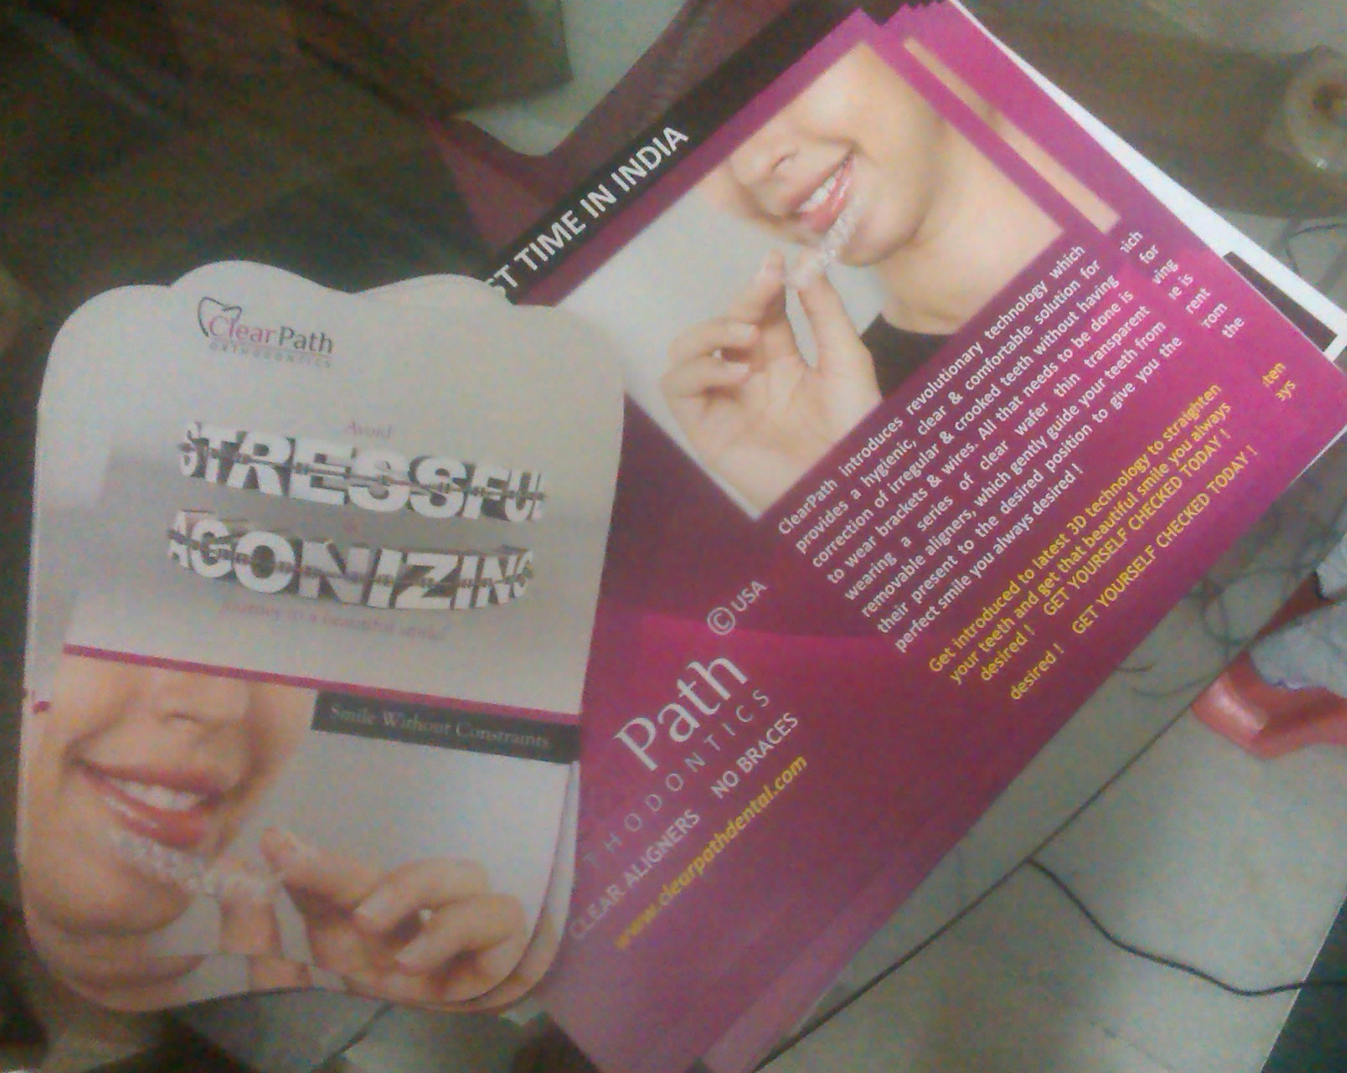

Slide 37
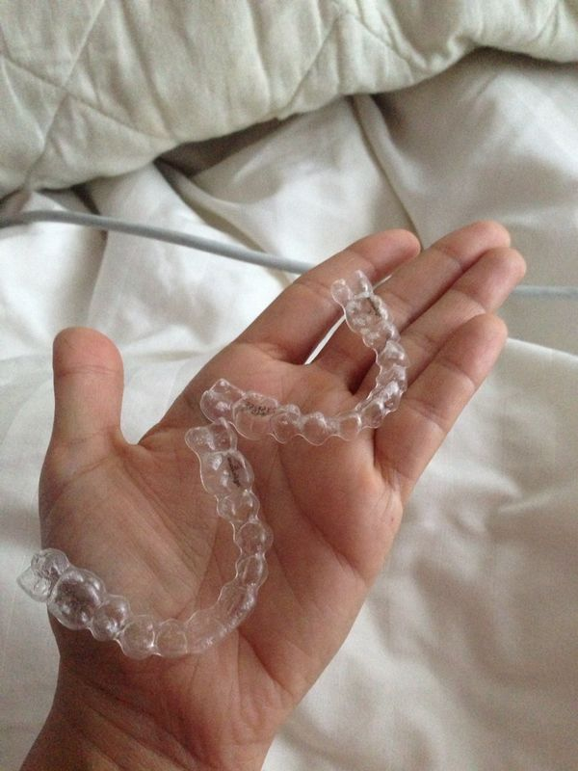
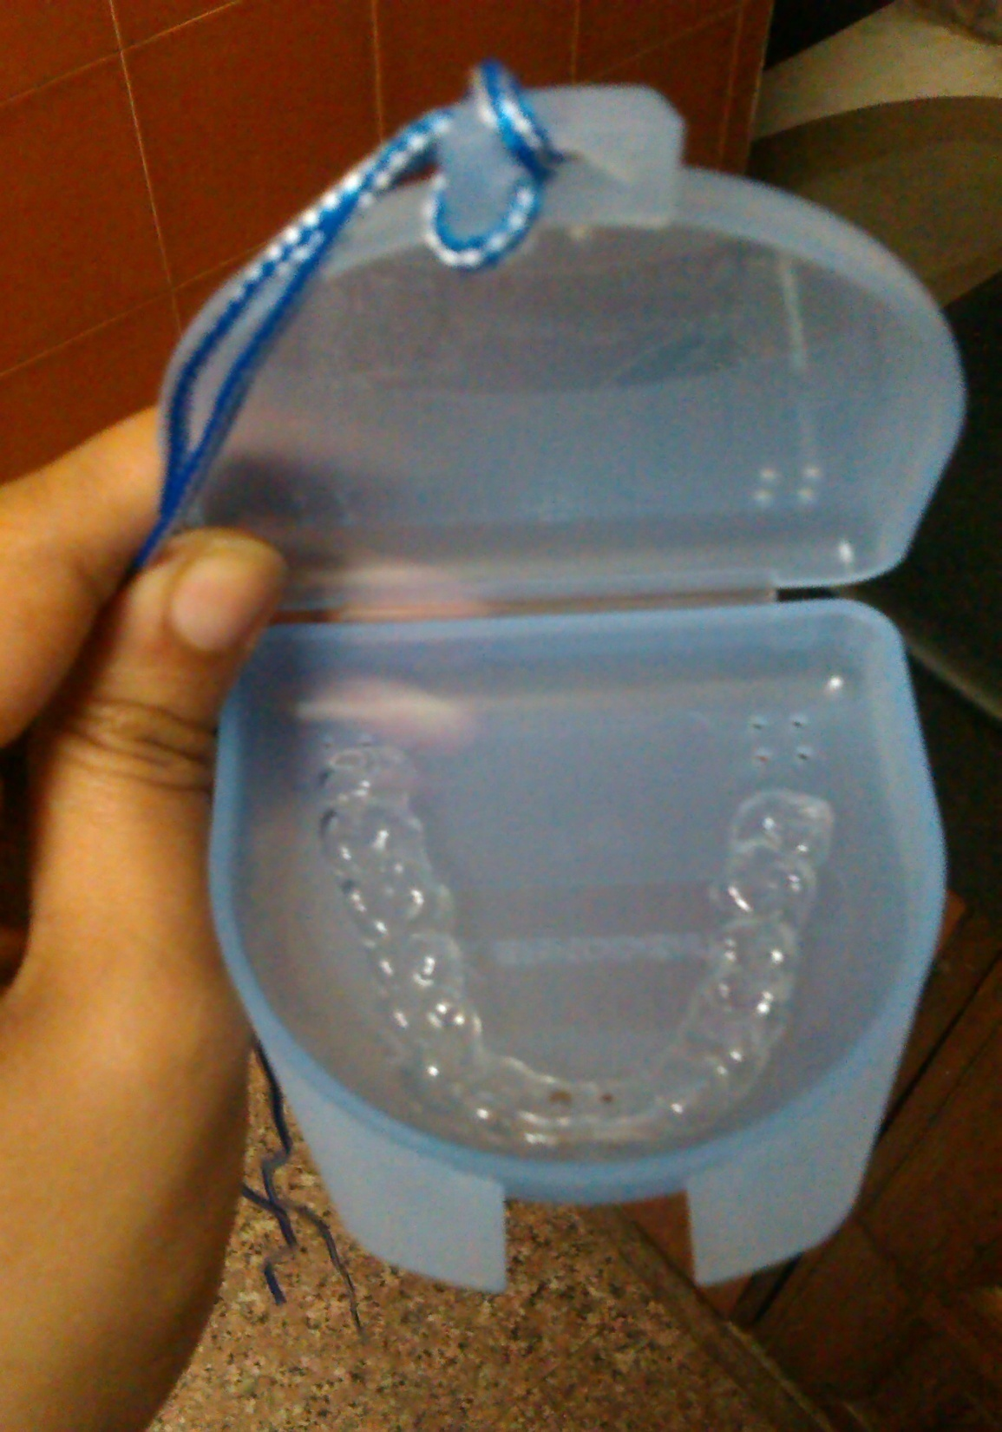

Slide 38
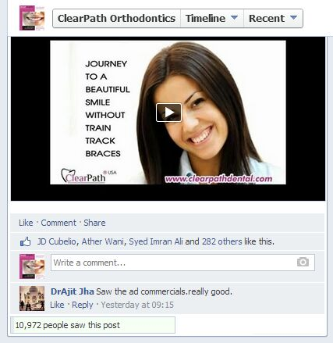
ADVERTISEMENT ON TV

Slide 39
THANK YOU

