Slide 1

Maternal smoking and Pregnancy wastage in Empowered Action Group States in India
International Institute of Health Management and Research IIHMR DELHI
Mentor: Dr. Mukesh Ravi Raushan
Assistant Professor, IIHMR Delhi
Presented by-
Dr. Ruchita Singh
PG/22/097

Slide 2

Mentor Approval

Slide 3
Introduction
Despite global commitments to improve maternal and child survival, there exists a significantly large loss related to pregnancy wastage, particularly in developing countries.
Pregnancy wastage which includes miscarriages, stillbirths, and ectopic pregnancies, is a common event, affecting up to a quarter of recognized pregnancies.
Pregnancy wastage in a females' life has an impact not only on emotional and physical state of the individuals and their families, but also acts as an indicator of quality of healthcare facilities available in the society.

Slide 4
Introduction
Live birth accounts for 89 percent of all pregnancies in the five years prior to the NFHS-5 survey in India, with the remaining 11 percent ending in an abortion, miscarriage, or stillbirth. A miscarriage occurred in 7 percent of pregnancies and an abortion occurred in 3 percent of them in the five years before the survey.
Pregnancy wastage is a significant public health challenge, with maternal smoking identified as a modifiable risk factor for adverse pregnancy outcomes.
WHO reports indicate that up to 250 million women worldwide are smokers. The percentage of women smokers is estimated at 22 percent in developed countries and at 9 percent in developing countries.

Slide 5
Introduction
Among the various factors like higher maternal age, educational attainment of the mother, and wealth status contributing to pregnancy wastage, smoking during pregnancy is the leading modifiable risk factor for poor birth outcomes, including stillbirth, miscarriage, and pre-term birth.
A significant portion of research conducted in India focuses on stillbirth rates and early neonatal deaths; data about pregnancy losses that are categorized as miscarriages and abortions is mainly absent.
Therefore, this study aims to estimate and understand the association between pregnancy wastage and maternal smoking along with various economic & socio-demographic factors in the Empowered Action Group (EAG) states.

Slide 6
Objectives of the Study
To study the current level of pregnancy wastage among smoker females in the EAG states of India.
To study the underlying common socio-economic factors of pregnancy wastage among smoker females in the EAG states of India.

Slide 7
Methodology
This study investigated the relationship between maternal smoking and pregnancy wastage in the Empowered Action Group States in India using the Indian version of Demographic Health Survey, National Family Health Survey (NFHS-5). The estimates are for Uttarakhand, Rajasthan, Uttar Pradesh, Bihar, Assam, Jharkhand, Odisha, Chhattisgarh, and Madhya Pradesh known as Empowered Action Group States, which include 324 districts of India.
The univariate, bivariate, and multivariate regression techniques were used to meet the objectives of the study. The pregnancy wastage and its predictors including tobacco use (smoking) were computed for the EAG states using STATA -14

Slide 8
Methodology
The duration and final outcome of pregnancy were used as dependent variable of pregnancy wastage. The pregnancy wastage and its predictors including tobacco use was computed for the EAG states.
Dependent variable: The pregnancy wastage status among females is assessed by ever smoking by the females in their lives.
Independent Variables: Age of Respondent, Place of Residence, Religion, Ethnicity, and Wealth index, Education, and Region.

Slide 9
Table of Description and Coding categories of variables used in the analysis
Description and coding categories of variables used in the analysis
Variables | Description and Coding categories
Age | The age of women recorded into categories from 15-49 years
Women’s educational status | The women’s educational attainment was recorded into 4 categories such as 0= illiterate; 1= Primary; 2= Secondary; 3= Higher and above
Types of Residence | The woman’s place of residence was recorded into 2 categories such as 1= Urban and 2= Rural
Wealth Index | The Women’s wealth of Index was recorded into 5 categories such as 1= Poorest; 2= Poorer; 3= Middle; 4= Richer; 5= Richest
Religion | The Women’s Religion was recorded into 4 categories such as 1= Hindu;2= Muslim; 3= Christian; and 4= Sikh and others
Ethnicity | The Caste was categorized as Scheduled Caste= 1; Scheduled Tribe= 2; Other Backward Class=3; and General= 4
Region | States were categorized into 2 regions namely; EAG states and Non EAG states where EAG States include Uttarakhand, Rajasthan, Uttar Pradesh, Bihar, Assam, Jharkhand, Odisha, Chhattisgarh, Madhya Pradesh and Non EAG States include the remaining states of India

Slide 10
Results
Among all the age categories, women aged 35 years experienced the higher rate of miscarriage and stillbirth 16.97%, followed by women aged 30-35 [12.97%] [Graph 1].
The educational attainment has a positive association with the pregnancy outcome – miscarriage and stillbirth [13.24% among women with higher education compared to below 10% among illiterate] [Graph 2].

Slide 11
Results
The age has a mix association with pregnancy wastage by smoking behavior of the females. Increasing age first decreases the wastage and then increases after age 30. The rate of change was found to be lower among non-smokers [Graph 3].
The educational attainment indicates accessibility to buy the smoking material. As the education increases pregnancy wastage increases and the rate of increase was multifold among those who smoke [Graph 4].

Slide 12
Results
The wealth status increases the affordability to buy the smoking material. As the wealth status increases from poor to rich, the pregnancy wastage increases and but the rate of increase was higher among smokers compared to those who do not smoke [Graph 5].
The ethnicity show the concentration of the pregnancy wastage by smoking behavior. Pregnancy wastage was higher among smokers. [Graph 6].

Slide 13
Results
Pregnancy wastage was higher among smokers compared to non-smokers in EAG States.
However, in some EAG states like Bihar, Uttarakhand, Jharkhand, and Madhya Pradesh pregnancy wastage was on the higher side when they were non-smokers compared to smokers. A deeper analysis is required to understand the contrasting pictures in these states [Graph 7]

Slide 14
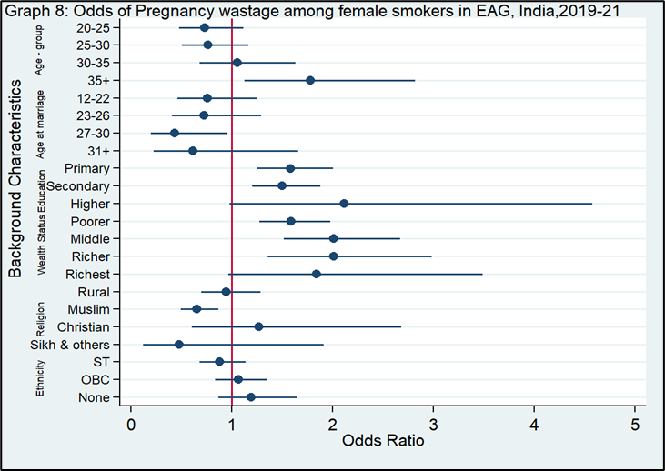
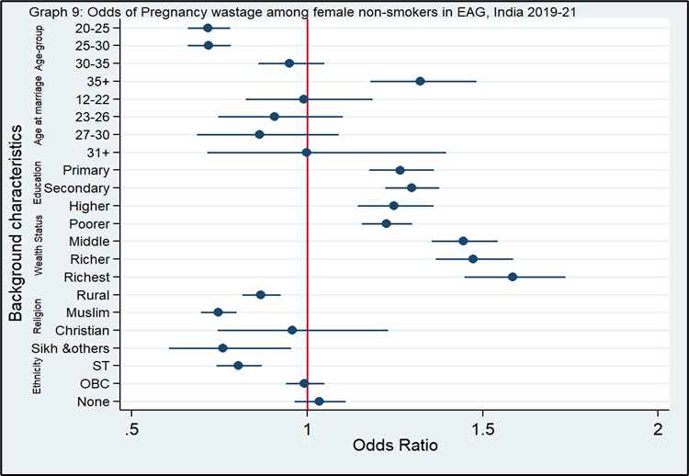
Results
The regression analysis shows that the odds of pregnancy wastage were significantly higher among women aged 35 and above [OR: 1.78, p<0.05], but it was much higher when they smoked in EAG states.
Similarly, the odds of pregnancy wastage among women belonging to rich households and smoke, the odds were 1.89, [OR: 1.56, p<0.001].
The urban women of EAG states were more likely to experience pregnancy wastage if they smoke than those of Non-EAG states.

Slide 15
Discussion
The tobacco epidemic is impacting the lives of women worldwide. Even though tobacco use in women has been reported to decline in India (GATS-2), women continue to shoulder a sizeable burden of its consequences in terms of tobacco-related diseases and mortality.
Despite the well-known risks, tobacco use during pregnancy and lactation remains one of the leading causes of poor pregnancy outcomes and prenatal death.
Although the WHO Framework Convention on Tobacco Control stressed the need to address gender-specific risks when developing tobacco control strategies, a tobacco control program that is specific for women is still lacking in India.
Education campaigns should focus on women living with smokers and women who are not aware of the adverse health effects of tobacco, using culturally appropriate programs. Evidence-based interventions urgently need to be implemented to prevent and control use of tobacco among pregnant women in India.

Slide 16
In the current study, women of wealthy and more educated groups of the Urban areas of the EAG States of India had a higher risk of pregnancy wastage than females in poorer and less educated groups of rural regions. The study shows that smoking behavior along with other factors such as the higher age of the mother have a significant positive association with pregnancy wastage.
Education as accessibility and wealth status as affordability proved to be statistically significant factors affecting pregnancy wastage in EAG states, India.
The ability of educated, wealthy, and urban group females to decide whether to smoke or not in accordance to their affordability and accessibility toward smoking materials as and when required, leads to adverse pregnancy outcomes.
Smoking as an epidemic in the Third World in the future, will continue to be one of the most important preventable risk factors for poor pregnancy outcomes.
Discussion

Slide 17
This study provides an estimate of the extent of pregnancy wastage among women in EAG States of India. Socio-economic factors like level of education, wealth status, place of residence are seen to influence the outcomes of pregnancy.
The key finding is the increasing prevalence of pregnancy wastage due to maternal smoking among the women of the EAG states in India. Despite progress in reducing overall rates of smoking in the country, the prevalence of smoking among the females is seen to increase.
This study underscores the importance of investing in region-specific interventions & strategies, such as increasing the awareness about the harmful effects of smoking among females and benefits of tobacco cessation especially during pregnancy.
Additionally, addressing the underlying causes of smoking, such as easy availability of smoking materials, lack of proper education about adverse effects of smoking, peer influences which are crucial for sustained progress for reducing smoking among the females of the EAG states.
Conclusion

Slide 18
Policy Recommendations
To effectively tackle the problem of pregnancy wastage among smoker females in India, a multi-sectoral and multi-stakeholder approach is essential, and the data can be used to form policy and planning efforts aimed at reducing the pregnancy wastage due to smoking among the women of the EAG States in India.
Prioritizing multisectoral action towards the development of a “Tobacco Free Future Generation” with women and youth as their key stakeholders for a meaningful impact.

Slide 19
References
Sharma S, Chaudhary J. Prevalence and Risk Factors of Pregnancy Wastage among Women in India. IegindiaOrg [Internet]. 2000;1–18. Available from: http://www.iegindia.org/upload/project_studies/1548766527.pdf
Strumpf EC, Austin N, Lang A, Derksen S, Bolton J, Brownell M, et al. The effects of early pregnancy loss on health outcomes and health care utilization and costs. Health Service Res. 2022;57(4):786–95.
Kumari R, Mengi V, Kumar D. Maternal risk factors & pregnancy wastage in a rural population of Jammu district. JK Sci. 2013;15(2):82–5.
WHO. Today’s Evidence Tomorrow’s Agenda. World Heal Organ [Internet]. 2009;91. Available from: http://www.who.int/entity/gender/women_health_report/full_report_20091104_en.pdf
CDC. Women and Smoking: A Report of the Surgeon General [Internet]. 2002. Available from https://www.cdc.gov/mmwr/preview/mmwrhtml/rr5112a4.htm

Slide 20

THANK YOU!!!

