Slide 1




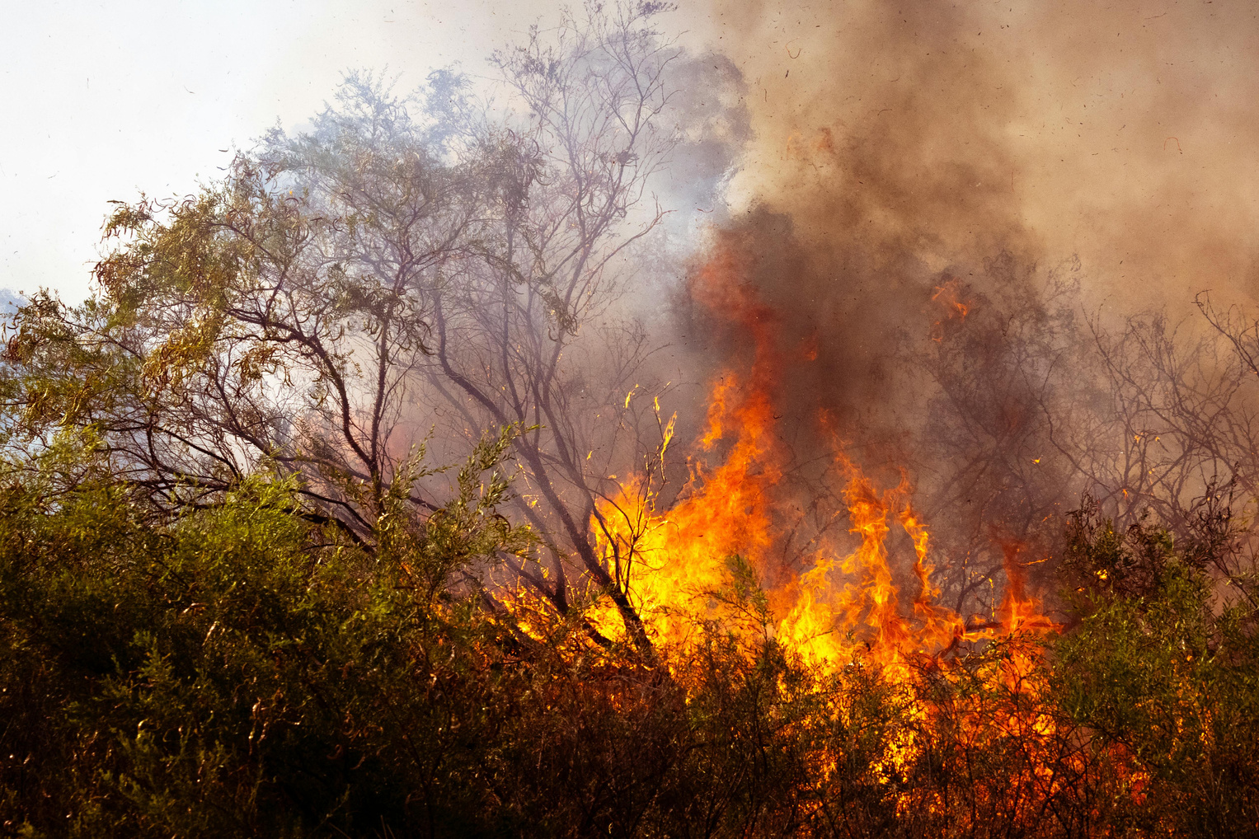
ASSESSING THE IMPACT OF CLIMATE CHANGE ON NON-COMMUNICABLE DISEASES OUTCOMES IN RAJASTHAN FROM 1990-2021
NATIONAL INSTITUTE OF HEALTH & FAMILY WELFARE
FACULTY MENTOR - DR. SUKESH BHARDWAJ
IIHMR DELHI

Slide 2









INTRODUCTION
Rajasthan’s Climate Challenges
Human Progress and Climate Trade-Offs
  Climatic zones range from semi-arid to very humid with rainfall from 100 mm (west) to >1020 mm (east)⁶.
  Despite increasing total rainfall (1951–2015), drought months have also increased, reflecting variability⁶.
  GHG emissions in Rajasthan projected to rise 1.7× by 2030; cement industry is the leading CO₂ emitter⁷.
  The 21st century enabled massive advancements but at environmental cost.
  Climate change, largely driven by human activity, threatens ecosystems and human civilization.¹
Missing Link: Climate and NCDs
NCD Escalation in Rajasthan
  75.13% rural population⁸.
  NCDs now contribute to 51.35% of DALYs in the state⁹.
  COPD rose from 8th to 2nd, IHD from 11th to 3rd, and asthma from 19th to 9th (1990–2019)⁹.
  Physical effects like rising sea levels are well studied.
  Climate’s impact on non-communicable diseases (NCDs) remains underexplored.¹
Understanding the nexus of Climate change and NCDs
Biological and Ecological Pathways¹⁰¹¹
Rise of NCDs Globally
  Heat exposure raises BP, triggers inflammation, worsens IHD, COPD, diabetes, especially in elderly/comorbid¹⁰.
  High humidity and altered rainfall worsen PM/ozone levels → asthma, stroke, renal strain¹¹.
  Poor air quality and nutritional stress amplify long-term NCD risks.
  NCDs contributed to 64.3% of all deaths in 2021, up from 59.5% in 2000.²
  IHD, stroke, COPD, and LRIs are top global killers—surpassed only by COVID-19 recently.²
India’s Dual Vulnerability
Bridging an Evidence Gap
  Tropical monsoon climate with regional extremes—coastal, arid, temperate.³
  1.43 billion people (2023) and 3rd largest GHG emitter globally.⁴
  NCDs caused 61.8% of deaths in 2016, vs. 27.5% from communicable and maternal causes.⁵
  Most research is short-term or infectious disease-focused.¹²
  This study uses GAMs, DLNMs, and ARIMA to explore 20-year climate–NCD correlations in Rajasthan.
  Findings will inform evidence-based adaptation and mitigation strategies.

Slide 3





SECONDARY OBJECTIVES
PRIMARY OBJECTIVE
TREND ANALYSIS
LAGGED ASSOCIATIONS
To assess historical time trends (1990–2021) in the mortality and prevalence of major NCDs in Rajasthan, stratified by sex.
To model lagged and non-linear climate–health relationships using Distributed Lag Non-linear Models (DLNMs), estimating delayed mortality impacts of climate variables.
To quantify the associations between long-term climatic exposures (temperature, humidity, and precipitation) and the burden of non-communicable diseases (NCDs)—specifically ischemic heart disease (IHD), stroke, chronic obstructive pulmonary disease (COPD), and asthma—in Rajasthan, India, using advanced statistical models that capture non-linear and lagged effects.
FORECASTING BURDEN
SEX DISAGGREGATION
To forecast future NCD burden (2021–2030) using climate-independent Auto-Regressive Integrated Moving Average (ARIMA) models, generating baseline trend trajectories
To identify sex-specific differences in climate–NCD relationships, with implications for gender-responsive health interventions.
POLICY TRANSLATION
To inform public health adaptation strategies by identifying climate-sensitive health risks relevant for Rajasthan’s health system.

Slide 4














METHODOLOGY
This study employed trend analysis, correlation testing, and advanced time-series modeling (ARIMA, GAM, DLNM) to examine how climate variability influences NCD burden in Rajasthan and to project future health risks.
Integration of findings
Software & Tools
GAM & DLNM
  Python: pandas, NumPy, seaborn for trend and correlation analysis
  R: mgcv, dlnm, forecast for advanced modeling (ARIMA)
  ARIMA projections offer a baseline scenario for NCD burden
  DLNM and GAM outputs provide the climate-attributable amplification of that burden.
Modeled non-linear and lagged effects of climate on NCD mortality and prevalence
Data Sources
Temporal Trends & Correlation Analysis
ARIMA Modeling
Policy Insights
  NCD Data (1990–2021):
  ▸ Global Burden of Disease (GBD), IHME [8]
  Climate Variables (1990–2021):
  ▸ Temperature, humidity, precipitation from NASA POWER [9]
  Air Quality (2004–2015):
  ▸ PM₁₀ from CPCB via Open Government Data Platform [10]
  NCDs and environmental variables visualized and examined (1990–2021)
  Explored associations between temperature, humidity, rainfall, PM₁₀, SO₂, NO₂ and NCDs
Forecasted NCD burden (2021–2030) using age-standardized rates
▸ Models validated using ADF & KPSS tests, Ljung–Box Q, and hold-out testing (1990–2015 vs 2016–2020)
▸ Accuracy assessed via RMSE, MAE, MAPE
Together, the findings inform how much worse the burden could be under continued climate change — helping guide adaptation strategies and timing of public health interventions in Rajasthan

Slide 5
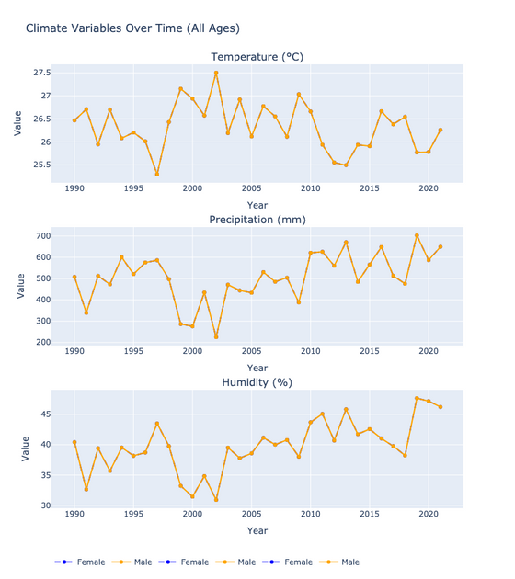
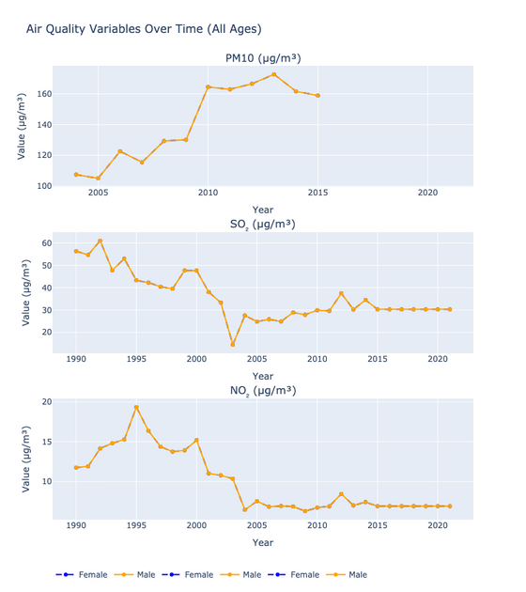
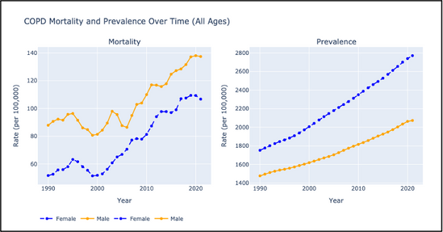
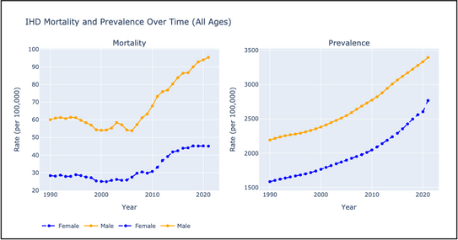
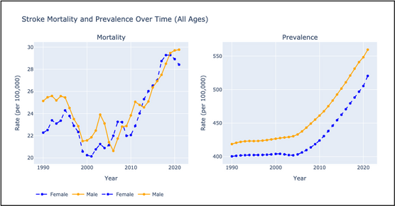
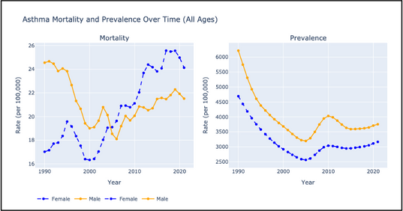
Temporal Trends in NCDs and Environmental Indicators
Environmental
Non-Communicable Diseases
  Annual Mean Temperature (AMT) showed fluctuations: from 26.5°C (1990) to 26.3°C (2021), with a low of 25.3°C (1997) and peak of 27.5°C (2002) — a +2.2°C difference between extreme points, clinically significant for health stress.
  Precipitation increased from 508.2 mm (1990) to 649.5 mm (2021); peak: 702.7 mm (2019); minimum: 224.9 mm (2002).
  Relative humidity rose from 40.4% (1990) to 46.2% (2021); highest: 47.7% (2019); lowest: 30.9% (2002).
  PM10 levels increased significantly between 2004–2015, from 107.4 µg/m³ to 158.9 µg/m³; peak: 172.7 µg/m³ (2013).
Asthma:
  Female mortality ↑42% (17 → 24.1); prevalence ↓33%
  Male mortality ↓13% (24.6 → 21.5); prevalence ↓40%
COPD:
  Female mortality ↑106% (51.7 → 106.7); prevalence ↑58%
  Male mortality ↑56% (87.9 → 137.4); prevalence ↑40%
IHD:
  Mortality ↑59% in both sexes; Female: 28.3 → 45.1; Male: 60.1 → 95.4
  Prevalence: Female: ↑75% (1583.8 → 2769); Male: ↑55% (2191.9 → 3399.3)
Stroke:
  Female mortality ↑27% (22.4 → 28.4); prevalence ↑30% (400.5 → 520.4)
  Male mortality ↑19% (25.1 → 29.8); prevalence ↑34% (418.7 → 559.5)

Slide 6
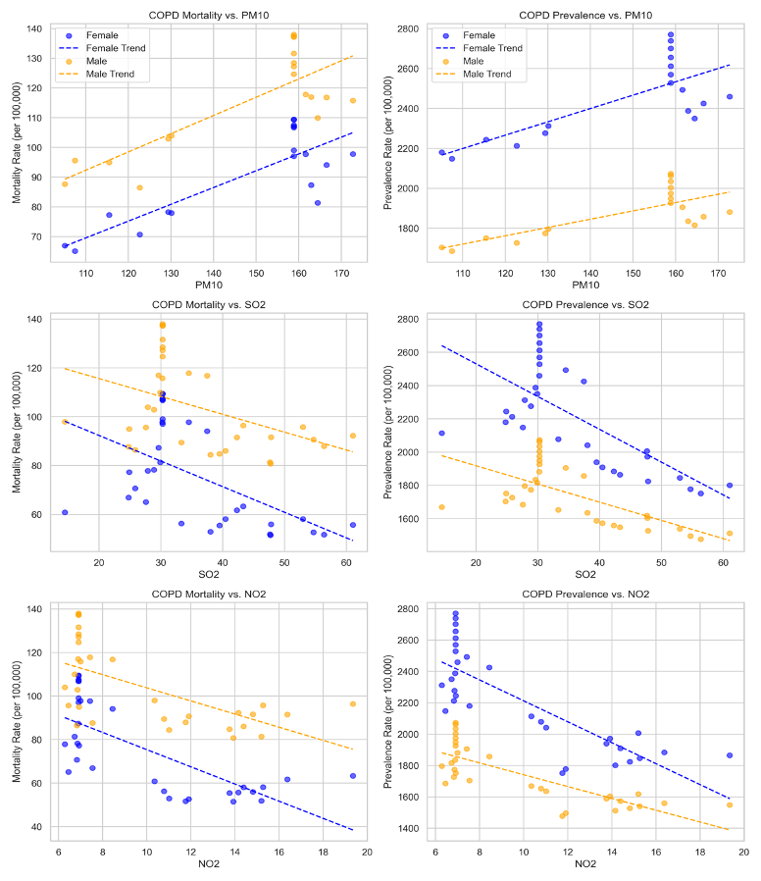
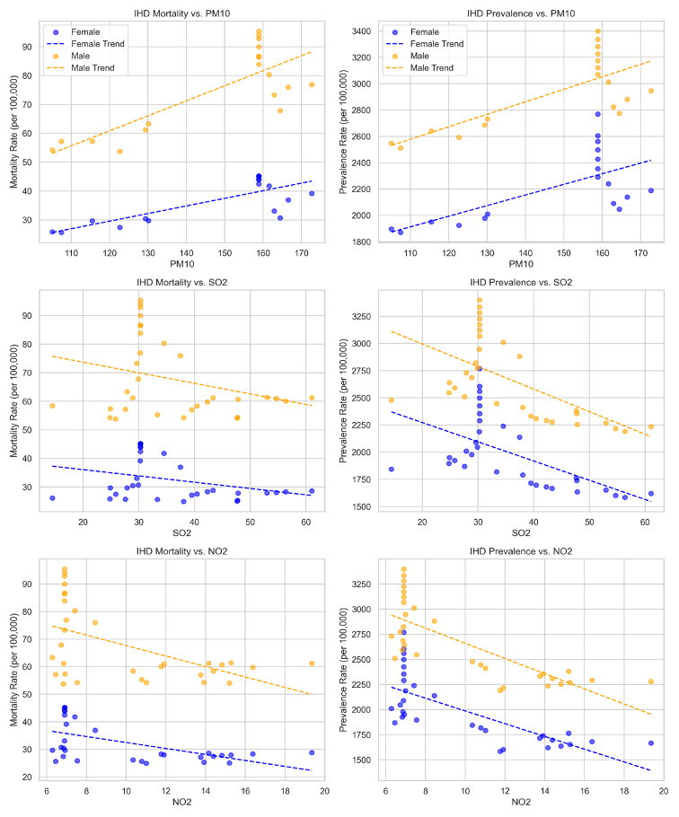
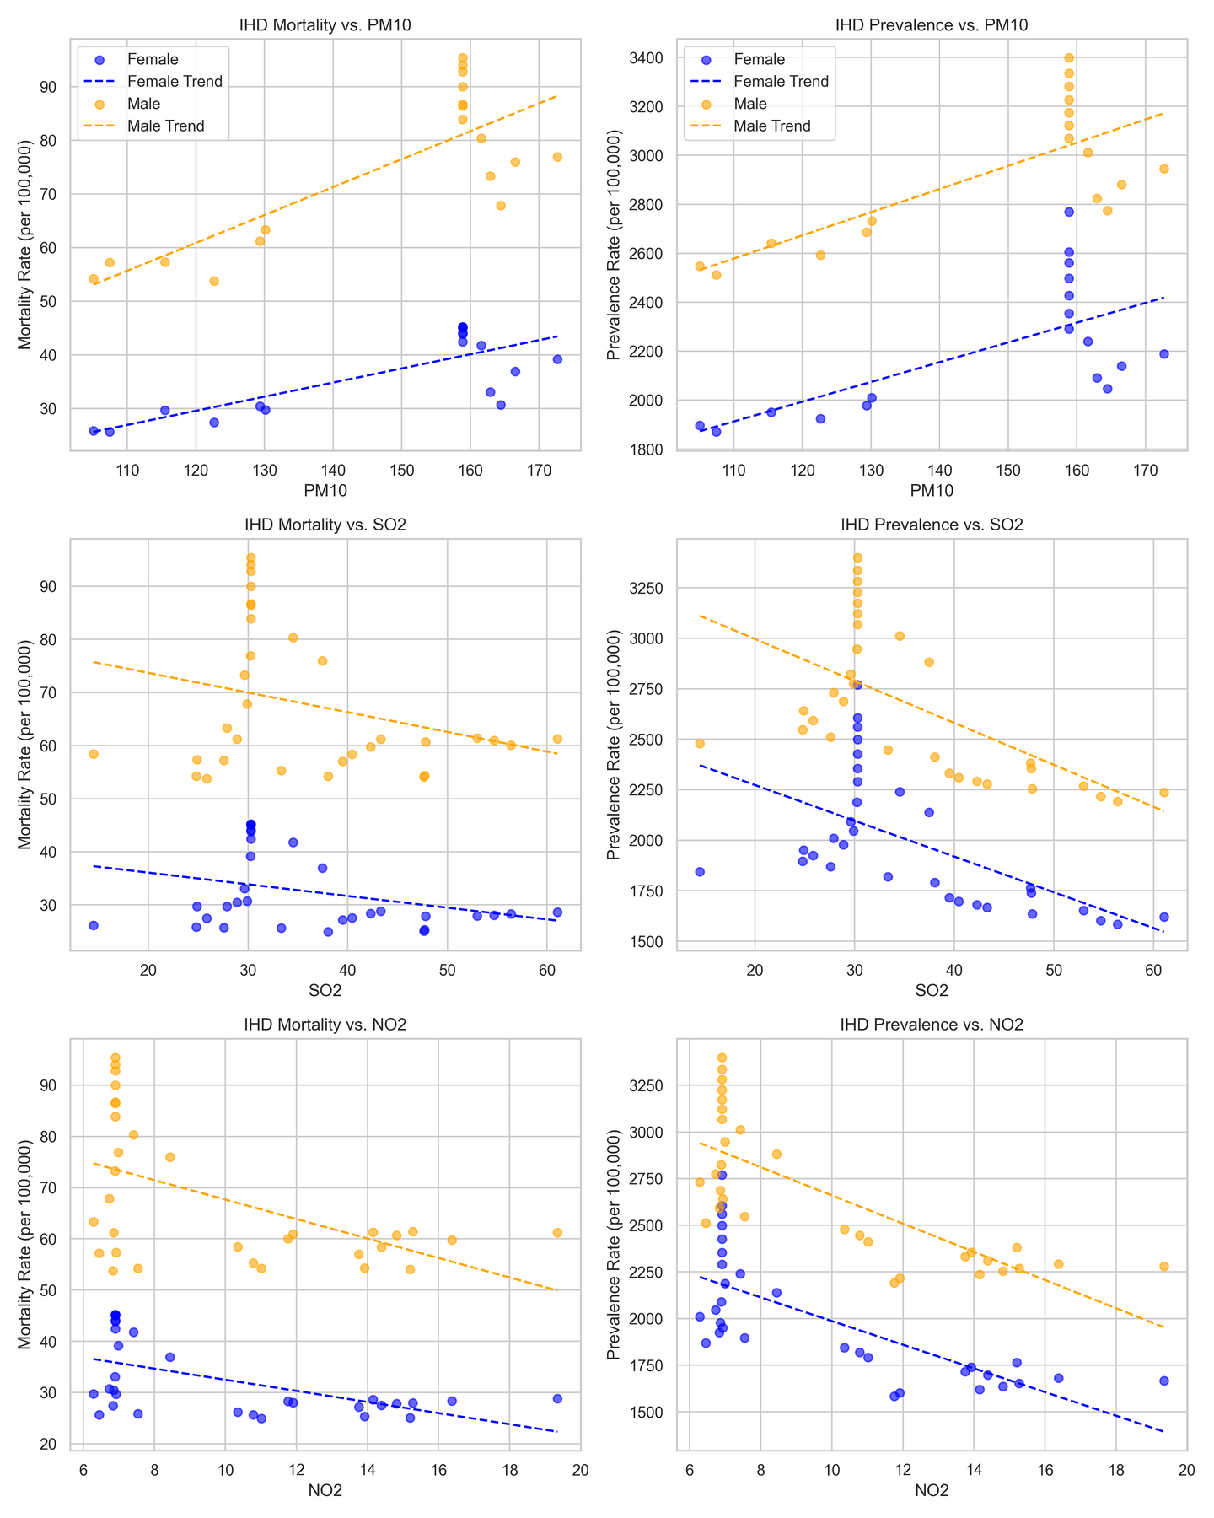
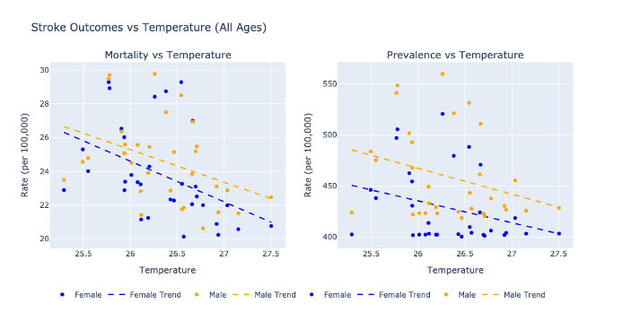
Correlations Between Environmental Variables and NCD Outcomes
Air Pollution Associations
PM10 showed strong positive correlations with all NCDs:
  Asthma mortality: R = 0.874 (F), 0.738 (M)
  COPD mortality: R = 0.82 (F), 0.801 (M)
  IHD mortality: R = 0.772 (F), 0.791 (M)
  Stroke mortality: R = 0.64 (F), 0.683 (M)
SO₂ and NO₂ had negative correlations with mortality but positive with prevalence in asthma — a contrasting trend possibly reflecting exposure-response lag effects.
Climate Variable Associations
Humidity and Precipitation:
  Moderate-to-strong positive correlations with most NCD mortalities (esp. stroke, IHD, COPD).
  Stroke mortality: R = 0.597 (humidity), R = 0.614 (precipitation) in females.
Temperature:
  Consistent negative correlations across all NCDs.
  Strongest for stroke: R = –0.438 (F), –0.397 (M)
  IHD mortality: R = –0.394 (F), –0.50 (M)

Slide 7
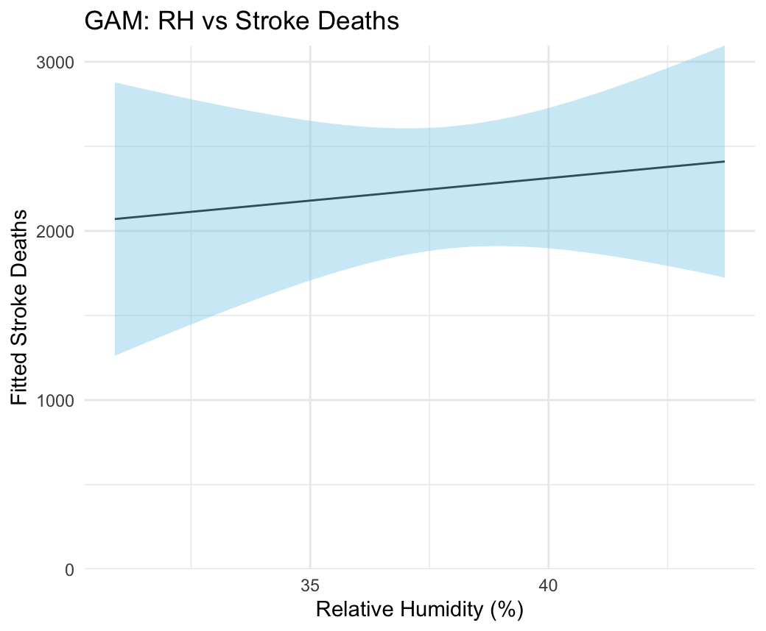
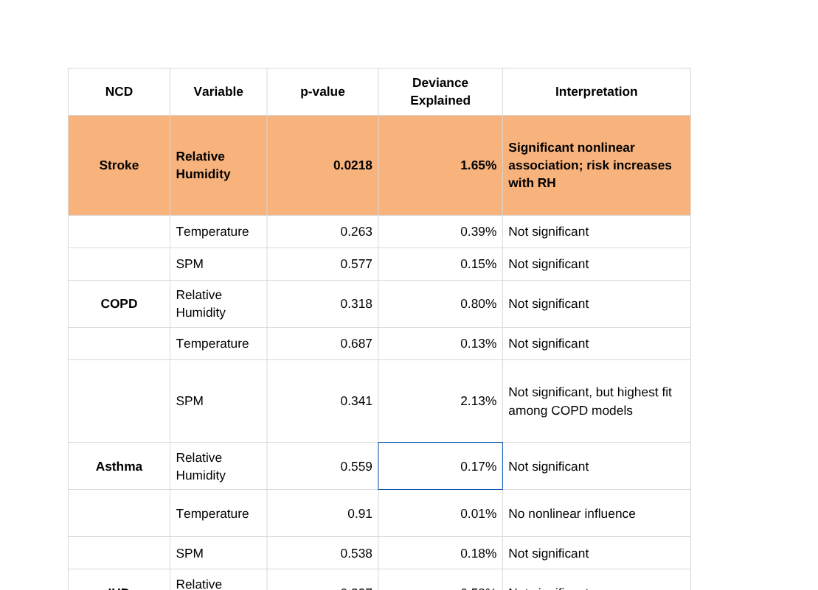
Nonlinear Associations using GAMs
  Among all models tested, only stroke mortality showed a statistically significant nonlinear association with relative humidity (p = 0.0218), though the explained deviance remained low (1.65%).
  Across other NCDs and variables, GAMs indicated minimal nonlinear associations and low model fit (0–2.1% deviance).
  All models showed low concurvity, suggesting model estimates are stable but that non-climatic factors dominate NCD mortality trends in this data.
  While relative humidity may influence stroke outcomes, results indicate that climate variables alone do not explain most variation in NCD mortality.
  This underscores the importance of considering multi-factorial drivers — such as healthcare access, behavioral risk factors, and socioeconomic conditions — in addition to environmental exposures.

Slide 8
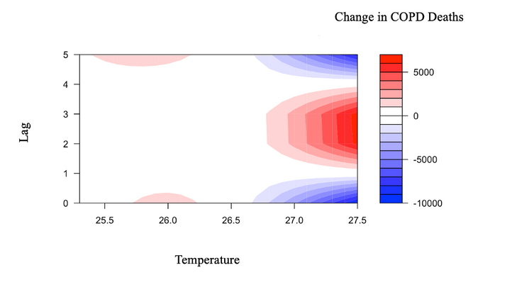
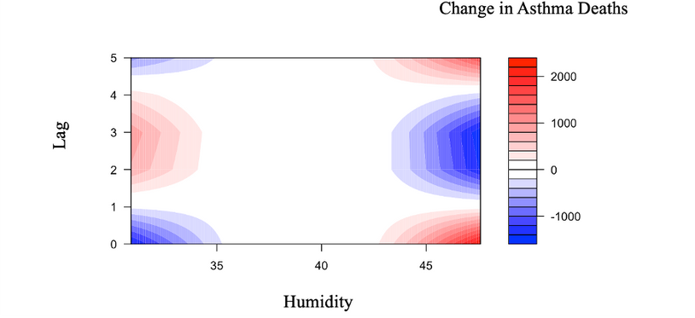
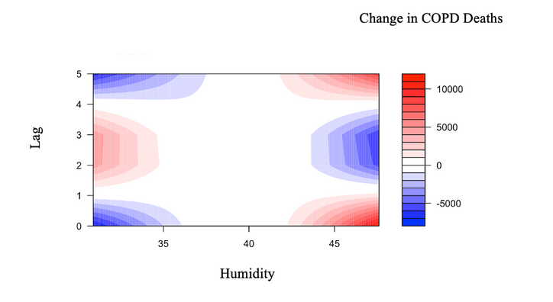
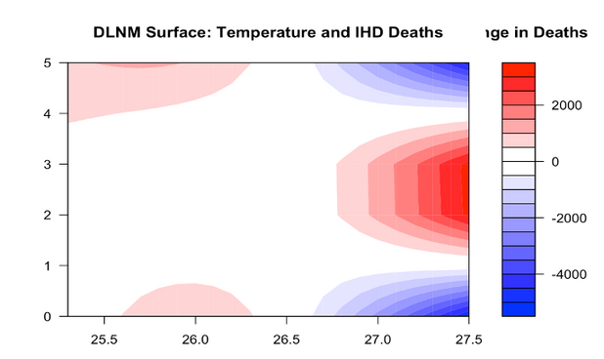
Lagged and Nonlinear Effects using DLNMs
Stroke vs Temperature
  A clear U-shaped curve: mortality increases at both cold and hot extremes.
  Highest mortality at 25.8°C → ~370 excess deaths (lag 0–2 years)
  Lowest mortality at ~26.9°C → ~120 deaths avoided
COPD vs Humidity
  Linear increase in mortality with rising humidity.
  Below 40% RH → ~4,650 fewer deaths
  Above 40% RH → ~10,600 excess deaths at 47.6% RH
  Indicates high vulnerability of airways to moist conditions
Asthma vs Humidity
  V-shaped relationship with mortality lowest at ~40% RH
  Both low and high humidity levels increase risk
  At 47.6% RH → ~726 excess deaths observed
  Suggests humidity extremes amplify allergen exposure or airway stress
IHD vs Temperature
  Inverse linear trend: colder temperatures elevate mortality
  At 25.3°C → ~1,650 additional deaths
  At 27.5°C → ~3,600 deaths avoided
  Suggests cold stress plays a stronger role in IHD outcomes
  Only 2 variables (humidity for stroke, COPD, IHD; temperature for stroke, IHD) showed consistent associations.
  DLNMs revealed lagged effects of 0–2 years, suggesting climate impacts are not always immediate.
  Despite statistical significance, deviance explained in GAMs was modest (1.8%–8%), emphasizing that non-climatic factors (e.g., access to care, air quality, behavioral risk) play a dominant role.
  Patterns indicate temperature and humidity thresholds where public health interventions (e.g., early warning systems, respiratory care) should be prioritized.

Slide 9
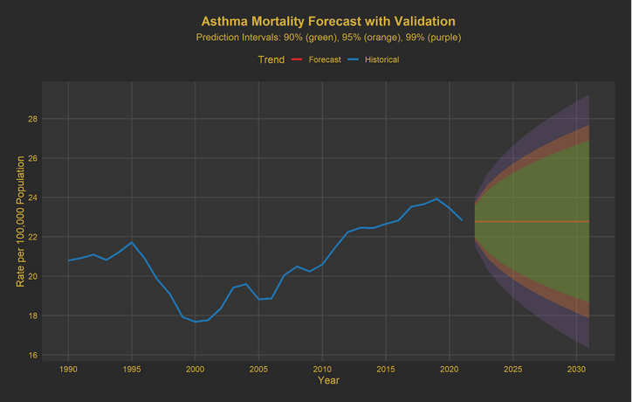
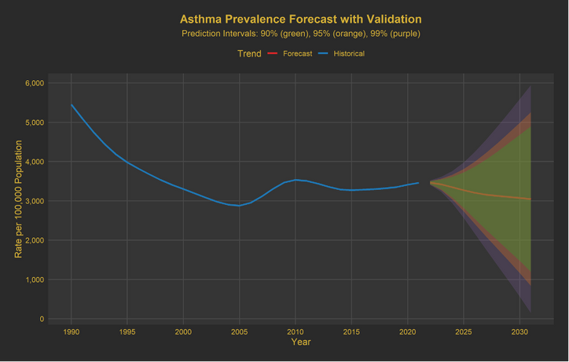
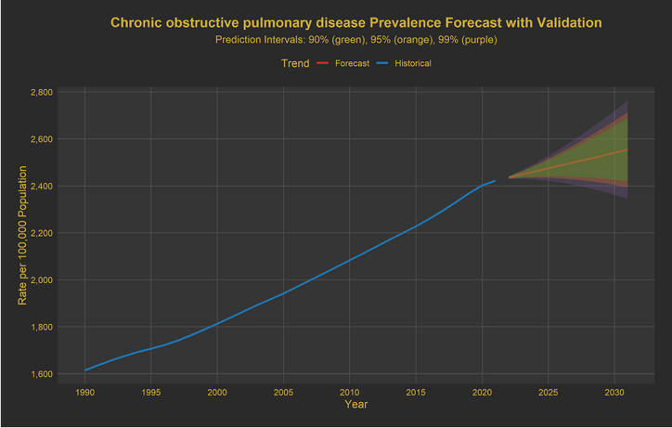
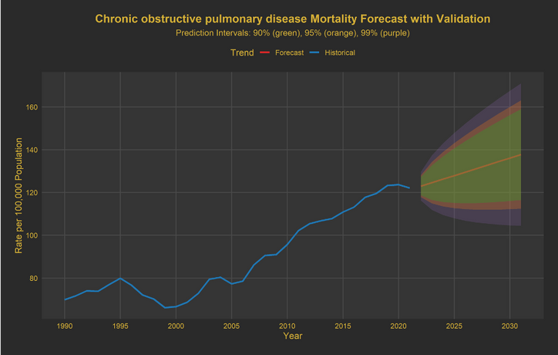
ARIMA Forecasts (2022–2030)
Climate-agnostic projections using historical trends (1990–2020)
Asthma Prevalence:
  Forecasted to decline slightly, but with a very wide 95% prediction interval (1,163–4,988), reflecting significant model uncertainty.
  Indicates potential volatility due to underdiagnosis, seasonal shifts, or systemic changes.
Asthma Mortality:
  Expected to remain stable, around 22.8 per 100,000, with moderate uncertainty.
  Suggests asthma-related deaths are not escalating under current conditions, though prevalence trends remain less predictable.
COPD Mortality:
  Shows the highest and steepest rise, forecasted to reach 136.1 per 100,000 by 2030.
  A clear, upward trajectory with narrow uncertainty indicates persistently increasing burden from chronic respiratory illness.
COPD Prevalence:
  Continues a modest but steady increase, reaching 2,541 per 100,000.
  Tight prediction intervals indicate high forecast confidence — underscoring a growing chronic care need.

Slide 10
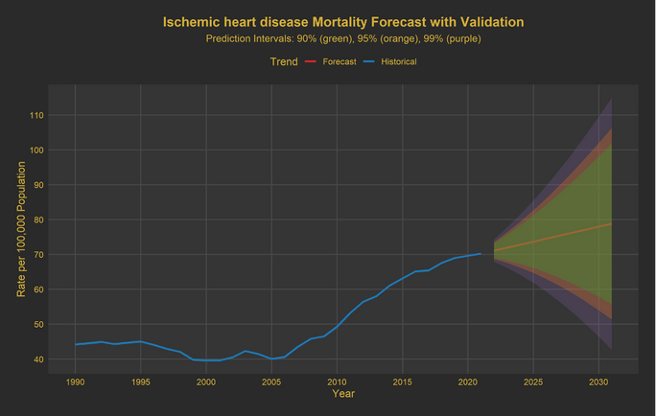
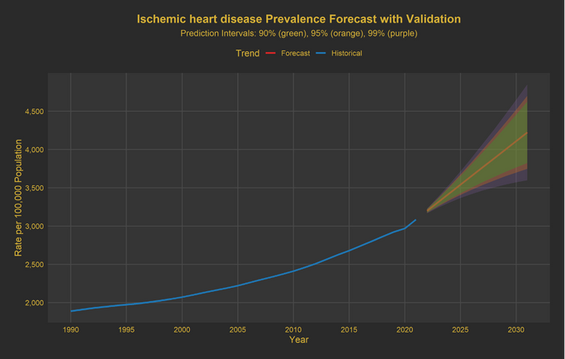
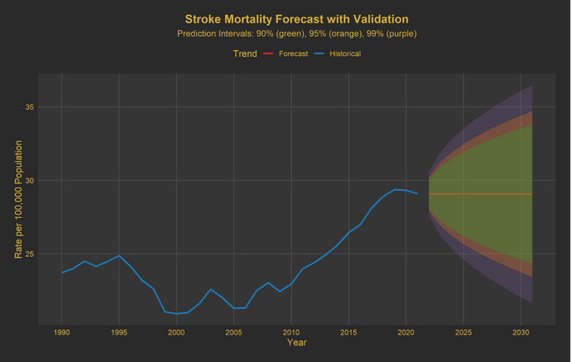
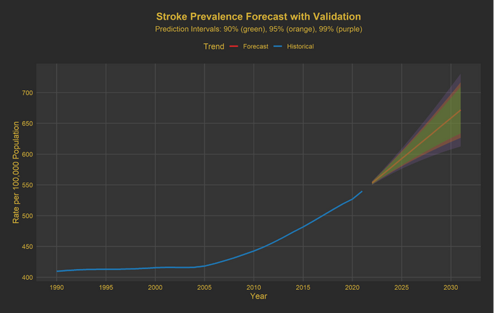
ARIMA Forecasts (2022–2030)
Climate-agnostic projections using historical trends (1990–2020)
IHD Mortality:
  Forecasted to rise to 78.0 per 100,000 by 2030.
  This represents a sustained cardiovascular mortality burden, aligned with India’s epidemiological transition.
IHD Prevalence:
  Expected to climb to 4,110 per 100,000, with moderate uncertainty.
  Reflects increasing chronic cardiovascular disease load, requiring long-term risk reduction efforts.
Stroke Mortality:
  Predicted to remain stable at ~29.1 per 100,000, with a narrow prediction range.
  May indicate that stroke risks are plateauing, possibly due to improvements in acute care or prevention.
Stroke Prevalence:
  Also relatively stable, forecasted at 659 per 100,000 by 2030.
  Indicates a persistent but controlled burden, not expected to escalate significantly under current trends.

Slide 11
Discussion
  Strong positive associations observed between PM10 and NCD mortality, especially:
    Asthma mortality (R = 0.874, female), COPD mortality (R = 0.82, female), IHD (R = 0.791, male)
  Humidity positively correlated with COPD, stroke, and IHD, while temperature showed consistent negative correlations — strongest for stroke (R = –0.438, female).
These findings are biologically plausible:
  Air pollution triggers inflammation and bronchoconstriction.
  High humidity promotes mucosal congestion, allergen proliferation, and secondary infections.
  Cold temperature increases vascular resistance and thrombosis risk, elevating IHD and stroke mortality.
  DLNMs – Strengthening Temporal Causality
  DLNMs revealed lagged effects, validating that health impacts can emerge up to 2 years post-exposure:
  Stroke mortality followed a U-shaped temperature response, peaking at 25.8°C
  COPD mortality increased steadily with humidity, with up to 10,600 excess deaths at 47.6% RH
  Asthma followed a V-shaped humidity response
  IHD showed inverse relation with temperature (↓1,650 deaths at 27.5°C)
This adds temporal depth and causal plausibility to the earlier cross- sectional associations.
CORRELATION ANALYSIS
DLNMS
01
03
02
  Among all models tested, only stroke mortality showed a statistically significant nonlinear association with relative humidity (p = 0.0218), explaining 1.65% of the deviance.
  Temperature effects were consistently non-significant across all NCDs, but the direction of association (mostly negative) was consistent with earlier correlation results.
  All models exhibited low concurvity and smoothness (edf ≈ 1), indicating stable fits with minimal complexity.
These findings suggest that while GAMs helped identify potential thresholds, the overall explanatory power was low (max 2.13%), reinforcing the view that non-climatic determinants (e.g., healthcare quality, comorbidities, behaviors) are the primary drivers of NCD mortality in this context.
04
  COPD and IHD mortality projected to rise by 14% and 9%, respectively, by 2030
  Asthma prevalence trendline shows a decline, but with a 95% PI spanning 1,163 to 4,988 — highlighting high uncertainty
  Stroke forecasts remain flat, indicating stabilization
These models do not include environmental exposures. Comparing them with DLNMs shows that:
“ARIMA likely underestimates future disease burden, especially for climate-sensitive conditions like COPD and stroke.”
GAMS
ARIMA FORECASTS

Slide 12
Discussion
01
Public Health Takeaways
  COPD and IHD are both increasing with or without climate inputs — but DLNMs show climate can further accelerate mortality, particularly in high-humidity and low-temperature scenarios.
  Stroke shows clear U-shaped temperature risk, highlighting the need for seasonal surge readiness and cold exposure prevention.
  Asthma trends are unstable, and models suggest a need to closely track pollution and allergen exposures in urban settings.
02
Programmatic and Policy Recommendations
  Integrate Climate Data into NCD Surveillance
  Link climate stations and health records to monitor thresholds for hospitalizations and mortality
  Develop Early Warning Systems
  Use DLNM findings to create lag-aware advisories (e.g., post-humidity surge alerts for COPD patients)
  Prioritize Vulnerable Populations
  Urban poor, elderly, and chronically ill will be disproportionately affected by environmental shifts
  Refine Forecasting with Exposure-Adjusted Models
  Build future models that incorporate climate, pollution, health behaviors, and access factors to simulate intervention scenarios
03
Future Directions
  Move from state-level to district-level forecasts
  Model compound exposures (e.g., heat + PM10)
  Explore adaptive thresholds for public health action (e.g., safe humidity levels for COPD patients)

Slide 13















COMMUNITY OUTREACH PROGRAMME
13
Day 2–5: Household Data Collection (WaSH)
Day 7–10: Continued HH Data Collection
Day 12: Visit to Local Health Centre
  Visited Ayushman Arogya Centre (AAC) or Primary Health Sub-centre.
  Interacted with health workers and ANMs.
  Understood their role in disease surveillance, immunization, and community health education.
Total
Visits
  Each day, 6–8 households were covered by each student.
  Used Kobo Toolbox for structured data collection on:
  Access to safe drinking water.
  Sanitation and toilet facilities.
  Continued household visits to cover the remaining population segment.
  Noted patterns in water sources (e.g., piped, tanker, borewell).
  Collected observational data on hygiene behaviour (e.g., handwashing stations).
Day 1: Orientation & Community Introduction
Day 6: Mapping External Environment
Day 11: Visit to Local Schools
Day 14: Continued HH Data Collection
  Met with the ASHA worker assigned to the locality — Ms. Brij Bala.
  Understood the socio-demographic and health profile of the community.
  Introduction to the community layout, informal leaders, and cultural considerations.
  Mapped key infrastructure including:
  Food shops, drug stores, waste disposal sites.
  Anganwadi Centre location and condition.
  Identified areas with open defecation or poor drainage.
Conducted a visit to local schools:
  Mapped school premises.
  Interacted with the school principal and teaching staff.
  Took contacts for future activities.

Slide 14
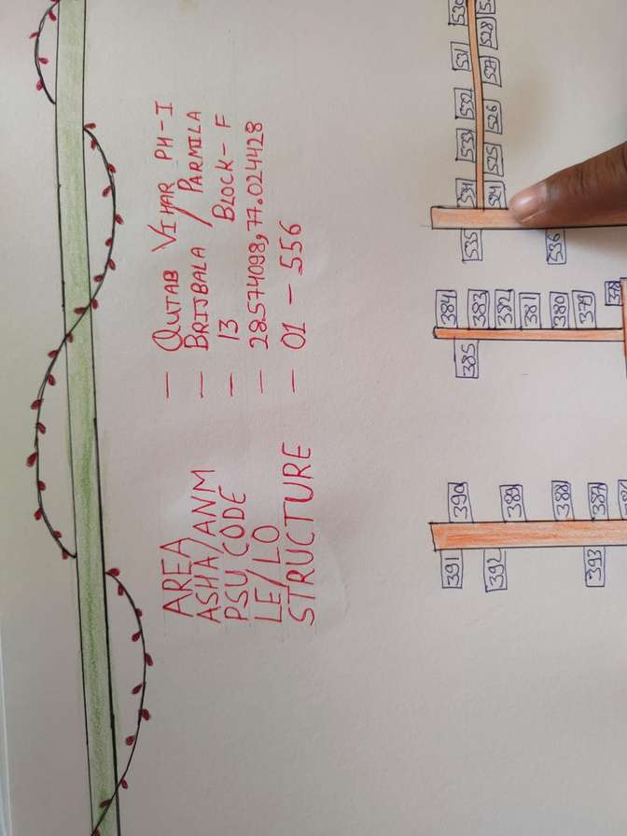
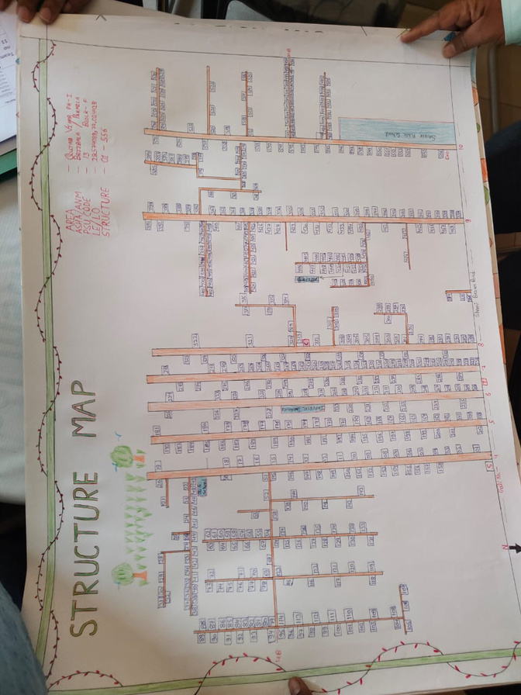








COP - Key Learnings
01
02
03
04
Effective Community Engagement
Hands-on Data Collection
Field Mapping Skills
Public Health System Exposure
Learned how to build rapport and communicate sensitively with diverse community members, including ASHA workers and local residents.
Developed skills in environmental and institutional mapping, identifying key landmarks like schools, Anganwadi centres, and sanitation facilities.
Gained practical experience using Kobo Toolbox for digital household surveys focused on WaSH indicators.
Understood the functioning of grassroots health systems through visits to local health centres and interaction with frontline workers.

Slide 15

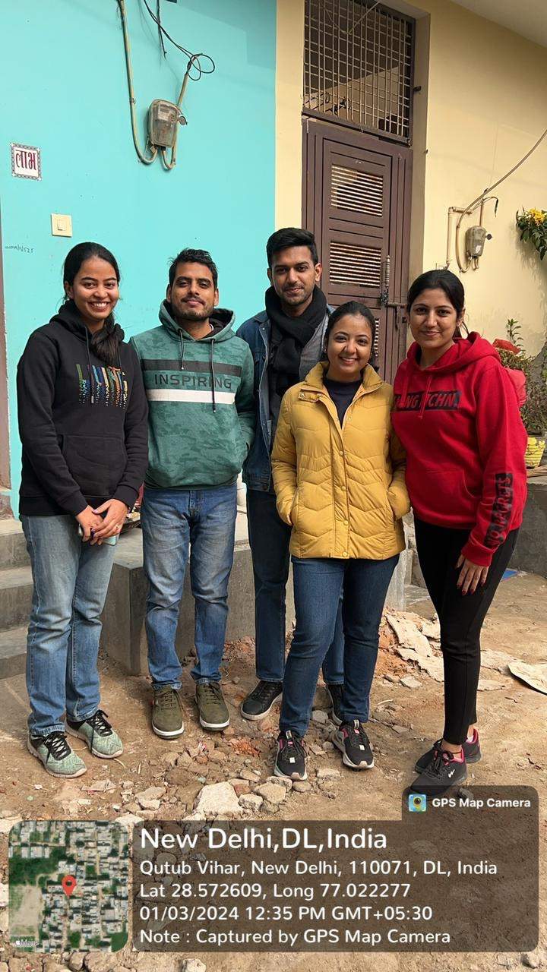
THANK YOU

