Slide 1
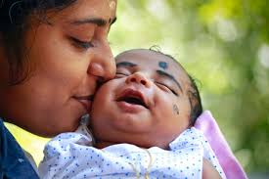
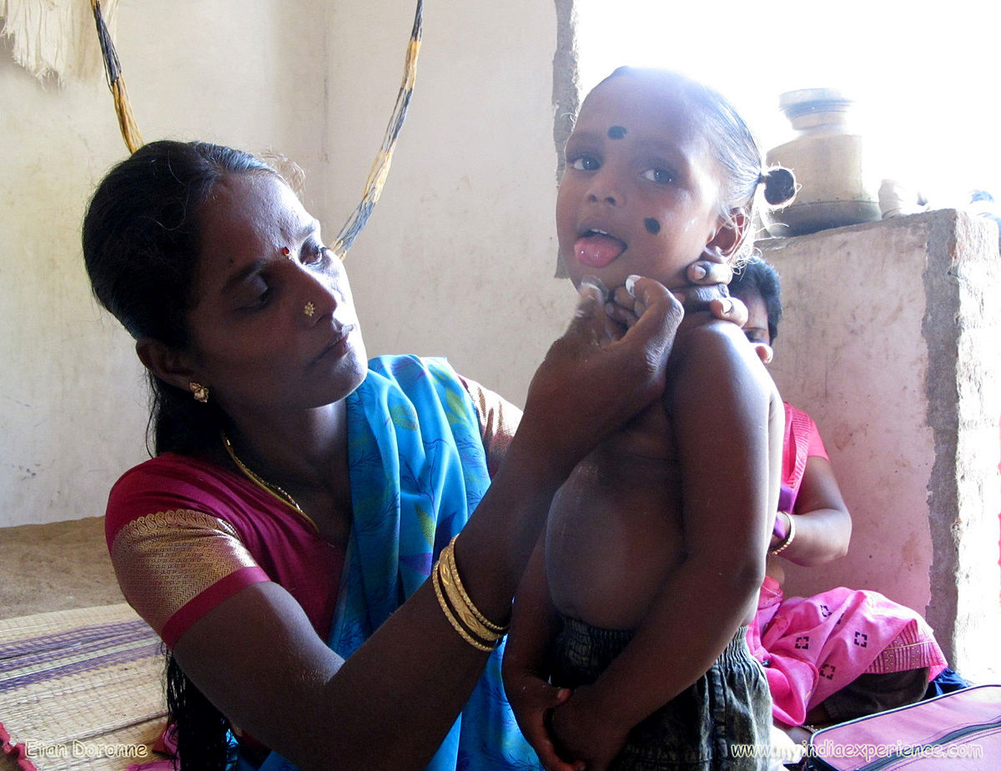

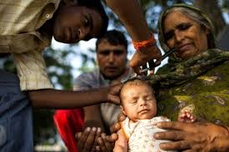

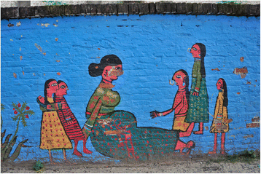

“Qualitative Study”
on
Traditional Beliefs and Practices During Postpartum Confinement Period
and Newborn Care
Among Maternal Grandmothers of
Muzaffarpur District of Bihar, India
By – Ayusman Jena
Guided by - Dr Sidharth Sekhar Mishra.
IIHMR Delhi.

Slide 2
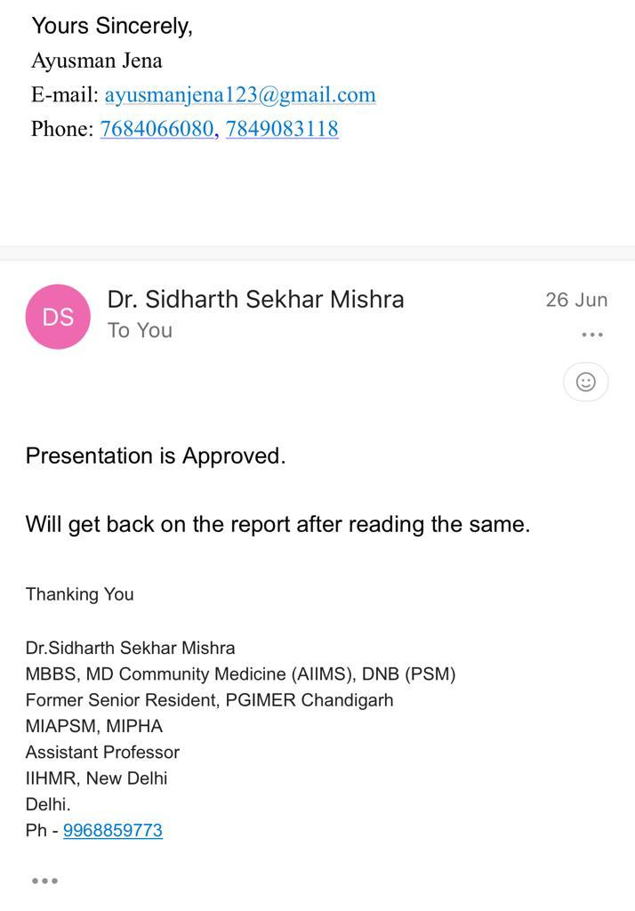

Slide 3



Introduction
Cultural and traditional practices, values and beliefs play an important role in the medical attention-seeking behavior of postpartum mothers as well as in newborn babies during the postnatal period and it can vary across different countries and regions.
Many cultures around the world observe specific postpartum rituals to avoid ill health in later years from the knowledge contained in ancient scriptures.
Indian postpartum care include a confinement period of forty days of rest for the mother after delivery, postnatal massage after delivery, hot water bathing during the postpartum period, belly binding, and a specific postnatal diet.
Neonatal care includes feeding the baby gutti, doing oil massage, leaving in sun
Several factors contribute to neonatal mortality in India and one of the reasons is following harmful newborn care practices such as applying different unsterile material on the umbilical cord and instilling liquids and oils in the ears and nose.

Slide 4
Objectives of the Study
General Objective
Specific Objective
To develop an understanding of the common Cultural traditions in Muzaffarpur District relating to newborn care, and the postpartum confinement period (up to 42 days after delivery).
To explore the knowledge, awareness, and perception of a female family member (Maternal Grandmother) about the puerperium period caring for the newborn.
To identify the main reasons why post-partum women, adhere to or discontinue some traditional harmful health practices and beliefs.
To understand the barriers and enablers for newborn care-related practises from a female perspective in the time of the postnatal period.

Slide 5
Methodology
STUDY DESIGN Qualitative study
STUDY SETTING Muzaffarpur District of Bihar.
STUDY POPULATION Females 40 years and above whose daughter has given birth in the last 42 days.
Inclusion Criteria Maternal grandmothers whose daughter is living with them after giving birth.
Exclusion criteria
Refuse to provide consent
SAMPLE SIZE
8
SAMPLING METHOD
Convenient
DATA COLECTION
Self-prepared Qualitative Tool
DATA ANALYSIS Thematic mapping

Slide 6
RESULTS: OBJECTIVE WISE
Good Practices
Practices without evidence
Harmful Practices

Slide 7
General objective (1/2):
To develop an understanding of the common cultural traditions relating to newborn care, and the postpartum period
(up to '42' days after delivery)
Themes | Sub themes | Findings
Roles & responsibility during postnatal period | Responsibility as a mother, Use of cultural practices, Family members support | Importance of keeping the child healthy and feeding breast milk Use of kadhu oil to avoid insect bites Use of powder to avoid foul smell Mother fed with lukewarm water for 12 days after delivery Family members support pregnant women by helping with tasks Recently delivered women given support by not being allowed to work for a month Husband supports in providing food to the family during this time
Traditional beliefs & other practices of care | Traditional practice’s Breastfeeding, Pre‑lacteal feeds Food for mother | Ancestors’ rituals are followed Child fed with honey and goat milk prior to breastfeeding Importance of cleaning the breast before feeding Awareness of the effectiveness of colostrum Breastfeeding the child until 6 months Mother fed sweets and ginger for first 6 days after giving birth Child not given solid foods until 6 months

Slide 8
General objective (2/2):
To develop an understanding of the common cultural traditions relating to newborn care, and postpartum period (up to '42' days after delivery)
Themes | Sub themes | Findings
Traditional beliefs and other practices of care | Stretching | Most of them agreed that stretching baby’s hands and legs
 | Massage, Cord care, Baby bath | Baby massaged in a prone position after 12 days of birth with kadhu oil. Medicines or kadhu oil used to help cord dry faster and fall off. Some respondents rely on a doctor’s care for cord care. Baby’s body wiped for first 2-12 days after birth. Baby bathed with cold water before 10 am after first 2-12 days.
 | Herbal medicine Evil eyes | Some respondents do not believe in evil eyes. Some protect the baby from evil eyes with kala tikka, Khurpi under the pillow, and moon-shaped metal ornaments and the Use of kajal on baby’s eyes to look bigger.

Slide 9
Specific Objective (1):
To explore the knowledge, awareness and perception of a female family member (maternal grandmother) about the puerperium period caring for the newborn.
Themes | Sub themes | Findings
Knowledge of traditional practices. | Ideas regarding different traditional harmful health practices, Consequences of these practices, Feel about harmful practices, Benefits of traditional practices for mother and newborn care. | The respondents mentioned that some people keep a knife or sickle under the baby’s pillow but Some respondents were not aware of any harmful traditional health practices. most agreed that applying kajal makes eyes look bigger in size. However, few respondents mentioned that using kajal on the 6th day after delivery can cause the baby’s eyes to become swollen, but people ignore this fact. Mother fed with ginger and sweets to strengthen the uterus. Mother was provided with lukewarm water and a mixture of ajwain and mangrela for recovery. Some mothers are not allowed to take a bath to keep their body warm. Some mothers fed fish and rice after 6 days post delivery for health.
Awareness on traditional practices in families of community. | Communities role in cultural practices of a both (mother and newborn).and Use of traditional practices in society. | community prioritizes the use of black dots (kala teeka) over kajal. Baby girls are allowed to go out with outsiders. Boys were kept untouched by outsiders and at home for 40 days. One respondent disagreed with this practice. Community prefers Baba Tel instead of kadhwa tel.

Slide 10
Specific Objective (1.2):
To explore the knowledge, awareness and perception of a female family member (maternal grandmother) about the puerperium period caring for the newborn.
Themes | Sub themes | Findings
Awareness on traditional practices in families of community. | Experience of others regarding the use of traditional practices | People keep knives and sickles under the pillow to get rid of ghosts. One respondent said women were not fed for 12 days to avoid becoming fat.
Understanding perception. | Personal preference on usage of traditional practices, Community perception towards mothers using cultural practices, Knowing the contributing factors to poor puerperium care | Mother not allowed to go out for 40 days after delivery to avoid evil spirits. No usage of oil for 12 days after the baby’s birth. Mothers take bath after 6 days. Kajal used to make eyes look bigger. Eye drops used by rich people to make baby’s eyes look better, mothers are not allowed to visit temples for 5-15 days after delivery. Care towards female children is not considered as important as care towards male children. Absence of mother-in-law and maternal grandmother during the puerperium period contributes to poor puerperium care.

Slide 11
Specific objective (2):
To identify the main reasons why post-partum women, adhere to or discontinue some traditional harmful health practices and beliefs
Themes | Sub themes | Findings
Sources of information. | Place of getting aware about newborn care practices | Mostly Neighbours house, friends’ and relatives’ house but one of them said Mother in laws house not in maternal mother’s house.
 | Source of information regarding cultural practices | The respondents mentioned that the source of information regarding cultural practices is gained from the mother-in-law or maternal mother.
Causes for adherence. | Acceptance of practices | Certain Practices were accepted to ensure recovery and avoid ill health of mothers. Baby was given ORS in case of fever and stomach problems. Baby fed with mother’s milk initially and dalia after a month.
 | Effects of practices on the health of mothers and their babies | Most respondents do not adopt any harmful practices, but one respondent said Even after doctors’ denial We use kajal for baby eyes.

Slide 12
Specific objective (2):
To identify the main reasons why post-partum women, adhere to or discontinue some traditional harmful health practices and beliefs
Themes | Sub themes | Findings
Impact on health. | Effects of practices on the health of mothers and their babies | some agreed that spiritual healing through magic(jhad phoonk) will cure fever but not cold and cough.
 | Deaths due to harmful health practices | Mostly not aware.

Slide 13
Specific objective (3):
To understand the barriers and enablers for newborn care-related practices from a female perspective in the time of postnatal period
Themes | Sub themes | Findings
Challenges faced by mother. | Pressure from both family and society | Mother-in-law support and maternal grandmother don’t.
 | Problem faced by new mother | Difficulty in breastfeeding.
Enablers for practices. | Decision making | Mothers are given autnomy to make decision.
 | Mother's autonomy | If mother has proper knowledge, she is allowed autonomy in taking care of her baby, otherwise, in-laws will take care. Most people agreed on a mother having autonomy for herself and her child.
 | Main enablers that facilitate women's access to care services | All of them agreed ASHA and ANM are the main sources who provide access to care services.

Slide 14
Discussion
Our study also found that women were not allowed to take baths during their postpartum period to keep their body warm.
Raven et al. found that Local health managers were concerned about the harmful effects caused by women not bathing during the postpartum period. But their study showed that all women carried out some hygiene practices and did not show signs of illness caused by different hygiene habits.
Our study too found delay in the bathing of the baby, early initiation of breastfeeding etc.
Vernekar et al. during the study in Goa found that Breastfeeding and newborn care practices such as early initiation and exclusive breastfeeding, delayed bathing of newborns and optimal cord care, also highlighted some good traditional customs and beliefs.
Our study do not relate with between demographic variables and cultural practices.
Reshma et al. in a study at Mangalore taluk found that there is a strong relationship between the demographic variables (type of family and religion) and cultural practices and beliefs on newborn care among mothers

Slide 15
Contd.
Our study found no such evidence in linkage of baby bath with disapproval by the community as our study found baby’s body is wiped with cloth and not bathed till 2-12 days after Birth.
Pati et al. during a study in Odisha found that early bathing ritual also has a social element. She stated that most mothers expressed their concern that if the baby is not cleaned by bathing immediately, their neighbours and relatives would disapprove of it. Fear of disapproval by the community is also another major reason for the early bathing of a baby
Our study finding which says women were not fed or fed with very little things to eat during the puerperium period, whereas some agreed that they serve fish and rice.
Our study found the use of Kadhu oil was prominent
Our study didn’t find any evidence of discarding milk
Bangarl et al. during a study in Uttarakhand found that traditional beliefs and practices like-
(1) discarding the milk produced in the early days after delivery in contrast
(2) Coconut oil massage resulted in significantly greater weight velocity in contrary
(3) women had dietary restrictions in the puerperium period which was similar and contrasting as

Slide 16

Conclusion
The limitation of our study is that the newborn care practices were not observed but only verbal information was obtained. The findings of our study cannot be generalized to all District/States in India as each Area has its own specific culture.
The study highlighted the need for culturally sensitive and respectful interventions that can engage the grandmothers as key stakeholders in improving the postpartum health outcomes of the mother and the newborn.
The study also highlights some of the good practices in the newborn care which can be motivated, at the same time the harmful practices can be avoided by educating and counselling the mother and her family members.

Slide 17
Recommendation
Appropriate education at the village level and community mobilization on healthy and harmful practices by health workers can be useful for improving health of mother and newborn babies.
Primary health care workers like ASHAs could be trained to recognize the existing local cultural beliefs and practices and to deliver appropriate behavior change communication strategies to preserve safe practices and avoid harmful practice.
Display of the pictures about the harmful practices with educational messages in health care centers may help in creating awareness.

Slide 18
References
Sujatha R. Cultural practices and beliefs on newborn care among mothers in a selected hospital of Mangalore taluk. Journal of Health and Allied Sciences NU. 2014;4(02):021-6.
Jenifer M, Benjamin EE. Cultural practices and beliefs regarding newborn care in South India. Indian Journal of Continuing Nursing Education. 2019;20(2):106.
Raven JH, Chen Q, Tolhurst RJ, Garner P. Traditional beliefs and practices in the postpartum period in Fujian Province, China: a qualitative study. BMC pregnancy and childbirth. 2007;7:1-11.
Dehury RK, Pati A, Dehury P. Traditional practices and beliefs in post-partum care: Tribal women in Maharashtra. ANTYAJAA: Indian Journal of Women and Social Change. 2018;3(1):49-63.
Osman A, Gaffer Y, Sharkawy A, Brandon D. Maternal cultural practices for neonates’ care in upper Egypt. Women and Birth. 2018;31(4):e278-e85.
Kaewsarn P, Moyle W, Creedy D. Thai nurses' beliefs about breastfeeding and postpartum practices. Journal of Clinical Nursing. 2003;12(4):467-75.
Alparslan Ö, Demirel Y. Traditional neonatal care practices in Turkey. Japan journal of Nursing science. 2013;10(1):47-54.
Vernekar PP, Cacodcar JA, Panandikar M, Almeida I. A study on traditional beliefs and practices during the postpartum period among mothers at a district hospital in Goa. International Journal of Preventive, Curative & Community Medicine (E-ISSN: 2454-325X). 2021;7(3):1-11.
Shahjahan M, Ahmed MR, Rahman MM, Afroz A. Factors affecting newborn care practices in Bangladesh. Paediatric and perinatal epidemiology. 2012;26(1):13-8.
Pati S, Chauhan AS, Panda M, Swain S, Hussain MA. Neonatal care practices in a tribal community of Odisha, India: A cultural perspective. Journal of tropical pediatrics. 2014;60(3):238-44.
Nethra N, Udgiri R. A study on traditional beliefs and practices in newborn care among mothers in a tertiary health care centre in Vijayapura, North Karnataka. Int J Community Med Public Health. 2018;5(3):1035-40.12. Kesterton AJ, Cleland J. Neonatal care in rural Karnataka: healthy and harmful practices, the potential for change. BMC Pregnancy and Childbirth. 2009;9(1):1-13.

Slide 19
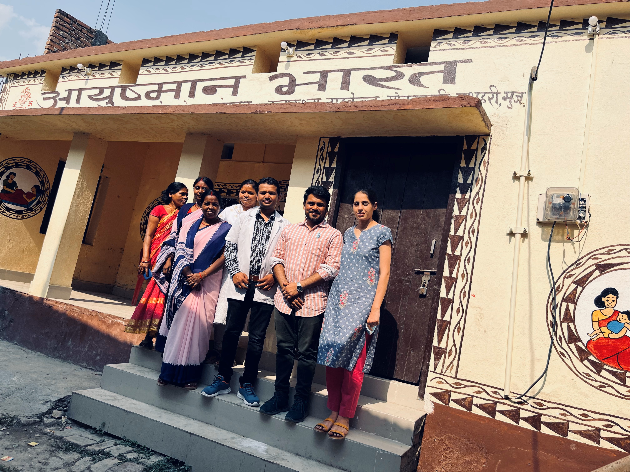
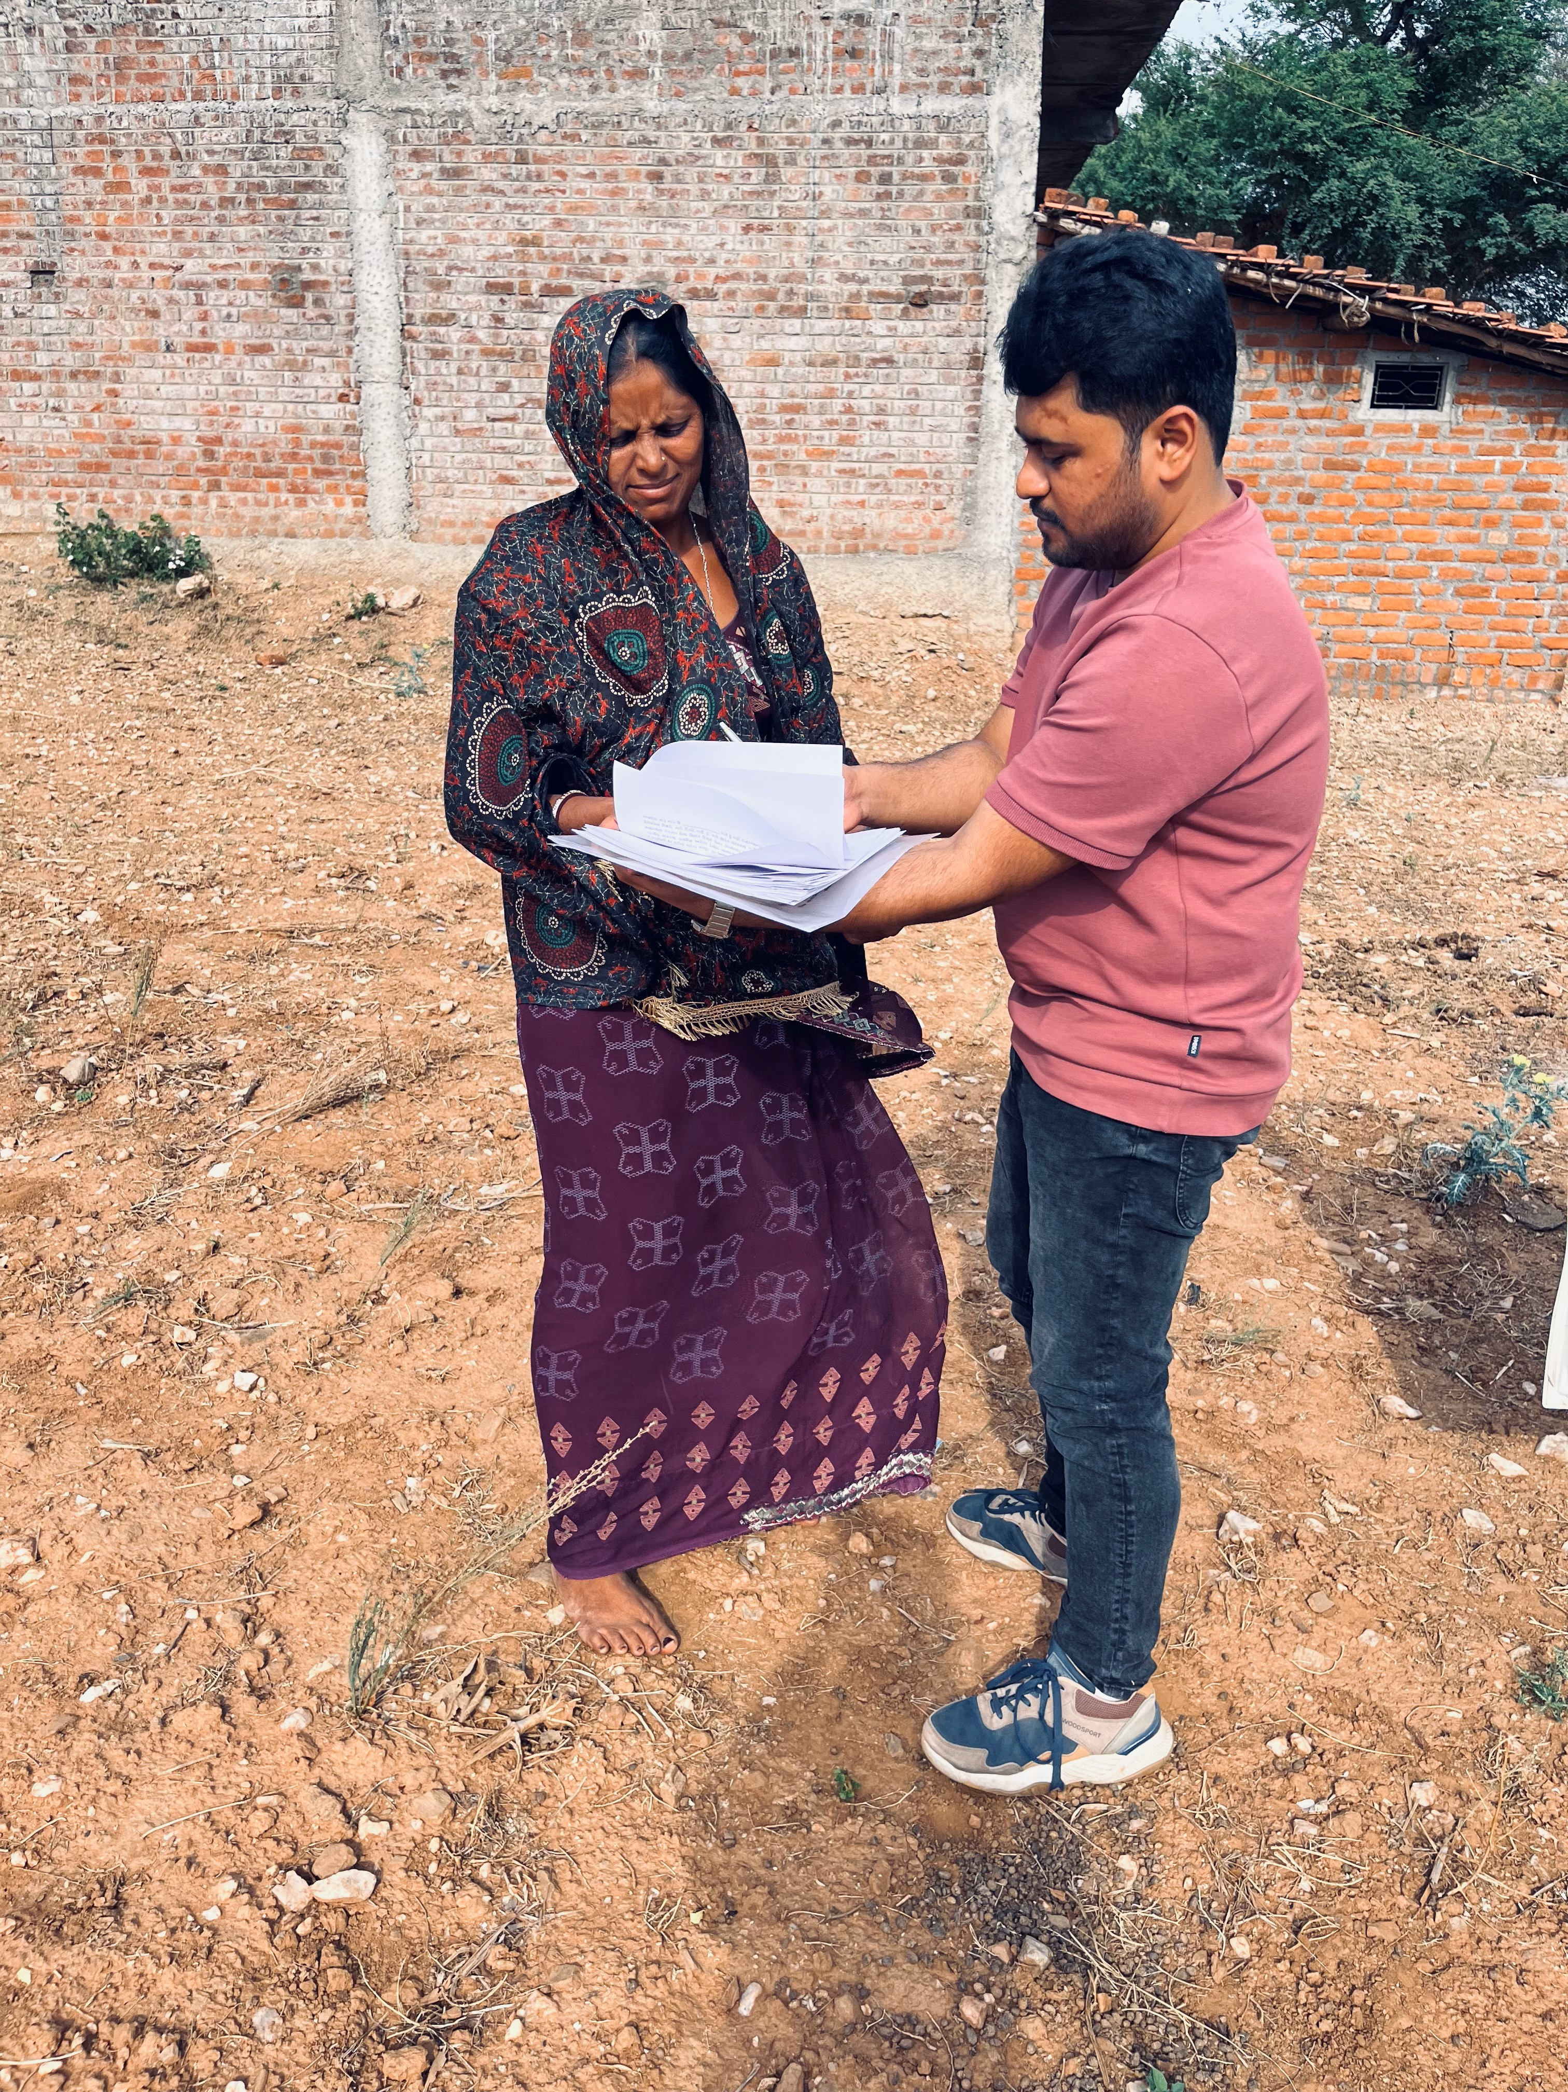
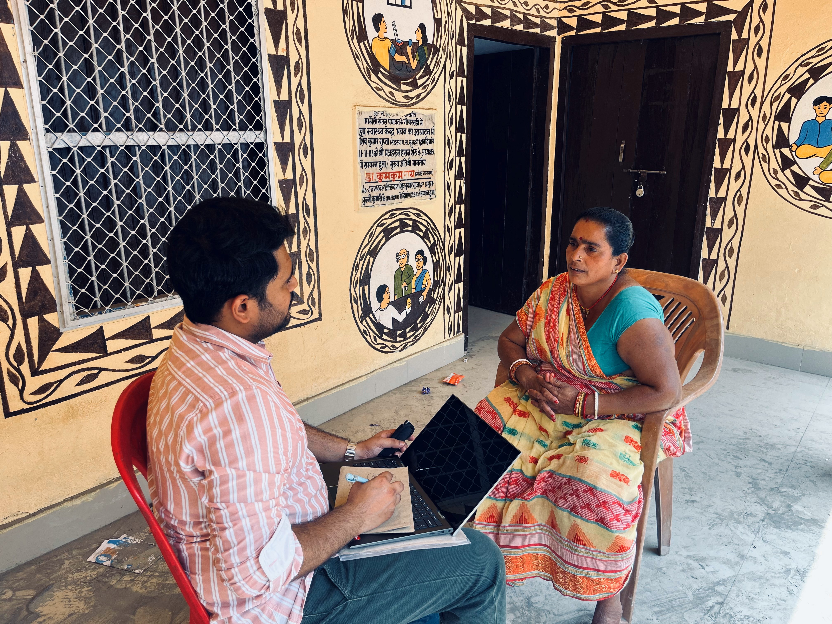
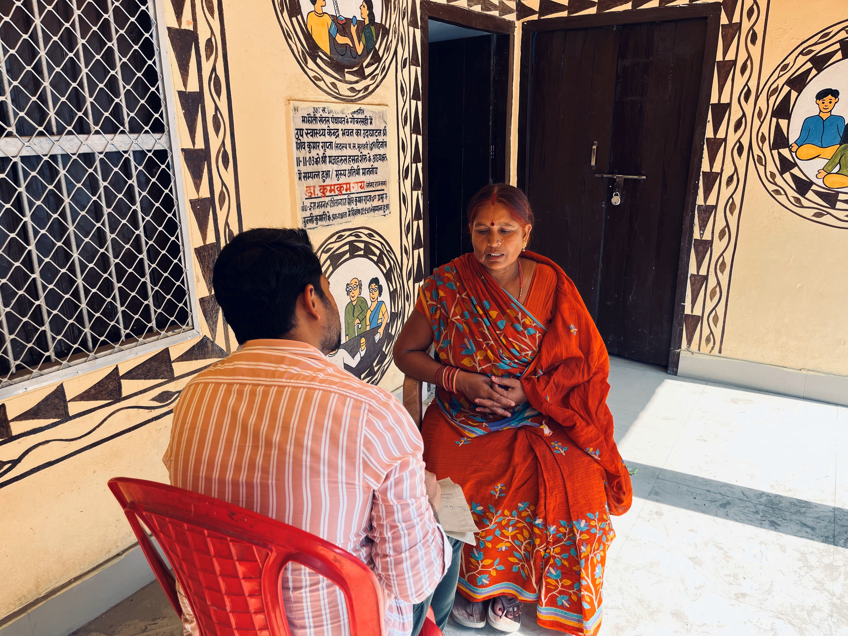
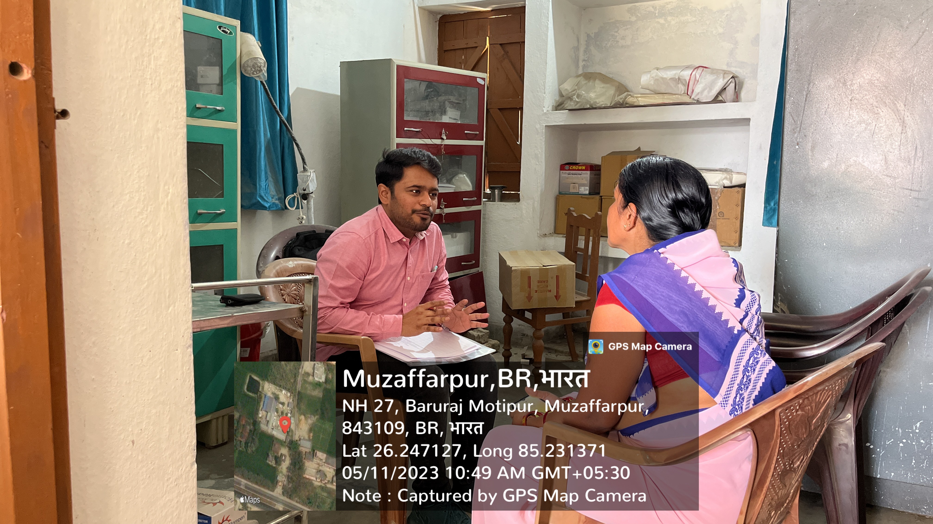
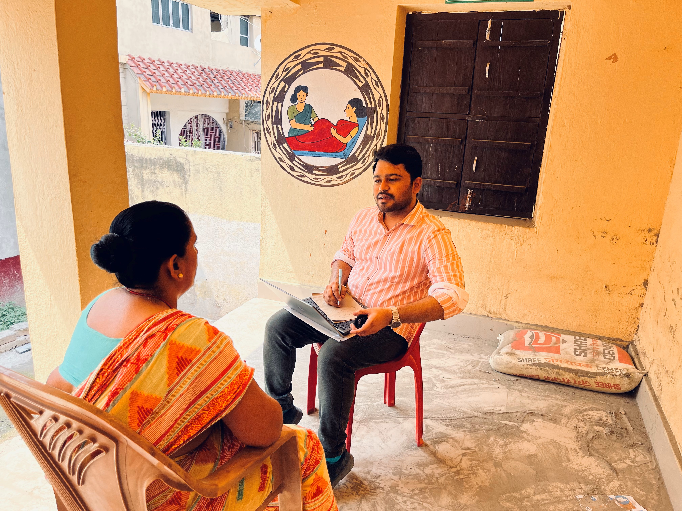
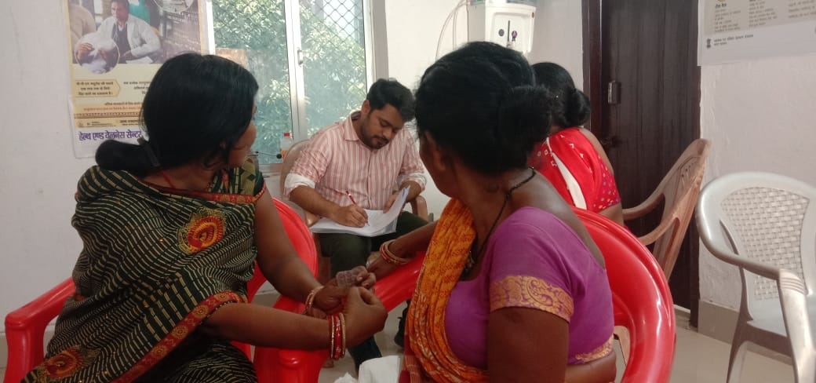
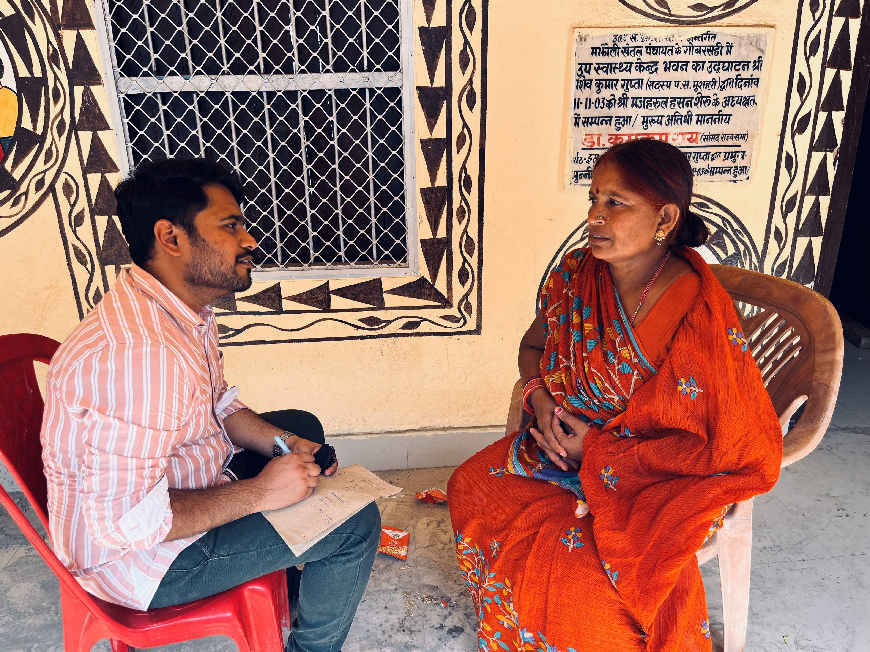
Pictorial JOURNEY

Slide 20


