Slide 1
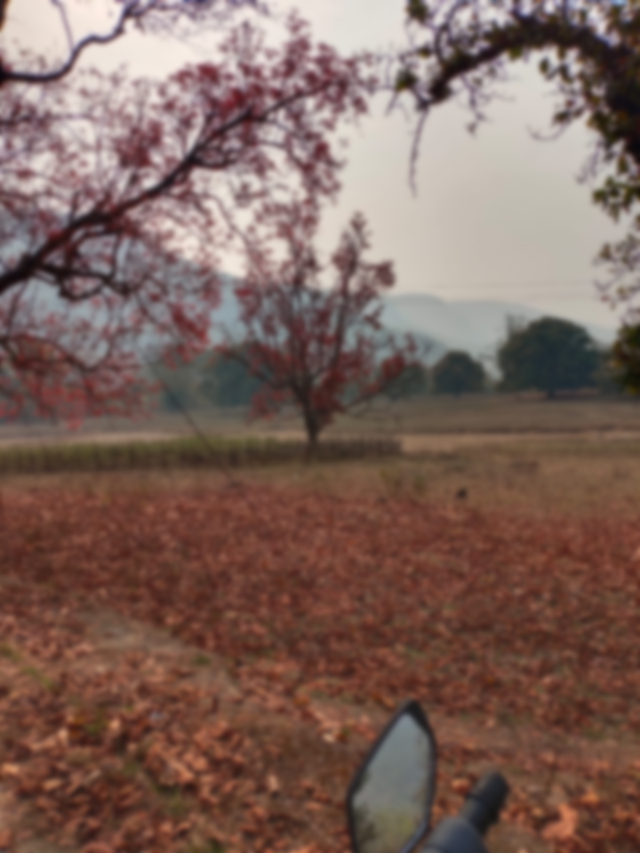
Assessment of Public Health Facility in Association with Climate Vulnerability in Raipur & Korba district of Chhattisgarh
Animesh Prasad Panda
PG/19/013
Guided by :
Ms Punita Kumar
Dr Sutapa B. Neogi

Slide 2
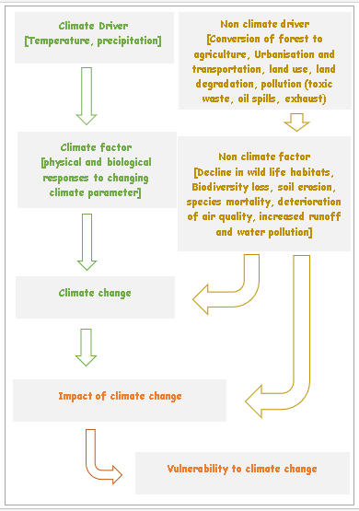
Climate Vulnerability
The degree of climate change to which a system is vulnerable to, or unable to cope with, such as climatic variations and human activities, is referred to as climate vulnerability.
These vulnerabilities can fall into five categories :
  Climatic [Flood, Drought, Cyclone, Heatwaves, Storm & Lightening's]
  Biological [ Epidemics, animal attacks]
  Geological [Earthquake, Forest fires]
  Accident [Fire, Explosion, Road & Rail Accidents, Building Collapses]
  Chemical, Industrial and [ Chemical and Industrial Disasters]

Slide 3
Methodology
Cross-Sectional study design
Study Sample
Place of study : district of Raipur and Korba from Chhattisgarh, India
All tertiary care & Community Health Centre has made compulsory to asses
A random sampling between Primary Health Centre
Data Collection
Duration of the study : 3 months starting from March 2021 to MAY 2021
The questionnaire was design with the help of a guidance document “Protecting Health from Climate Change: Vulnerability and Adaptation Assessment” from WHO
Data filled with the help of the software “KoBoCollect” an android based application
Data Analysis
Data was clean in Microsoft excel and then analysed with the help of STATA and Microsoft Excel.
 | Freq. | Percent
Total Health Facility
CHC | 11 | 19.64
District Hospital | 2 | 3.57
Medical College and Hospital | 1 | 1.79
PHC | 42 | 75

Slide 4

The assessment is permitted by State Health Resource Centre, Chhattisgarh
State Health Resource Centre, Raipur under Ministry of Health and Family Welfare of Chhattisgarh.
SHRC work as a collaboration between Government and civil society in order to provide necessary technical support to the health department for designing and implementing health sector reforms in the state including community-based health programmes
State Health Resource Centre,
First Floor, Health Training Centre Building, Bijli Chowk, Kalibadi, Raipur 492001, Chhattisgarh
Vision Statement
To facilitate attainment of ‘Peoples health in Peoples hands’
Mission Statement
To empower communities, specially women, to exercise their right to health and health care
To facilitate effective health sector strengthening with focus on community processes, decentralization and quality of care
To facilitate networking of state and civil society organizations and inter-sectoral convergence

Slide 5
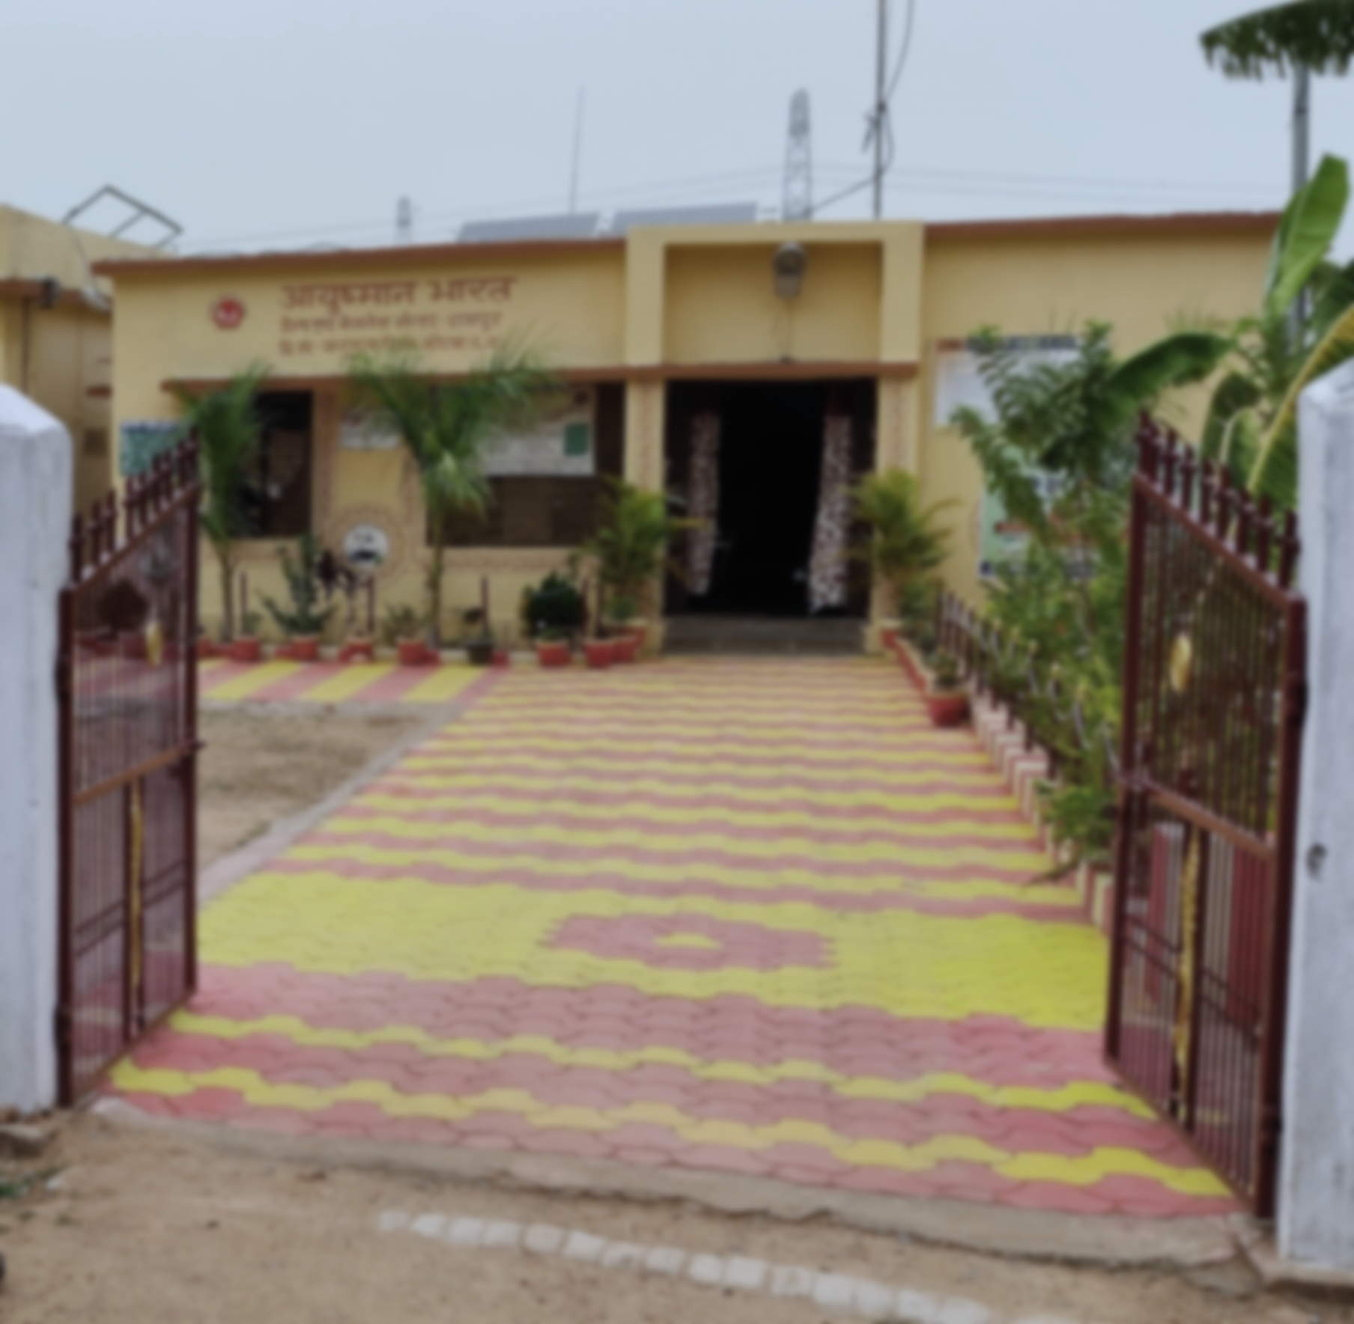
Objective
To understand the likelihood of climate vulnerability and its impact on public health facility
To identify the gaps of public health facility Infrastructure related to climate vulnerability
To identify the preparedness of Health Facility for Climate Vulnerability

Slide 6
Results 1. Likelihood

Slide 7
Results 2. Damages
What is the possibility of death or injury occurring due to this event in the hospital surrounding?
What is the scale of physical losses or damage to the hospital due to this event?

Slide 8
Results 3. Preparedness
Any disaster plan present to respond to this particular event?
What is the response time in hours for the Incident commander and his team to be on scene?
No | 52
Yes | 4
Mock Drills or training done for this particular event?

Slide 9
Preparedness Within The Infrastructure

Slide 10
Conclusion
Possibility of death in the hospital surrounding might be less, but that can’t predict the future possibility on upcoming calamities.
Damages to building infrastructure on such events have higher ratios than other damages. Economically, the damage to a building infrastructure costs the administration more money in such calamities.
In addition, interruptions in health service due to such circumstances exempt the health facility's objectives. Where they depend completely on referral to higher centres rather than handling on their own.
Recommendation
An active emergency plan with well-trained staff to respond in time.
Developing the infrastructure to climate resilient Health facility [lightening’s protected wiring]
Providing IEC material to raise awareness on community
Creating a public-private partnership around with such events can be valuable.

Slide 11
2Program Outcomes (rate how your course addresses the POs by giving a score of 1,2,3- 1: Slight (Low) 2: Moderate (Medium) 3: Substantial (High)
1. Internalize the concepts of management such as healthcare delivery system, strategic planning, HR, marketing, finance and operations | 2. Apply knowledge of research and management techniques and functions in an integrated manner in healthcare set up | 3. Use appropriate skills to support healthcare organizations to take informed decision in planning, building and managing healthcare organizations | 4. Utilize learning acquired from trainings and practical exposures in real time situations.
3 | 3 | 2 | 4

Slide 12
THANK YOU

