Slide 1


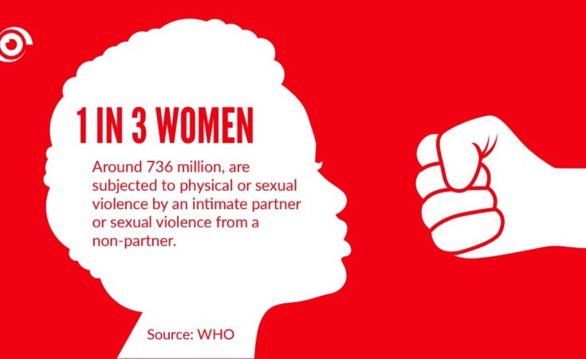
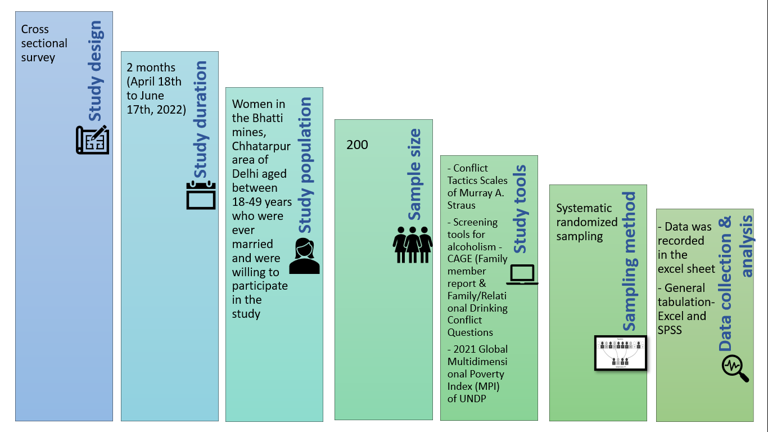
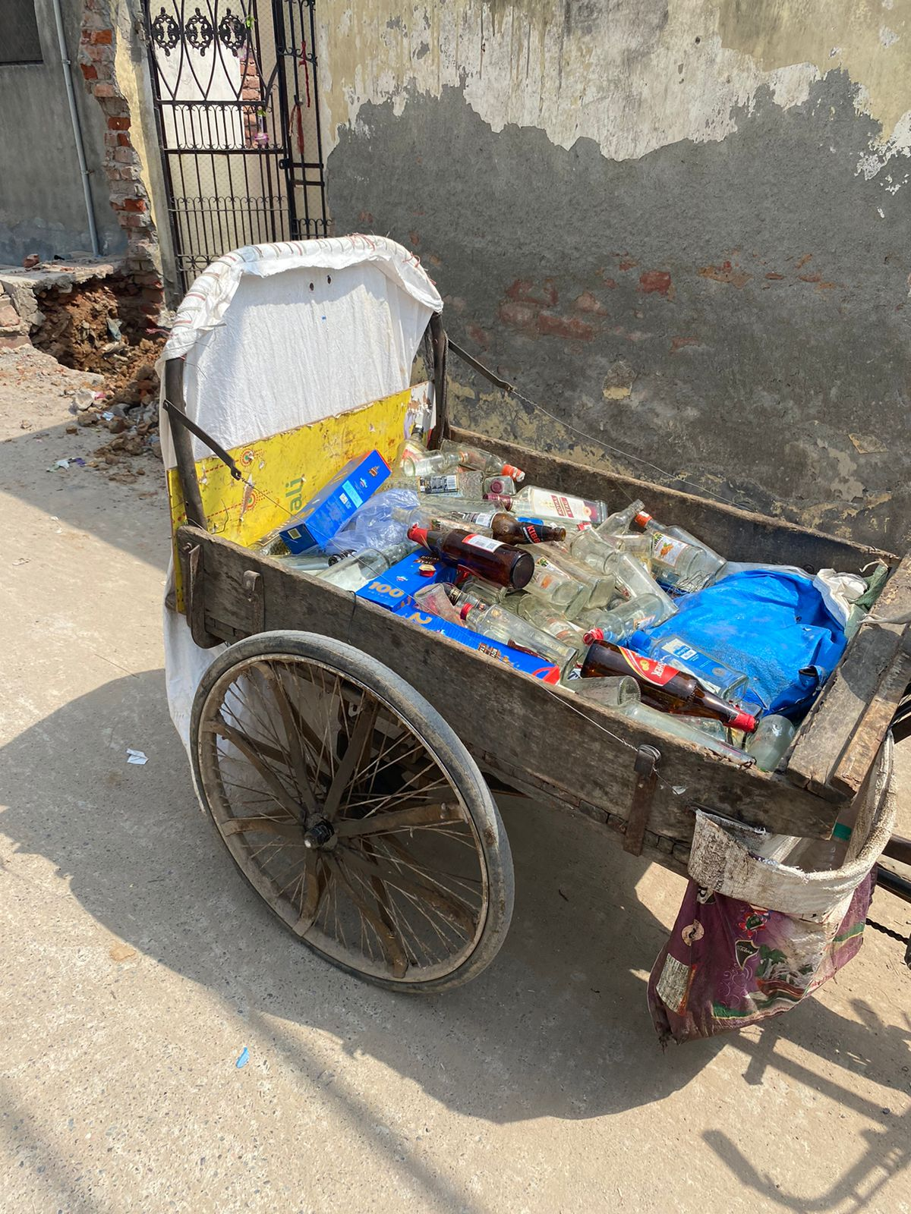
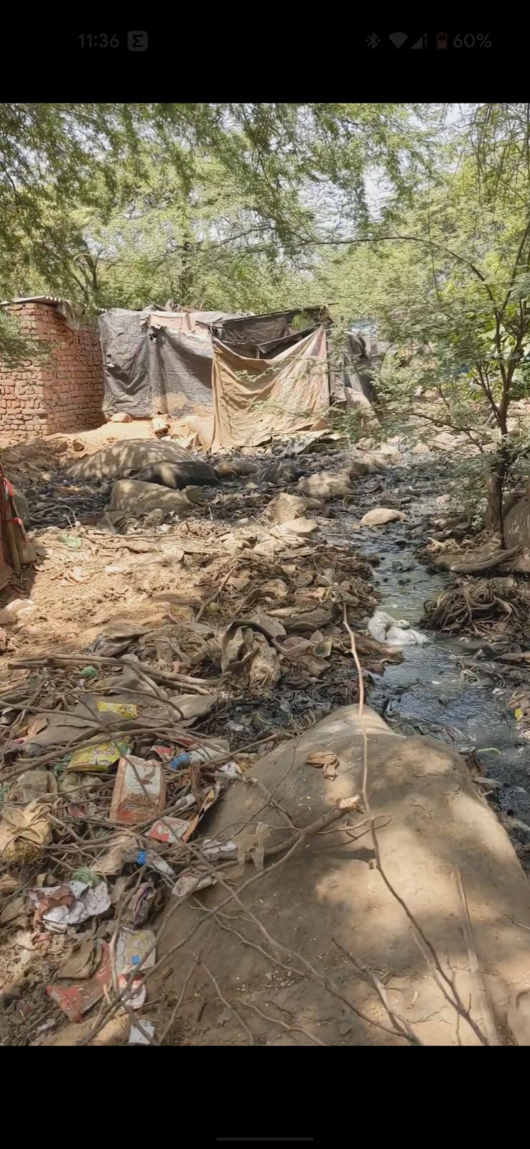
An Exploratory study of Determinants of Intimate partner conflict and Gender based Violence in Bhatti mines, Chhatarpur area of Delhi
Dr. Yasmin Khan.131
Faculty Mentor: Dr. Rohini Ruhil
INTRODUCTION
RESULTS
DISCUSSION
CONCLUSION & RECOMMENDATIONS
Gender based violence (GBV) is the violation of human rights of women, to live with freedom.
Globally 30% women experience some kind of GBV in their lifetime - WHO.
National Family Health Survey (NFHS-5) data, ~30% of women in India were exposed to GBV.
GBV comparatively more in rural areas (31.6%) compared to urban areas (24.2%).
In Delhi, violence against women were recorded at 22.6%.
42% men and 52% women considered beaten by husband to be justified.
Working status:
Violence was greater among the females whose partners worked for ≤4 days per week.
Deprivation:
Deprivation has statistically significant correlation with physical violence.
Alcoholism:
Correlation between partner’s alcoholism and gender-based violence was highly statistically significant, with staggering 92% of violence seen among females whose partners were alcoholic compared to 8% of violence occurring to women whose partners were non-alcoholic.
Education:
Husband’s education status had a correlation with physical violence (p value = 0.028).
Important to work on the root cause factors that effects or cause GBV
Understanding various factors such as livelihood, standard of living, health, education, alcoholism, deprivation, etc. - most essential step for elimination of GBV.
Financial control to women
Influence normative beliefs in the social environment.
Stronger enforcement of current laws against domestic violence
Create spaces where women may come together to connect and offer one another support
Economic self-sufficiency strategies need to be proactive
OBJECTIVES
To determine the existing status of GBV including physical, emotional, and sexual violence in women aged 18-49 years.
To assess the determinants of GBV namely age and age at marriage, disparity in education and incomes of the partners.
To analyse the correlation between deprivation and intimate partner interpersonal conflict in women aged 18-49 years.
To analyse the correlation between alcoholism and intimate partner interpersonal conflict in women aged 18-49 years.
p-value = 0.0000001
MATERIALS AND METHODS
p-value = 0.004
REFERENCES
Violence against women [Internet]. [cited 2022 Feb 21]. Available from: https://www.who.int/westernpacific/health-topics/violence-against-women
National Family Health Survey (NFHS-5) [Internet]. [cited 2022 Feb 21]. Available from:http://rchiips.org/nfhs/factsheet_NFHS-5.shtml
Roy AS, Sen N, Bagchi SS. Gender-based Violence in India in Covid-19 Lockdown. :15.

