Slide 1

Title: Understanding the perspective of patients on cataract surgery in an eye care hospital, New Delhi
Centre for Sight
Priyansha Srivastava
Dr.Rupsa Banerjee
IIHMR Delhi

Slide 2
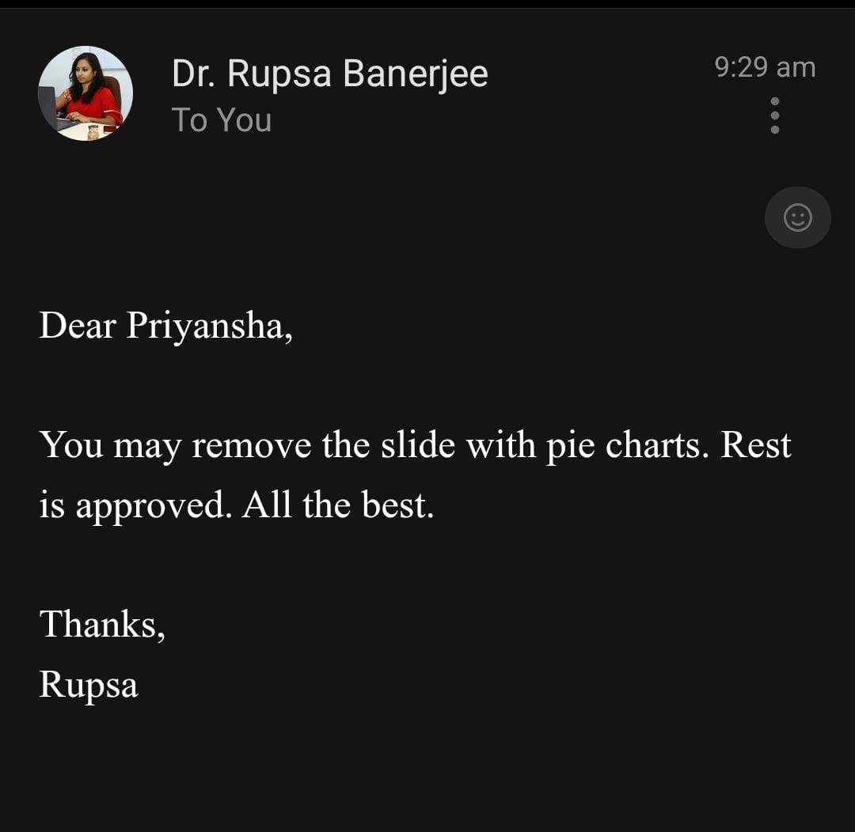
Mentor Approval

Slide 3
Introduction
Cataract is the most common, reversible cause of visual impairment and blindness in the world. Cataract surgery in primitive form has been around for millennia but the last 50 years have witnessed a monumental revolution in cataract surgery making it the most common, and one of the most successful, operations world-wide¹. Despite medical recommendations, many patients refuse or delay surgery due to various factors. Understanding these barriers is essential for improving healthcare delivery and patient outcomes². This study explores the psychological, financial, social, and systemic factors influencing patients’ decisions and proposes strategies to enhance surgical acceptance. By bridging the gap between medical recommendations and patient decisions regarding cataract surgery, the findings will help in designing targeted interventions to reduce cataract-related blindness and improve healthcare delivery.

Slide 4
Objectives of Your Study
To examine the key reasons patients refuse cataract surgery.
To assess financial, psychological, and cultural influences on decision-making.
To evaluate the role of healthcare communication and trust in doctors on decision-making.
To develop strategies to improve patient acceptance rates.

Slide 5
Methodology
Study Design: Cross sectional descriptive study
Sample Size: 100 patients who refused or delayed cataract surgery
Sampling method: Consecutive sampling method
Study setting: Centre for sight, Dwarka

Slide 6
Methodology
Data Collection: Primary data
Structured questionnaires for quantitative analysis.
Timeline: 3 months

Slide 7
Ethical considerations:
This research has adhere to the highest ethical standards to ensure confidentiality, protection, dignity and rights of all patients.
I had took informed consent forms with the clear explanation, methodology, benefits, risks etc.
Participants in the study has been entirely voluntary, they had rights to decline or withdraw from the study.
All data collected has been kept confidential.
The data collected has been solely used for academic and healthcare purposes.

Slide 8
Results
1. Overview of Demographic Data
Education level | Frequency | %age
Primary | 39 | 39%
No formal education | 26 | 26%
Secondary | 20 | 20%
Graduate+ | 15 | 15%
Gender | Frequency | %age
Male | 55 | 55%
Female | 45 | 45%
Monthly income | Frequency | %age
Below 25k | 27 | 27%
25-50 k | 18 | 18%
50-75 k | 30 | 30%
Above 75k | 25 | 25%
Employement Status | Frequency | %age
Employed | 35 | 35%
Retired | 33 | 33%
Unemployed | 32 | 32%
Age: The respondents ages ranged from 41-80 years, with a concentration in the 50-75 age range, which is representative of the average cataract patient demographic.

Slide 9
Results
2.Awareness and Perception of Cataract Surgery
Awareness: The majority of respondents (70%) were aware of cataracts, but only 50% were aware of their advantages.
There are gaps in patient education, since only about 40% of respondents said that a clinician clearly explained the operation.
The cost of surgery ranged from Rs.247 to 24,593, and many people cited this as a barrier (e.g., "Cost of living is high," "Fear of pain").
The "Below 25k" income group accounted for 60% of respondents who cited cost as a barrier.
Schemes/Aid: Only 30% were aware of financial aid schemes, but 50% said they would consider surgery if aid were available.
3. Perceptions of Surgery
Fear and misconception: 45% said they were afraid of surgery, which they frequently associated with "pain" or "complications." Decisions were influenced by negative experiences from family members (e.g., "Didn’t improve vision," "Blur vision") for 40% of respondents.
Influence of the Community: "Encourage" (30%), "Discourage" (35%), and "Neutral" (35%), according to the community, were the three main opinions.

Slide 10
Results
4. Trust and Decision-Making
Trust in Hospitals: 55% trusted hospitals, but distrust was higher among those with negative experiences.
Doctor-Patient Interaction: Only 40% felt doctors gave them enough time, suggesting rushed consultations may hinder informed decisions.
Convincing Factors:
- Top motivators: "Free surgery" (35%), "Family support" (30%), and "Better explanation" (20%).
- 15% said "Nothing would convince me," often due to deep-seated fears or prior negative outcomes.
5. Key Trends
Income Disparities: Lower-income groups were more cost-sensitive but also more likely to consider surgery if aid was provided.
Education Gap: Those with no formal education were less likely to understand benefits or trust medical advice.
Cultural Factors: Preferences for "traditional medicine" and reliance on family opinions were notable barriers.

Slide 11
Discussion
1. Financial Barriers:
Cost remains a critical hurdle, especially for low-income respondents. Expanding subsidies or insurance coverage could improve uptake.
2. Education and Communication:
Misinformation and lack of clarity from doctors contribute to fear. Targeted campaigns and better patient counseling are needed.
3. Community Influence:
Negative word-of-mouth significantly impacts decisions. Involving community leaders in awareness programs could mitigate this.
4. Trust Deficit:
Improving transparency (e.g., clearer cost breakdowns, success rate data) and doctor-patient rapport may increase trust.
5. Cultural Sensitivity:
Addressing fears of pain/complications and leveraging family support as a motivator could enhance acceptance.

Slide 12
Discussion
Recommendations
Policy: Subsidize surgery costs and promote aid schemes more effectively.
Healthcare Providers: Train doctors to communicate risks/benefits clearly and address patient concerns empathetically.
Awareness: Use local media and community networks to counter myths and highlight success stories.

Slide 13
Conclusion
The data highlights several key barriers to cataract surgery uptake. Financial constraints, especially among low-income groups and retirees, remain a major obstacle, often worsened by limited awareness of government aid or insurance. Low education levels contribute to poor understanding of the surgery’s benefits, while inadequate communication from doctors fosters fear and hesitation. Social influences, such as community beliefs, negative experiences shared by others, and cultural trust in alternative treatments, also impact decisions. To improve uptake, a multi-faceted approach is needed i.e, addressing financial barriers, enhancing doctor-patient communication, and promoting community-based awareness and trust-building initiatives.

Slide 14
References
Yousef A Fouad, Amr Mohamed ElGwaily & Yasmine Maher Shaaban. (2025) Screening for Occult Macular Pathology Prior to Cataract Surgery Using Optical Coherence Tomography. Clinical Ophthalmology 19, pages 317-324.
McGhee CNJ, Zhang J, Patel DV. A perspective of contemporary cataract surgery: the most common surgical procedure in the world. J R Soc New Zeal. 2020; doi:10.1080/03036758.2020.1714673
Finger, R. P., et al. (2011). “Predictors of cataract surgery uptake: findings from the Andhra Pradesh Eye Disease Study.” British Journal of Ophthalmology, 95(5), 624–628.
Lewallen, S., & Courtright, P. (2000). “Recognizing and reducing barriers to cataract surgery.” Community Eye Health, 13(34), 20–21. https://www.ncbi.nlm.nih.gov/pmc/articles/PMC1705916/
Ramke, J., et al. (2018). “Effective cataract surgical coverage: an indicator for measuring quality-of-care in the context of Universal Health Coverage.”

Slide 15
INVOLVEMENT IN COMMUNITY OUTREACH PROGRAMME (COP) ACTIVITIES
Total no. of visits done by the Student: 10
Day-wise activities done by the student:
Mapping and listing the area.
Interaction with the community and frontline healthcare workers.
Conducted awareness program in the school. (Group project)
Visited to various hospitals for see the infrastructure and understand the functioning of the department.

Slide 16
KEY LEARNING FROM COP ACTIVITIES
Mapping and Listing of the Area
Understanding Community Layout: Developed a detailed understanding of the geographical distribution of households, health facilities, and key resources.
Interaction with Community : providing awareness in the community about various diseases and natural calamities.
Interaction with community: making people aware about what to do during earthquake and fire.

Slide 17
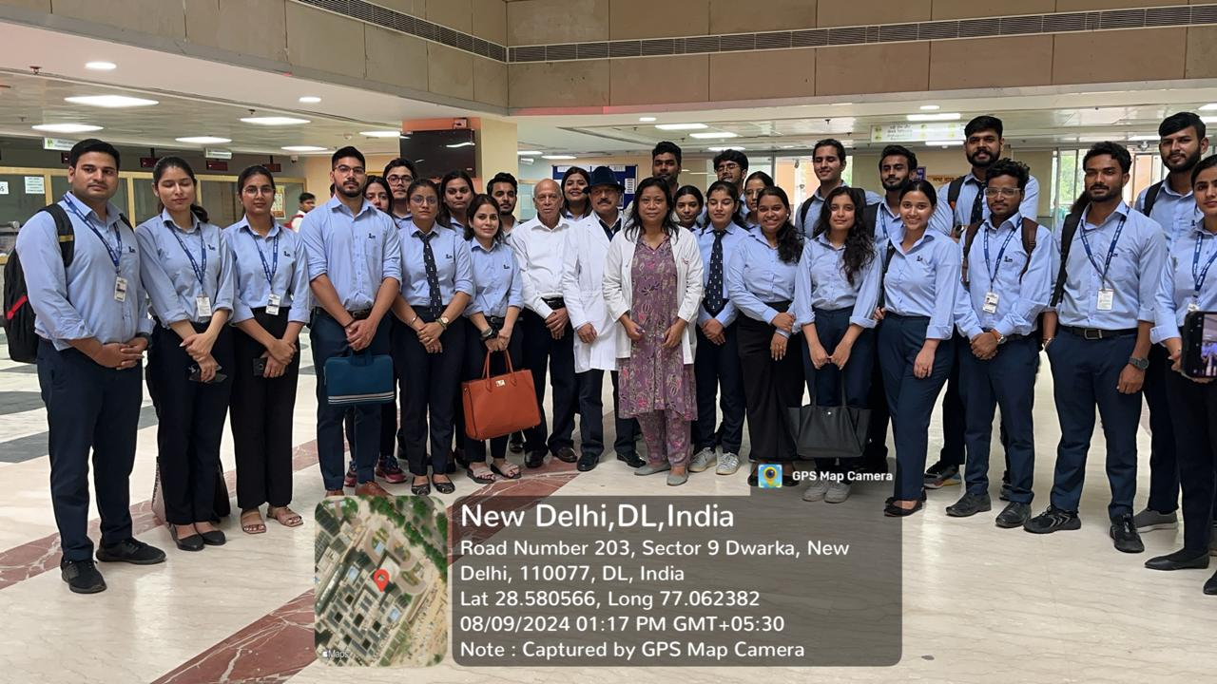
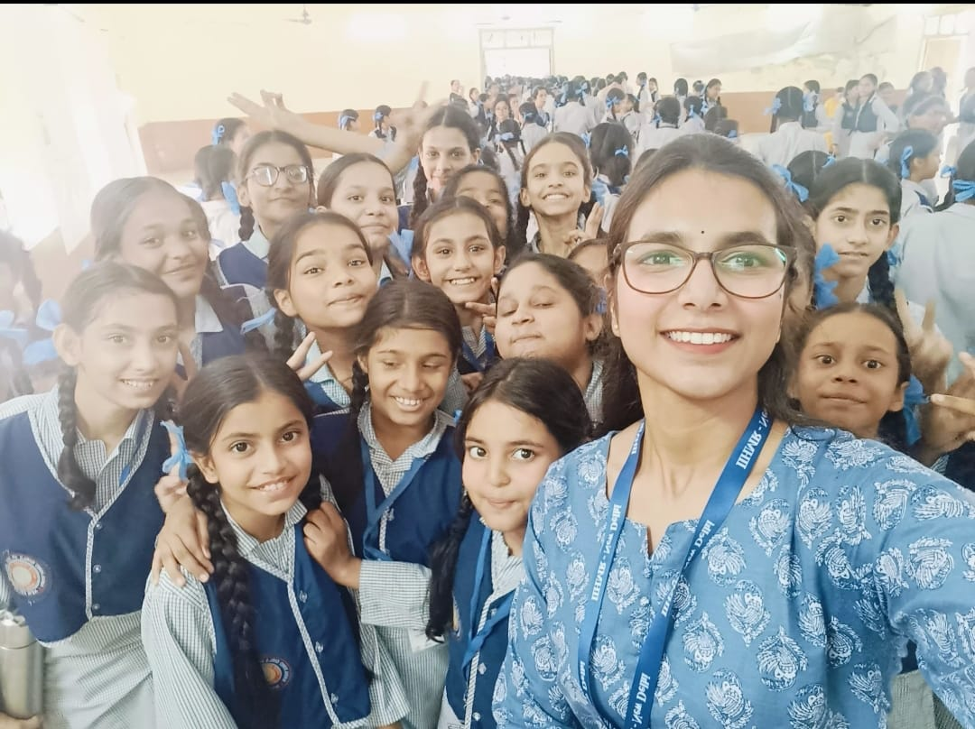
COP FIELD ACTIVITIES PHOTOGRAPHS

Slide 18
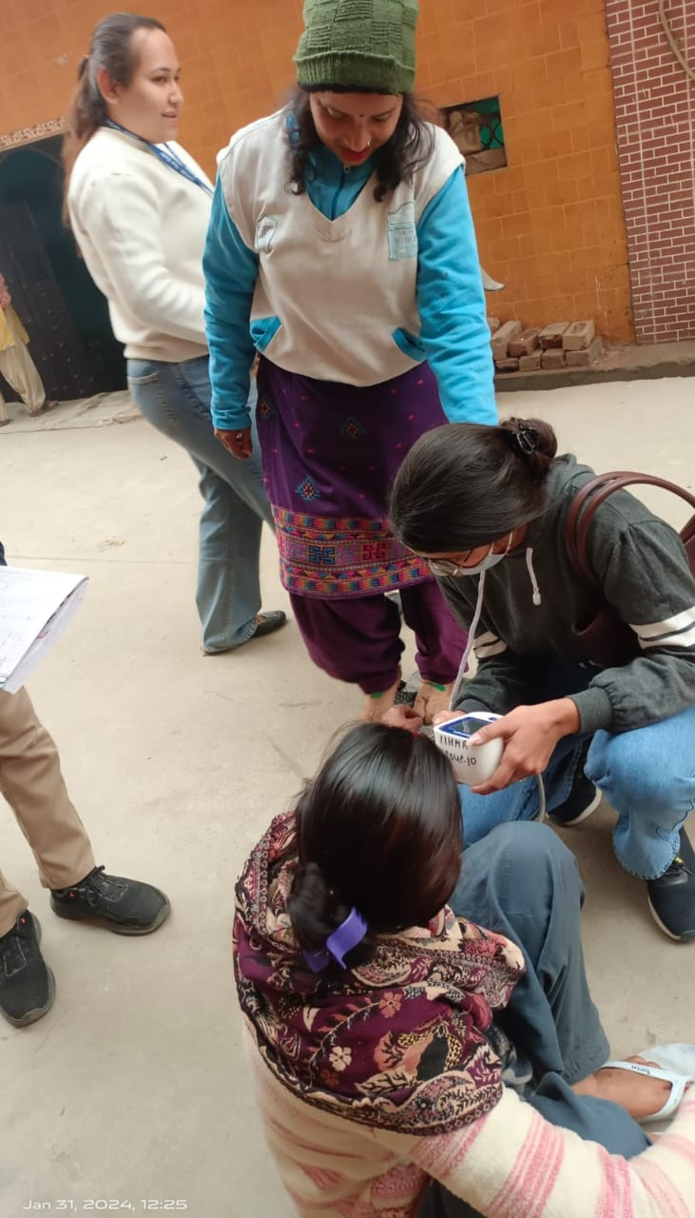
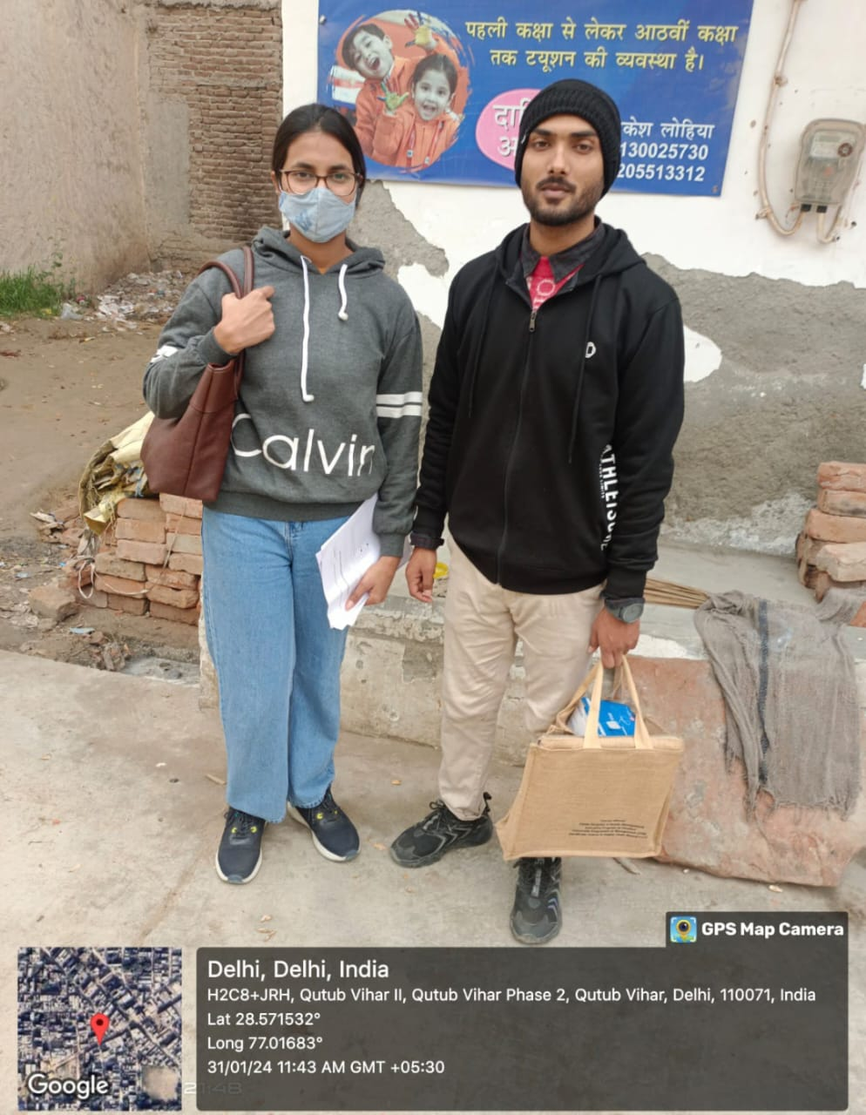
Pictorial Journey

Slide 19
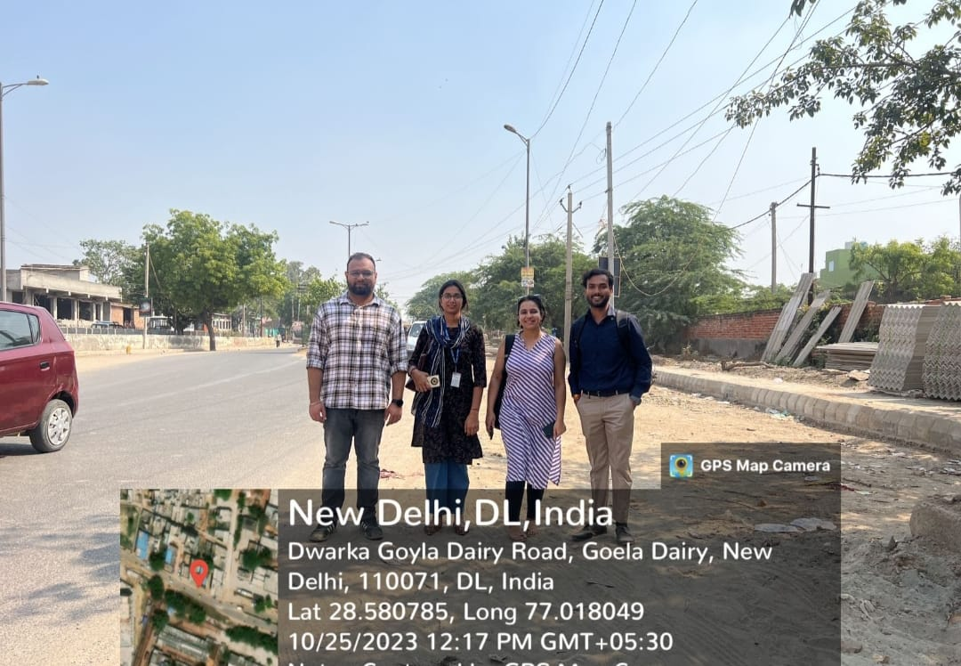
Pictorial Journey

Slide 20
Thank You
Any Questions

