Slide 1







Family Planning Program Outcomes:
Patterns and Predictors in Bihar
Presented by- Anmol Rai.
Guided by- Sukesh Bhardwaj, IIHMR, Delhi.

Slide 2
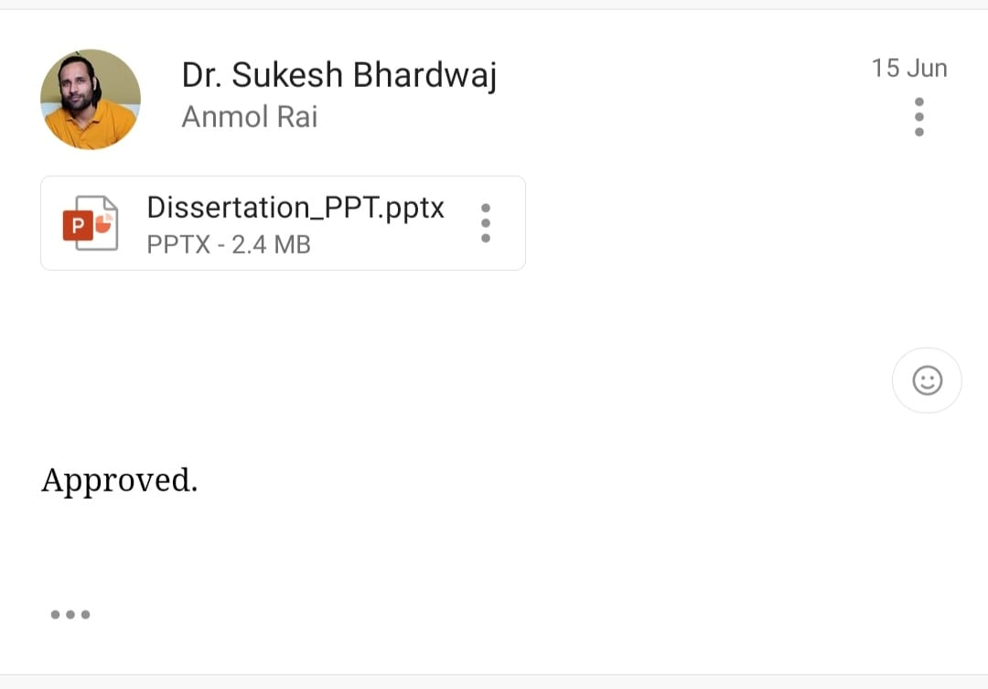
Screenshot of approval

Slide 3
Background
Family planning is the deliberate effort to regulate the number and spacing of children through contraception and other methods, enabling informed reproductive choices for individuals and couples(WHO)
Family planning programs in Bihar aim to promote reproductive health and empower communities. Despite challenges like high fertility rates and limited access to healthcare, efforts by the government and NGOs have increased awareness and access to services.
Socio-demographic factors and cultural norms still influence contraceptive use. Understanding these predictors is crucial for targeted interventions.
By addressing barriers and improving care quality, policymakers can enhance family planning effectiveness and improve maternal and child health in Bihar.

Slide 4



Objectives
To understand the patterns and trends of family planning programs in Bihar
To identify key predictors influencing the success or failure of family planning initiatives in Bihar

Slide 5

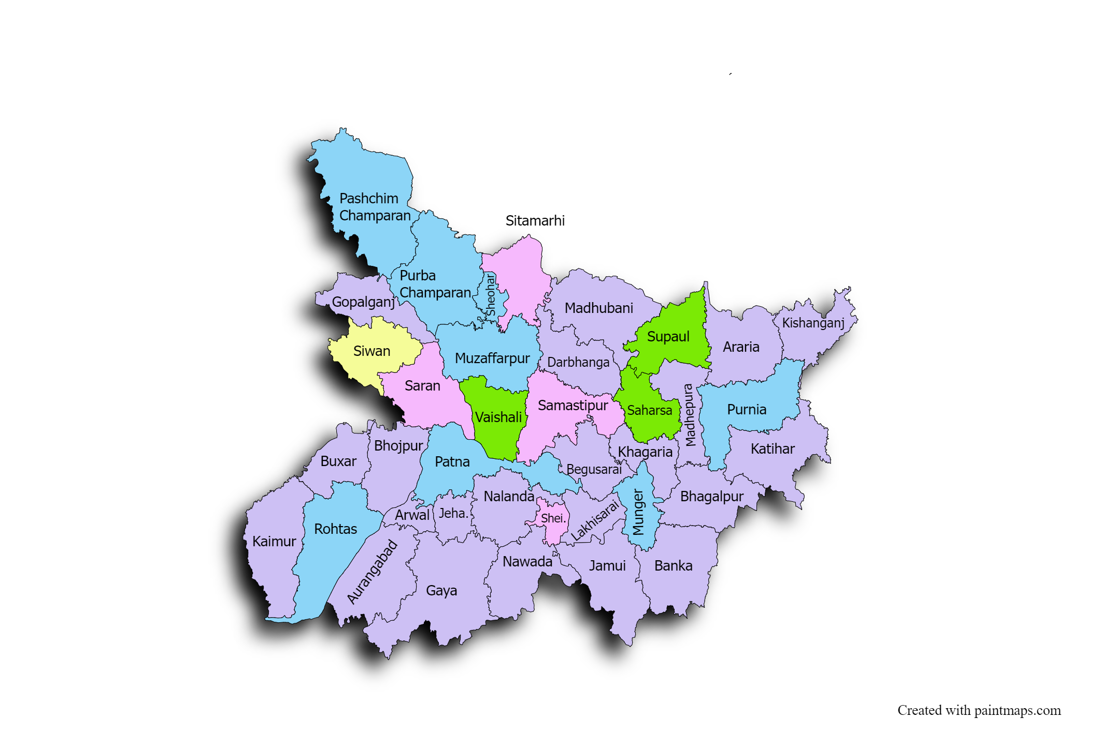
Study Area

Slide 6
Methodology
This study has use the data collected and involves analysis of the program monitoring collected under the Bihar Technical Support Program (BTSP) working closely with the government of Bihar
Study Design:-
  Community-based Cross-sectional study across 38 districts of Bihar conducted in three rounds- April-June 2016, September-December 2018, and February-April 2021.
Sampling:-
  Multistage sampling(in three phases), with blocks as major sample units and Anganwadi facilities and municipal wards as secondary units for rural and urban regions.
  Cluster random sampling selected five blocks from each district, and
  SSUs were chosen based on reported populations using Probability Proportional to Size sampling.
  Samples for each round were newly selected to prevent overlap and ensure representativeness.

Slide 7
Methodology
Inclusion criteria-
Currently married women aged 15-49 residing in households for at least three months
Exclusion criteria-
Women living in hostels,
Widowed,
Divorced,
Separated,
Temporary visitors.
Sample size estimation-
The sample size for these indicators was calculated following the binomial formula assuming the most conservative estimate i.e. an indicator value (p)of 50% (or 0.5). At an α error of 5 and absolute precision of 10%, the desired sample size for each district turned out to be 384. Assuming a design effect of 1.5, the sample size was inflated to 576. To account for 2-4% data loss, a rounded figure of 600 per district was decided upon.
Thus, the total sample of MWRA respondents to be sampled per district turned out to be 600 or 22,800 (600*38 districts) MWRA respondents from the entire state.

Slide 8
Variables
Socio-demographic | Reproductive Profile | Exposure to media and programmatic platforms | Outcomes Variables
Age of respondent | Number of Living Children | Exposure to media | Unmet need for spacing,
Religion | History of any abortion | SHG membership | Overall Unmet need,
Caste | Migrant husband | Awareness about Nai Pahal Kit | Modern Contraceptive method use,
Respondent's education |  | Any discussion on FP took place during the VHSND session. | Traditional method uses, and
Wealth index |  | FP-related interaction with FLW (in the last 12 months) | Modern spacing method use,
Respondent's occupation |  | Participated in Saas-Bahu Sammelan in last 12 month
Husband's occupation |  | Exposure of SARATHI VAN

Slide 9


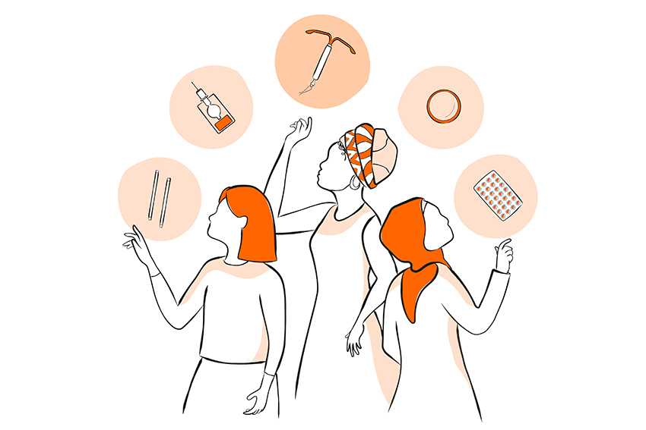
Results: Descriptive
R1-22800
N= R2-22800
R3-22668
Religion
Caste
R1-22800
N= R2-22800
R3-22668
R1-22800
N= R2-22800
R3-22668
R1-22800
N= R2-22800
R3-22668
Age of the respondents
R1-22800
N= R2-22800
R3-22668

Slide 10
Results: Descriptive
Wealth Index
Respondent occupation
Round-3
Respondent education
2016 R-1
N= 22800
2018 R-2
N= 22800
2021 R-3
N= 22668

Slide 11
Results: Descriptive
Husband’s occupation
Migrant Husband
No of living children
History of abortion
2016 R-1
N= 22800
2018 R-2
N= 22800
2021 R-3
N= 22668

Slide 12
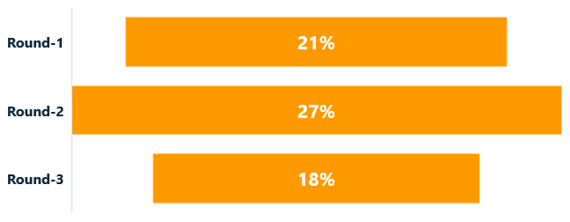
Results: Descriptive
Media Exposure
FLW Interaction on FP in last 12 months
SHG Membership
FP discussion during VHSND session
2016 R-1
N= 22800
2018 R-2
N= 22800
2021 R-3
N= 22668

Slide 13
Results: Descriptive
Participated in Saas-Bahu Sammelan in last 12 months
Awareness about Nai Pahal Kit
CPR
Exposure of SARATHI VAN
MCPR
2018 R-2
N= 22800
2021 R-3
N= 22668

Slide 14

Results: Descriptive
Unmet Need
Method Used
छोटा परिवार सुखी परिवार
2016 R-1
N= 22800
2018 R-2
N= 22800
2021 R-3
N= 22668

Slide 15

Results: Stratified
Traditional Method Use by Husband’s Migration
Traditional Method Use by Different Age Group

Slide 16
Results: Stratified
Traditional Method Use by No of living children
Traditional Method Use by Any Abortion
Traditional Method Use by Media Exposure
Traditional Method Use by FLW Interaction
Traditional Method Use by Discussion on FP during VHSND

Slide 17
Results: Stratified
Modern Contraceptive Use by No of living children
Modern Contraceptive Use by Any Abortion
Modern Contraceptive Use by Media Exposure
Modern Contraceptive Use by SHG Membership
Modern Contraceptive Use by Discussion on FP during VHSND

Slide 18
Results: Stratified
Modern Contraceptive use by (Participation in Saas Bahu Sammelan and Exposure to Sarathi Van
Modern Contraceptive use by Awareness of Nai Pahel Kit
Modern Contraceptive Use by Different Age Group

Slide 19
Results: Stratified
Modern Spacing Method Use by Husband’s Migration
Modern Spacing Method Use by Different Age Group

Slide 20
Results: Stratified
Modern Spacing Method Use by No.. Of Living Children
Modern Spacing Method Use by Any Abortion
Modern Spacing Method Use by Media Exposure
Modern Spacing Method Use by FLW Interaction
Modern Spacing Method Use by Discussion on FP during VHSND

Slide 21
Results: Stratified
Unmet Need by Husband’s Migration
Unmet Need by Participation In Saas Bahu Sammelan
Unmet Need by Different Age Group

Slide 22
Results: Stratified
Unmet Need by No.. Of Living Children
Unmet Need by Any Abortion
Unmet Need by Media Exposure
Unmet Need by SHG Membership
Unmet Need by Discussion on FP during VHSND

Slide 23
Results: Stratified
Unmet Need For Spacing by Husband’s Migration
Unmet Need For Spacing by Participation In Saas Bahu Sammelan
Unmet Need For Spacing by Different Age Group

Slide 24
Results: Stratified
Unmet Need For Spacing by No.. Of Living Children
Unmet Need For Spacing by Any Abortion
Unmet Need For Spacing by Media Exposure
Unmet Need For Spacing by SHG Membership
Unmet Need For Spacing by Discussion on FP during VHSND

Slide 25
Discussion
Over recent years, there has been a noticeable increase in the use of modern contraceptive methods in Bihar.
Government initiatives, such as the free distribution of contraceptives and awareness campaigns, have significantly contributed to this trend.
However, traditional methods still prevail in some rural areas due to cultural preferences and lack of access to modern options.
Community health workers (ASHAs) and local NGOs have played significant roles in spreading awareness and providing necessary information at the grassroots level.
Initiatives like the National Family Planning Program and state-specific schemes have provided a robust framework for implementation

Slide 26
Discussion
The Total Fertility Rate (TFR) in Bihar has shown a downward trend, indicating the effectiveness of family planning initiatives.
Improved spacing between births has led to better maternal health outcomes, including reduced maternal mortality rates.
Contraceptive use is higher among more educated and economically stable families, highlighting the role of socioeconomic factors in family planning decisions.
Strengthening educational and awareness campaigns to address myths and provide accurate information about family planning.

Slide 27
References
Government of Bihar. (n.d.). Health Management Information System. Retrieved from http://statehealthsocietybihar.org/hmis-dashboard
IIPS and ICF. (2017). National Family Health Survey (NFHS-4), 2015-16: India. Mumbai: IIPS.
Jejeebhoy, S. J., & Zavier, A. J. F. (2015). Assessing Progress, Impact, and Next Steps in India's Family Planning Programme. Mumbai: International Institute for Population Sciences.
Raj, A., Ghule, M., Battala, M., Dasgupta, A., Ritter, J., Nair, S., ... & Silverman, J. G. (2015). Brief Report: Prevalence and Predictors of Unintended Pregnancy Among Women: An Analysis of the Baseline Data From a Longitudinal Study of Women in Rural Maharashtra, India. BMC Public Health, 15(1), 1-9.
Navaneetham, K., & Dharmalingam, A. (2002). Utilization of maternal health care services in Southern India. Social Science & Medicine, 55(10), 1849-1869.

Slide 28
References
Jejeebhoy, S. J. (2000). Women’s autonomy in rural India: Its dimensions, determinants, and the influence of context. In H. Presser & G. Sen (Eds.), Women’s empowerment and demographic processes: Moving beyond Cairo (pp. 204–238). Oxford University Press.
Sinha, R. K., & Kaur, P. (2014). Health care infrastructure in Bihar: A critical analysis. Global Journal of Medicine and Public Health, 3(5), 1-9.
Bhattacharyya, A., et al. (2012). Contraceptive practices and its relationship with quality of life in women. Journal of Clinical and Diagnostic Research, 6(8), 1382-1385.
International Institute for Population Sciences [IIPS]. (2017). National Family Health Survey (NFHS-4), 2015-16: India. Mumbai: IIPS.
Bajpai, N., & Dholakia, R. H. (2013). Family planning and fertility behavior: Evidence from Uttar Pradesh, Bihar, and Rajasthan. Economic and Political Weekly, 48(29), 71-81.
International Institute for Population Sciences [IIPS]. (2017). National Family Health Survey (NFHS-4), 2015-16: India. Mumbai: IIPS.

Slide 29

Thank You!
Any Questions???

Slide 30
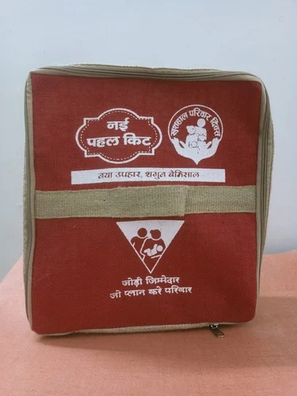
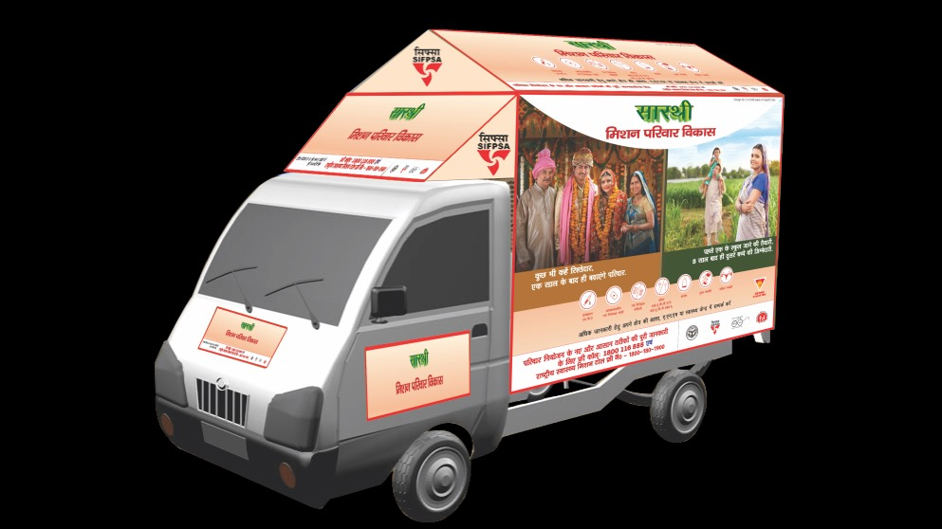
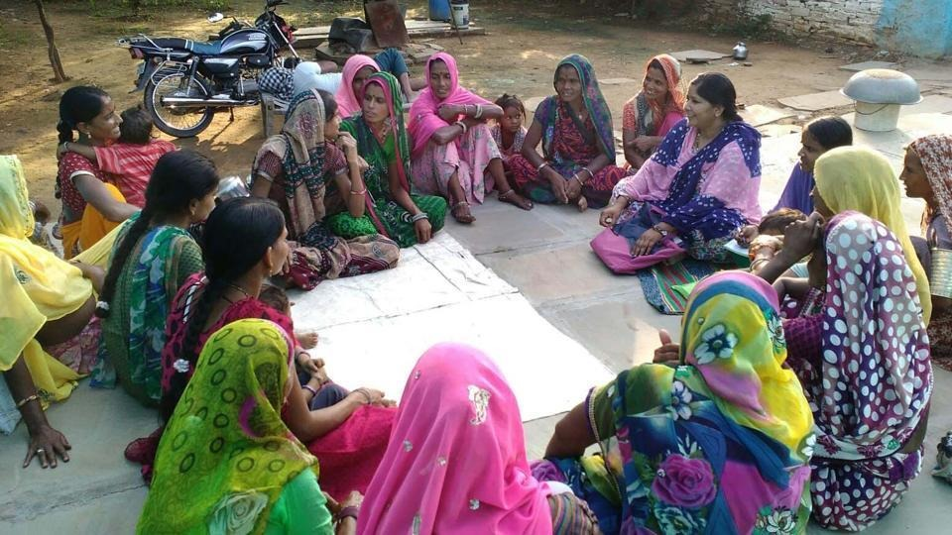
Pictorial Journey

