Slide 1

Evaluating the Impact of Nutritional Habits on the Quality of Life among Migrant College Students
Submission By: Dr.Saumya Pathak(PG/23/102)
Mentor: Dr.Nidhi Yadav

Slide 2


Slide 3
Introduction
Migration is defined as movement of people from one place to another, with intention of settling permanently or temporarily at a new geographic region. It can internal or external.
Higher education institutions are mostly located in economically developed states. To promote a balanced regional development is crucial to facilitate quality of education across the states. Student migration has increased from one state to another in pursuance of quality education.
In accordance with the census 2011, a total of 54,02,238 students from other states migrated for higher education across the country. From the total, males make up 60.34%, and females make up 65.72%. As compared to the 2001 census, the total number of students that migrated was 33,18,176. Males migrated in large numbers with 70.70%. On the other hand, females moved with 41.44%. In the duration from 2001 to 2011, the number of female migrants increased drastically.
Change in their daily diets, induced by the migration, therefore, becomes a critical aspect of determining their physical and mental well-being.

Slide 4
The last two centuries have experienced a dramatic change in diets across the world, both in developed and developing countries. The transition from living in the comfort of home to independent living at a relatively newer place brings both opportunity and challenges for students. It is especially true for a country like India, which exhibits substantial areal variations and traditional vegetarian patterns in eating habits and dietary components. The daily diet of students faces various challenges in this case which majorly affects their quality of life.
QOL is a construct defined as an individual’s perception of their position in life in the context of the culture and value systems in which they live and in relation to their goals, expectations, standards and concerns. In general, university students have several unhealthy behaviours, such as unhealthy eating habits, decreased physical activity, increased alcohol and marijuana intake, reduced sleep, and risky sexual behaviour, all of which impacts negatively on their QOL.
Eating habits are individual and collective behaviours that influence the human relationship with food in sociocultural and environmental contexts. These eating habits can be conceptualized as healthy when they follow national and international dietary recommendations based on a varied and balanced diet, and unhealthy when foods high in critical nutrients, such as sugary drinks, snacks, fried foods and others, are consumed in excess, which has a negative effect on health.

Slide 5
Rationale
Due to the growing number and variety of higher education institutions across the country, college students' internal mobility has increased significantly in recent years. Students between the ages of 17 and 28 frequently experience major shifts in food availability, dietary habits, and lifestyle routines when they move away from home to seek educational possibilities. These alterations may cause nutritional imbalances and upset long-standing eating patterns, which may have an impact on their general quality of life, including their academic achievement, mental and physical health, and overall well-being.
While some studies have explored youth nutrition and the quality of life separately, or focused on general student populations, very few have specifically looked at how internal migration within India affects both dietary behavior and quality of life in an integrated manner. Most of the existing research is either regional. My study attempts to bridge this gap by focusing on students who have shifted from their native places to pursue higher education, and how that shift alters their nutritional choices, routines, and overall well-being. It’s this unique intersection — migration, nutrition, and quality of life — that makes my research relevant and necessary."

Slide 6
Importantly, the research sample includes students from varied universities across India, ensuring diversity in regional backgrounds, food cultures, and institutional contexts. This inclusivity strengthens the relevance and applicability of the findings across a broad spectrum of student populations.
By analyzing these nutritional shifts in relation to students' quality of life, the study will provide valuable insights for educational institutions, public health professionals, and policymakers. The findings can inform the development of more inclusive campus food services, nutritional awareness programs, and student support policies that recognize and address the unique challenges faced by migrating students in India.

Slide 7
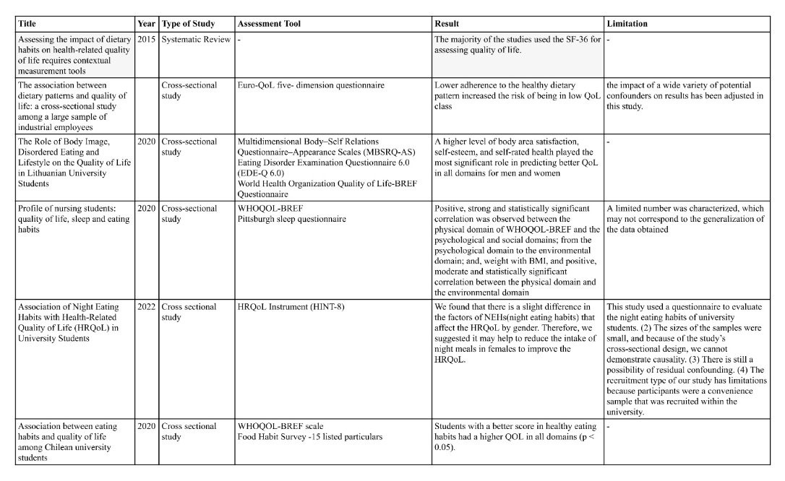
Review of Literature

Slide 8

How do the nutritional habits of college students aged 17-28 year who migrate from their homes to different regions across India impact their Quality of life?
Research Question

Slide 9
Objectives
1.General Objective:
To investigate the effect of nutritional habits on quality of life among college students living away from home.
2. Specific Objectives:
To identify common dietary patterns among college students living away from home.
To assess the status of quality of life among these students, including physical health, psychological health, social relationships and environmental quality of life
To explore the factors influencing the nutritional choices of these students.
To explore the relationship between nutritional habits and migration.
To explore how Quality of life of these students is influenced by their nutritional habits.

Slide 10
Hypothesis
Null Hypothesis (H₀):
There is no significant relationship between the nutritional habits of migrated college students and their quality of life across physical, psychological, social, and environmental domains.
Alternative Hypothesis (H₁):
There is a significant relationship between the nutritional habits of migrated college students and their quality of life across physical, psychological, social, and environmental domains.

Slide 11
Methodology
Study Design: This is a descriptive cross-sectional survey study(Primary Study)
Study Area:
Students from:
1.PGIMER Chandigarh
2.SVYASA University Bengaluru
3.Amity University Gurugram
4.Amity University Noida
5.DR B R Sur Homeopathic Medical College & Research Centre New Delhi
6.IIHMR New Delhi
7.NIT Hamirpur

Slide 12
Study Participants: College students aged 17-28yr who live away from home.
Study Variables: General Characteristics, Eating Habits, Quality of Life.
Sampling Method: Convenience sampling through college networks, student organizations, and social media platforms.
Sample Size: A sample size of 284 students will be targeted to ensure a representative analysis.
University/College | Estimate Population | Migration Proportion(30%) | Migrated Population | Tapped Population
PGIMER Chandigarh | 700 | 30% | 210 | 90
SVYASA University Bengaluru: | 1500 | 30% | 450 | 150
Amity University Gurugram | 15000 | 30% | 4500 | 250
Amity University Noida | 30,000 | 30% | 9000 | 300
DR B R Sur Homeopathic Medical College & Research Centre New Delhi | 500 | 30% | 150 | 50
IIHMR New Delhi | 500 | 30% | 150 | 200
NIT Hamirpur | 3,000 | 30% | 900 | 50
 | 51200 |  | 15360 | 1090

Slide 13
Sample Size Calculation (Cochran’s Formula)
Using Cochran’s formula for a finite population (N = 1090), with:
Z = 1.96 (95% confidence level)
p = 0.5 (maximum variability)
e = 0.05 (margin of error)
The calculated sample size was 284.
Note: Following data cleaning, which involved removal of incomplete, inconsistent, or duplicate entries, the final sample size used for statistical analysis was 218 valid responses.

Slide 14
Data Collection Tool: Google Forms Questionnaire (attached below)- WHOQOL BREF, Eating habits questionnaire, General characteristic form.
Data Analysis: The data will be analysed using statistical software Statistical Package for the Social Sciences (SPSS).
Ethics and Consent:
Informed Consent: Participants will be informed about the study’s purpose, the voluntary nature of participation, and the confidentiality of their responses. Consent will be obtained via the Google Form.

Slide 15
Results
✅ Objective 1: To identify common dietary patterns among migrated college students
🔸 Fast Food & Snacks Consumption
70% of students reported consuming fast food 5–6 times per week.
65.1% reported eating snacks (like chips, namkeen, biscuits) 2–3 times per week.
🔸 Fruit and Vegetable Intake
Only 43.1% reported consuming fruits and vegetables daily.
Remaining 56.9% consumed them less frequently, indicating low micronutrient intake.
🔸 Milk Preference
Full cream milk: 38.1%
Skimmed milk: 36.7%
Toned milk: 8.3%
Flavored milk: 7.3%
Soya milk: 5%
Others: 4.6%
🔸 Breakfast Type
Indian traditional breakfast (e.g., poha, paratha, upma): 53.2%
Bread & egg: 25.2%
Cereals (cornflakes/muesli): 15.1%
No breakfast or skipping: 6.4%

Slide 16
Objective 2: To assess the Quality of Life status of students
🔸 WHOQOL-BREF Domain Mean Scores
Domain | Mean | SD
Physical QoL | 3.58 | 0.58
Psychological QoL | 3.28 | 0.61
Social QoL | ~3.3 | —
Environmental QoL | ~3.5 | —
The physical QoL domain had the highest mean score (3.58), followed by environmental (~3.5).
The psychological QoL domain was the lowest (3.28).
🔸 Gender-Based Differences in QoL Domains (from Correlation Table)
Gender vs Psychological QoL:
r = –0.145, p = 0.032
→ Indicates significant difference based on gender( Weak but negative correlation)
Gender vs Physical QoL:
r = –0.140, p = 0.039
Gender vs Environmental QoL:
r = –0.136, p = 0.044
Female students reported statistically lower scores across domains.

Slide 17
✅ Objective 3: To explore factors influencing nutritional choices
🔸 Gender-Based Food Choice Crosstabs
Milk Preference by Gender:
  Males: More inclined to choose full cream milk (dominant)
  Females: Skewed towards skimmed milk (36.7%) and flavored options
Snack Frequency by Gender:
  Females had a higher response rate in the 2–3 times/week category (not quantified in %, but evident in Crosstab counts)
  🔸 Socioeconomic Status (SES) Influences
Fast Food Frequency:
  Middle SES students reported the highest frequency (5–6 times/week)
Extra Salt Use:
  More common among lower SES and PG/hostel-based students
Type of Milk Consumed:
  Higher SES: Skimmed or flavored milk
  Lower SES: Full cream and toned milk

Slide 18
✅ Objective 4: To explore the relationship between migration and changes in nutritional habits
🔸 Breakfast Type by Migration Region (Cross-tab)
Metro Migrants (Delhi, Mumbai, Bengaluru):
  More frequently consumed bread, eggs, cereals
Semi-Urban/Rural Migrants (e.g., Bihar, UP, Odisha):
  Preferred traditional Indian breakfast
  🔸 Milk Type by Migration Region
Metro regions: Higher use of skimmed and flavored milk
Non-metro regions: More full cream and toned milk consumption
🔸 Fruit & Vegetable Intake by Migration Region
Metro migrants: Lower frequency of daily fruit/veg intake
Semi-urban/rural migrants: Higher daily intake reported

Slide 19
🔸 Multiple Response Data:
Fried food, sugary drinks, and sweet snacks were more commonly selected by students from urban regions (descriptive trend).
Note: Chi-square Test Output (Migration × Nutrition)
Pearson Chi-square: 572.438, df = 252, p = .000
BUT: 316 cells (98.8%) had expected counts <5
Interpretation: Test assumption violated due to too many categories, so results not reliable
***Out of 218 participants = 67.3% consume alcohol 3-4 times a week
Out of 218 participants= 58.6% smoke often

Slide 20
Objective 5: To determine effect of nutritional habits on Quality of Life
🔸 Correlation (Pearson's )
Predictor | QoL Domain | r | p-value
Unhealthy food habits | Physical QoL | –0.143 | 0.035
Unhealthy food habits | Psychological QoL | –0.128 | 0.061
Unhealthy food habits | Environmental QoL | –0.115 | 0.089
Gender | Psychological QoL | –0.145 | 0.032
🔸 Regression Analysis (for QoL Domains)
Physical QoL
R² = 0.006 (i.e., dietary habits explain 0.6% of variance)
No significant predictors except gender (borderline)
Psychological QoL
Gender was a significant predictor:
β = –0.158, p = 0.021(The negative beta means that female students (assuming coded as lower value) tend to report lower psychological QoL than males)
Environmental & Social QoL
No significant predictors from dietary habit variables
Models were statistically non-significant (p > 0.05)

Slide 21
Discussion
The current study explored how nutritional habits affect the quality of life (QoL) of college students who have migrated from their hometowns for education. The findings reveal both individual and contextual influences shaping dietary behaviors and well-being.
From a public health perspective, the study highlights a concerning trend: frequent consumption of fast foods and snacks and inadequate intake of fruits and vegetables. These findings align with national data (e.g., NFHS and NSSO reports) which show increased processed food reliance among urban youth and working students. Migration further intensifies these habits, as students face time constraints, poor access to home-cooked food, stress, and limited nutritional awareness.
The gender differences observed (e.g., females choosing healthier milk but reporting lower QoL scores) suggest that nutritional decisions are shaped by social roles, perceptions of body image, and differing stress experiences—something widely documented in adolescent health literature.

Slide 22
Moreover, although diet showed only a modest influence on physical QoL, the stronger association of QoL with gender and SES implies that dietary interventions alone may not suffice. The study supports a holistic view, consistent with WHO’s social determinants of health framework, suggesting the need for integrated strategies addressing diet, mental health, socio-economic stressors, and accommodation-related challenges.
The limitation of chi-square analysis due to sparse data (98.8% cells with <5 counts) While regression and correlation were appropriately used to explore relationships between dietary habits and QoL domains, future research could benefit from category consolidation
In the broader context, these findings are important for hostel policy, student wellness programs, and targeted health education, particularly for students from disadvantaged backgrounds or high-migration corridors

Slide 23
Conclusion
The study concludes that unhealthy dietary habits are common among migrated college students, marked by high fast food and snack intake, and low fruit/vegetable consumption. These patterns appear to have a mild but statistically significant impact on physical health, but are not strong predictors of overall quality of life.
Gender and socio-economic status were more consistent predictors of QoL, with females and students from mid or lower SES groups reporting more dietary compromises and lower well-being scores.
While students from metro regions were more likely to consume processed and ready-to-eat foods, the statistical tests for migration effects were inconclusive, highlighting a need for simplified variable categories in future work.
Overall, the study suggests that nutritional interventions alone are insufficient. To improve student well-being, colleges and health systems must focus on integrated strategies combining dietary education, mental health support, and inclusive campus living environments.

Slide 24
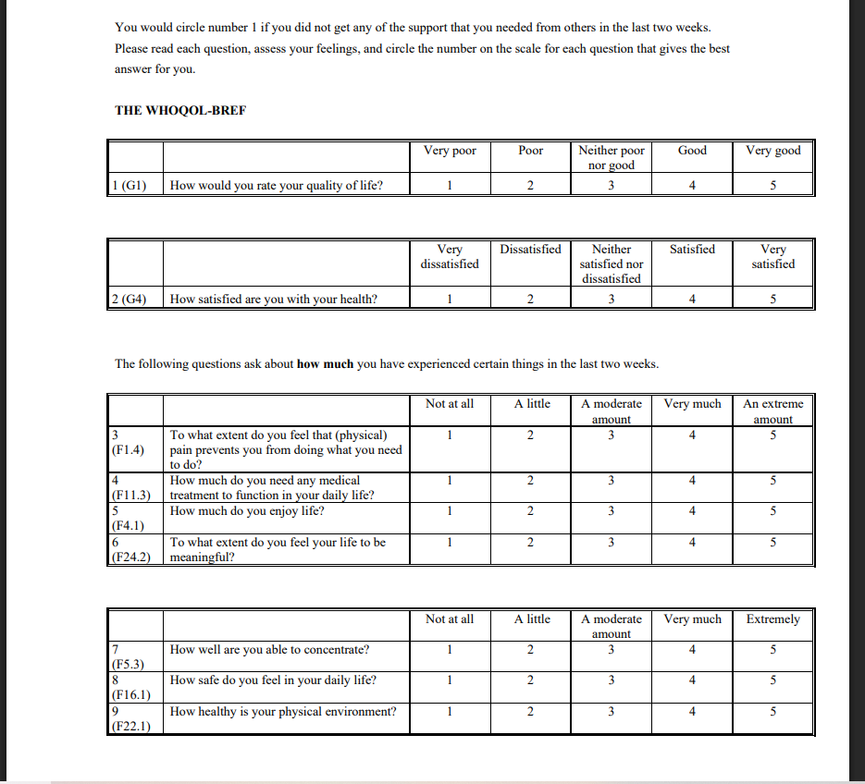
Annexures(WHOQOL BREF)

Slide 25
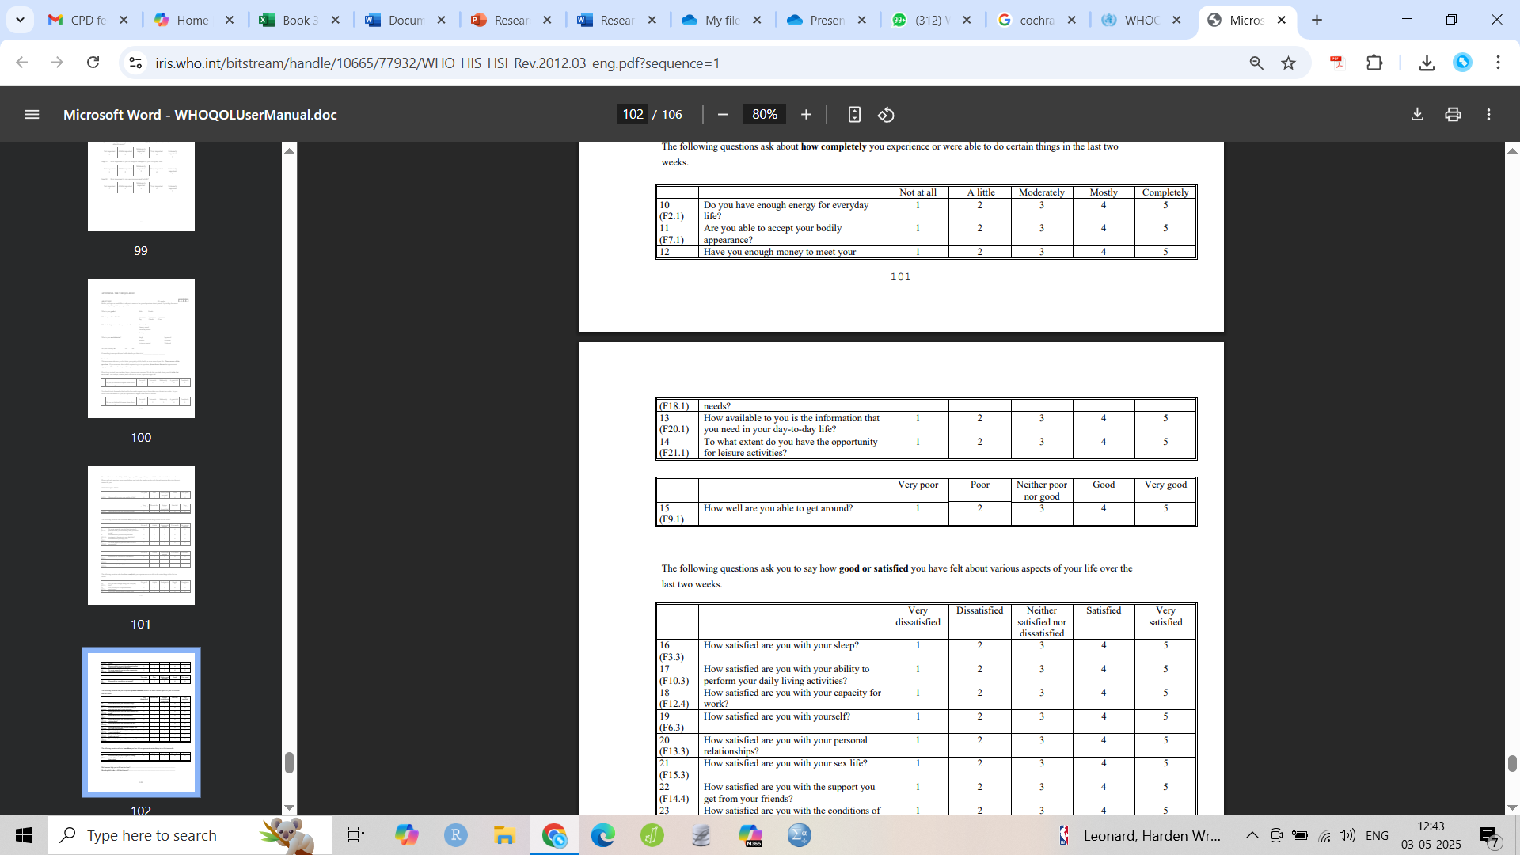
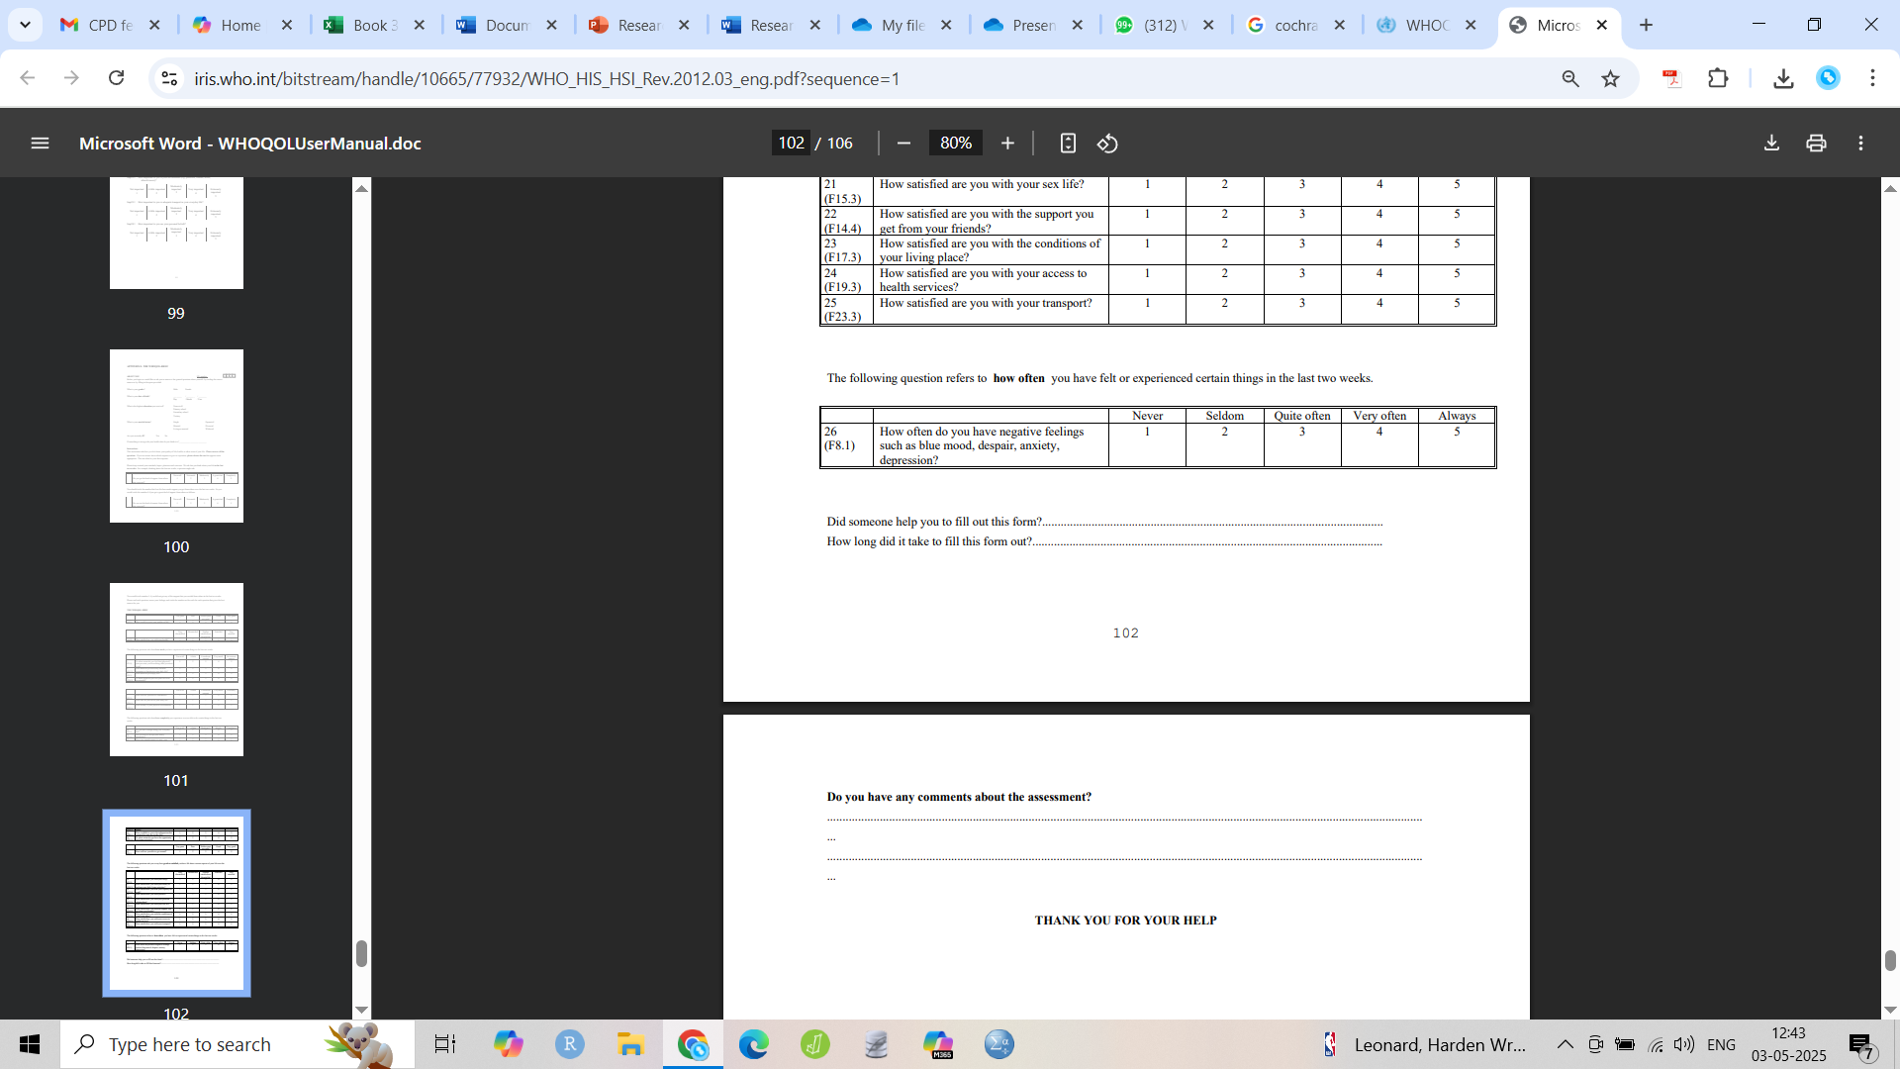

Slide 26
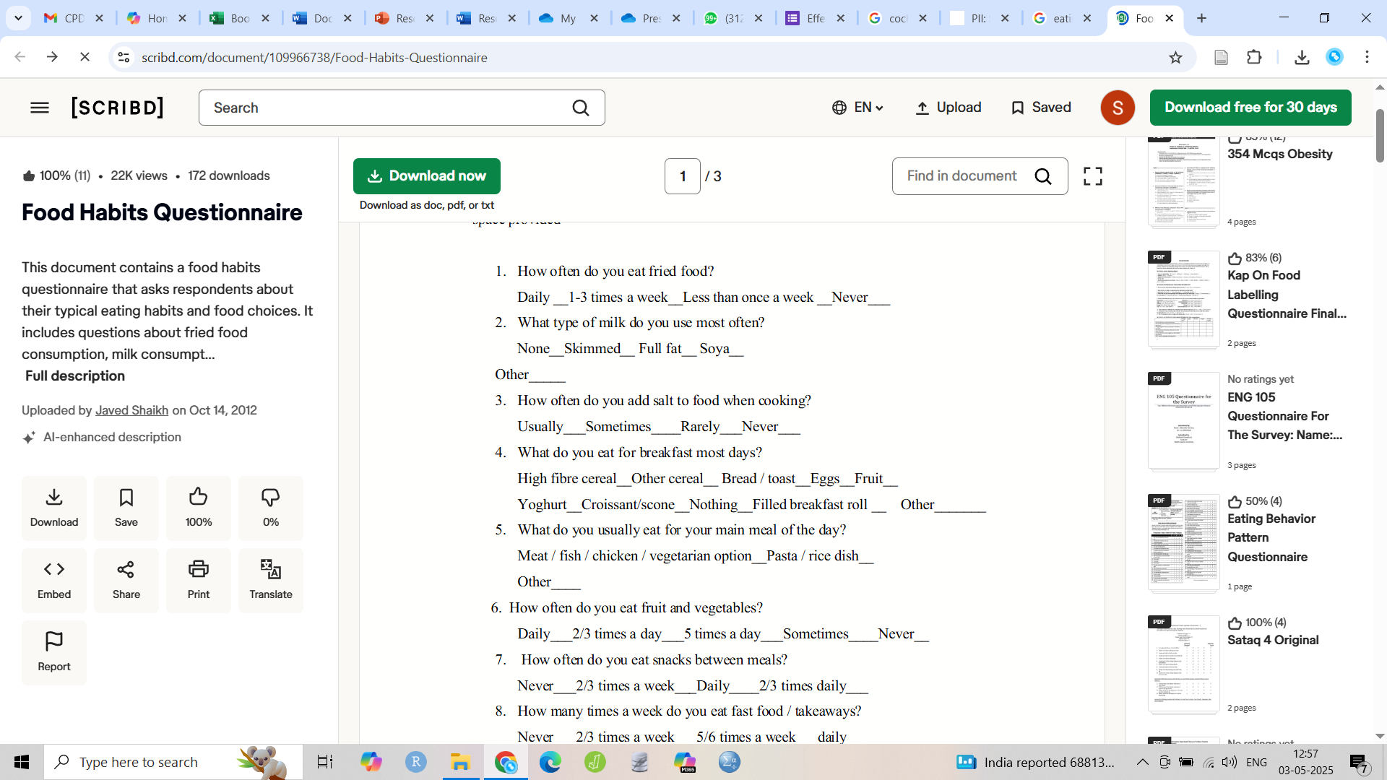
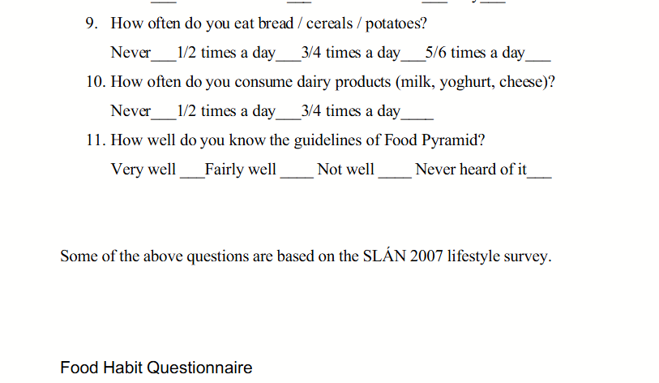
EHQ(some of questions from SLAN 2007 lifestyle survey)

Slide 27
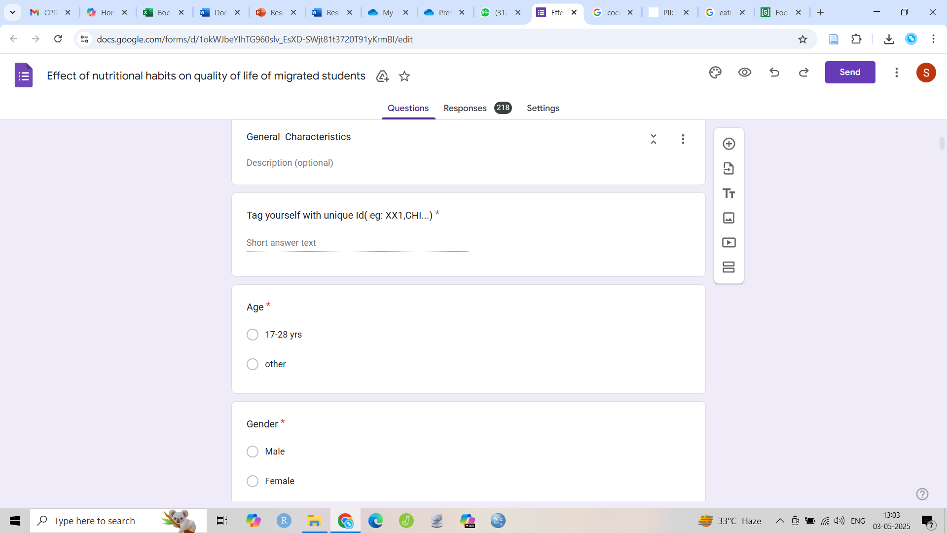
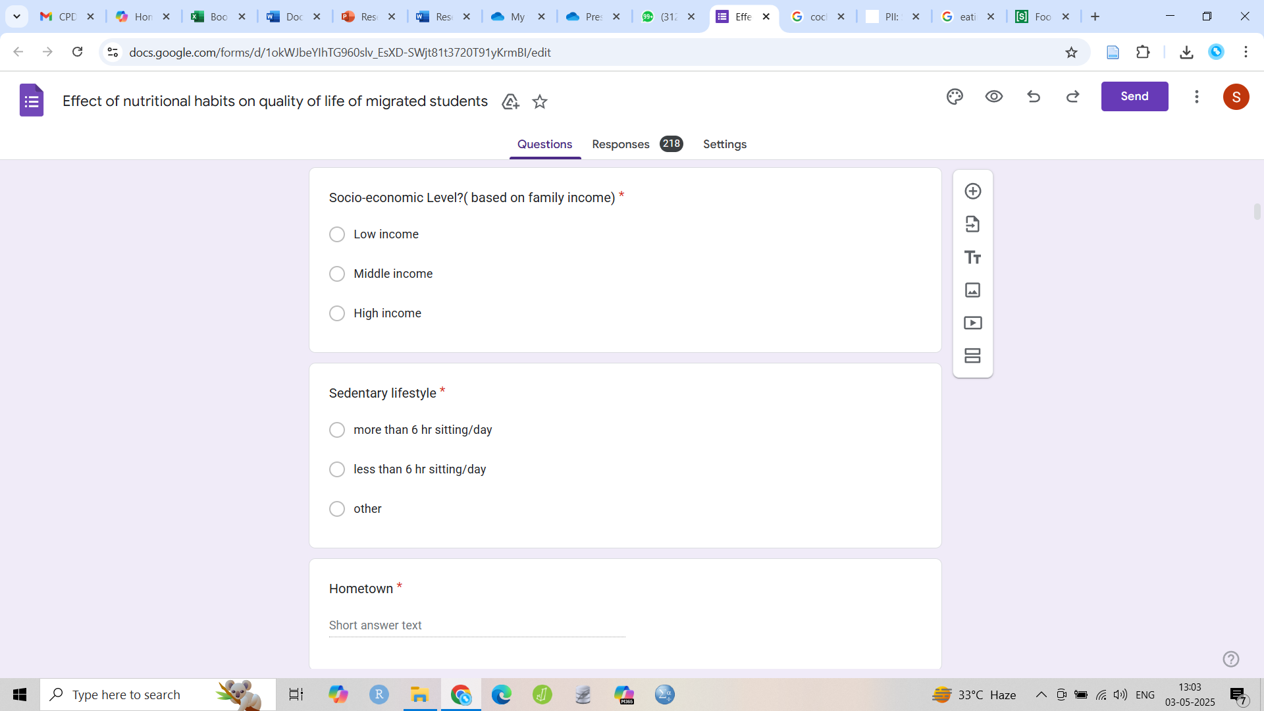
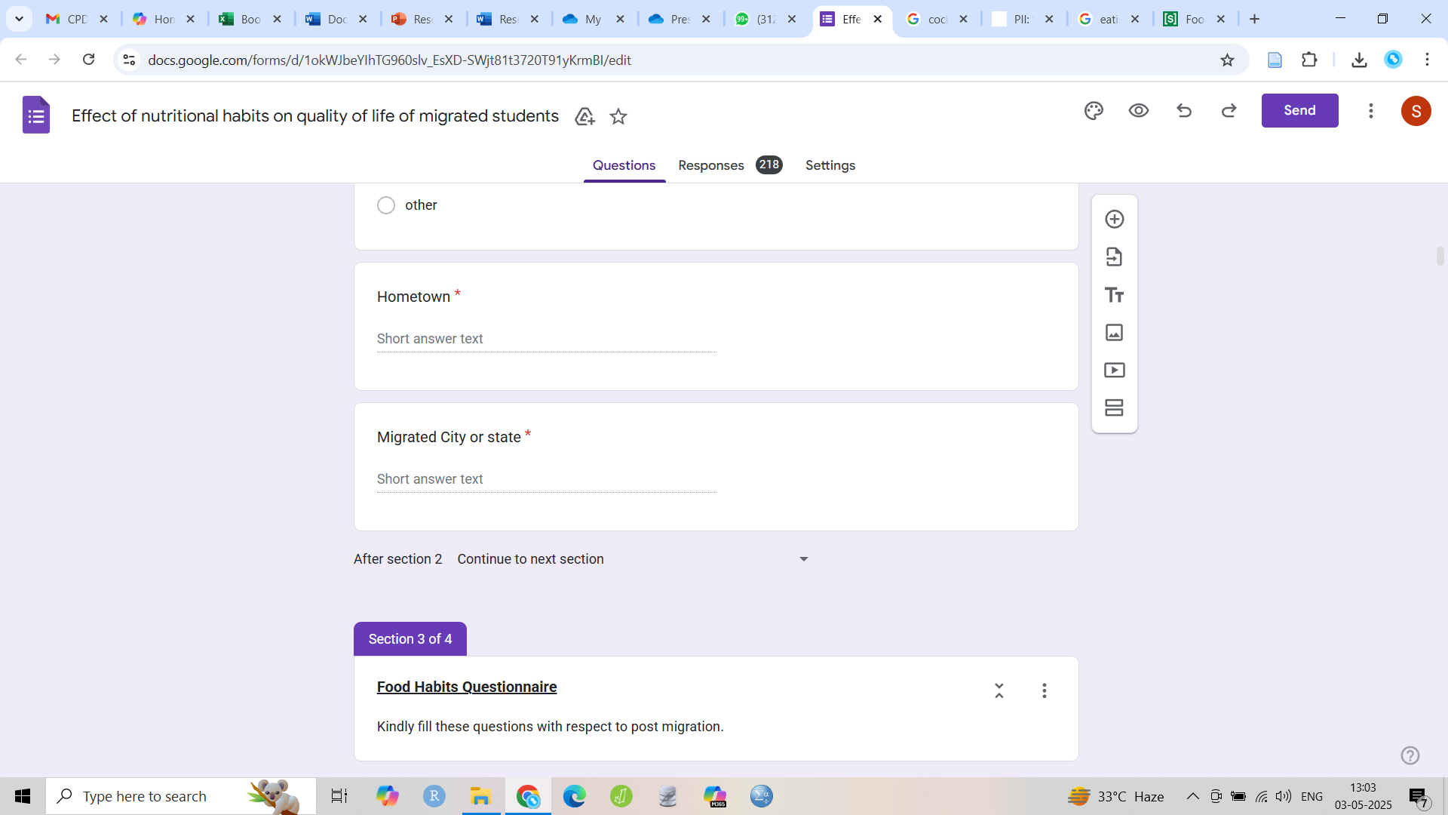
General Characteristic question

Slide 28
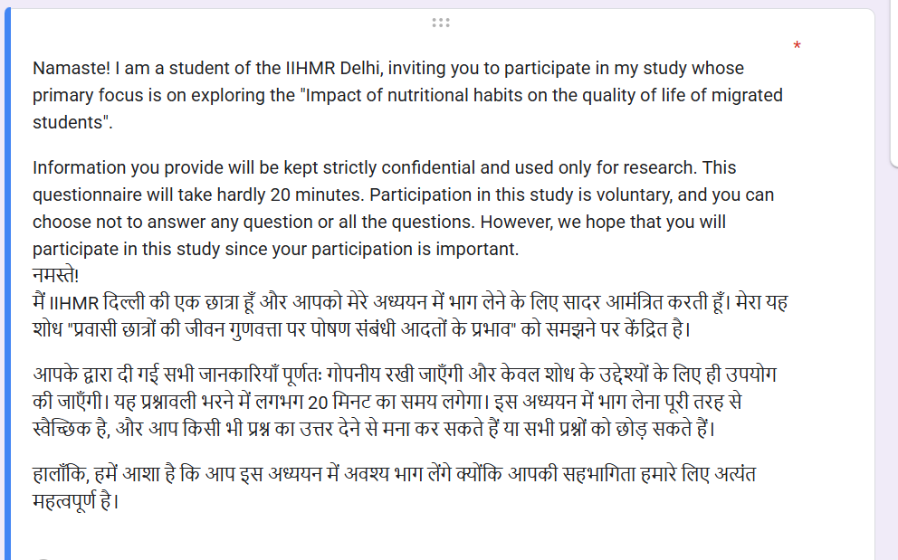
Consent Form

Slide 29
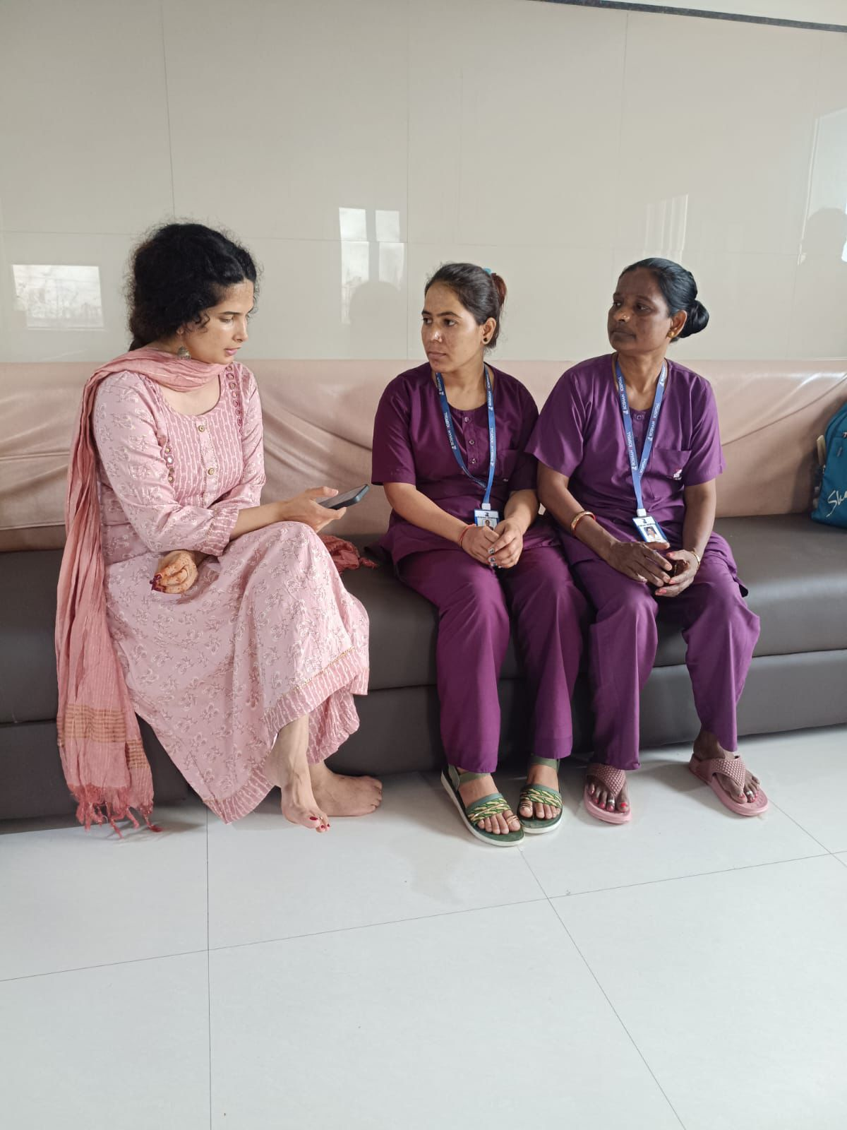
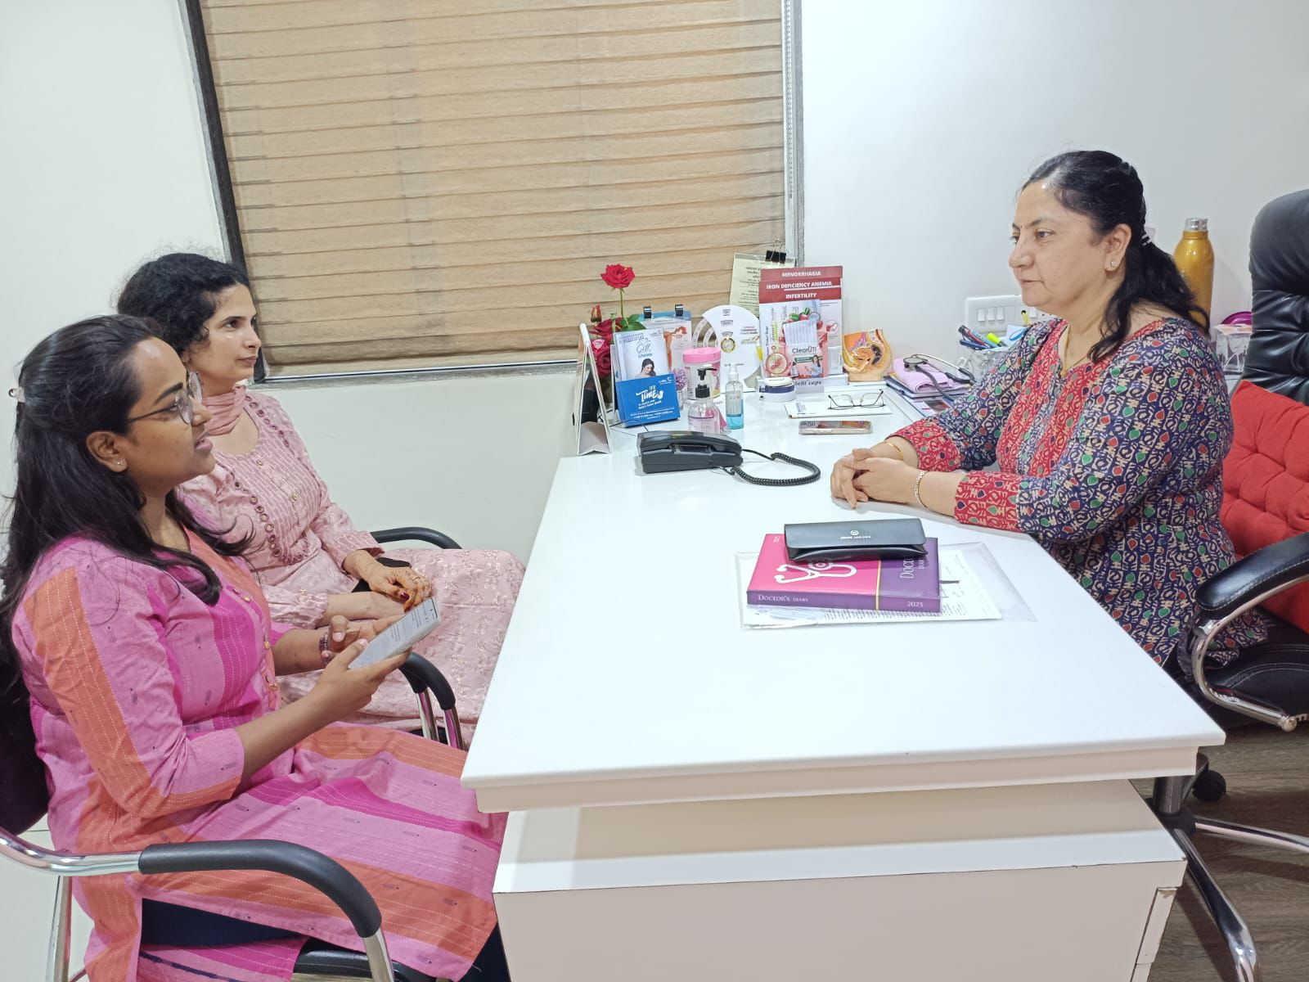
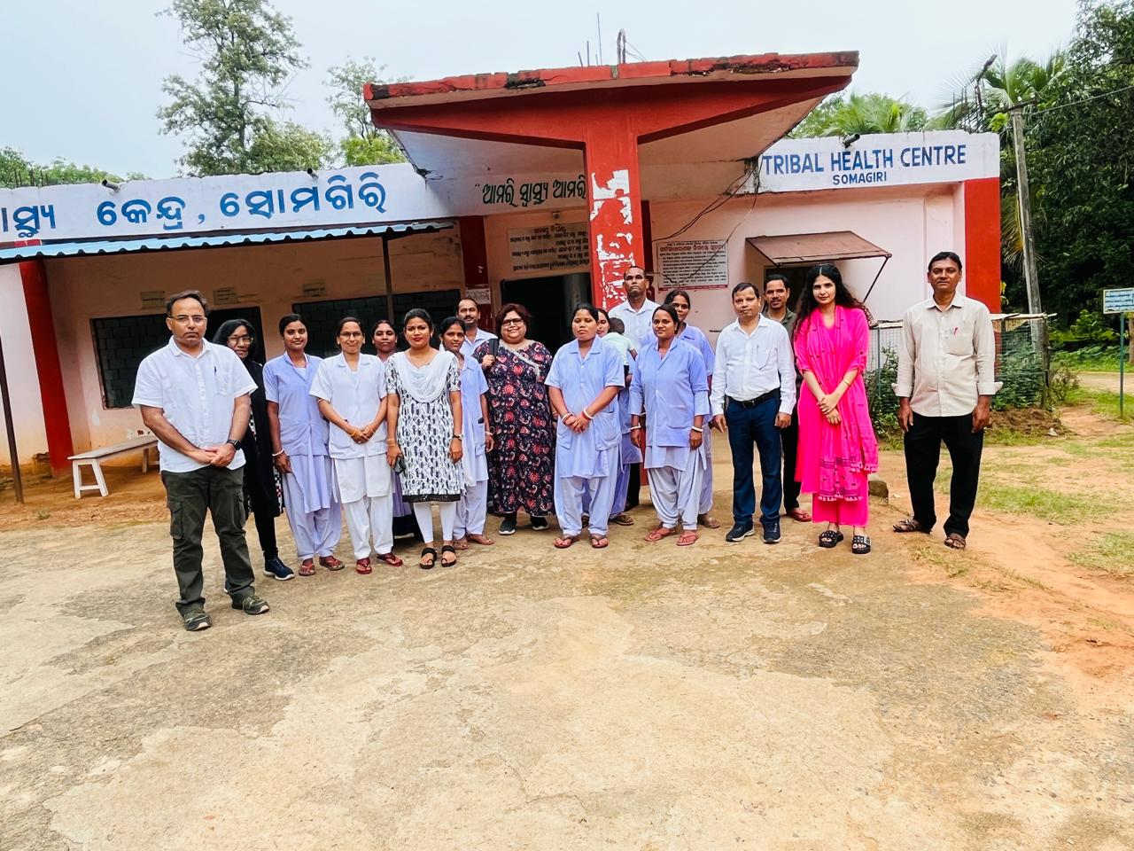

Slide 30


