Slide 1
EVALUATION OF ROUTINE IMMUNIZATION PROGRAM IN A DISTRICT OF KARNATAKA
Dr. Pravin Swami

Slide 2
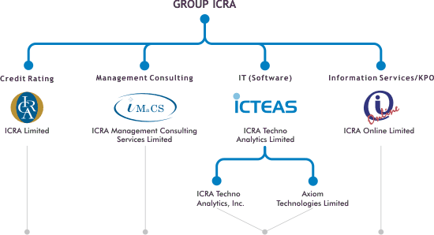
ORGANIZATION PROFILE

Slide 3
ICRA ( IMaCS)
Launched in 1991 in India,
ICRA has been set up by a number of prominent Indian financial institutions, banks, and insurance companies.
Works for developmental sectors like agriculture, rural, healthcare, economic, environmental, energy, human development and social sub-spheres of development.
Functionally, the practice addresses the areas of investment in private sector development, public sector service delivery systems, institutional development, governance, and public sector reform.

Slide 4
MANAGERIAL DUTIES
Monitoring and Supervision
Technical and managerial support to the district officials
Reviewing the micro plan
Capacity building of the ANMs and other personnel involved with immunization in the district

Slide 5


India’s Immunization Programme
An Update
Notes:
5

Slide 6
Overview of Universal Immunization Programme (UIP)
One of the largest, ongoing public health interventions in the country
Centrally sponsored programme under National Rural health Mission - NRHM (2005-12)
Programme targeted ~ 26 million infants and 30 million pregnant women in 2009-10
All the vaccines are procured by central government with 100% domestic funding
Notes:
Since 2006, two new vaccines have been introduced in select districts & states: Hep B and JE
6

Slide 7
Full Immunization Coverage (DLHS-3)
Coverage | States/UT
Low (<50%) | Uttar Pradesh, Meghalaya, Madhya Pradesh, Tripura, Arunachal Pradesh, Bihar, Manipur and Rajasthan
Medium (50-70%) | Mizoram, Assam, Jharkhand, Gujarat, Chhattisgarh, Haryana, Orissa, Jammu & Kashmir, Uttarakhand, Andhra Pradesh, Delhi, D&NH and Maharashtra
High (>70%) | Chandigarh, West Bengal, Karnataka, Sikkim, Kerala, Punjab, Pondicherry, Himachal Pradesh, Tamil Nadu, Lakshadweep, A & N Islands, Daman & Diu and Goa

Slide 8
OBJECTIVE
To evaluate routine immunization program in the district at end user perspective.

Slide 9
SPECIFIC OBJECTIVES
To assess the supply of vaccines and logistics
To understand the challenges and opportunities for improving the immunization coverage.
To identify the constraints from service provider side for better immunization performance and facilitate corrective actions through the district steering committee.
To strengthen the capacity of district and block level officials for better monitoring and supervision of routine immunization program at district level.

Slide 10
METHODOLOGY
Study Design – Cross Sectional
Study Duration – Feb,2012 to April,2012
Study Area – AWCs in Raichur Dist.
Data Collection – RI session monitoring format approved by the state government authorities
Data Analysis – MS Excel
Limitations – Few AWCs, Cold Chain Focal Points not covered

Slide 11
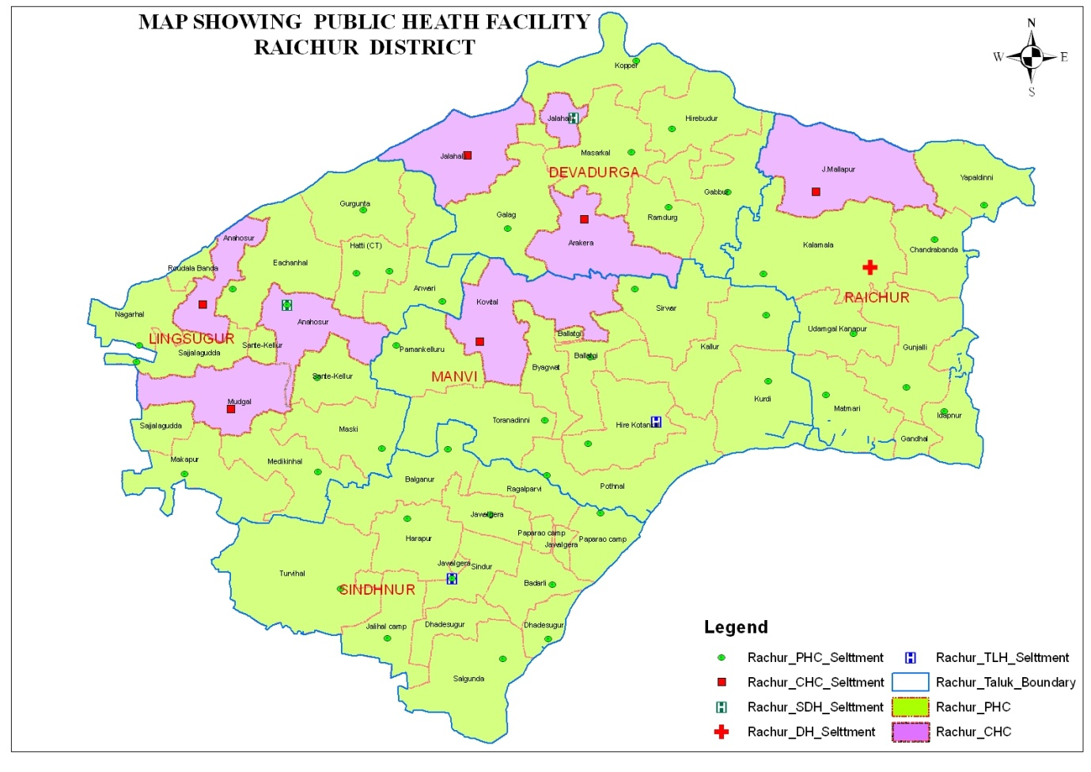
RAICHUR MAP

Slide 12
RESULTS & FINDINGS

Slide 20
OBSERVATIONS
Administrative formalities and processes resulting in delay in implementation of activities, hence impacting the uptake of services.
Flood prone district with uneven geographical distribution leads to poor connectivity to reach the facility.
Inappropriate implementation of micro plan.

Slide 21
RECOMMENDATIONS
Ensuring timely sessions
Supply related factors – Vaccines, Logistics
Improving injection safety & cold chain system
Increasing the no. of health workers
Increasing outreach services & IEC activities
Frequent catch up rounds
Behavioural change, Motivation, Training

Slide 22
REFERENCES
Immunization Handbook for Health Workers, New Delhi, Government of India,2006, (http://www.whoindia.org/LinkFiles/Routine_Immunization_Immunization_Handbook_for_Health_Workers_2006.zip)
India National Universal Immunization Programme Review, New Delhi, United Nations Children’s Fund- World Health Organization, 2004,(http://www.whoindia.org/LinkFiles/Routine_Immunization_Acknowledgements_contents.pdf)
National Family Health Survey (NFHS-3), 2005-06: India, Mumbai, International Institute of Population Sciences and Macro International, 2007, (http://nfhsindia.org/nfhs3_national_report.html)
Training for Mid level Managers Modules (MLM), Geneva, World Health Organization,2008 (http://www.who.int/immunization_delivery/systems_policy/training/en/index1.html)
Text book of Public Health & Community Medicine, Department of Community Medicine, AFMC, Pune, 2009
http://www.who.int/topics/immunization/en/ Accessed on April 30, 2012

Slide 23
THANK YOU

