Slide 1

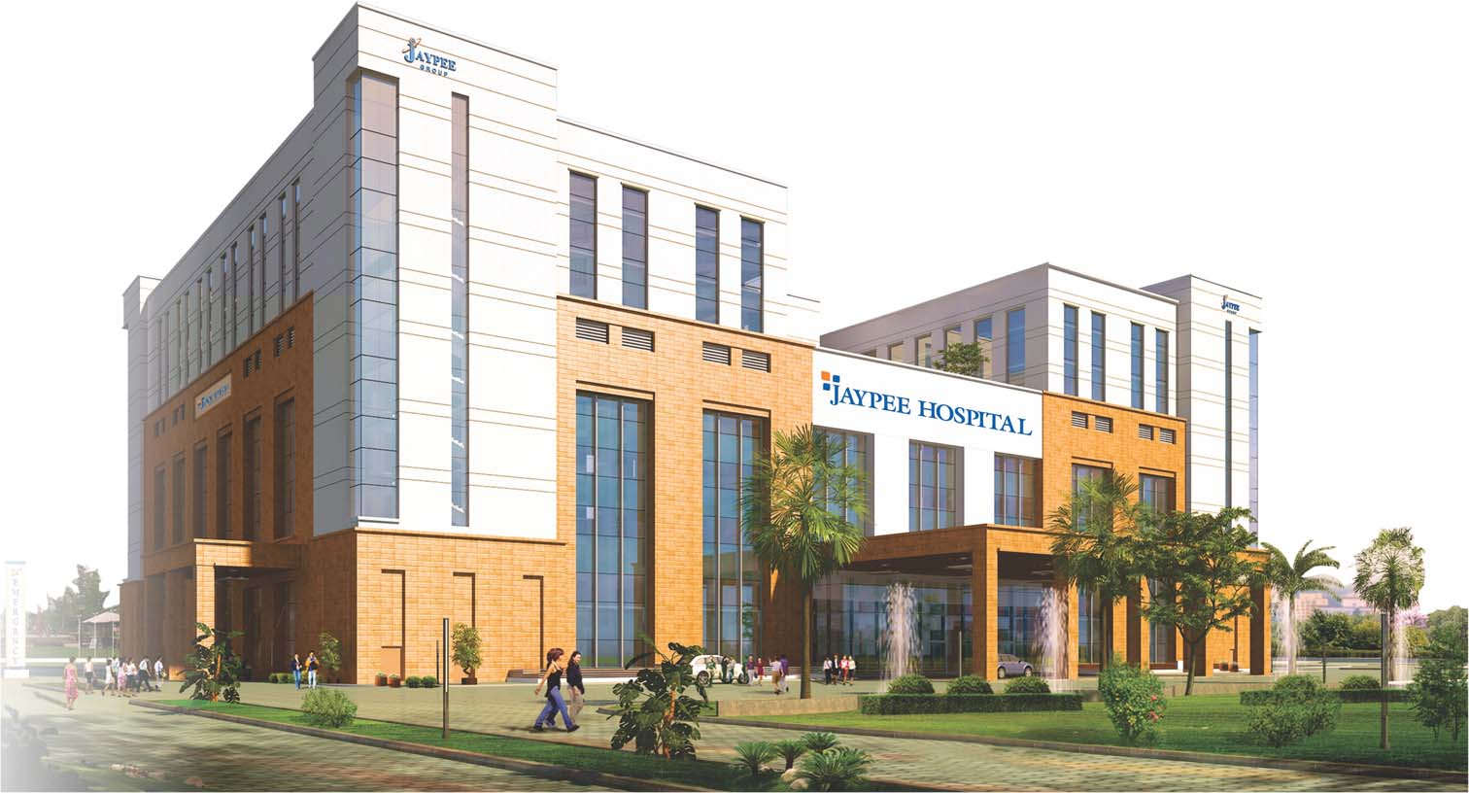
Employee engagement practices
In jaypee hospital
Submitted by-
Dr. Anisha Sonal
HR
Jaypee Hospital

Slide 2

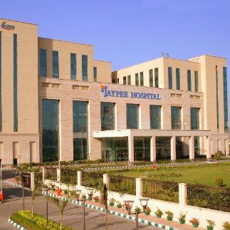
About jaypee hospital
Jaypee Hospital is the flagship hospital of the Jaypee Group. This hospital has been planned and designed as a 1200 bedded tertiary care multi-speciality facility and has commissioned 525 beds in the first phase.
VISION
Promoting healthcare to the common masses with the growing needs of society by providing quality and affordable healthcare with commitment.
MISSION
The Jaypee Group is committed to building Jaypee Hospital as a super-speciality hospital with advanced healthcare facilities, the latest diagnostic services and state-of-the-art technology focused on medical specialities that meet the healthcare needs of the population. The Jaypee Hospital will be the ultimate choice for medical care.
CORE VALUES
    Quality
    Innovation
    Teamwork
    Service
    Integrity
    Compassion

Slide 3
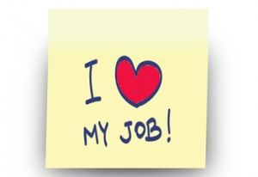
How Many of You Would Like to…
Now the question arrives what is need?
why it is important?
Before answering I would like to ask you
Work in/with an organization where
ALL EMPLOYEES say,
“I LOVE MY JOB!”
?
?
?
Notes:
Raise hands Yep we all would!

Slide 4
Employee engagement program
"Employee Engagement is a measureable degree of an employee's positive or negative emotional attachment to their job, colleagues and organization which profoundly influences their willingness to learn & perform at work. To foster a culture of engagement, HR leads the way to design, measure and evaluate proactive workplace policies and practices that help attract and retain talent with skills and competencies necessary for growth and sustainability.
“Engaged employees are defined as those who are “mentally and emotionally invested in their work and in contributing to their employer’s success.”
Employee engagement is the extent to which
employees feel passionate about their jobs,
are committed to the organization,
and put discretionary effort into their work.

Slide 5

The Business Impact of Employee Engagement:
The Corporate Leadership Council has completed a study of the engagement level of 50,000 employees around the world. And found that…
  Those employees who are most committed (engaged) perform 20% better and are 87% less likely to leave the organization.
Notes:
Morale…
As you can see here, even more proof that our positive coaching and feedback have a direct impact on productivity and retention!

Slide 6
Commitment Levels
Those employees who are most committed (engaged) perform 20% better and are 87% less likely to leave the organization
$$$
Internal Commitment
PERFORMANCE
External Commitment
ENGAGEMENT
Notes:
If we truly want to reach the highest levels of performance we have to create a culture that fosters internal commitment…
An enabling culture leads to committed employees which leads to higher employee performance which translates to:
Increased Profitability
Increased Customer Satisfaction and Loyalty
Enhanced Employee Performance

Slide 7



What Happens in the Center…
No response
No response
I think that’s how I was supposed to do it?
It doesn’t matter if I do it or not…
Wow! I did it!
Notes:
This is what we see happening in centers that don’t provide immediate, effective feedback to agents when they do things right.
What is the power of praise?
Praise is a form of communication.
In order to be effective, it must be sincere.
All of the effort we have put into getting agents to perform well is a waste of time if we don’t tell the agents that we recognize their improvement.
The result is that agents feel that their effort wasn’t important or didn’t matter so why bother.
Praise provides recognition and appreciation to our employees: Two of the top needs employees cite as motivators.
Giving appropriate, realistic, sincere praise builds trust, the cornerstone of any relationship. And as we said earlier coaching is not an event but rather a relationship.

Slide 8

Employee Engagement Framework
An employee engagement model based on statistical analysis and widely supported by industry research.
Engagement with
The Organization
Engagement with
“My Manager”
High Performance
Strategic Alignment
Competency

Slide 9

Objective of the study
To analyze and understand the conceptual framework of the employee engagement practices in Jaypee Hospital
To bring to light the relationship between employer and employee during engagement practices
To study the various area and determine the problems and solutions provided by Jaypee Hospital in reducing the gap between different departments by creating an alignment through fun activities (creative activities, quiz competition, fun games & recognizing the employees & celebrating their birthday and work anniversary).
To explore the psychological experience towards engagement practices and work involvement

Slide 10

methodology
Data collection
Primary data
Questionnaire
Direct observation
Secondary data
Internal organiz-
ational record
Internet

Slide 11

Sampling plan
Sampling Units: Employees of Jaypee hospital.
Sample Technique: Convenient Sampling.
Research Instrument: Structured Questionnaire (set of 10 close ended questions)
Sample Size:100
Data analysis plan- The data collected through questionnaires has been analyzed and interpreted with the help of Microsoft Excel in order to obtain the desired information

Slide 12
QUESTIONARE ON EMPLOYEE ENGAGEMENT
Please tick mark the relevant option as provided against each question
Name: | Department:
Employee I.D: | Date:
Questions | Strongly agree | Agree | Neutral | Disagree | Strongly disagree
Organization conduct employee engagement activities time to time to keep me engaged.
The recreational/engagement activities makes me look forward to work
These sessions are informative, interactive & work as good platform to have an interaction between people & senior management
The activity were well organized/prepared and gave insights on new ways of working in a team
These activities are stress busters & I feel energized to go back to work
Events such as Mashik Utsav (celebration of employee’s birthday) makes me feel valuable and create a sense of oness which will keep me attached to the organization
Events like Pratistha (employee of the month) keep me motivated to perform well & dedicate towards accomplishing the vision of the organization.
Events like Samiksha (competition & games) gives a good learning as well as fun & interaction with inter-department employees
I’ll recommend my colleagues to participate in such engagement activities.
Such kind of activities should happen in future as it keeps us engaged and interested

Slide 16

conclusion
According to the analysis of data on employee engagement activities, it is concluded that most of the employee working in Jaypee hospital agree to the fact that employee engagement activities should be done from time to time.
By participating in various engagement activities they are able to form a connection with the organization that makes them feel an important part of it.
It was also seen that to the majority of the employees the activities were a stress buster and made them feel energized to go back to work.
According to the analysis, the employees felt that these sessions are informative, interactive & it work as good platform to have an interaction between people & senior management.

Slide 17

Events such as Mashik Utsav (celebration of employee’s birthday) makes employees feel valuable and it create a sense of oness which will keep them attached to the organization & meanwhile will increase the employees satisfaction
Events like Pratistha (employee of the month) keep them motivated to perform well & dedicate towards accomplishing the vision of the organization & will decrease the rate of attrition of employees
Employees of the Jaypee hospital were satisfied with such kind of activities that they believe that these kind of activities should happen in future as it keeps them engaged and interested they will recommend their colleagues to participate in such engagement activities n future too.

Slide 18

Recommendation &
suggestion
To bridge in the gaps between various departments, communications and
interactions should happen in the form of various informal gatherings on weekends.
Some other activities like picnics, art and craft, outdoor games, sports events,
get-together, music and dance competitions should also be organized from time to time
Co-ordination in terms of work management between various departments should
be worked upon and maintained.

Slide 19


It is seen that though the majority of the employees find the engagement activities interesting, but the participation level is not upto a certain level it should be according to the number of employees working in the organization.
Hence in order to motivate the employees for active participation, activities of their interest should be organized on a regular basis.
Some more in house activities like, yoga classes, coffee with the leaders or music classes can be arranged for the employees for their active participation
& to decrease the level of dissatisfaction among the employees.

Slide 20

Key learnings
Learned how to conduct an employee engagement program in an organization.
Learned being an HR representative how to build a relationship & Loyalty
with the employees in an organization.
Learned how an organizations tuned to be the “voice of the employee”
and ensure that valued employees are engaged with the organization.
From this study I found that Rewarding, Engaging, and Retaining Key Talent
have been correlated with high levels of quality, productivity and attendance. And secondly correlated higher levels of employee engagement with higher levels of new product innovation. And a third has observed some very positive business outcomes, in large part because of its focus on employee engagement

Slide 21

Glimpse of employee engagement
Program in
Jaypee hospital, “sehbhagita”

Slide 22
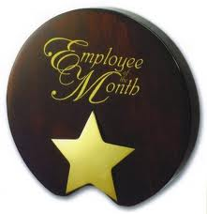



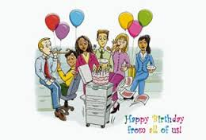



JAYPEE FAMILY…
joining hand in hand
VISHISITH DIWAS
विशिष्ट दिवस
Celebrating special days like DOCTOR’S day & NURSES’S day etc
PRATISTHA
प्रतीष्ठा
Star employee of the month
SEHBHAGITA सह्भागिता
MASIK UTSAV
मासिक उत्सव
Celebrating birthday’s of the employee
SPORTS DIVA
दिवा
Sports competition among employees
SAMIKSHA
समीक्षा
Conducting various competitions & games among employees
FREAKY
FRIDAY

Slide 23

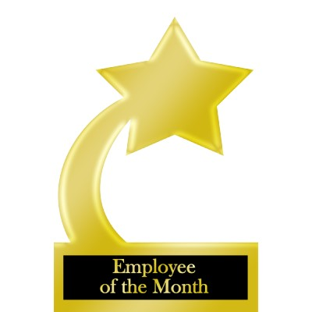


This freaky Friday we are coming up with the STAR employee of the month. So vote yourself & become the star of the Jaypee family
Below attached is the nomination form which is to be submitted on or before 23rd of March..DON’T MISS IT…

Slide 24
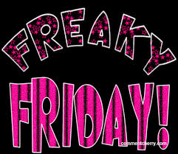
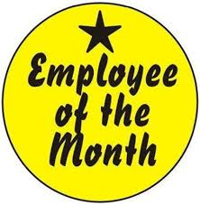


We are ready with another
Event this freaky Friday
with the Presentation of blood bank deptt.
Along With the celebration of
Employee’s birthday, employee of the
month award And
many more exciting
Things…
So Join SEHBHAGITA on 24th of April at 3.30pm in the Auditorium-2

Slide 25


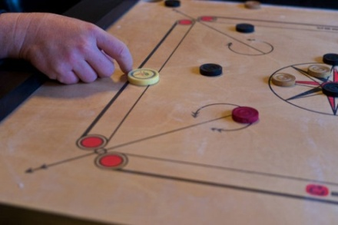

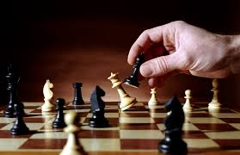
Sehbhagita
Sports diva
One spirit, one team,
Lets all win…
Get your game on…
HR is organizing sports
Competition among all employees in the month of May ,June & July .
Rush to our Sports coordinator
Dr. Anisha Sonal(HR) (8642) for your registration latest by 10th of May.
Events:- Carom, Chess, T.T., badminton

Slide 26




with
We are organizing a poster making
Competition on 5th of May on the occasion of
World hand hygiene day
Rules for participation
1) Theme:- Hand hygiene. Tag line should be given
2) Nominations can be given department wise or in a team of 2-3 members
3) Participants will be provided chart paper, color & paint brush. They'll have to carry extra decorative items if needed
Venue:- Auditorium-2
Time:- 3pm-4.30pm
You can give your nominations till 4th of May through mail to MS. Pooja Chauhan (HR)

Slide 27
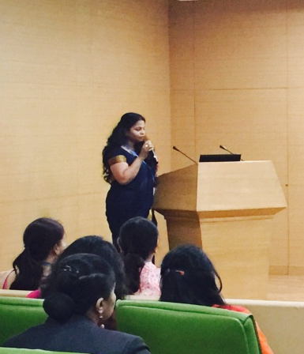
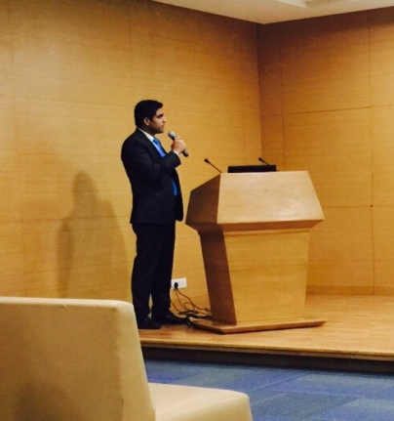
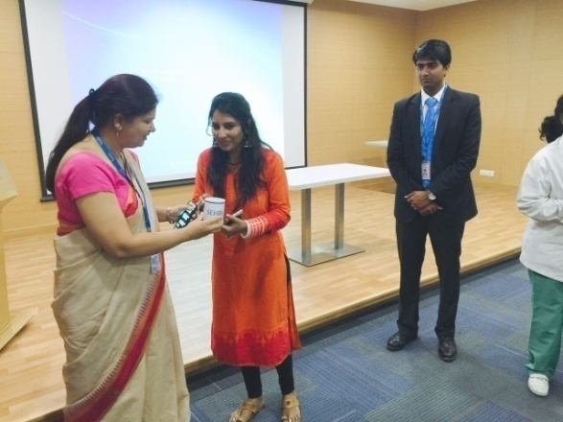
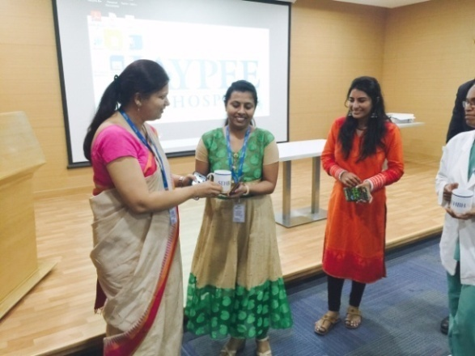
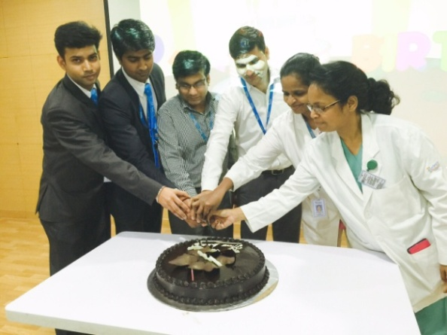
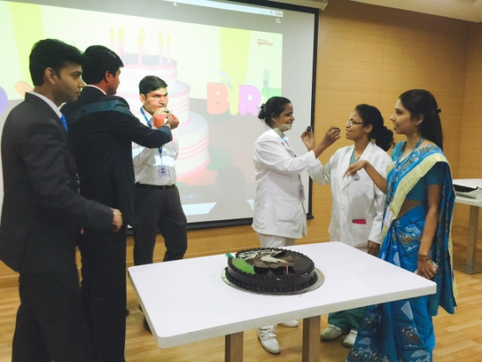
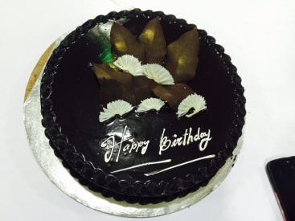
Pcs presentation
Award for the winner in game
Popular award for women’s day celebration
Glimpse of
sehbhagita
Celebration of
mashik utsav

Slide 28


