Slide 1

Obstructive sleep apnea amongst heavy good vehicle drivers: A systematic review
IIHMR - DELHI
Presented By: Mentored By:
Priyanka Joshi Dr. Ekta Saroha
PG/21/075 - IIHMR, Delhi Associate Professor & Dean
17th June 2023

Slide 2

Screenshot of Approval

Slide 3
Obstructive Sleep Apnea
Sleep disordered breathing(SDB)
Repetitive complete and/or partial collapses (apnoea and hypopnea respectively) of the upper airways
Clinical Features
Insomnia, Nocturia
Morning headaches
At times asymptomatic
Hypertension
Impaired memory and concentration
Reduced intellectual ability
Disturbed personality and mood
Symptoms
Daytime Symptoms
Excessive daytime sleepiness
Fatigue
Non- Restorative sleep
Cognitive impairment
Apnea = Cessation of airflow > 10 seconds
Hypopnea = Decreased airflow >_ 10 seconds
Night- time symptoms
Snoring, gasping or choking in sleep
Witnessed apnea in sleep
Insomnia
Night- time awakenings, dry mouth
Nocturnal gastro- oesophageal reflux
Morning Headaches
Impotence, erectile dysfunction

Slide 4
Diagnosis of OSAS
Fulfillment of A or B+C criterion
Excessive daytime sleepiness that is not explained by other factors
Two or more of the following that are not explained by other factors:
Choking or Gasping during Sleep
Recurrent awakenings from sleep
Unrefreshing sleep
Daytime fatigue
Impaired concentration
C. Overnight monitoring demonstrates 5 to 10 or more obstructed breathing events/hour during sleep
Risk Factors
Large neck size >_ 17 inches
Obesity
Aging
Male sex
Smoking
Alcohol intake
Severity of OSA –
Less than 5 events/ hour – Normal
5 – 15 events/ hour – Mild OSA
15 – 30 events/ hour – Moderate OSA
Greater than 30 events/ hour – Severe OSA

Slide 5
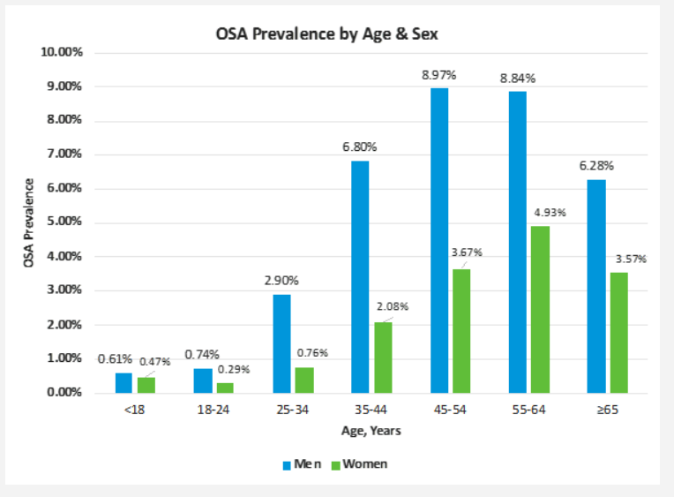
Prevalence
Global prevalence
AHI ≥5 events per h: 711-961 million (moderate to severe OSA: 272-458 million)
Men more prevalent to OSA then women
The maximum risk of OSA lies between (45 to 65) years of age
According to a study OSA characterized by abnormal Apnea Hypopnea index and symptoms of excessive daytime sleepiness) in western countries)

Slide 6
Prevalence
Average prevalence for OSA in India – (13.7%)
OSA with daytime symptoms – (3.57)
1/7th
Of world’s adult population are estimated to have OSA
Obesity is more than twice as prevalent among truck drivers compared to the general population
(69% vs. 31%)
A Study said that , 10 countries with the highest OSA prevalence (AHI ≥5/h)
China, USA, Brazil, India, Pakistan, Russia, Nigeria, Germany, France and Japan.
The five countries with the highest OSA prevalence (AHI ≥15/h)
China (estimated at 66 million patients, prevalence estimate of 8.8% of population ages 30–69)
India (29 million, 5.4%)
Brazil (25 million, 26%)
USA (24 million, 14.5%)
Russia (20 million, 25.6%)
Notes:
Facts, proof points, doctors, expertise, numbers, claims, template

Slide 7
OSA at risk population
OSA is quite prevalent globally, studies show that Individual of more than 18-45 years of age are at risk of OSA, people who are at risk of obesity are prone to OSA
Male are more at risk as compared to females
Heavy goods vehicle drivers as well as pilots and the population working in rotational shifts are at high risk of OSA.
Lorry driving has been identified as one of the most hazardous working professions, hence HGV drivers are exposed to a multitude of health- related risk factors associated with their occupations as result.

Slide 8

Introduction – Heavy good vehicle
Motor Vehicle Act describes heavy good vehicles as “ any goods carriage, gross vehicle weight of which or tractor or a road roller, whose weight exceeds 12,000 Kg
Total transport contribution to Gross value addition – 5%
Road transport contribution – 3.3%
In the category of impacting vehicles, truck/lorry has the 3rd highest share (12.3%) of total crashes (MoRTH)
Road accidents claimed 1,53,972 lives and harmed 3,84,448 people in 2021
Age range that is most severely hit by road accidents is 18 to 45 years old, which accounting for almost 67% of all accidental deaths.
HGV at risk of OSA
Sedentary behavior
Inadequate diet
Obesity
Proportion of hypertension
Field visit to transport Nagar
Notes:
HGV drivers play a significant role in the economy, yet they often go untreated in poor and crowded countries like India where access to even the most basic healthcare is scarce. Road traffic accidents are one of the biggest causes of mortality in India, and sleep apnea is a serious issue everywhere, thus it is imperative to address health issues for this population.

Slide 9
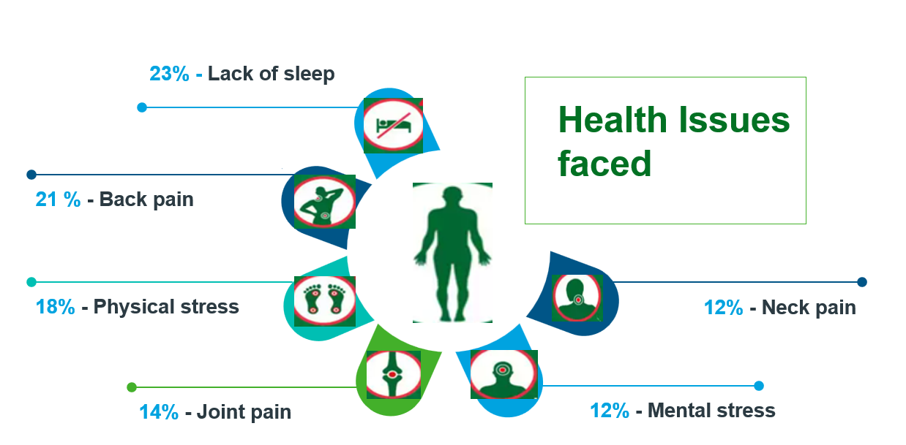
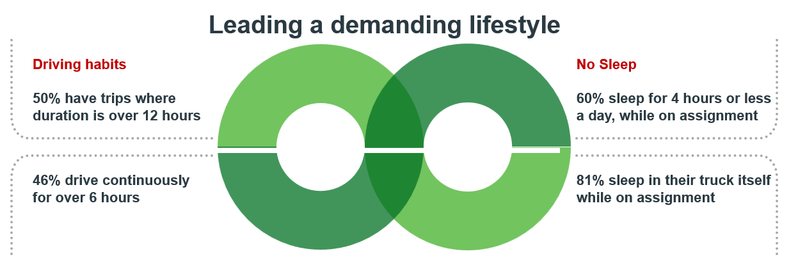
HGV drivers in India
India tops the world in road crash deaths.
Average driving hours per day – (11.9 hours)
49% drive vehicles even if - fatigued or sleepy.
Over 9 out of 10 respondents (93%) confirmed that other than salary/wages, they do not get any social security benefits (such as provident fund, pension, health insurance, life insurance, gratuity, etc).
Over 50% of Indian truck drivers had health issues (TOI)
Lifetime prevalence of - 18.0% for obstructive sleep apnea (n=372).

Slide 10
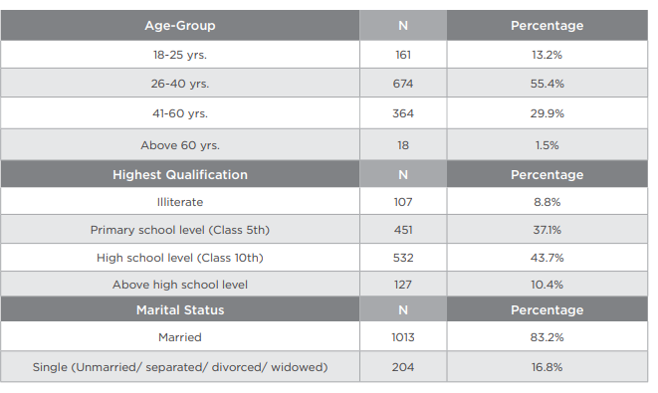
Demographic profile of truck drivers
A total of 1217 truck drivers were covered in the study.
Age-group classification-
55.4% of drivers fall in the category of 26-40 years
30% fall in the category of 41-60 years
Based on educational qualification-
37.1% of truck drivers were educated up to primary level (until Class 5th)
44% were educated up to high school level (until Class 10th)
8.8% were illiterate

Slide 11
Health programs by Indian government
Steps taken by Indian government for Heavy vehicle drivers-
INSTITUTES OF DRIVING TRAINING AND RESEARCH (IDTRs), REGIONAL DRIVER TRAINING CENTRE (S) - (RDTCs) DRIVING TRAINING CENTRES-(DTCs) DURING 15™ FINANCE COMMISSION CYCLE PERIOD (2021-22 to 2025-26)
Introduced an - Induction Training Course in Heavy Motor Vehicle Driving
The new Motor Vehicles (Amendment) Act 2019 has omitted the Minimum Education Qualification Clause.
Notes:
1st Sep, 2018, centre has power to implement a national transport policy in consultation with states (to address vehicle’s insurance, compensation for victims on road)

Slide 12
Public relevance of OSA with HGV
Heavy vehicles plays an important role in transportation, they are dealing with intra or inter state transportation :
HGV are the backbone of supply chain in India as 70% domestic transportation are done with HGV
90% passenger traffic, 67% freight controlled by road transport
Demand for goods is rising with urbanization, population increase, the rise of e-commerce, and rising income levels
Trucks are handling most of the movement of the goods-
22% - agricultural goods
39% - mining products
39% - manufacturing-related commodities
Impact in supply chain procedure – (India & neighboring countries)
Notes:
Impact in supply chain procedure will hamper economy

Slide 13
Objectives
01
To review the burden of obstructive sleep apnea among HGV in India
To highlight key points from obstructive sleep apnea, heavy good vehicles research in India
To recommend policies at various levels to address this cause & to recommend priority research topics for obstructive sleep apnea, heavy good vehicle drivers
02
03
Notes:
To identify knowledge gaps, will be the first step of research, to identify topics which have not been covered, what all should we research in India based on existing literature, Short term researches, long term researches etc

Slide 14
Methodology
Searched most recent systematic review on Correlations of Obstructive Sleep Apnea Syndrome and Daytime Sleepiness with the Risk of Car Accidents in Adult Working Population: A Systematic Review and Meta-Analysis with a Gender-Based Approach on PubMed/Google scholar on (15.04.2023) Reviewed recent systematic review(s) to determine Key words/MeSH terms – Databases – Pubmed, Google scholar Filters Article types Inclusion/exclusion criteria
Systematic search methods Key words/Mesh terms: Obstructive sleep apnea syndrome) AND (Truck Drivers) ((Obstructive sleep apnea) AND (HGV)) (Sleep apnea) AND (Stop bang) (OSA) AND (India) (Sleepiness) AND (Truckers)

Slide 15
Systematic search methods
Databases: Pubmed and Google scholar Other data sources: Bibliography of recent systematic review(s) and other closely relevant articles
Filters: Date range: (1993/01/01) to (2023/06/01) 30 years Abstract Full text Free full text
Language: English
Article type: Systematic Review Rapid review Cross sectional study Narrative review Meta-analysis

Slide 16
Systematic search methods
Date of Search: (2023/04/11) to (2023/06/11)
Review process: Number of reviewers: 1 Review of title----abstract----complete article Publication selection criteria HGV population Commercial drivers Heavy motor vehicle drivers Truckers Sleep apnea Road accidents Age ≥ 18 years Global
Exclusion Criteria: Duplicate publications Studies reporting the prevalence of central sleep apnea only
Notes:
(the focus is upon Indian population), hence tried finding articles, reviews studies addressing Indian context but since there’s a scarce of research hence global context was later adopted

Slide 17
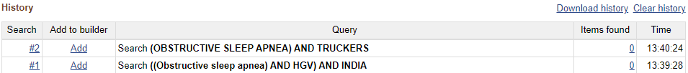


Systematic review methods
Data compilation: Publication year Study population Type of review Publication year Study site Data analysis: Numbers Counts Proportions

Slide 18
Results
Total number of Systematic reviews found – 9
S.no | Title | Year of publication | Findings
1. | Correlations of Obstructive Sleep Apnea Syndrome and Daytime Sleepiness with the Risk of Car Accidents in Adult Working Population: A Systematic Review and Meta-Analysis with a Gender-Based Approach | 2023 | No significant correlation was found between sleepiness and car crashes, but subjects with sleep-disordered breathing were at increased risk of car accidents (OR = 1.81; 95%, p < 0.001)
2. | Risk assessment of road traffic accidents related to sleepiness during driving: a systematic review | 2022 | Sleepiness and sleep deprivation were related to road traffic accidents; and sleep deprivation was the main contributor to drowsiness while driving
Notes:
PubMed and Google Scholar were searched for articles published from 1993 to 2023 that reported the prevalence of OSA diagnosed via sleep monitoring and the prevalence of HGV at risk for OSA and their association with environmental and lifestyle factors, as assessed by symptomatology and/or sleep questionnaires. Database of sleep societies and online articles for relevant abstracts were looked upon

Slide 19
4. | Detecting driver fatigue using heart rate variability: A systematic review | 2022 | Progress in the field of driver fatigue detection system (technology) is needed to determine the relationship between Heart rate variability and different fatigue causal factors and its connection to driver performance.
5. | Sensitivity and specificity of the driver sleepiness detection methods using physiological signals: A systematic review | 2021 | A critical need for progressing any system is a revalidation of the system on a new sample of users. These aspects indicate considerable progress is needed with physiological-based driver sleepiness systems before they are at a sufficient standard to be deployed on-road.
6. | I think I'm sleepy, therefore I am - Awareness of sleepiness while driving: A systematic review | 2021 | This review provides evidence that drivers are aware of drowsiness while driving, and stopping driving when feeling 'sleepy' may significantly reduce crash risk.

Slide 20
7. | Risk of Motor Vehicle Accidents Related to Sleepiness at the Wheel: A Systematic Review and Meta-Analysis | 2017 | Sleepiness at the wheel was associated with an increased risk of motor vehicle accidents (pooled OR 2.51 [95% CI]
8. | Continuous positive airway pressure reduces risk of motor vehicle crash among drivers with obstructive sleep apnea: systematic review and meta-analysis | 2010 | Observational studies indicate that CPAP reduces motor vehicle crash risk among drivers with OSA. [RR- 0.2] [CI- 95%]
9. | The role of driver sleepiness in car crashes: a systematic review of epidemiological studies | 2001 | To estimate the burden of injury due to fatigue-related crashes in the population, information is required from well-designed observational epidemiological studies about the prevalence of fatigue in the car driving population

Slide 21
Number of articles found | 42
Number of titles reviewed Systematic review Review Literature review Narrative review Rapid review Meta analysis Integrated review | 9 6 4 3 3 3 2
Number of abstract reviewed | 35
Number of OSA HGV studies from India | 3-4 studies
Number of OSA HGV studies by country | (Countries are not clearly defined in all studies)
OSA HGV burden in India | ----

Slide 22
Limitations
Restriction of search to free full text
Exclusion of Cohort, Case – control, RCT and other types of study
Although important interactions between driver sleep, dietary, and exercise behaviours are probable, no peer-reviewed driver sleep study has fully examined potential relationships with diet and exercise
No proper information regarding the site of research is found in many of the studies
There’s an extreme shortage of research on this literature in Indian context, HGV drivers being a major contributor to the economy needs to be majorly focused upon and , this area needs to be researched upon

Slide 23
Highlights from studies

Slide 24
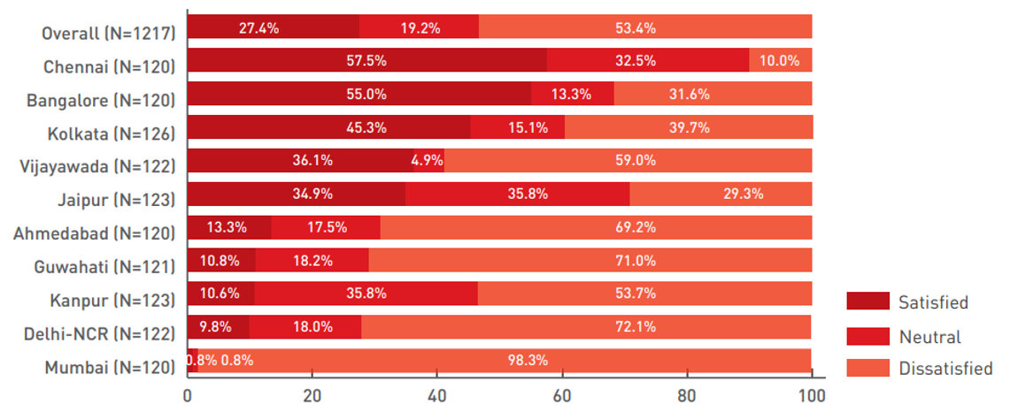
Drivers satisfaction with the driving profession
The top three reasons listed by satisfied drivers were:
Easy money - (55.7%)
Requirement of low educational qualification or technical knowledge - (47.9%)
Freedom of work - (44.3%)
883 truck drivers were dissatisfied Reason for dissatisfaction:
Unscheduled working hours
High risk of death/injury on the job owing to road crashes, lack of safety on highways.

Slide 25
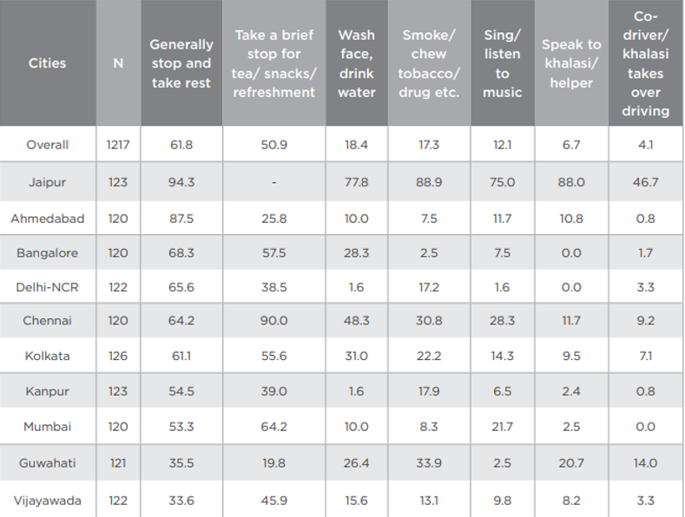
Methods to address fatigue/ sleepiness during trips
Total sample – 1217
62% of the truck drivers generally stop on highways to take rest/sleep
51% take a brief stop for tea/snacks/refreshments
18.4% stop for washing their face/drinking water
17.3% halt for a smoke/tobacco/drugs

Slide 26
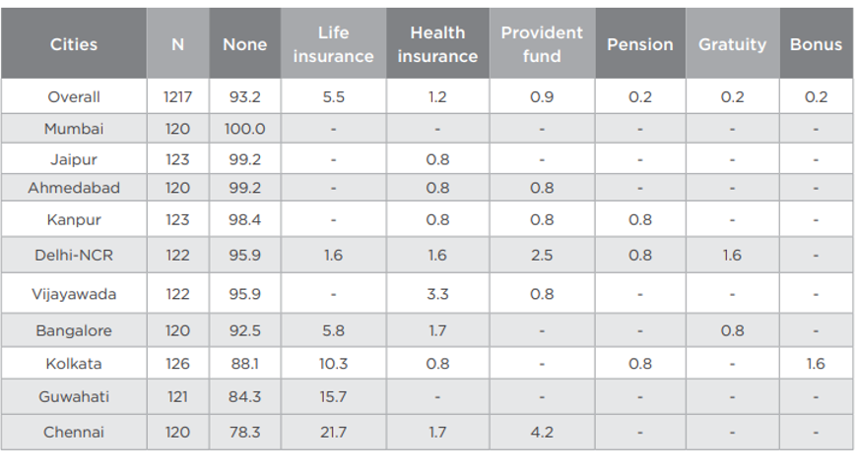
Social security benefits to drivers
Total sample – 1217
5.5% - Life insurance
1.2% - Health insurance
0.9% - Provident fund
0.2% - Pension
0.2% - Bonus

Slide 27
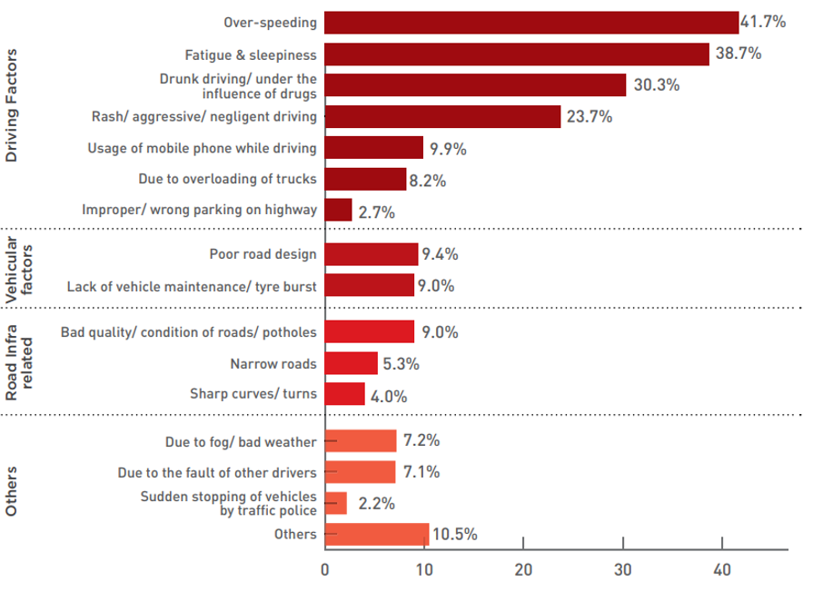
Reasons for crashes involving truck drivers
Fatigue & sleepiness is the second most reason for road traffic accidents with – 38.7%

Slide 28
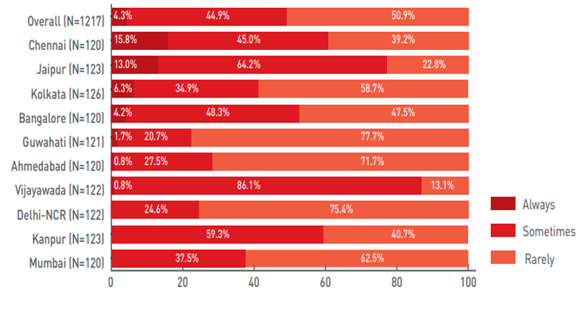
Driving even if fatigue or sleepy
51% - Rarely drive when they feel fatigued or sleepy.
4% - Always
45% - Sometimes drive vehicles even if feeling fatigued or sleepy.
Notes:
Drivers have stated that they do so in order to match the delivery time.

Slide 29
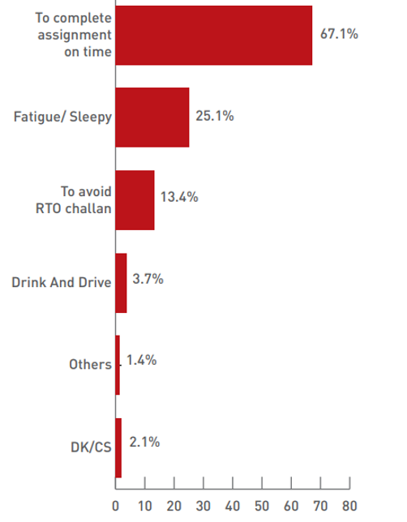
Reasons for over speeding
67.1% - Overburdened with assignments
25.1% - Feel fatigued/ sleepy while driving
13.4% - To avoid getting challaned
Low availability of roadside amenities –
Eat, Halt, Rest, Sleep, Medical emergency
To finish the assignment on time, drivers compromise with their sleeping time
Notes:
Claim -Fleet owners take up multiple assignments to generate more revenue, leading to drivers being overburdened with work causing over-speeding.

Slide 30
Recommendations
Government level
1. Truck drivers should be grouped under a formal remuneration structure along with mandatory social security benefits including insurance, provident fund
2. The norms with respect to working hours of truck drivers should be implemented as per the Motor Transport Workers Act.
3. An audit of transporters
4.Well designed rest stops can improve the health of truck drivers as well as improve road safety.
5. Waving of taxes to make a fund for introducing welfare schemes for truck drivers
6. Better facilities
7. Establish truck driving training schools
8. Strict enforcement of laws related to corruption, bribery and extortion. Strict vigilance and regular patrolling on highways
9. Create awareness and sensitize department officials against corruption and illegal practices.
Notes:
green tax, toll tax, road tax, parking tax

Slide 31
Recommendations
Authorities level
Online Documentation (i.e. new/ renewal of driving license and permit, fitness certificate, registration of vehicle etc)
Monitor enforcement officials’ behavior and corrupt practices on highways (wear camera on check posts or while issuing challans)
3. At various checkpoints and toll gates, CCTV cameras should be installed to keep an eye on corrupt officials
4. Regular patrolling on highways (to reduce corruption and theft of goods from trucks)
5. Dedicated helpline number for truck drivers
6. The relevant provisions of the Motor Vehicles (Amendment) Act 2019, along with important traffic rules, should be displayed on highways, checkpoints, toll plazas
Notes:
Such a helpline number should be displayed prominently on highways.

Slide 32
Recommendations
Transport Associations & Fleet Owners’ level
1. Conduct regular workshops and programs
2. Health care awareness campaigns
3. Conduct medical camps along with other stakeholders
4. Transport associations along with Government and corporates should help in providing better amenities for truck drivers on highways
5. Fleet owners should encourage truck drivers to participate in road safety awareness workshops to make them aware of responsible driving behaviour and other traffic rules and regulations.
6. No pressurization with respect to quick delivery
7. Ensure sufficient rest
Notes:
Such a helpline number should be displayed prominently on highways.

Slide 33
References
Global burden of sleep‐disordered breathing and its implications - Lyons - 2020 - Respirology - Wiley Online Library
Traffic accidents in commercial long-haul truck drivers: the influence of sleep-disordered breathing and obesity - PubMed (nih.gov)
Prospective assessment of the risk of obstructive sleep apnea in patients attending a tertiary health facility in Sub-Saharan Africa - PubMed (nih.gov)
The occurrence of sleep-disordered breathing among middle-aged adults - PubMed (nih.gov)
Higher prevalence of smoking in patients diagnosed as having obstructive sleep apnea - PubMed (nih.gov)
https://www.ncbi.nlm.nih.gov/pmc/articles/PMC9319534/
https://zeenews.india.com/auto/exclusive-how-sleep-apnea-contributes-to-road-accidents-in-the-country-and-how-to-tackle-it-2432165.html
https://www.financialexpress.com/auto/commercial-vehicles/sleep-apnea-increases-risk-of-road-accidents-by-300-sleep-testing-how-it-can-improve-road-safety/2214767/
https://www.ncbi.nlm.nih.gov/pmc/articles/PMC2792976/
https://journals.sagepub.com/doi/epdf/10.1177/216507991406200305
https://auto.hindustantimes.com/auto/news/sleep-testing-can-reduce-sleep-disorder-related-road-accidents-in-india-41620010214153.html
https://timesofindia.indiatimes.com/auto/policy-and-industry/driver-fatigue-led-road-accidents-approaches-india-could-take-to-prevent-these/articleshow/97048300.cms
Global burden of sleep‐disordered breathing and its implications - Lyons - 2020 - Respirology - Wiley Online Library
https://www.thelancet.com/journals/lanres/article/PIIS2213-2600(19)30226-7/fulltext#:~:text=Global%20prevalence%20of%20sleep%20apnoea%20(AHI%20%E2%89%A55%20events%20per,%E2%89%A515%20events%20per%20h)
Sleep, Dietary, and Exercise Behavioral Clusters among Truck Drivers with Obesity: Implications for Interventions - PMC (nih.gov)

Slide 34
References
https://link.springer.com/article/10.1007/s00420-021-01675-1
https://link.springer.com/article/10.1007/s00420-021-01675-1
https://www.livemint.com/
https://pubmed.ncbi.nlm.nih.gov/15646234/ , Road transport year book (2015 -16)
https://timesofindia.indiatimes.com/auto/miscellaneous/over-50-indian-truck-drivers-face-health-issues-study/articleshow/64667437.cms,
https://www.journalijar.com/uploads/77_IJAR-24845.pdf
https://morth.nic.in/sites/default/files/circulars_document/Final%20Guidelines%20of%20IDTR%20RDTC%20scheme%20circulated%281%29%281%29.pd

Slide 35

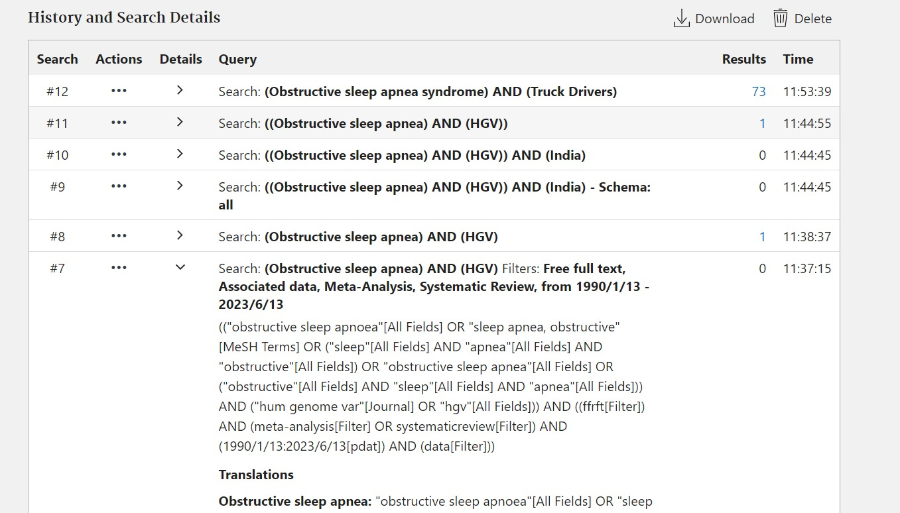
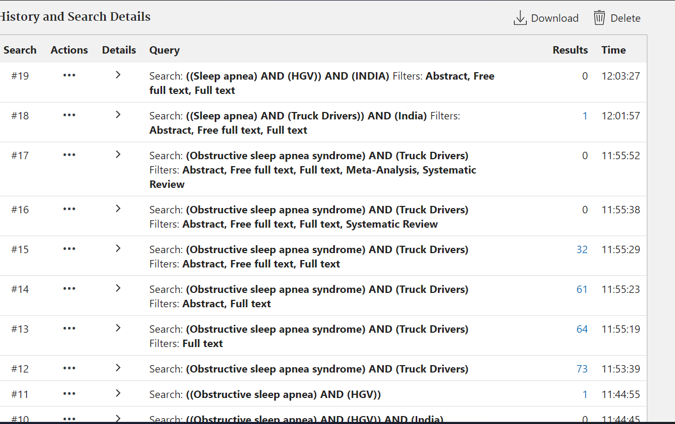
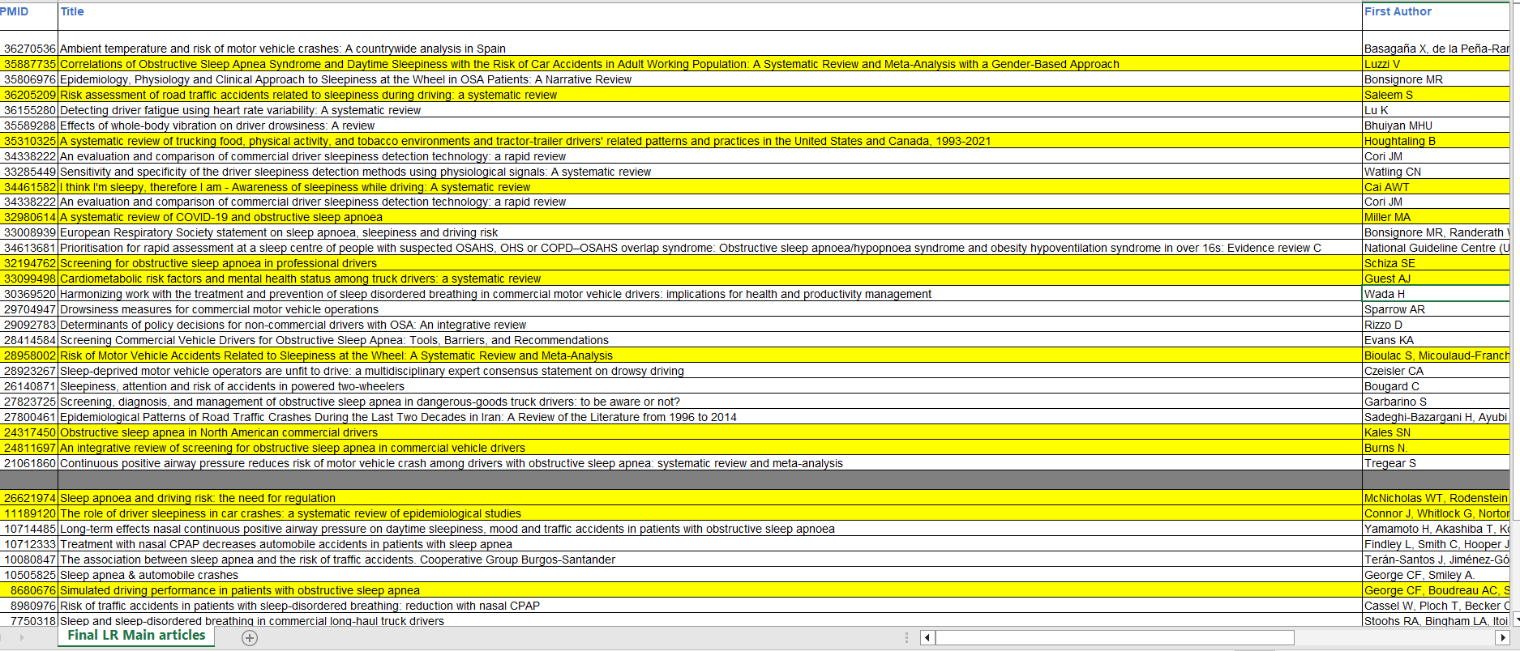

Slide 36
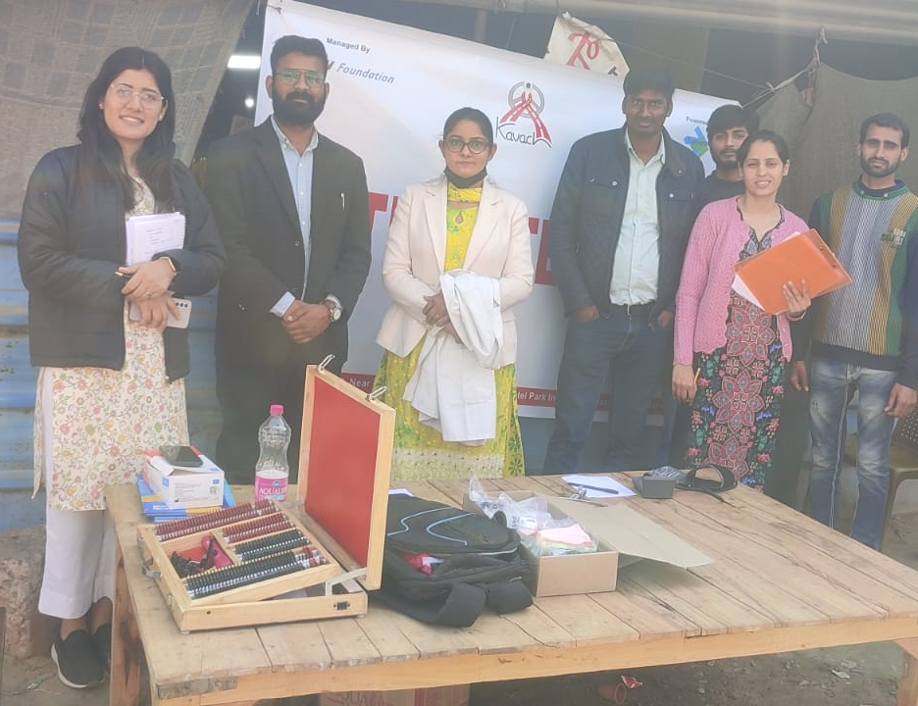
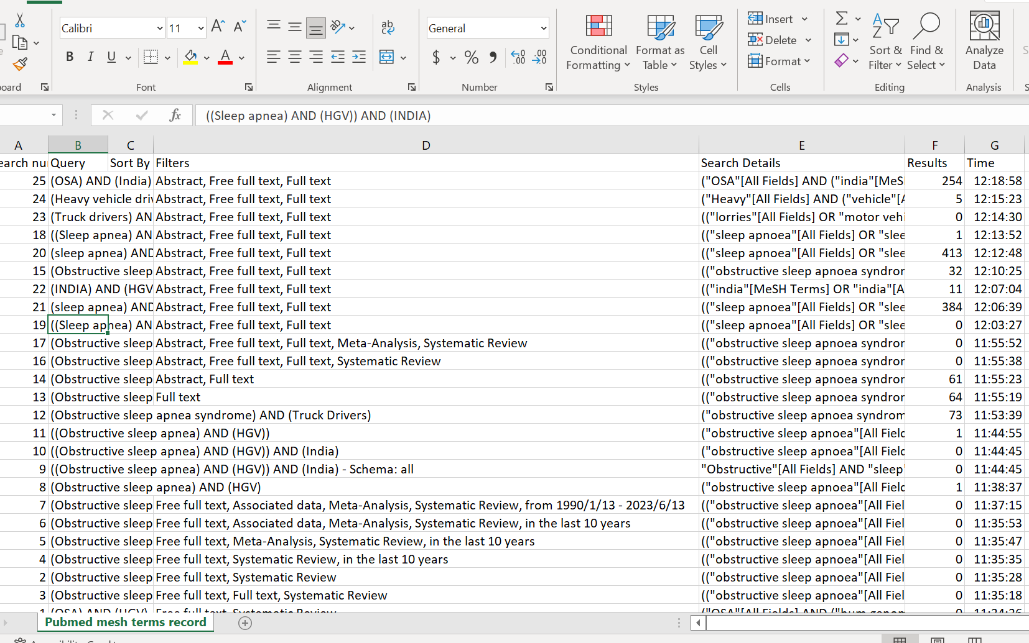
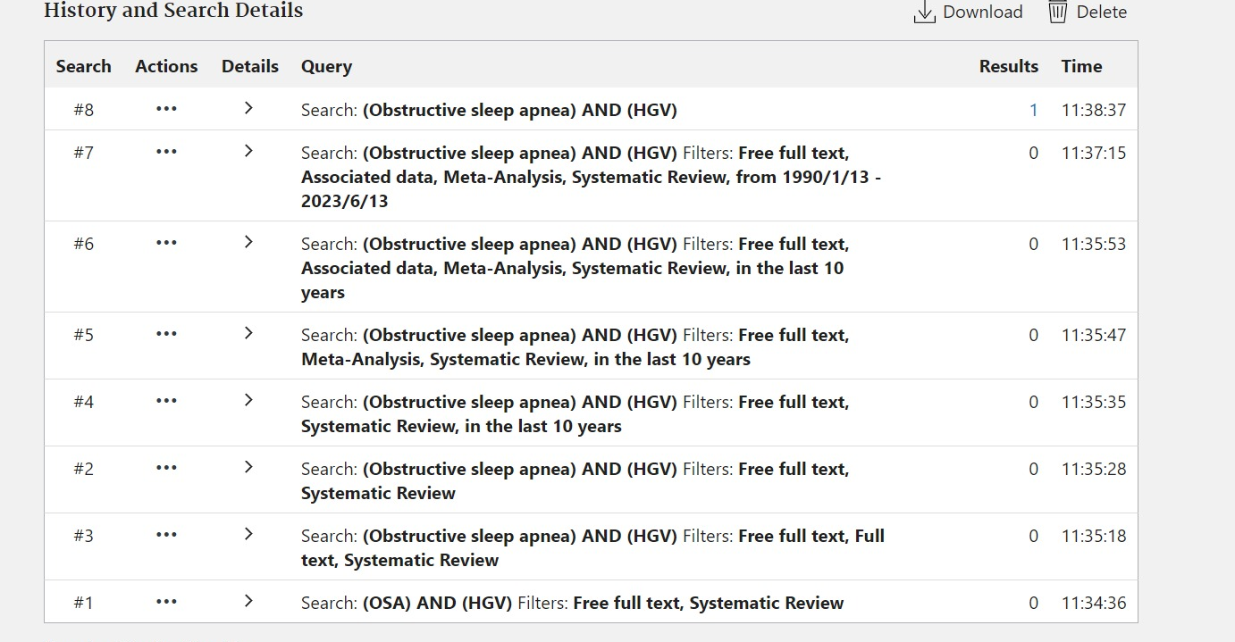


Pictorial Journey

