Slide 1
Assessment of the services at Aagan Wadi Centers (AWCs) in a rural block of Mirzapur UP
Guided By:-
Dr. A. K. Khokhar
Presented By
Dr. Phaneendra Mani

Slide 2
Introduction
The word Anganwadi means "courtyard shelter" in Indian languages. They were started by the Indian government in 1975 as part of the ICDS program to combat child hunger and malnutrition.
13.3 lakh Anganwadi and mini-Anganwadi centres are operational out of 13.7 lakh sanctioned AWCs.
These centres provide:-
1- Supplementary nutrition
2- Non-formal pre-school education
3- Nutrition and health education
4- Immunization
5- Health check-up
6- Referral services

Slide 3
OBJECTIVES OF THE STUDY
To assess the Infrastructure of AWCs.
To assess the availability of logistics at AWCs in terms of ‘Weight monitoring’.
To assess the services of AWCs in terms of ‘Take Home Ration’.

Slide 4
RESEARCH METHODOLOGY
Study Type- Cross sectional study
Study Area- The study was conducted at City block(Gramin) of Mirzapur district (Uttar Pradesh) with a sample size of 30 AWCs.
Study Period- 3 months
Study Respondents- The respondents for the following were AWWs.
Sample Method- The sampling method used for the study is simple convenient sampling.
Sample Size- 30 samples were taken.
Data Collection Technique- Face to face interview and direct observation.
Data Collection Tool- Adopted and modified Structured questionnaire.
Data Analysis- The data analysis was done in MS Excel
Ethical Consideration-Data confidentiality was maintained throughout the study. The data is used for the dissertation purpose only.

Slide 5
Rationale
India comprises 28% of the global burden of stunting
In India 20 per cent of children less than 5 years of age suffer from wasting. 40% of Indian children under 5 years are underweight and 48 % are stunted.
Uttar Pradesh and Bihar contribute ~40% of stunted children in India (11% of global burden of stunting)

Slide 6
OBJECTIVE
To assess the infrastructure of AWCs.

Slide 7
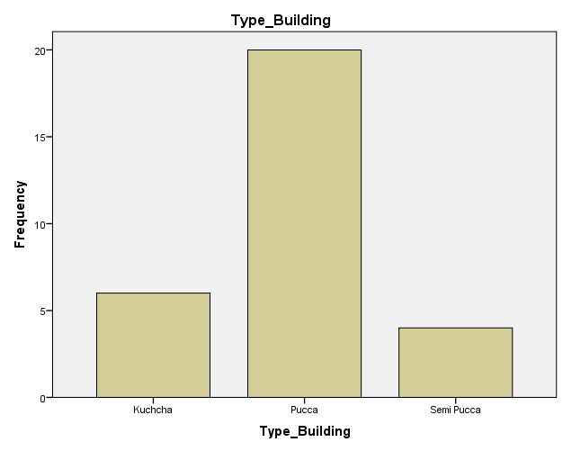
Type of Building
 |  | Frequency | Percent
 | Kuchcha | 6 | 20.0
 | Pucca | 20 | 66.7
 | Semi Pucca | 4 | 13.3
 | Total | 30 | 100.0
As per the given table only 66.7% of AWCs have
Pakka building remaining 20% have Kachcha
and 13.3% semi pakka.

Slide 8
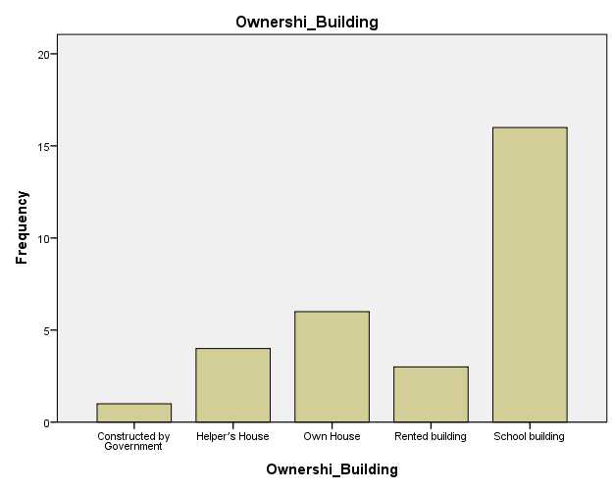
Ownership Of Building
 |  | Frequency | Percent
Valid | Constructed by Government | 1 | 3.3
 | Helper’s House | 4 | 13.3
 | Own House | 6 | 20.0
 | Rented building | 3 | 10.0
 | School building | 16 | 53.3
 | Total | 30 | 100.0
Most of the AWCs are running in the Schools
Building (53.3%) and about 10% is in rented
building. There is only 3.3% building that is
constructed by GOI. 13.3% and 20% are running in
helpers house and AWW own house, respectively.

Slide 9
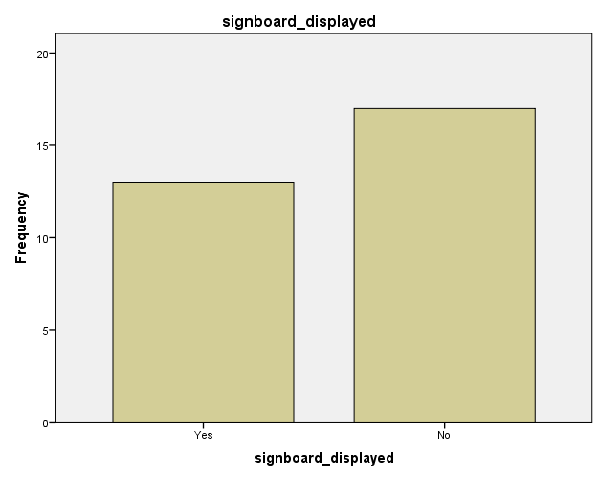
Sign board displayed
 |  | Frequency | Percent
Valid | Yes | 13 | 43.3
 | No | 17 | 56.7
 | Total | 30 | 100.0
Out of 30 AWC only 43.3% have sign boards and 56.7% have no sign-boards in front of their building.

Slide 10
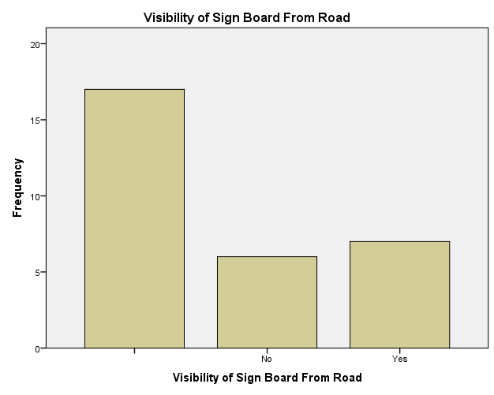
Sign Board Visible from road
 |  | Frequency | Percent
Valid |  | 17 | 56.7
 | No | 6 | 20.0
 | Yes | 7 | 23.3
 | Total | 30 | 100.0
Only 23.3% sign board are visible from road side.
Rest of 20% signs at AWCs are not visible from road

Slide 11
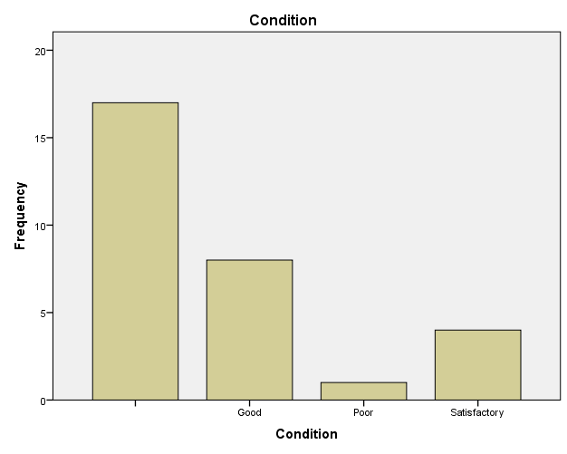
Condition of sign board
 |  | Frequency | Percent
Valid |  | 17 | 56.7
 | Good | 8 | 26.7
 | Poor | 1 | 3.3
 | Satisfactory | 4 | 13.3
 | Total | 30 | 100.0
Only 26.7% of the AWCs have good condition
of sign board and 13.3 % are satisfactory remaining
3.3 % are in poor condition.

Slide 12
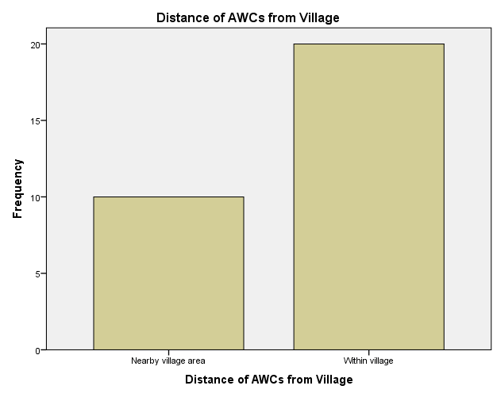
Distance of AWCs from Village
 |  | Frequency | Percent
Valid | Nearby village area | 10 | 33.3
 | Within village | 20 | 66.7
 | Total | 30 | 100.0
Out of 30 AWC 66.6 % of AWCs centers are within the village and 30% are near to village.

Slide 13
Finding: As per the analysis of data, even though, most of the AWCs in blocks have pakka buildings, they are mostly running in the school building, very few of the AWCs have their own building i.e Government constructed buildings. Only half of the AWCs are there where Sign boards are present and within them only half of the AWCs have sign boards that are visible from road side, AWC are within the village and few are a little bit away from the village, which may be the cause of less participation of population with the AWCs.
Recommendation: Overall the infrastructure seems to be OK for AWCs , however there are certain aspects where further improvement can be done. More buildings should be constructed by government, dedicated purely to AWCs. Apart from that the visibility of the AWCs should also be increased , so that the beneficiaries could come to know about the existence of AWCs in their neighborhood. Accessibility to the AWCs can also be further improved by opening AWCs within the boundary of villages, so that people can easily commute to such centers.

Slide 14
OBJECTIVE
To assess the services of AWCs in terms of ‘Take Home Ration’

Slide 15
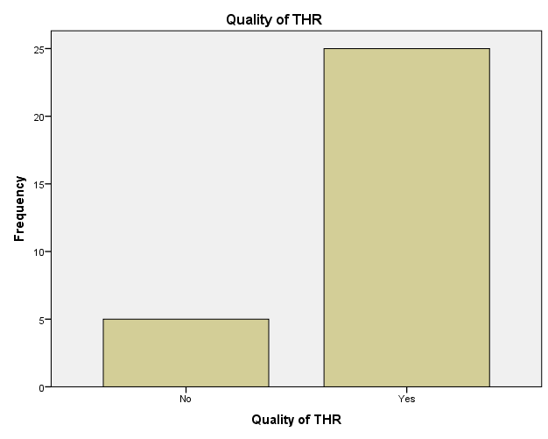
Quality of THR
 |  | Frequency | Percent
Valid | No | 5 | 16.7
 | Yes | 25 | 83.3
 | Total | 30 | 100.0
Quality of take home ration is good at 83.3% of the AWCs but 16.7% of AWCs are not receiving good quality take home ration as per the experience of angan wadi workers

Slide 16
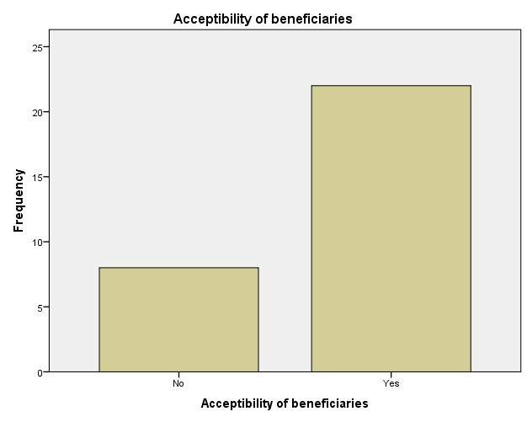
Acceptability of beneficiaries
 |  | Frequency | Percent
Valid | No | 8 | 26.7
 | Yes | 22 | 73.3
 | Total | 30 | 100.0
73.2% of the Angan wadi workers were of the opinion that there is acceptability of take home ration by the beneficiaries, only 26.7 % of the Anganwadi workers were of the opinion that the home ration provided by AWCs are not acceptable by beneficiaries.

Slide 17
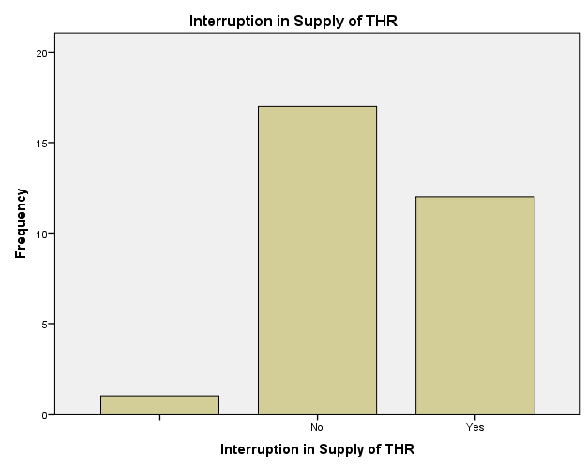
Interruption in Supply of THR
 |  | Frequency | Percent
Valid |  | 1 | 3.3
 | No | 17 | 56.7
 | Yes | 12 | 40.0
 | Total | 30 | 100.0
40% of the respondents said that there is disruption in the supply of THR whereas 56.7% of them said that the supply is regular.

Slide 18
If yes ( Within 3 month)
 |  | Frequency | Percent
Valid |  | 19 | 63.3
 | Shortage of Supply | 8 | 26.7
 | Transport Problem | 3 | 10.0
 | Total | 30 | 100.0
The above table shows the reasons for the interruption of supply of THR. The main reason sighted was the shortage of supply (73.2% ) and transport problem (10%)

Slide 19
Result
Finding: Take home ration provided to the beneficiaries was found to be of the good quality according to AWWs, however it was also found that the some of the beneficiaries are not accepting the THR provided by the AWCs. It was found that there is severe interruption in the supply of THR. The demands put by the beneficiaries is not being met by the AWCs. There seems to be the shortage of supply, there could be varied reasons for this, one of them might be of transportation facility.
Recommendation: To improve the services of THR , the beneficiaries should be encouraged to get THR from the AWCS, but before that the channel of distribution should be strengthened. The timely delivery of the Ration should be insured by making adequate transportation facility.

Slide 20
OBJECTIVE
To assess the availability of logistics at AWCs in terms of weight monitoring

Slide 21
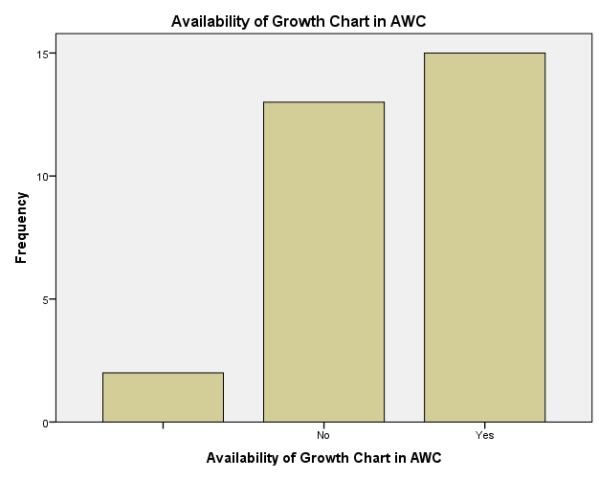
Availability of Growth Chart in AWC
 |  | Frequency | Percent
Valid |  | 2 | 6.7
 | No | 13 | 43.3
 | Yes | 15 | 50.0
 | Total | 30 | 100.0
Availability of WHO Growth Chart was there in 50% of the AWCs. 43.3% of the AWCs didn’t have Growth Chart, 6.7 % of the angan wadi workers were not aware about growth chart.

Slide 22
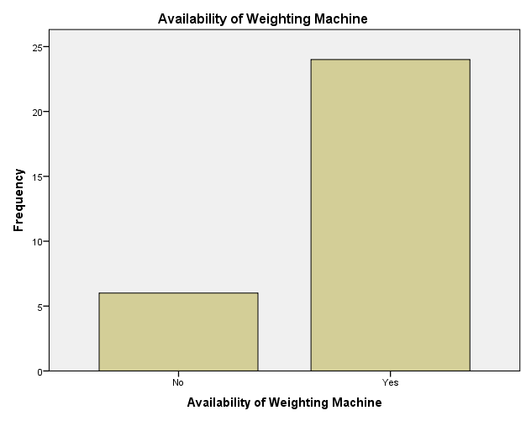
Availability of Weighting Machine
 |  | Frequency | Percent
Valid | No | 6 | 20.0
 | Yes | 24 | 80.0
 | Total | 30 | 100.0
Out of 30 AWCs, 80% had weighing machine
Available, 20% of AWCc did not have weighing
machine which is compulsory in AWCs.

Slide 23
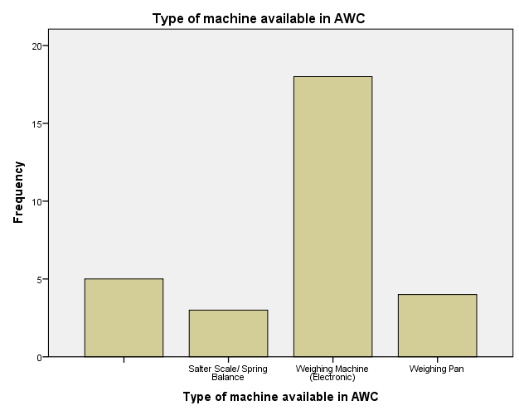
Type of machine available in AWC
 |  | Frequency | Percent
Valid |  | 5 | 16.7
 | Salter Scale/ Spring Balance | 3 | 10.0
 | Weighing Machine (Electronic) | 18 | 60.0
 | Weighing Pan | 4 | 13.3
 | Total | 30 | 100.0
There are various type of wight machine but
Electronic machines are present at 60% of AWCs,
13.3 % had weight pan and only 10% had spring
machine available.

Slide 24
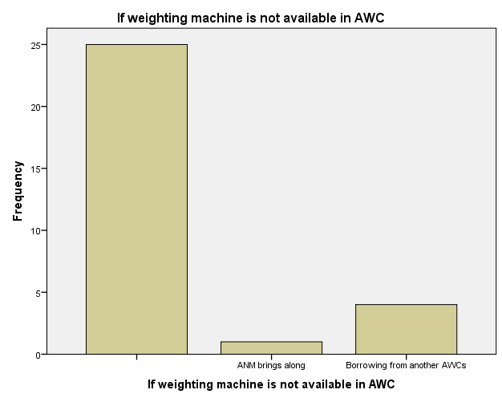
If weighting machine is not available in AWC
 |  | Frequency | Percent
Valid |  | 25 | 83.3
 | ANM brings along | 1 | 3.3
 | Borrowing from another AWCs | 4 | 13.3
 | Total | 30 | 100.0
If the weighting machine is not available in AWC,AWW arrange machine by borrowing from Other AWCs (13.3%) and borrowing from ANM is 3.3%.

Slide 25
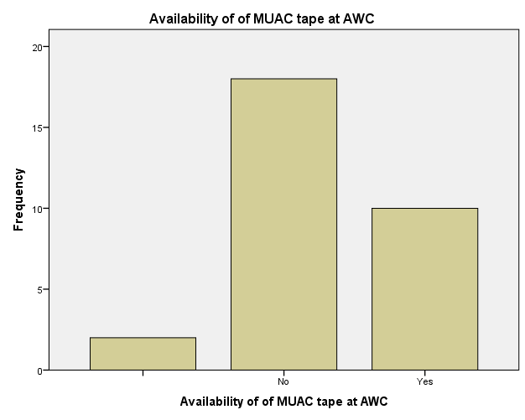
Availability of of MUAC tape at AWC
 |  | Frequency | Percent
Valid |  | 2 | 6.7
 | No | 18 | 60.0
 | Yes | 10 | 33.3
 | Total | 30 | 100.0
Availability of MUAC tape is very less in AWCs
Only 33.3% had MUAC tape, 66.7% did not
have MUAC tape, 6.7% AWW were not aware of
MUAC tape.

Slide 26
Result
Findings: The data analysis shows that the basic instruments for weight measurement is available at most of the AWCs and even if they are not available there is proper arrangement for getting a weighing machine in case there is a need. There seems to be a shortage of growth chart and MUAC tape at the AWC centers. These are important for the monitoring of growth and nutrition states especially in case of children.
Recommendation: All these basic instruments are not costly and it must be provided to each and every AWCs, if it has to improve the services of AWCs.

Slide 27
Conclusion
There are few things where improvement can be done. A better service delivery system can be ensured by making improvements in infrastructure, accessibility of AWCs, supply chain and availability of basic instruments at AWCs. This will further improve beneficiaries nutritional status and weight monitoring. Enhanced services could improve beneficiary satisfaction and they will be interested in coming to AWCs to avail the services.

Slide 28
Thank you

Slide 29
Thank You

