Slide 1
A Study to assess the Awareness and Preparedness of Fire Safety in a Multi-Speciality Hospital At New Delhi
Institute : Sitaram Bhartia Institute Of Science And Research
Project by: Dr Ridhima Kataria
PG/21/083
Mentor : Dr Pijush Kanti Khan

Slide 2
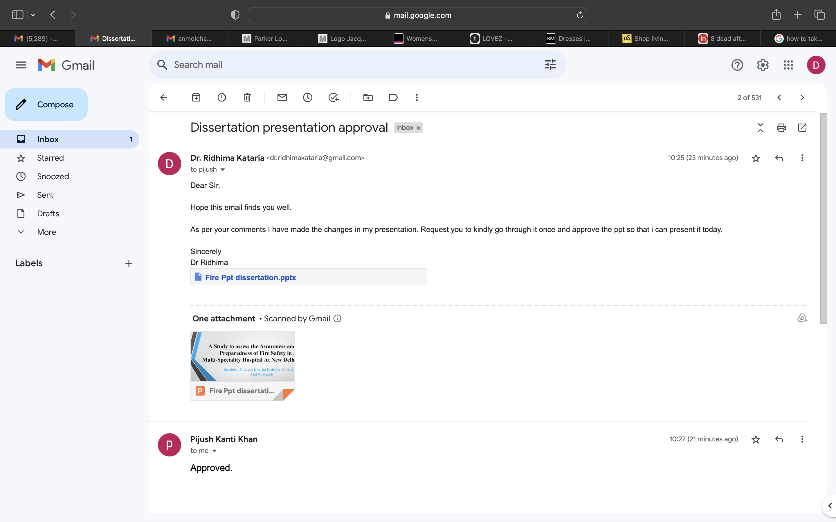
APPROVAL FROM MENTOR FOR FINAL DISSERTATION PRESENTATION
NOTE : The Study was approved by the SRB committee of IIHMR,Delhi

Slide 3
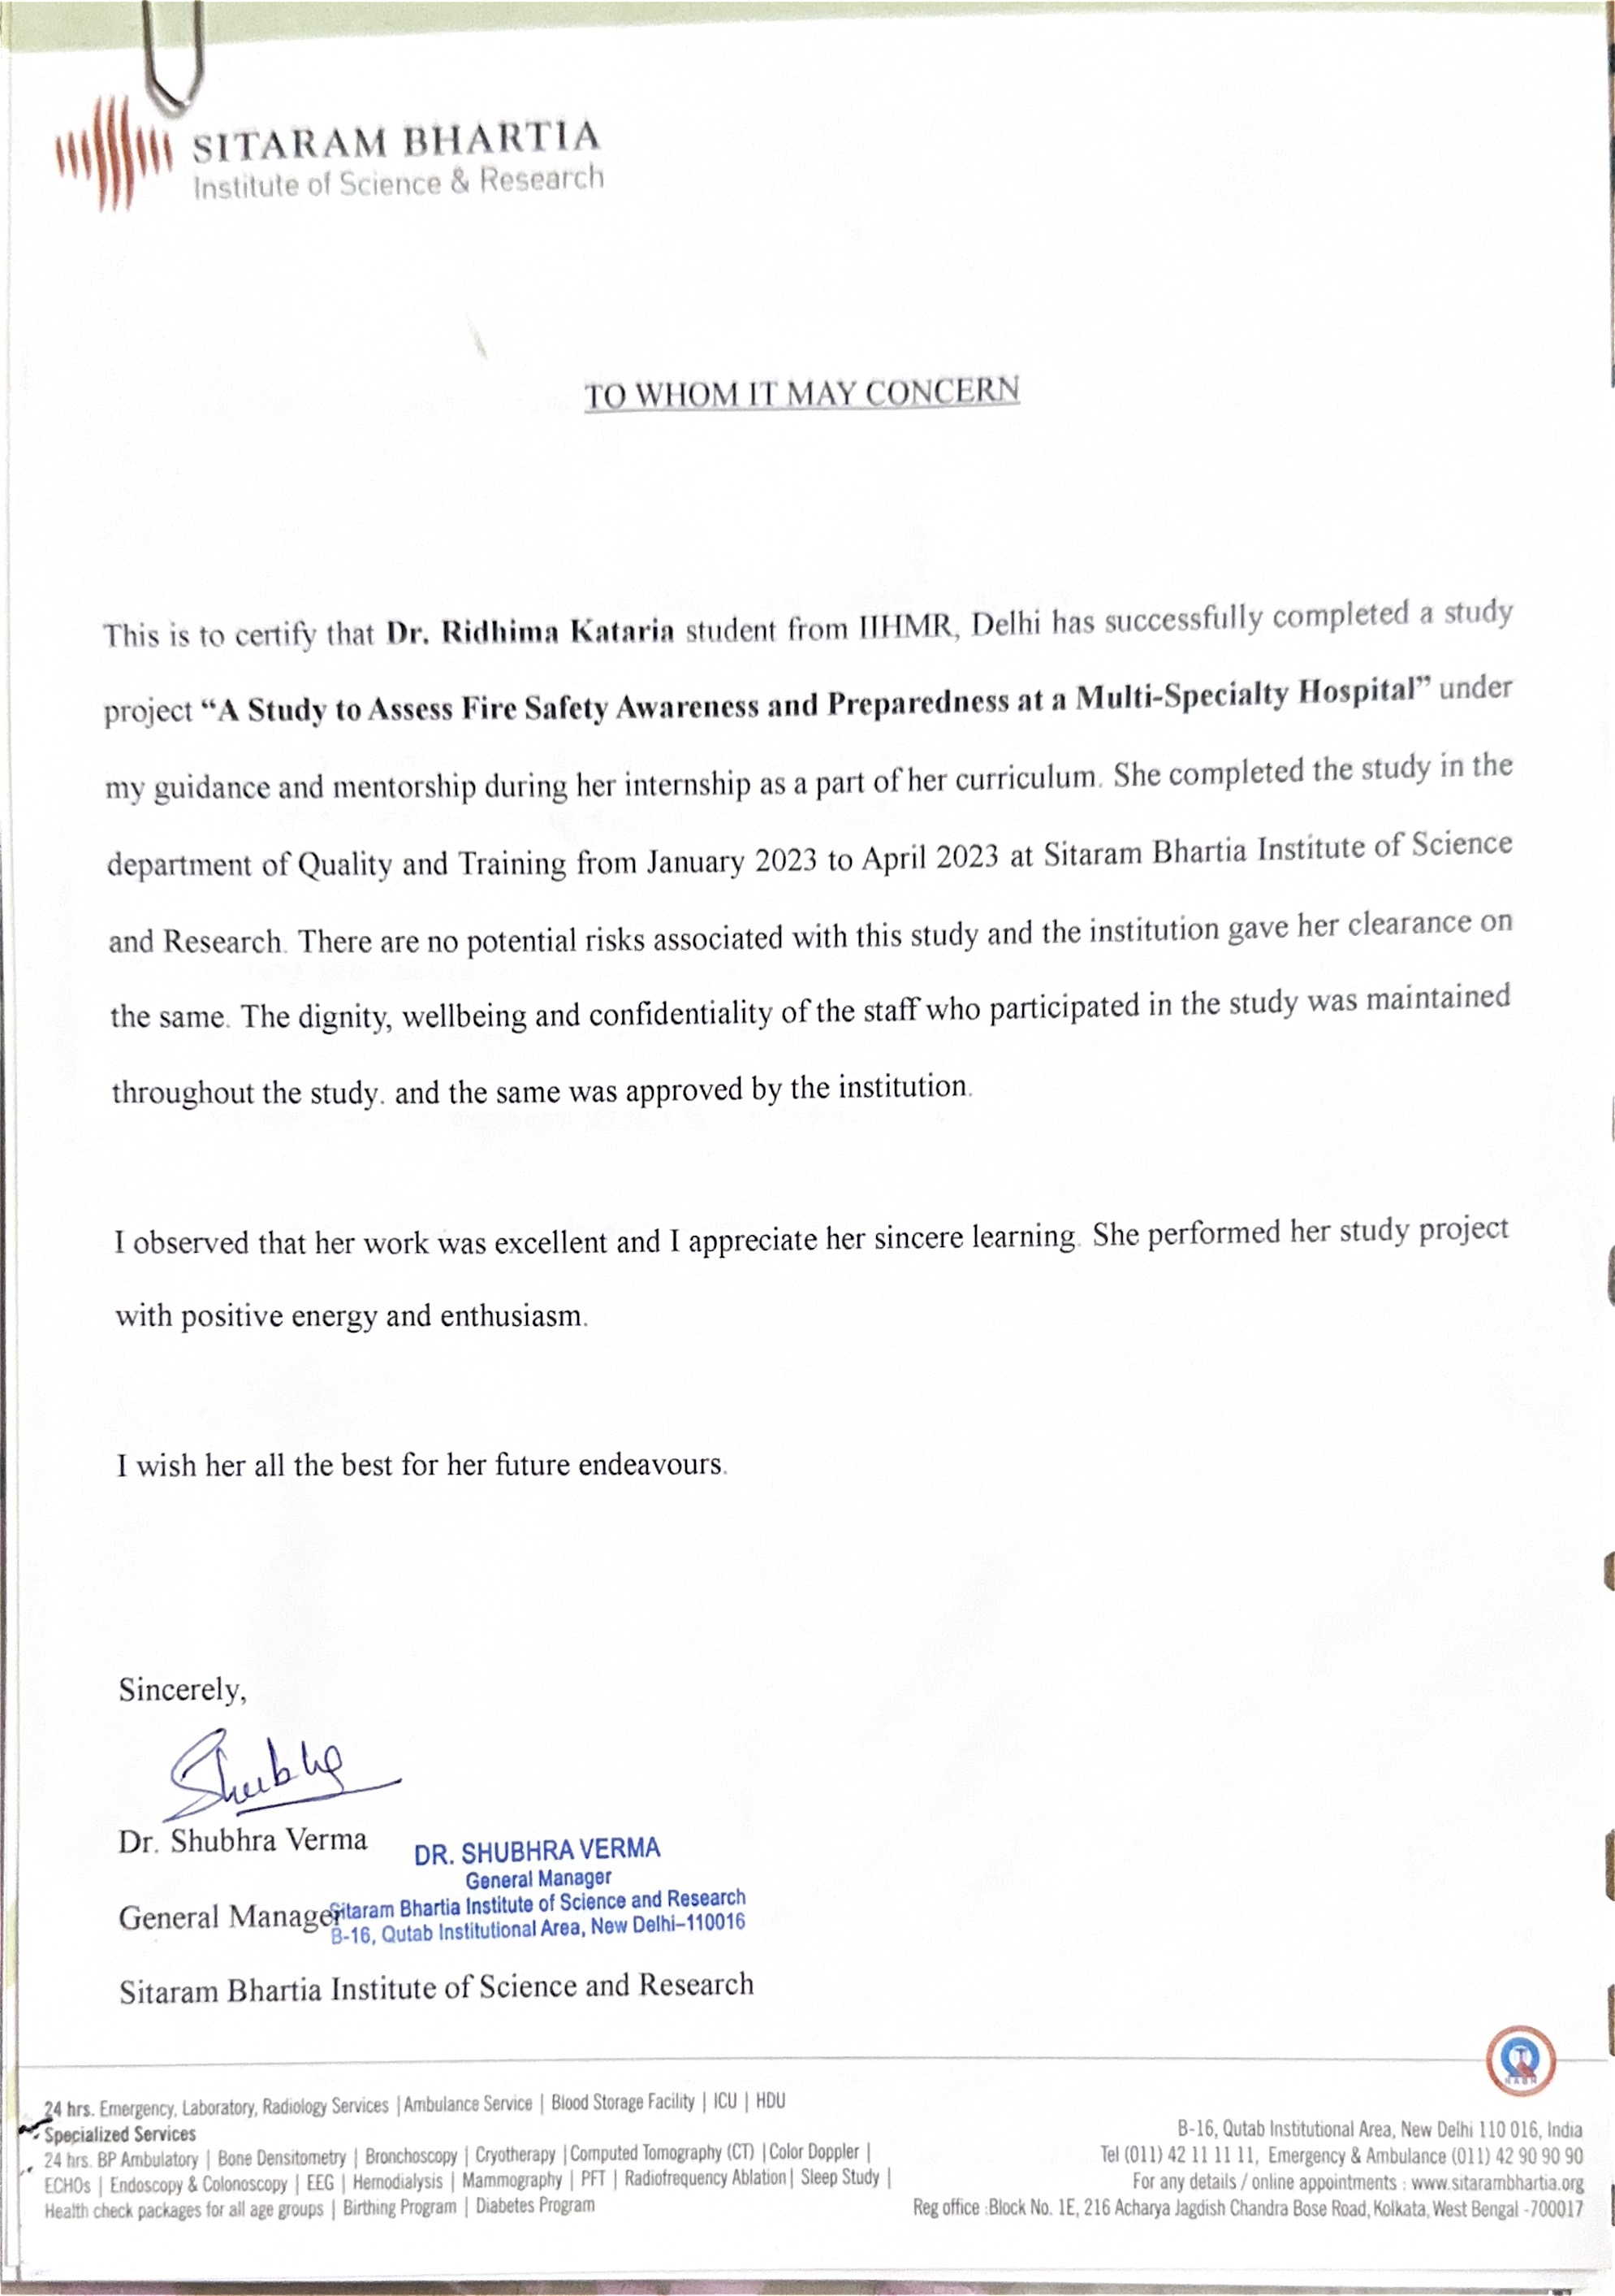
APPROVAL FROM HOSPITAL TO CARRY OUT STUDY AT THEIR INSTITUTION

Slide 4
BACKGROUND
Did You Know??
In 2021, India sadly recorded 1.6 million fire accidents, with 27,027 innocent lives lost.
Fire is a normal process for our ecosystem, but it can also result in fatal accidents that result in destruction.
For a fire to start, three things must interact: heat, fuel, and oxygen. Like the epidemiological triad for disease, fire also can be extinguished by removing one of the 3 components.
Fire is of the greatest safety risk, which affects not only industrial, residential and commercial structures but also hospital buildings.

Slide 5
In recent years, reports of fire outbreaks in medical facilities have been made in news both locally and internationally:
  AMRI Hospital in Kolkata, India, experienced a fire outbreak in 2011, which resulted in the deaths of 93 people, including those who were hospital patients and those in the intensive care unit (Indian express, October 19, 2016).
  Fire accident at a psychiatric hospital outside of Moscow in 2013 resulted in the deaths of about 38 people, including members of the medical staff (Seattle Times, April 26, 2013)
  Ten people died in an orthopaedic hospital in Fukuoka, Japan (BBC News, October 11, 2013)
  At New Life Multispecialty Hospital, a private hospital in the Madhya Pradesh region of India's Jabalpur district, a large fire broke out on August 1 2022, which killed eight people and three were critically injured. After the fire incident was investigated, it was discovered that the hospital's fire No Objection Certificate (NOC) had expired.

Slide 6
Regulations for fire safety and prevention are more stringent for hospitals.
Despite the SOPs and rules that each hospital has established for such emergency scenarios, these situations require an instant and effective response from all the healthcare professionals.
Hospital fire are not easily controllable, and the consequences of fire in hospitals can be devastating as most patients cannot move out of the building on their own.
Any healthcare facility that houses patients is required to have fire safety amenities like fire hydrant systems, emergency exits, various types of fire extinguishers, and a secure gathering area.
Inadequate fire drill training and a lack of fire-related knowledge contribute to firefighting process delays.
The successful use of any type of fire equipment depends upon the elements such as equipment, maintenance and training.
Keeping in mind the above factors, the purpose of this study is to ascertain the level of awareness and knowledge among healthcare professionals as well as the preparedness of a multispecialty hospital for fire safety and its management.

Slide 7
OBJECTIVE
A Study to Assess the Awareness and Preparedness of Fire Safety in a Multi-Speciality Hospital at New Delhi

Slide 8
The study is conducted in Sitaram Bhartia Institute of Science and Research, a multi-speciality hospital in New Delhi. The specific objectives are :
To assess the Fire Safety Awareness amongst healthcare workers of the hospital
To assess the Fire Safety Preparedness of the hospital
To suggest improvements enhancements to the hospital's fire safety measures.

Slide 9
STUDY DESIGN
Study Duration
February to April 2023
Sample Population
Healthcare workers working at Sitaram Bhartia Institute of Science and Research
Sample size
Sample size of 195 healthcare workers
Study Type
Cross Sectional Study
Mode Of Data Collection
Primary Data
Sampling
Convinince Sampling

Slide 10
Inclusion Criteria
All the healthcare workers working in Sitaram Bhartia Institute of Science and Research, including Clinical and Non Clinical staff.
Exclusion Criteria
Healthcare workers who have been working in Sitaram Bhartia Institute of Science and Research for less than 3 months have been excluded from the study.

Slide 11
METHODOLGY
The steps for assessment for Fire Safety Awareness will be proceeded as follows:
To assess the Fire Safety knowledge of the healthcare workers a survey questionnaire was devised, which consisted of 14 questions. Prior to enrollment, all participants gave their informed consent and had the option of participating in the study or not.
The study examined staff training and skills in emergency situations to gauge how well the hospital is prepared for fire safety. A fire safety mock drill is also carried out in the hospital in front of two members of the Disaster committee (Code Red). To record the observations, a 23-steps checklist with a response time is used to record the observation.

Slide 15
RESULT
Results of the Fire Awareness Assessment
The fire awareness assessment involved 195 healthcare professionals, of which 79 (42%) were clinical staff (doctors, nurses and other clinical staff) and 116 (58%) were non-clinical staff (administrative, security, housekeeping and maintenance staff).
The scoring of the survey was done using “All or null” principle, where each right response received 1 score, while each wrong response received 0 score. Knowledge scores of <11 (below 80%) were considered "Below Average” while scores of >11 (above 80%) were considered “Above Average”.
Participants who score MORE than 80% | 136
Participants who score LESS than 80% | 59

Slide 16
Responses given by participants to each question in the fire awareness assessment

Slide 17
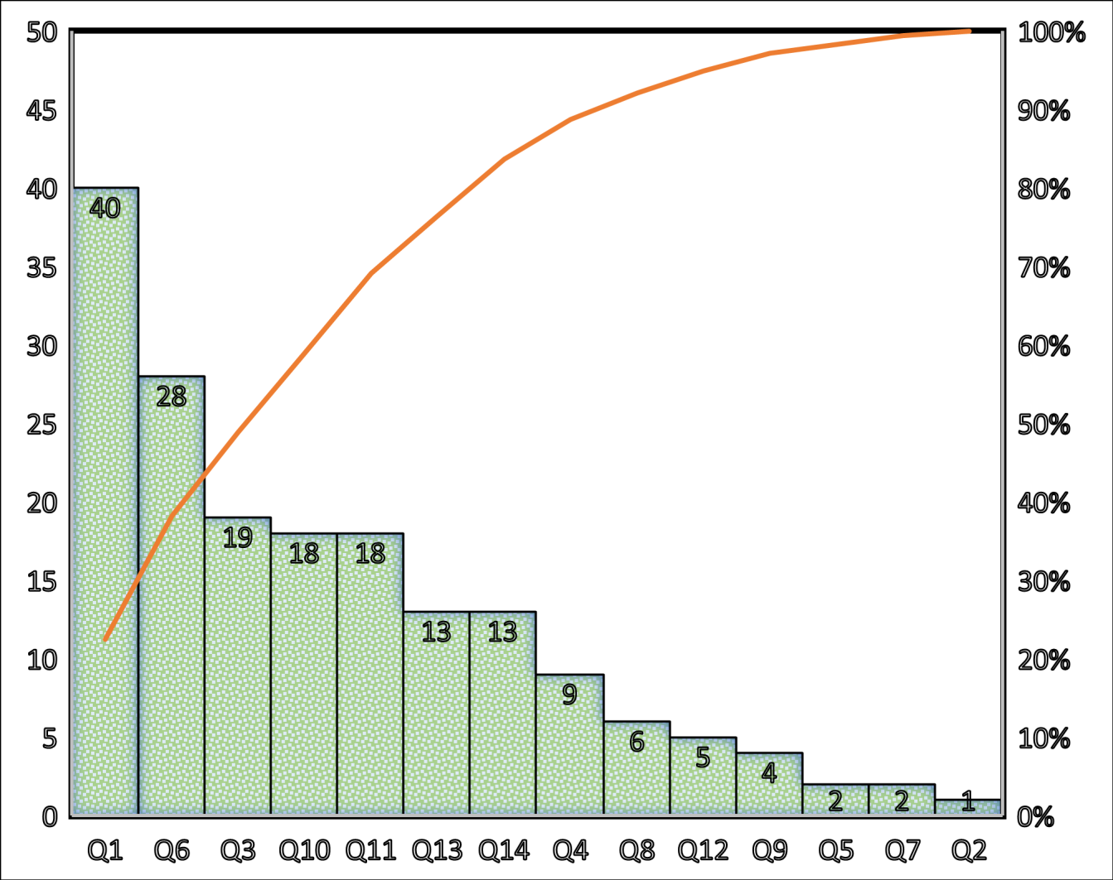
Pareto Analysis of the Non-compliances in the fire awareness assessment question wise
According to the Pareto Analysis, six questions—Q1, Q6, Q3, Q10, Q11, and Q13—were responsible for 80% of the non-compliance in the fire awareness assessment and are thus identified as a potential area for improvement.

Slide 18
Results of the Fire Mock Drill (To access Preparedness of staff)
From the analysis we infer that out of 23 steps observed during mock drill assessment, 21 areas(86%) were meeting compliance; whereas 2 areas (14%) were not meeting compliance, and hence needs further improvement.

Slide 21
DISCUSSION
The Fire Awareness Assessment
In this study, out of 195 participants, 136 individuals (approximately 70%) received scores of more than 80% on the fire awareness assessment, reflecting a thorough understanding of the hospital's fire safety policies and plan.
59 participants (about 30%) received evaluations below 80%, Suggesting scope of improvement in these areas.
Areas of Improvement Carved Out By Paetro Analysis
40% of the respondents were unsure of full form of the acronym designated for the fire assembly area
28% were unsure of the order of events they will follow in case of a fire emergency
19% were not aware of the emergency number that must be called in case of a fire emergency
18% were unaware of the location where injured or rescued patients from fire sites are transferred for medical treatment
18% of respondents were unaware were unaware of the staff role in a fire emergency
13% were unaware of the type of fire extinguisher to use in the event of an electric fire.

Slide 22
Fire Mock Drill (To access Preparedness of staff)
The first responder was not aware of the disaster number (6006) during the mock drill also was reminded to tell the phone exchange that it was a "mock drill”.
After receiving the call from the first observer, the telephone exchange staff announced “code red." The security, housekeeping, and maintenance staff rushed to the fire site with a fire extinguisher and other necessary equipment after hearing the Code Red announcement over the PA system.
All the other healthcare workers in the hospital reached the assembly area on time.
To evaluate the performance of the fire safety rescue team, dummy patients were placed at fire site to test the evacuation process.
It was observed that the status and rescue operation were insufficiently coordinated between the head of security and the chairperson of the ICC during this assessment.
Additionally, the security personnel dialed the incorrect disaster number just as it was time to declare code green (all clear).

Slide 23
CONCLUSION
A commendable level of fire safety awareness and training was present among the majority of hospital staff. However, taking into account the severity of fire disaster which may lead to loss of life and property, it is imperative to build a robust system and empower staff to a level that they are able to handle the situation and respond efficiently without panicking.

Slide 24
RECOMMENDATION
The Head of the Department (HOD) may periodically hold trainings at the departmental level. To do this, department-based training (both critical and non critical areas) should reinforce role-specific sessions in which specific roles are assigned to specific staff members. Also, the HOD should include code red trainings in their departmental training calendar and must provide the training division a record of the training calendar, attendance, and evaluations.
The fire safety training modules could be revised periodically and ought to adhere to the hospital's fire safety plan and fire safety SOP.
The hospital can regularly hold mock drills to evaluate the staff's level of training, and more staff members should be encouraged to take part, including doctors who are also a part of the front-line personnel.
To gauge the staff's knowledge of fire safety, fire safety assessments be performed every six months. In order to track development and comprehension. It is important to identify the gaps and include them in the training module's improvement scope.
At the time of induction new employee could be assessed for fire safety and according to that the training needs can be catered

Slide 25
LIMITATION
The findings and recommendations of the study cannot be generalised because it was only conducted at one hospital in New Delhi.
The sample used in the mock fire drill was dependent on its accessibility. Therefore, it's possible that a 100% sample wasn't present when the observations were taken.

Slide 26
REFERENCES
A guide to fire safety in hospitals, article published on June 10,2021, retrieved from https://bengaluru.citizenmatters.in/fire-safety-in-hospitals-covid-19-61472
Fire safety and protection in hospital article retrieved from http://www.hospitalinfrabiz.com/fire-safety-and-protection-in-hospital.html
Indian express, October 19, 2016. Indian Express recalls the catastrophic AMRI Hospital fire in Kolkata in 2011, in which 93 people were killed. Indian Express new retrieved from https://indianexpress.com/article/explained/kolkata-hospital-fire-accident-amri-fire-3090423/
Kulkarni, R. S., Giri, P. A., & Gangwal, P. R. (2016). Knowledge and practices regarding fire safety amongst health care workers in tertiary care teaching hospital in Marathwada region of Maharashtra, India. International Journal of Community Medicine and Public Health, 3(7), 1900-1904. https://ijcmph.com/index.php/ijcmph/article/view/335
Seattle Times, April 26, 2013. 38 die in mental hospital fire outside Moscow. Seattle Times news retrieved from https://www.seattletimes.com/nation-world/38-die-in-mental-hospital-fire-outside-moscow-1/
Yeturu, S. K., Annapurani, R., Janakiram, C., Joseph, J., & Pentapati, K. C. (2016). Assessment of Knowledge and Attitudes of Fire Safety-An Institution Based Study. Journal of Pharmaceutical Sciences and Research, 8(11), 1281. https://scholar.google.com/scholar?hl=en&as_sdt=0%2C5&q=Assessment+of+Knowledge+and+Attitudes+of+Fire+Safety-An+Institution+Based+Study&btnG=
Patharla SS, Pyreddy SR, Panthagani SN. A study on reported fire incidents in major hospitals of India. International journal of community medicine and public health (Gujarat). 2020;7(10):3896-906. https://www.researchgate.net/publication/345661050_A_study_on_reported_fire_incidents_in_major_hospitals_of_India

Slide 27
Ukegbu AU, Njoku PU, Metu KC, Onyeonoro UU, Obiechina OC, Ozurumba CC, Ebidan CN. Workplace Fire Safety: Knowledge and Preparedness in a Public Tertiary Healthcare Facility in Abia State, South East Nigeria. Journal of Community Medicine and Primary Health Care. 2022 Aug 9;34(2):94-108. https://www.researchgate.net/publication/362675358_Workplace_Fire_Safety_Knowledge_and_Preparedness_in_a_Public_Tertiary_Healthcare_Facility_in_Abia_State_South_East_Nigeria
Hindustan Times, April 17, 2019. Small hospitals in Delhi face closure over stricter fire-safety norms. Hindustan Times retrieved from https://www.hindustantimes.com/delhi-news/small-hospitals-face-closure-over-stricter-fire-safety-norms/story-vbOIQPsuit5qmIehm1tTHJ.html
India Today, August 1, 2022. 8 Dead after fire breaks out at hospital in MP’s Jabalpur, probe panel formed. India Today retrieved from https://www.indiatoday.in/india/story/massive-fire-hospital-madhya-pradesh-jabalpur-fire-tender-1982436-2022-08-01
Quartz (Publication), April 14, 2022. More than 120 Indians have died in hospital fire since August 2020. Quartz retrieved from https://qz.com/india/2154791/indias-hospital-fires-have-killed-over-120-since-august-2020

Slide 28
Thank You

Slide 29
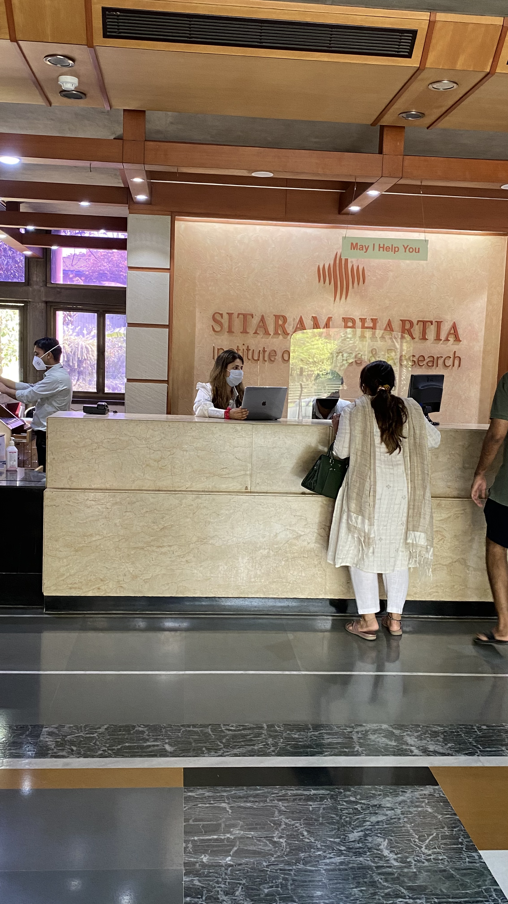
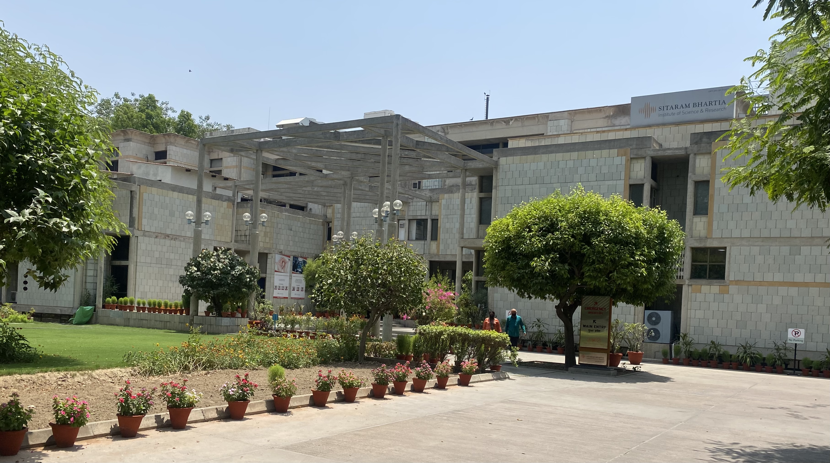

Slide 30
