Slide 1
A CROSS SECTIONAL STUDY ON PERSONAL HYGIENE HABITS AND SANITATION PRACTICES AMONG SCHOOL CHILDREN OF AN URBAN PRIMARY GOVERNMENT SCHOOL OF DELHI
Col Pramod Dahitule
PG/16/036
IIHMR Delhi

Slide 2
INTRODUCTION
India is one of the largest countries of the world with diverse population both in geographical and cultural terms.
Open defecation remains the predominant norm and poses one of the biggest threats to the health of the people in India (64 percent of India's population still defecate in the open).
Everyday over 800 children die globally from preventable diseases caused by poor water, lack of sanitation and hygiene.
Adequate sanitation, together with good hygiene and safe water, are fundamental to good health and to social and economic development.

Slide 3
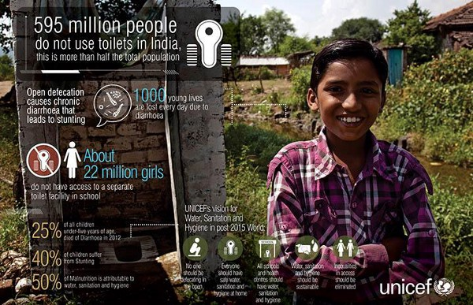

Slide 4
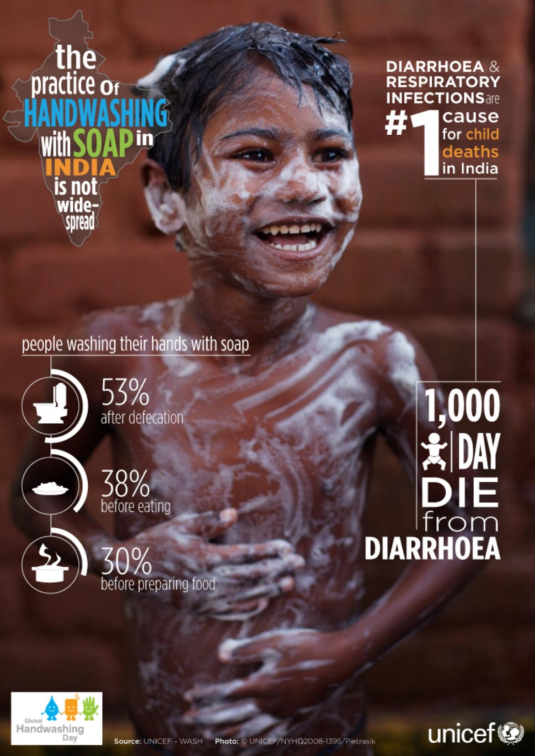

Slide 5
INTRODUCTION
Good personal hygiene habits and sanitation practices are major contributors of personal health among children.
Foundation stone of above attributes can be well laid right from primary schooling.
Knowledge, skills and habits translates into attitude and behaviour in observing these twin functions.
Synergy between students, peers, teachers, parents and health educators will translate into exponential long term results.
To achieve this scientific, analytical assessment is pre-requisite for designing evidence based targeted intervention.

Slide 6
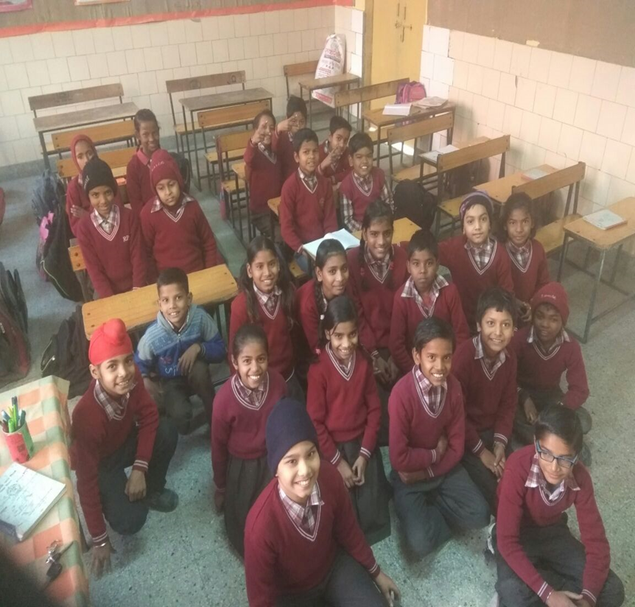

Slide 7
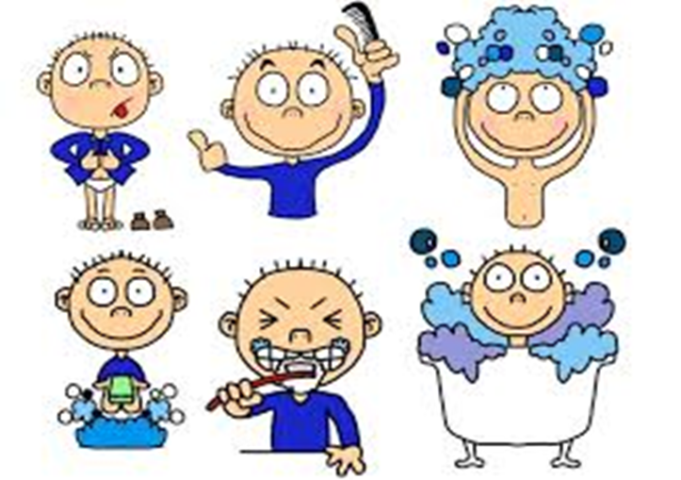
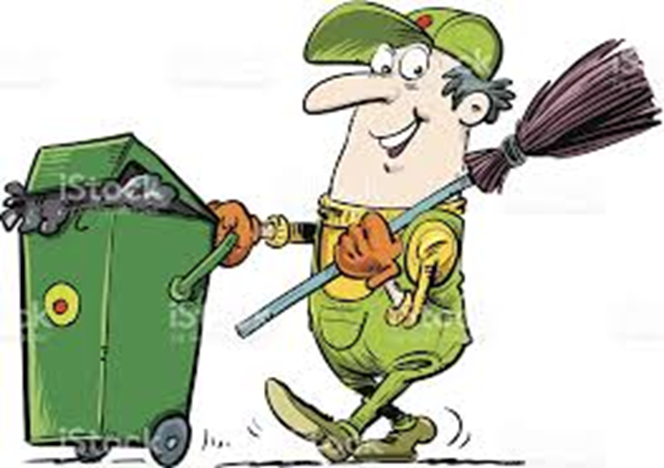
PERSONAL HYGIENE AND SANITATION
Personal hygiene involves those practices performed by an individual to care for one’s bodily health and well being, through cleanliness.
Sanitation refers to provision of facilities and services for the safe disposal of human urine and faeces.

Slide 8
OBJECTIVES OF THE STUDY
GENERAL OBJECTIVE: To assess the personal hygiene habits and sanitation practices among the students of an urban primary government school of Delhi.
SPECIFIC OBJECTIVES:
  To assess the personal hygiene habits of the students of an urban primary school.
  To assess the sanitation practices of the students of an urban primary school.

Slide 9
METHODOLOGY
STUDY AREA: Urban MC Primary School situated in the North-West district of Delhi, Rohini zone. The area has slums within reach thereby giving an excellent opportunity to conduct the study.
STUDY PERIOD: The study was carried out in phases between December 2017- February 2018.
    Phase 1: Designing the study and pretesting the instrument.
    Phase 2: Data collection phase.
    Phase 3: Data analysis and drafting of report.
STUDY DESIGN: Cross-sectional descriptive study involving quantitative method of data collection.
STUDY POPULATION: Students from grade three to grade five.
INCLUSION AND EXCLUSION CRITERIA: Students present on the day of study who voluntarily gave consent were included in the study. Those absent were not included.
SAMPLE SIZE: On the day of data collection all 190 students present, consented and voluntarily participated in the study.

Slide 10
METHODOLOGY
STUDY VARIABLES:
TOOLS AND TECHNIQUES: Tri-sectional questionnaire consisting of following areas was designed:
  Section 1: Demographic Profile of respondents
  Section2: Personal hygiene habits: Total of 20 questions distributed among above six variables.
  Section 3: Sanitation practices: Total of 11 questions distributed among above three variables.
Personal Hygiene Variables | Sanitation Variables
Hand Washing habits | Cleanliness Practices
Eating Habits | Waste Management Practices
Brushing Habits | Food and Water Storage Practices
Bathing Habits
Dressing Habits
Nail and Hair Care

Slide 11
METHODOLOGY
PRE-TESTING: Questionnaire was first drawn in English, translated to Hindi and then back translated to English to test validity. One student per class and five students per grade selected for pre testing. Necessary changes incorporated after analysis of responses.
PERMISSION: Obtained from Assistant Director (Education) NDMC (North Delhi Municipal Corporation). Written permission taken from school authorities.
ETHICAL CONSIDERATION: The teachers, parents and participants were informed about the risks and benefits of the study. Consent letter was drafted to be signed by parents. Also an assent section was incorporated in the form for students.

Slide 12

DATA ANALYSIS PLAN
Preparation of score card:
    For every correct response, 1 mark was given and 0 for incorrect responses.
    Simple frequencies were calculated.
    A numerical scale of 0-10 was developed to calculate the mean score.
For score of an individual question:
        $\frac{Expected response}{total respondents}$ * 10
For cumulative score of multiple questions:
        $\frac{Total of all expected responses of all questions}{Total respondents ∗total number of questions}$ *10
Based on the above mean scores, areas were classified in to good performing areas and poor performing areas (critical areas).
The critical areas were then cross tabulated with demographic factors to find out the possible reasons of poor scores.

Slide 13
RESULTS: OVERVIEW
Personal hygiene habits scored 7.65 on the scale of 0-10 whereas Sanitation scored 6.6.
Thecontributing variables for personal hygiene habits were hand washing habits, brushing bathing and eating habits, dressing habits and nail and hair care.
Similarly for sanitation, the cleanliness of area, food and water storage arrangement and waste management were main contributing variables.

Slide 14
CLASSIFICATION OF INDICATORS
PERSONAL HYGIENE HABITS INDICATORS
SANITATION PRACTICES INDICATORS

Slide 15
RESULTS: PERSONAL HYGIENE HABITS
The overall mean score of Personal hygiene habits came out to be 7.65.
Any area below 7.65 was taken as critical areas.
Three critical areas were defined:
  Nail and hair care: 5.15
  Brushing habits: 7.14
  Eating habits: 7.17

Slide 16
RESULTS: ANALYSIS OF CRITICAL AREAS
Once critical areas were defined, further analysis was done to find out the possible reasons of the low score.
This analysis was done after cross tabulating each area with the demographic factors.
The demographic factors taken up for analysis included: gender, age, parent’s education, parent’s occupation and socio-economic status of the respondents.

Slide 17
CRITICAL AREA: NAIL AND HAIR CARE ANALYSIS
Weakest area identified: Presence of head lice
Cross tabulation findings:
  Head lice more common in girls
  Frequent presence of head lice increases with age.
  Positive association was seen with mother’s education. Illiterate mothers scored 1.3 whereas mean score of educated mothers came out to be 4.03
  Negative association found with mother’s employment. Employed mothers scored 2.8 in comparison to unemployed who scored 3.3.
It can be said that educated mothers who are there with children are better in managing head lice .

Slide 18
CRITICAL AREA: BRUSHING HABITS ANALYSIS
Weakest area identified: Brushing frequency
Cross tabulation findings:
  Frequency of brushing teeth twice a day is very low in girls (3.8).
  Frequency of brushing twice daily increases with age.
  Positive association was seen with mother’s education. Illiterate mothers scored 4.2 whereas mean score of educated mothers came out to be 4.90.
  Positive association found with mother’s employment. Employed mothers scored 4.9 in comparison to unemployed who scored 4.0
It can be said that educated employed mothers are more aware of benefits of brushing twice daily and put in good habits in her children as well.

Slide 19
CRITICAL AREA: EATING HABITS ANALYSIS
Weakest area identified: Use of plastic tiffin or polybag for eating lunch.
Cross tabulation findings:
  Very few students use steel tiffin box for having lunch at school (3.73).
  Rest of them either use poly bags or plastic tiffin boxes.
  Positive association was seen with mother’s education. Illiterate mothers scored 2.90 whereas mean score of educated mothers came out to be 3.90.
  Positive association found with mother’s employment. Employed mothers scored 3.80 in comparison to unemployed who scored 3.30.
It can be said that educated employed mothers are more aware and make sure that their child carries proper steel tiffin to school.

Slide 20
RESULTS: SANITATION PRACTICES
The overall mean score of Personal hygiene habits came out to be 6.60.
Any area below 6.60 was taken as critical areas.
Two critical areas were identified:
  Cleanliness practices: 5.10
  Food and water storage practices: 6.40

Slide 21
CRITICAL AREA: CLEANLINESS
In this section two questions were drafted.
The second question was about the type of waste present. So it couldn’t be scored as per the scoring criteria.
This 5.10 scores says that almost half of the respondents have garbage around their house.
When asked about the type of waste present, they mainly responded with HUMAN WASTE.

Slide 22
CRITICAL AREA: FOOD AND WATER STORAGE PRACTICES
Weakest area identified:
  Source, storage and handling of drinking water.
Cross tabulation findings:
  Mother’s education has positive relation with the above three areas.
  Mother’s employment has comparatively lesser impact.

Slide 23
DISCUSSION
Assessment of personal hygiene and sanitation was main purpose of the study. Cross-sectional method was adopted. Consent from parents and accent from students duly ensured. Identification of weaker areas enabled evidence based targeted interventions.
Construction of uniform numerical scale enabled scientific and impartial quantification of assessment areas.
Study limitations: Assessment based on only one primary school students and peer influence may have introduced bias in the study.
The comparison with other studies in Mumbai (2015) and Ethiopia (2015) concludes similar results in the area of hand wash using soap, after use of toilets and trimming of nails. Variation of almost 25 percent was noticed for hand wash before meals, the lower score in this study may be attributable to non availability of soap in school.
For assessment of cleanliness of area in particular and sanitation in general, a more detailed study is recommended.

Slide 24
RECOMMENDATIONS
Awareness being key, mothers' involvement in awareness program is the key recommendation.
Educational and recreational activities involving participation of students and supportive supervision by teachers on preceding study areas be taken up.
Quarterly interaction between teachers and parents be utilized for sharing of knowledge of subject.

Slide 25
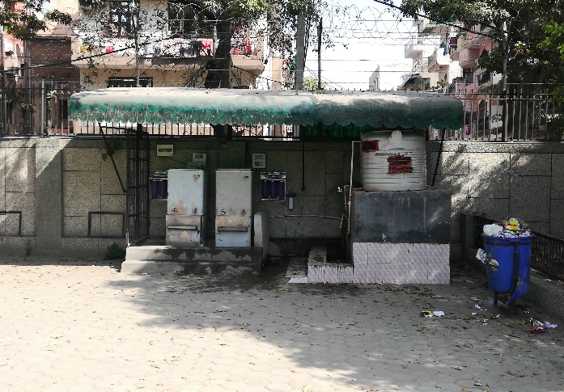
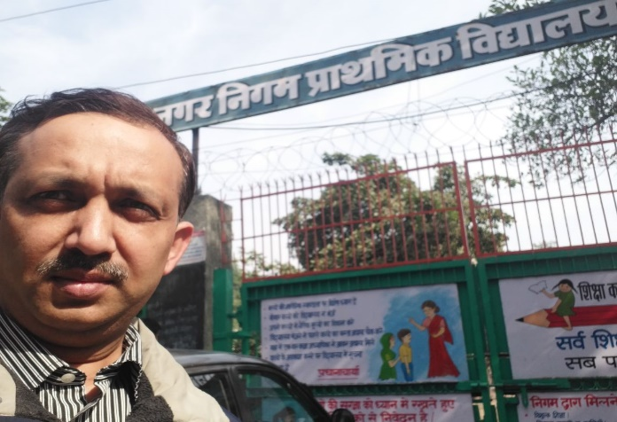
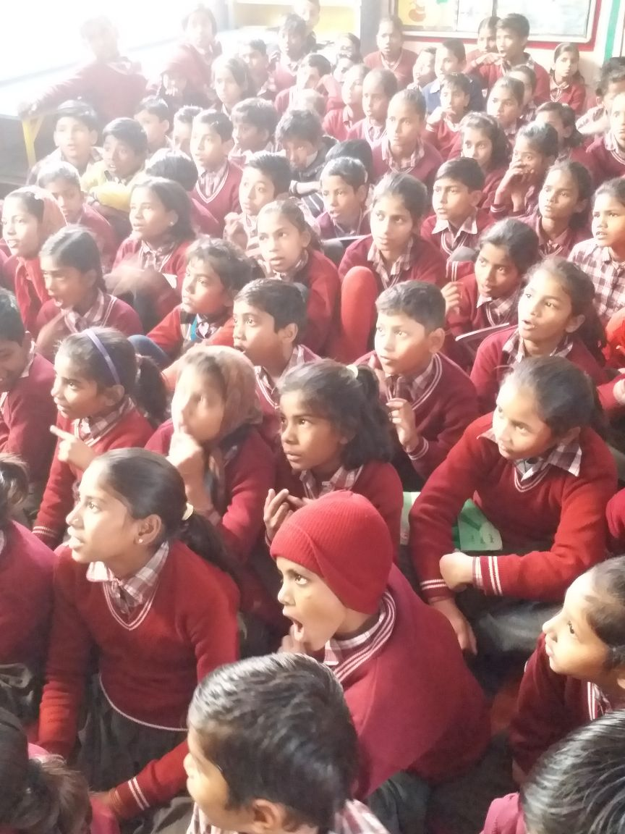
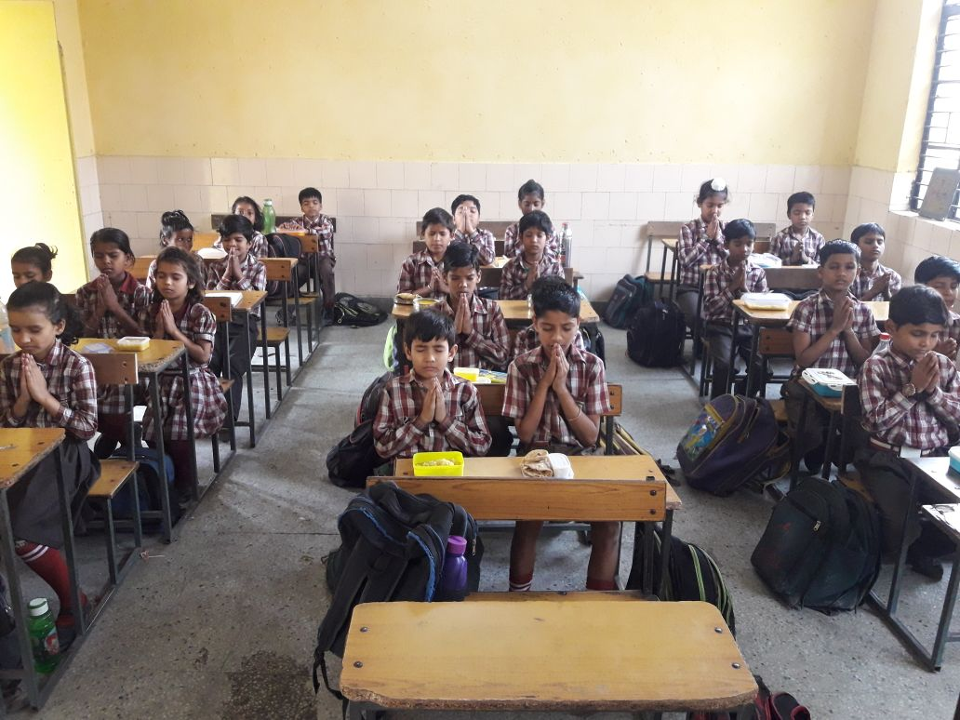
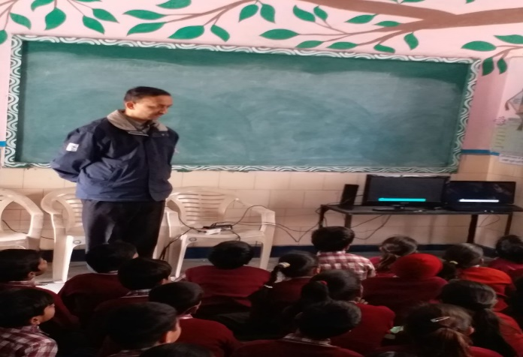
Study Highlights
Central Drinking water facility at school
Main school entrance
Students praying before mid-day lunch
During class interaction with students
Students during interaction

Slide 26
REFERENCES
International Institute for Population Sciences (IIPS) and Macro International. National Family Health Survey (NFHS-3), 2005-06: India. Vol 1. Mumbai: IIPS; 2007.
SSHE Global Symposium “Construction is not enough” Delft, The Netherlands. 2004. Jun 8-10, School Sanitation and Hygiene Education in India: Investment in Building Children's Future; pp. 3–4. Available from http://ddws.gov.in/POPUPS/SSHE_in_India_paper_2004.pdf [last assessed on 2009 Sep 23rd] [date of citation June, 2004]
School Sanitation and Hygiene Education in India: Investment in Building Children's Future. SSHE Global Symposium “Construction is not enough” Delft, The Netherlands. 2004. Jun 8-10, p. 5. Available from: http://ddws.gov.in/POPUPS/SSHE_in_India_paper_2004.pdf [last assessed on 2009 Sep 23] [date of citation June, 2004]
International Institute for Population Sciences (IIPS) and Macro International. National Family Health Survey (NFHS-3), 2005-06: India. Vol 1. Mumbai: IIPS; 2007.
https://www.ncbi.nlm.nih.gov/pmc/articles/PMC3902684/

Slide 27
REFERENCES
http://onlinelibrary.wiley.com/doi/10.1111/j.1936-704X.2010.00082.x/full
https://www.unicef.org/wash/
CWW WASH baseline study report, July 2016
A study on Water Sanitation Hygiene and Hand Washing practices among Mothers of under 5 Children attending tertiary care hospital in Kolkata, India. Dr. Maumita De, Dr. Pranita Taraphdar.
Guideline Series: Towards Better Programming: A Sanitation Handbook by UNICEF.
Swachh Bharat Swachh Vidyalaya: Clean India: Clean Schools, a Handbook by Ministry of Human Resource Development.
Progress on Drinking water, Sanitation and hygiene, 2017 Update and SDG baselines, World Health Organization (WHO) and the United Nations Children’s Fund (UNICEF) 2017, JMP Report.

Slide 28
REFERENCES
Soap stories and toilet tales, 10 case studies, UNICEF.
Water, Sanitation and Hygiene (WASH) in Schools. UNICEF.
A cross sectional descriptive study of hand washing knowledge and practices among primary school children in Mumbai, Maharashtra, India. Priyanka P. Gawai, Sachin A. Taware1, Ameeta S. Chatterjee, Harshad P. Thakur. International Journal of Community Medicine and Public Health. Gawai PP et al. Int J Community Med Public Health. 2016 Oct; 3(10):2958-2966. http://www.ijcmph.com.
Why water, sanitation and hygiene matter. Georgia B Savage, Alison K Macintyre, James H Wicken (WaterAid Australia, Melbourne, Australia), Yael Velleman (WaterAid, London, United Kingdom), Virginia Sarah (Fred Hollows Foundation, London, United Kingdom).
Assessment of Hand Washing Practice and its Associated Factors among First Cycle Primary School Children in Arba Minch Town, Ethiopia, 2015. Behailu Besha, Hailu Guche, Dawit Chare, Abebech Amare, Amelmal Kassahun, Engida Kebede,Yinager Workineh, Tomas Yeheyis, Mulugeta, Shegaze, Adisu Alemayehu and Aman Yesuf. Besha et al., Epidemiology (Sunnyvale) 2016, 6:3. http://dx.doi.org/10.4172/2161-1165.1000247.
Impact of Water, Sanitation, and Hygiene Interventions on improving Health Outcomes among School Children. Ashish Joshi and Chioma Amadi. Center for Global Health.

Slide 29
THANK YOU!

