Slide 1
DISSERTATION PRESENTATION
in reward for
Post Graduate Diploma in Health and Hospital Management
Submitted by:
Nidhi Khatura
PG/13/040

Slide 2
CONTENTS
Organization Profile
Dissertation Project
Objectives
Methodology
Frame work
Findings and Analysis
Conclusion

Slide 3
Organization Profile
Dissertation Project
Objectives
Methodology
Framework
Findings and Analysis
Conclusion

Slide 4

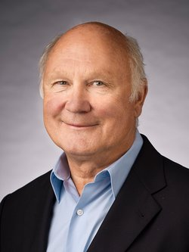

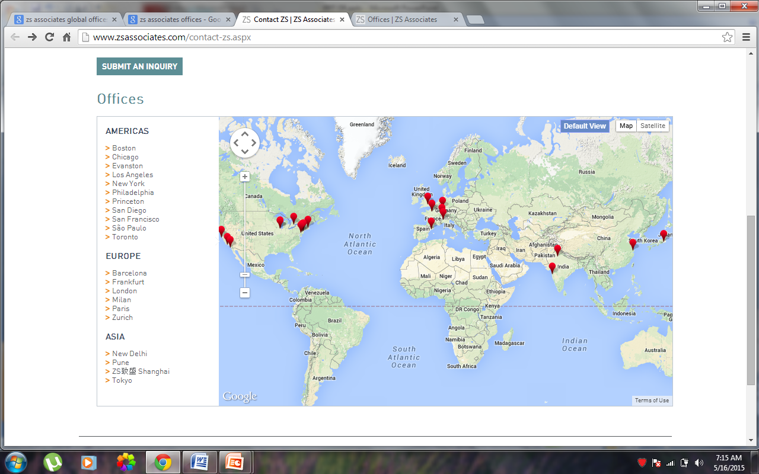
ZS ASSOCIATES INDIA PVT. LTD
About
ZS Associates is a Global professional services firm
Z and S
Global Presence
Andy Zoltner Prabha Sinha

Slide 5
Services
Serving clients in pharmaceuticals, consumer products, energy, high tech, insurance and medical products.
Sales and Marketing
Business Consulting
Business Analytics
Business technology
Business operations
Knowledge Management
Offers a broad spectrum of business research, presales and other knowledge based services to the clients and internal stake holders
Deep research to bring together a unique combination of business research, life sciences and clinical experiences
Knowledge Management Associate
Develop and maintain knowledge for the firm.
Organization, dissemination of external and collective knowledge of the firm to help the project teams and services

Slide 6
Organization Profile
Dissertation Project
Objectives
Methodology
Framework
Findings and Analysis
Conclusion

Slide 7
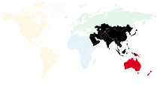
Comparative Analysis of European and Asia Pacific Healthcare systems
The countries included in the study are:
European Region:
Austria, Belgium, Czech Republic, Denmark, Finland, France, Germany, Greece, Ireland, Hungary, Norway and Slovakia
Asia Pacific Region:
Australia, India, Vietnam, Hong Kong, Philippines, Indonesia andMalaysia

Slide 8
Organization Profile
Dissertation Project
Objectives
Methodology
Framework
Findings and Analysis
Conclusion

Slide 9
General Objective
To compare the healthcare system of European and Asia Pacific countries.
Specific Objectives
To study the healthcare and pharmaceutical system of the European countries.
To compare the healthcare and pharmaceutical structure within Europe.
To study the healthcare and pharmaceutical system of the Asia Pacific countries.
To compare the healthcare and pharmaceutical structure within Asia Pacific.
To understand the entry and exit barriers for a pharmaceutical companies, while exploring the business opportunity in European union as well as Asia Pacific countries

Slide 10
Organization Profile
Dissertation Project
Objectives
Methodology
Study Framework
Findings and Analysis
Conclusion

Slide 11

STUDY METHODOLOGY
Descriptive Study
Time Period
  Two and a half month
  11th February 2015 to 24th April 2015
Secondary Research
  Public data sources
  Subscribed data sources

Slide 12
Public Data Sources
The essential information has been gathered from various authentic public data sources such as government websites, sources for global data, such as:
  WHO Reports
  World Data Bank
  OECD i Library
  company reports
  organizations websites.

Slide 13
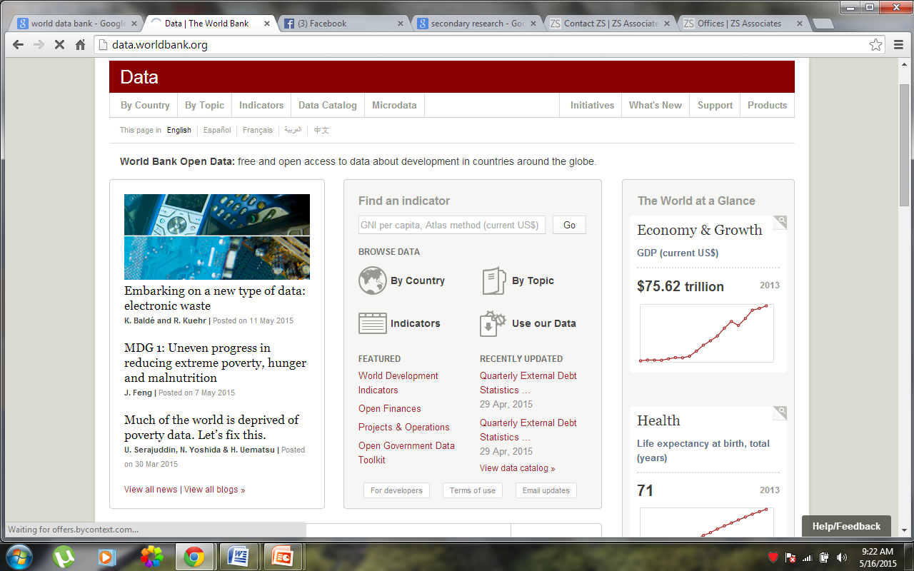
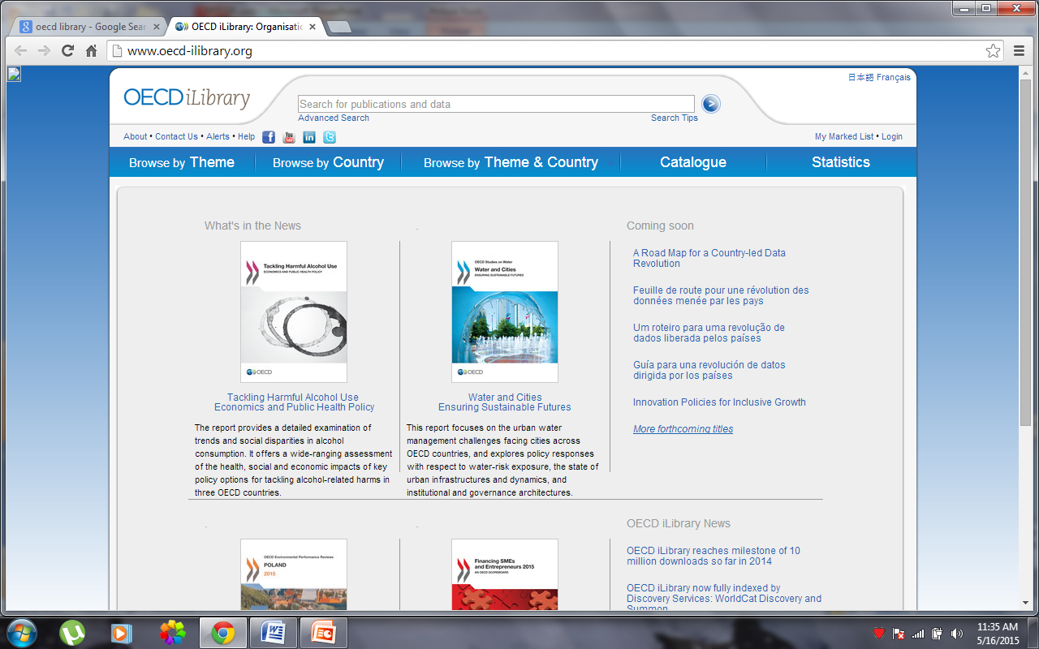
World
Data Bank
OECD i
Library

Slide 14
Subscribed Data Sources
These data sources are employed by various organizations to get authentic and reliable data on various markets.
One can get subscription for the reports from various companies
These are the paid sources i.e. the subscription is chargeable, users are required to pay for the data
The Data Monitor , one such data source has been employed in the study

Slide 15
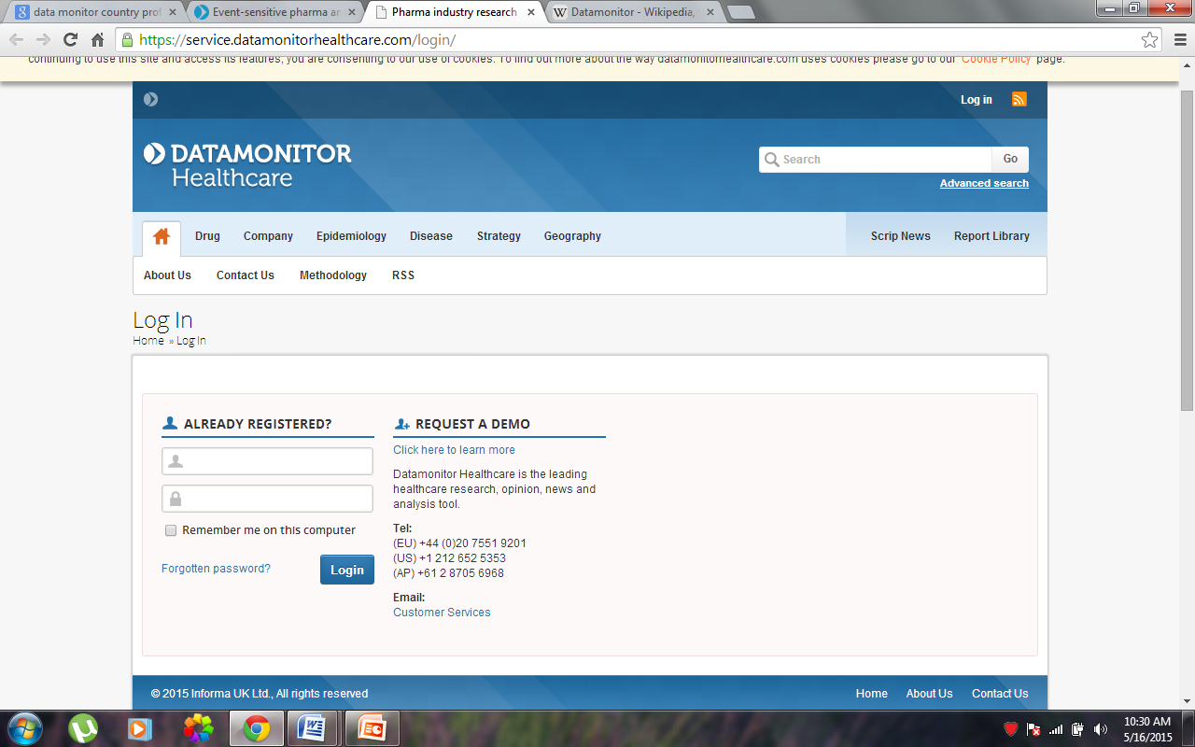
Data Monitor
DM is an international company providing market intelligence, data analysis, and opinion via a worldwide network of in-house analysts
Its website claims to have over 6,000 clients, which it helps make strategic and operational decisions.
Business Monitor International (BMI)
BMI provides proprietary data, analysis, ratings, rankings and forecasts covering 195 countries and 24 industry sectors. It is a data and intelligence tool assessing global, regional, country and company developments and trends.

Slide 16
Organization Profile
Dissertation Project
Objectives
Methodology
Study Framework
Findings and Analysis
Conclusion

Slide 17
FRAMEWORK
I | Healthcare needs and Demands | Demographic indicators | Population size, Population above 65 years, population growth rate
 |  | Macro economic indicators | GDP, GDP, Growth rate, GDP per capita, Health expenditures,
 |  | Healthcare indicators | IMR, LE,
 |  | Healthcare resources | Workforce, Hospitals
II | Health care Financing and Organization system
III | Pharmaceutical system | Pharmaceutical market
 |  | Drug Approval process
 |  | Pricing regime
 |  | Reimbursement Regime
 |  | Intellectual property
 |  | Marketing/ Distribution

Slide 18
Organization Profile
Dissertation Project
Objectives
Methodology
Study Framework
Findings and Analysis
Conclusion

Slide 19
I. Healthcare Needs and Demands

Slide 20
Demographic Indicators
  Population size
Country | Population (2013)
Austria | 8,479,823
Belgium | 11,182,817
Czech Republic | 10,514,272
Denmark | 5,614,932
Finland | 5,438,972
France | 65,939,866
Germany | 80,651,873
Greece | 11,027,549
Hungary | 9,893,899
Ireland | 4,597,558
Netherlands | 16,804,432
Norway | 5,080,166
Slovak Republic | 5,413,393
Spain | 46,617,825
Sweden | 9,600,379
United Kingdom | 64,106,779
Table 1: Population in EU (2013) Source: World Data Bank
Country | Population
Australia | 23,129,300
Hong Kong | 7,187,500
India | 1,252,139,596
Indonesia | 249,865,631
Malaysia | 29,716,965
Philippines | 98,393,574
Thailand | 67,010,502
Table 2: Population in Asia Pacific (2013) Source: World Data Bank
Population of EU Member States range from 4.5 million, as the lowest in Ireland to 80 million, being the highest in Germany.
The population in APAC is much greater than that of the European countries.

Slide 21
ii. Population Growth Rate
Most of the Asia Pacific countries exhibit a high population growth rate, where as European countries namely Greece and Hungary have a negative population growth rate

Slide 22
ii. Population above 65 years (%)
All of the European countries have a substantial ( around or above 15) percentage of over 60 population
Among APAC , Australia and Hong Kong have a good over 60 population
A substantial percentage of over 60 population reflects the presence of a strong healthcare system. Also, such geographies are good opportunity for the pharmaceutical market

Slide 23
2. Macroeconomic indicators
  i. Gross Domestic Product
There is a wide disparity in GDP between and within the regions of Europe and Asia Pacific.
In Europe, Germany France and UK have a high GDP value which is even greater than India and australia which are the high GDP countries in Asia Pacific region.

Slide 24
ii. GDP Growth Rate

Slide 25
iii. GDP per capita
The per capita expenditure on healthcare is one of the highest in Norway

Slide 26
Australia is a country with high per capita expenditure.

Slide 27
iv. Health Expenditure
Health expenditure in European countries
Country | Healthcare Expenditure
 | Total Health expenditure ( as % of GDP) | Public Health expenditure (as % of total Health expenditure) | Private Health expenditure ( as % of total health expenditure) | Private Health expenditure (as % of private Health expenditure)
Austria | 11 | 75.7 | 24.3 | 65.2
Belgium | 11.2 | 75.8 | 24.2 | 82.3
Czech Republic | 7.2 | 83.3 | 16.9 | 94.1
Denmark | 10.6 | 85.4 | 14.6 | 87.4
Finland | 9.4 | 75.3 | 24.7 | 75
France | 11.7 | 77.5 | 22.5 | 32.9
Germany | 11.3 | 76.8 | 23.2 | 55.6
Greece | 9.8 | 69.5 | 30.5 | 86.6
Hungary | 8 | 63.6 | 36.4 | 75.5
Ireland | 8.9 | 67.7 | 32.3 | 52.1
Netherlands | 12.9 | 79.8 | 20.2 | 41.7
Norway | 9.6 | 85.5 | 14.5 | 95.9
Slovak Republic | 8.2 | 70 | 30 | 73.9
Spain | 8.9 | 70.4 | 29.6 | 77.1
Sweden | 9.7 | 81.5 | 18.5 | 88.1
UK | 9.1 | 83.5 | 16.5 | 56.4

Slide 28
Country | Health Expenditure
 | Total Health expenditure ( as % of GDP) | Public Health expenditure (as % of total Health expenditure) | Private Health expenditure ( as % of total health expenditure) | Out of Pocket Health expenditure (as % of private Health expenditure)
Australia | 9 | 67 | 33 | 56
Hong Kong | 5.1 | 48.7 | 51.3 | --
India | 4 | 1.3 | 98.7 | 85.9
Indonesia | 3.1 | 1.2 | 98.8 | 75.1
Malaysia | 4 | 2.2 | 97.8 | 79.9
Philippines | 4.4 | 1.4 | 98.6 | 82.9
Thailand | 4.6 | 3.7 | 96.3 | 56.7
Vietnam | 6 | 2.5 | 97.5 | 85
APAC has a very low Total Health Expenditure as compared to European countries
Most of the countries have a very high private health expenditure.

Slide 29
3. Healthcare Indicators
European Countries
APAC
Country | Healthcare Indicators
 | IMR | Life Expectancy
Austria | 3 | 81
Belgium | 4 | 80
Czech Republic | 3 | 78
Denmark | 3 | 80
Finland | 2 | 81
France | 4 | 82
Germany | 3 | 81
Greece | 4 | 81
Hungary | 5 | 75
Ireland | 3 | 81
Netherlands | 3 | 81
Norway | 2 | 81
Slovak Republic | 6 | 76
Spain | 4 | 82
Sweden | 2 | 82
United Kingdom | 4 | 81
Country | Health Expenditure
 | IMR | Life expectancy (years)
Australia | 3 | 82
Hong Kong | 41.4 | 84
India | 24.5 | 66
Indonesia | 7.2 | 71
Malaysia | 23.5 | 75
Philippines | 11.3 | 69
Thailand | 19 | 74
Vietnam | 41.4 | 76
Wide difference exists in the global health indicators across the countries

Slide 30
II. Healthcare Financing and Organization

Slide 31
European Countries
There are three predominant systems of health care finance in the European Union.
  Beveridge model: public finance by general taxation
  The Bismarck model: public finance based on compulsory social insurance
  Private finance based on voluntary insurance, which covers only a small minority of EU citizens entirely, but which also operates on top of social insurance as a supplementary form of funding health care.
Similar system exists in Asia Pacific Regions, Financed throgh one or mix of the following:
  public finance by general taxation
  Public/ community financed through social insurance
  Private voluntary health insurance

Slide 32
Healthcare Financing in Europe
Healthcare Financing in APAC
Countries | Predominant system of finance | Main supplementary system of finance
Finland, Greece, Ireland, Sweden, spain, United kingdom | public: taxation | private voluntary insurance, direct payments
Denmark | public: taxation | direct payments
Austria, Belgium, france, Germany | public: compulsory social insurance | private voluntary insurance, direct payments, public taxation
Norway | mixed compulsory social insurance and private voluntary insurance | public taxation, direct and private voluntary insurance payments
Health care systems of Asia provide very limited financial risk protection.
The role of public prepaid schemes such as tax and social health insurance is minimal, and out-of-pocket payment is a major source of financing.

Slide 33
II. Healthcare Resources and Utilization

Slide 34
Healthcare workforce, hospitals and Hospital beds in Europe
Country | Doctors | Doctors per 1000 population | Nurses per 1000 | Hospitals | Hospital beds
Austria | 40,912 | 486 | 797 | 310 | 63,951
Belgium | 41,979 | 378 | 1415 | 363 | 72,147
Czech Republic | 38,983 | 371 | 879 | 357 | 73,592
Denmark | 19,056 | 340 | 1540 | 69 | 19,609
Finland | 14,369 | 270 | 960 | 380 | 31,989
France | 2,14,558 | 338 | 930 | 4171 | 418836
Germany | 4,51,280 | 560 | 1138 | 2017 | 668861
Greece | 65,973 | 610 | 330 | 337 | 35000
Hungary | 33,769 | 341 | 642 | 167 | 71343
Ireland | 17,278 | 270 | 1220 | 176 | 20,477
Netherlands | 49,242 | 291 | 844 | 129 | 79052
Norway | 18,414 | 361 | 1251 | 74 | 168178
Slovak Republic | 16,233 | 330 | 600 | 111 | 34,629
Spain | 1,84,996 | 396 | 528 | 738 | 149454
Sweden | 37,262 | 387 | 1100 | 73 | 26010
United Kingdom | 1,74,698 | 277 | 947 | NA | 189545

Slide 35
Healthcare workforce, hospitals and Hospital beds in APAC
Country | Health care resources and Work Force
 | Doctors | Doctors (per 1000) | Nurses | Hospitals | Hospital Beds
Australia | 76,326 | 3.3 | 3,28,817 | 2079 | 90,2031
Hong Kong | 13,203 | - | 45,846 |  | 27400
India | 7,86,626 | 0.7 | 14,31,000 | 12760 | 5,76,793
Indonesia | 74,959 | 0.3 | 0.9 |  | 2,24,878
Malaysia | 26,745 | 0.9 | 2.45 |  | 56,462
Philippines | - | - | 4,88,000 |  | 98,393
Thailand | 1,62,412 | 0.65 | 1.524 | 1300 | 13402
Vietnam | 60,156 | 0.65 |  | 903 | 250,000

Slide 36
IV. The Pharmaceutical System

Slide 37
Pharmaceutical Market
  Market value
  Market share
  Drug Sales
    Prescription
    OTC
    Generic
    Patented
    Therapeutic Share
  Pharmaceutical Trade
    Imports
    Exports

Slide 38
Pharmaceutical Market value , 2013 European
Country | Market value (US$ billion) | Prescription drug sales (as %of total sales) |  | OTC sales as % of total sales
 |  | Patented drug sales as % of total sales. | Generic drug sales as % of total sales
Austria | 6.05 | 67.5 | 12.6 | 19.9
Belgium | 7.70 | 78.7 | 10.6 | 10.7
Czech Republic | 3.66 | 48.9 | 33.7 | 7.4
Denmark | 3.58 | - | - | -
Finland | 3.393 | 69.1 | 18.8 | 12.1
France | 3.17 | 66.5 | 16.5 | 17
Germany | 52.82 | 65.8 | 22.5 | 11.7
Greece | 7.45 | 68.2 | 23.3 | 8.5
Hungary | 2.53 | 49.3 | 34 | 16.7
Ireland | 2.77 | 88 |  | 12
Netherlands | 8.04 | 23.2 | 63.7 | 13.1
Norway | 3.363 | - | -
Slovak Republic | 2.20 | 40.3 | 41.6 | 12.1
Spain | 31.79 | 82.9 | 10.3 | 6.8
Sweden | 5.70 | 75.6 | 15.1 | 9.3
United Kingdom | 36.15 | 59.5 | 24.8 | 15.7

Slide 39
Pharmaceutical Market value , 2013 European Countries
Country | Market value | Prescription drug sales (as % of total sales) |  | OTC sales as % of total sales
 |  | Patented drug sales as % of total sales. | Generic drug sales as % of total sales
Australia | 23.4 | 67.5 | 12.6 | 19.9
Hong Kong | 1.33 | 57 | 24.8 | 15.7
India | 15.4 | 8.7 | 75.9 | 14.4
Indonesia | 6.123 | 19.3 | 41 | 39.7
Malaysia | 2.11 | 40.3 | 52.7 | 27
Philippines | 3.5 | 28 | 32.7 | 29.3
Thailand | 4.69 | 30.1 | 50.3 | 19.6
Vietnam | 3.30 | 22.3 | 51.2 | 26.4
APAC has a low market value
India has a high generic drug market

Slide 40

ii. Pharmaceutical Approval Process
Registration and grant of Market Authorization
General process of drug Approval includes:
  Evaluating safety and efficacy data
  Evaluation of the dossier
  Licensing
  Inspecting manufacturing facilities and distribution channels
  Monitoring drug adverse reactions for investigational and marketed drugs
  Controlling drug promotion and advertising.

Slide 41
The Pharmaceutical approval process in European countries
Four processes
National Approval Procedure
This procedure is used whenever a company wants to commercialize a product in only one EU Member State
The National procedure is specific to each country i.e; each country within the EU has its own procedures for authorizing a marketing application for a new drug
A national market authorization is valid for five years
The Centralized Procedure
Europe wide authorization procedure, conducted by EMA’s Committee for Human Medicinal Products (CHMP), an organism containing representatives of all Member states, EEA members, patient organizations and health professionals.
Two member states are first selected, a rapporteur and a co-rapporteur. These two member states will be responsible for the creation of an evaluation report that will be assessed by the CHMP

Slide 42
The Mutual Recognition Procedure
This procedure requires the drug to already be approved in a member state
This procedure is based on the principle that a Marketing authorization and evaluation in one Member States (the so-called concerned Member States)ought to recognize the competent authorities of the other member states,
Decentralized Procedure
The decentralized procedure works in a similar way as the mutual recognition one, except here the medicinal product in question has not yet received a marketing authorization in any Member State at the time of application.
Like the MRP, a reference member state is chosen, which will evaluate the MAA.
The remaining member states then proceed to give their opinion on the evaluation.
If all concerned member states agree on the evaluation by the reference member state, the drug will be approved and allowed for sale in those countries(14). If a member state disagrees, the Co-ordination Group for Mutual Recognition and Decentralized Procedures will, like in the MRP, play a referee role

Slide 43
Pharmaceutical Approval Processes in various European countries
Country | Approval Process | Approving Authority
Austria | Centralized, National, MCP | Austrian Federal Office for safety in Healthcare
Belgium | Centralized, National, MCP | Federal Agency for Medicine and Healthcare
Czech Republic | Any of the four | State Institute of Drug Control
Denmark | Any of the four | Danish health and Medicine Authority
Finland | Any of the four | Finish Medicine Agency
France | Any of the four | National Drug Regulatory Body
Germany | Any of the four | Federal institute for drugs and medicinal devices
Greece | National procedure (lengthy) or EU procedures | National Pharmaceutical organization (EOF)
Hungary | National Procedure | National institute for Pharmacy
Ireland | Any of the four procedures | Health Product Regulatory Authority
Netherland | National, Centralized and MCP | Medicine evaluation Board
Norway | Centralized or MRP (EEA) | Norwegian Medicine Agency
Slovak Republic | National ,centralized, the MRP | Medicine Evaluation Board
Spain | Any of the four | Spanish Medicine and Health Product Agency
Sweden | Centralized procedure or MRP | Medical product Agency
UK | Any of the four | Medicines and Healthcare products Regulatory Agency

Slide 44
Pharmaceutical Approval Processes in Asia Pacific countries
Country | Approving Authority | Approval Procedure
Malaysia | Drug Control Authority (DCA) | Three staged Process: Preliminary Screening Laboratory Testing Dossier evaluation
Thailand | Thai Food and Drug Administration | Drug Approval is a combination of two separate stepped processes: Market Authorization Drug Registration A drug is first granted a conditional Approval for two year for its safety monitoring fulfilling which it qualifies for unconditional approval.
Vietnam | Drug Administration Vietnam | The process involve pre submission preparation, manufacture sign on dossier, submission of dossier, Dossier evaluation.
Hong Kong | Pharmacy and Poisons Board | The process relies reviewing the application on the basis of safety, efficacy and quality.

Slide 45
Indonesia | National Agency for Drug and Food Control | Two stepped procedure: Pre registration Screening of drug registration Determination of registration category and evaluation path Registration Issuance of head of agency submission letter Drug registration application and dossier submission Dossier evaluation
India | Central Drug Standard Control Organization (CDSCO) | Submission of application to Investigation New drug (IND) Examination and review by New Drug Division Recommendations from Drug Controller General of India (DCGI) Licensing by CDSCO and DGCI
Australia | Therapeutic goods Administration | Submission of application to TGA Premarket evaluation, quality, safety and efficacy. Price assessment and inclusion in PBS
Phillipines | Food and Drug Administration | Issue of LTO (License to Operate) by FDA Registration of Drug by the Center for Drug Regulation and Research

Slide 46
ii. Pharmaceutical Pricing Regime
The pharmaceutical pricing refers to determining the selling price of the drugs at various stages.
Pricing startegies:
  Free Pricing
  Price Negotiation
  External Referencing
    The practice of using the price(s) of a medicinal product in one or several countries in order to derive a benchmark or reference price for the purposes of setting or negotiating the price of the product in a given country.

Slide 47
  Internal Referencing
  Describes the practice of setting the price to be paid by public payers by comparing prices of equivalent or similar products in a chemical, pharmacological or therapeutic group. The ‘reference price’ applies to all pharmaceuticals within the corresponding group of products.
  Profit control
  Describes a profit framework which is negotiated periodically between the Department of Health and the pharmaceutical industry (Pharmaceutical Price Regulation Scheme, PPRS)

Slide 48
Pricing Techniques in European countries
Pricing techniques | Free Pricing | External Referencing | Internal Referencing | Cost plus | Negotiations | Profit capping | Others
Countrie | UK (non reimbursable drugs), Sweden (inpatient drugs), Spain (Out patient drugs), Slovak (reimbursable drugs), Austria, Belgium, Hunagary (for non reimbursable), France (non reimburse drugs) | Spain, Slovak (non reimbursable drugs), Norway, Netherlands, Czech Republic, Ireland, Hungary, Greece | Spain, Germany ( for therapeutic and generic substitutes) | Spain | France (reimbursable), Germany (drugs with no additional benefits) |  | Norway (stepped price method for generics), Netherlands, Ireland (strict cost saving method). Hungary (for reimbursable)

Slide 49
Pricing Techniques in APAC
Pricing techniques | Free Pricing | External Referencing | Internal Referencing | Cost plus | Negotiations | Profit capping | Others
Countries (APAC) | Malaysia, Indonesia (pvt. sector medicines), Thiland, Vietnam, |  |  |  |  | India, Indonesia (public sector medicines) | Philippines

Slide 50
iii. Pharmaceutical Reimbursement Regime
Once a regulatory agency has determined the clinical benefit and safety of a product and pricing has been confirmed , a drug manufacturer will typically submit it for evaluation by a payer of some sort.
 | Positive list/ negative list | Therapeutic value | cost | dispensing unit (OPD/IPD or prescription/ OTC) | Automatic reimbursement | Any other
Europe | Germany | Belgium, Czech republic, Denmark, finland. France, hungary, Norway, | Finland, Ireland, sweden | Czech Republic, Slovak republic (IPD), Spain, UK (NHS), | Greece | Netherland (Based on substitutability/ therapeutic comparability), Norway (duration of a disease), Germany (age)
APAC | Malaysia, Vietnam, hongkong, Thailand, India | Philippines |  | Vietnam (HOM) | Australia | Phillipines

Slide 51
iii. Pharmaceutical Intellectual Property Regime
Ideas, inventions, and creative expressions based on which there is a public willingness to bestow the status of property.
Patent, copyright, trademark,
USTR (United State Trade Representative) and PhRMA (Pharmaceutical Research and Manufacturers of America)
Priority Foreign Country
Priority Watch List
Watch List

Slide 52
USTR and PhRMA status on Pharmaceutical IP regime
PhRMA Status |  | Priority Foreign Country | Priority Watch List | Watch List
2014 | Europe | Nil | The European Union, Hungary | Finland, Greece, Germany, Spain
 | Asia Pacific | India | Indonesia, Thailand | Vietnam, Malaysia, Philippines
USTR Status |  | Priority Foreign Country | Priority Watch List | Watch List
2014 | Europe | Nil | Nil | Finland, Greece
 | Asia Pacific | Nil | India, Thailand | Vietnam

Slide 53
iii. Pharmaceutical Distribution and Marketing Practices
Single Channel | Multi-channel | Self dispensing doctors | Pharmacy chain permisible | Sales by non pharmacies | Internet pharmacies | Direct supply by manufacturers
Sweden Greece Finland | Sweden France Spain Czech Republic | Austria, Netherland | Austria, finland, france, germany (under certain conditions), Greece, hungary, Ireland (under certain conditions), Spain, Netherlands | Belgium Denmark | Austria, belgium, finland, france, germany, Greece, hungary, Ireland, Spain, Sweden, Denmark, Slovakia, ireland | Hungary germany
India, philippines |  | Malaysia | Hong kong | Indonesia, Vietnam

Slide 54
Conclusion
Summary Matrix

Slide 55
Color Key for Comparison
Color | Interpretation | Healthcare system | Pharmaceutical market | Approval | Pricing | Reimbursement | IP | Distribution
Blue | Conducive/ Attractive | Funded primarily through public taxation | Higher market value, high growth and potential | All four | Free Pricing, negotiations | Automatic reimbursement, Mandatory Insurance | Non watch list | Direct dispensing. Self dispensing doctors
green | Moderate | Social health insurance, pvt. Voluntary insurance | Moderate potential | Mix model | Mixed model | Category specific , Mixed Model | Watch listed | Dominated by a few Wholesalers
Red | Stringent/ Poor | Direct payment | Low market value, high growth and potential | National procedures (EU/ Non EU) | Tight pricing regulations | Strict inclusion criteria | Priority foreign country/ priority watch list | No regulation in distribution

Slide 56
EUROPEAN AND ASIA PACIFIC COUNTRIES HELTHCARE SUMMARY MATRIX
 | Healthcare system | Pharmaceutical market | Approval | IP | Pricing | Reimbursement | Distribution
Austria | Compulsory social insuracne | 6.05 | Centralized, National, MRP | NL | External Price Referencing | Automatic reimbursement | Primarily done by pharmacies
Belgium | Compulsory social insuracne | 7.70 | Centralized, National, MCP | NL | Free pricing | Strict inclusion criteria | Mostly dispensed through independent pharmacies
Czech Republic | Direct payment | 3.66 | Any of the four | NL | External Referencing (21 EU countries) | Moderate inclusion criteria | dominated by domestic and regional generic companies,
Denmark | Public : taxation and direct payments | 3.58 | Any of the four | NL | Free Pricing | Based on expenses | Dominated by three main wholesalers

Slide 57
Finland | public: taxation | 3.393 | Any of the four | WL | Reference pricing | Category specific reimbursement rate, moderate to high co payment | Single chain, dominated by two wholesalers
France | Compulsory social insuracne | 3.17 | Any of the four | WL | Mix of free pricing and negotiation | Reimbursed through mandatory insurance | Multichain system for distribution
Germany | Public cumpulsory insurance | 52.82 | Any of the four | WL | Mix of reference pricing, negotiations and maximum pricing | Runs a negative list | Manufacture and wholesalers dispense directly to pharmacies
Greece | public: taxation | 7.45 | National procedure (lengthy) or EU procedures | WL | External pricing (lowest in EU) | Automatic reimbursement | Manufacturer can supply directly to the hospitals

Slide 58
Hungary | Mix of public taxation and SHI | 2.53 | National Procedure | NL | Mix of reference pricing, free pricing and profit regulations | Negative list | Manufactures are allowed to send pharmaceuticals directly to hospitals
Ireland | public: taxation | 2.77 | Any of the three procedures | NL | Internal referencing and strict price cuts | Easy inclusions on list, no or very low co payment | Prior marketing approval not priority
Netherlands | SHI, voluntary pvt insurance and direct payment | 8.04 | National, Centralized and MRP | NL | Max. retail price and external referencing | Strict inclusion criteria | Pharmacies and self dispensing doctors form a major channel
Norway | mixed compulsory SHI and private voluntary insurance | 3.363 | Centralized or MRP (EEA) | NL | External Price referencing | Very low co payment | Three chains control the wholesalers and dominate pharmacy outlets

Slide 59
Slovak Republic | Direct payment/ SHI | 2.20 | National ,centralized, the MRP | NL | Mix of free pricing and external referencing | Category specific reimbursement rate, moderate to high co payment | Dominated by wholesalers
Spain | public: taxation | 31.79 | Any of the four | NL | Mix of free pricing, External referencing ,Internal referencing, Cost plus referencing | Category specific reimbursement rate, moderate to high co payment | Multichannel distribution system
Sweden | public: taxation | 5.70 | Centralized procedure or MRP | NL | Free pricing | Strict inclusion criteria | Single and double channel distribution system
UK | NHS on public taxation | 36.15 | Any of the four | NL | Free pricng, negotiations and profit control | Reimbursed under NHS | Direct to pharmacy model permissible

Slide 60
Australia | public: taxation | 23.4 | Non EU National Procedure |  | Cost plus, reference pricing, and weighted average monthly method | Automatic reimbursement | Wholesale market dominated by three players
Hong Kong | Direct paument/ shi | 1.33 | Non EU National Procedure | NL | Unregulated | Essential drug list | Patented and generic drugs are mainly distributed directly to hospitals, clinics or other institutions.
India | Direct payment | 15.4 | Non EU National Procedure | PFC | Regulated by capping industry profit | NELM | highly fragmented

Slide 61
Indonesia |  | 6.123 | Non EU National Procedure | PWL | Private sector unregulated. Others high profit margin | Essential drug list, under strict price control | Single chain, drug stores, Plantations, doctors, grocery,pedolars, general stores and hospitals
Malaysia |  | 2.11 | Non EU National Procedure | WL | Free pricing in pvt. Public prices by govt. | Drug formulary | 30% of the pharmaceuticals are distributed by pharmacies. A further 26% and 19% are distributed by physicians and government hospitals, respectively.

Slide 62
Philippines | Direct payment | 3.5 | Non EU National Procedure | WL | Very strict regulations | Essential Medicine List, strict inclusion | Wholesalers and importers are the major distributors
Thialand | Mix of social Health | 4.69 | Non EU National Procedure | PWL | No price control | National essential drug list, strict inclusion | The GPO (Government Pharmaceutical Organization), supplies about 1000 products to over 10,000 facilities
Vietnam | Direct payment | 3.30 | Non EU National Procedure | WL | Highly regulated | Reimbursement list and SHI | Distribution is conducted through two channels

Slide 63
THANK YOU

