Slide 1

Diagnostic Landscape Review of Brucellosis: A Neglected Zoonotic Disease in the Indian Public Health System
IIHMR, DELHI
Presented by: Dr. Divyanshu(PT)
Faculty Mentor: Dr.Ekta Saroha
IIHMR Delhi

Slide 2

Mentor Approval

Slide 3
Background with Rationale
Brucellosis, a highly infectious but under-recognised zoonotic disease caused by Brucella spp., poses a major public health and economic threat in India. Despite over 500,000 global human cases annually, underreporting obscures the true burden. Recent Indian studies show human seropositivity rates up to 16.7% and livestock rates averaging 12%, with chronic illness, reproductive complications, and musculoskeletal pain driving morbidity. In animals, infertility, abortions, and reduced milk yield lead to annual losses of over USD 3.4 billion, and human cases contribute to over 177,000 DALYs annually. Diagnosis remains challenging—culture methods are slow, serological tests lack field adaptability, and rapid tests show inconsistent accuracy. This landscape review evaluates the availability, performance, field suitability, and regulatory approval of brucellosis diagnostics across India’s public health system—from the PHC level to central reference labs. Findings aim to support evidence-based strategies for surveillance, vaccination, and outbreak response by guiding program planners, technical agencies, and community implementers.

Slide 4
Literature Review
The FAO (2003) advocates a One Health approach for brucellosis control, stressing the need for coordinated human and animal surveillance. It recommends RBPT for field screening and ELISA/CFT for lab confirmation, while noting that culture, though the gold standard, is often impractical in low-resource settings. The report also emphasises local validation of tests, lab strengthening, and data integration across sectors.FAO, 2003 – Guidelines for coordinated human and animal brucellosis surveillance.
Deka et al. (2018) conducted a comprehensive review of bovine brucellosis, examining its widespread occurrence, associated risk factors, and the economic burden it places on India’s livestock and dairy industry. The study also highlighted major shortcomings in existing diagnostic methods, especially the absence of dependable confirmatory tests at the field level and continued use of obsolete or low-accuracy techniques. https://www.ilri.org/knowledge/publications/bovine-brucellosis-prevalence-risk-factors-economic-cost-and-control-options
Lindahl et al. (2019) highlighted the fragmented diagnostic landscape in India, revealing the lack of standardisation across human and veterinary health sectors. Their collaborative workshop identified diagnostics as a critical priority under a One Health framework, emphasising the need for inter-sectoral coordination and laboratory strengthening at multiple health system levels.Lindahl et al., 2019 – Trop. Anim. Health Prod.
From a veterinary perspective, Upadhyay (2020) reviewed the status of brucellosis in India, pointing out that ELISA and RBPT are the most widely used diagnostic methods, though often without proper validation or quality assurance in field settings.Upadhyay, 2020 – IJVPH

Slide 5
Literature Review
5) PMC (2021) This review focused on laboratory diagnosis of human brucellosis, reaffirming culture as the gold standard despite its long turnaround time. Serological assays remain central in routine use, while PCR-based methods offer improved speed and specificity but are rarely implemented in the Indian public sector. The paper called for urgent standardization of diagnostic protocols and improved access to molecular diagnostics, especially in endemic regions.
6) In terms of human health burden, Parai et al. (2022) reported a significant seroprevalence of brucellosis among both tribal and non-tribal populations in Eastern India. Their state-wide survey utilised serological tools and called for improved diagnostics in peripheral and rural settings, especially where clinical symptoms are non-specific and limited. Parai et al., 2022 – Front. Microbiol
7) Praharee (2023) emphasised the economic impact of bovine brucellosis and linked ineffective control efforts to diagnostic limitations, including inaccessible gold standard methods like culture and Complement Fixation Test (CFT) in field or district labs. Praharee, 2023 – Pashudhan Prahree
8) Building on these observations, Kalambhe et al. (2025) reported cases of human brucellosis in Punjab that remained undetected due to non-specific symptoms. Their study emphasised the persistent diagnostic shortcomings at the primary care level and highlighted how misdiagnosis and low clinical awareness contribute to significant underreporting. Kalambhe et al., 2025 – Vet World

Slide 6
Objectives of Your Study
Primary Objective:
-To review and map available diagnostic tools for brucellosis using gold standard benchmarks and evaluate their suitability across different levels of the public health system, including veterinary clinics
Secondary Objectives:
-To assess diagnostic tools for field-level screening.
-To evaluate the appropriateness of diagnostics for confirmatory testing at district/state-level labs.
-To identify gaps and recommend strategies for diagnostic strengthening in the brucellosis control effort.

Slide 7
Research Question
What are the currently available diagnostic tools for brucellosis in India, and how do they compare in terms of assay type, regulatory approval, field vs. lab suitability, accuracy, and integration into the public health system?
Population (P): Human cases and Animal cases of Brucellosis in India, within the context of the Indian public health system.
Intervention (I): Use of currently available diagnostic tools for Brucellosis both nationally and internationally.
Comparator (C): Comparison between different diagnostic tools in terms of assay type, lab vs. field applicability, and regulatory status.
Outcome (O): Evaluation of diagnostic performance (sensitivity, specificity, accuracy), regulatory approval, and integration into national or subnational public health programs.

Slide 8
Methodology
Study Focus and Selection Criteria: The review focused on commercially available Brucellosis diagnostic kits
A clear research question guided the development of an evaluation framework.
Literature Review: A focused review of peer-reviewed studies, government guidelines, and technical reports was conducted
Data Sources: Data were gathered from multiple secondary sources
Information was extracted and compiled into a structured Excel matrix
Analysis and Interpretation: Kits were comparatively assessed using a scoring matrix

Slide 9
Methodology
Scoping review PRISMA-ScR
Inclusion: Assays with ≥95% sensitivity, validated 95% specificity data 5% of per capita annual health expenditure cost ≤₹6,602, and regulatory approval.
Exclusion: Missing performances or criteria, Reports lacking primary data or robust methodology or failing to meet minimum sensitivity (≤95%) and documenting.
Data extraction: Assay name, sample type, Manufacturer, Usage, Cross reactivity, sensitivity, specificity, LOD, cost, Available in India or not, approved/Certified, field suitability.
Search Keywords: “Brucella” OR “brucellosis” AND (diagnosis OR test OR assay) AND India (2000–2025).
Search Databases: PubMed, Product company websites, govt websites like WHO, ICMR, NCDC, IVRI and the Ministry of Health & Family Welfare (MoHFW), Google Scholar, MedExpo, regulatory listings and related authentic sources etc.
Screening and data cleaning will be done using Microsoft Excel, Cost Affordability Analysis

Slide 10
Stakeholders in the Diagnostic Landscape Review
International Technical Partners
Procurement and Logistics Agencies
Manufacturers and Distributors
End Users and Community Representatives
Field Implementers
National Regulatory and Technical Authorities
Programmatic and Surveillance Bodies
Reference and Public Health Laboratories

Slide 11
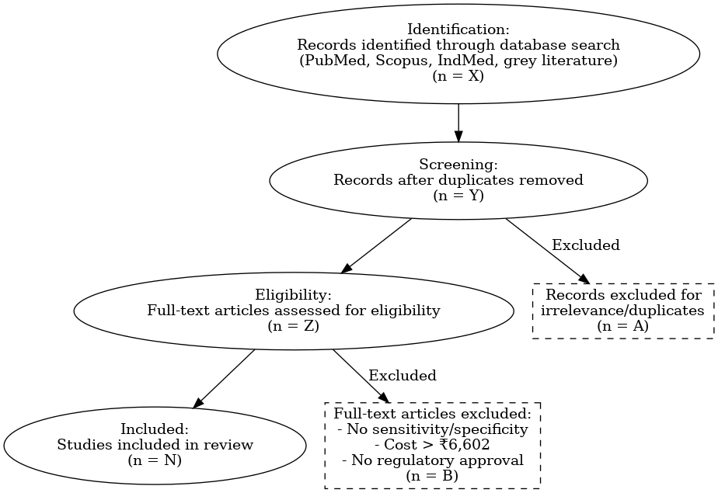
PRISMA
ScR
CHART

Slide 12
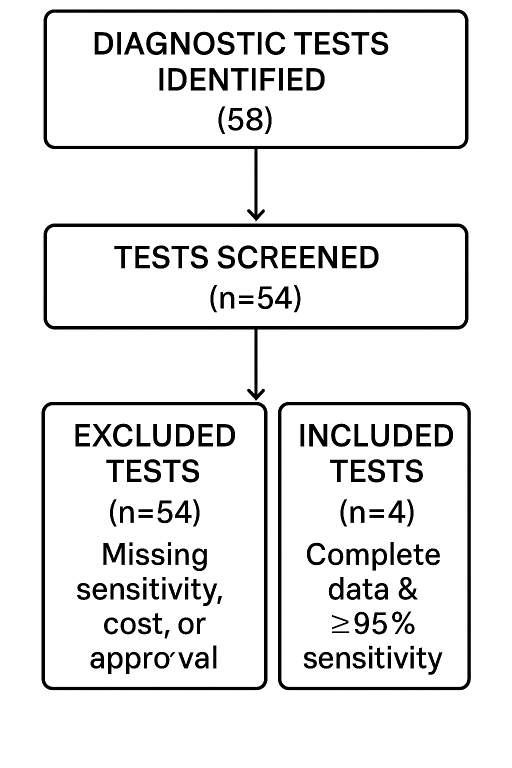
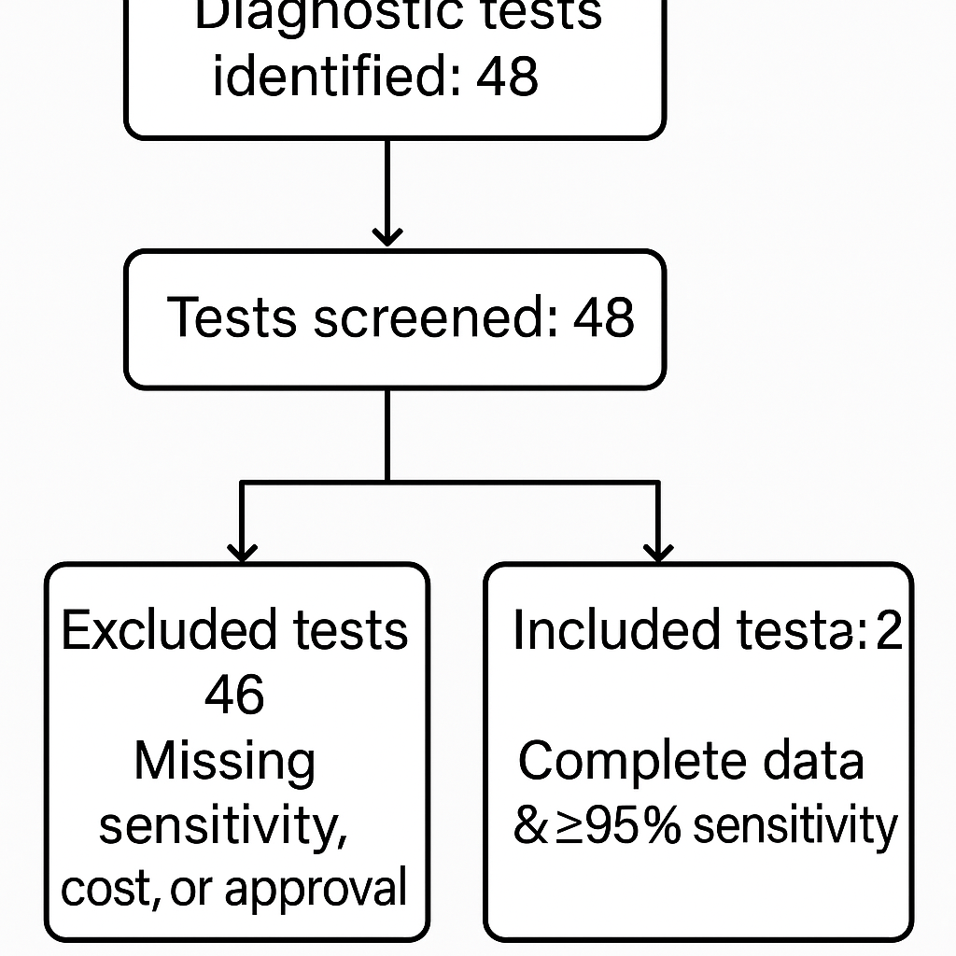
Animal Brucellosis Diagnostic Tests
Human Brucellosis Diagnostic Tests
Diagnostic Test identified :48
45
3

Slide 13
Current Landscape of Human Brucella Diagnostics
ASSAY TYPE | NAME/BRAND | MANUFACTURER | APPROVED/CERTIFED | USE LEVEL
IgG/IgM ELISA | Brucella IgG/IGM ELISA Kits | IBL International, Hamburg, Germany | CE& IVD marked | PHC/CHC
Rapid Test (Antibody) (Immunocapture-Agglutination Test) | BrucellaCapt BCAP Test | Vircell SL, Santa Fe, GRANADA, SPAIN | CE& IVD marked | District Lab/Referral/Vet clinics
Rapid Test (Antigen) | Brucella IgG/IgM Rapid Test, Class Type: Class B | Biotrol Laboratories Pvt. Ltd. | ICMR | District Lab/Referral/Vet clinics
Real Time PCR | Hi‐PCR® Brucella Probe PCR Kit | HIMEDIA HiMedia Laboratories Private Limited, | WHO GMP certified ISO 9001-2015 CERTIFIED ISO 13485-2016 CERTIFIED | State/VRDL

Slide 14
Performance Summary
KITS TYPE | SENSITIVITY | SPECIFICITY | LOD | COST | CROSS REACTIVITY
IgG/IgM ELISA | For IgM: 95%, For IgG: 100% | For IgM: 95%, IgG: 98.78% | _ | 250 | No cross reactivity
Rapid Test (Antibody) (Immunocapture-Agglutination Test) | 97.29 | 97.08 | Not available | 300 | Not available
Rapid Test (Antigen) | 96.5 | 99.6 | _ | 50 | _
Real Time PCR | Analytical sensitivity: 100% | Provides rapid, accurate, sensitive and specific detection of Brucella strains. | 9 copies/µL | 154 | No cross reactivity

Slide 15
Recommendations
Field (PHC/CHC)
Quick, easy, useful during outbreaks, Batch testing; minimal equipment
District Labs
Reliable confirmation for surveillance,Point-of-care; results in minutes
State/VRDL
Confirm atypical cases, leverage molecular platforms
IgG/IgM ELISA
Rapid Test (Antibody)
Rapid Test (Antigen)
Real Time PCR

Slide 16
Current Landscape of Animal Brucella Diagnostics
ASSAY TYPE | NAME/BRAND | MANUFACTURER | APPROVED/CERTIFED | USE LEVEL
Rapid Test | Bovine Brucella Ab Rapid Test | Ubio Biotechnology Systems Private Limited | ISO 13485:2016 | PHC/CHC
Buffered acidified plate antigen test (BAPAT) | BAPA Antigen Suspension | ICAR-IVRI | OIE, ICAR, GMP lab manufacturing license | PHC Screening
Rapid Test | B.Brucella/TB-FMD Combo Rapid Test | Ubio Biotechnology Systems Private Limited | ICMR | District Lab/Referral/Vet clinics
No test | - | - | - | State/VRDL

Slide 17
Performance Summary
KITS TYPE | SENSITIVITY | SPECIFICITY | LOD | COST | CROSS REACTIVITY
Rapid Test | 96.8 | 99.1 | Not available | 350 | No cross reactivity
Buffered acidified plate antigen test (BAPAT) | 98.04 | 99.00% | Qualitative | 250 | Yersinia enterocolitica, Francisella tularensis
Rapid Test | 97.4 | 98.8 | - | 330 | -

Slide 18
Recommendations
Field (PHC/CHC)
Quick, easy, useful during outbreaks,Batch testing; minimal equipment
District Labs
Reliable confirmation for surveillance,Point-of-care; rapid (15 min), no cold chain
State/VRDL
Buffered acidified plate antigen test (BAPAT)
Bovine Brucella Ab Rapid Test
No Test available
TB-FMD Combo Rapid Test

Slide 19

Recommendations
RDT (Rapid Diagnostic) Kits
ELISA Kits
PCR Kits
Choose only CDSCO-licensed and ICMR- or IVRI-evaluated RDTs with independently validated sensitivity ≥95%.
- Prioritize approved manufacturers.(Ubio for animal)
- field-level screening in district hospitals, veterinary clinics, and mobile camps.
Ensure vendor support for equipment maintenance and calibration.
Prioritise ICMR-NIV and IVRI certified IgG/IgM ELISA kits (e.g., IBL International for humans).
- Supplement with CE/ISO marked kits that meet sensitivity and specificity benchmarks.
Agglutination/
Confirmatory
-Standardize procurement RBPT from ICMR/IVRI-listed suppliers for rapid, low-cost confirmation.
- For lab-based confirmation, select immunocapture (Brucellacapt) or tube agglutination kits with documented regulatory approval.
Stock Monitoring
- Require real-time stock tracking and reporting as part of procurement agreements.
- Set minimum/maximum inventory thresholds at all health-system tiers to prevent shortages/lapse.
Training & QA Materials
- Mandate supplier-supported training, proficiency testing, and provide documentation (SOPs, QC logs.
- Implement external quality assurance (EQA) as procurement deliverables.

Slide 20
Stakeholders Role
1.Health Program Planners (MoHFW, State Missions)
Prioritize funding for high-performing, cost-effective, and approved tests only.
Procurement guidance to standardize diagnostic platforms for better surveillance and outbreak response level.
2. Technical Partners (ICMR, NCDC, IVRI)
Identify gaps and fast-track validation studies for promising new technologies.
Provide Technical guidelines for test adoption and periodic review of performance in Indian contexts.
3. Procurement & Logistics Agencies
Negotiate prices, guarantee bulk supply, demand regulatory compliance, and ensure cost does not exceed affordable policy thresholds.
Integrate diagnostics into the NHM supply chain, State e-procurement portal platforms for Tracking.
4. Diagnostic Manufacturers
Align product development to meet regulatory and field-suitability benchmarks.
Pursue local regulatory clearances (CDSCO/ICMR) and offer field training, support, & post-market surveillance
5. Field Implementers & Laboratory Staff
Targeted training, SOPs, & external QA processes—enhance skills and reliability of diagnosis at all system levels.
6. Community Representatives
Access to accurate, approved, and affordable diagnostic results in faster case detection & reduced disease burden.
Transparency in procurement and quality strengthens community trust in public health interventions.

Slide 21
Discussion Points
Tier-Specific Options Exist Accurate, cost-effective tests are available across all care levels, but field-level performance data remain scarce.
Animal Testing Still, Traditional MRT and ELISA are widely used but show limited reliability in field conditions.
Use DALY-Based Costing evaluating tests via cost per DALY can improve procurement decisions at national/state levels.
Promoting One Health shared diagnostics across human-animal health for each state-specific prevalence can enhance integrated disease surveillance.
Build Ecosystem Capacity Strengthening QC systems, supply chains, and personnel training is vital for sustainable diagnostics.
QUADAS-2 helps with critical appraisal and is a reliable tool to assess bias and relevance in diagnostic accuracy studies/systematic reviews.

Slide 22
Limitations
Incomplete Diagnostic Data-Several diagnostic kits lacked complete information on sensitivity, specificity, cost, or regulatory approval.
Potential Reporting Bias-The analysis was based on published studies and manufacturer datasheets, which may introduce reporting bias.
Time-Bound Findings-Regulatory approvals and kit availability may have changed, making the findings a snapshot of the current landscape.
Limited Field-Level Validation- Many diagnostic assays have not been validated in real-world or rural settings, limiting their generalizability.
Regulatory Gaps in Veterinary Kits-Most veterinary diagnostic kits do not appear in CDSCO listings, raising concerns about their regulatory oversight and quality assurance.

Slide 23
References
Lindahl, J. F., Vrentas, C. E., Deka, R. P., Hazarika, R. A., Rahman, H., Bambal, R. G., … Srinivas, K. (2019). Brucellosis in India: results of a collaborative workshop to define One Health priorities. Tropical Animal Health and Production, 52(1), 387–396. https://doi.org/10.1007/s11250-019-02029-3
Parai, D., Sahoo, S. K., Pattnaik, M., Swain, A., Peter, A., Samanta, L. J., … Bhattacharya, D. (2022). Seroprevalence of human brucellosis among the tribal and non-tribal population residing in an eastern state of India: Findings from the state-wide serosurvey. Frontiers in Microbiology, 13(PMC9742238). https://doi.org/10.3389/fmicb.2022.1070276
Deka, Ram Pratim Magnusson, UlfGrace, Delia Lindahl, Johanna F. (2018). Bovine brucellosis: Prevalence, risk factors, economic cost and control options with particular reference to India – a review. Retrieved June 10, 2025, from International Livestock Research Institute website: https://www.ilri.org/knowledge/publications/bovine-brucellosis-prevalence-risk-factors-economic-cost-and-control-options.
Kalambhe, D. G., Sundar, B., & Bedi, J. S. (2025). Seroprevalence of brucellosis in humans with non-specific clinical symptoms in Punjab, India. Veterinary World, 18(2231-0916), 819–826. https://doi.org/10.14202/vetworld.2025.819-826

Slide 24
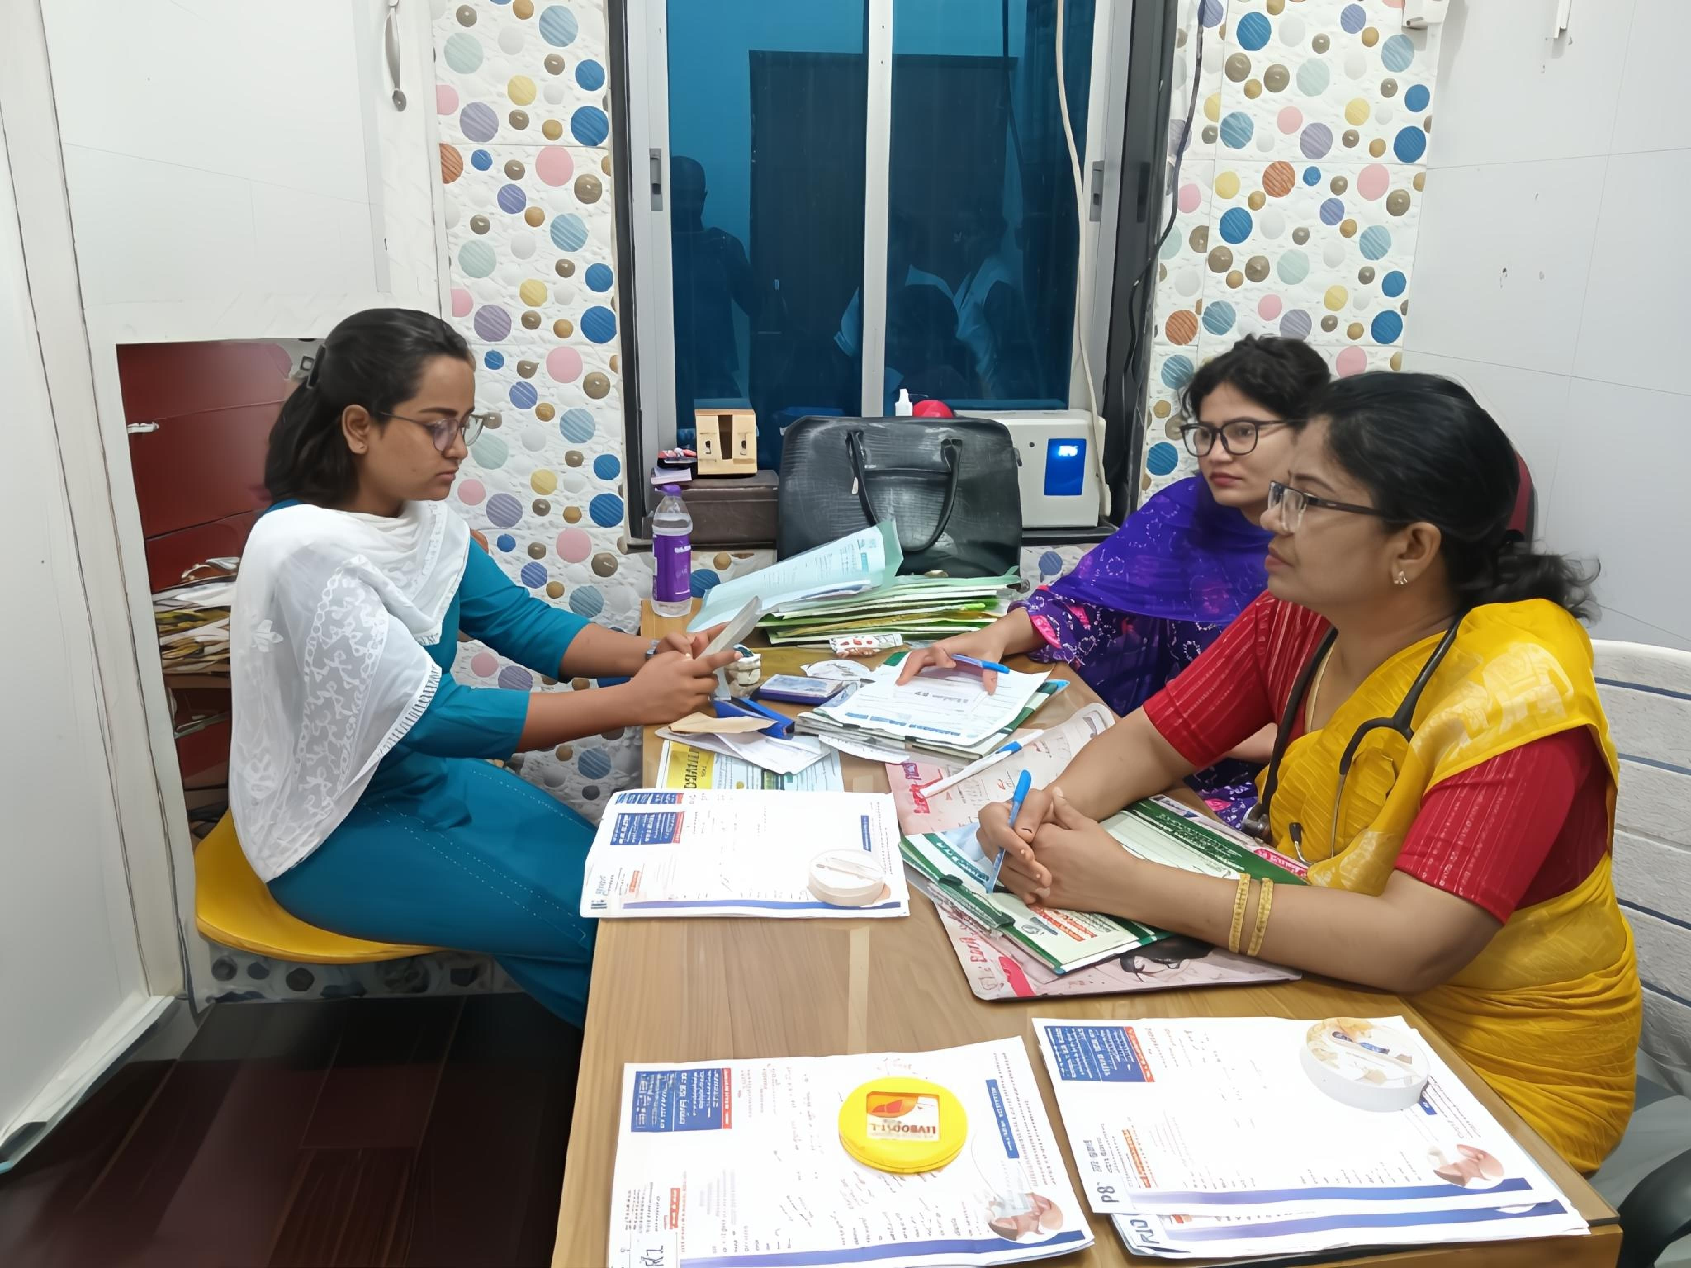
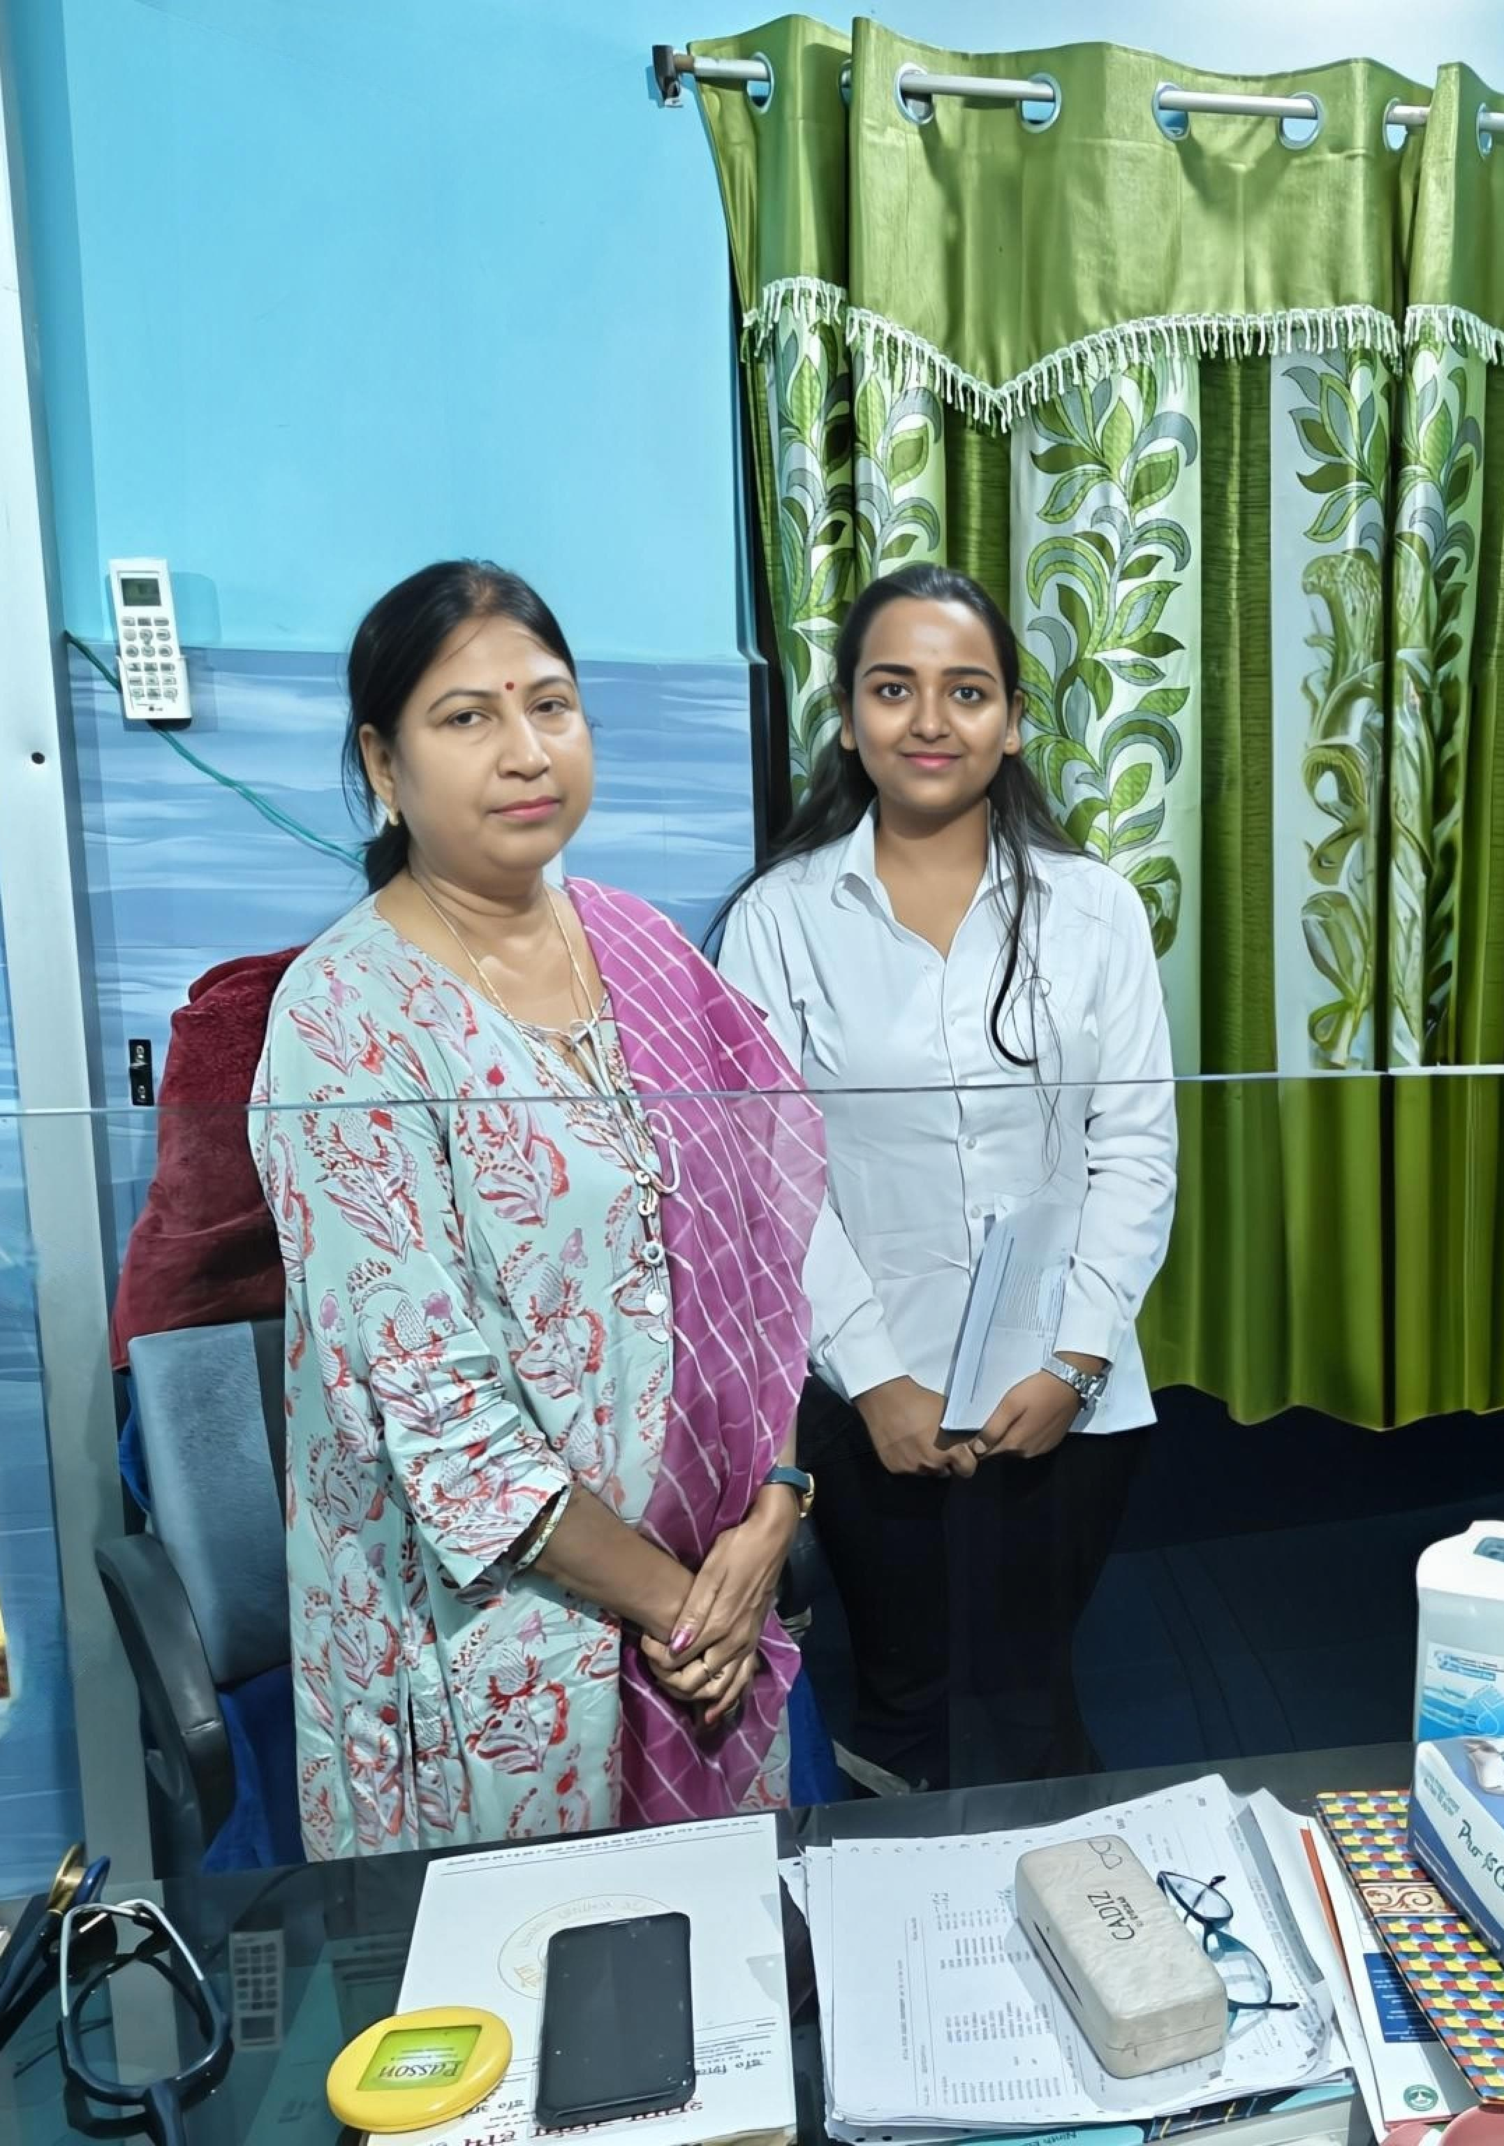
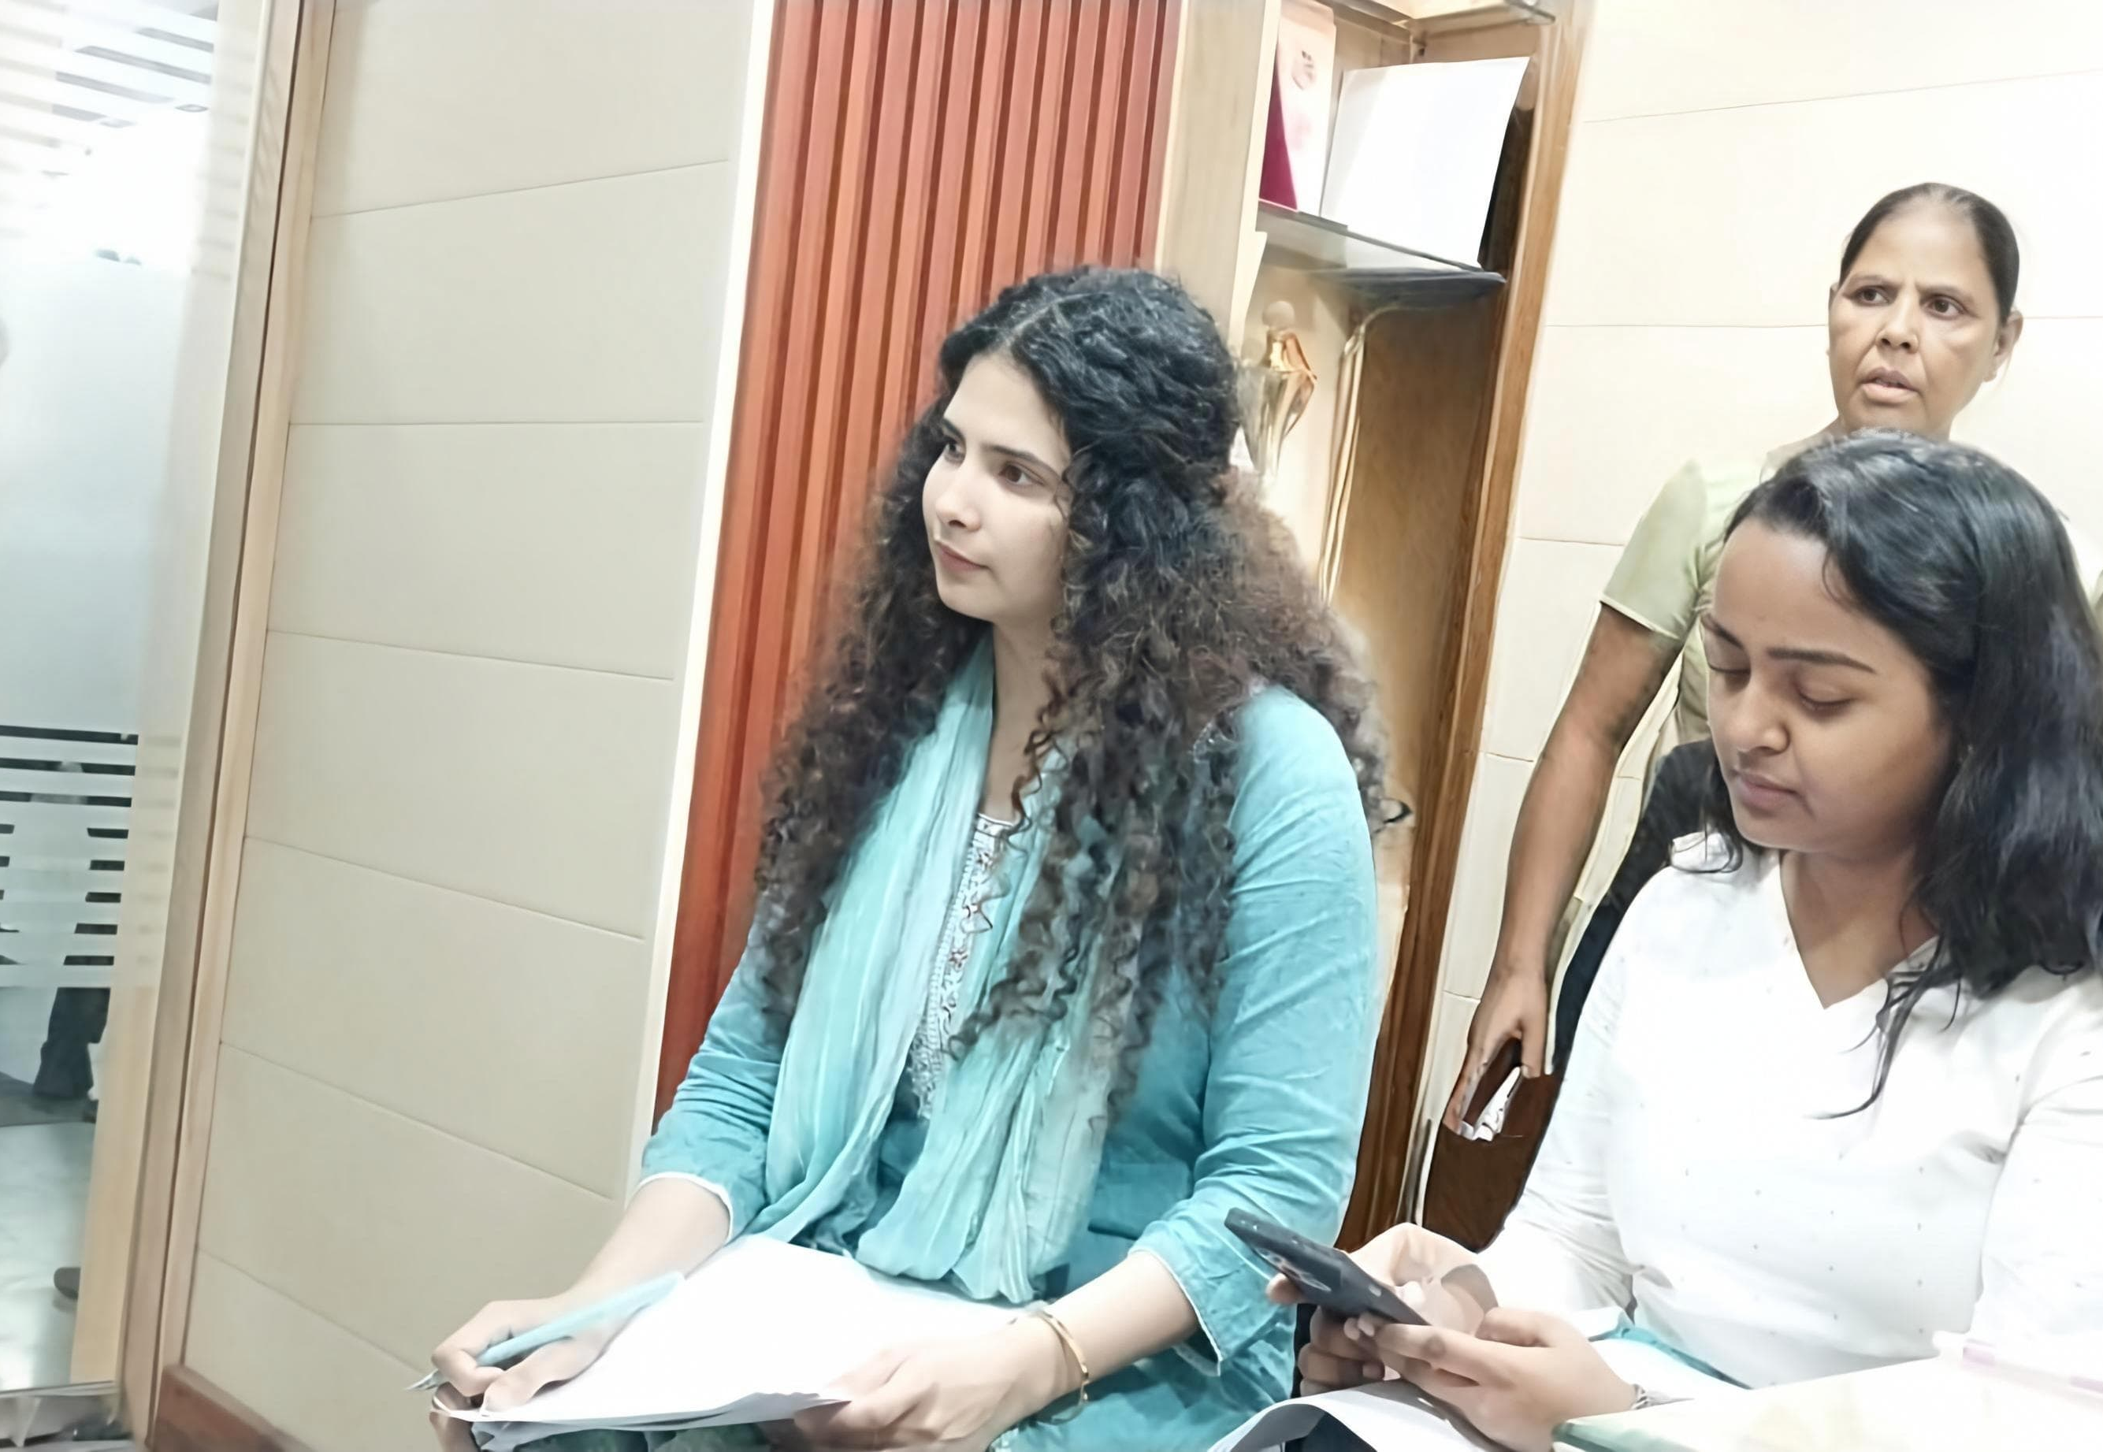
Pictorial Journey
1.) Having a Discussion with a Doctor on intrapartum and newborn clinical practices.
2.)Peripheral Facility visit (PMJAY) in Bihar
3.) Conducting Piloting practice for reviewing our Baseline data collection Tools in Agra UP

Slide 25
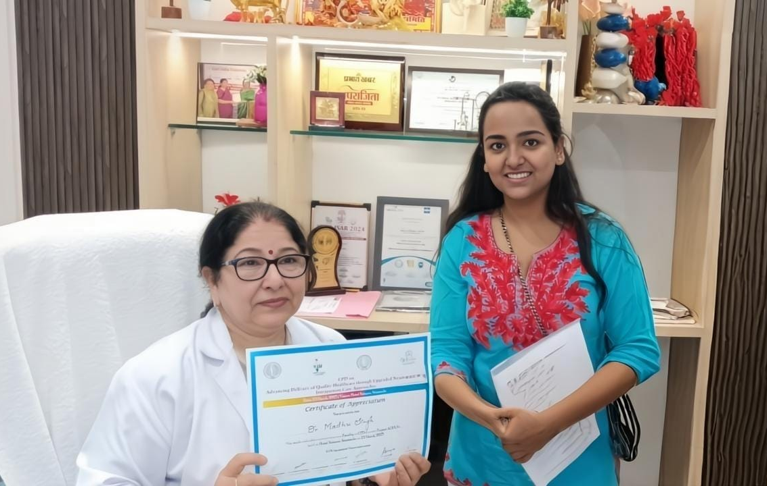
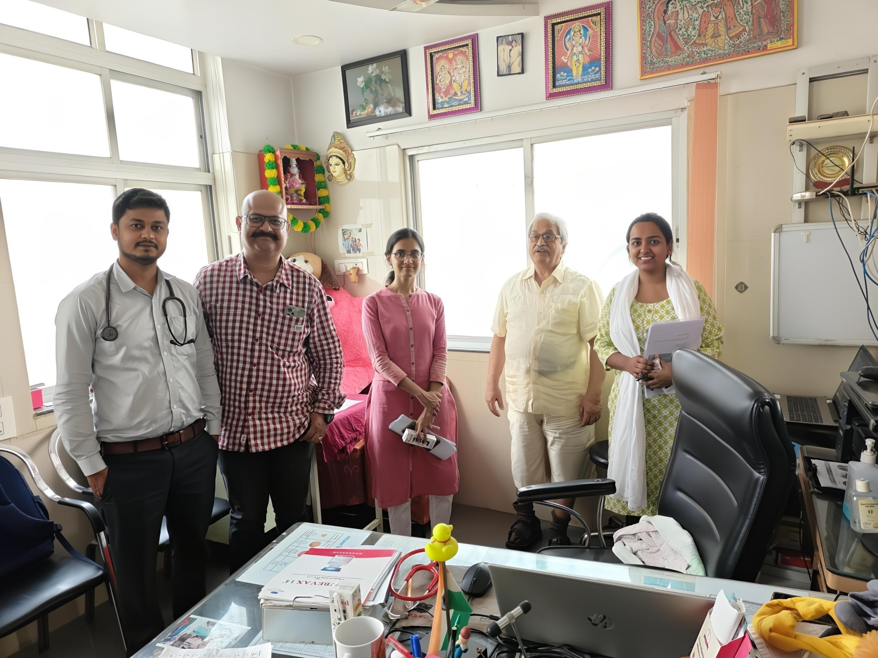
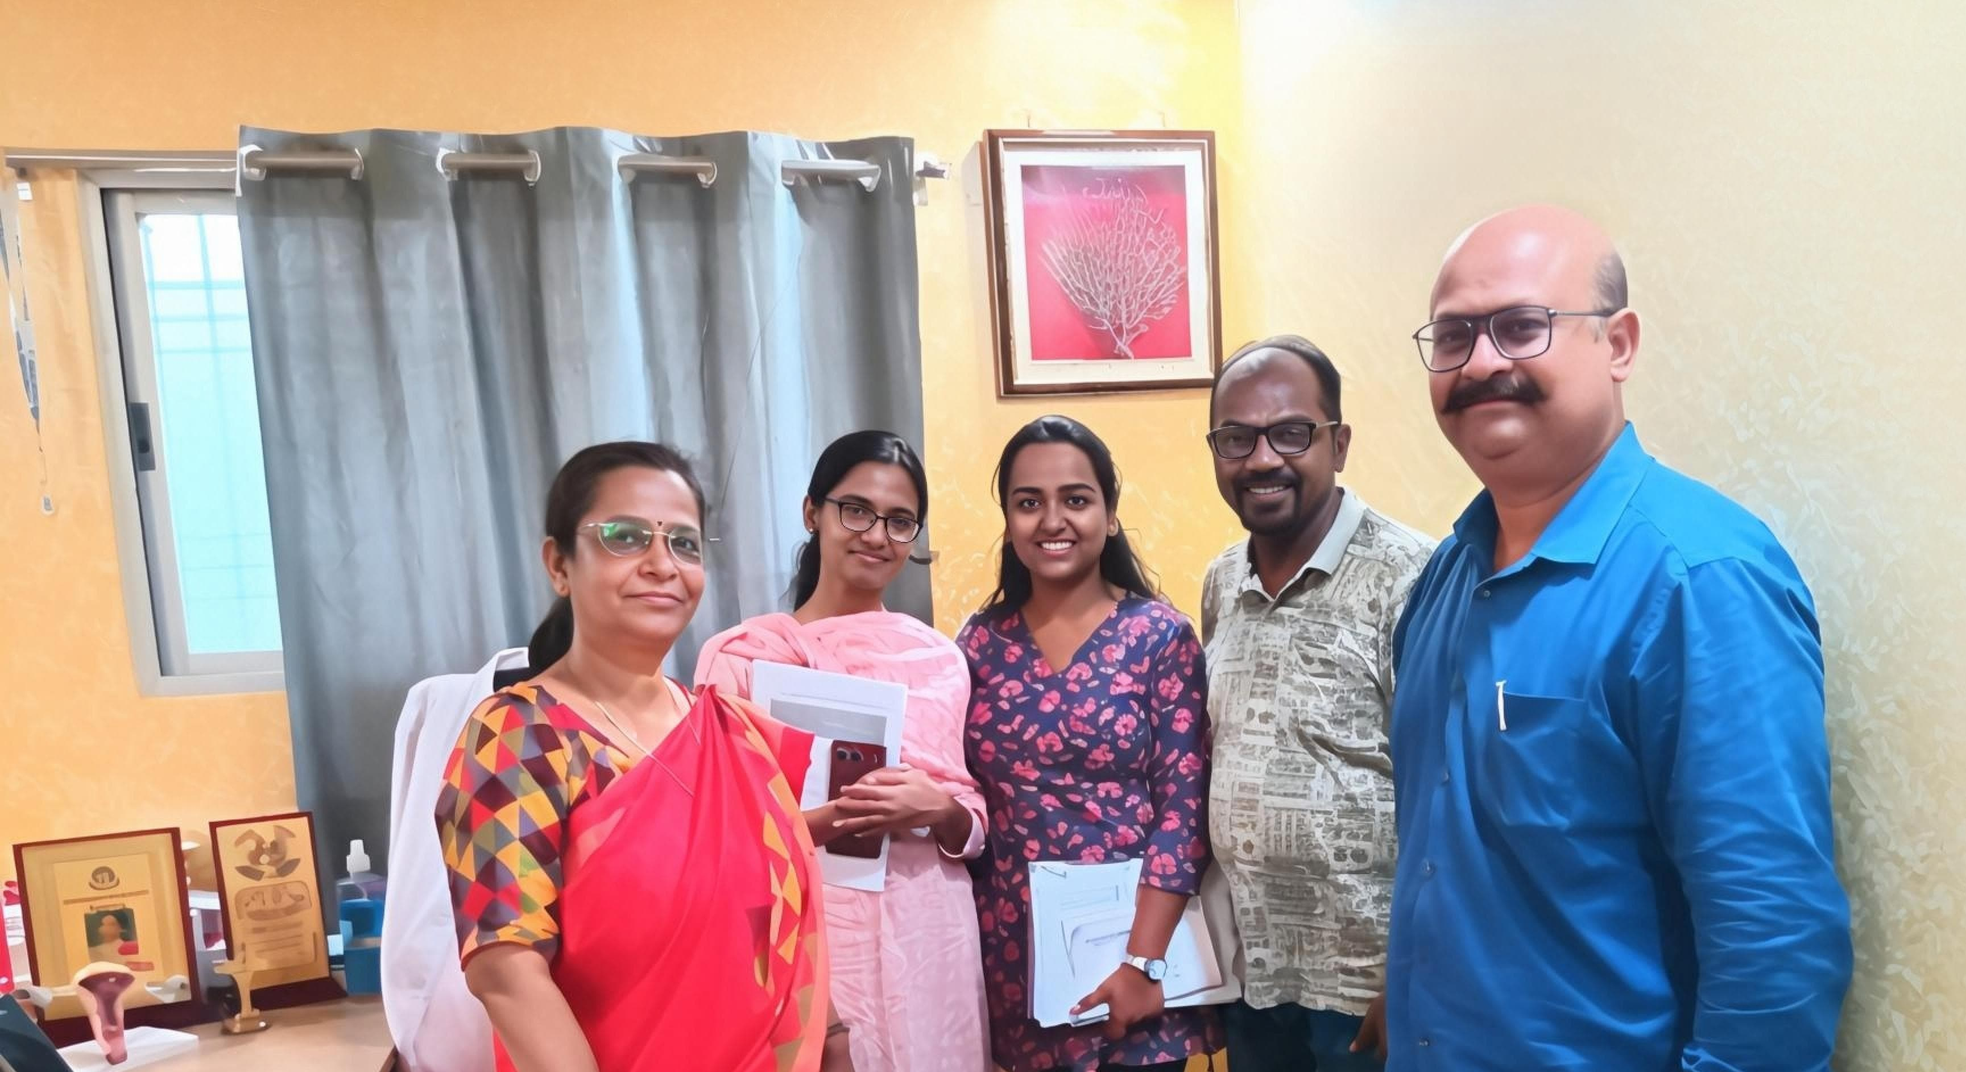
Pictorial Journey
Dharbhanga & Sitamarhi

Slide 26
Thank You
Any Questions

