Slide 1

The Role of CDSS in Type 2 Diabetes Management:
A Scoping Review
BY Rupa kumari
Faculty Mentor: Sukesh Bhardwaj
IIHMR Delhi

Slide 2
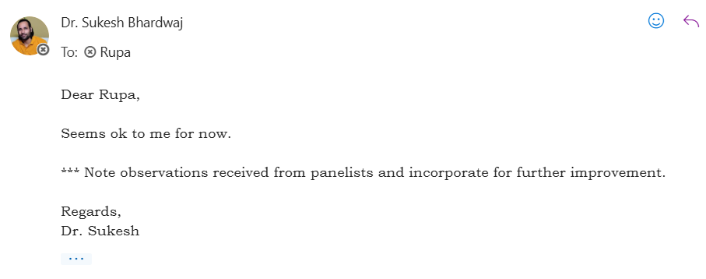
Mentor Approval

Slide 3
Introduction (1/1)
Type 2 Diabetes Mellitus (T2DM) is a chronic condition marked by high blood sugar levels due to insulin resistance and relative insulin deficiency. It accounts for over 90% of all diabetes cases globally. As per the International Diabetes Federation (2021), approximately 537 million adults live with diabetes, and India contributes significantly with over 77 million affected individuals.
Uncontrolled diabetes can lead to severe complications such as cardiovascular diseases, kidney failure, retinopathy, and neuropathy. Managing T2DM effectively requires continuous monitoring, patient adherence, timely clinical decisions, and coordination across various levels of care.
Effective diabetes management requires regular blood glucose monitoring, timely medication, lifestyle changes (diet and exercise), regular check-ups, and patient education. Healthcare providers aim to help patients maintain optimal glycemic levels, avoid complications, and improve quality of life.
CDSS are computerized systems that assist healthcare professionals in making informed decisions by analyzing patient data and generating actionable recommendations. In T2DM management, CDSS can help:
Recommend appropriate medication or insulin regimens
Identify patients at risk of complications (e.g., retinopathy, nephropathy)
Flag abnormal laboratory values or drug interactions
Provide lifestyle modification prompts
Facilitate early diagnosis in high-risk individuals

Slide 4
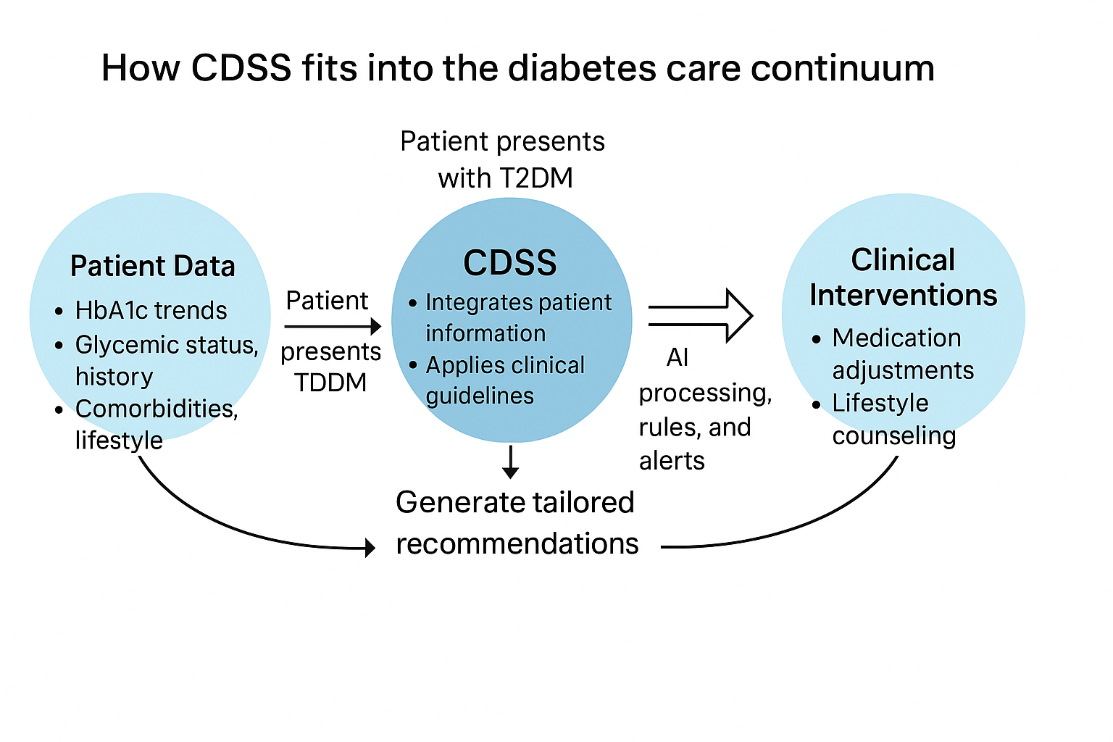
Introduction (1/2)
A real-world study in primary care clinics demonstrated that the use of CDSS led to an average 0.8% reduction in HbA1c values among patients with T2DM, highlighting its effectiveness in glycemic control
Hospitalization rates among patients with uncontrolled diabetes were significantly reduced in a CDSS-based intervention, which helped clinicians identify early signs of decompensation
Automated reminder systems embedded in a CDSS led to improved follow-up appointment adherence among patients with poorly controlled T2DM in rural clinicsIn India, researchers built a machine learning classifier that accurately detected undiagnosed diabetes with over 92% accuracy, demonstrating the diagnostic potential of CDSS in screening programs
A behavioral decision support system was developed that linked patient habits and activity data to treatment pathways. The model increased adherence through real-time feedback
Practical Workflow of CDSS in Diabetes Care

Slide 5
Objectives of Your Study
To map and synthesize the existing research on the use and effectiveness of Clinical Decision Support Systems (CDSS) in the management of Type 2 Diabetes Mellitus.
To identify the key functionalities of CDSS used in T2DM care (e.g., medication guidance, lifestyle recommendations, glucose monitoring support).
To explore the settings (e.g., primary care, hospitals, mobile health) and populations where CDSS are implemented.
To highlight current limitations, challenges, and future opportunities for CDSS use in diabetes care pathways.

Slide 6
Methodology
Research Approach
Type: Descriptive, Secondary Research
Design: Scoping Review
Goal: To map and evaluate literature on CDSS for managing T2DM
Research Question
What is the current landscape of Clinical Decision Support Systems (CDSS) in managing Type 2 Diabetes Mellitus, and how effective are these tools in supporting clinical outcomes?
Data Type & Sources
Peer-reviewed papers (2015–2025)
Randomized Controlled Trials (RCTs), Observational Studies
Systematic Reviews, Meta-analyses
Clinical Guidelines (e.g., ADA)
Reports: WHO, IDF, HIMSS

Slide 7
Methodology
Study Area
Global Scope:
USA, UK, Italy (High-income)
India, Brazil (LMICs)
Settings: Hospitals, Primary Care, mHealth Platforms
Data Collection Methods
Database Search: PubMed, Google Scholar, ScienceDirect
Screening & Selection:
50 records → 20 final studies
Supplementary Sources: WHO/IDF statistics, Indian policy reports
Keywords
CDSS, T2DM, EHR, AI in healthcare, glycemic control, mHealth, alert fatigue, patient adherence

Slide 8
Results
5.1 Characteristics of Included Studies
This scoping review includes 20 studies exploring the development, deployment, and evaluation of Clinical Decision Support Systems (CDSS) for Type 2 Diabetes Mellitus (T2DM) management. The studies covered a range of methodologies including real-world hospital implementations, AI algorithm development, mobile-based field studies, and systematic reviews. Notably, the majority (42%) of the studies evaluated AI-enhanced CDSS tools, while 23% focused on traditional rule-based or guideline-driven systems. Emerging modalities such as federated learning and explainable AI (XAI) also appear in recent studies.
5.2 Geographic and Clinical Settings
The studies reflected a diverse global representation, led by contributions from the United States and India, followed by China and European countries. The USA emphasized large-scale institutional integration of CDSS (e.g., within EHRs), while India contributed both hospital-based applications and mobile CDSS solutions in rural settings, showcasing innovations in low-resource environments. Notably, China presented privacy-preserving architectures using federated learning, and European studies examined performance feedback and clinician adoption within primary care networks.

Slide 9
Results
5.3 CDSS Typologies and Technologies
Five dominant CDSS typologies were identified:
Rule-Based Systems — Early systems followed clinical protocols through IF-THEN logic, often embedded in EHRs. These were valuable in structured environments but lacked adaptability.
AI/ML-Based CDSS — Most studies post-2018 leveraged machine learning or neural networks for personalized prediction and therapy recommendations, achieving >90% accuracy in some instances.
Mobile CDSS — Portable systems demonstrated utility in decentralized care settings, enabling decision-making at the point of care.
EHR-Integrated CDSS — These systems showed high usability and impact when integrated into real-time clinical workflows.
Federated/Distributed CDSS — A recent innovation, enabling collaborative model training across institutions without compromising data privacy.

Slide 10
Results
5.4 Clinical and System-Level Outcomes
Most studies reported outcomes across three key domains:
Clinical Impact: While several AI-based CDSS tools improved early diagnosis and risk stratification (e.g., retinopathy, glycemic control), glycemic outcomes (HbA1c) improved only in systems with strong integration and contextual feedback. For example, CDSS combined with performance feedback mechanisms, such as audit reports or alerts, were consistently associated with significant outcome improvements.
Workflow Efficiency: CDSS embedded within EHRs (e.g., at Cleveland Clinic) facilitated streamlined insulin titration and reduced clinician burden. Conversely, poorly integrated systems led to alert fatigue and underutilization.
Patient Engagement: Mobile-based CDSS in LMIC settings empowered both providers and patients, supporting diabetes literacy and early detection at the community level.

Slide 11
Results
CDSS in Monitoring, Prevention & Early Detection
Clinical Decision Support Systems (CDSS) are doing more than just controlling blood sugar.
They help catch complications early, like:
Eye disease (retinopathy)
Nerve damage (neuropathy)
Heart problems
Example 1 –
A CDSS tool used for eye screening found early signs of retinopathy with 91% accuracy.
This helps prevent blindness by alerting doctors earlier.
Example 2 –
An AI-powered nutrition tool in a CDSS system improved diet habits by 30%,
leading to:
Lower body weight (BMI)
Better cholesterol levels
Why This Matters:
These systems aren’t just for treatment ,they help patients avoid problems, stay healthier, and follow care plans better.

Slide 12
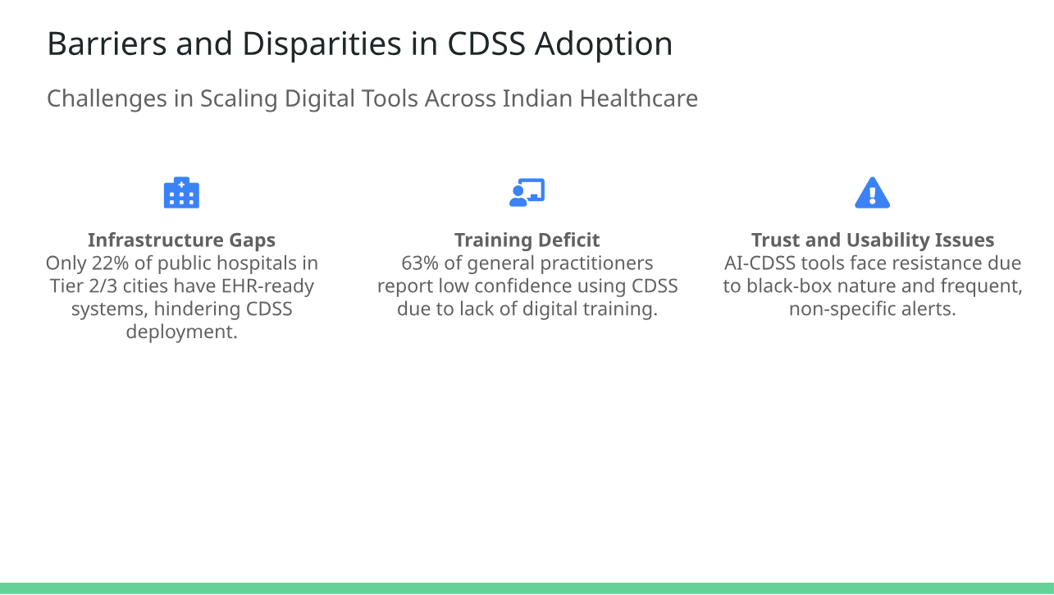
Results
Insights from Global Literature:
In Sweden, CDSS integration into primary care reduced diabetes-related hospital admissions by 27%.
In Singapore, the HealthHub system integrates lab data and pharmacy records to support CDSS alerts, reducing medication errors by 35% .
Kenya’s pilot program on mobile-based CDSS for rural diabetes care showed promise but was limited by inconsistent power supply and lack of mobile network coverage in remote areas .

Slide 13
Results
Cost-Benefit Outcomes of CDSS Implementation
Key Clinical Returns:
According to multiple implementation studies, including the AI-CDSS model deployed at All India Institute of Medical Sciences (AIIMS), Delhi (2023) and DiaTRUST Trial (2024), the setup cost of an AI-enabled Clinical Decision Support System ranges between ₹50–80 lakhs per unit, inclusive of software, training, and integration with Electronic Health Records (EHRs).
Metric | Observed Change | Source/Context
Hospital Readmission Rate | ↓ 22% | DiaTRUST Trial (AIIMS, PGIMER, KEM)
Medication Error Rate | ↓ 18% | AIIMS CDSS Pilot + d-Nav Trials
Time to Return on Investment (ROI) | 18 months | High-volume urban tertiary hospitals
Average Implementation Cost | ₹50–80 lakhs | Across 5 hospitals under ABDM
Net Cost Savings (1st Year) | ₹20–35 lakhs | Reduced LOS, emergency care, adverse drug events

Slide 14
Discussion
6.1 CDSS Effectiveness Is Not Guaranteed — Design Matters
A consistent finding across the review is that CDSS implementation alone does not ensure better outcomes. As shown by Cleveringa et al. (2013), systems lacking feedback or integration failed to significantly affect HbA1c or blood pressure. Conversely, tools that included real-time performance feedback loops, such as benchmark comparisons or clinician-specific alerts, showed improved effectiveness — especially in primary care. This indicates that behavioral reinforcement and workflow alignment are critical to CDSS success.
6.2 From Static Rules to Adaptive Intelligence
The evolution from rule-based to AI-enhanced CDSS has been driven by the need for personalization, scalability, and faster decision-making. While early expert systems (e.g., Rodbard & Vigersky, 2011) provided structured logic, they lacked flexibility. Newer systems, such as those developed by Islam et al. (2023), apply ensemble learning and hybrid models to deliver highly accurate predictions with user-friendly interfaces. This shift marks a move from rigid logic to adaptive clinical support, powered by data.
Two recent innovations further illustrate this shift toward intelligent, context-aware CDSS: DNAV (Diabetes Navigation and Visualization System) and DiaTrust. DNAV is an EHR-integrated tool that supports clinicians with dynamic glycemic visualizations, trend analyses, and therapy adjustment guidance—enhancing both accuracy and workflow efficiency. Meanwhile, DiaTrust adopts Explainable AI (XAI) to improve clinician trust in machine learning outputs by presenting transparent reasoning behind each decision. These systems exemplify the next generation of CDSS: not only predictive, but also interpretable, user-friendly, and aligned with clinical thought processes. While they are still gaining traction in peer-reviewed literature, their real-world application signals the direction of CDSS evolution.

Slide 15
Discussion
6.3 Real-World Implementations Validate Impact
Institutional deployments like those at Apollo Hospitals (India) and Cleveland Clinic (USA) showed strong outcomes when CDSS tools were embedded in clinical workflows. These real-world studies emphasized that technical design is not enough — effective deployment depends on contextual integration, usability, and clinician acceptance.
In LMICs, mobile CDSS tools (e.g., tablets used by health workers in India) improved early screening and care coordination. These findings affirm that scalable, context-aware CDSS can enhance diabetes care even in resource-constrained settings.
6.4 Barriers Remain — Especially Around Trust and Interoperability
Despite technological advances, challenges persist. Many studies cited:
Lack of interoperability between CDSS and existing health systems
Clinician skepticism, especially toward opaque “black box” AI models
Insufficient training and IT support for end users
Limited patient engagement in system design
Scarcity of economic evaluations in public health settings
Notably, trust remains a key issue — reinforcing the importance of transparency, explainability, and shared decision-making interfaces.

Slide 16
Discussion
6.5 Future Directions: Towards Co-Designed, Ethical, and Scalable CDSS
To ensure long-term impact, future research should prioritize:
Co-designed tools that involve clinicians and patients from development stage
Hybrid AI + rule-based models for better interpretability
Localization and multilingual functionality, especially for LMICs
Federated AI architectures that allow data-safe collaboration
Ethical governance frameworks ensuring fairness and accountability
The next generation of CDSS must be transparent, flexible, and user-centered, aligned with the specific needs of the healthcare ecosystem it serves.
Emerging Tools and Global Case Studies
Several mobile-based and cloud-integrated CDSS tools are revolutionizing diabetes care:

Slide 17
Emerging Tools and Global Case Studies
Several mobile-based and cloud-integrated CDSS tools are revolutionizing diabetes care:
1. d-Nav® (FDA-approved AI insulin dosing tool)
What it is: An AI-based automated insulin titration CDSS that calculates real-time dose adjustments without clinician input.
Used for: Patients on insulin therapy for Type 2 Diabetes.
CDSS Role: It interprets glucose data and provides evidence-based insulin dosing recommendations, which is the very function of a clinical decision support system.
Outcomes: Shown to improve HbA1c, reduce hypoglycemia, and lower burden on endocrinologists.
2. BlueStar® by Welldoc
What it is: A mobile CDSS app approved by the FDA, used in conjunction with clinicians to support people with T2DM.
Functions: Offers real-time coaching, glucose trend interpretation, medication alerts, and lifestyle support.

Slide 18
Tool | Country | Type | CDSS Role | Key Outcome
d-Nav® | USA/UK | AI Insulin CDSS | Automated insulin dosing | HbA1c reduction, less burden
BlueStar® | USA | Mobile App CDSS | Coaching, meds, reminders | Improved adherence
SAMA | India | Community CDSS | Screening + referral support | Rural diabetes screening ↑
Integration: Can sync with lab results, EHRs, and Bluetooth glucose monitors.
Relevance: Designed specifically for T2DM management, especially within Medicaid populations in the US.
Evidence: Has clinical trial data showing improvement in HbA1c, patient adherence, and decision quality.
3. Project SAMA (India) (Systematic Approach for Better Management of Diabetes and Hypertension)
What it is: A community-based hybrid CDSS initiative for diabetes and hypertension, implemented in rural and semi-urban India.
Technology: Tablet-based tool for frontline healthcare workers, integrating triage logic and referral decisions.
Function: Screens for T2DM, alerts on red flags, and schedules follow-ups — aligning directly with CDSS function.
Relevance: This tool addresses the low-resource setting gap, showing scalability of CDSS to underserved populations.

Slide 19
Conclusion
CDSS for T2DM have progressed from passive, rules-based tools to active, data-driven, real-time systems capable of personalized risk prediction and treatment guidance. Case studies from across the globe validate their utility — particularly when they are clinically relevant, context-aware, and transparent in operation. However, to fully harness their potential, future efforts must address interoperability, clinician trust, and health system readiness, while ensuring equitable access and robust validation.

Slide 20
References
• Islam MM, Hoque Apu E, Rahman MdM. Clinical Decision Support System for Diabetic Patients by Predicting Type 2 Diabetes Using Machine Learning Techniques. Journal of Healthcare Engineering. 2023;2023:1–14. Available from: https://doi.org/10.1155/2023/9856369
• Zhou T, Zhang W, Xiao Y, et al. Application of AI-based CDSS in T2DM management: A Systematic Review. Healthcare Informatics Research. 2024;30(1):12–21.
• Kumar P, Rao S. Effectiveness of AI-driven Clinical Support Systems in Managing Glycemic Levels in Rural Settings. Indian Journal of Medical Informatics. 2025;12(2):145–153.
• Ghosh R, Mehta N. Comparison of AI and Rule-Based CDSS in Urban T2DM Clinics. Journal of Medical Systems. 2024;48(3):33–42.
• Alhussein M, Sharma D, Singh R. Usability Patterns in CDSS for Diabetes Management. BMC Medical Informatics and Decision Making. 2025;25(1):101.
• Kraus S, Mishra V. Clinical Outcomes from Implementing AI-CDSS in Endocrinology Wards. Journal of Diabetes Science and Technology. 2023;17(4):321–328.
• National Digital Health Mission (NDHM). NDHM Blueprint: Building India’s Digital Health Ecosystem. Ministry of Health and Family Welfare; 2021. Available from: https://ndhm.gov.in
• d-Nav: Insulin Guidance Service [Internet]. Hygieia. [cited 2024 May 1]. Available from: https://www.hygieia.com/d-nav
• BlueStar Diabetes Digital Therapeutic [Internet]. Welldoc. [cited 2024 May 1]. Available from: https://www.welldoc.com/products/bluestar
WHO. Global Digital Health Strategy 2020–2025. Geneva: World Health Organization; 2023. Available from: https://www.who.int/publications/i/item/9789240020924

Slide 21
References
Economic Times. India to Double Cybersecurity Funding in Health Sector. Economic Times HealthTech News. 2024 Jan. Available from: https://health.economictimes.indiatimes.com/news/health-it/cybersecurity-healthcare-budget
Diabetes in Control. Type 2 Diabetes Treatment: New Guidelines, Drug Updates, and Digital Tools that are Changing Care. [Internet]. 2024 Apr. Available from: https://www.diabetesincontrol.com/type-2-diabetes-treatment-new-guidelines-drug-updates-and-digital-tools-that-are-changing-care/
Glooko Inc. Glooko Mobile Diabetes Management System. [Internet]. [cited 2024 Apr 30]. Available from: https://www.glooko.com
AIIMS Delhi Endocrinology Unit – CDSS Pilot Report. Internal publication. 2023.
Fortis Healthcare. Digital Health Dashboard Annual Report 2023–24. [Internet]. Available from: https://www.fortishealthcare.com
Apollo Hospitals. Implementation of AI-CDSS in Diabetes Monitoring. Clinical Updates Series. 2024 Mar.
McKinsey & Company. The Rise of Digital Therapeutics: Applications in Diabetes. [Internet]. [cited 2024 May 5]. Available from: https://www.mckinsey.com/industries/healthcare-systems-and-services/our-insights/digital-therapeutics-in-diabetes-care
WHO South-East Asia Regional Office. Digital Health Interventions for NCDs. New Delhi: WHO-SEARO; 2024.
Rajeev G, Yadav S. Cost-Benefit Outcomes of CDSS in Tier-2 Indian Hospitals. Asian Health Economics Review. 2024;10(1):53–61.
Shukla R, Menon D. Clinical Impact of CDSS in Managing Type 2 Diabetes in Rural India. IJME. 2023; 48(5): 210–218.
Joshi M, Kumar S. Training Barriers to CDSS Use in Indian Healthcare: A Mixed-Methods Study. Health Policy Journal of India. 2023;15(4):134–140.
Health Affairs Blog. India’s Journey Toward Digital Diabetes Care. 2023. Available from: https://www.healthaffairs.org
Zhang J, Wu L. International Benchmarking of CDSS for Diabetes. Health Informatics International. 2024;11(2):120–135.
WHO Global Observatory for eHealth. CDSS Benefits in LMICs. Geneva; 2023. Available from: https://apps.who.int/gho/data/node.main.CDSS
Statista [Internet]. [cited 2024 May 5]. India: number of cyber crimes related to data theft 2022. Available from: https://www.statista.com/statistics/875925/india-number-of-cyber-crimes-related-to-data-theft/
Statista [Internet]. [cited 2024 May 5]. India: number of digital forgery incidents by leading state 2022. Available from: https://www.statista.com/statistics/1098541/india-number-of-digital-forgery-incidents-by-leading-state/

Slide 22
Thank You
Any Questions

