Slide 1

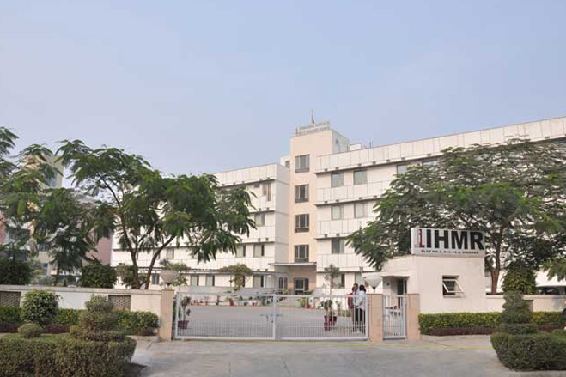

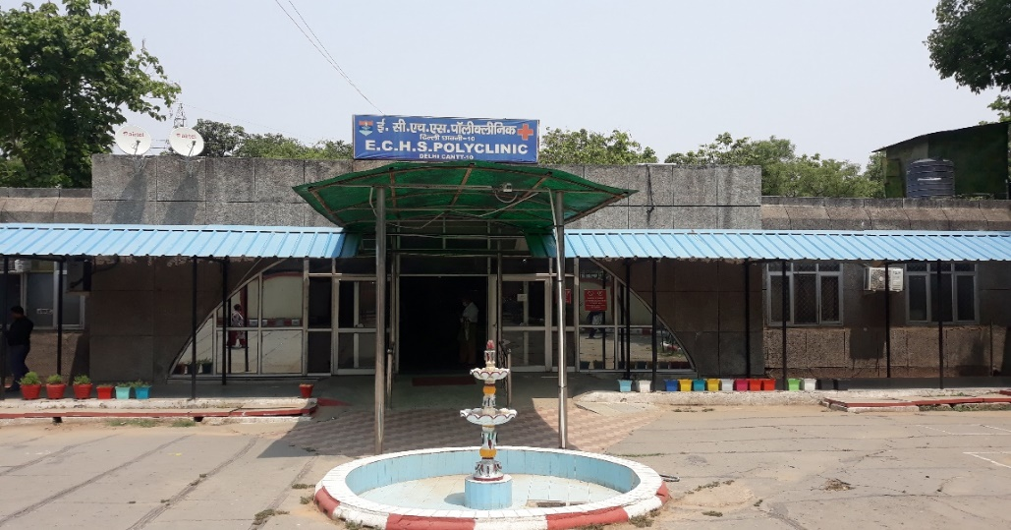

QUALITY ASSESSMENT AND AUDIT OF ECHS POLYCLINIC, BASE HOSP, DELHI CANTT
COL TARUN KUMAR SINGH
ROLL NO PG/20/099
MENTOR – DR BS SINGH

Slide 2
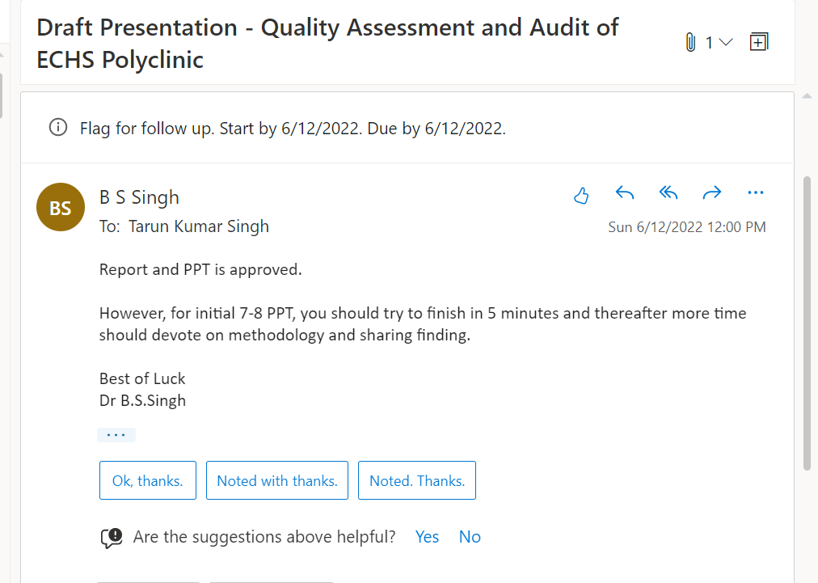
APPROVAL

Slide 3
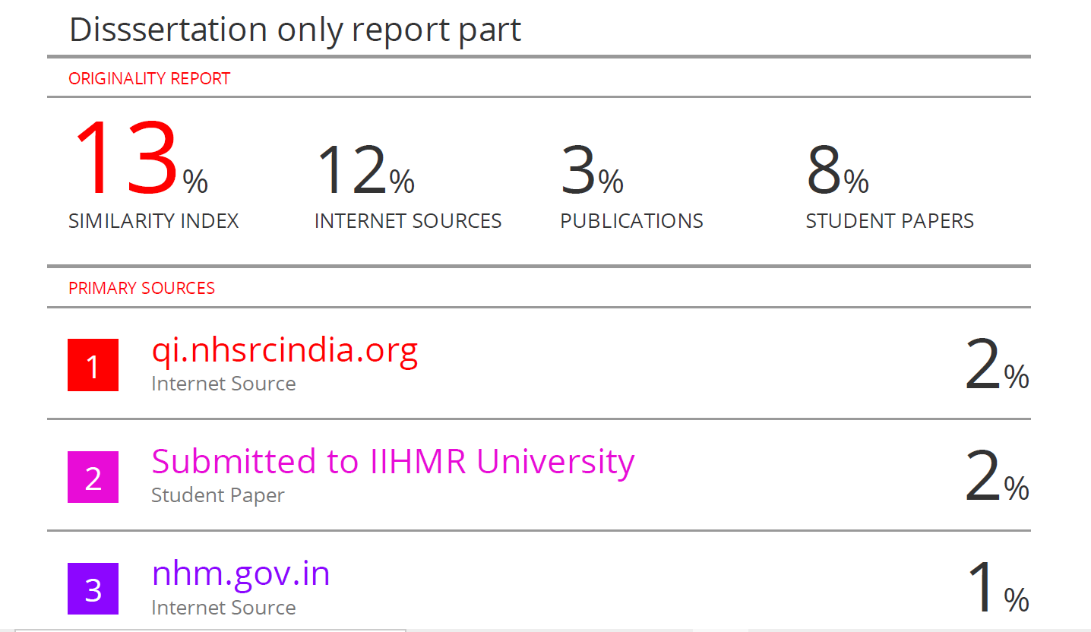
PLAGIARISM REPORT

Slide 4
INTRODUCTION
The Ex-Servicemen Contributory Health Scheme (ECHS) was launched on 01 Apr 2003.
Ex-servicemen pensioners and their dependents who were only entitled for treatment in service hospital are now authorized treatment also in empanelled private hospitals.
More than 30 lakh Ex-Servicemen today and the number grows by 55,000 to 60,000 every year.
Retirement at relatively younger age ; 85 percent of the armed forces personnel compulsorily retire between 35-37 years of age and 12-13 percent between 40-54 years of age.
Study was undertaken with an objective to develop an in-depth understanding of Organization Structure, Operations, Management and Policies of ECHS and to carry out “Quality Assessment and Audit of ECHS Polyclinic”, Base Hospital, Delhi Cantt.

Slide 5
PROBLEM STATEMENT
The fact that the veterans (ESMs) still getting medical facilities leads to increased load on the existing polyclinics which may adversely affect the quality of services. Thus, there is a need to carry out the “Quality Assessment and Audit of ECHS Polyclinics” for continuous quality improvement to further improve the existing system and services in ECHS.

Slide 6
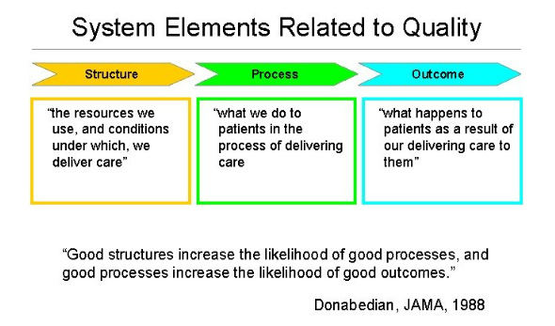
QUALITY ASSURANCE
Well maintained Infra, adequate & skilled HR, functional equipment & instruments, and sufficient drugs & consumables ensure the fulfilment of the ‘Structural’ requirements for establishing a well-functional health facility.
However, for attaining enhanced satisfaction with improved clinical ‘Outcomes’, it becomes equally pertinent to ensure ‘Quality’ in the ‘Processes’ of the care within a health facility.
As a healthcare provider, while it is important to ensure provision of safe and evidence based clinical care, it is equally fundamental to provide the care that makes patients’ and visitors’ experiences rewarding.

Slide 7
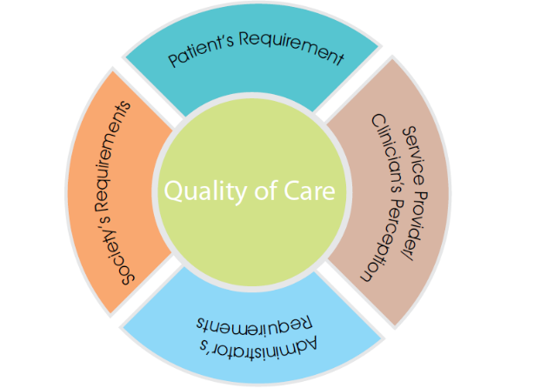
QUALITY OF CARE
Ensuring ‘Quality of Care’ as a key component would require undertaking conscious and concerted efforts to identify the ‘Gaps’ by measuring the Quality of Care (QoC) in all its three dimensions, namely Structure, Process and Outcome (Donabedian Model of QoC).
Subsequently, available resources are channelized, and focussed efforts undertaken for closing the gaps and bringing about the ‘Improvement’ in the services.
For ensuring provision of ‘Quality of Care’, IsQua (International Society for Quality in Healthcare) accredited National Quality Assurance Standards (NQAS) have been formulated by the Ministry of Health & Family Welfare, for District Hospitals, Community Health Centres, PHCs, UPHCs and Health & Wellness Centres/ Sub centres.
Setting standards is a dynamic process, and the standards provide roadmap for the health facilities to improve the care.

Slide 8
REVIEW OF LITERATURE
An in-depth review of literary articles from Google Scholar, Pub Med, IJMR etc, published and unpublisheds reports and official websites of Indian government (ECHS, NHSRC), was conducted to come up with the following themes
Overview
Need of Quality audit
Available Quality tools for Public Health System
NQAS
KAYAKALP
PATIENT SATIS-FACTION
ECHS
CGHS

Slide 9
LITERATURE REVIEW
S.No | Study | By | Published | Location | Methodology
1. | Client satisfaction in ECHS Polyclinic : An Experience from India | Naveen Phuyal Ashok Jindal,YSM Sandip Mukerji | MJSBH Vol 14 Issue 2 Jul- Dec 2015 | ECHS polyclinic | Observational and Analytical Cross sectional Duration -2 yrs Sample size -400 (obtained by estimation of proportion) Stratified Sample Criteria of selection of sample Staff beneficiary excl Every third OPD patient (Systematic Random Sampling) Patients who had at least 3 vis, > 18y, willing Vetted Structured Questionnaire was used
2. | Quality Assessment of Artemis Hospital, Dwarka, New Delhi | Col MM Thakur | 2017 | Artemis Hospital | Observational, Descriptive, Cross sectional study. Evaluation done on the parameters of Quality Assessment Tool Kit. NABH Check list
3. | Healthcare Delivery and Stakeholder’s satisfaction under social health insurance schemes in India : An evaluation of CGHS and ECHS | Sukumar Vellakkal Shikha Juyal Ali Mehdi | Indian Council for Research on International Economic Relation (ICRIER) Dec 2010 | 12 Indian Cities | Primary Survey of 1204 CGHS ,640 ECHS primary beneficiaries, 100 empaneled health care providers and 100 scheme officials

Slide 10
LITERATURE REVIEW
S No | Study | By | Published | Location | Methodology
4. | An Audit of Prescribing practices of CGHS dispensaries of Kolkata, India | A Chattopadhyay Tanushree Mondal Tushar Kanti Saha Badal Kumar Sahu Jashodip Bhattacharya | IOSR Journal June 2013 | 5 out of 18 CGHS Dispensaries in Kolkata | Systematic random sampling of 5 Dispensaries and 412 patients . Informed consent
5. | Reforming CGHS into a ‘Universal Health Coverage’ model | Rakesh Sarwal | The National Medical Journal of India, Vol 28, No 1,2015 | India | Interview of CGHS beneficiaries, MO and administrators. Published articles and documents of CGHS UHC
6. | Inclusive management of Ex-Servicemen in India: Satisfaction of Air force veterans from resettlement facilities with special reference to Tamil Nadu | Kari Mahajan R Krishnaveni | IIMB Management Review,2017 | Tamil Nadu | Descriptive, conclusive, cross sectional data with longitudinal study covering veterans superannuating in past 30 y. Subjects AF veterans other rank

Slide 11
OBJECTIVE(s) - RESEARCH
The Objectives of the research are as under:-
(a) Carry out “Quality Assessment and Audit of the ECHS Polyclinic” to assess the existing services delivery standards.
(b) To suggest measures/ procedures for improvement to meet the requirement of improving quality and enhanced satisfaction level.

Slide 12
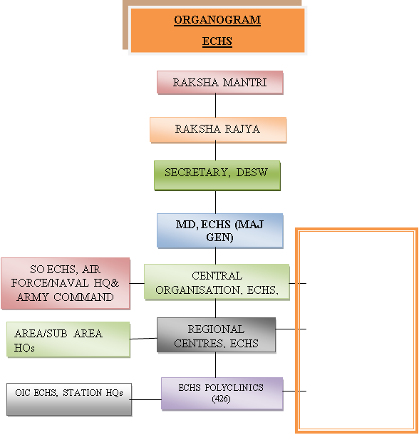
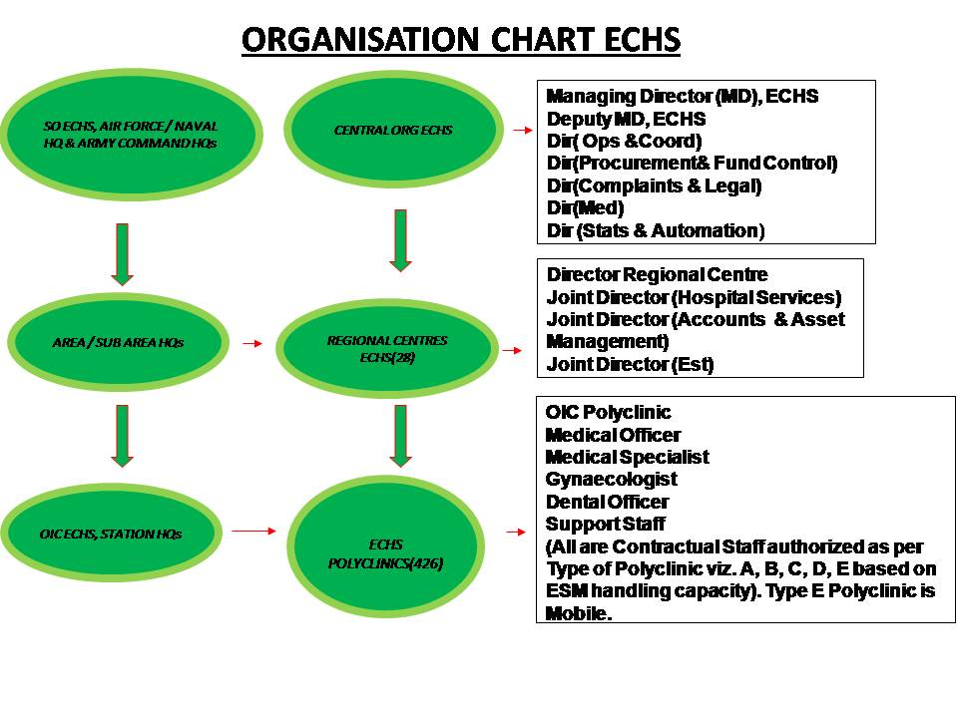

Slide 13
ECHS POLYCLINIC, BASE HOSP, DELHI CANTT
Mil Stn, Type ‘A’ ECHS Polyclinic. Co-loc with Base Hospital, Delhi Cantt.
This polyclinic is responsible to look after the armed forces veterans (AFVs) and their dependents of all Eleven Administrative or Revenue Districts of Delhi.
The dependency is as given below:-
  Primary Membership Veterans - 1,34,908.
  No of Dependents on Polyclinic - 2,41,722.
  No of Patients Visiting Polyclinic - Approx 1100-1200 (daily), 25000 (one month).

Slide 14
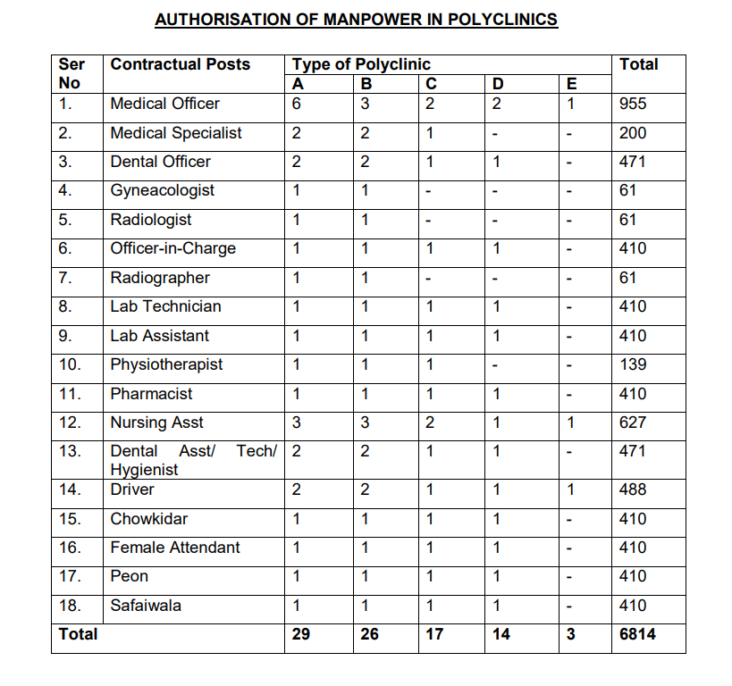

Slide 15

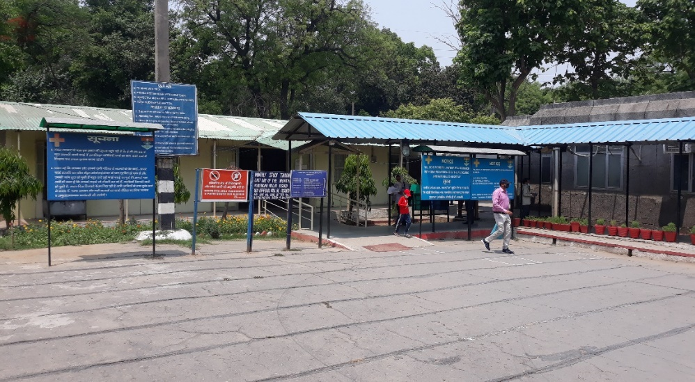
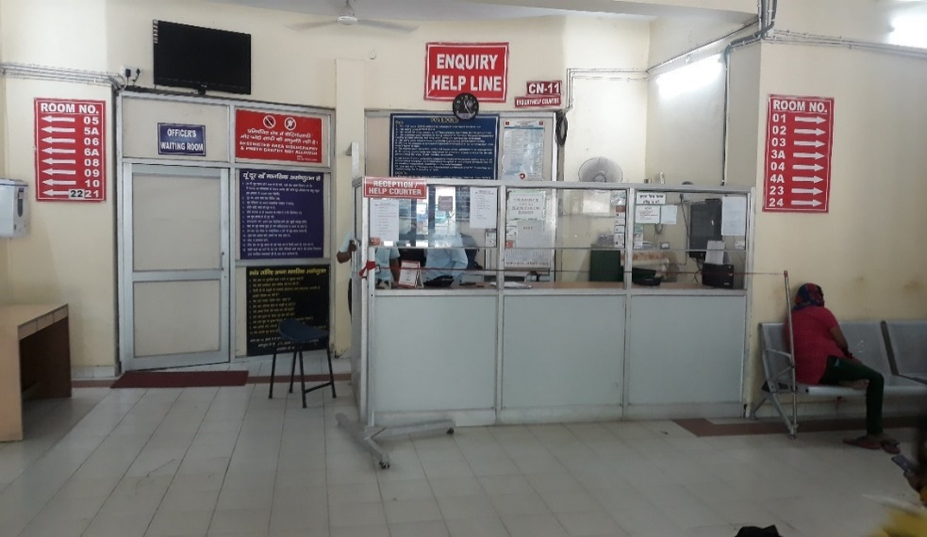
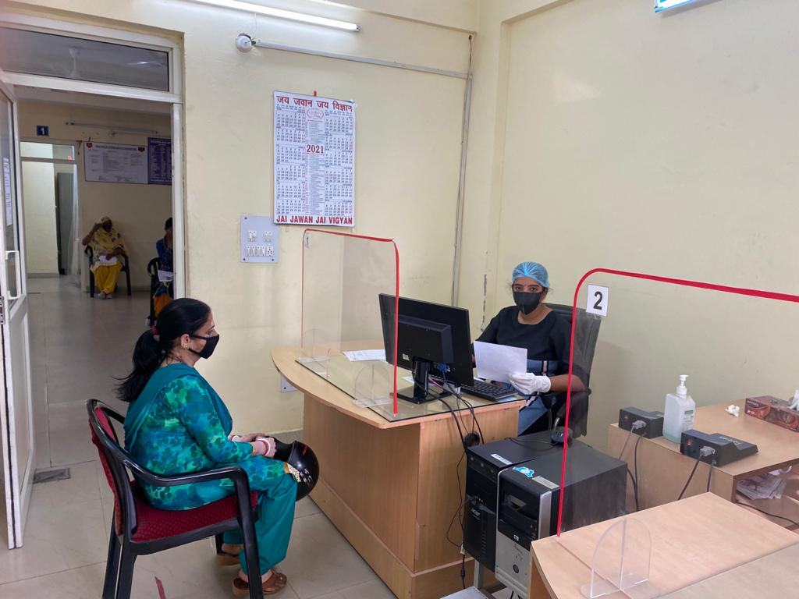
ECHS POLYCLINIC, BASE HOSP, DELHI CANTT

Slide 16
ROLE AND FUNCTIONING
To Provide quality healthcare to ESM Pensioners and their Dependents.
Cashless/ Cap less treatment through ECHS polyclinic, Service Hospitals and Empaneled Hospitals.
Out Patient Care is provided by polyclinic and In patient care (Hospitalization) through BHDC, AHRR and Empaneled Civil Hospitals.

Slide 17
METHODOLOGY
Study Location: ECHS Polyclinic, Base Hospital, Delhi Cantt.
Study Period: 15 Mar - 15 Jun 22.
Study Design: NQAS and KAYAKALP Audit, Patient Satisfaction Survey.
Tools of Data Collection:-
  Primary Data. Observation, Interview (Interaction with concerned authorities, patients), Quality Assessment Tools (PHC Tool kit, PHC Kayakalp Checklist), Questionnaire.
OPD sheet of NQAS PHC Toolkit_19March20 and (http://qi.nhsrcindia.org/cms-category/nqas-tools)
PHC Kayakalp Checklist without beds-JUNE 2019 (http://qi.nhsrcindia.org/cms-category/tools-kayakalp)
  Secondary Data. Policy, Procedures (SOPs) and Records.
Study Population: ECHS patients (Master Card Holders, Consenting).
Sample Size: 100.
Sampling Method: Convenient.
Data Analysis: Microsoft Excel.

Slide 18
STUDY DESIGN
Phase 1 – NQAS (National Quality Assurance Stds) Audit.
Phase 2 – KAYAKALP Audit.
Phase 3 – Patient Satisfaction Survey.

Slide 19
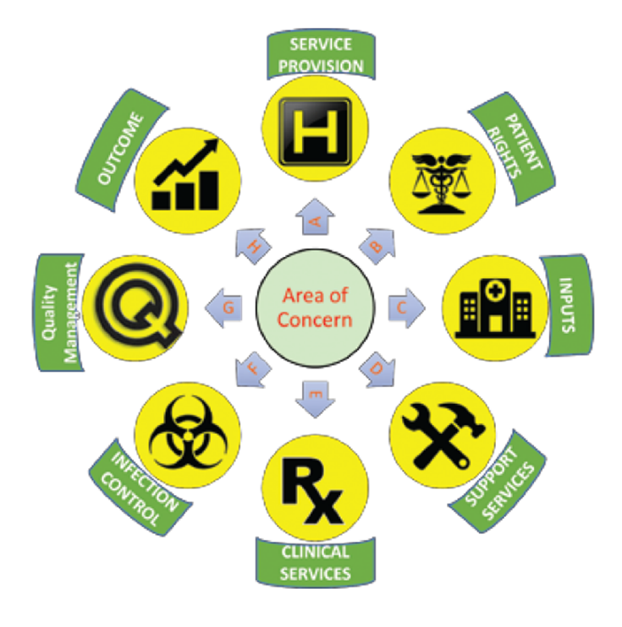
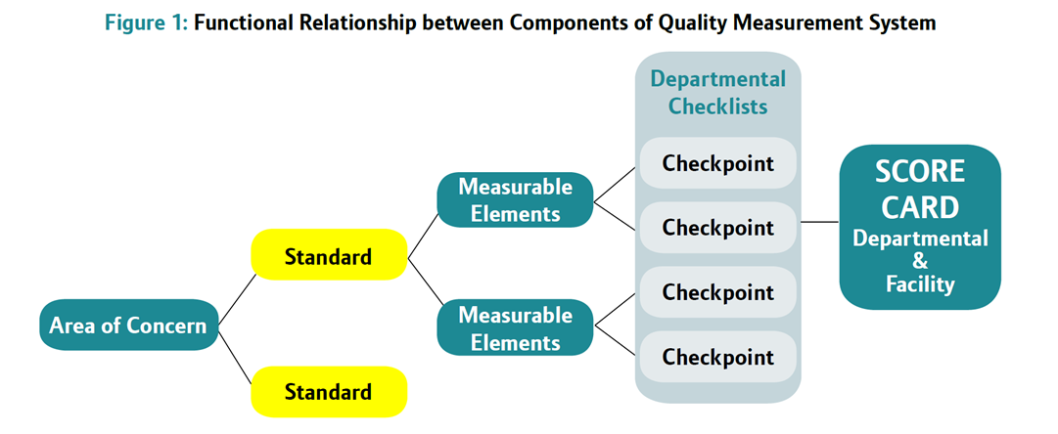
PHASE 1 - NQAS
NQAS Toolkit for PHC_2020 designed by NHSRC (National Health Systems Resource Centre) which is being utilized by Indian Public Health Organization for “Quality Assessment and Accreditation” of CHCs, PHCs and Urban PHCs was used.
The main pillars of Quality Measurement Systems are Quality Standards. These standards have been defined for various level of facilities under NQAS. The standards have been grouped within the Eight Areas of Concern.
Each standard further has specific Measurable Elements. These standards and Measurable elements are checked in each department of a health facility through department specific checkpoints.

Slide 20
MEASUREMENT SYSTEM FOR VARIOUS FACILITIES
Component | DH | CHC | PHC | UPHC
Area of concern | 8 | 8 | 8 | 8
Standards | 74 | 65 | 50 | 35
Measurable elements | 362 | 290 | 250 | 198
Checklists | 18 | 12 | 6 | 12

Slide 21
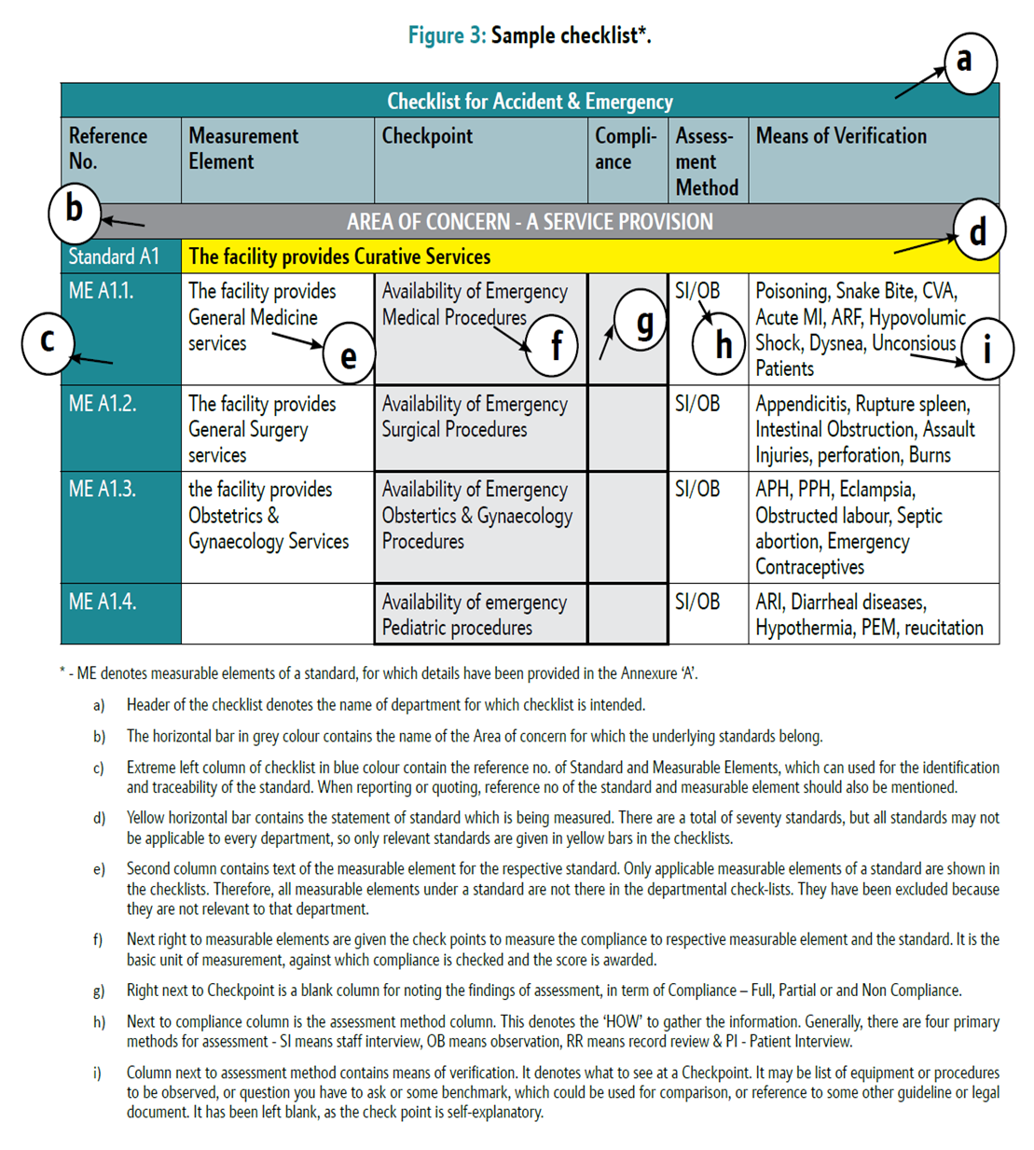
NQAS : CHECKLIST

Slide 22
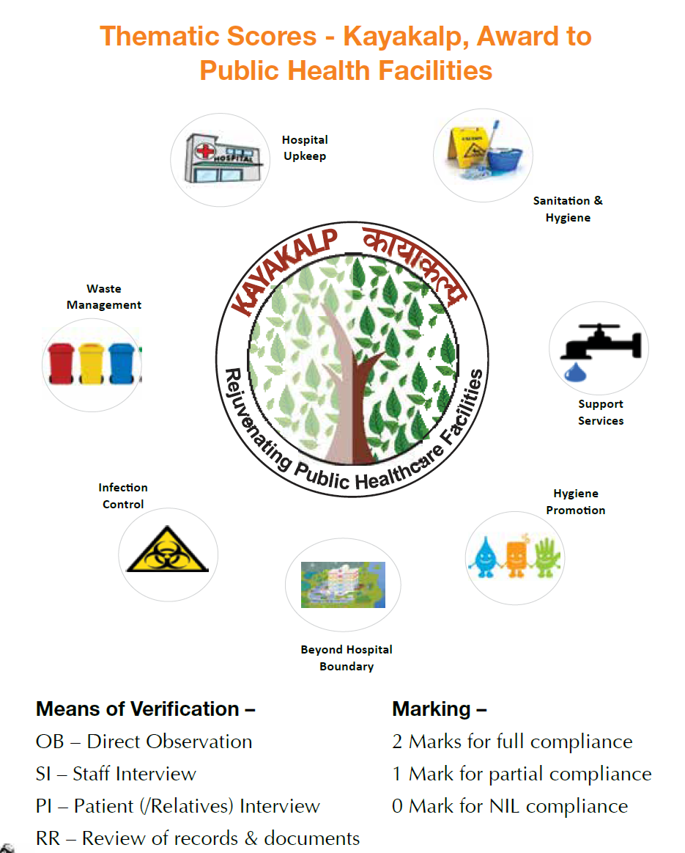
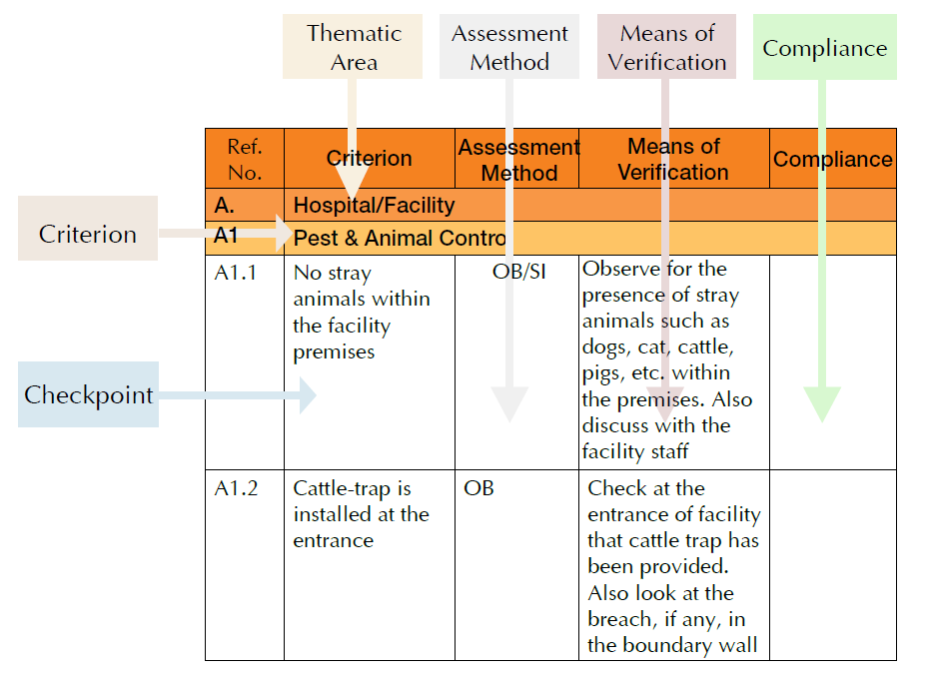
PHASE 2 - KAYAKALP
Kayakalp Checklist_2019 designed by NHSRC (National Health System Resource Centre) for Urban PHC without beds was applied.
Kayakalp aims to promote Cleanliness, Hygiene, and Infection Prevention. It is an award scheme in which facilities are assessed at three-level (Internal, Peer, External) using objective checklist covering seven thematic areas.
Facilities scoring 70% and above after external assessment are recognized and incentivized.

Slide 23
PHASE 3 – PATIENT SATISFACTION SVY
A questionnaire was fielded to the ESM visiting the ECHS Polyclinic.
  Study Design and Area. A cross sectional study involving ECHS Polyclinic at BHDC, taking care of all the veterans and their dependents in eleven districts of the state of Delhi. The ESM and the dependents come for the first point of contact for their health care needs.
  Study Population. For survey, the participants were drawn from the beneficiaries visiting the polyclinic who were Master card holders and given Consent.
  Sampling Method. The total number of dependent beneficiaries on the Polyclinic are as on 15 Mar 2022 were 3,76,630 out of which 1,34,908 were Master Card holders. Non-Probability, Convenient sampling was adopted to collect information from patients.
  Sample Size. The sample size was 100 as the respondents were not very keen to participate in the survey due to Covid 19 pandemic.

Slide 24
RESULTS

Slide 25
RESULTS : NQAS
OPD Score Card
 | OPD Score | 75.5814
 | Area of Concern wise Score
A | Service Provision | 38.88888889
B | Patient Rights | 86.11111111
C | Inputs | 90.54054054
D | Support Services | 100
E | Clinical Services | 82.65306122
F | Infection Control | 100
G | Quality Management | 57.14285714
H | Outcome | 16.66666667

Slide 26
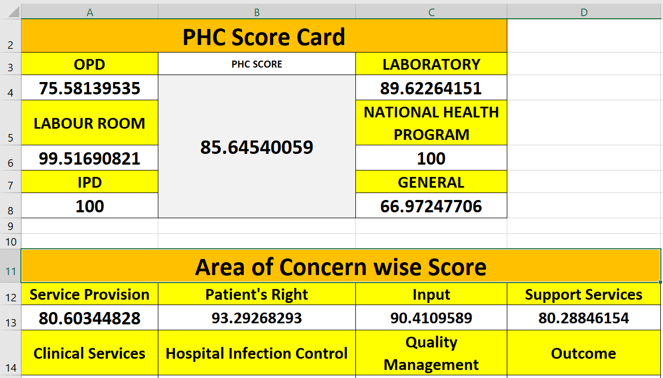
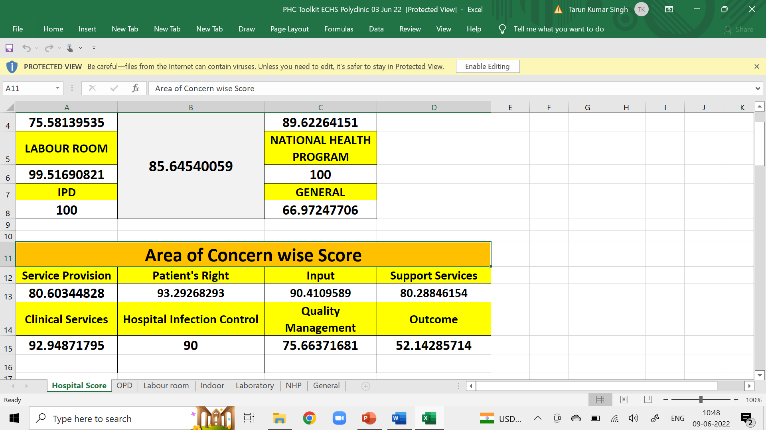
RESULTS
NQAS SCORECARD FOR PHC

Slide 27
NQAS : GAPS
OPD Score Card
 | OPD Score | 75.5814
 | Area of Concern wise Score
A | Service Provision | 38.88888889
B | Patient Rights | 86.11111111
C | Inputs | 90.54054054
D | Support Services | 100
E | Clinical Services | 82.65306122
F | Infection Control | 100
G | Quality Management | 57.14285714
H | Outcome | 16.66666667
1. Service Provision
- Although the Allopathic medicines are available as per formulary, facility does not provide AYUSH services as mandated.
2. Patient Rights
- Formulary needs to be displayed.
- IEC corner of the polyclinic needs improvement in terms of health education material displayed and latest ECHS policy in vernacular medium.
- Privacy aspect needs to be strictly followed during consultation.
3. Inputs
- Unidirectional flow of services does not exist.
- Inadequate Fire safety measures.
4. Support Services
- Drug expiry data management documentation needs to be strengthened.

Slide 28
NQAS : GAPS
OPD Score Card
 | OPD Score | 75.5814
 | Area of Concern wise Score
A | Service Provision | 38.88888889
B | Patient Rights | 86.11111111
C | Inputs | 90.54054054
D | Support Services | 100
E | Clinical Services | 82.65306122
F | Infection Control | 100
G | Quality Management | 57.14285714
H | Outcome | 16.66666667
5. Clinical Services
- Although the facility ensures follow up of patients discharged from higher facilities, it is patient dependent, it needs to work independently and real time.
- Facility lacks well documented/ practiced triage system in case of mass casualty, emergency protocol, CPR etc.
- MLC (Medico Legal Cases) handling not defined well.
6. Infection Control
- Non display of hand hygiene at point of use.
- Decontamination drills to be well defined.
7. Quality Management
- Comprehensive Patient satisfaction survey not carried out.
- No internal assessment mechanism exists.
8. Outcome
- The facility lacks Service Quality Indicators measures.
- No system to assess whether State/ National benchmarks are being achieved.

Slide 29
RESULTS
SCORECARD – KAYAKALP AUDIT OF POLYCLINIC

Slide 30
KAYAKALP : GAPS
1. PHC Upkeep
  No earmarked store for condemned stores.
  Rain water harvesting mechanism needs to be installed.
2. Sanitations and Hygiene
  Three bucket system for cleaning.
3. Waste Management
  Innovations in general waste management be encouraged (Recycle).
4. Infection Control
  IEC of hand hygiene at some point of use is lacking.
  Spill management protocol not displayed.
  Reporting of notifiable diseases & events needs to be streamlined.
5. Support Services
  Maintenance standards of equipment, Ambulance, Generators.
6. Hygiene Promotion
  Training & capacity building and standardisation to required level is lacking.
7. Beyond Hospital Boundaries
  Not applicable to subject Polyclinic.

Slide 31
PATIENT SATISFACTION SURVEY : FINDINGS
Gender of the Respondents
Among the total respondents interviewed, a sizeable number of them (63 per cent) were males than females (37 per cent).
Dependents of the Respondent
Number of dependents reveals that a 62% of them have less than 2 or less dependents, 28% have more than 2 to 3 dependents and 10% of them have 4-6 dependents.

Slide 32
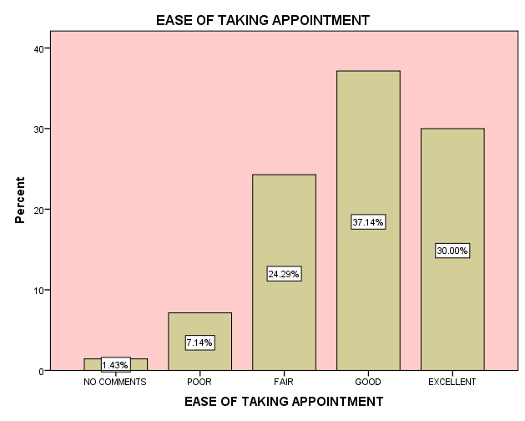
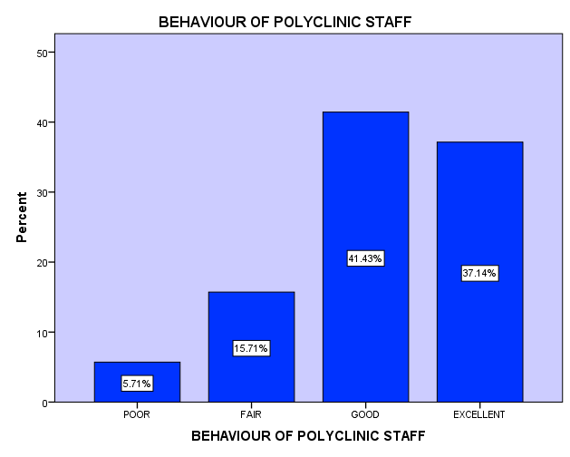
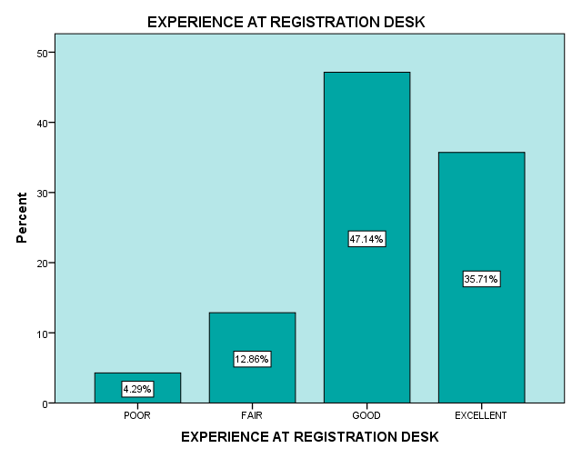
PATIENT SATISFACTION SURVEY : FINDINGS
Ease of Taking Appointment
The beneficiaries are satisfied with the comfort levels of taking appointment with 67% rating it Excellent to Good. Registration experience at the polyclinic has also been good with 82% rating it Excellent to Good.
Behaviour of Staff
Behaviour of the staff has been rated exemplary.

Slide 33
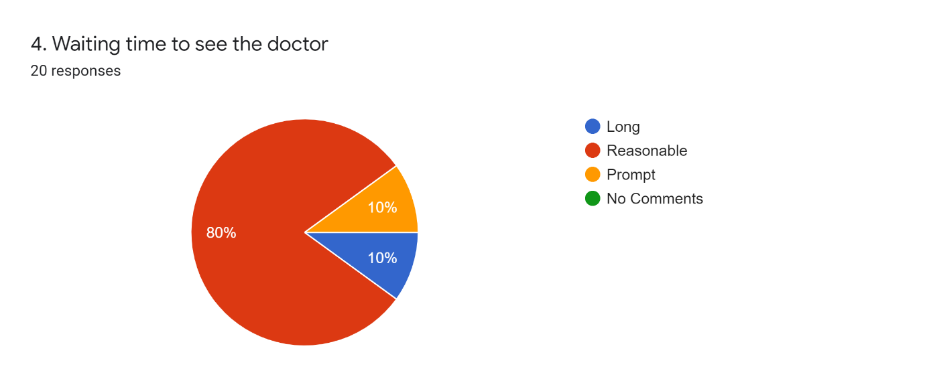
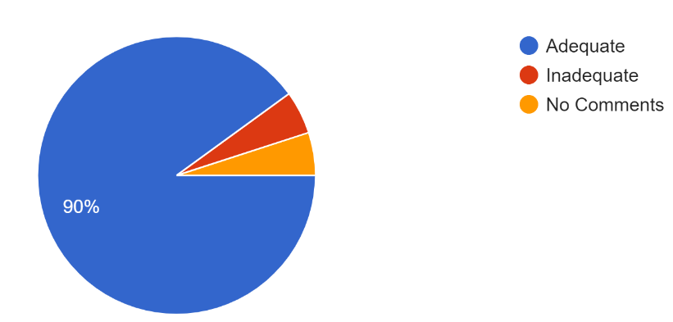
PATIENT SATISFACTION SURVEY : FINDINGS
Consultation
Waiting Time
Waiting time to see the doctor has been rated reasonable by 80% respondents.
Amount of Time spent in Consultation
Respondents are happy with the amount of time spent with the Medical officer.
90% find it adequate.

Slide 34
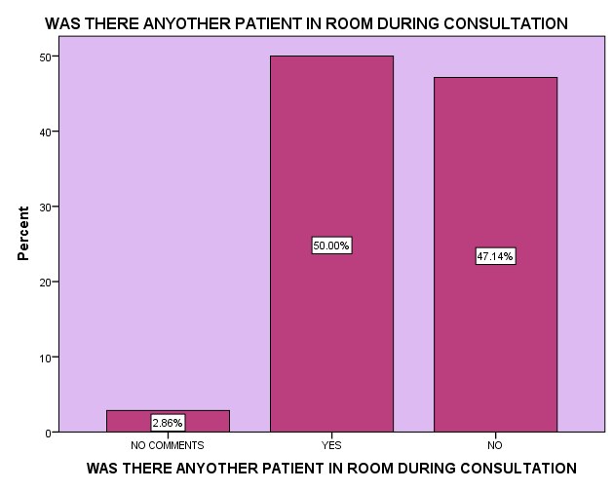
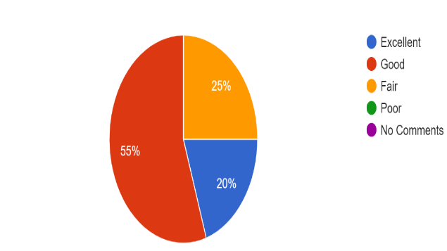
PATIENT SATISFACTION SURVEY : FINDINGS
Consultation
Privacy issues
- Half of the beneficiaries have confirmed presence of other patients during the consultation which is violation of privacy protocol.
- This feedback is mainly due to presence of two Medical officers in one consultation room.
Quality of Consultation
- Quality of consultation have been rated high (75% rated it Ex/ Good).
- 70% of the beneficiaries are willing to recommend this polyclinic to others.

Slide 35
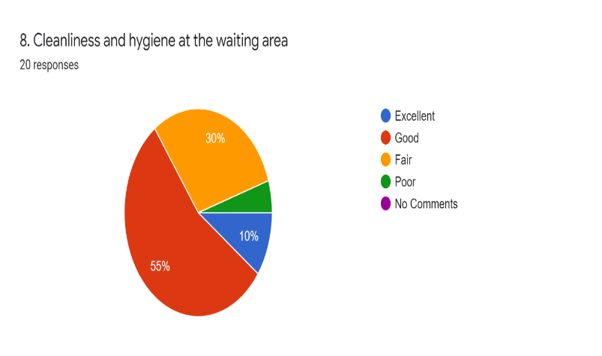
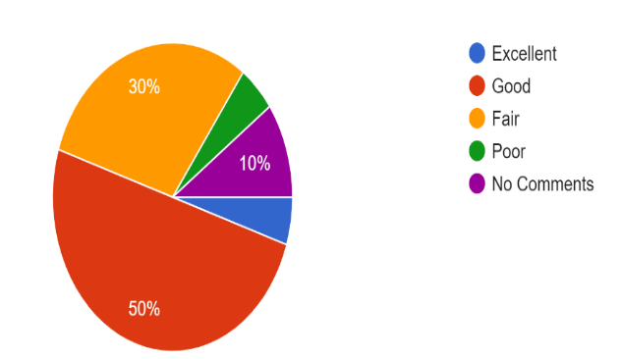
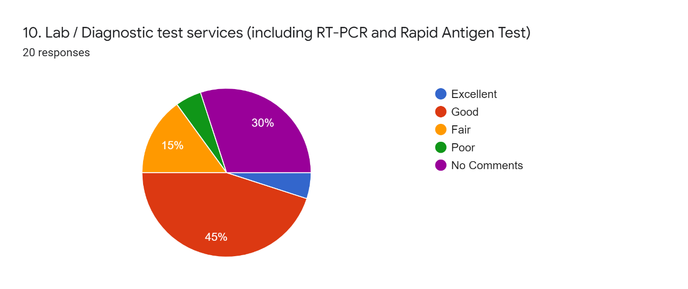
PATIENT SATISFACTION SURVEY : FINDINGS
Services
Cleanliness and Pandemic Protocols
Hygiene and Pandemic protocol have been rated good and encouraging.
Laboratory/Diagnostic Tests
70% of respondents are happy with Lab/ Diagnostic services, which is adequate.

Slide 36
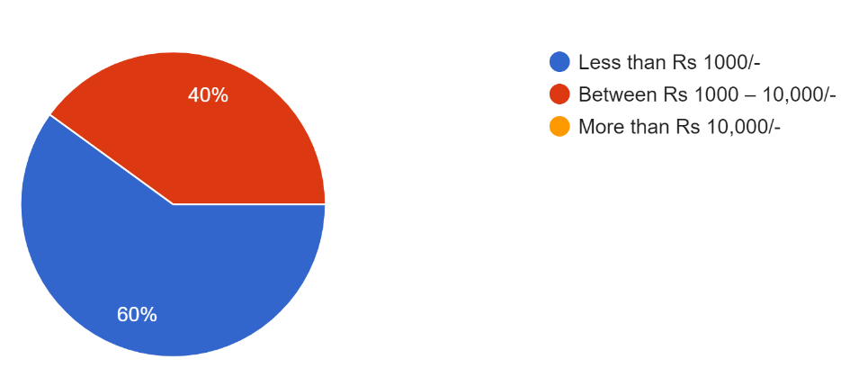
PATIENT SATISFACTION SURVEY : FINDINGS
Services
Medicine's Availability
Satisfaction level of medicines available at Polyclinic reveals that 85% of the respondents were satisfied; and 15% of them were not satisfied due to non-availability of medicines.
Out of Pocket Expenditure
OOPE on medical care of 40% beneficiaries is between Rs 1000-Rs 10000, which is on higher side and cause of concern.
OOPE of Beneficiaries

Slide 37
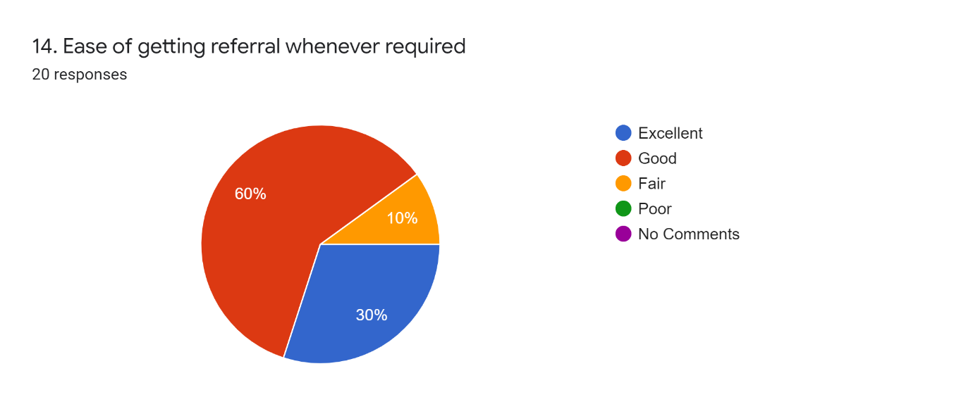
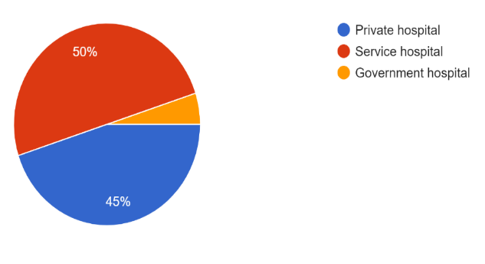
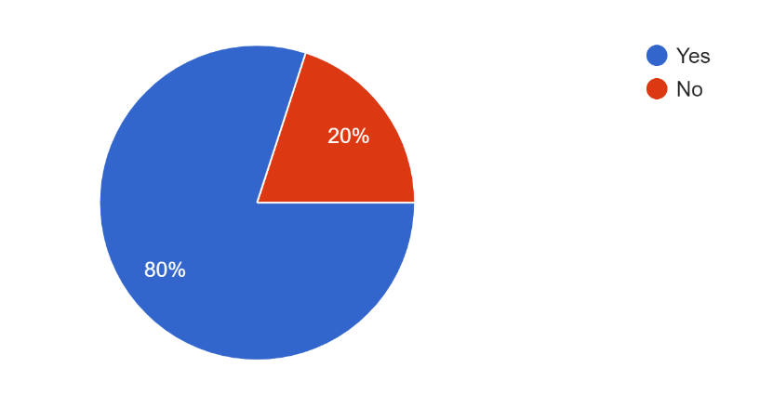
PATIENT SATISFACTION SURVEY : FINDINGS
Referral
A sizeable number (85%) of beneficiaries are satisfied with current referral system. 45% would like to get referred to Private Facility and about 50% to Service Hospitals and has very few takers for Government facilities.
Ease of Referral
Referral Preference
Satisfaction Level at Empanelled Hospital
The survey revealed that a considerable number (80%) are satisfied with the referral being made to the empanelled hospitals.
Empanelled facilities Satisfaction

Slide 38
FINDINGS
 | Other Important Findings | Reason
1. | No of Doctors | No of doctors be increased to reduce the waiting time
2. | Lab/Diagnostics tests | Report to be made available same day
3. | Medicines | Costly medicines not available. In lieu medicines issued. Medicines of all strengths not available.

Slide 39
CONCLUSION
NQAS
NQAS Score Card for OPD is 75.58, which is reasonably high. It should be read in conjunction with following facts that:-
  The standards have neither been designed for the subject health facility nor were they prepared for such an audit, therefore not applicable in absolute terms.
  The final score has a weightage of all 6 categories (OPD, Labour Room, IPD, Laboratory, NHP, General) out of which only one category, i.e., OPD has been assessed.
  The relative score of OPD is high because, not mandated sections of standards have been awarded full 2 marks.
  The audit has been carried out in restricted pandemic conditions.

Slide 40
CONCLUSION
KAYAKALP
2. Kayakalp Score is 87.90%, which is well above the pass criteria, but this result has to be read in conjunction with the facts that:-
  The standards have neither been designed for the subject health facility nor were they prepared for such an audit, therefore not applicable in absolute terms.
  The criteria which have not been mandated have been awarded full 2 marks.
  The standards have not been designed for the subject facility.
  The audit has been carried out in restricted pandemic conditions.

Slide 41
CONCLUSION
Patient Satisfaction Survey
Registration experience of the beneficiaries has been rated high and ease of taking appointment good. The behavior of the staff at ECHS polyclinic was considered exemplary.
Consultation wait time needs to be brought down and privacy protocol during consultation require attention.
3. The satisfaction with the specialist care and the empanelled hospitals was mostly good.
4. Laboratory services are satisfactory.
5. Availability of medicines needs improvement, and OOPE of beneficiaries needs to be brought down. Though the amount expended on purchase of medicines is generally fully reimbursed. Costly medicines at times are not available and availability of medicines of different potencies at times is an issue.
6. The beneficiaries are satisfied with health services of polyclinic and empanelled private partners but relatively more satisfied with Base Hospital. Referral service is good and beneficiaries prefer to get referred to Service Hospitals.

Slide 42
RECOMMENDATIONS
An all-encompassing (Stakeholders) Quality Audit system needs to be designed by Central Organisation ECHS for all types of Polyclinics for enhancing overall quality.
Although the customer (ESM) should be the focus but a superior quality system should include all stake holders as under:-
  Inhouse Health Facilities, Polyclinics.
  Beneficiaries.
  Employees.
  Partners (Empanelled facilities).
An extensive application of NQAS and Kayakalp Checklist in all types of Polyclinics be carried out by team of experts (including internal and external) before adapting/ designing and adopting the system. Remove the clauses not applicable and include the ones which are missing. Professional help in this regard may also be sought.

Slide 43
RECOMMENDATIONS
4. Constitute an internal audit team.
5. Regular updating of the Polyclinic formulary so that latest medicine prescribed by Empanelled facilities doctors are made available to beneficiaries. Range and depth of medicines needs to be to scientifically analyzed to reduce OOPE of the beneficiaries.
6. Waiting time of the patients need to be reduced, for which MO be absolved from all administrative duties during consultation hours.
7. Online or tele-appointment system be made more popular and user friendly for veterans.

Slide 44
REFRENCES
COECHS. (2021, April). https://echs.gov.in/. Retrieved from Official ECHS Web Portal, maintained & managed by COECHS : https://echs.gov.in/
Department of Ex-servicemen Welfare, MoD, GoI. (2020, APR). http://desw.gov.in/. Retrieved from Department of Ex-servicemen Welfare: http://desw.gov.in/
Dudeja, P. A. (2013). Health promotion initiatives: An experience of a Well Women’s Clinic. Medical Journal Armed Forces India .
(2008). ECHS Handbook. New Delhi: Directorate of Personnel, Air Headquarters .

Slide 45
DISCUSSION

Slide 46
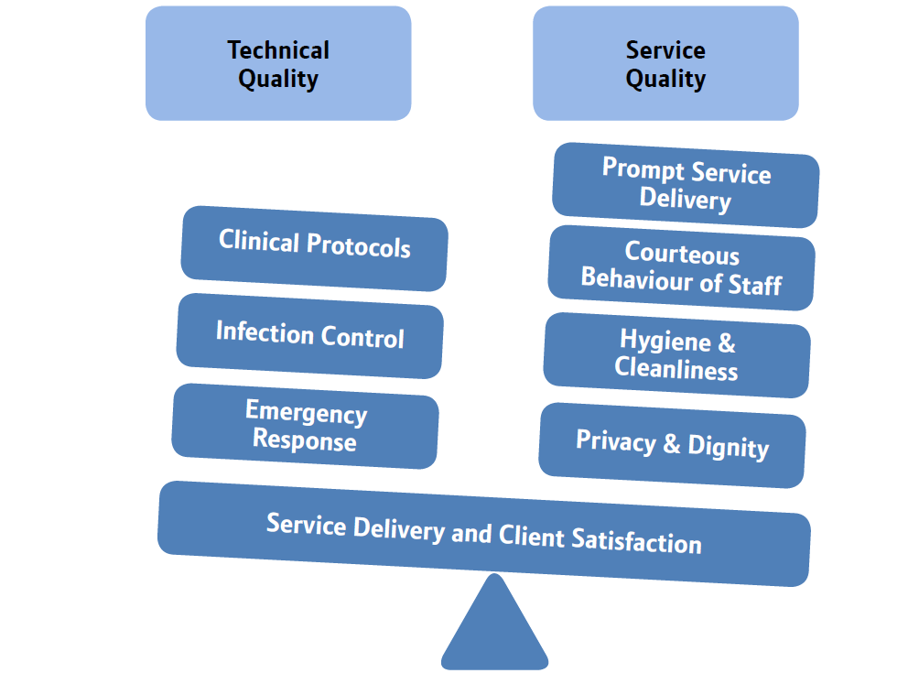
QUALITY - SUB COMPONENTS

Slide 47
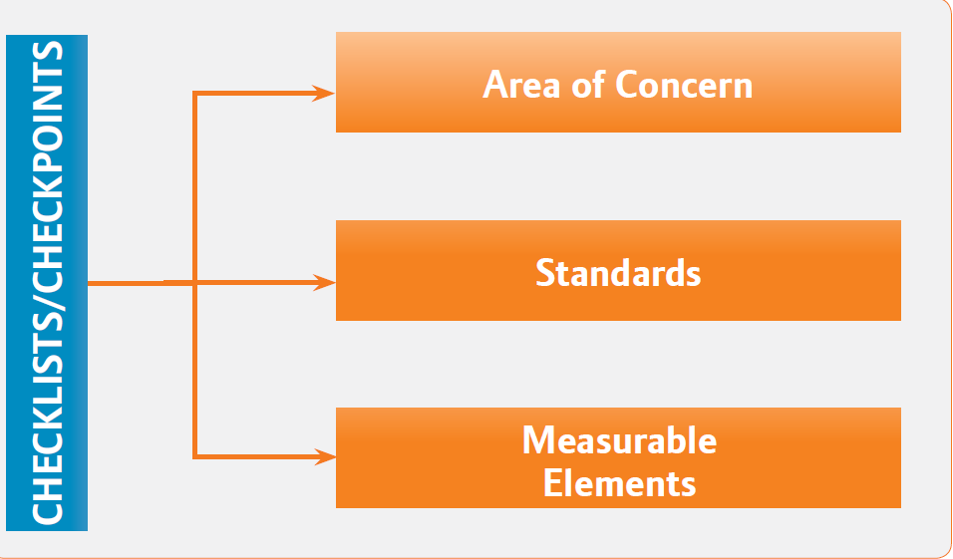
ASSESSMENT

Slide 48
QUALITY OF HEALTHCARE - WHO
a. Patient-Centred: delivering health care, which takes into account preferences and aspirations of the service users, and is in congruent with their cultures. It implies that patients are accorded dignified and courteous behaviour. Their reasonable belief, practices and rights are respected.
b. Equitable: delivering health care which does not vary in quality because of personal characteristics such as gender, caste, socioeconomic status, religion, ethnicity or geographical location.
c. Accessible: delivering health care that is timely, geographically reasonable, and provided in a setting, where skills and resources are appropriate to the medical need.

Slide 49
QUALITY OF HEALTHCARE - WHO
d. Effective: delivering health care that is based on the needs, and is in compliance to available evidences. Therefore, observance of treatment guidelines and protocols is important for ensuring the quality of care. The delivered health care results into the improved health outcomes for the individuals in particular, and community in general.
e. Safe: delivering health care which minimizes risks and harm to the users.
f. Efficient: delivering health care in a manner which maximizes productivity out of the deployed resources. The wastes are avoided.

Slide 50
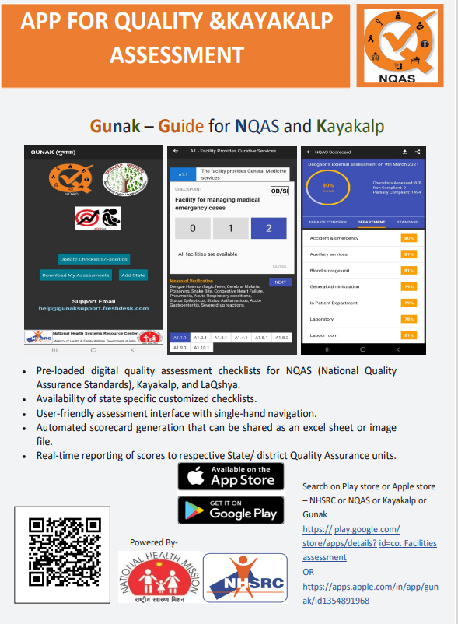
GUNAK – GUIDE FOR
NQAS AND KAYAKALP

Slide 51
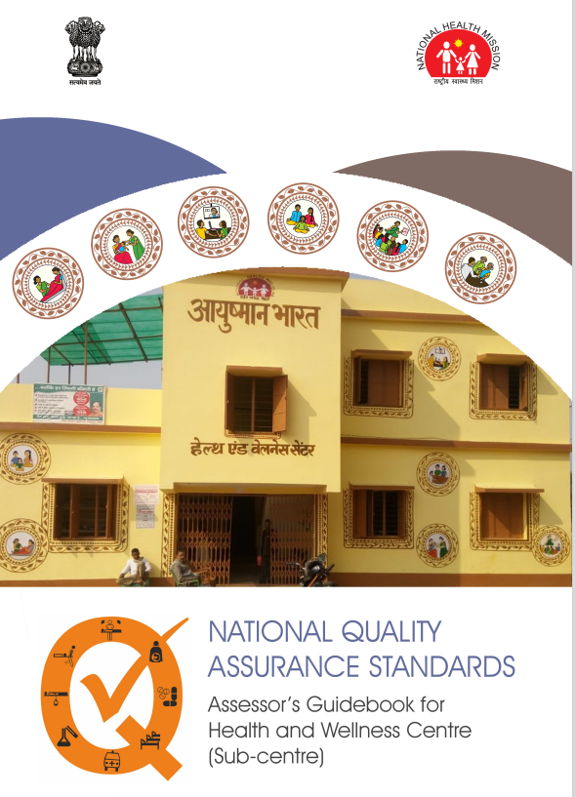
NQAS STANDARDS

