Slide 1

‘Interconnected Risks’ network analysis of Psychosocial risk factor in maternal prepartum and postpartum period
Dr. Anandhi Ramchandran
IIHMR Delhi
Presented By -Dr. Anshuma Mahalle
PG/23/021

Slide 2
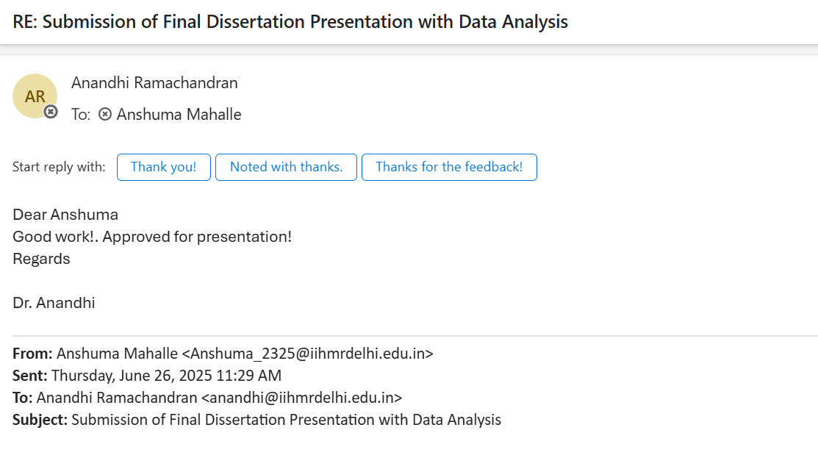

Slide 3

‘Interconnected Risks’ network analysis of Psychosocial risk factor in maternal prepartum and postpartum period.
Mental health during pregnancy and postpartum is a crucial public health concern. Psychosocial risks like stress, depression, and lack of support can significantly affect maternal and infant outcomes.
Despite increasing awareness, many women remain undiagnosed or unsupported due to limited screening tools and systemic gaps in community health programs.
This study investigates how perceived social support; family support and financial strain influence maternal stress and depressive symptoms during prenatal and postnatal periods.
The research focuses on a community-based cohort of pregnant and newly delivered women from semi-urban/rural settings.

Slide 4


Objectives of the Study
1
To assess the prevalence of perceived stress and depressive symptoms in prenatal and postnatal women.
2
To examine the impact of financial strain on maternal
psychological wellbeing.
3
To evaluate the protective role of perceived social support on stress and depression.
4
To apply correlation and network analysis for identifying core psychosocial variables influencing mental health outcomes.

Slide 5

Methodology
Study Design & Participants
Data Collection Method
Study Design: Cross-sectional
observational study
Structured questionnaire-based interviews
Statistical Tools
• Participants: Total of 80 women
(Each group of 40 prenatal and postnatal phases)
SPSS v28: Descriptive statistics, Pearson correlations, regression analysis
Instruments Used
Prenatal Psychosocial Profile (PPP)
Perceived Stress Scale (PSS)
Financial Strain Index
Edinburgh Postnatal Depression Scale (EPDS)
Multidimensional Scale of Perceived Social
Support (MSPSS)
R v4.3.1: Network analysis (qgraph), visualization of inter-variable relationships
Graphical Representation
Histograms, boxplots, bar charts, scatter plots, network diagrams to aid interpretation

Slide 6
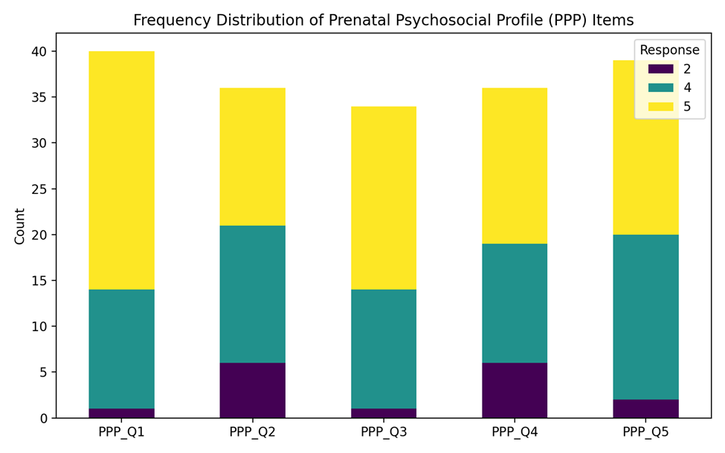
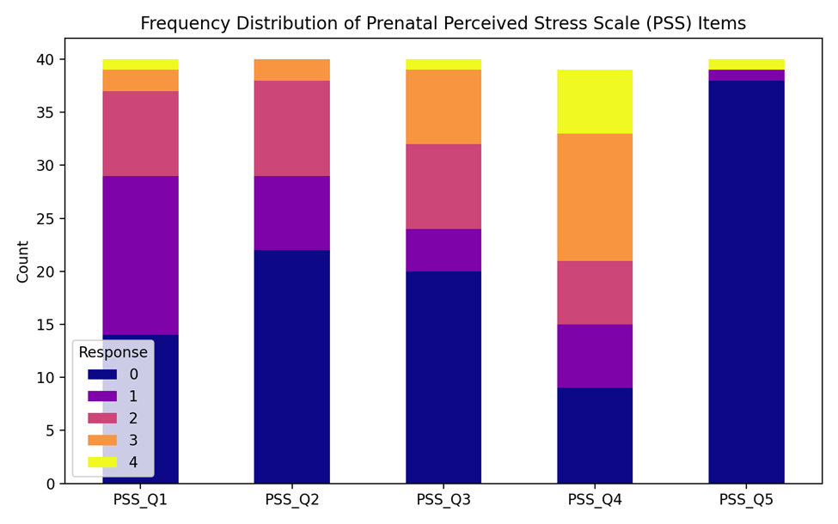
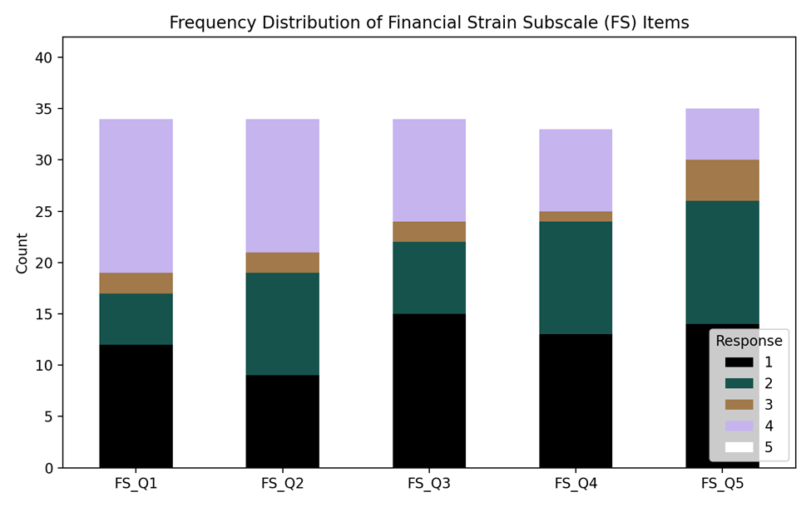
Results
Group A Prenatal Phase
1 Descriptive Statistics
Prenatal Psychosocial Profile (PPP):
  Mean = 21.1
  Median = 21.5
  Mode = 25
Perceived Stress Scale (PSS):
  Mean = 5.125
  Median = 4.5
  Mode = 2
  Most participants endorsed the lowest-stress options, indicating generally low perceived stress.
Financial Strain Subscale:
  Taller upper segments in bar charts suggest high responses (ratings of 4–5) on items indicating financial dependency and emotional impact.
2.Frequency Distribution

Slide 7
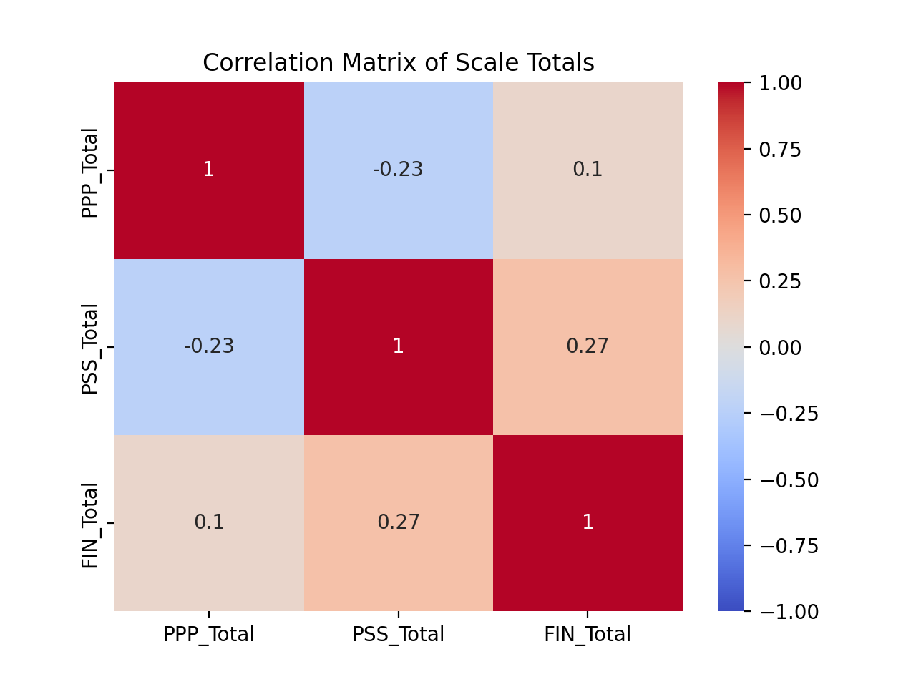
Group A Prenatal Phase
3.Correlation Analysis
PPP vs. PSS: r ≈ -0.23 (Pearson) → Mild negative correlation: higher psychosocial profile scores link to lower stress.
PSS vs. Financial Strain: r ≈ 0.27 (Pearson) → Weak positive relationship: more financial strain associates with more stress.
PPP vs. Financial Strain: r ≈ 0.10 → Virtually no correlation.
Demographic Correlations (Spearman):
  Age vs. PPP: ρ ≈ 0.19
  Age vs. PSS: ρ ≈ -0.26
  Age vs. Financial Strain: ρ ≈ -0.35
    Education vs. Financial Strain: ρ ≈ -0.46
  Group (prenatal class vs. comparison) showed consistent negative correlation with PPP and positive with PSS and Financial Strain.
4.Regression Analysis
Only two predictors were significant:
  PPP_Total: One-point increase predicted a 0.47-point drop in PSS score.
  Group (prenatal class vs. comparison): Comparison group showed higher stress.
R² = 0.39 → The model explains 39% of the variability in stress.
Financial strain, education, occupation did not significantly predict PSS when controlling for other variables.

Slide 8
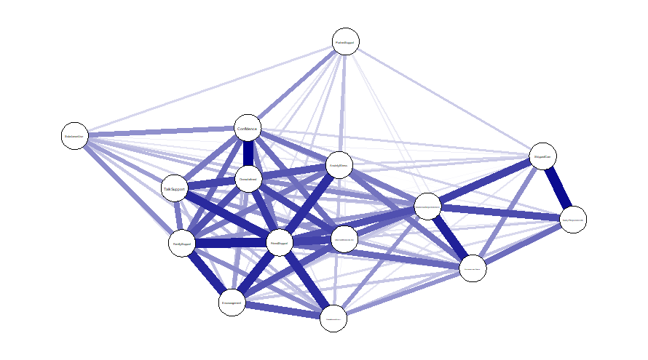
Group A Prenatal Phase
Network Analysis (R Studio)
Correlations ≥0.3 were visualized in a network graph.
Strong intra-subscale correlations show consistency.
Negative correlations (e.g., Unnamed: 8 and 15 = -0.55) reveal inverse relationships.
Central variables (“hubs”) and bridges identified include support-related and stress-linked items.
This supports a systems-based understanding of interlinked maternal stress factors.

Slide 9
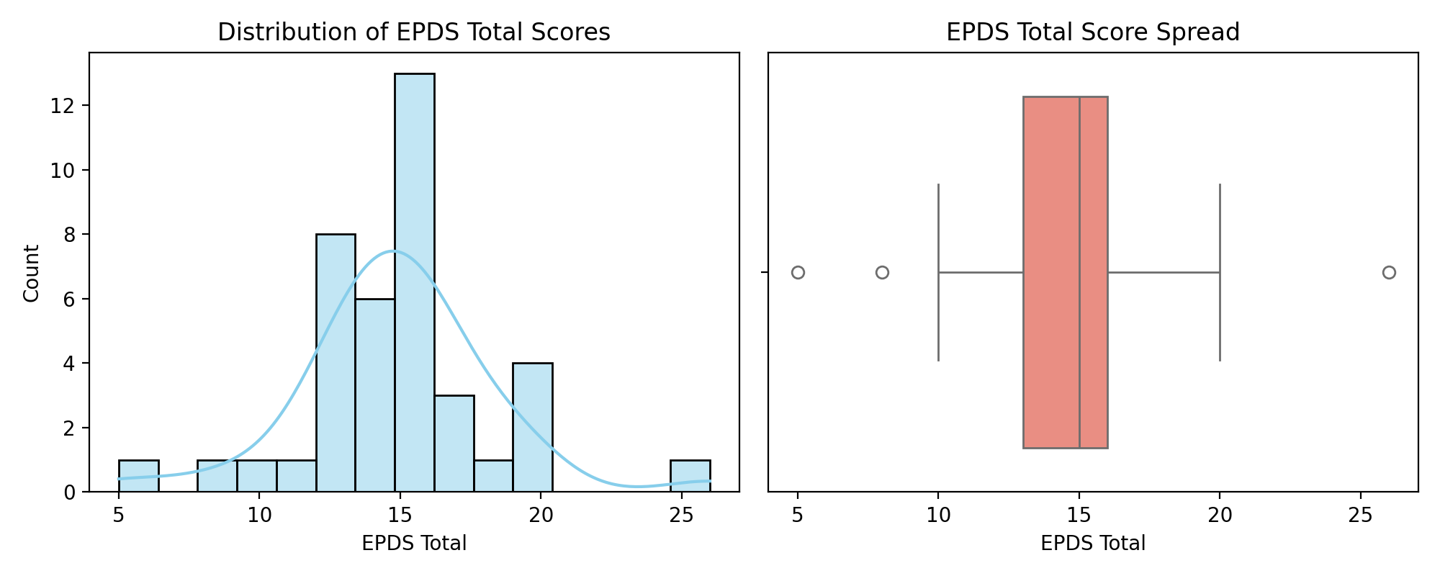
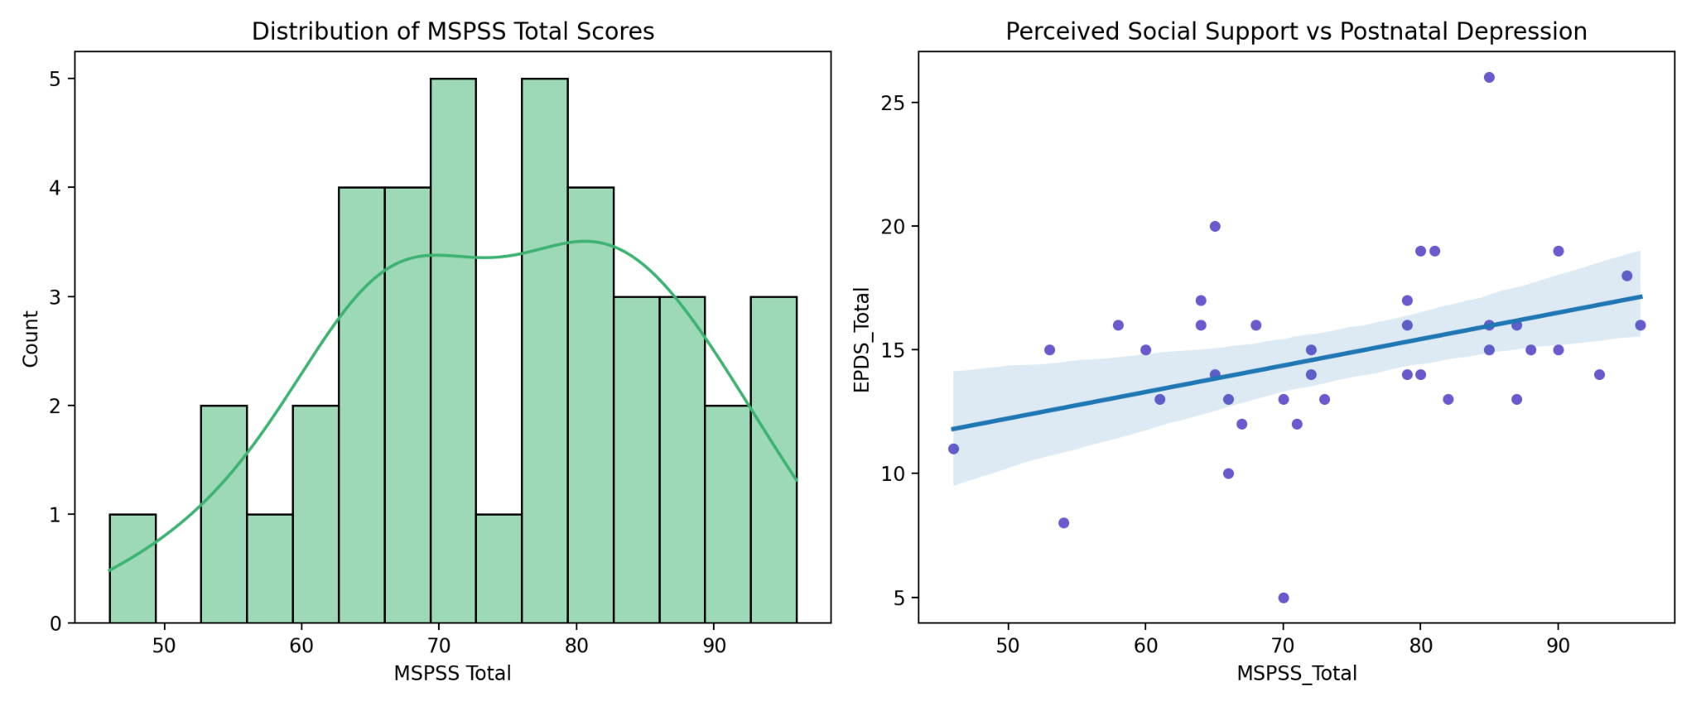
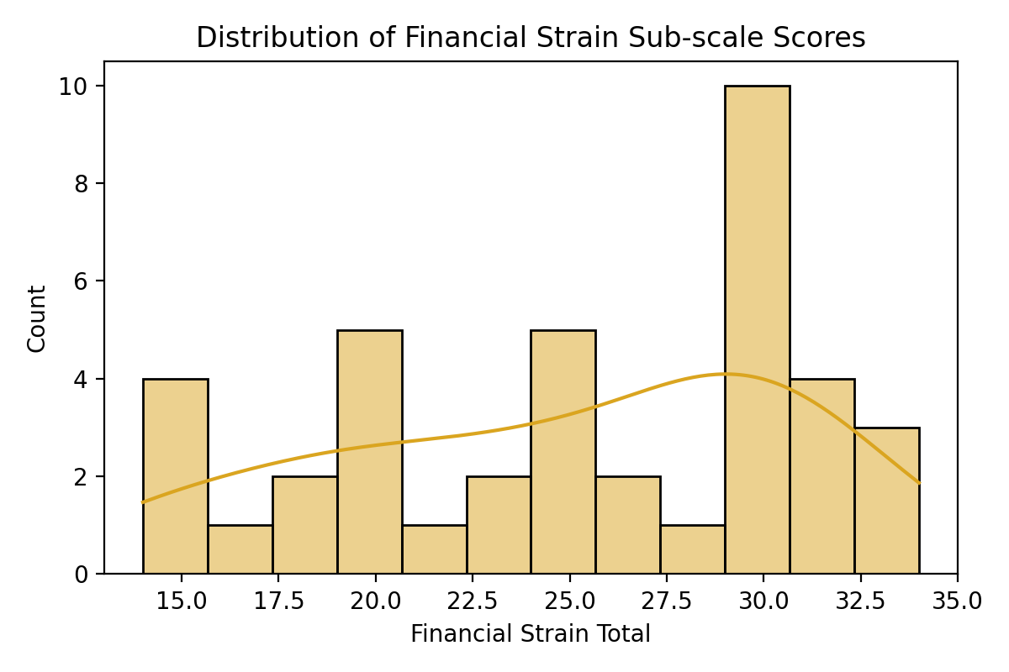
Frequency Distributions
Results
Group B Postnatal Phase
Descriptive Statistics
Edinburgh Postnatal Depression Scale (EPDS):
  Mean = 14.9
  Median = 15
  Mode = 16
  Most mothers clustered between scores of 12–17.
Multidimensional Scale of Perceived Social Support (MSPSS):
  Mean = 4.19
  Median = 4.21
  Mode = 4.17 (on a 1–7 scale)
  Indicates moderate perceived support in the sample.
Financial Strain Subscale:
  Most scores clustered in the high 20s; score of 29 was most common.
  Histogram shows a slight left skew; few respondents had very low or very high scores.

Slide 10
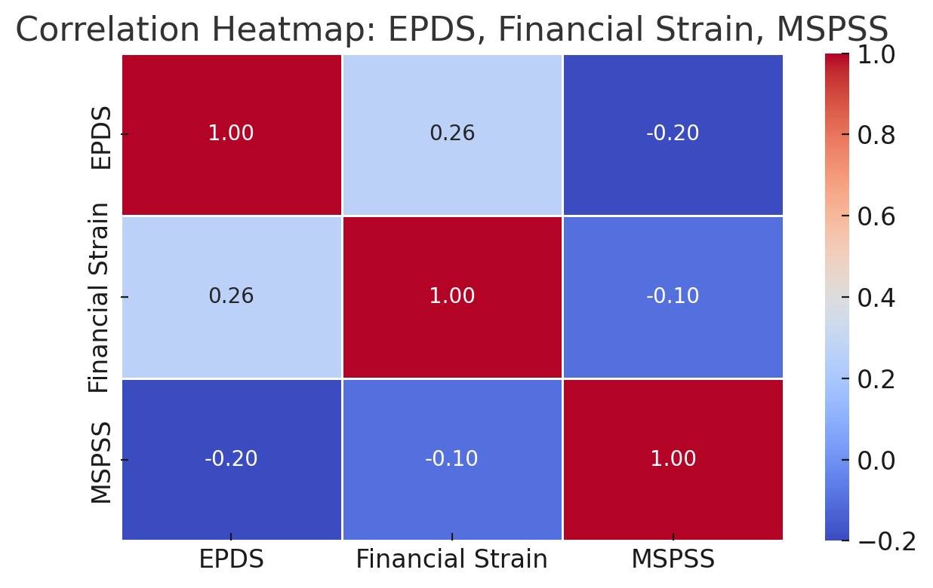
Group B Postnatal Phase
Correlation Analysis
EPDS vs. Financial Strain:
  Pearson: r = 0.26 (p ≈ 0.10)
  Spearman: ρ = 0.28 (p ≈ 0.08)
  Suggests a weak-to-moderate positive relationship—higher financial strain tends to align with higher depression scores.
MSPSS vs. EPDS:
  Scatter plot reveals a weak negative trend—higher social support relates to slightly lower depression scores.
Regression Analysis
EPDS vs Financial Strain
Dependent Variable: EPDS (Edinburgh Postnatal Depression Score)
Independent Variable: Financial Strain
Pearson Correlation (r): 0.26 (p ≈ 0.10)
Spearman rho (ρ): 0.28 (p ≈ 0.08)
Regression Interpretation:
The positive correlation indicates that as financial strain increases, EPDS scores also tend to increase.
However, p-values (~0.08–0.10) suggest the relationship is not statistically significant at the 0.05 level, but it's marginally suggestive of an association.

Slide 11
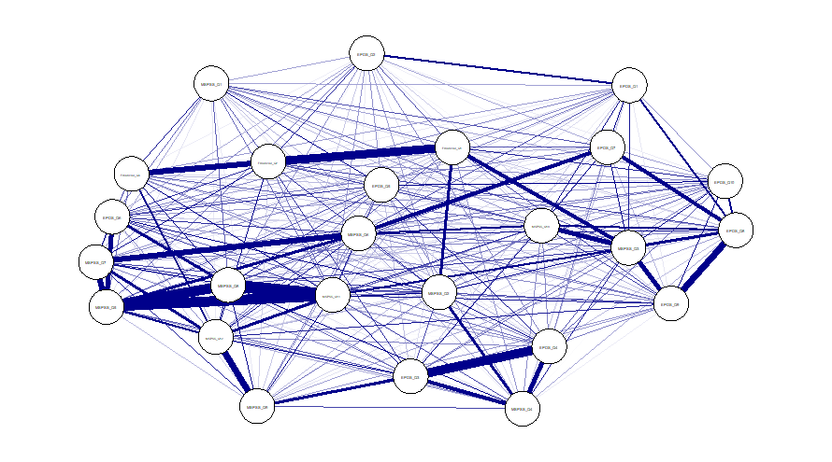

Group B Postnatal Phase
1. EPDS Inter-Item Connectivity:
Items EPDS_Q3 & EPDS_Q4 show a strong negative correlation (r = -0.60), indicating inverse symptom responses—likely measuring contrasting aspects of mood or behavior.
Moderate internal correlations (r = 0.39 between Q1 & Q2) suggest good coherence within the depression scale, though some weak or negative links point to diverse symptom patterns.
2. MSPSS (Social Support) Clusters:
MSPSS items form dense internal clusters, especially:
  MSPSS_Q5–Q8 and MSPSS_Q11–Q12 share strong connections
  (e.g., Q5-Q8 = r = 0.64; Q11–Q12 = r = 0.42)
  Suggests internal consistency within perceived support from family/friends/significant others.
These clusters act like “resilience hubs” in the network.

Slide 12
Group B Postnatal Phase
3. EPDS vs. MSPSS Relationships:
Mostly negative correlations between EPDS items and MSPSS items (e.g., EPDS_Q1 vs MSPSS_Q10 = r = -0.34), indicating:
Higher perceived support is associated with lower depression symptoms.
This supports the buffering hypothesis, where social support mitigates depressive risk.
4. EPDS vs. Financial Strain:
Modest positive links (e.g., EPDS_Q2 with Financial_Q2 = r = 0.28; EPDS_Q7 with Financial_Q1 = r = 0.22)
Implies increased financial difficulty is related to higher depressive symptoms.
Though correlations are not strong, they’re consistent across multiple EPDS items, reinforcing the trend.
5. MSPSS vs. Financial Strain:
Mostly weak or negative correlations between MSPSS and financial strain variables.
Example: MSPSS_Q12 vs Financial_Q3 = r = -0.36
Suggests those with greater support may perceive less financial strain or cope better with it.

Slide 13

Discussion
Group A Prenatal Phase
This study reveals that psychosocial risks during the prenatal period are interconnected, with social support and financial strain playing pivotal roles.
The Prenatal Psychosocial Profile (PPP) score indicates most participants had moderate to high levels of support. Perceived stress remained low overall, yet elevated among those with high financial strain.
Regression analysis confirms that psychosocial resources (PPP) and prenatal class participation are significant protective factors. Demographics like age and education showed weak to moderate associations but were not significant in multivariate models.
Network analysis visualized central and bridging symptoms, such as social support and emotional wellbeing items, offering a roadmap for targeted interventions.

Slide 14

Discussion
Group B Postnatal Phase
The EPDS results indicate that a considerable portion of the sample exhibits moderate depressive symptoms. The high mean score calls attention to the mental health needs of new mothers in the postpartum period.
A key finding is the trend of increased depressive symptoms with higher financial strain. Although this trend was only marginally significant statistically, it supports earlier research that financial vulnerability may worsen postpartum emotional health.
Moderate levels of perceived support suggest potential for intervention. Social support appears inversely associated with depression symptoms, consistent with buffering theory in maternal mental health.
The group comparison and correlation results hint at meaningful connections among variables, but the relatively small sample size limits broader generalization. Larger, multivariate studies are warranted.

Slide 15
Conclusion
Core Insight: Financial strain and depressive symptoms are positively correlated; social support appears protective.
Clinical Relevance: Mental health screening must be routine in maternal care, especially for economically vulnerable women.
Action Points:
  Encourage prenatal class participation.
  Strengthen support systems through family or community resources.
  Design data-informed maternal mental health policies using network-based frameworks.

Slide 16
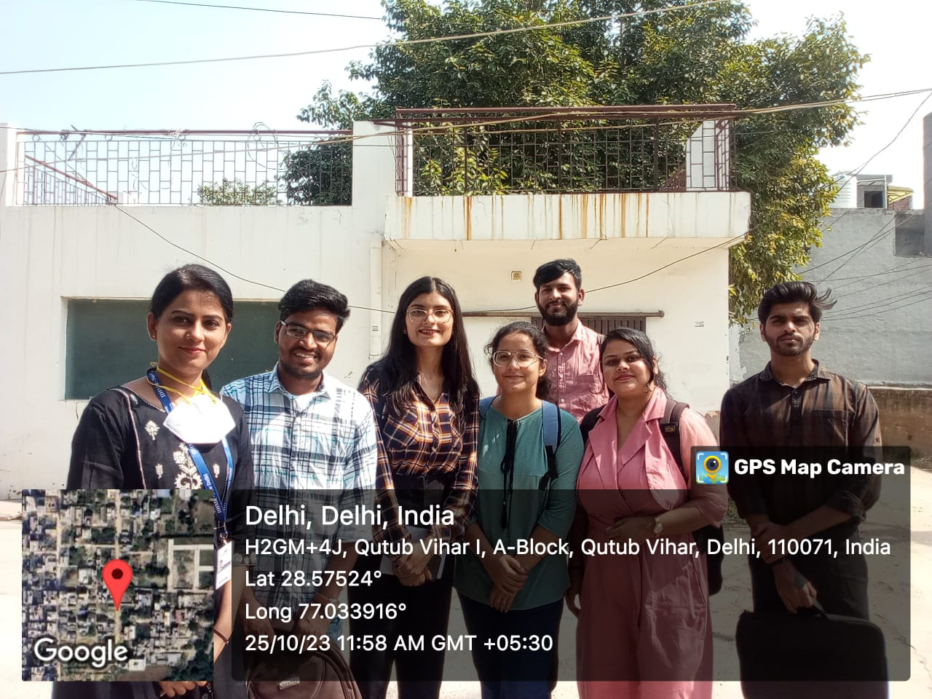

INVOLVEMENT IN COMMUNITY OUTREACH PROGRAMME (COP) ACTIVITIES
Total no. of visits done by the student: 10 (Goyala Dairy)
Activities done by student:
Conducted mapping and listing of the assigned community area.
Collected and recorded demographic information of the local population.
Performed primary health assessments, including:
  Measurement of height and weight
  Monitoring of blood pressure (BP)
Engaged in community interaction through collaboration with Frontline Health Workers (FLWHs) to understand local health practices and challenges.

Slide 17
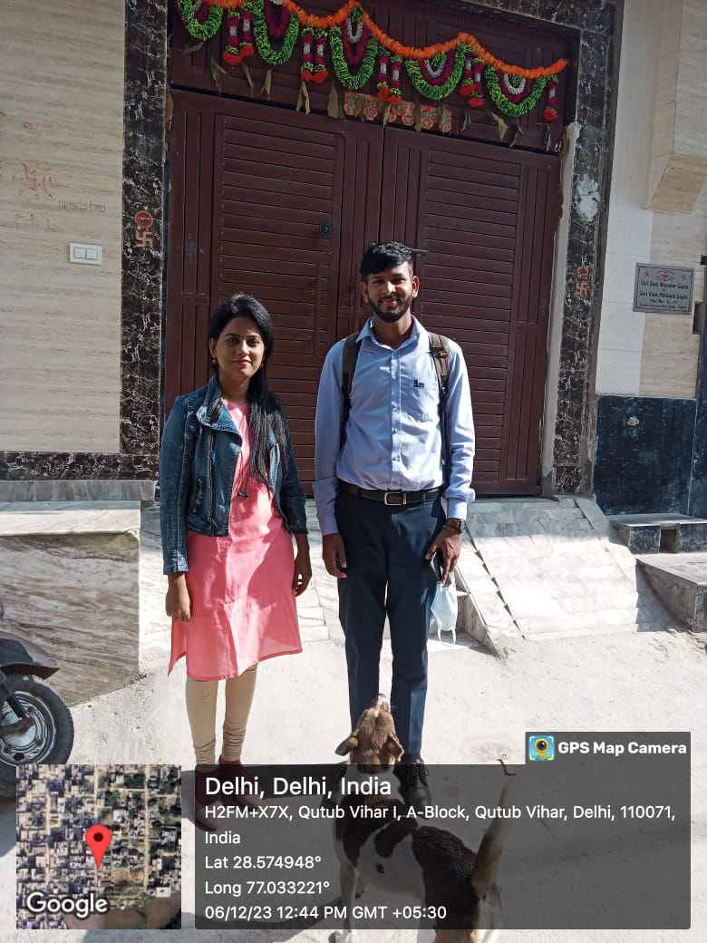
Key Learnings from COP Activities
Understood the basics of community mapping and demographic data collection.
Gained hands-on experience in measuring height, weight, and blood pressure.
Learned the role and responsibilities of Frontline Health Workers (FLWHs) through field interaction.
Improved communication skills and awareness of community health practices.

Slide 18
Thank you

