Slide 1
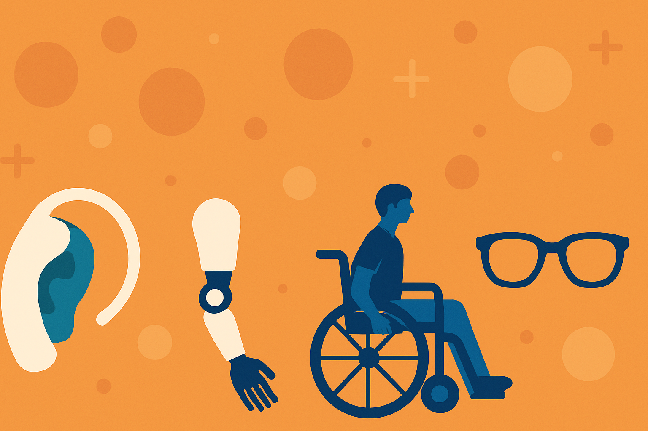

Scoping review focused on determining the access and coverage of assistive technology and associated facilitators and barriers in India
IIHMR, Delhi
Presenter: Eshika Bindal
PGDM 2023-25
IIHMR Delhi
Mentor: Dr. Punit Yadav
Professor
IIHMR Delhi

Slide 2
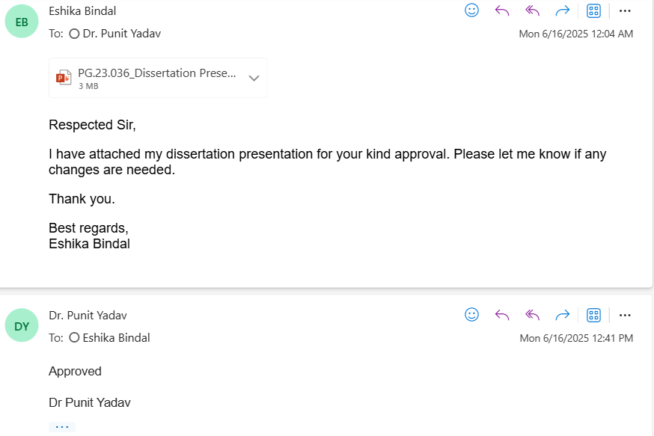
Mentor’s Approval

Slide 3
Introduction
Assistive Technology comprises the application of assistive products — any external devices, software, equipment, or instruments—to help individuals with disabilities improve their functional capabilities and inclusive social participation.
2.5 billion people globally need AT; projected to reach 3.5 billion by 2050 due to population growth and lifestyle diseases.
AT supports access to healthcare, education, employment, social inclusion.
Crucial for children’s development and contributes to economic growth.
Ensuring universal access to AT is key to achieving the SDGs.

Slide 4
Introduction
Access gap: Only 3% coverage in LMICs vs 90% in HICs.
Barriers:
Demand-side: low awareness, stigma, affordability
Supply-side: poor design, limited availability, low quality
India’s disability prevalence: 2.2% (~31 million people); higher among elderly, children, marginalized groups (NSS 2018)
PwDs face exclusion, low workforce participation (36%), and high health expenditure
Lack of national data on AT access & coverage limits evaluation and planning.
This review aims to determine the access and coverage of AT and associated facilitators and barriers in India. While existing literature provides valuable insights into the coverage and barriers related to the use of AT in India, an attempt to compile and synthesize evidence at the national level is lacking.

Slide 5
Objectives of Your Study
Research question
What is the access and coverage of assistive technology and what are facilitators and barriers to access and coverage in India?
Objectives:
To systematically collate evidence on met and unmet needs and identify facilitators and barriers to access and coverage of assistive technology in India.

Slide 6
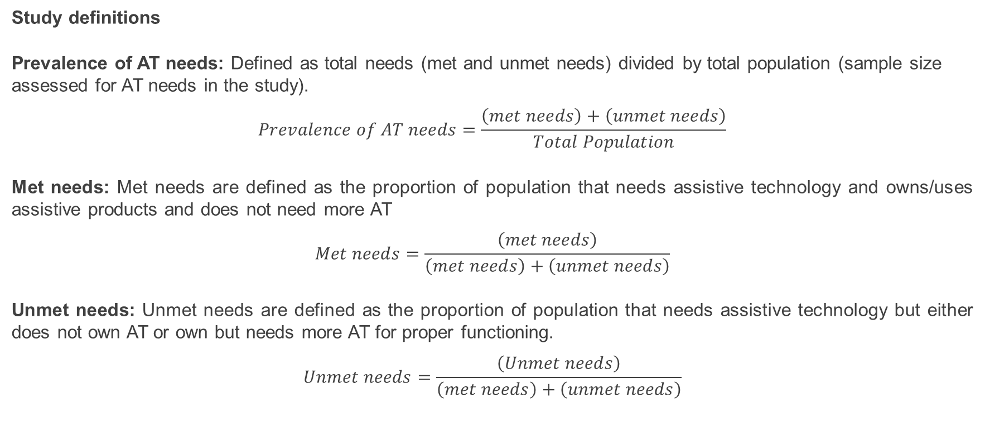
Methodology
Study definitions
Prevalence of AT needs: Defined as total needs (met and unmet needs) divided by total population (sample size assessed for AT needs in the study).
$$Prevalence of AT needs=\frac{\left(met needs\right)+\left(unmet needs\right)}{Total Population}$$
Met needs: Met needs are defined as the proportion of population that needs assistive technology and owns/uses assistive products and does not need more AT
$$Met needs=\frac{\left(met needs\right)}{\left(met needs\right)+\left(unmet needs\right)}$$
Unmet needs: Unmet needs are defined as the proportion of population that needs assistive technology but either does not own AT or own but needs more AT for proper functioning.
$$Unmet needs=\frac{\left(Unmet needs\right)}{\left(met needs\right)+\left(unmet needs\right)}$$

Slide 7
Methodology
Type of Study: Scoping Review
Framework: Population, Concept, Context (PCC)
Guidelines: PRISMA-ScR
Databases: PubMed, ProQuest, Web of Science
Key concepts addressed:
assistive technology;
functional categories of AT, including hearing, vision, mobility, self-care, communication, and cognition;
access and coverage of AT; and
barriers and facilitators to access and coverage.
Screening and Data Extraction
Performed in Microsoft Excel
Title & Abstract Screening and full-text review for eligible studies
Standardized data extraction form was prepared
Data Synthesis
Quantitative synthesis: Descriptive summary of AT access and coverage
Qualitative synthesis: Thematic analysis of barriers and facilitators

Slide 8
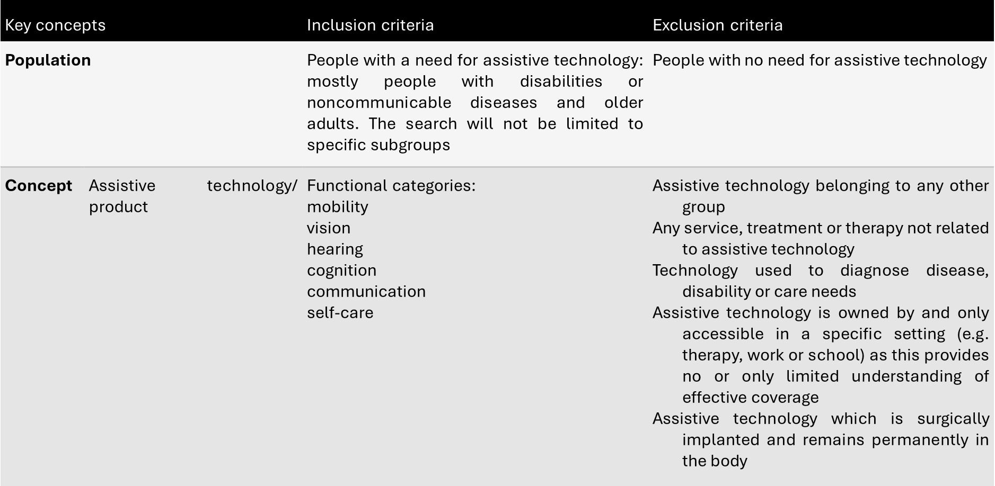
Methodology
Inclusion and Exclusion criteria

Slide 9
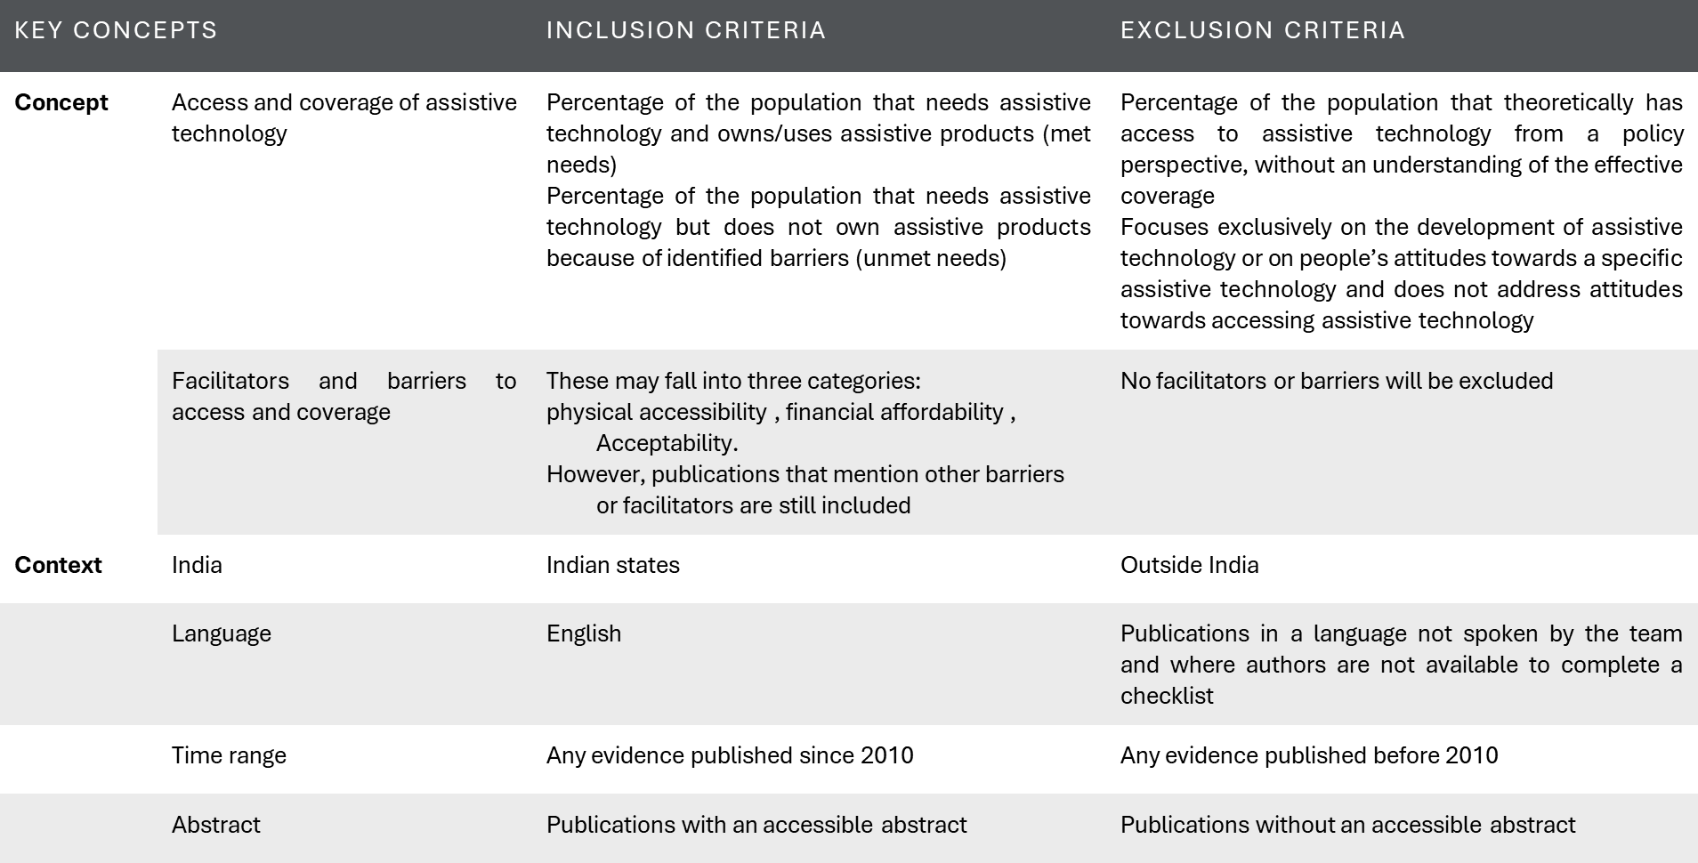
Methodology
Inclusion and Exclusion criteria

Slide 10
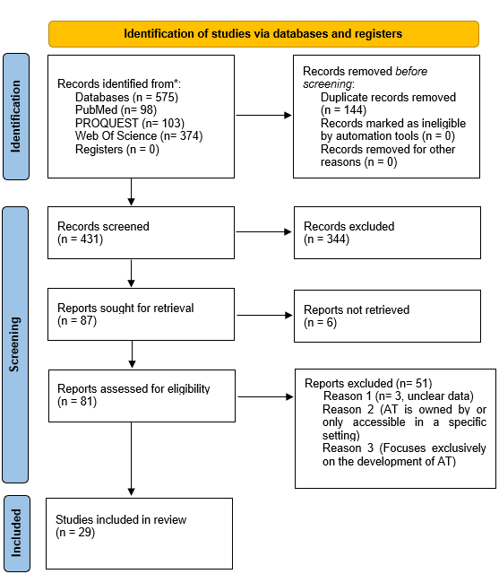
Results
Figure:
PRISMA Flow Diagram of the Study Selection Process

Slide 11
Study | Study setting | Sample size | Age group | Functional domain | Condition | Assistive Technology used | Prevalence of need | % of Population owning or using AT (Met Need) | % of Population Needing but Not Owning Assistive Products (Unmet Needs):
Vignesh,2021,Delhi | Community, Urban | 555 | 60 yr and above | Vision | Refractive errors | Spectacles | 84% | 59% | 40.60%
Srinivas,2017, Telangana. | Community, Rural | 5881 | 40 years and above | Vision | Near Vision Impairment | Spectacles | 63.70% | 26.40% | 73.60%
Srinivas,2021,Telangana | Community, Rural | 5357 | 40 years and above | Vision | Near Vision Impairement | Spectacles | 34.72% | 31.80% | 66.80%
Srinivas,2021,Andhra Pradesh | Community, Rural | 2587 | 41 years and above | Vision | Distance Vision Impairement | Spectacles | 13.45% | 37.40% | 53.70%
Sumit,2022,Haryana | Community, Rural | 3246 | 35 years and above | Vision | Presbyopia | Spectacles | 42.90% | 25.80% | 74.22%
Srinivas,2013,Andhra Pradesh | Community, Rural and Urban | 7378 | 40 years and above | Vision | Refractive errors | Spectacles | 12.90% | 38.00% | 62%
Srinivas,2013,Andhra Pradesh | Community, Rural and Urban | 7378 | 40 years and above | Vision | Presbyopia | Spectacles | 47.20% | 27.00% | 73.00%
Srinivas,2012,Andhra Pradesh | Community, Rural | 1560 | 40 years and above | Vision | Refractive errors | Spectacles | 16% | 28.40% | 71.60%
Srinivas,2012,Andhra Pradesh | Community, Rural | 1560 | 40 years and above | Vision | Presbyopia | Spectacles | 45.20% | 11.13% | 88.86%
AmitBhardwaj,2023,Odisha | Community, Rural, Urban | 3745 | 40 years and above | Vision | Refractive errors | Spectacles | 13.30% | 68.90% | 31.12%
Srinivas,2013,Andhra Pradesh | Community, Rural, Urban | 494 | 50 years and above | Vision | Refractive errors | Spectacles | 23.10% | 35% | 65.00%
Srinivas,2013,Andhra Pradesh | Community, Rural, Urban | 494 | 50 years and above | Vision | Presbyopia | Spectacles | 54.90% | 28.86% | 71.13%
Srinivas,2017,Telangana | Community, Rural | 5881 | 40 years and above | Vision | Refractive errors | Spectacles | 8.60% | 53.60% | 46.40%
Sumit,2019,Haryana | Community, Rural | 6910 | 15 years and above | Vision | Refractive errors | Distance Vision Spectacles | 16.23% | 33.33% | 66.66%
Dorothy,2021,Telangana | Community, Rural | 3574 | All Age groups | Vision | Vision Impairment | Distance glasses | Mild (7.2%), Moderate (3.7%) | Mild VI (44%), Moderate VI (87%) | Mild VI (56%), Moderate VI (13%)
Dorothy,2021,Telangana | Community, Rural | 3574 | All Age groups | Mobility | Musculoskeletal Impairment | Wheelchairs | 0.10% | 33.30% | 66.66%
Dorothy,2021,Telangana | Community, Rural | 3574 | All Age groups | Hearing | Hearing Impairment | Hearing Aids | 3.10% | 4.50% | 96%

Slide 12
Results
12/29 studies reported prevalence of need and coverage of AT in India
No data on the access and coverage of AT in three domains (Communication, cognition, self-care)
Vision
12 studies
Prevalence of need ranged from 8.6% to 84%
Met need ranged between 11.13% to 87%
Unmet need often exceeded 70% in rural settings
Mobility
Only 1 study reported
Prevalence: 0.1%
Met need: 33.3%
Unmet need: 66.6%
Hearing
Only 1 study reported:
Prevalence: 3.1%
Met need: 4.5%
Unmet need: 96%
Prevalence of needs and coverage of AT

Slide 13
Results
Barriers (24 studies)
Category | Key Barrier Examples
1. Awareness & Perception | Low/no awareness, denial of need, age-related beliefs, felt AT won’t help
2. Financial | High device cost, out-of-pocket expenses, no money for repairs or replacement
3. Accessibility | Long travel, poor infrastructure, no escort, urban-centered services
4. Availability / Supply | Devices not available locally, lack of trained staff, no repair system
5. Social Stigma | Embarrassment, teasing, discrimination, stigma with aging or disability
6. Device Issues | Poor fit/quality, uncomfortable, not customizable, malfunctioning devices
7. Behavioral | Forgetfulness, laziness, disinterest, non-compliance
8. Policy / Bureaucracy | Complex procedures, limited structured programs
9. Healthcare System | Apathy, no follow-up, misinformation, lack of counselling
10. Environmental | Unsafe roads, poor lighting, unfriendly infrastructure
11. Acceptance / Adaptation | Family/user rejection, discomfort, abandonment due to pain
12. Dissatisfaction | No perceived benefit, unmet expectations
13. Design / Functionality | Standardized design, not user-centered, not suited for Indian needs

Slide 14
Results
Facilitators (14 Studies)
Category | Key Facilitator Examples
1. Perceived Benefit / Experience | Vision improvement, improved daily function, comfort with devices, feeling normal
2. Health System & Service Delivery | Local providers (e.g. ophthalmologists, eye camps), ASHAs, DDRCs, trained community workers
3. Civil Society & Community Support | NGO-run camps, CSR initiatives, DPOs, donations, community-run programs
4. Social & Family Support | Family encouragement, peer support, optimistic parenting
5. Education | Literacy level, teacher support, inclusive schools using AT (e.g., large print, braille)
6. Technology & Innovation | Accessibility apps (JAWS), smartphones, internet for independence
7. Financial Care | Affordable local materials, local artisans trained for repairs
DDRC: Deendayal Disabled Rehabilitation Scheme; DPO: Disabled People’s Organizations; JAWS: Job Access With Speech (screen reader software)

Slide 15
Discussion
Despite numerous studies on vision, unmet needs for spectacles remain high across various studies (up to 88.86%), suggesting persistent barriers to access even for relatively simple AT such as spectacles.
Data on the barriers and facilitators of AT coverage were more comprehensive.
Lack of awareness emerged as the most common and cross-cutting barrier across all functional domains, affecting both initial care-seeking and continued use of assistive technology.
Domain-specific challenges included stigma in hearing and vision, financial and design-related barriers in mobility, and limited professional knowledge in cognition and communication.
Support from NGOs and community-based workers was the most common facilitator across all domains, helping bridge gaps in access, training, and service delivery.
The extent to which each barrier and facilitator influences access to assistive technology in India is highly context-dependent, shaped by factors such as socio-economic status, geographic location, disability type, and the structure of local health and support systems.

Slide 16
Limitations
Limited quantitative data on AT access and coverage; only 3 of the 6 WHO functional domains (vision, hearing, mobility) were covered, highlighting significant evidence gaps in communication, cognition, and self-care.
No available data on facilitators for communication, cognition, and self-care domains.
Limited data on barriers in hearing, mobility, communication, and cognition; no data found for self-care.
Lack of standardized definitions for assessing AT needs led to inconsistent or unclear interpretation of coverage.

Slide 17
Recommendations
The findings underscore the urgent need for a robust national data collection system on AT needs and coverage across all functional domains in India.
Prioritize research and programmatic attention to lesser-studied domains (cognition, communication, and self-care), where access gaps and needs remain largely unassessed.
Interventions must be multi-faceted, addressing financial, social, systemic, and supply-side barriers.
Invest in local manufacturing, repair services, and affordable AT innovation.
Leveraging existing community-based health networks and civil society organizations is critical for improving outreach and awareness.

Slide 18
Conclusion
India faces a substantial unmet need for assistive technology, with significant access gaps highlighted by the scarcity and uneven distribution of quantitative data.
While vision AT shows some coverage, the unmet needs remain high, and other crucial functional domains like communication, cognition, and self-care are severely under-researched.
A complex interplay of demand-side barriers (awareness, stigma, affordability) and supply-side challenges (availability, accessibility, quality, policy gaps) impedes AT access.
Leveraging facilitators such as local service delivery models, community support, and financial innovations is essential.
Future efforts must prioritize comprehensive data collection, targeted interventions across all functional domains, and a collaborative approach involving government, healthcare, and civil society to achieve universal access to AT in India.

Slide 19
References
[1] Assistive technology n.d. https://www.who.int/news-room/fact-sheets/detail/assistive-technology (accessed April 2, 2025).
[2] Disability n.d. https://www.who.int/news-room/fact-sheets/detail/disability-and-health (accessed April 1, 2025).
[3] Position paper by Persons with Disabilities | Department of Economic and Social Affairs n.d. https://sdgs.un.org/documents/position-paper-persons-disabilities-21637 (accessed April 1, 2025).
[4] Senjam SS, Mannan H. Assistive technology: The current perspective in India. Indian J Ophthalmol 2023;71:1804–9. https://doi.org/10.4103/IJO.IJO_2652_22.
[5] Byrne S. The Right to Leisure for Children with Disabilities: Towards Greater Awareness and Implementation. Int J Sociol Leis 2024;7:369–90.
[6] Global report on assistive technology . World Health Organization and the United Nations Children’s Fund (UNICEF); 2022.
[7] Mishra S, Mohanty SK. Out-of-pocket expenditure and distress financing on institutional delivery in India. Int J Equity Health 2019;18:99. https://doi.org/10.1186/s12939-019-1001-7.
[8] NSS report no. 583: Persons with Disabilities in India NSS 76th round (July – December 2018) n.d. https://pib.gov.in/pib.gov.in/Pressreleaseshare.aspx?PRID=1593253 (accessed April 1, 2025).
[9] Rashmi R, Mohanty SK. Socioeconomic and geographic variations of disabilities in India: evidence from the National Family Health Survey, 2019–21. International Journal of Health Geographics 2024;23:4. https://doi.org/10.1186/s12942-024-00363-w.
[10] Pattnaik S, Murmu J, Agrawal R, Rehman T, Kanungo S, Pati S. Prevalence, pattern and determinants of disabilities in India: Insights from NFHS-5 (2019–21). Front Public Health 2023;11:1036499. https://doi.org/10.3389/fpubh.2023.1036499.
[11] Yadav J, Tripathi N, Menon GR, Nair S, Singh J, Singh R, et al. Measuring the financial impact of disabilities in India (an analysis of national sample survey data). PLoS ONE 2023;18:e0292592. https://doi.org/10.1371/journal.pone.0292592.
[12] Yadav J, Nilima, Sharma P. Regional pattern of disabilities and socioeconomic disadvantage among youth in India: a geospatial analysis. GeoJournal 2022;87:3759–74. https://doi.org/10.1007/s10708-021-10455-w.
[12] HTWE O, YULIAWIRATMAN BS, TANNOR AY, NOR ASIKIN MZ, SOH E, DE GROOTE W, et al. Barriers and facilitators for increased accessibility to quality rehabilitation services in low- and middle- income countries: a systematic review. Eur J Phys Rehabil Med 2024;60:514–22. https://doi.org/10.23736/S1973-9087.24.08154-1.
[12] Scoping. PRISMA Statement n.d. https://www.prisma-statement.org/scoping (accessed June 15, 2025).
[13] Emerson LP, Job A, Abraham V. A Model for Provision of ENT Health Care Service at Primary and Secondary Hospital Level in a Developing Country. BioMed Research International 2013;2013:1–5. https://doi.org/10.1155/2013/562643.
[14] Gajapati CV. Awareness of Presbyopia among Rural Female Population in North Karnataka. JCDR 2017. https://doi.org/10.7860/JCDR/2017/26125.10608.
[15] Senjam S, Foster A, Bascaran C, Vashist P. Awareness, utilization and barriers in accessing assistive technology among young patients attending a low vision rehabilitation clinic of a tertiary eye care centre in Delhi. Indian J Ophthalmol 2019;67:1548. https://doi.org/10.4103/ijo.IJO_197_19.
[16] Sivakumar P, Vedachalam R, Kannusamy V, Odayappan A, Venkatesh R, Dhoble P, et al. Barriers in utilisation of low vision assistive products. Eye 2020;34:344–51. https://doi.org/10.1038/s41433-019-0545-5.
[17] Vignesh D, Gupta N, Kalaivani M, Goswami AK, Nongkynrih B, Kumar Gupta S. Barriers to treatment-seeking for impairment of vision among elderly persons in a resettlement colony of Delhi: A population-based cross-sectional study. Indian Journal of Medical Research 2021;154:623–30. https://doi.org/10.4103/ijmr.IJMR_592_19.
[18] Brien M, Krishna D, Borish M, Coutinho F, Bernardo A, Shah SR, et al. Enabling local provision of assistive products in rural South India: an organisational survey of needs, barriers, and facilitators. Disability and Rehabilitation: Assistive Technology 2024;19:2904–14. https://doi.org/10.1080/17483107.2024.2321601.
[19] Chen MZ, Lee L, Fellinghauer C, Cieza A, Chatterji S. Demographic and environmental factors associated with disability in India, Laos, and Tajikistan: a population-based cross-sectional study. BMC Public Health 2022;22:607. https://doi.org/10.1186/s12889-022-12846-1.
[20] Rani PK, Kasoju R, Komara V, Kothapalli R, Choudary D, Korani J, et al. Envisioning Eye Care From a Rural Perspective: A Photovoice Project From India. Int Q Community Health Educ 2017;37:161–71. https://doi.org/10.1177/0272684X17736153.
[21] Boggs D, Kuper H, Mactaggart I, Murthy G, Oye J, Polack S. Estimating assistive product need in Cameroon and India: results of population‐based surveys and comparison of self‐report and clinical impairment assessment approaches. Tropical Med Int Health 2021;26:146–58. https://doi.org/10.1111/tmi.13523.

Slide 20
References
[22] Bapat GM, Sujatha S. Identification and analysis of knee–ankle–foot orthosis design requirements based on a feedback survey of orthosis users in India. Disability and Rehabilitation: Assistive Technology 2019;14:82–90. https://doi.org/10.1080/17483107.2017.1416187.
[23] Borade N, Ingle A, Nagarkar A. Lived experiences of people with mobility-related disability using assistive devices. Disability and Rehabilitation: Assistive Technology 2021;16:730–4. https://doi.org/10.1080/17483107.2019.1701105.
[24] Pal J, Ammari T, Mahalingam R, Alfaro AMH, Lakshmanan M. Marginality, aspiration and accessibility in ICTD. Proceedings of the Sixth International Conference on Information and Communication Technologies and Development: Full Papers - Volume 1, Cape Town South Africa: ACM; 2013, p. 68–78. https://doi.org/10.1145/2516604.2516623.
[25] Pal J, Lakshmanan M. Mobile devices and weak ties: a study of vision impairments and workplace access in Bangalore. Disability and Rehabilitation: Assistive Technology 2015;10:323–31. https://doi.org/10.3109/17483107.2014.974224.
[26] Dimintiyanova OY, Meershoek A, De Kuyper NH, Rao AP, Bhat AK. Mothers’ perspectives on the use and acceptability of 3d printed prosthesis by their children with congenital upper limb difference in India: a qualitative study. Disability and Rehabilitation 2024:1–11. https://doi.org/10.1080/09638288.2024.2421431.
[27] Marmamula S, Khanna RC, Kunuku E, Rao GN. Near visual impairment and spectacle coverage in Telangana, India. Clinical Exper Ophthalmology 2017;45:568–74. https://doi.org/10.1111/ceo.12943.
[28] Marmamula S, Keeffe J, Challa R, Mohd J, Khanna RC. Near-vision impairment and effective near-vision spectacle coverage in two districts in Telangana, India: a population-based cross-sectional study. BMJ Open 2021;11:e047131. https://doi.org/10.1136/bmjopen-2020-047131.
[29] Marmamula S, Banerjee S, Yelagondula VK, Khanna RC, Challa R, Yellapragada R, et al. Population-based assessment of prevalence of spectacle use and effective spectacle coverage for distance vision in Andhra Pradesh, India – Akividu Visual Impairment Study. Clinical and Experimental Optometry 2022;105:320–5. https://doi.org/10.1080/08164622.2021.1916386.
[30] Malhotra S, Vashist P, Kalaivani M, Rath RS, Gupta N, Gupta SK, et al. Prevalence of presbyopia, spectacles coverage and barriers for unmet need among adult population of rural Jhajjar, Haryana. Journal of Family Medicine and Primary Care 2022;11:287–93. https://doi.org/10.4103/jfmpc.jfmpc_1148_21.
[31] Marmamula S, Khanna RC, Narsaiah S, Shekhar K, Rao GN. Prevalence of spectacles use in A ndhra P radesh, I ndia: R apid A ssessment of V isual I mpairment project. Clinical Exper Ophthalmology 2014;42:227–34. https://doi.org/10.1111/ceo.12160.
[32] Marmamula S, Madala SR, Rao GN. Prevalence of uncorrected refractive errors, presbyopia and spectacle coverage in marine fishing communities in South India: Rapid Assessment of Visual Impairment (RAVI) project. Ophthalmic Physiologic Optic 2012;32:149–55. https://doi.org/10.1111/j.1475-1313.2012.00893.x.
[33] Senjam S, Vashist P, Gupta N, Malhotra S, Misra V, Bhardwaj A, et al. Prevalence of visual impairment due to uncorrected refractive error: Results from Delhi-Rapid Assessment of Visual Impairment Study. Indian J Ophthalmol 2016;64:387. https://doi.org/10.4103/0301-4738.185614.
[34] Karki J, Rushton S, Bhattarai S, Norman G, Rakhshanda S, De Witte PL. Processes of assistive technology service delivery in Bangladesh, India and Nepal: a critical reflection. Disability and Rehabilitation: Assistive Technology 2024;19:292–301. https://doi.org/10.1080/17483107.2022.2087769.
[35] Rajan AP, Chanu AR, Venkataraman S, Singh U. Prosthesis Usage and Functional Status in Upper Limb Amputees: A Prospective Cross-Sectional Study. Cureus 2024. https://doi.org/10.7759/cureus.65677.
[36] Bhardwaj A, Vashist P, Singh Senjam S, Gupta V, Gupta N, Manna S. Rapid Assessment of Avoidable Visual Impairment in Two Coastal Districts of Eastern India for Determining Effective Coverage: A Cross-Sectional Study. JOVR 2023;18:182–91. https://doi.org/10.18502/jovr.v18i2.13185.
[37] Archana G, Krishna Y, Shiny R. Reasons for nonacceptance of hearing aid in older adults. Indian J Otol 2016;22:19. https://doi.org/10.4103/0971-7749.176513.
[38] Marmamula S, Ravuri LVCS, Boon MY, Khanna RC. Spectacle Coverage and Spectacles Use among Elderly Population in Residential Care in the South Indian State of Andhra Pradesh. BioMed Research International 2013;2013:1–5. https://doi.org/10.1155/2013/183502.
[39] Marmamula S, Khanna R, Kunuku E, Rao G. Spectacles use in a rural population in the state of Telangana in South India. Indian J Ophthalmol 2017;65:509. https://doi.org/10.4103/ijo.IJO_324_16.
[40] Malhotra S, Kalaivani M, Rath R, Prasad M, Vashist P, Gupta N, et al. Use of spectacles for distance vision: coverage, unmet needs and barriers in a rural area of North India. BMC Ophthalmol 2019;19:252. https://doi.org/10.1186/s12886-019-1262-3.
[41] Jaiswal A, Aldersey HM, Wittich W, Mirza M, Finlayson M. Using the ICF to Identify Contextual Factors That Influence Participation of Persons With Deafblindness. Archives of Physical Medicine and Rehabilitation 2019;100:2324–33. https://doi.org/10.1016/j.apmr.2019.03.010.

Slide 21
INVOLVEMENT IN COMMUNITY OUTREACH PROGRAMME (COP) ACTIVITIES
Total no. of visits done by the Student: 10
Activities done by student:
1.Mapping and listing of the area
2. Interaction with Community and FLWHS

Slide 22
KEY LEARNING FROM COP ACTIVITIES
Understanding Community layout
Understanding field level challenges
Working mechanism of Community workers

Slide 23
Thank You
Any Questions

