Slide 1

Bibliometric Analysis on Transforming Enterprise Imaging in Healthcare: The Role of Artificial Intelligence in Modern Radiology
By Aditi Sinha
CARPL.AI
Department: Enterprise Partnerships
Faculty Mentor: Dr. Anandhi Ramachandran
IIHMR Delhi

Slide 2
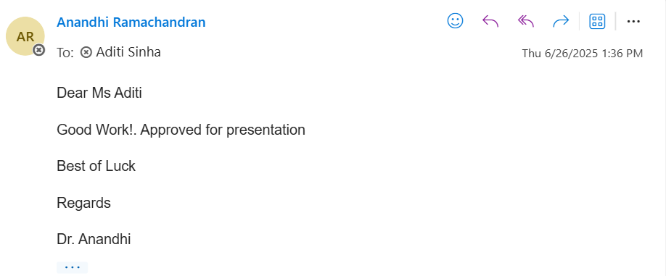
Mentor Approval

Slide 3
Introduction (1/2)
Radiology is undergoing a transformative shift with the integration of artificial intelligence (AI) into imaging workflows.
Traditional radiology relied heavily on manual interpretation, which is time-consuming and prone to inter-observer variability.
AI, particularly deep learning models like convolutional neural networks (CNNs), enhances accuracy in tasks like classification and detection.
Enterprise imaging refers to system-wide management of images across departments (radiology, pathology, dermatology, etc.).
Integrating AI into enterprise imaging supports triage, report automation, storage optimization, and predictive insights

Slide 4
Introduction (2/2)
Opportunities, Challenges, and Study Justification
AI tools can improve diagnostic precision, reduce turnaround time, and manage high imaging volumes efficiently.
Natural Language Processing (NLP) and AI-powered scheduling are streamlining radiology workflows.
Key challenges: explainability, interoperability across PACS/VNA/EHRs, algorithmic bias, and regulatory barriers (GDPR, HIPAA).
There's a growing need for structured evaluation of AI’s implementation in radiology – both technically and ethically.
This study uses bibliometric and thematic analysis to assess the trajectory and maturity of AI in enterprise imaging research.

Slide 5
Objectives of Your Study
The specific objectives of this study are as follows:
To examine the evolution of research output related to AI in enterprise imaging from 2014 to 2024, identifying patterns in publication frequency and thematic shifts.
To determine the most influential contributors—authors, institutions, journals, and funding bodies—that have shaped the development of AI research in radiological imaging.
To identify and categorize emerging research themes and conceptual clusters within the literature, with particular emphasis on algorithmic innovations, clinical integration, and operational optimization.
To explore how existing studies address major challenges such as algorithm transparency, system interoperability, model validation, regulatory compliance, and ethical considerations.
To detect gaps in the current body of literature and highlight future research opportunities that can facilitate responsible and effective deployment of AI tools in radiological practice.

Slide 6
Methodology(1/2)
Search Keywords:
  Core terms: Artificial Intelligence, Enterprise Imaging, Modern Radiology, Deep Learning in Radiology
  Supplementary terms: Algorithm Transparency, Interoperability, Regulatory Compliance, Ethical Considerations
Inclusion criteria were as follows:
  Articles with a clear focus on the application or evaluation of AI in radiological or enterprise imaging settings.
  Studies discussing implementation, validation, or conceptual design of AI tools within imaging systems.
Exclusion criteria included:
  Studies not focused on radiological imaging.
  Non-English publications.
  Articles lacking full-text availability.
Bibliometric tools and software:
  VOSviewer was utilized for the generation of bibliometric maps and co-occurrence networks.
  Google sheet and quillbot were used for data cleaning, frequency analysis, and visualization of publication trends.
A total of 68 articles meeting the inclusion criteria were shortlisted for analysis.

Slide 7
Methodology(2/2)
The following bibliometric indicators and visual analyses were conducted:
  Annual Publication Trends: The temporal distribution of relevant publications from 2014 to 2024 was charted to identify growth patterns.
  Authorship and Collaboration Analysis: The most prolific authors and co-authorship networks were identified, highlighting influential contributors and collaborative clusters.
  Citation and Co-citation Analysis: Citation counts were aggregated, and co-citation networks were mapped to identify foundational literature and intellectual linkages.
  Keyword Co-occurrence Analysis: Frequently occurring keywords were extracted and grouped into thematic clusters to identify conceptual structures and research hotspots.
  Thematic Mapping: Themes such as technical innovation, workflow optimization, explainability, bias, and regulatory compliance were manually coded and validated against keyword networks and article abstracts.
  Top Journals and Institutions: Journal distribution and institutional affiliations were analyzed to identify leading publication venues and contributing organizations.

Slide 8
Results (1/3)
Trends in Publication Volume and Thematic Orientation
Steady increase in AI-enterprise imaging publications since 2014; sharp rise post-2018.
Peak output between 2020–2023 reflects global surge in AI adoption across healthcare.
Themes evolved from algorithm development to clinical translation and ethical integration.
Notable shift towards studies addressing AI deployment in real-world radiology settings.
Leading Contributors: Authors, Institutions, and Journals
Most cited authors: Reabal Najjar, Michele Avanzo, Giovanni Pirrone
Highly publishing institutions: Stanford, NIH (USA), Tsinghua University (China), and UCL (UK).
Top journals: European Radiology, AJR, Journal of the American College of Radiology, EBioMedicine.
Widely cited articles:
  PMC Book Chapter on AI in Radiology – 3,840 citations
  Survey on XAI – 2,316 citations
  GAN in Medical Imaging – 2,040 citations

Slide 9
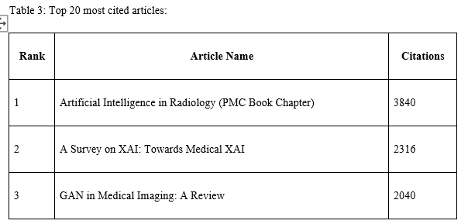
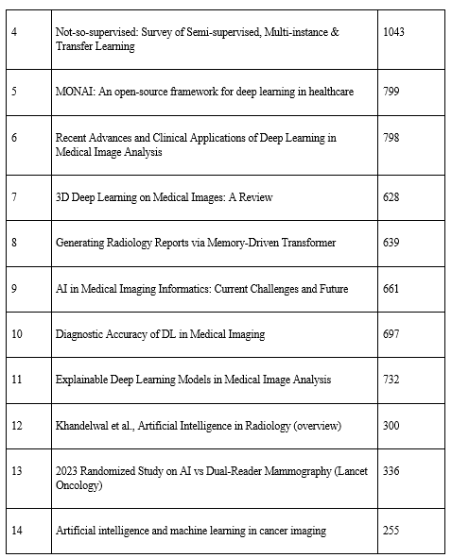
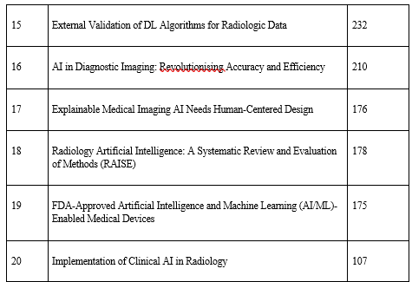
Results (2/3)
Thematic Clusters and Research Trends
Eight major thematic clusters were identified:
Technical Innovation – DL models (CNNs, GANs, transformers)
Workflow Optimization – PACS integration, AI triage, productivity tools
Clinical Implementation – Diagnostic accuracy, triage models
Explainability & Interpretability – XAI frameworks like SHAP, Grad-CAM
Bias & Fairness – Addressing data imbalance and demographic equity
Regulatory Governance – TRIPOD-AI, CONSORT-AI, GDPR, HIPAA
Radiologist–AI Collaboration – Human-in-the-loop, AI training inclusion
Modality-Specific Research – Mammography, oncology, abdominal imaging
Key Implementation Challenges
Explainability: Widely discussed; visual and statistical XAI tools proposed across many studies.
Bias & Fairness: Identified as a systemic issue; calls for fairness-aware learning and bias auditing.
Interoperability: Growing focus on integrating AI tools within PACS/VNA/EHR systems.
Clinical Trust: Radiologist education and involvement shown to be crucial for AI adoption.
Regulation: Real-world deployment lags due to unclear post-market surveillance requirements.

Slide 10
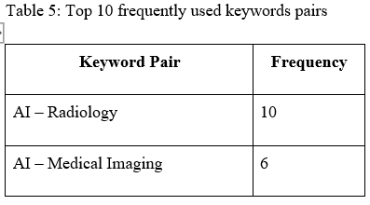
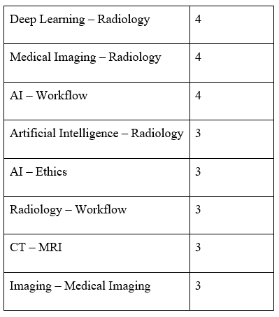
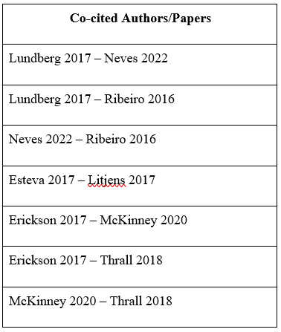
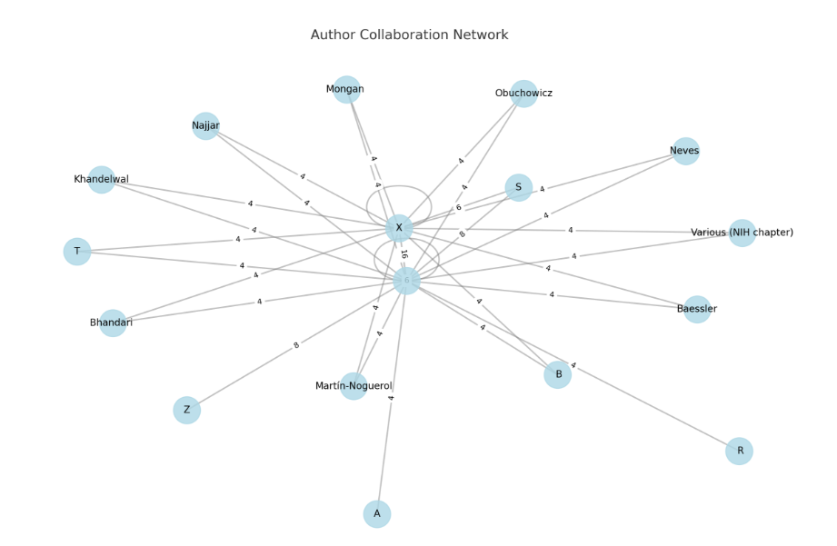
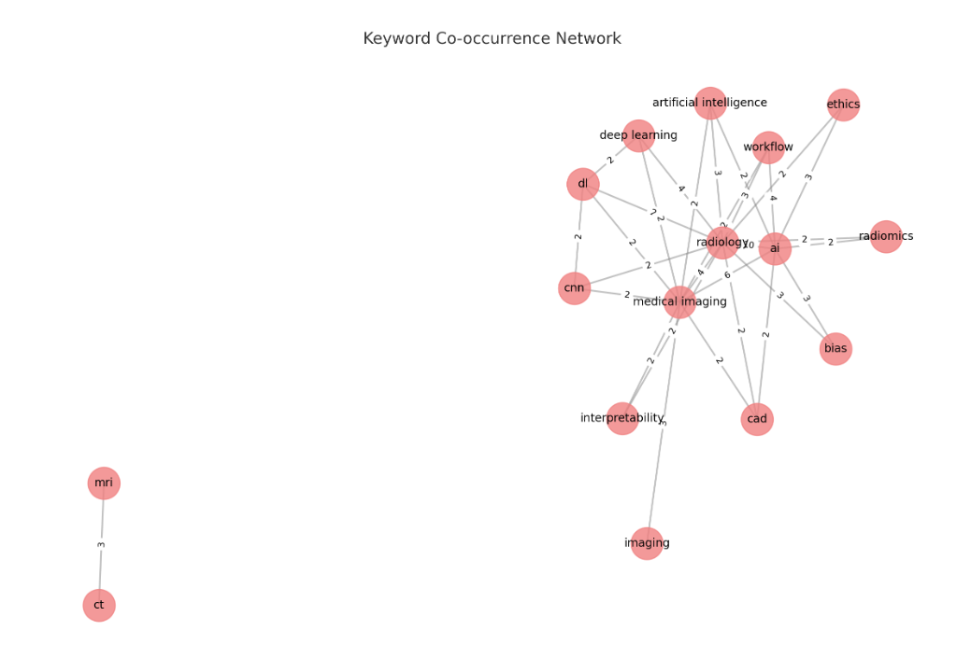
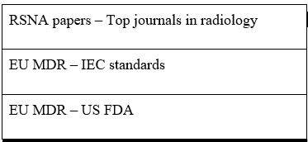
Results (3/3)
Underexplored/Emerging Areas for Future Research
Low number of prospective and multicenter validation studies.
Sparse literature on AI use in low-resource settings and non-Western populations.
Need for AI systems tailored for pediatric radiology and rare diseases.
Governance frameworks still evolving—room for empirical studies on post-deployment AI impact.
Integration of AI with real-time decision support and multi-modal imaging systems is nascent.

Slide 11
Discussion (1/2)
Rapid growth in AI radiology research post-2018, but limited real-world deployment.
Most studies focus on model performance; fewer assess clinical usability or patient outcomes.
Explainability tools (e.g., SHAP, Grad-CAM) are common, yet few studies explore clinician interaction with them.
Workflow integration models exist but lack large-scale validation in hospital settings.
Regulatory frameworks like TRIPOD-AI and CONSORT-AI are cited, but post-market evidence remains sparse.

Slide 12
Discussion (2/2)
Bias and fairness are discussed conceptually; practical audits and fairness metrics are rare.
Limited representation of LMICs creates a geographic research imbalance.
Radiologists are increasingly involved as AI trainers, validators, and workflow designers.
Most cited work focuses on technical advances; real-world trials and outcome-based studies are underrepresented.
Ethical concerns around accountability, explainability, and informed consent remain unresolved.

Slide 13
Conclusion
AI has significant potential to revolutionize enterprise imaging in radiology.
The field is advancing technically, but faces practical and ethical hurdles.
Interdisciplinary collaboration is vital for responsible deployment.
Greater transparency, fairness, and regulation are key for clinical acceptance.
Future research should focus on validation, usability, and bias mitigation.
Radiology’s future is augmented—not replaced—by AI.

Slide 14
References (Only Vancouver Style)
Avanzo M, Stancanello J, Pirrone G, Drigo A, Retico A. The Evolution of Artificial Intelligence in Medical Imaging: From Computer Science to Machine and Deep Learning. Cancers (Basel). 2024 Nov 1;16(21):3702. doi: 10.3390/cancers16213702. PMID: 39518140; PMCID: PMC11545079.
Najjar, R. (2023). Redefining Radiology: A Review of Artificial Intelligence Integration in Medical Imaging. Diagnostics, 13(17), 2760. https://doi.org/10.3390/diagnostics13172760
Ana Barragán-Montero, Umair Javaid, Gilmer Valdés, Dan Nguyen, Paul Desbordes, Benoit Macq, Siri Willems, Liesbeth Vandewinckele, Mats Holmström, Fredrik Löfman, Steven Michiels, Kevin Souris, Edmond Sterpin, John A. Lee,
Artificial intelligence and machine learning for medical imaging: A technology review, Physica Medica, Volume 83, 2021, Pages 242-256, ISSN 1120-1797, https://doi.org/10.1016/j.ejmp.2021.04.016. (https://www.sciencedirect.com/science/article/pii/S1120179721001733)
Debnath J. Radiology in the era of artificial intelligence (AI): Opportunities and challenges. Med J Armed Forces India. 2023 Jul-Aug;79(4):369-372. doi: 10.1016/j.mjafi.2023.05.003. Epub 2023 Jun 2. PMID: 37441285; PMCID: PMC10334252.
Bhandari A. Revolutionizing Radiology With Artificial Intelligence. Cureus. 2024 Oct 29;16(10):e72646. doi: 10.7759/cureus.72646. PMID: 39474591; PMCID: PMC11521355.
Obuchowicz R, Lasek J, Wodziński M, Piórkowski A, Strzelecki M, Nurzynska K. Artificial Intelligence-Empowered Radiology-Current Status and Critical Review. Diagnostics (Basel). 2025 Jan 24;15(3):282. doi: 10.3390/diagnostics15030282. PMID: 39941212; PMCID: PMC11816879.
Hosny A, Parmar C, Quackenbush J, Schwartz LH, Aerts HJWL. Artificial intelligence in radiology. Nat Rev Cancer. 2018 Aug;18(8):500-510. doi: 10.1038/s41568-018-0016-5. PMID: 29777175; PMCID: PMC6268174.
Kelly BS, Judge C, Bollard SM, Clifford SM, Healy GM, Aziz A, Mathur P, Islam S, Yeom KW, Lawlor A, Killeen RP. Radiology artificial intelligence: a systematic review and evaluation of methods (RAISE). Eur Radiol. 2022 Nov;32(11):7998-8007. doi: 10.1007/s00330-022-08784-6. Epub 2022 Apr 14. Erratum in: Eur Radiol. 2022 Nov;32(11):8054. doi: 10.1007/s00330-022-08832-1. PMID: 35420305; PMCID: PMC9668941.
Rubin DL. Artificial Intelligence in Imaging: The Radiologist's Role. J Am Coll Radiol. 2019 Sep;16(9 Pt B):1309-1317. doi: 10.1016/j.jacr.2019.05.036. PMID: 31492409; PMCID: PMC6733578.
Xuxin Chen, Ximin Wang, Ke Zhang, Kar-Ming Fung, Theresa C. Thai, Kathleen Moore, Robert S. Mannel, Hong Liu, Bin Zheng, Yuchen Qiu, Recent advances and clinical applications of deep learning in medical image analysis, Medical Image Analysis, Volume 79, 2022, 102444, ISSN 1361-8415, https://doi.org/10.1016/j.media.2022.102444.
Singh SP, Wang L, Gupta S, Goli H, Padmanabhan P, Gulyás B. 3D Deep Learning on Medical Images: A Review. Sensors (Basel). 2020 Sep 7;20(18):5097. doi: 10.3390/s20185097. PMID: 32906819; PMCID: PMC7570704.
Dikici E, Bigelow M, Prevedello LM, White RD, Erdal BS. Integrating AI into radiology workflow: levels of research, production, and feedback maturity. J Med Imaging (Bellingham). 2020 Jan;7(1):016502. doi: 10.1117/1.JMI.7.1.016502. Epub 2020 Feb 11. PMID: 32064302; PMCID: PMC7012173.
Erdal, Barbaros & Gupta, Vikash & Demirer, Mutlu & Fair, Kimberly & White, Richard & Blair, Jeffrey & Deichert, Barbara & Lafleur, Laurie & Qin, Ming & Lacima, David & Genereaux, Brad. (2023). Integration and Implementation Strategies for AI Algorithm Deployment with Smart Routing Rules and Workflow Management: A Reference Implementation (Preprint). 10.2196/preprints.54786.
Loper MR, Makary MS. Evolving and Novel Applications of Artificial Intelligence in Abdominal Imaging. Tomography. 2024 Nov 18;10(11):1814-1831. doi: 10.3390/tomography10110133. PMID: 39590942; PMCID: PMC11598375.

Slide 15
INVOLVEMENT IN COMMUNITY OUTREACH PROGRAMME (COP) ACTIVITIES
Total no. of visits done by the Student: 10
Day-wise activities done by the student:
Promoting Preventive Health Through Community Engagement
On-Ground Screening and Awareness Drives
Collaboration with ASHAs for Local Health Insights

Slide 16
KEY LEARNING FROM COP ACTIVITIES
Bridging the knowledge gap
Empowering Communities Through Health Literacy
Privacy by Design, Trust by Implementation

Slide 17
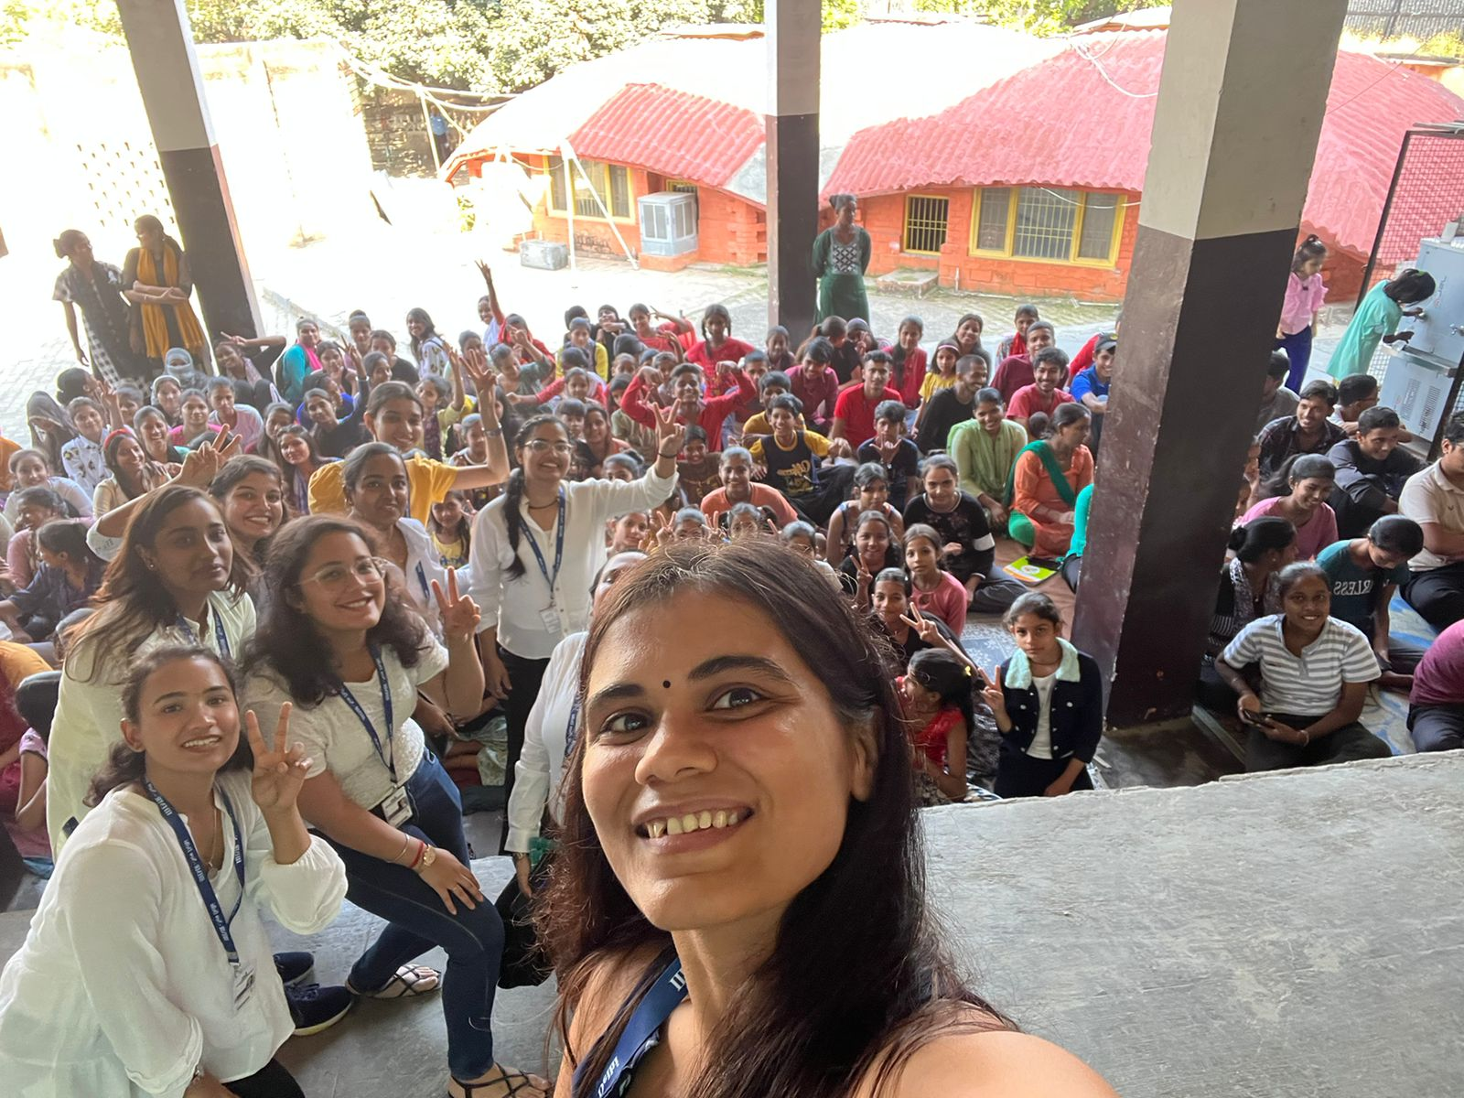
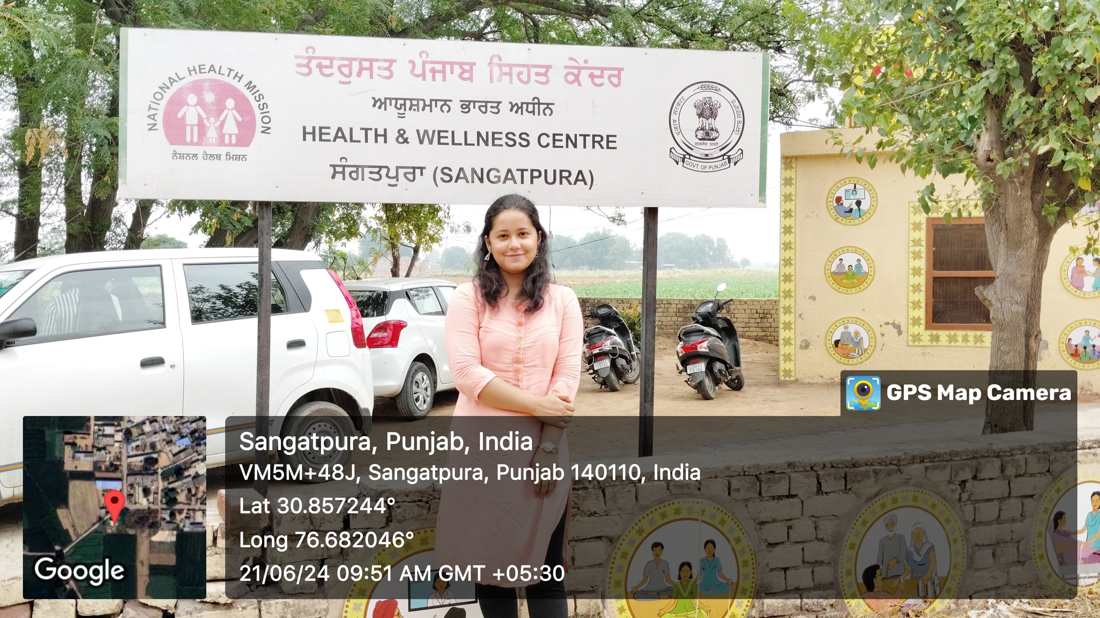
COP FIELD ACTIVITIES PHOTOGRAPHS

Slide 18
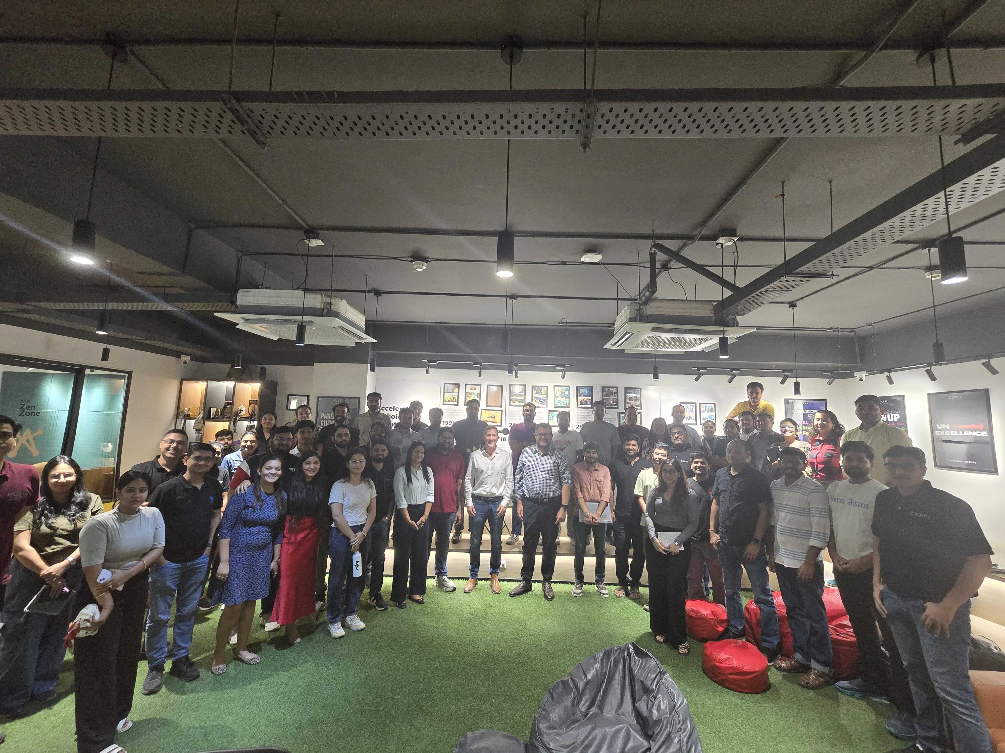
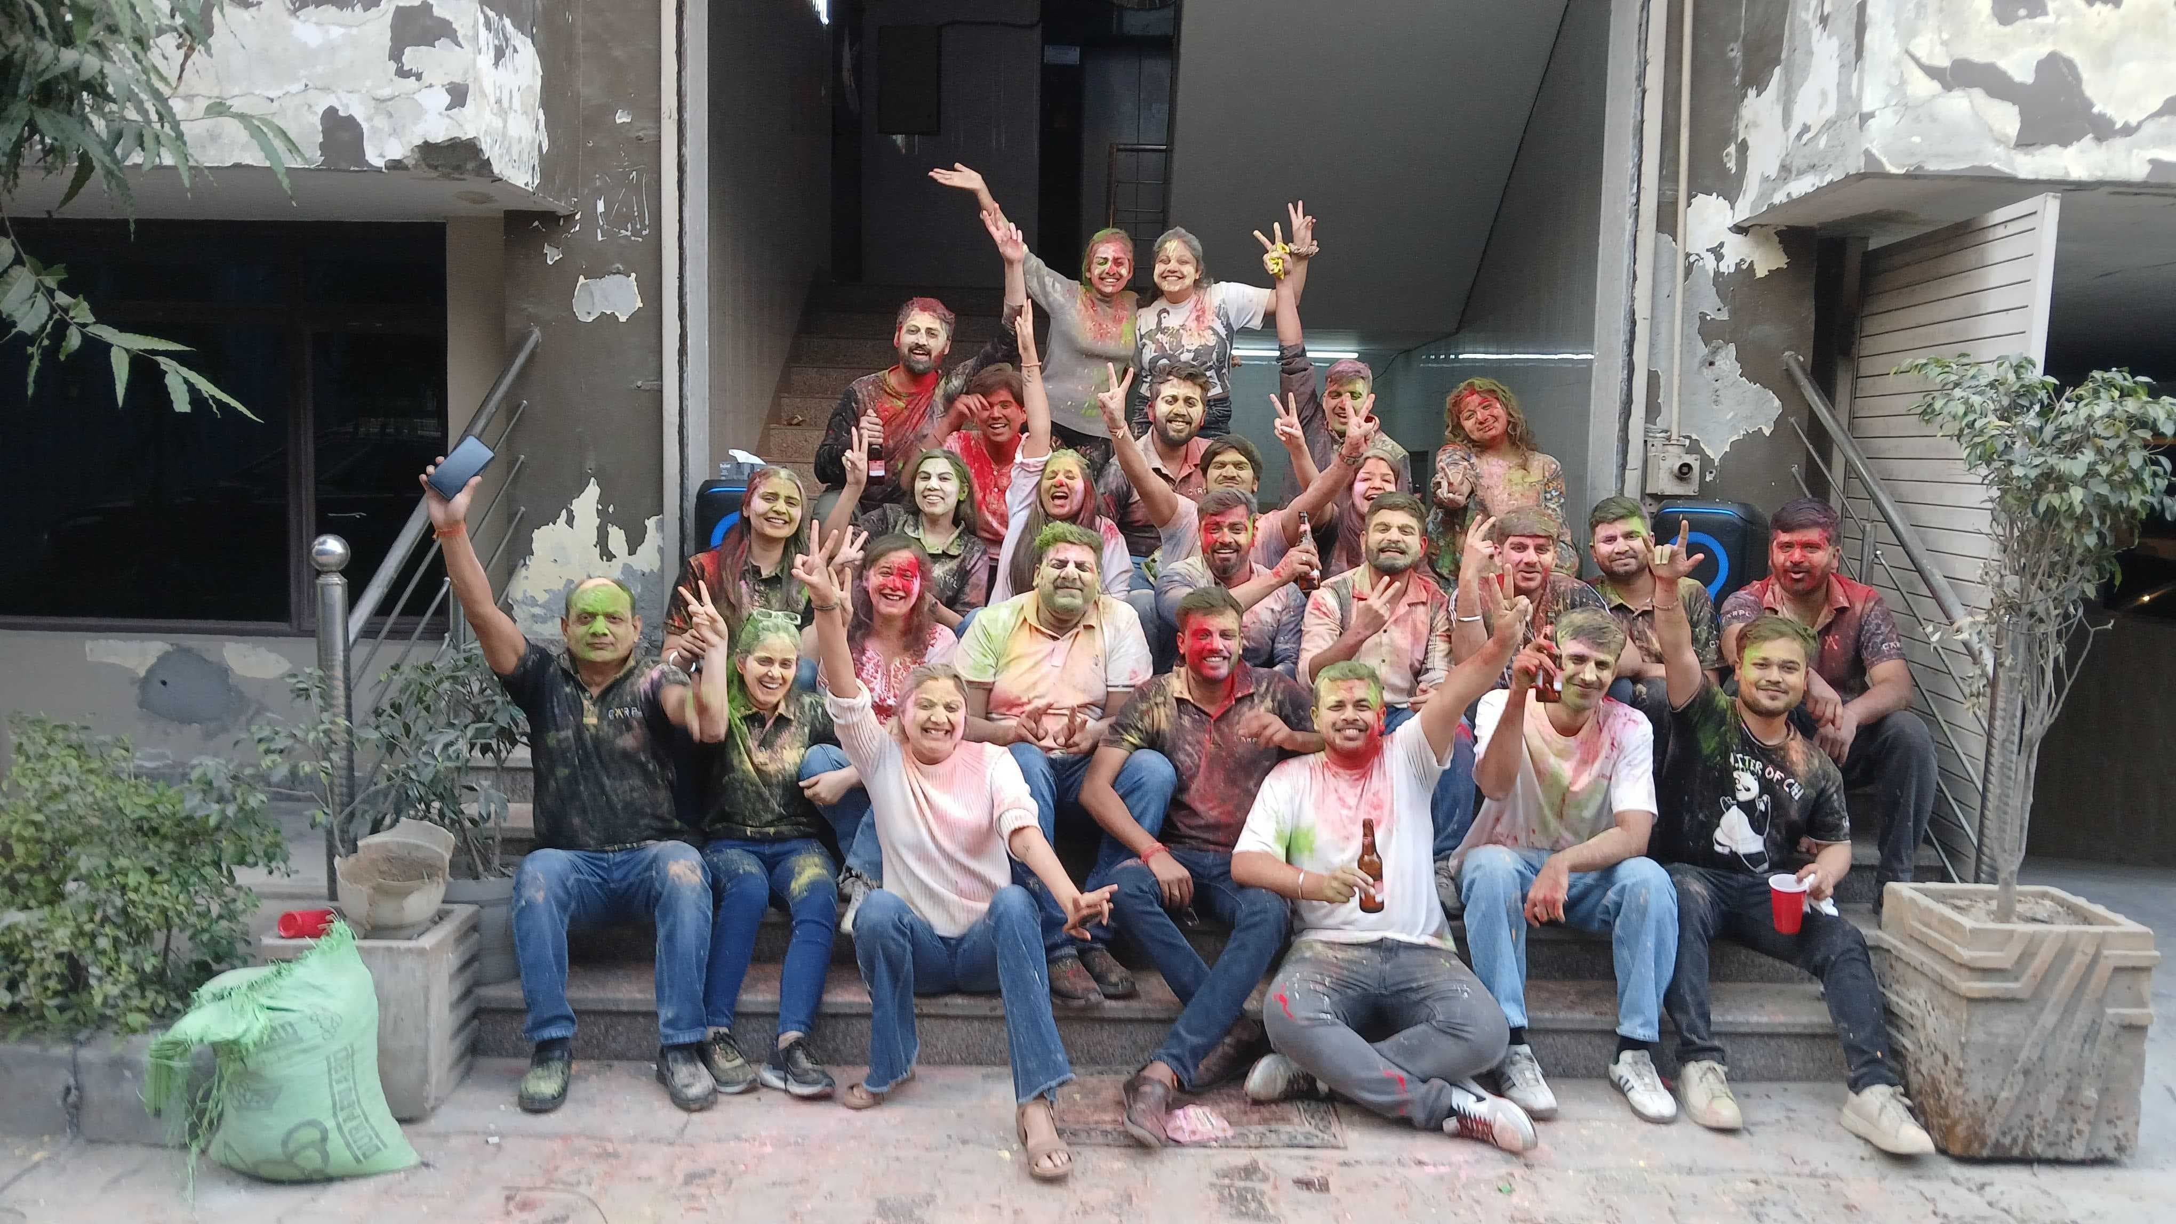

Pictorial Journey

Slide 19
Thank You
Any Questions

