Slide 1

“To ascertain the capability of Apple and Fitbit watches to detect mental stress in adults”
Curio Digital Therapeutics
Presented By:
Dr. Malvika Lodhi
PG/21/055
Faculty Mentor:
Dr. Mukesh Ravi Raushan
IIHMR Delhi

Slide 2

Mentor Approval

Slide 3
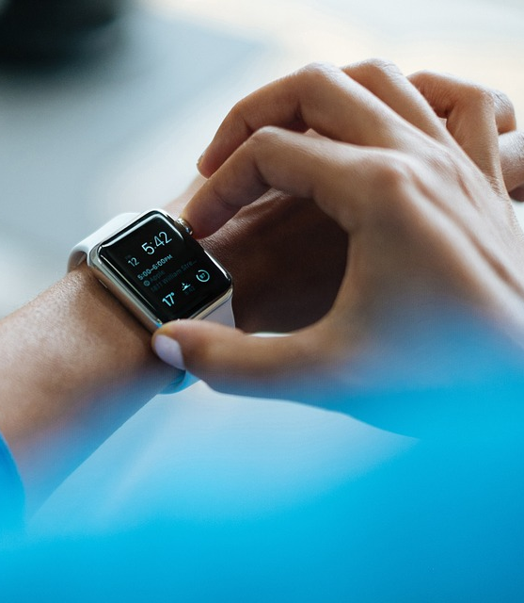
Introduction
Wearable technology like Apple Watch and Fitbit Watch has gained popularity.
These devices offer fitness tracking, heart rate monitoring, and sleep tracking features.
Interest is growing in their potential for managing mental health, particularly stress.
Mental stress is a pressing concern in today's fast-paced society.
This literature review explores research on the effectiveness of Apple Watch and Fitbit Watch in detecting mental stress-related physiological changes

Slide 4
Objectives
Primary Objective: To examine the efficacy of Apple Watch and Fitbit Watch in detecting mental stress in adults.
Secondary objective: Identify current and potential physiological or physiologically related monitoring capabilities of the Apple Watch and Fitbit Watch that are relevant to mental health monitoring.

Slide 5
Methodology
Study Design: Literature review
Study Period: 3 months
Type of Data: Secondary data obtained from published literature
Method of Data Collection:
  Electronic databases, including PubMed and Google Scholar.
  Keywords: Apple Watch, Fitbit Watch, wearable technology, mental stress, mental health, and stress management, sleep, Heart Rate, Energy expenditure.
  Screened the titles and abstracts of the identified studies.
  Selected studies based on their relevance to the objectives and the inclusion/exclusion criteria.

Slide 6
Methodology
Inclusion Criteria:
  Studies examining the use of Apple Watch and Fitbit Watch in detecting heart rate, sleep, blood pressure, exercise expenditure, and atrial fibrillation.
  Studies published between 2016 - 2022.
Exclusion Criteria:
  Studies focusing on children and old adults.
  Studies using other wearable devices or mobile apps.
  Studies not reporting on physiological or physiologically related monitoring capabilities of the Apple Watch and Fitbit Watch.
  Studies not relevant to the research question.

Slide 7
Results
A total of 521 paper titles were identified, with 115 reviewed in full.
Out of the reviewed papers, 25 (22%) were related to Apple Watch and Fitbit Watch validation or comparison studies.
Total Studies | 25
Positive Outcome | 18
Negative Outcome | 7

Slide 8
Results
 | Study Outcome
Study Focus | Positive | Negative
HR | 7 | 3
Sleep | 6 | 1
HR & EE | 4 | 0
BP | 3 | 1
Total | 20 | 5
Most studies showed that the Apple Watch & Fitbit Watch could measure heart rate acceptably correctly.
Both watches were able to record sleep and wakefulness accurately.
Accurate Blood pressure measurements are difficult for both devices, with the Apple Watch generally providing the best results.

Slide 9
Literature Review
Study | Study focus | Outcome
Shcherbina et al 2017 | HR and EE | Lowest error in HR and EE for cycling; highest error for walking ‎ Apple Watch achieved the lowest overall error in HR and EE of the tested devices (Basis Peak, Fitbit Surge, Microsoft Band, Mio Alpha 2, PulseOn, and Samsung Gear S2)
Dooley et al, 2017 | HR and EE | Apple Watch HR mean absolute percentage error was between 1.14% and 6.70%, not significantly different during baseline and vigorous-intensity treadmill exercise; lower HR in light- or moderate-intensity treadmill exercise and recovery ‎ EE mean absolute percentage error was between 14.07% and 210.84%, measuring higher EE in all states compared with the criterion measure (Parvo Medics TrueOne 2400) ‎ HR and EE results were mostly better than other tested devices (Fitbit Charge HR and Garmin Forerunner 225)‎
Abt et al 2018 | Maximal HR | Apple Watch had good to very good criterion validity for measuring maximal HR with no substantial under- or overestimation‎
Roomkham et al 2019 | Sleep monitoring | Apple Watch had high accuracy (97.3%) and sensitivity (99.1%) in detecting sleep and adequate specificity (75.8%) in detecting wakefulness ‎

Slide 10
Literature Review
Study | Study Focus | Outcome
Nuss et al, 2019 | BP | Apple Watch overestimated BP in women and underestimated BP in men Pooled relative error was 24.3%, 18.6% for men, and 19.9% for women Neither device showed accurate results compared with BP measured.
Thomson et al 2019 | HR | ECG correlation was strongest for very light intensity with a >0.90 concordance correlation coefficient Most relative error rates were <5% with a maximum of 5.73% Apple Watch was more accurate in recording HR than the Fitbit Charge HR 2
Nelson and Allen, 2019 | HR | Apple Watch 3 was generally accurate across a 24-hour period compared with ECG; the mean difference was −1.8 bpm, the mean absolute error was 5.86%, and the mean agreement was 95 Apple Watch was more accurate than Fitbit Charge
Falter et al, 2019 | HR and EE in patients with cardiovascular disease | Apple Watch showed good correlation without systematic error comparing Apple Watch PPG HR with ECG ground truth. Apple Watch showed a systematic overestimation of EE compared with indirect calorimetry. Apple Watch HR accuracy was clinically acceptable

Slide 11
Literature Review
Study | Study Focus | Outcome
Düking et al, 2020 | HR and EE | Apple Watch 4 showed the highest validity in measuring HR, followed by Polar Vantage V, Garmin Fenix 5, and Fitbit Versa The coefficient of variation for HR was 0.9% to 4.3% and, for EE, it was 13.5% to 27.1%
Espinosa et al, 2020 | Step counting and HR | The walking error was 2.6%; jogging error was 5.1% HR limit of agreement was −2.2 to 1.8 bpm for walking and −3.5 to 4.3 bpm for jogging Apple Watch displayed a high level of agreement and was highly accurate
Seshadri et al, 2020 | HR in patients with AF | Patients with AF showed a correlation coefficient of 0.7 between Apple Watch 4 and telemetry Apple Watch 4 HR was more accurate for patients in the AF condition than for those not in the AF condition Caution suggested in Apple Watch HR monitoring in patients with arrhythmia
Huynh et al, 2021 | HR in patients with obstructive sleep apnea and AF | Correlation coefficient was 0.88, suggesting acceptable agreement between Apple Watch 1 and telemetry.

Slide 12
Discussion
Apple Watch showed acceptable heart rate measurement with increased errors during movement, while Fitbit Watch had some limitations.
Apple Watch generally provided better results for energy expenditure despite overestimation compared to Fitbit Watch.
Both Apple Watch and Fitbit Watch demonstrated high agreement in heart rate variability and energy expenditure measurements.
Blood pressure detection results were mixed, with potential for ongoing monitoring.
Apple Watch & Fitbit watch recorded sleep and wakefulness accurately.

Slide 13
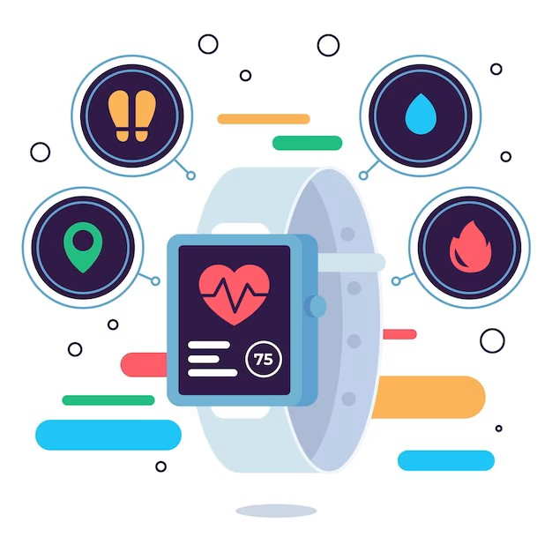
Conclusion
Limited evidence exists regarding the effectiveness of Apple Watch and Fitbit in measuring mental stress.
Physiological indicators such as increased heart rate, blood pressure, ECG changes, and sleep disturbances can indicate mental stress.
Correlating multiple data points and integrating subjective self-reporting can enhance stress assessment.
Mental stress is influenced by subjective experiences and external factors, which may not be fully captured by wearables alone.
Further research is needed to validate these findings and enhance the accuracy of wearable devices in assessing mental stress.

Slide 14
References
Binsch O, Wabeke T, Valk P. Comparison of three different physiological wristband sensor systems and their applicability for resilience- and work load monitoring. 2016 IEEE 13th International Conference on Wearable and Implantable Body Sensor Networks (BSN). 2016 Jun;
Shcherbina A, Mattsson C, Waggott D, Salisbury H, Christle J, Hastie T, et al. Accuracy in Wrist-Worn, Sensor-Based Measurements of Heart Rate and Energy Expenditure in a Diverse Cohort. Journal of Personalized Medicine [Internet]. 2017 May 24;7(2):3. Available from: https://www.mdpi.com/2075-4426/7/2/3
Dooley EE, Golaszewski NM, Bartholomew JB. Estimating Accuracy at Exercise Intensities: A Comparative Study of Self-Monitoring Heart Rate and Physical Activity Wearable Devices. JMIR mHealth and uHealth [Internet]. 2017 Mar 16 [cited 2019 May 27];5(3):e34. Available from: https://mhealth.jmir.org/2017/3/e34
Wang R, Blackburn G, Desai M, Phelan D, Gillinov L, Houghtaling P, et al. Accuracy of Wrist-Worn Heart Rate Monitors. JAMA Cardiology [Internet]. 2017 Jan 1;2(1):104. Available from: https://jamanetwork.com/journals/jamacardiology/article-abstract/2566167
Hernando D, Roca S, Sancho J, Alesanco Á, Bailón R. Validation of the Apple Watch for Heart Rate Variability Measurements during Relax and Mental Stress in Healthy Subjects. Sensors [Internet]. 2018 Aug 10;18(8):2619. Available from: https://www.mdpi.com/1424-8220/18/8/2619

Slide 15
References
Nuss KJ, Thomson EA, Courtney JB, Comstock A, Reinwald S, Blake S, et al. Assessment of Accuracy of Overall Energy Expenditure Measurements for the Fitbit Charge HR 2 and Apple Watch. American Journal of Health Behavior. 2019 May 1;43(3):498–505.
Thomson EA, Nuss K, Comstock A, Reinwald S, Blake S, Pimentel RE, et al. Heart rate measures from the Apple Watch, Fitbit Charge HR 2, and electrocardiogram across different exercise intensities. Journal of sports sciences [Internet]. 2019;37(12):1411–9. Available from: https://www.ncbi.nlm.nih.gov/pubmed/30657025/
Nelson BW, Allen NB. Accuracy of Consumer Wearable Heart Rate Measurement During an Ecologically Valid 24-Hour Period: Intraindividual Validation Study. JMIR mHealth and uHealth [Internet]. 2019 Mar 11;7(3):e10828. Available from: https://www.ncbi.nlm.nih.gov/pmc/articles/PMC6431828/
Falter M, Budts W, Goetschalckx K, Cornelissen V, Buys R. Accuracy of Apple Watch Measurements for Heart Rate and Energy Expenditure in Patients With Cardiovascular Disease: Cross-Sectional Study. JMIR mHealth and uHealth. 2019 Mar 19;7(3):e11889.
Düking P, Giessing L, Frenkel MO, Koehler K, Holmberg HC, Sperlich B. Wrist-Worn Wearables for Monitoring Heart Rate and Energy Expenditure While Sitting or Performing Light-to-Vigorous Physical Activity: Validation Study. JMIR mHealth and uHealth. 2020 May 6;8(5):e16716.

Slide 16
Thank You

Slide 17
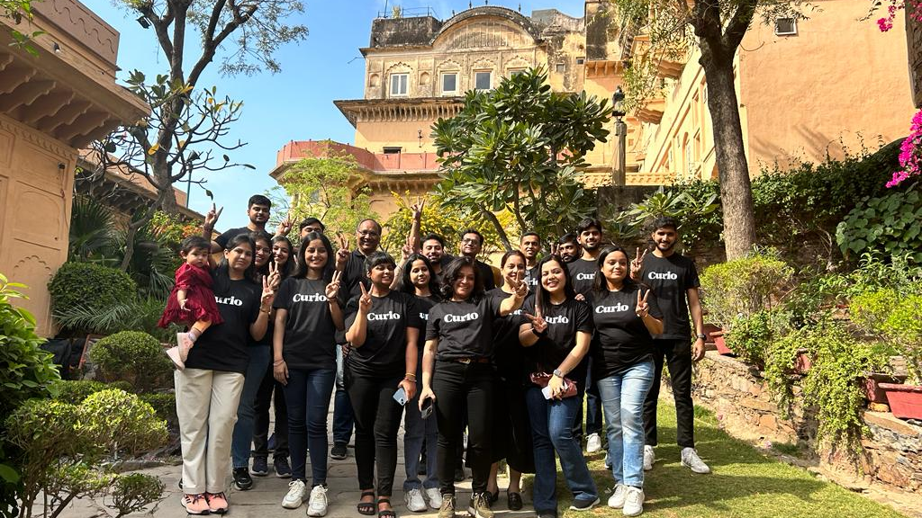
Curio Digital Therapeutics

Slide 18
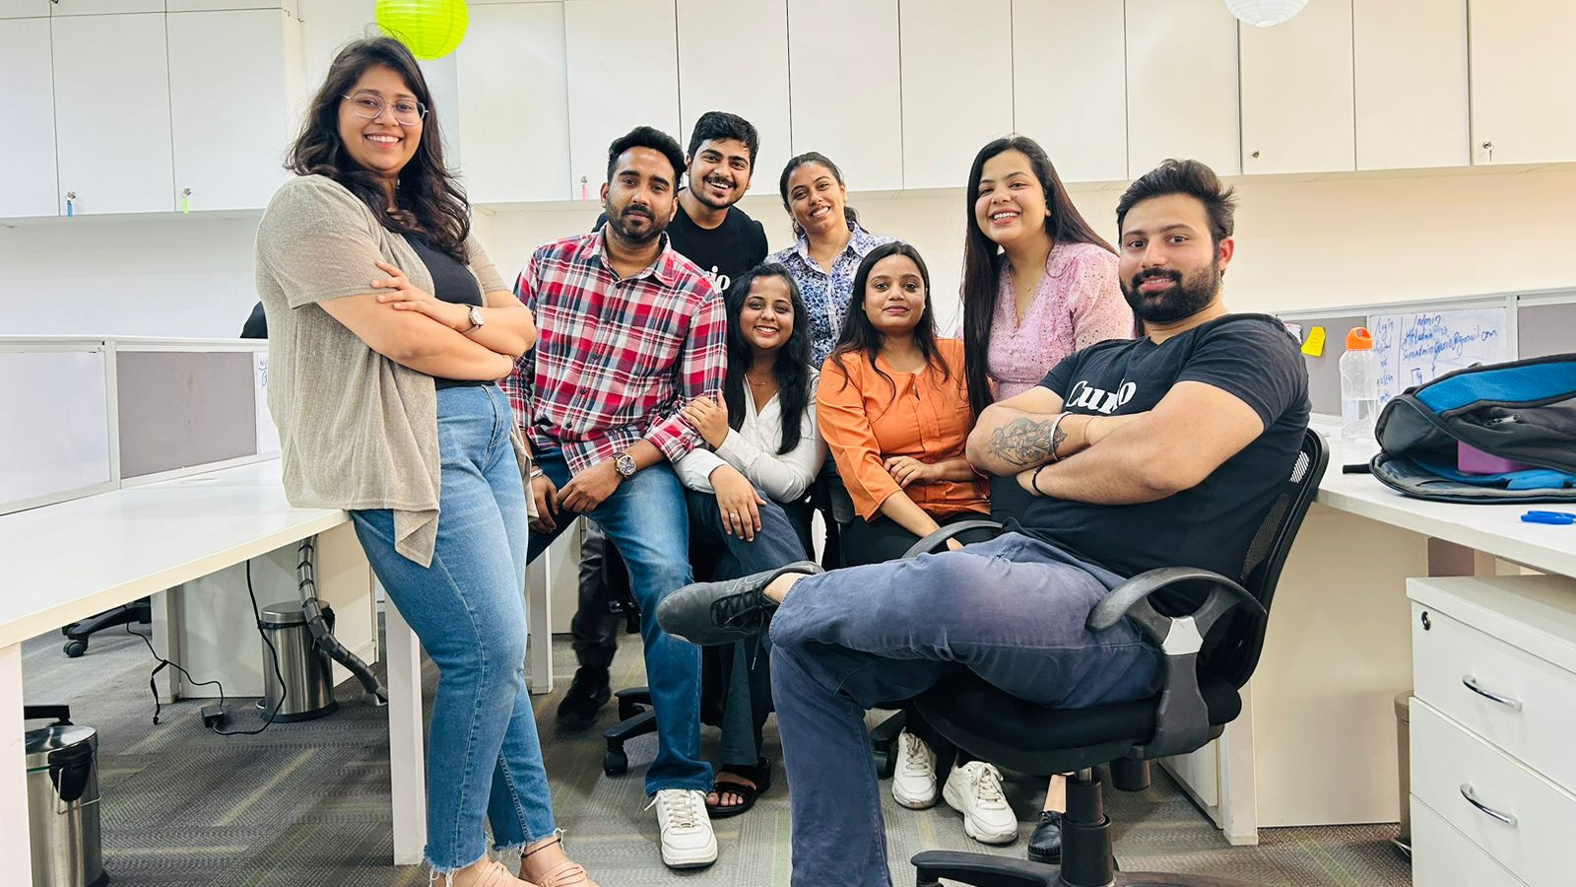
Curio Digital Therapeutics

