Slide 1

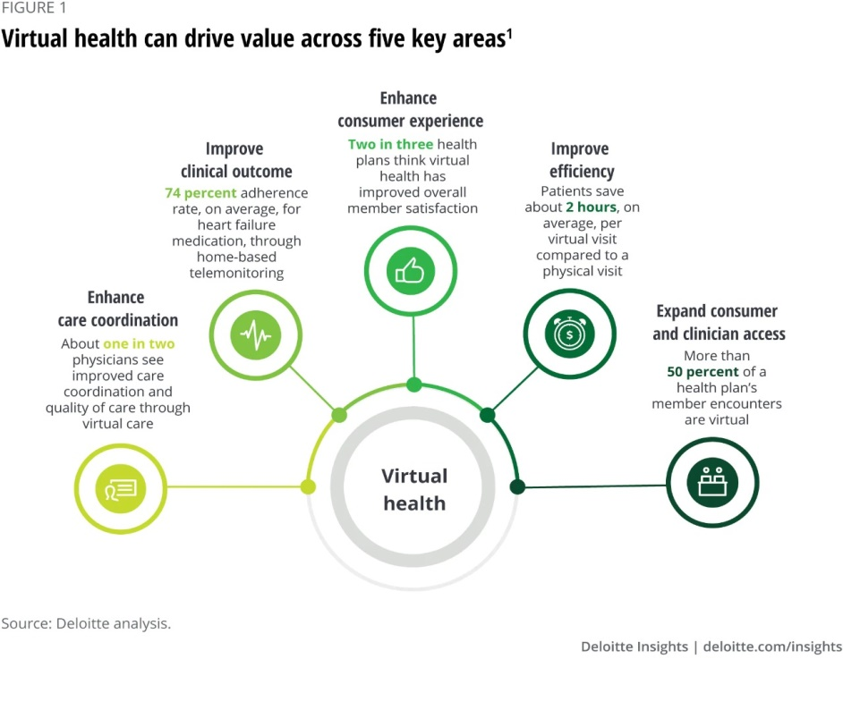
INTRODUCTION
Comparison between Digital & Face to Face Doctor Patient Consultation
By Tripti Tyagi guided by Ms.Divya Aggarwal
INTERNATIONAL INSTITUTE OF HEALTH MANAGEMENT RESEARCH, New Delhi
RESULT
DISCUSSION
LIMITATIONS
Nowadays, there are such a significant number of approaches to speak with your doctor, from in person visits to video tests to texts. In spite of the fact that screen-to-screen contact among patient and doctor so far stays moderately phenomenal, there is proof that patients need approach to online communication.
The findings showed that face to face patient provider communication had a positive association with online patient-provider communication suggesting that different channel of communication can be integrated into healthcare system, performing complementary functions to each other.
Patients found that communication through digital medium was trustworthy,cost effective and convenient but it lacks a policy to support patients from poor households.
Technology-supported communication is viewed by many patients as atleast a partial solution to the complex challenges of delivering healthcare to an ageing and increasingly diverse population.
Remote consultations offer potential advantages to patients and the healthcare system.But fears have been expressed that they may be clinically risky or can be less acceptable to patients or staff and they bring technical, logistical and regulatory challenges.
Digital contact may permit minor issues to be contacted without face to face or personal visit, but it might miss uncommon however genuine conditions which potentially lead to higher number of doctor visits in subsequent days.
Regardless of the channel of patient- provider associations, connections matter.
REFERENCE
Limited journal articles that focused on the difference.
Time period of some of the literature reviewed was not given.
Jiang, S. (2019). The Relationship between Face-to-Face and Online Patient-Provider Communication: Examining the Moderating Roles of Patient Trust and Patient Satisfaction.
Kiek Tates, M. L. (2017). The Effect of Screen-to-Screen Versus Face-to-Face Consultation on Doctor-Patient Communication: An Experimental Study with Simulated Patients.
Mafruha Alam, C. B. (2019). Patients’ and Doctors’ Perceptions of a Mobile Phone–Based Consultation Service for Maternal, Neonatal, and Infant Health Care in Bangladesh: A Mixed-Methods Study.
Trisha Greenhalgh, S. V.-R. (2014). Virtual online consultations:advantages and limitations (VOCAL)study.
https://www2.deloitte.com/us/en/insights/industry/health-care/future-of-virtual-health.html
OBJECTIVE
To examine the preference between digital and interpersonal doctor patient communication among people.
METHODOLOGY
The secondary search method was adopted to conduct the review.
The following databases were searched on: pub med-NCBI, Google scholar, BMJ and Research gate. Keywords- Digital communication, interpersonal communication, patient satisfaction, health care effectiveness, relationship building.
Inclusion-Papers published between 2014-2020 , papers which included comparison between both mediums
Exclusion-Non scientific website, articles focusing on specific disease.
CONCLUSION
The world is encountering digital revolution. This study examined that the patients are similarly happy with both mediums as long their needs are being fulfilled effectively.

Slide 2


