Slide 1



Evaluating the Effectiveness of Hospital Information System Training: A Case Study on Doctor and Nurse Training for OPD Registration, EMR Utilization, and Indentation Management at AINU Hospital, Silliguri, West Bengal.
Organisation : MyHealthcare Technologies
Clinical Team
Presented by: Dr. Vaibhav Sethi
Healthcare IT(PG/23/125)
Mentor: Dr.Sumant Swain
IIHMR Delhi

Slide 2
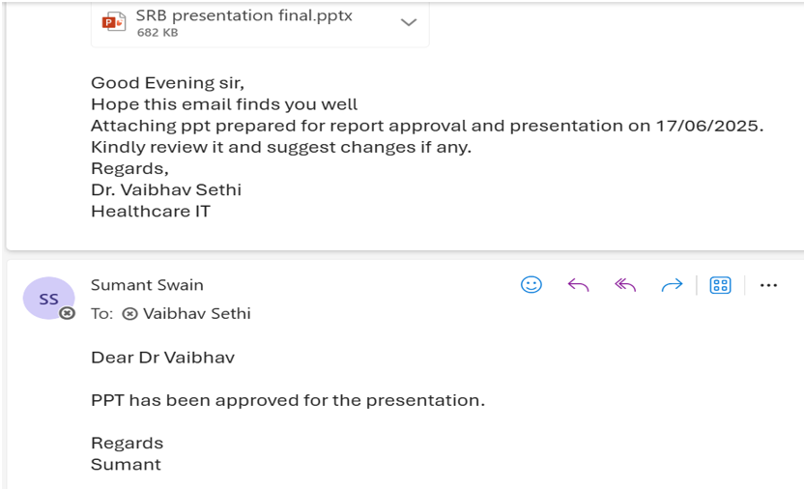
Mentor Approval

Slide 3
Introduction (1/2)
Hospital Information Systems (HIS) are integrated software programs designed to manage clinical, financial, and administrative operations in healthcare settings. They streamline workflows between departments, increase efficiency, and improve patient care through modules for OPD registration, EMR utilization, and indentation management.

Slide 4
Introduction (2/2)
This research proposal aims to evaluate the effectiveness of HIS training for doctors and nurses at AINU Hospital in Silliguri, West Bengal. The study assessed how well medical professionals are trained in using these critical systems and identify areas for improvement to enhance system usability and workflow efficiency.

Slide 5
Objectives of Your Study
Primary Objective: Evaluate the effectiveness of HIS training for doctors and nurses at AINU Hospital
Specific Objectives:
To evaluate the level of adoption and proper usage of Electronic Medical Records (EMR) by trained doctors and nurses.
To determine the satisfaction and perceived usefulness of HIS training among healthcare professionals at AINU Hospital familiarity, readiness, and confidence levels
To identify the challenges faced by doctors and nurses in implementing HIS functions post- training.

Slide 6
Methodology
Study design: Cross-sectional Design
This study employed a cross-sectional design. Data was be collected from a specific sample of Doctor, Nursing staff at AINU Hospital at a single point in time. This design is particularly suited to investigate the immediate impact of the new Hospital Information System (HIS) training program on staff's familiarity, readiness, and perceived confidence level.
Study period: 3 Months(March-June 2025)
Sampling method: Convenience sampling
Study Population: Doctor(6), Nursing Staff(16)
Inclusion Criteria:
All full-time and part-time Doctors, Nurses at AINU Hospital who will be using the new HIS.
Exclusion Criteria:
Staff members who will not be using the new HIS in their daily tasks will be excluded to ensure the data collected reflects the experiences of those directly impacted by the training program. Staff members who are on leave or unavailable during the data collection period will be excluded to minimize participation bias and ensure data integrity.
Data Collection Method & Tool:
This study utilized a combinedd quantitative and qualitative data collection methods to gain a more comprehensive understanding of the impact of the HIS training program.

Slide 7
Results (1/5)
Data Analysis
Demographic Characteristics:
Experience - 2/22 with Less than a year, 3/22 with 1-3 years of experience, 7/22 with 3-5 years of experience, 10/22 with More than 5 years of experience
Specialization - 4 out of 6 doctors are Urologists, 2 doctors have specialized in Nephrology.
Data was collected using Google Forms and analyzed using Microsoft Excel for both quantitative interpretation and visual representation.
The study analyzed responses from a sample of 22 healthcare professionals, including both in- house doctors and nurses who underwent HIS training.
Survey questions were designed to evaluate the participants’ knowledge, system usability experience, and practical application of HIS functionalities post-training.
The analysis aimed to determine the effectiveness of the HIS training in improving platform understanding, adoption, and workflow efficiency among clinical staff.
Exclusion Criteria: Part-time/ On-call doctors and any new joinee (doctor &/or nurse) post training.
Knowledge about Hospital Information System (HIS):
Usability with HIS- 19/22 respondents have had an exposure to using a Hospital Information System, before the training
Familiarity with features of an HIS- 6 out of 22 had a familiarity with Prescription making, 7/22 with Diagnosis and entering order sets, 4 with Managing patient history, 2/22 with viewing test results and previous records, 3 out of 22 with Navigating the HIS dashboard for patient consultations

Slide 8
Results (2/5)

Slide 9
Results (3/5)
Perceptions Toward HIS Usage:
Perceived Training Impact: 72% of respondents reported that the training was very effective in helping them understand and use the HIS platform for clinical functions such as prescription entry and order placement.
Confidence in Using HIS: A majority of trained staff expressed increased confidence in handling patient prescriptions and raising indent requests post-training.
Practices Related to HIS Functionality:
Prescription & Order Efficiency: Over 60% of respondents observed improved accuracy and reduced time in prescription writing and order management after undergoing the training.
Usage Frequency: More than half of the doctors and nurses reported regular use of the HIS for these tasks post-training, indicating increased adoption.
Statistical Analysis:
Correlation Observation: A positive association was noted between prior digital literacy and ease of adapting to HIS modules, particularly among younger staff.
Therefore, the number of literate females between the age bracket of 15 to 49 years residing in Delhi (sample size) to be surveyed under this study is 230.

Slide 10
Results (4/5)
(Doctor’s Pain points)

Slide 11
Results (5/5)
(Nurses' Pain points)

Slide 12




Discussion (1/2)
Baseline HIS Experience
All participants had prior exposure to the Hospital Information System (HIS), providing a foundational familiarity that enabled a focused assessment of training impact.
Pre – Training
(Doctors & Nurses)
Diagnosis Entry Pattern
Before training, 75% of users entered diagnoses manually for every case, indicating underutilization of tools like order sets or saved templates
Workflow Challenges
Many respondents faced difficulties with critical workflows such as raising admission/surgery requests and ordering medications, reflecting gaps in system navigation skills.
System Usage Barriers
Manual dependency and lack of awareness about available HIS features limited efficiency and consistency in prescription and order management.

Slide 13
Discussion (2/2)
Diversified Diagnosis Entry
After training, users adopted varied strategies: 34% began copying and modifying past entries, 33% continued manual input, and 33% started using order sets, indicating improved system utilization.
Post – Training
(Doctors & Nurses)
Perceived Workflow Efficiency
A strong 74% of respondents rated the training as a 4 or 5-star improvement in workflow efficiency, confirming the training’s positive impact on daily clinical operations.
Ongoing Challenges
Despite gains, 33% reported issues with non-intuitive system navigation, while 28% faced customization limitations, suggesting room for UI/UX and functional enhancements.
Improved System Confidence
Post-training, doctors and nurses demonstrated increased confidence and consistency in using HIS for documentation, prescribing, and order placement—addressing earlier functional bottlenecks.

Slide 14
Conclusion
The findings of this study demonstrate the overall effectiveness of the MyHealthcare HIS platform implementation. Users reported high satisfaction with the system's usability and functionality, with appreciation for its ability to streamline tasks like patient Consultation Medication indentation, and document Management. The training program played a crucial role in this success, with users commending the clarity of the materials, the interactivity of the sessions, and the expertise of the trainers. These factors contributed significantly to user confidence and preparedness in using the new HIS.

Slide 15
References
Management information system for public health facilities in Haryana. ResearchGatehttps://www.researchgate.net/publication/343157910
Srivastava, S. K. (2016). Adoption of Electronic Health Records: A Roadmap for India. Healthcare Informatics Research, 22(4), 261–269. https://doi.org/10.4258/hir.2016.22.4.261
Kumari, N., & Suresh Kumar, P. K. (2023). A case study on acceptance of hospital information systems (HIS) among nurses in a tertiary care hospital. International Journal of Case Studies in Business, IT, and Education (IJCSBE), 7(3), 149–161. https://doi.org/10.47992/IJCSBE.2581.6942.0292
D'Costa, S., & Sinha, R. K. (2021). Usability assessment of hospital information system integrated electronic medical record. Health Services and Outcomes Research Methodology, 21(3), 339–362. https://doi.org/10.1007/s10742-020-00238-0

Slide 16
INVOLVEMENT IN COMMUNITY OUTREACH PROGRAMME (COP) ACTIVITIES
Total no. of visits done by the Student: 10
Day-wise activities done by the student:
Mapping and listing of the area.
Interaction with the community and frontline healthcare workers.
Conducted health profile survey

Slide 17
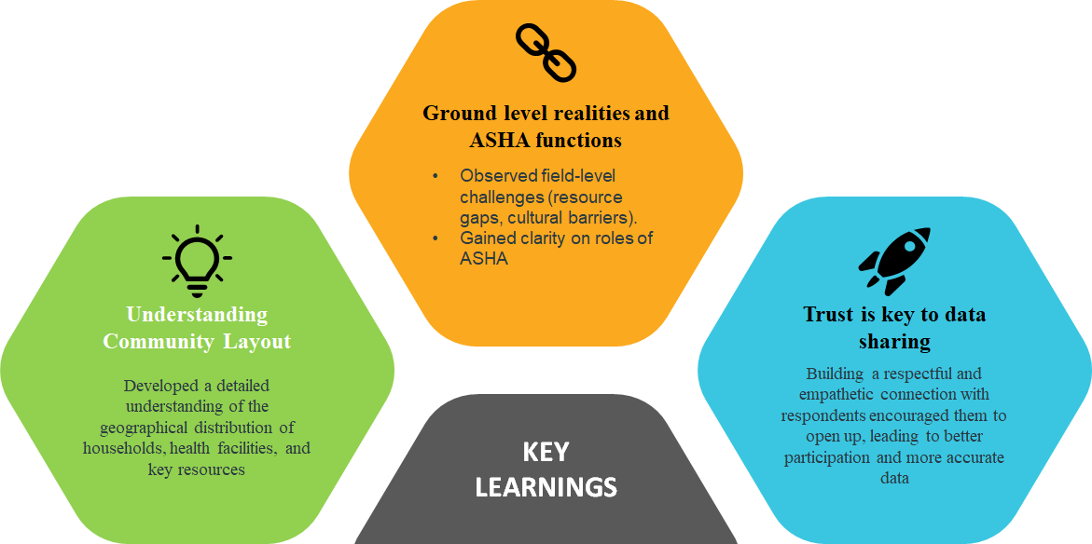
KEY LEARNING FROM COP ACTIVITIES

Slide 18

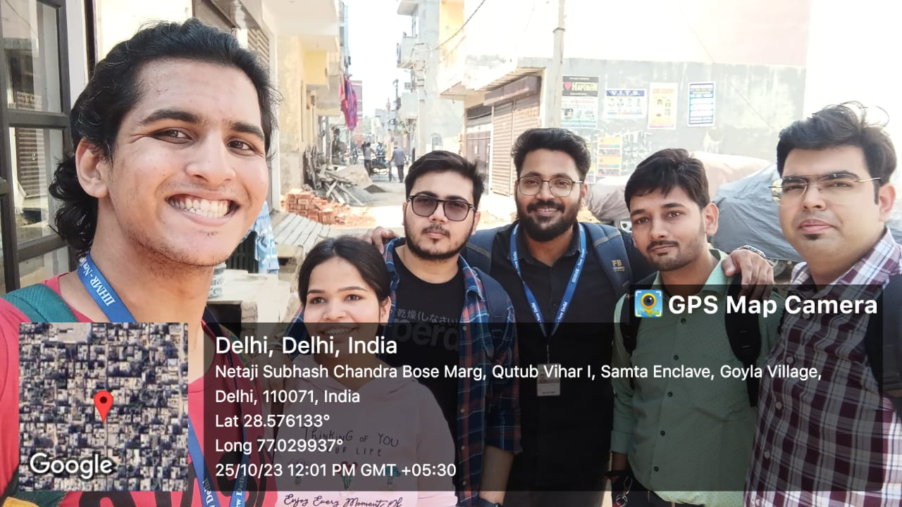
COP FIELD ACTIVITIES PHOTOGRAPHS

Slide 19
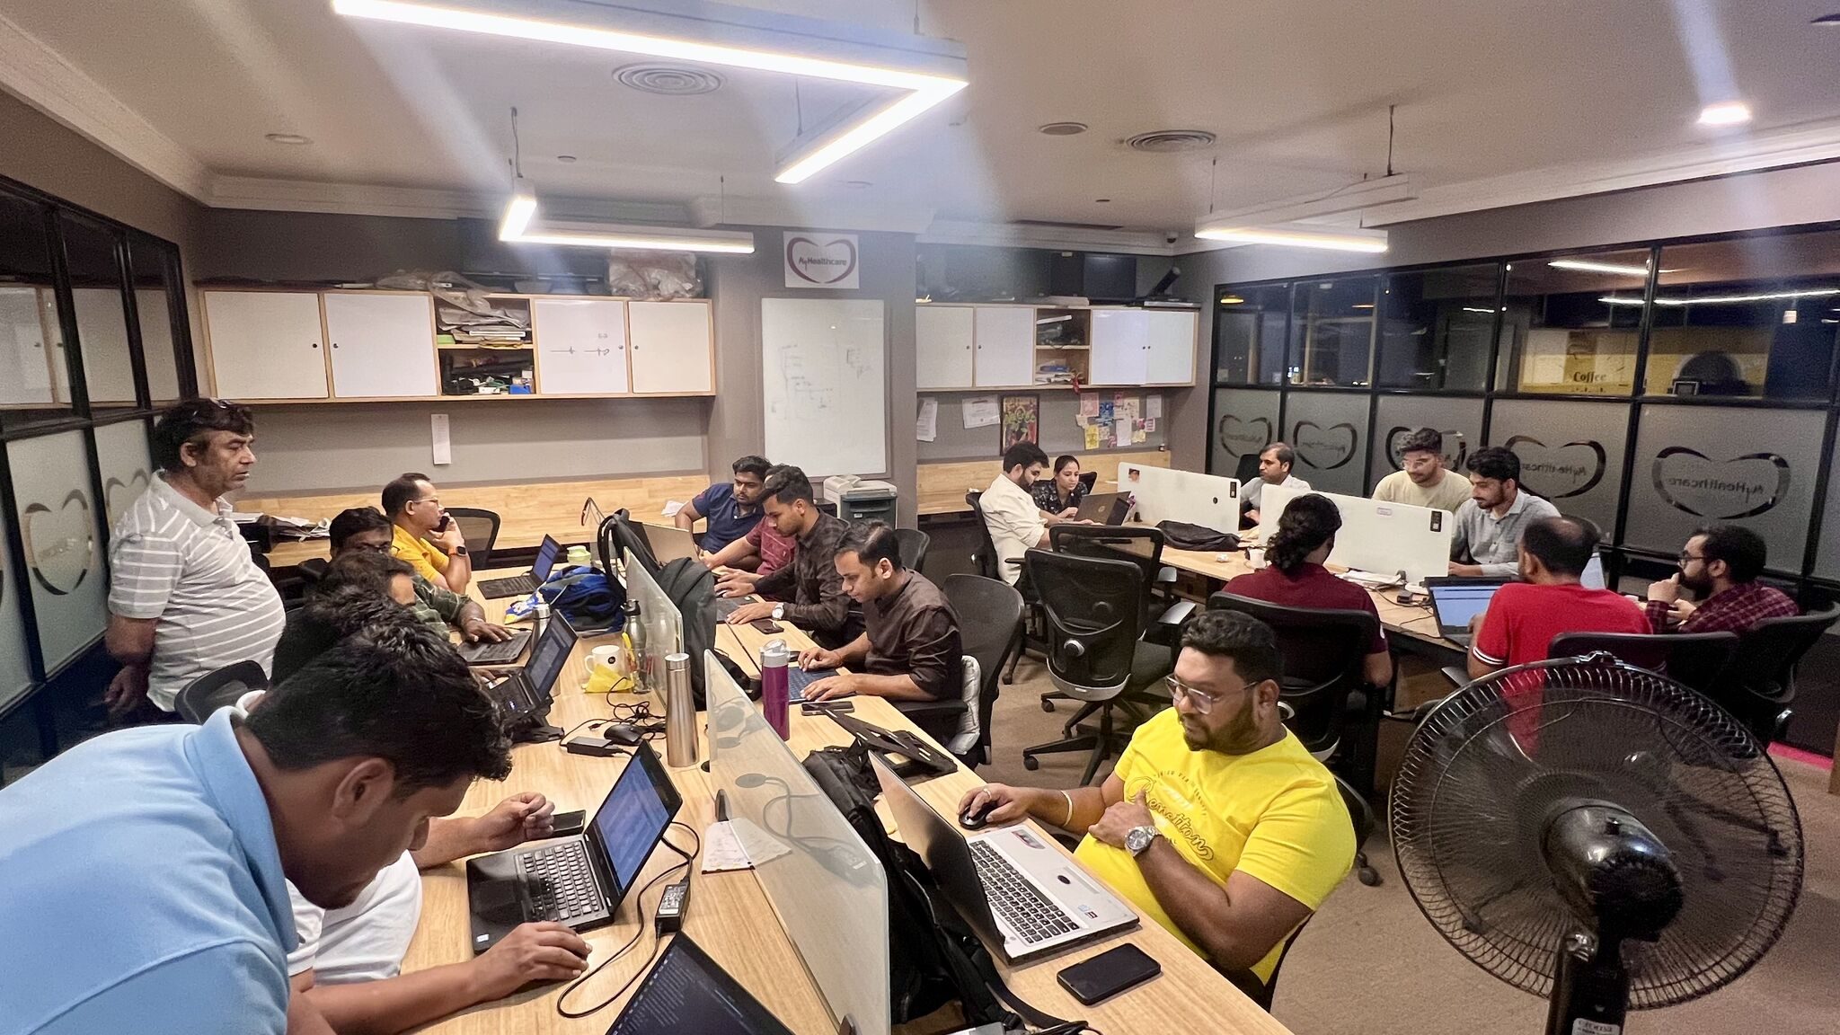
Pictorial Journey

Slide 20
Thank You
Any Questions

