Slide 1


Landscape Analysis of Human Resources for Health - Punjab, India
Presented by : Dr. Kovid Gupta
IIHMR Mentor : Dr. Rupsa Banerjee
IIHMR Delhi

Slide 2
Screenshot of Approval

Slide 3
Introduction
A robust and equitably distributed human resources for health (HRH) workforce is crucial for a functional healthcare system. This report presents a comprehensive analysis of HRH in Punjab, India, examining workforce size, geographic distribution, skill mix, and existing challenges. This analysis is essential for policymakers, healthcare administrators, and public health professionals in Punjab to develop evidence-based interventions to address workforce shortages, optimize skill distribution, and enhance healthcare service accessibility and quality.
Key areas of analysis include:
Workforce Composition: A detailed breakdown of healthcare professionals in Punjab, including physicians, nurses and other healthcare professionals.
Geographical Distribution: Assessment of the distribution of healthcare professionals across rural and urban areas, identifying disparities in access to healthcare services.
Skill Mix: Evaluation of the skill mix within the healthcare workforce to identify shortages of specialized personnel and imbalances in skillsets, informing targeted training programs and recruitment initiatives.
Workforce Challenges: Exploration of challenges such as workforce migration, attrition rates, age related factors.

Slide 4
Objectives
To provide a detailed breakdown of the quantitative and qualitative composition of the healthcare workforce in Punjab, including physicians, nurses, allied health workers, and public health specialists.
Conduct a comprehensive quantitative and qualitative analysis of Punjab's healthcare workforce, encompassing physicians, nurses, allied health professionals, and educational and training institutes.
Evaluate the vacant and sanctioned positions across the state to understand the staffing gaps.
Assess the distribution of nurses and doctors across the public and private healthcare sectors in Punjab.
Identify the specialty-wise distribution of specialist healthcare providers within the state.
Analyzing the nurse-to-doctor ratio and exploring strategies for enhancement.

Slide 5
Methodology
To comprehensively analyze the Human Resources for Health (HRH) in Punjab, the following data sources and methods were utilized:
HRH Vacancies, Sanctioned Positions, and Specialist Cadre Analysis:
  Data from the National Health Systems Resource Centre (NHSRC) were used to analyze HRH-related policies and implementations. This included a detailed evaluation of vacant and sanctioned positions across the state, as well as identifying the specialty-wise distribution of specialist healthcare providers within Punjab.
Workforce Distribution Analysis:
  The National Health Workforce Accounts (NHWA) and National Sample Survey Office (NSSO) data were used to assess the distribution of doctors and nurses across public and private healthcare sectors in Punjab.
Data Analysis: The analysis of the collected data was performed through a structured and systematic approach to provide comprehensive insights into the HRH landscape in Punjab

Slide 6
Results
1. Current Workforce Statistics:
Nurses: 17.7 per 10,000 persons according to the National Health Workforce Accounts (NHWA)
Doctors: 8.8 doctors per 10,000 persons as per NHWA data
2. Distribution Across Regions:
In Punjab, there is a marked disparity in the distribution of healthcare professionals between rural and urban areas. Approximately 27% of doctors and 36% of nurses are employed in rural regions, while the remaining 73% of doctors and 64% of nurses work in urban areas.
3. Educational & Training Institutions:
Medical Colleges: 10 (around 1500 students graduate each year)
Nursing Colleges: 114 institutions (around 7,000 students graduate each year)
Allied Health Institutes: 15

Slide 7
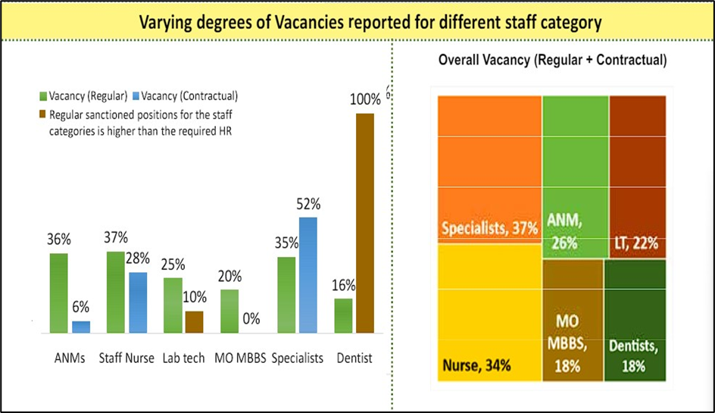
1. The stock data of NHWA suggested nurse to doctor ratio (number of nurse/midwives per doctor) to be 2.1:1 at the all-India level with Punjab (6.4:1)
Number and percentage distribution of allopathic doctors and nurse in Punjab, 2018, the number of nurses is significantly more as compared to doctors.
2. The overall staff vacancy can be seen from all the departments. The requirements of Specialists is significantly higher as compared to other positions.
Source: NHSRC : All State infographics of HRH,2020

Slide 8

3. Distribution of doctors and nurses across public-private and major states in Punjab, 2018 almost more than 50% of the doctors work in the public sector and around 40-45% work in the private sector. Nurses work significantly more in the private sector.
4. Speciality wise breakup of the Specialists in the form of pie chart where we can see the majority of the doctors have specialisation in the Surgery followed by Medicine and the least can be seen in Microbiology
Source: Estimates from NSSO 2017– 18
Source: Punjab Public Health Workforce Report.pdf (nhsrcindia.org)

Slide 9
Discussion
1. Challenges:
Doctor Shortage: Data suggests a potential shortage of doctors in Punjab, particularly specialists, compared to the national average.
Urban-Rural Disparity: There's a concentration of doctors and specialists in urban areas, leaving rural areas with limited access to qualified healthcare professionals.
Specialist Gap: The data indicates a significant vacancy rate for specialists, creating a gap in critical medical expertise.
2. Potential Solutions:
Encourage Rural Practice: Loan repayment programs or rural practice incentives can attract medical graduates to underserved areas.
Invest in Specialist Training: Targeted programs or scholarships can incentivize doctors to pursue specialist training in high-demand areas.
Improve Working Conditions: Strategies to address workload, compensation, and career development can help retain specialists in Punjab.
Explore Public-Private Partnerships: Collaboration between public and private sectors can optimize resource allocation and improve access to specialists in rural areas.

Slide 10
Limitations of Study
Limitations of the Data on HRH Governance in Punjab
Timeliness: The data might not be current. Since the HRH situation can change rapidly, outdated data may not reflect the present challenges and opportunities.
Level of Detail: The data provides a general overview but may lack details on specific challenges faced by different cadres of health workers (e.g., nurses vs. specialists) or in different facility types (e.g., primary health centers vs. district hospitals).
Focus on Numbers: The data focuses on vacancies, staff distribution, and ratios. It may not capture qualitative aspects like staff motivation, job satisfaction, or the impact of working conditions on service delivery.

Slide 11
Conclusion
Educational and Training Capacity: Despite a reasonable number of medical and nursing colleges, the distribution of graduates does not seem to sufficiently address the healthcare workforce demands in both urban and rural settings. This suggests a need for targeted policies to encourage healthcare professionals to serve in underserved areas, possibly through incentives or mandatory service obligations.
Healthcare Workforce Distribution: Punjab faces a notable urban-rural disparity in healthcare professional distribution, with a significant majority concentrated in urban areas. This disparity highlights a potential challenge in equitable healthcare access across the state, particularly in rural regions where healthcare needs may be substantial but resources are limited.
Educational and Training Capacity: Despite a reasonable number of medical and nursing colleges, the distribution of graduates does not seem to sufficiently address the healthcare workforce demands in both urban and rural settings. This suggests a need for targeted policies to encourage healthcare professionals to serve in underserved areas, possibly through incentives or mandatory service obligations.
Specialization and Staffing Gaps: The data indicates a higher demand for specialist doctors, particularly in surgical and medical disciplines. This aligns with broader healthcare trends where specialized care is increasingly required. Addressing these gaps will be crucial for enhancing healthcare delivery and outcomes in Punjab.

Slide 12
Public vs. Private Sector Engagement: The majority of doctors are employed in the public sector, whereas nurses predominantly work in the private sector. This distribution underscores differing employment preferences and possibly varying working conditions between sectors, which could influence workforce retention and healthcare service quality.
Policy Recommendations: To improve healthcare access and quality in Punjab, policies should focus on:
Incentivizing healthcare professionals to work in rural areas.
Increasing specialized training opportunities to meet specific healthcare demands.
Enhancing public-private collaborations to optimize resource utilization and service delivery.

Slide 13
References
Karan A, Negandhi H, Hussain S, Zapata T, Mairembam D, De Graeve H, Buchan J, Zodpey S. Size, composition and distribution of health workforce in India: why, and where to invest? Hum Resour Health. 2021 Mar 22;19(1):39. doi: 10.1186/s12960-021-00575-2. PMID: 33752675; PMCID: PMC7983088.
Karan A, Negandhi H, Hussain S, Zapata T, Mairembam D, De Graeve H, et al. Size, composition and distribution of health workforce in India: why, and where to invest? Human Resources for Health [Internet]. 2021 Mar 22;19(1). Available from: https://human-resources-health.biomedcentral.com/articles/10.1186/s12960-021-00575-2
‌National Health Systems Resource Centre. All State Infographic [Internet]. New Delhi: National Health Systems Resource Centre; 2021 [cited 2024 Jun 23]. Available from: https://nhsrcindia.org/sites/default/files/2021-06/All%20State%20Infographic__INNER_0.pdf

Slide 14


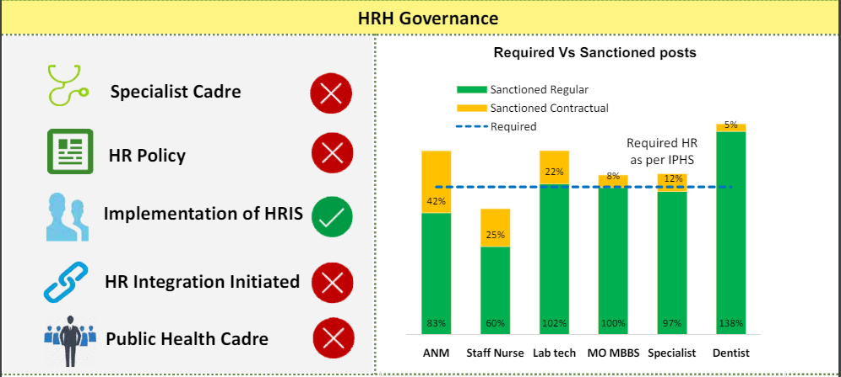
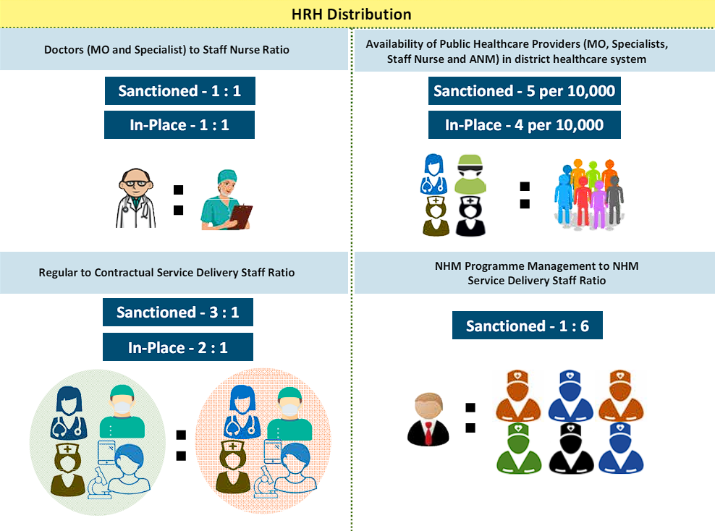
Landscape Analysis of Human Resources for Health - Punjab, India
Guide Name : Mr. Chander Pal Thakur & Done by : Kovid Gupta (PG/23/051)
IQVIA
INTRODUCTION
Objective: To assess the current status of human resources for health (HRH) in Punjab, India, and identify gaps, challenges, and opportunities for improvement.
Scope: Covers various healthcare cadres including doctors, nurses, allied health professionals, and support staff.
Key Findings
1. Current Workforce Statistics:
Doctors: 8.8 per 10, 000 population
Nurses: 17.1 per 10,000 population
2. Distribution Across Regions:
Urban Areas: Higher concentration of doctors and specialists.
Rural Areas: Shortage of qualified healthcare professionals, leading to over-reliance on primary healthcare providers.
3. Educational & Training Institutions:
Medical Colleges: 10
Nursing Schools: 25
Allied Health Institutes: 15
4. Challenges Identified:
Urban-Rural Disparity: Significant difference in HRH availability.
Training Gaps: Insufficient continuous professional development.
Retention Issues: High turnover rates in rural areas due to lack of incentives and career growth opportunities.
5. Opportunities for Improvement:
Policy Interventions: Enhancing rural postings with better incentives.
Training Programs: Establishing continuous education and training programs.
Innovative Solutions: Telemedicine and mobile health units to bridge the gap.
RESULTS
1. Prioritize and fill vacant SPMU positions through targeted recruitment and streamlined appointments.
2. Implement a needs-based staffing model and redeploy trained staff to high-demand facilities.
3. Conduct regular KPI reviews and established an HRMIS for improved workforce management.
4. Deploy AYUSH FMOs to underserved areas and establish a grievance redressal mechanism.
5. Increase medical workforce generation and implement staffing policies based on healthcare needs.
METHODOLOGY
Data Collection: Surveys, Interviews, Government Records, and Health Facility Assessments
Data Analysis: The secondary data was organized and analysed to identify trends, patterns, and gaps in HRH in Punjab.
CONCLUSION
The healthcare workforce in Punjab faces significant challenges due to disparities in the distribution of medical professionals and facilities. Despite a 9.85% annual growth in registered nurses and midwives from 2010 to 2017, shortages persist, especially in rural areas. The doctor-to-nurse ratio is 6.4:1, higher than the national average. Resources are unevenly distributed, with Amritsar, Ludhiana, and Patiala housing a substantial portion of healthcare infrastructure, while Fatehgarh Sahib, Fazilka, and Pathankot face severe shortages. Urban areas have better access to healthcare, exacerbating rural underservice. Efforts to improve the situation include increasing medical college intakes, though the overall density remains below WHO standards. Governance issues include a lack of specialist and public health cadres. Immediate actions involve filling vacancies and needs-based staffing; mid-term measures include performance monitoring and HRMIS implementation; long-term strategies focus on increasing workforce and retention through incentives.
BIBLIOGRAPHY
World Health Organization. "Global Health Workforce Statistics." Accessed June 23, 2024. WHO.Ministry of Health and Family Welfare, Government of India. "National Health Profile 2023." Accessed June 23, 2024. Ministry of Health and Family Welfare.KPMG in India. "Strengthening Healthcare Workforce in India: The 2047 Agenda." Accessed June 23, 2024. KPMG.

Slide 15
Thank You
Any Questions

Slide 16
Internship Experiences
What did you learn (skill/ topic)?
Overall self comments on Internship
Advanced Data Analysis: I developed proficiency in analyzing complex datasets using statistical software and data visualization tools to derive strategic insights.
Project Management: I gained hands-on experience in coordinating project timelines, delegating tasks, and fostering team collaboration to ensure project goals were met efficiently.
Healthcare Industry Knowledge: My internship at IQVIA deepened my understanding of the Public Health and Pharmacueticals sectors, including regulatory frameworks and market dynamics, enhancing my industry-specific expertise.
The internship at IQVIA was a valuable learning experience that allowed me to apply theoretical knowledge in a practical setting. I appreciated the opportunity to work alongside industry professionals and contribute to meaningful projects. The skills I acquired, particularly in data analysis and project management, have equipped me with a solid foundation for future career growth in the healthcare sector.

Slide 17
Suggestions Given to Organization
Streamline Data Integration: Improve data integration across teams to enhance analysis efficiency and insights.
Expand Professional Development: Offer workshops or certifications in advanced analytics to empower employees and keep them abreast of industry trends.
Promote Cross-Functional Collaboration: Foster stronger collaboration between departments to encourage innovation and knowledge sharing.
Enhance Customer Insights: Use advanced analytics for deeper customer understanding and better engagement strategies.
Embrace Healthcare Innovation: Explore AI and machine learning applications to innovate healthcare solutions and improve outcomes.

Slide 18
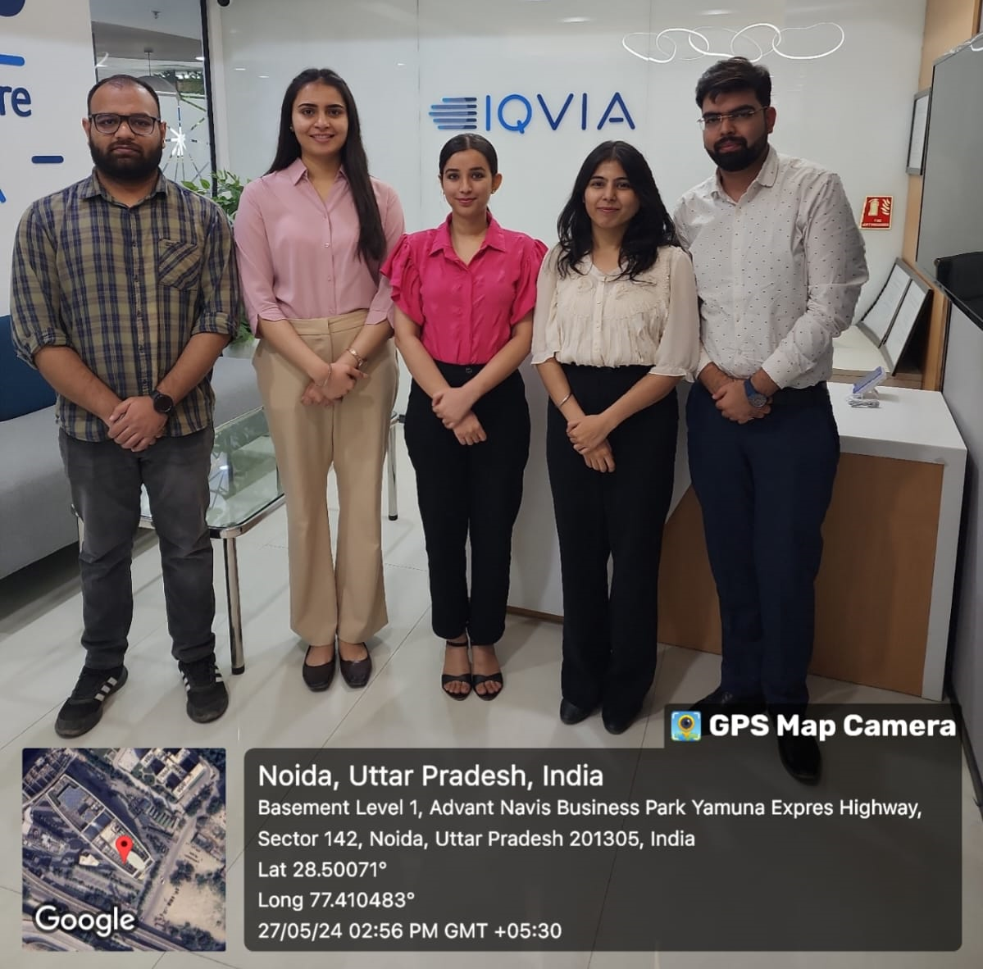
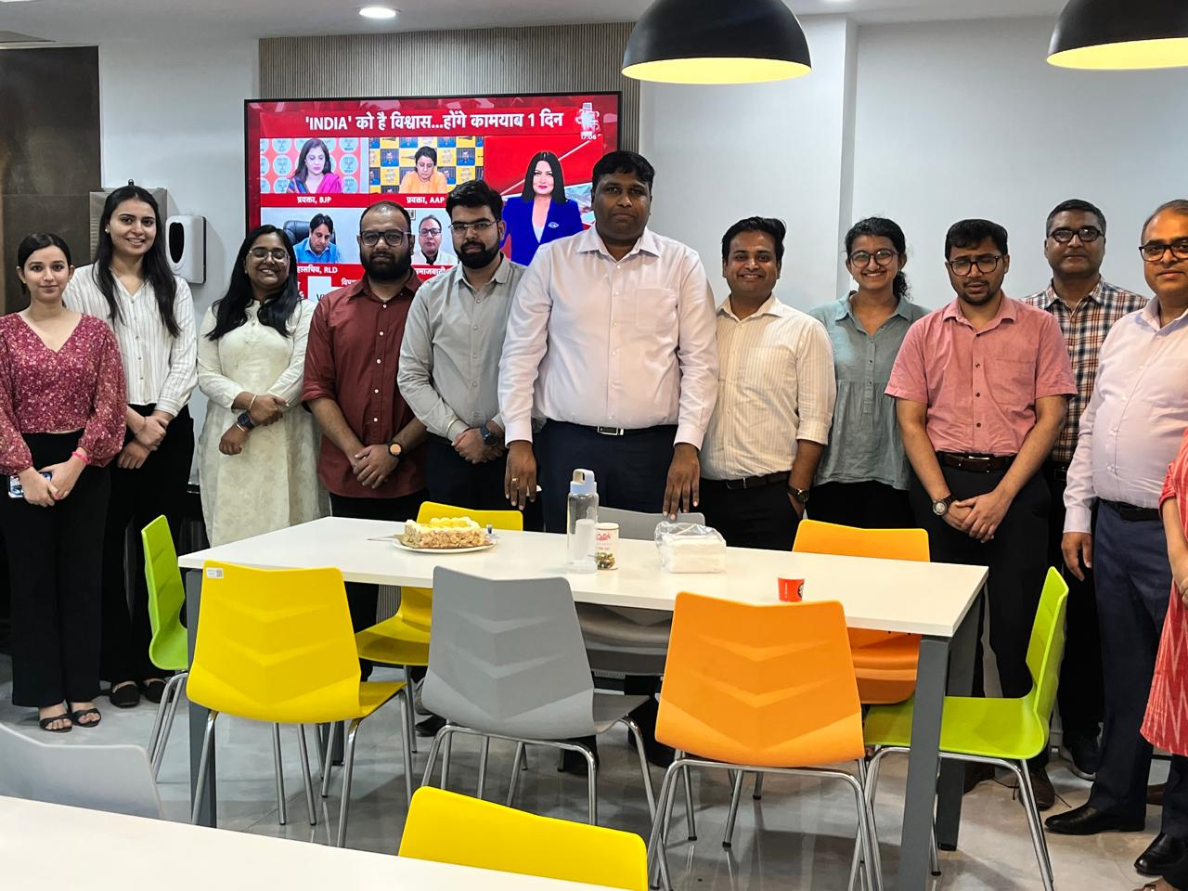
Pictorial Journey

Slide 19
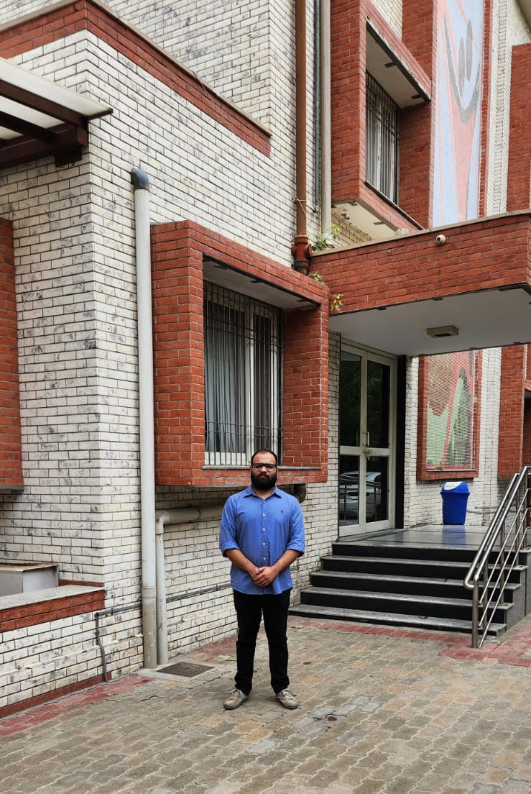
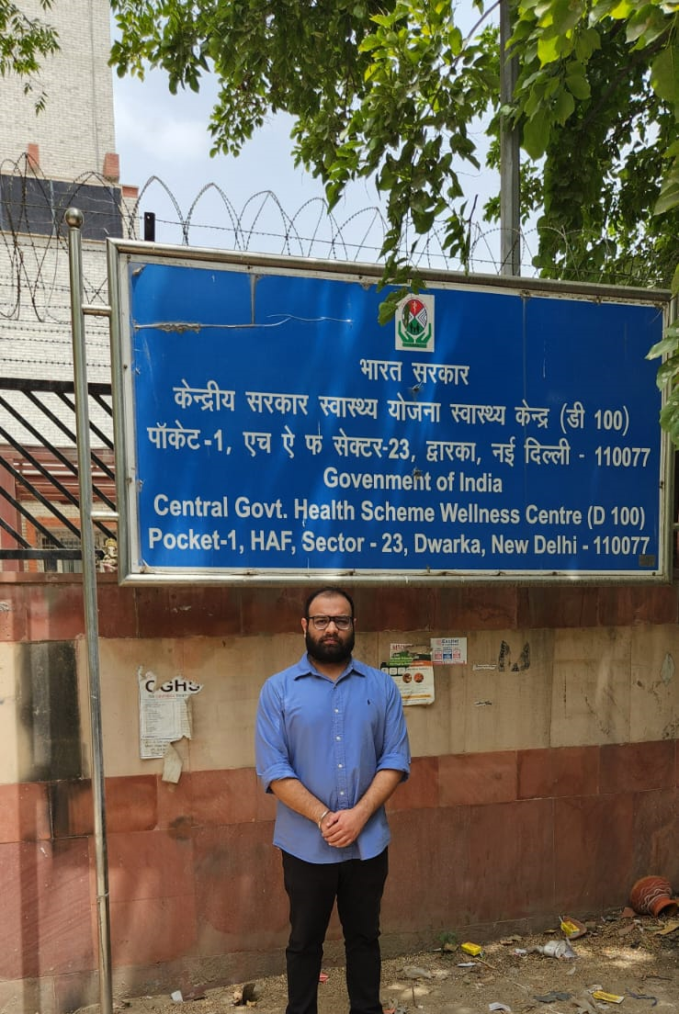
Health and Wellness Centre

Slide 20
Health and Wellness Centre
Human resources – Total - 20
  6 – Doctors
  1 – Nursing officer
  3 – Pharmacy officers
  1– Clerical staff
  1 – Data entry operator
  2 – Multi Tasking Staff
  3 – House keeping staff
  3 – Security guards
Patient flow
  300 – 500 daily
Diagnostics
  No diagnostics available
Infrastructure
  The building is functional but could benefit from regular maintenance.
  Sanitation and cleanliness are maintained at a satisfactory level

Slide 21
Suggestions for improvement
Establish Diagnostic Facilities
Despite having the necessary infrastructure, the Centre lacks essential diagnostic services such as a pathology lab and other testing facilities. Implementing these will enhance healthcare quality by providing timely and accurate diagnoses.
2. Introduce Wellness Programs
To improve patient wellness, it is recommended to introduce yoga and other wellness programs. These services will offer holistic health benefits, fostering physical, mental, and emotional well-being.

