Slide 1

Telepsychiatry in India: Current challenges and Future Directions
Ernst & Young LLP
Name: Shivangi Dash
Faculty Mentor: Dr. Punit Yadav
IIHMR Delhi

Slide 2
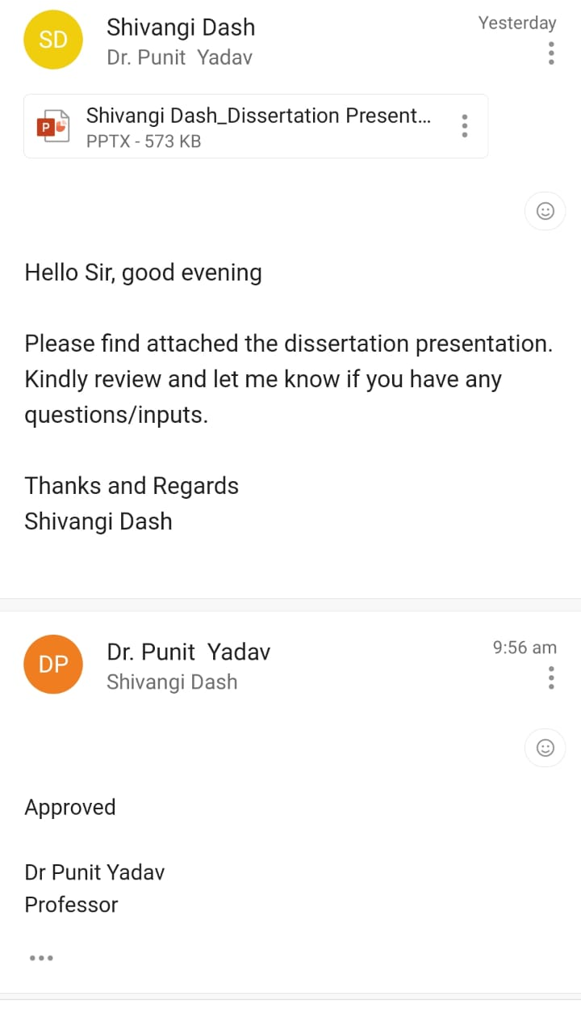
Mentor Approval

Slide 3
Introduction
Telepsychiatry is the application of telemedicine in psychiatry, allowing remote engagement for mental health treatment.
Research shows that telepsychiatry is comparable to in-person services in terms of reliability and treatment outcomes [1].
The COVID-19 pandemic accelerated the adoption of telepsychiatry globally, with significant increases in utilization.
The global market for digital mental health is expected to reach $41.3 billion by 2025 [2].

Slide 4
Introduction
According to a survey conducted by the Indian Psychiatry Society, in 2021, around 45% of psychiatrists in India reported using telemedicine platforms during the pandemic to provide mental health services [3].
The National Mental Health Program and Tele-MANAS initiative promote telepsychiatry in rural areas and underserved populations.
Government initiatives like e-Sanjeevani - National Telemedicine Service and Tele-MANAS aim to increase access to mental health services through teleconsultations.
Private sector platforms like Practo, Lybrate, and mfine offer telepsychiatry services in India, connecting patients with mental health professionals [4].

Slide 5
Objectives of Your Study
Primary
To identify the barriers/challenges faced by telepsychiatry providers and psychiatric patients in India as well as recommend any technology interventions that can help overcome this gap in future.
Secondary
To identify the current trends of telepsychiatry in India and abroad, including the types of services offered and the technologies used.
To analyse the ethical and legal issues surrounding telepsychiatry, such as privacy, informed consent, and liability.

Slide 6
Methodology
Study Design: Narrative Literature Review
Search Strategy: Databases searched: PubMed, PsycINFO, Scopus, and Google Scholar. Search terms used included combinations of the following keywords: "telepsychiatry," "telemedicine," “tele mental health services," "India," "challenges," "barriers," "implementation," “digital,” “technology,” “intervention."
Inclusion Criteria: (1) Published within year 2010-2023, (2) focused on telepsychiatry, (3) involved psychiatrists and/or psychiatric patients, (4) compared telepsychiatry with physical or in-person consultation, (5) reported on the challenges faced in telepsychiatry, and (6) discussed potential digital/technology interventions.
Exclusion Criteria: (1) Studies not specific to India or those that did not address the specified outcomes (2) Articles lacking empirical or substantive content (e.g., opinion pieces, editorials), and (3) Articles published in languages other than English.
Study Selection: Initially Title and Abstract screening was carried out, followed by full-text review to include the remaining studies in the final synthesis.
Sample Size: A total of 77 research papers were reviewed by full text, out of which 36 were selected for final inclusion in this report.
Data Extraction and Analysis: Thematic analysis was employed to identify common themes like: Patient Satisfaction, Psychiatrist Satisfaction, Patient Management & Security/Confidentiality Issues.

Slide 7
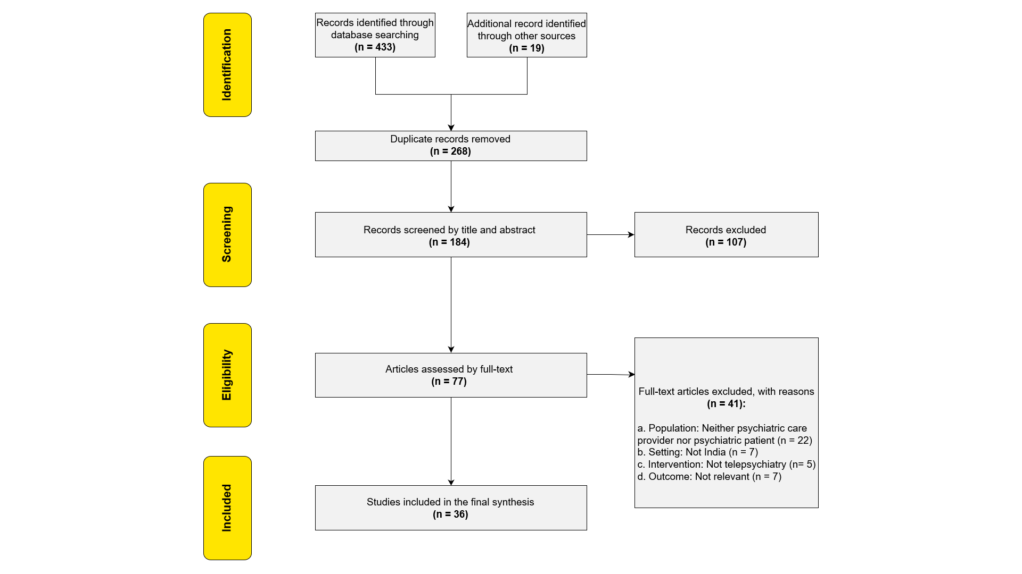
Methodology

Slide 8
Results
Reference | Year | Study Objective | Methodology | Key Findings
Sagar and Singh | 2022 | Evaluate the National Tele-Mental Health Program in India | Analysis of program implementation | The program shows promise in expanding mental health care access, but challenges in infrastructure and workforce need to be addressed
Drago et al. | 2016 | Conduct a meta-analysis of assessment and treatment via videoconferencing in psychiatry | Meta-analysis | Videoconferencing is a viable option for conducting psychiatric assessments and delivering treatments
Gururaj et al. | 2017 | Present the findings of the National Mental Health Survey of India 2015–16 | National survey | Provides prevalence data and outcomes related to mental health in India
Math et al. | 2019 | Estimate the cost of implementing the Mental Healthcare Act 2017 in India | Cost estimation study | Estimates the financial implications of implementing the Mental Healthcare Act in India
Campbell et al. | 2014 | Conduct a multisite randomized controlled trial on internet-delivered treatment for substance abuse | Randomized controlled trial | Internet-delivered treatment shows promise in addressing substance abuse and improving treatment outcomes
Park et al. | 2019 | Review the use of virtual reality in the treatment of psychiatric disorders | Literature review | Virtual reality has shown potential as a therapeutic tool for various psychiatric disorders

Slide 9
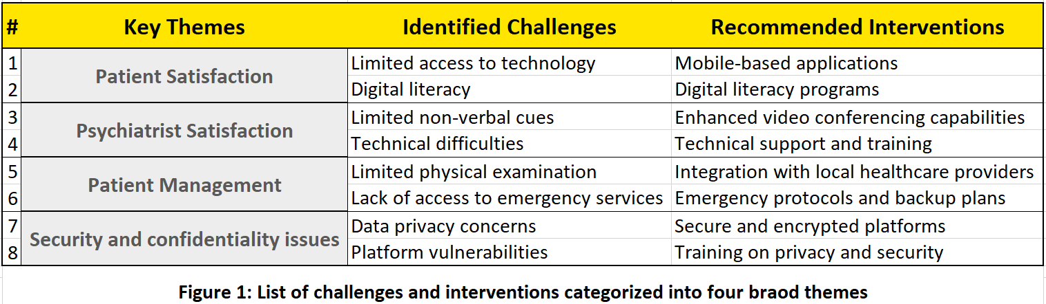
Results

Slide 10
Results
1
2
3
4
Theme 1: Patient Satisfaction
Theme 2: Psychiatrist Satisfaction
Theme 3: Patient Management
Theme 4: Security or Confidentiality Issues
Barriers/Challenges:
Limited access to technology: Many patients in India, especially in rural areas, face barriers to accessing telepsychiatry services due to limited access to computers or smartphones.
Digital literacy: Low digital literacy among some individuals hinders effective participation in telepsychiatry sessions.
Digital Interventions:
Mobile-based applications: User-friendly mobile apps can provide easy access to telepsychiatry services through smartphones.
Digital literacy programs: Training programs can improve patients' comfort and confidence in using technology.
Barriers/Challenges:
Limited non-verbal cues: Telepsychiatry consultations lack some non-verbal cues, impacting psychiatrists' ability to assess patients accurately.
Technical difficulties: Connectivity issues and platform glitches frustrate psychiatrists and hinder effective communication.
Digital Interventions:
Enhanced video conferencing capabilities: High-quality video and audio capabilities can facilitate better communication.
Technical support and training: Comprehensive technical support and training can mitigate challenges associated with technical difficulties.
Barriers/Challenges:
Limited physical examination: Telepsychiatry limits physical examinations, affecting accurate diagnosis and treatment monitoring.
Lack of access to emergency services: Immediate access to emergency services may be limited in telepsychiatry.
Digital Interventions:
Integration with local healthcare providers: Collaboration with local providers can facilitate physical examinations and access to emergency services.
  Emergency protocols and backup plans: Developing protocols and backup plans ensures patient safety during emergencies.
  Barriers/Challenges:
  Data privacy concerns: Patients have concerns about sharing sensitive information on digital platforms.
  Platform vulnerabilities: Data breaches and unauthorized access compromise patient security.
  Digital Interventions:
  Secure and encrypted platforms: Implementing platforms with robust security measures addresses data privacy concerns.
  Training on privacy and security: Education on best practices ensures adherence to confidentiality standards.

Slide 11
Discussion
Barriers and Challenges
For Telepsychiatry Providers
Technological issues: Software compatibility, connectivity problems, and technical glitches [3,4].
Reimbursement and medicolegal concerns: Inadequate reimbursement and worries about liability [5].
Psychiatrist satisfaction: Mixed findings, with some concerns about missing non-verbal cues and anxiety about technology [6].
For Psychiatric Patients
Connectivity issues: Limited internet access in rural areas affecting seamless telepsychiatry services [5,6,7,11].
Patient satisfaction: Ensuring high patient satisfaction with telepsychiatry by addressing connectivity and technical challenges [5,6].
Patient management: Difficulty in conducting comprehensive assessments remotely and limited multidisciplinary collaboration [4,6].
Technology Interventions for Future Improvement
Artificial Intelligence (AI): Automating administrative tasks, personalized treatment plans, and chatbots for support and information.
Mobile Applications: User-friendly interfaces for secure messaging, appointment scheduling, and self-help resources.
Remote Monitoring Devices: Continuous assessment of patient functioning, enabling personalized treatment adjustments.
Telecollaboration Tools: Facilitating communication and interdisciplinary collaborations among healthcare professionals.
[2,5,6,9,11]

Slide 12
Discussion
Current Trends in Telepsychiatry:
Services offered: Virtual consultations, remote assessments, medication management, and therapy sessions.
Technologies used: Video conferencing platforms, secure messaging systems, remote monitoring devices, and mobile applications.
[12,13,14,16].
Ethical and Legal Issues in Telepsychiatry:
Privacy and confidentiality: Robust encryption techniques, adherence to privacy regulations, and secure storage of patient records.
Informed consent: Ensuring patients understand the limitations and risks of telepsychiatry services.
Liability: Addressing concerns regarding medicolegal issues, liability, and responsibility for patient outcomes.
[15,17,21,24].
Recommendations for Ethical and Legal Compliance:
Data protection: Complying with relevant data protection laws and implementing secure video conferencing platforms.
Comprehensive training: Providing psychiatrists and staff with training on data privacy protocols and ethical guidelines.
Cultural considerations: Adapting telepsychiatry services to the cultural context and ensuring inclusivity and equity.
[15,18,19,21,24].

Slide 13
Conclusion
Telepsychiatry in India has great potential for expanding access to mental healthcare services.
Challenges include connectivity, technical difficulties, patient management, and security/confidentiality.
Incorporating technology interventions like VR, AI, big data analytics, mobile apps, remote monitoring, chatbots, telemedicine platforms, ML, and gamification can enhance telepsychiatry.
Further research is needed to address ethical and societal concerns.
Recommendations:
Improve telepsychiatry tools: Collaborate with solution providers to enhance digital tools for secure, engaging, and evidence-based telepsychiatry services, while ensuring a cohesive user experience.
Ensure accessibility and privacy: Increase awareness, affordability, and trust in telepsychiatry services, emphasizing anonymity, confidentiality, and data protection to encourage utilization and maintain transparent communication about data access and policies.
Foster comprehensive care: Integrate mental health support with physical health services, promoting a holistic approach to patient care for improved outcomes.

Slide 14
References
Sagar R, Singh S. National Tele-Mental Health Program in India: A step towards mental health care for all? Indian J Psychiatry. 2022 Mar-Apr;64(2):117-119. doi: 10.4103/indianjpsychiatry.indianjpsychiatry_145_22. Epub 2022 Mar 24. PMID: 35494321; PMCID: PMC9045352.
Malhotra S, Chakrabarti S, Shah R. Telepsychiatry: Promise, potential, and challenges. Indian J Psychiatry. 2013;55:3-11.
Gururaj G, Varghese M, Benegal V, et al. National Mental Health Survey of India, 2015–16 prevalence, pattern and outcomes. Bengaluru: NIMHANS, 2017.
World Health Organization. Mental health atlas 2014. Geneva: WHO, 2015.
Sunderji N, Crawford A, and Jovanovic M. Telepsychiatry in graduate medical education: a narrative review. Acad Psychiatry. 2015;39:55-62.
NIMHANS. INDIANS. Bengaluru: NIMHANS, 2019.
Torous J, Staples P, and Onnela J-P. Realizing the potential of mobile mental health: new methods for new data in psychiatry. Curr Psychiatry Rep. 2015;17(8):602.
Wootton R, Craig J, and Patterson V. Introduction to telemedicine. Boca Raton, FL: CRC Press, 2017.
Drago A, Winding T, and Antypa N. Videoconferencing in psychiatry, a meta-analysis of assessment and treatment. Eur Psychiatry. 2016;36:29-37.
Lakhtakia T, Torous J. Current directions in digital interventions for mood and anxiety disorders. Curr Opin Psychiatry. 2022 Mar 1;35(2):130-135. doi: 10.1097/YCO.0000000000000772. PMID: 34966117.
Math SB, Gowda GS, Basavaraju V, et al. Cost estimation for the implementation of the Mental Healthcare Act 2017. Indian J Psychiatry. 2019;61:S650-S9.

Slide 15
Thank You
Any Questions

