Slide 1

DISSERTATION PRESENTATION
Presented by
Abhimanyu Dabas

Slide 2

Mentor Approval

Slide 3

INTRODUCTION
Presented by- Abhimanyu Dabas
Roll No- PG/21/142
Under the mentorship of- Dr. Himanshu Tolani
Duration of Dissertation- 3 months
Dissertation Company- My Healthcare
Technologies Pvt Ltd

Slide 4
Dissertation Topic
Analyzing the factors affecting the acceptability of new My Healthcare HIS system among the Nursing staff of a renowned hospital in Udaipur

Slide 5

Introduction of the organization
MyHealthcare Technologies is a digital health tech company, that works with hospitals, clinics in building out an integrated, digital patient care ecosystem – with patient centric care delivery at its core, the platform builds a complete healthcare ecosystem around a patient or their families across doctor consultation (physical or virtual), diagnostics health, vaccination programs and more.
Our Founders->

Slide 6

Introduction Hospital Information System
HIS is a comprehensive, integrated information system designed to manage all the aspects of a hospital's operation, such as clinical, administrative, financial, and legal issues and the corresponding processing of services.
HIS system implemented in hospital provide help to the clinical staff by increasing their speed and reducing their dependency on paper.

Slide 7
Objectives of the Study
PRIMARY OBJECTIVE-
  To understand the acceptability of the HIS system among the nursing staff and to analyze the factors affecting it.
SECONDARY OBJECTIVE-
  To understand the level of help a HIS system provides to the hospital in its clinical process.

Slide 8
Methodology
Study Setting | A renowned hospital in Udaipur, Rajasthan
Study Approach | Cross-Sectional Study
Study Period | 10th of March 2023 - 16th of April 2023
Sampling and Sample Size | Convenience Sampling (Total Population- 162, Total Responses- 151)
Method Of Data Collection | Survey Through Google Form
Tools Used | Semi- Structured Questionnaire, MS Excel
Inclusion Criterion | Nursing Officers of Renowned hospital in Udaipur
Exclusion Criterion | Doctors and other staff members were excluded because of their unavailability
.The google form was circulated among the nursing officers. All the members were provided training before the implementation of the new system, and during post implementation they used the clinical process, i.e., IPD, OPD and OT EMR.

Slide 9
Literature Review
S.No | Title | Authors | Year Of Publication | Study Outcome
1 | The acceptance level of Hospital Information Management System (HIMS) among the nursing officials working in a teaching hospital | M. Mahla, S. Talati, K. Gupta, R. Agarwal | 2021 | The aim of this study was to observe the level of acceptance of HMIS among nursing officials working at a teaching hospital. Among all participants, nearly half of them had good acceptability to the HIMS system, this is may be due to their job profiles, distribution of their working places, and their past experiences with HMIS
2 | Role of educational level as moderator in health management information system (HMIS) adoption among healthcare professionals in the ESIC main hospital and dispensaries in the Tirunelveli sub-region | C. Pichaandy, C. Sriram | 2022 | An observational study which aimed towards proving that education is an important factor in predicting HMIS adoption by healthcare professionals in the Employees State Insurance Corporation (ESIC) main hospital and dispensaries. The study shows that educational qualification of the HCPs greatly influences the HMIS adoption process.
3 | Knowledge, Practice, Attitude, Usability and Satisfaction Related to Existing Hospital Information System among Nurses | N. Kusum, Sarita, M. George | 2021 | A descriptive cross-sectional study was conducted among the Nurses in Wards, ICUs, and Emergency Department at ILBS, New Delhi, data was collected using Structured knowledge questionnaire, The study clearly projected that the nurses had average knowledge with good documentation practice and favorable attitude related to HIS but least satisfied with the system speed.
4 | Factors Affecting Successful Implementation of Hospital Information Systems | M. Farzandipur, E. Azimi, F. Rangrez Jeddi | 2017 | Human factors including computer skills, perceiving usefulness, and perceiving the ease of a hospital information system use are more effective on the acceptance and successful implementation of hospital information systems; then the technological factors play a greater role

Slide 10

Result

Slide 11
Result
  After a thorough analysis from literature, I was able find the respective factors that affect the acceptability of nursing towards a HIS system.
  The level of training provided to the respective staff about the system
  The amount of computer knowledge that they have or if they have any prior education about any HIS system
  An easy system to use, with a smaller number of clicks
  Availability of proper Infrastructure
Age Group | No of Nurses taking part in Training Assessment | No. of nurses taking part in Post Implementation assessment
20-30 | 91 | 92
30-40 | 43 | 43
40 & above | 11 | 11

Slide 12
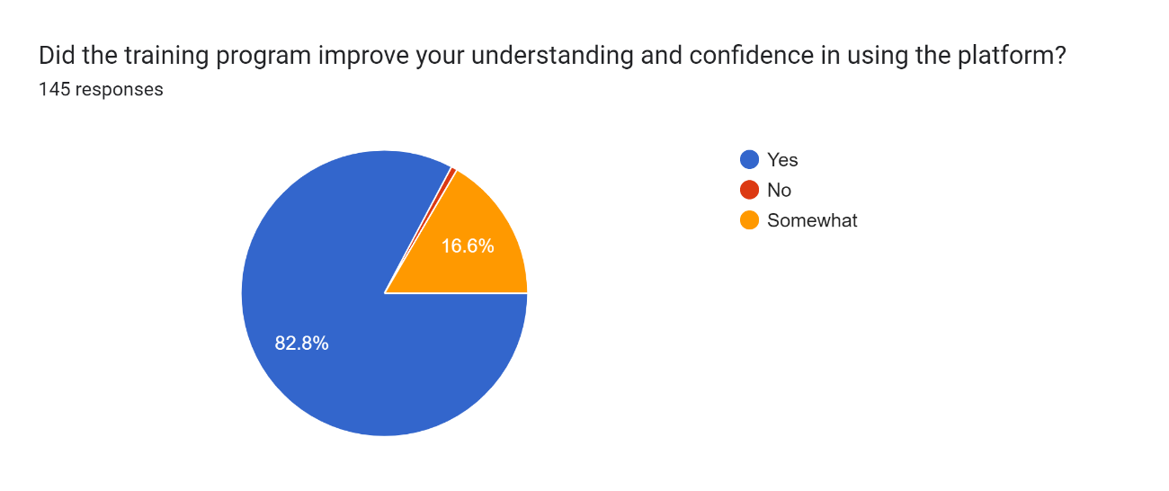
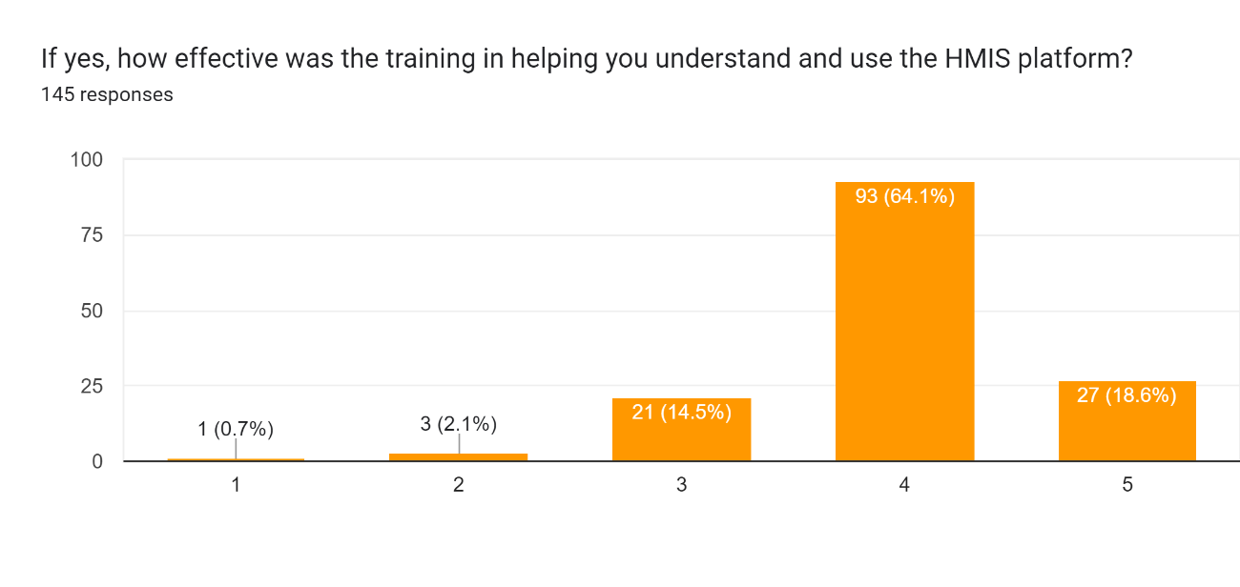
Result
The following data clearly depicts the following outcomes from the training point of view:
  The training that was given to the nursing officer in the hospital was adequate for them to understand and use the new system efficiently.
  The special attention that was given to the training bear fruit, and imparted confidence among the nursing staff for the new HIS system.

Slide 13
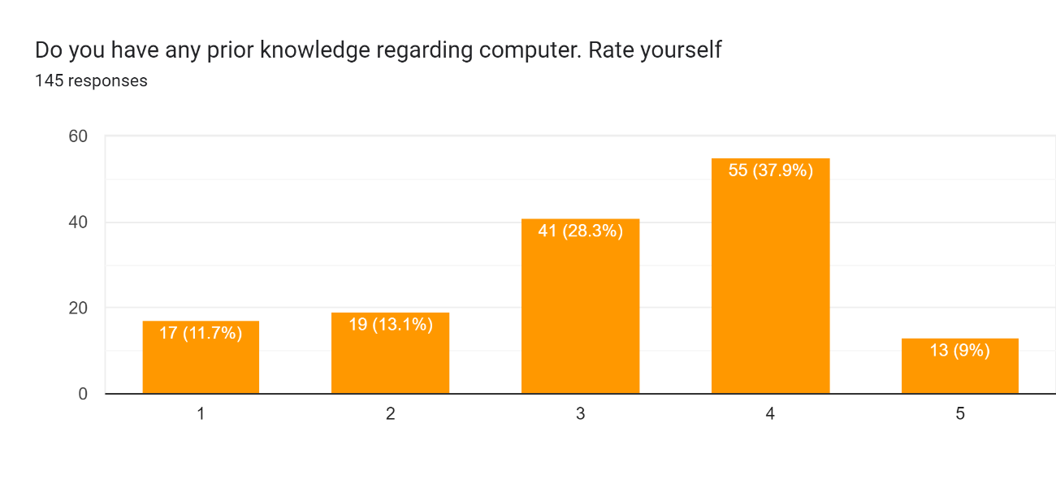
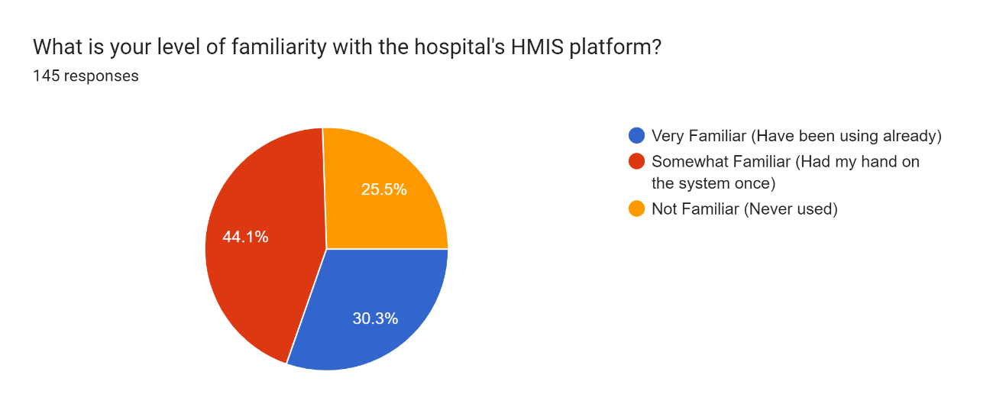
Result
The following data depicts the outcomes from the prior knowledge point of view:
  The prior knowledge regarding computer is quite adequate, like if 3 is considered the median mark then 109 respondents claim that they have a suitable computer knowledge. It helps with them understanding the new system well.
  Along with this, the hospital had a prior working system, which the nursing was using to order medicine and order consumables, so almost 75% claim that they have been using the earlier system, hence they have a familiarity with a HIS system. Again, helping them to understand the new one well.

Slide 14
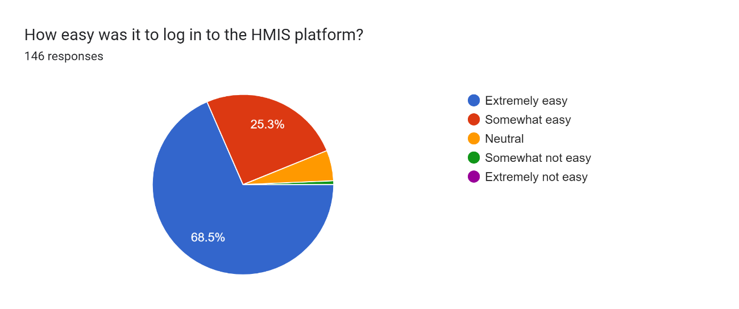
Result
The nursing staff was enquired after the post implementation phase, about the usability of the new MHEA system.
  Clearly through the outcome we can see than more than 65% found It extremely easy to use.
The features provided in the mhea system, and the number of clicks which have been reduced from the previous system clearly depicts in the outcomes.

Slide 15
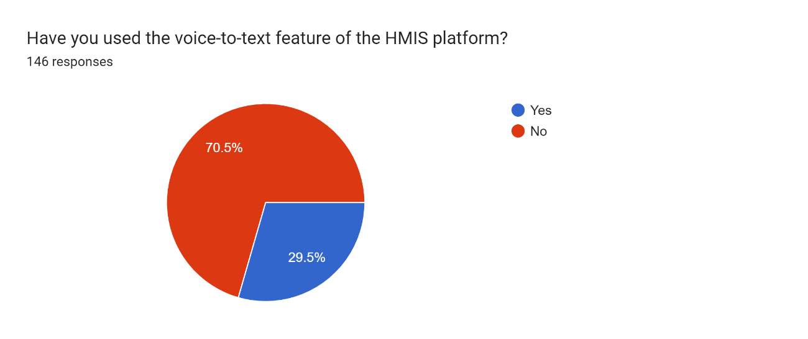
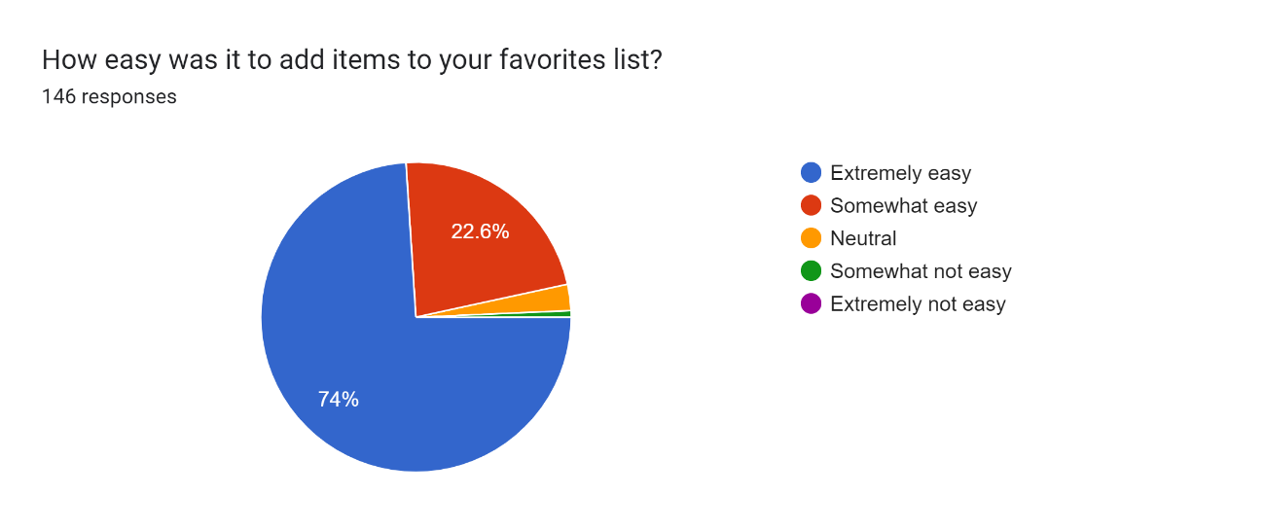
- Here is a very interesting outcome, 70% of the nursing staff did not find the Voice-to-text feature of MHEA system usable, as they were not able to use it.
After a thorough observation, it was clear that the infrastructure in the IPD and OT was incompatible for it.
- Whereas another feature which differentiates the MHEA system from others is the favorite feature,
From the outcome, its clear that the nursing staff found it very useful, while performing their activities.
Clearly the favorite feature reduced the number of clicks subsequently.
During the Training assessment, the nursing staff found that the voice to text and favorite feature are the ones that are very helpful for them, hence they were considered during the post implementation questionnaire.

Slide 16

Discussion
Most nursing staff in this research paper is of the age group 20-30 years, technically speaking they are just pass out, they ae quite tech savvy, even though during the UG period there was no proper curriculum for it, hence it was comfortable for them to adapt to this new system.
The staff was already made aware of the new deployment hence rather than coming as a shocker to the staff, it was an easy transition for them.
The team gave a good amount of attention towards the training of the nursing staff, and other HCPs, the front-end support was there for an ample amount of time, even after the implementation, this gave a confidence within the HCPs to check every aspect of the system.
  The training itself motivated the HCPs to be more interactive and rectify their queries.
  Hands on practical knowledge was imparted to the staff, even late night, sessions were provided to them, so that they all could be prepared for the D-day.

Slide 17

Discussion
While discussing this one must also note that the IT team of the hospital made sure that they also were in constant support with their staff, regarding any query.
The HCPs were provided with a dummy system, for them to investigate the various aspects of the system, so that can use it by themselves and assess their needs and requirements. If they find any lack of training, then they could be trained again.
Also, the management was also working pro actively to ensure that the HCPs get proper training. Several users were given more than 5 training sessions.

Slide 18

Conclusion
Our study concluded that the overall user acceptance for HIMS is good although there is a lot of scope for improvement.
The infrastructure did pose a challenge but, it was adequate for the system to function efficiently.
The factors that affected the acceptability were kept in mind and due attention was given upon them.
The HIS system is a boon to the working of a hospital, especially considering the clinical work process, the nursing staff which is the primary user of the HIS system from them also it is a boon.
Feature and reducing the number of clicks is mandatory when it comes to increase the acceptability and adaptability of the HIS system.
Training should be given due attention, because it becomes a backbone to any implementation. The MHEA team gave due attention to the training part, morning, evening and even late-night session were organized for the nursing staff.

Slide 19

Limitation of the study
This outcome cannot be condensed for the whole HIS system, this study only covered the clinical process and only the nursing staff, there are several other users for the clinical EMR part.
The study was conducted in very niche area and considering that it cannot be normalized for other study.

Slide 20
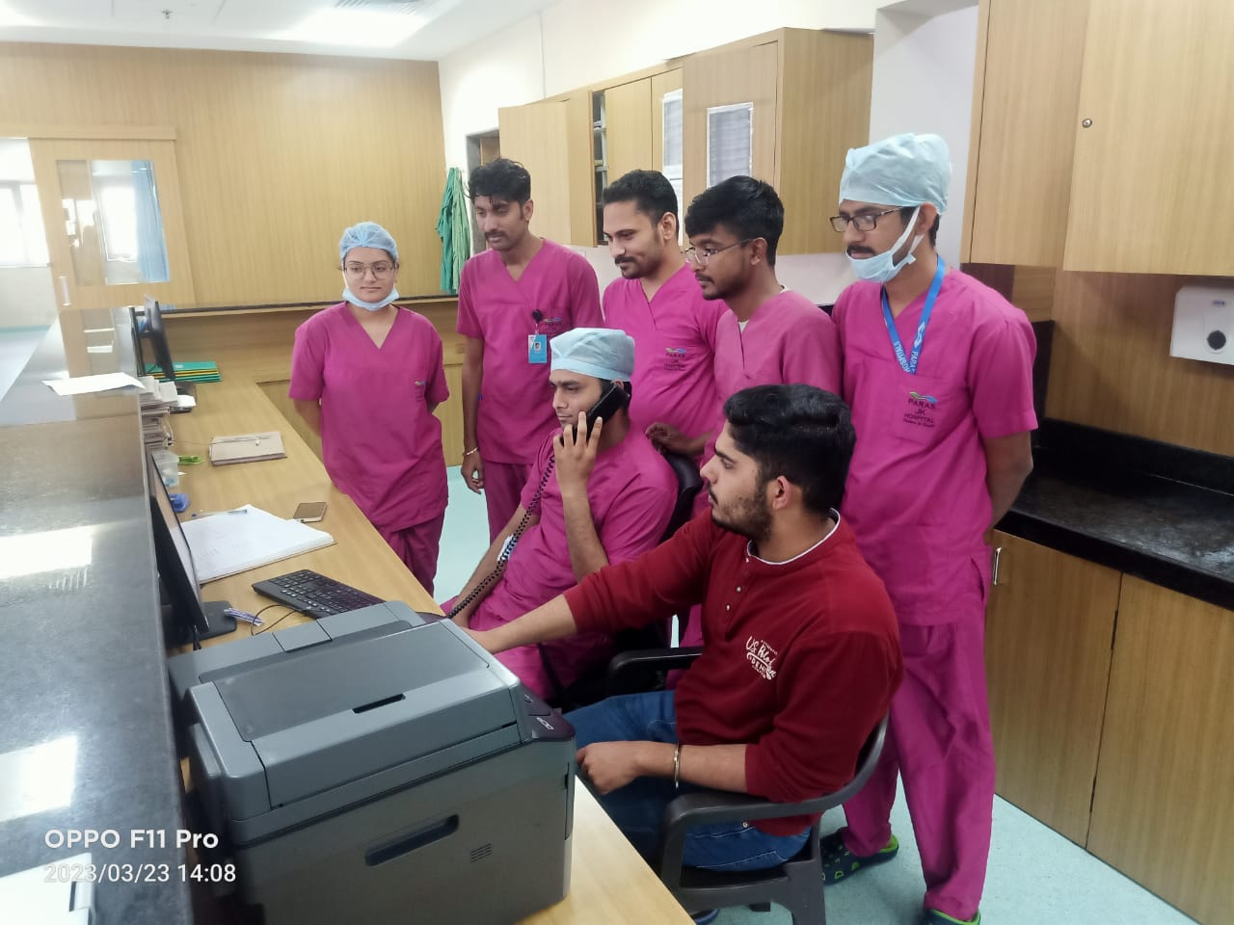

Pictorial journey

Slide 21

THANK YOU

