Slide 1


Medical Record Review Audit as a Method for Developing Safe Patient Care
Under the guidance of:
Dr. B.S Singh
Associate Professor,
IIHMR, New Delhi
By:
Anmol Sharma
PG/19/015
IIHMR, New Delhi

Slide 2
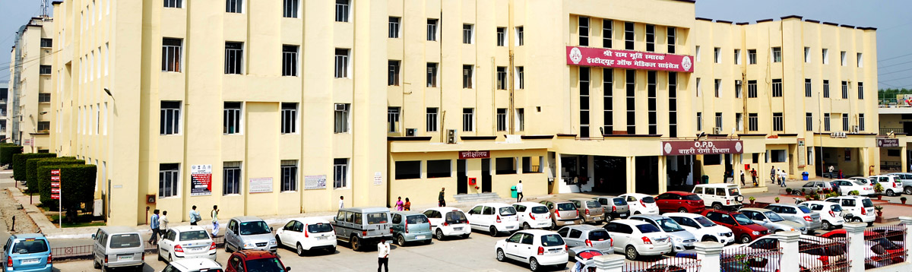

About Shri Ram Murti Smarak Institute of Medical Sciences Hospital
Shri Ram Murti Smarak Institute of Medical Sciences is a private medical college located near Bareilly, Uttar Pradesh, India. The college affiliated to M. J. P. Rohilkhand University, On July 4, 2002, Shri Ram Murti Smarak Institute of Medical Sciences opened its most modern 950-bed, centrally air-conditioned, Multi-Super Specialty, Tertiary Care, and Trauma Hospital. The hospital contains 600 teaching beds where students seeking their MBBS taught and trained. The care of patients on these beds is provided at no cost to them. The hospital is well-equipped to deliver high-quality education and training to students in a variety of departments. Students are exposed to a range of patients during their clinical training to help them become proficient in the area of medicine.

Slide 3


Introduction
Quality assurance: The department aims to improve the quality of care and patient safety in Hospital. It formulates policies and procedures to ensure the safety of patients and the quality of care.
What is case file?
Medical reports that detail a patient's medical condition, clinical observations, laboratory test results, pre- and postoperative care, progress, and medication are referred to as case files. If taken correctly, notes will aid the doctor in deciding whether or not the treatment is appropriate.
What is Case file audit?
In simplest terms, case or medical file audit is a record analysis that identifies what is being performed properly and what needs to be improved. Medical report audits may be conducted by an impartial body or by employees of an organisation, depending on the goal.

Slide 4


AIM &OBJECTIVE
Objective:
To do Medical Record file audit of inpatient medical record to improve quality of care in hospital
To find out the practices of documentation of patient records among the medical staff of hospital.
To compare the difference between the compliance of in-patient records and the standard compliance set by the hospital
Finally to look overall performance of the SRMS IMS for medical record documentation.
AIM :
The audit is to ensure that all clinical records are maintained to the highest standard as well as providing a benchmark to continually improve the quality and accuracy of clinical records.

Slide 5


METHODOLOGY
Study Type: Descriptive study conducted to understand the activities and identify the problems.
Location of Study: Shri Ram Murti Smarak Institute of Medical Sciences Hospital
Duration of Study: Two months (5-04-2021 to 4-06-2021).
Sample Size: The data collected was secondary and the source was the discharge cases file available in the medical record Department. Sampling technique use is convenient sampling. The technique used was reviewing of files and observing the medical records of the patient. A structured checklist (audit tool) is used to keep as the quality indicators. Sample size was 400 case files.
Inclusion Criteria: IPD Department selected namely: Ophthalmology, Surgery, Gynaecology, ICU, General Medicine, Radiation Oncology, Paediatric, patient medical record files, discharge files.
Exclusion Criteria: Emergency and active files excluded from the study due to covid-19.

Slide 6
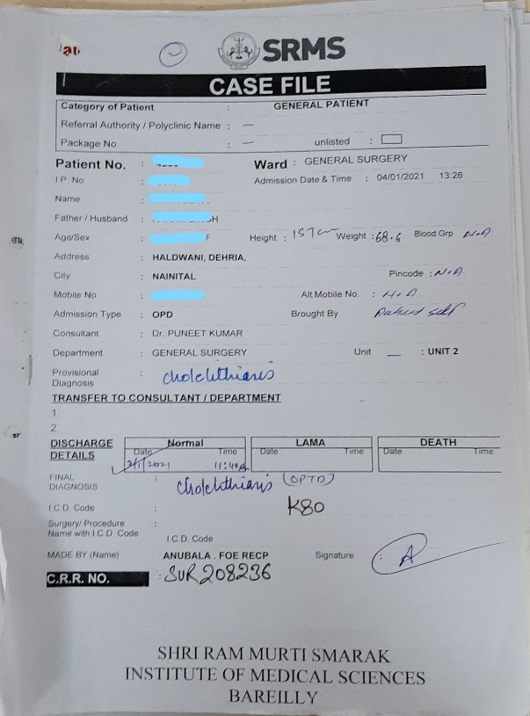
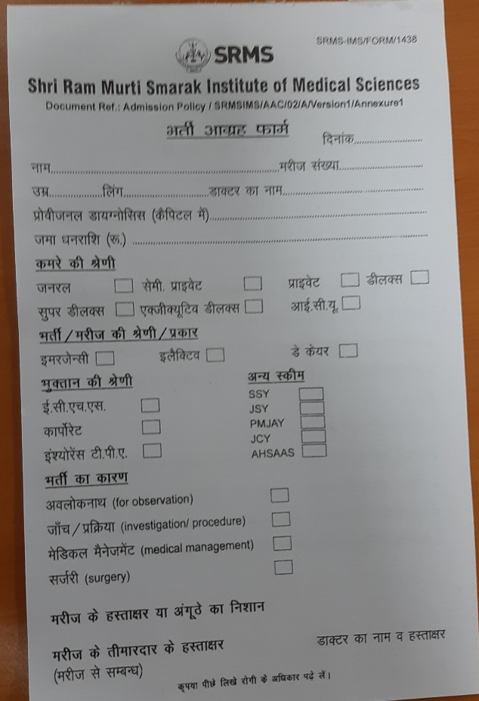
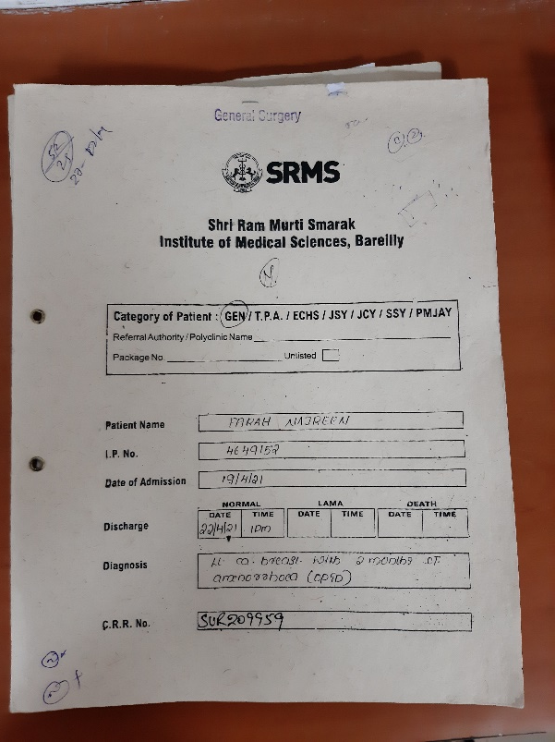
Key Parameters selected from Checklist
Cont.
Face sheet, Admission advice form, OPD prescription vitals information, OPD prescription Drug allergy, OPD Prescription medication in capital letter, IPD prescription Treatment/progress record, IPD prescription Medication chart of nurse in Capital letter, Nursing assessment form, Staff hand over record, Overall prescription in capital, Plan of care properly written, MRD IPD file checklist.
Case file
Face sheet
Admission advice form

Slide 7
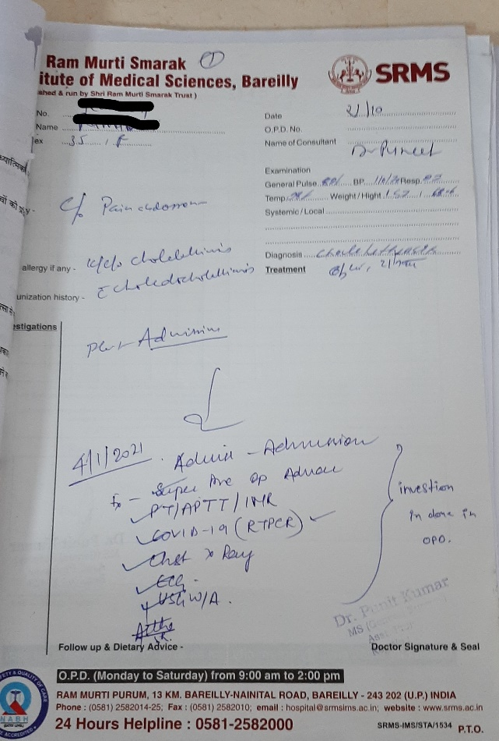
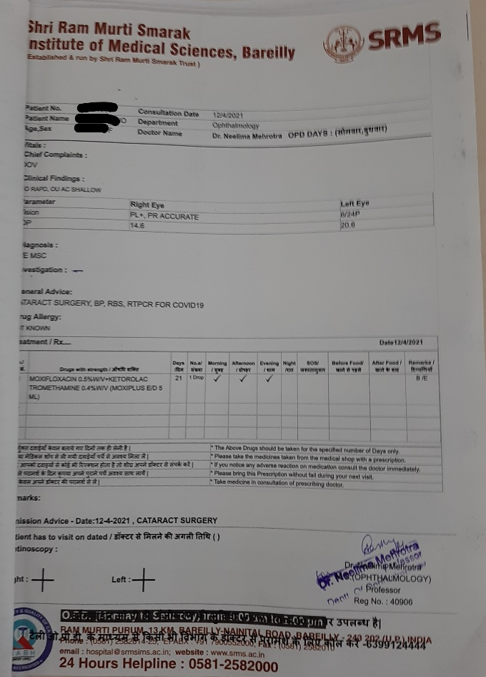
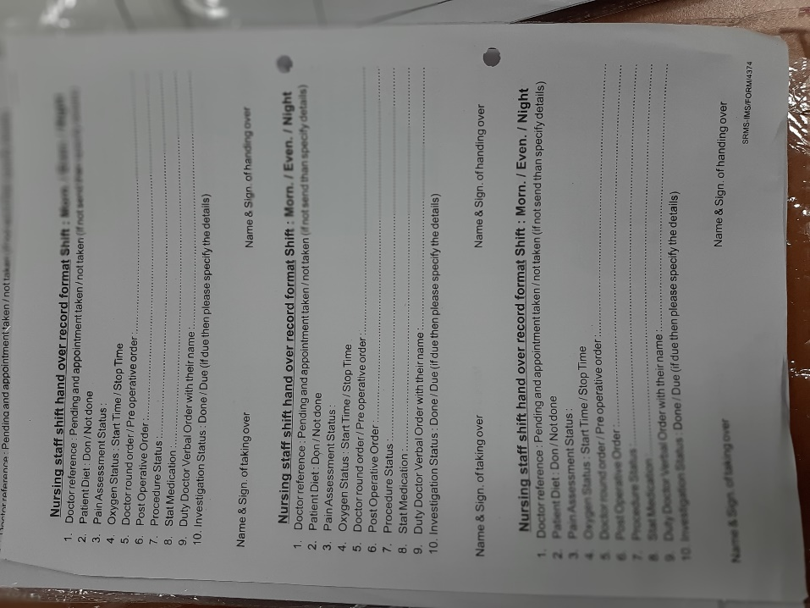
Cont.
OPD manuscript prescription
OPD computerized prescription
Staff hand over record

Slide 8
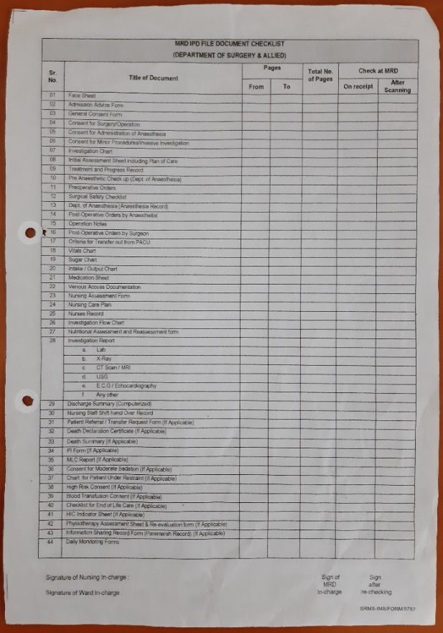
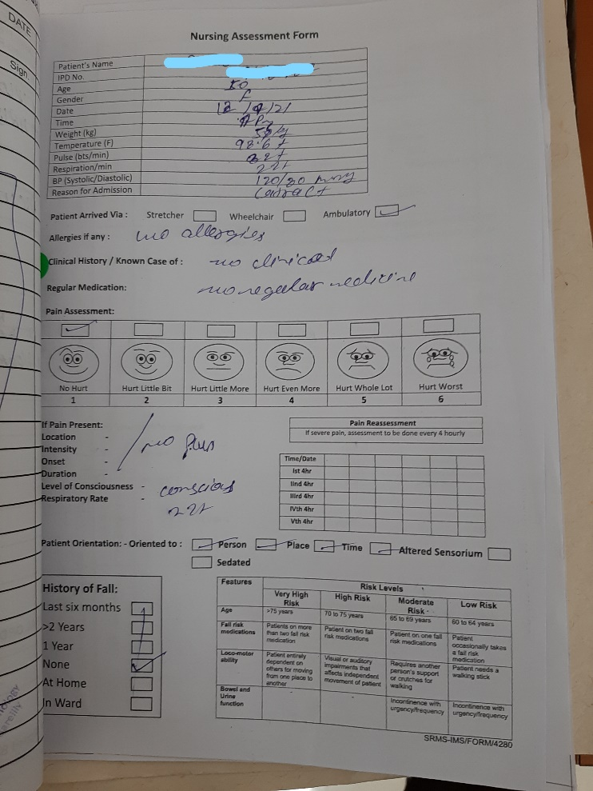
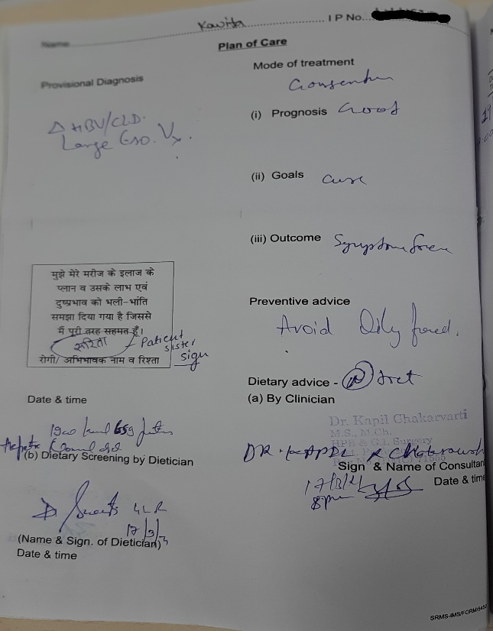
Cont.
MRD IPD file checklist
Nursing assessment form
Plan of care properly written

Slide 9
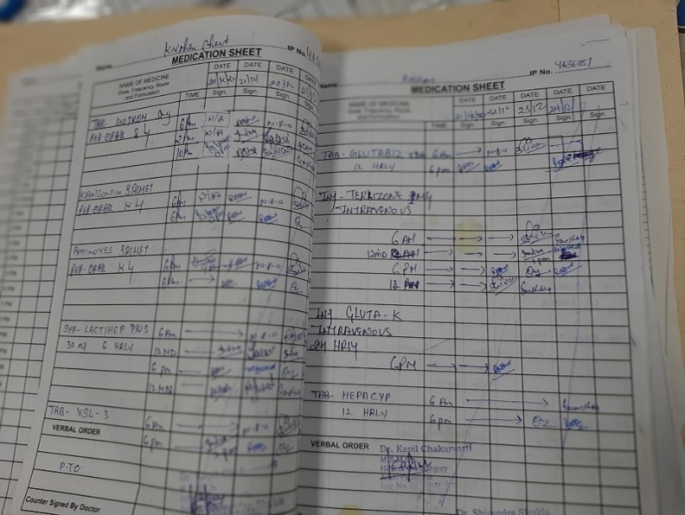
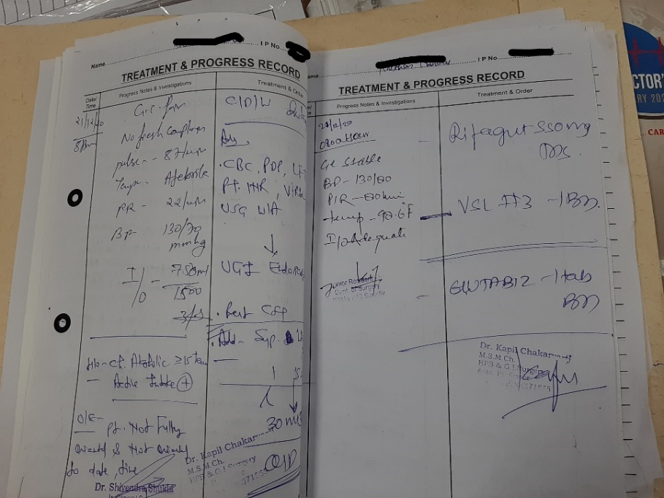
Cont.
Medication sheet
Treatment and progress record

Slide 10
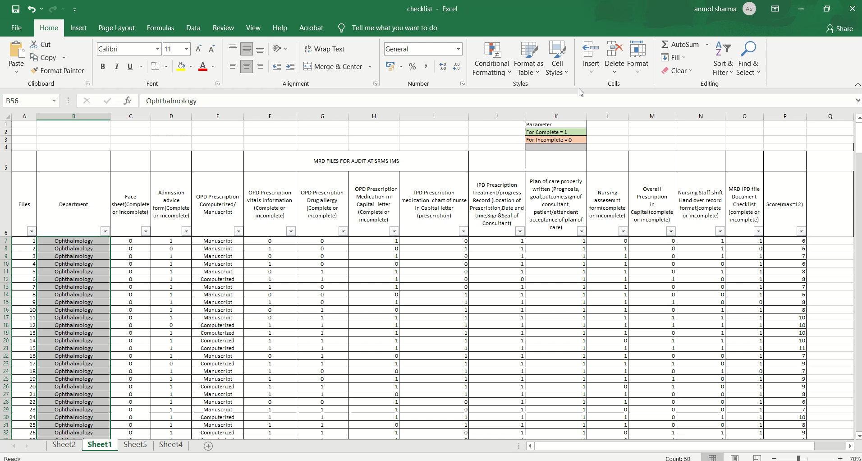
Cont.
Notes:
The video above shows how the results were calculated after the audit, twelve parameters have been calculated from the audit sheet; for each parameter a score is shown which is one for complete and zero for incomplete; the maximum value of a single file can be calculated as 12, the last column in the sheet written as score which shows the final mark of a single file.

Slide 11
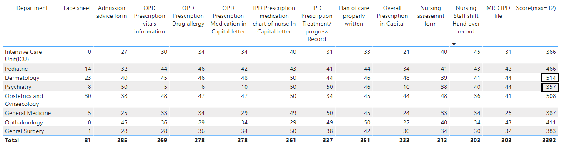

Results
Table shows Final Results from the checklist
For score Max=600(12*50)
Max for selected parameters =400(8*50)
Max= 4,800(600*8)
• Results are compared and drawn with the aid of Power BI.

Slide 12

Cont.
• According to the audit, the Dermatology Department received the highest score of 514 points out of 600, indicating that 85.66 percent of files were completed.
• The Obstetrics and Gynaecology department came in second place with a score of 508 out of 600, or 84.66 percent completion of files.
• The third place finisher was Paediatric, with 466 points out of 600, or 77.66 percent completion of files.
• In addition, the Ophthalmology Department received 411 points out of 600, indicating that 68.5 percent of the files were completed.
• General Medicine came in second with 387 points out of 600, or 64.5 percent completion of files.
• General Surgery came in second with 383 points out of a possible 600. That equates to 63.83 percent of the files being completed.
• The Intensive Care Unit (ICU), which received 366 points out of a possible 600, is in second place. That equates to 61 percent of the files being completed.
• The psychiatry department received the lowest score, 357 points out of 600. That is 59.5 percent of the files completed.

Slide 13
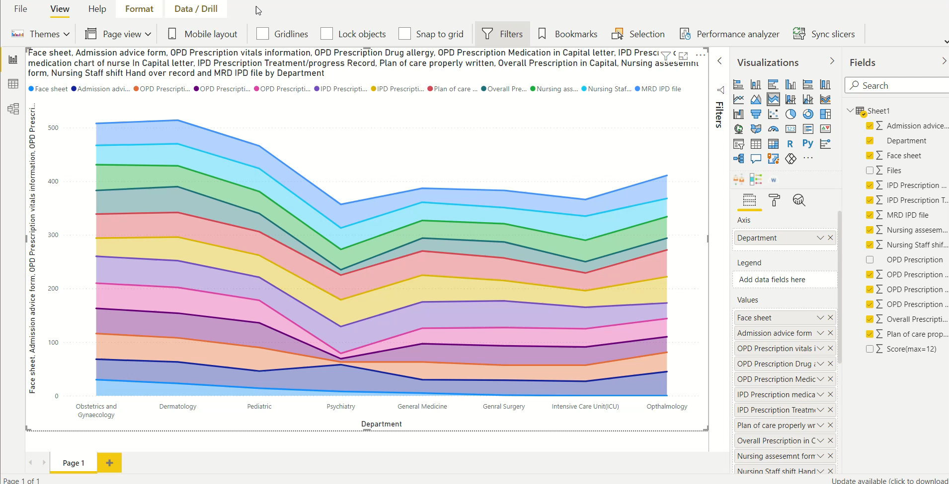
Cont.
Video Shows performance of all Departments during the Audit

Slide 14
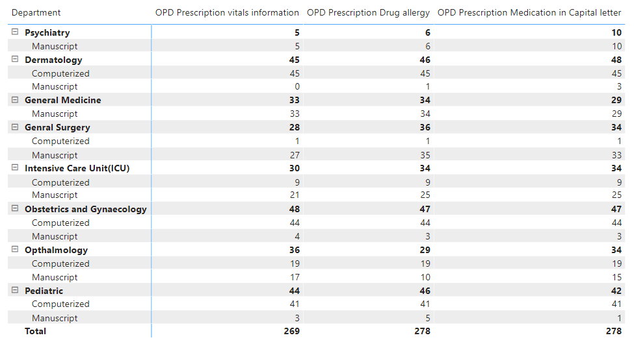
Cont.
Table shows OPD prescription Manuscript vs Computerized with three parameters selected from the audit.

Slide 15
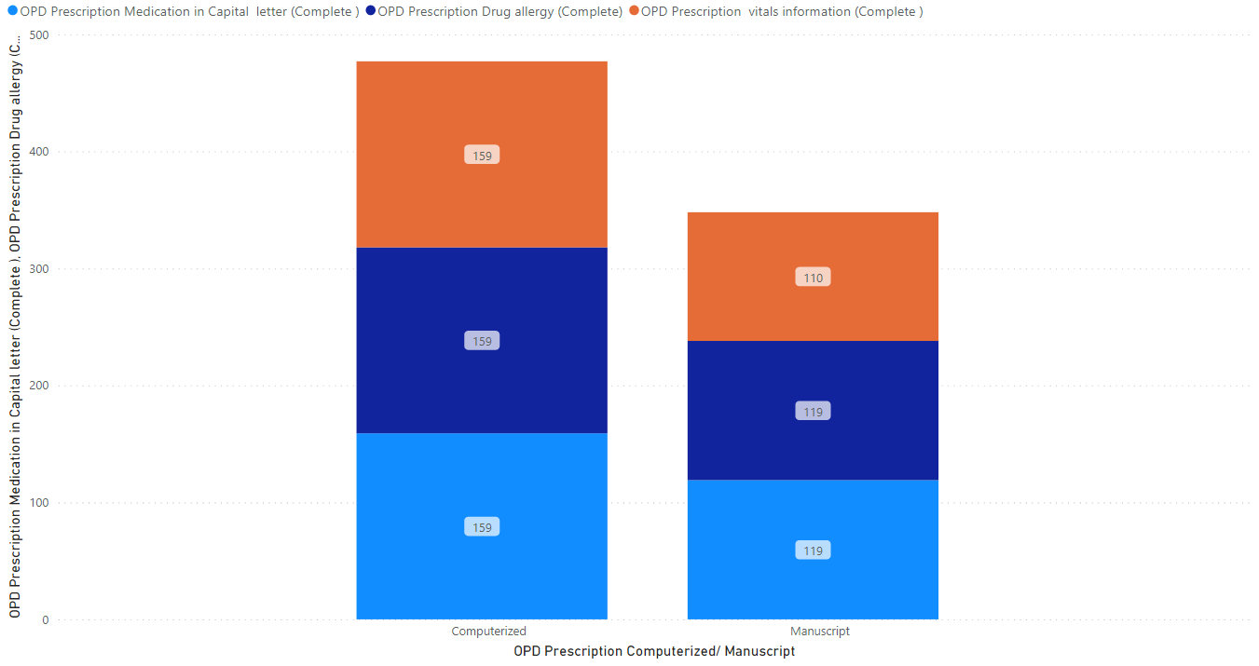
Cont.
Graph shows the difference in number of completions score for manuscript vs computerized OPD prescription.

Slide 16
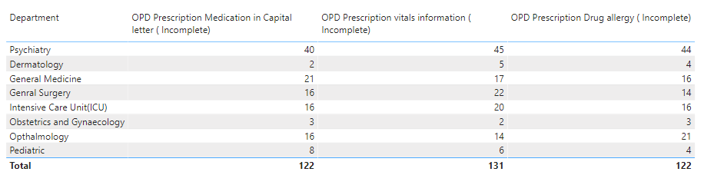
Cont.
Table shows the Number of incompletions for OPD Manuscript Prescription for three parameters taken during audit.
It has been discovered that all OPD prescriptions written with a computer are found to be 100 percent complete when compared to those written with a manuscript.
And also Obstetrics and Gynaecology, Dermatology, and Paediatrics performed better than the other departments, this is because these departments have more computerised prescriptions than the other departments.

Slide 17

overall performance of hospital
Serial No | Parameter | Total | Maximum score | Completion percentage
1 | Face sheet | 81 | 400 | 20.25%
2 | Admission advice form | 285 | 400 | 71.25%
3 | OPD prescription vitals information | 269 | 400 | 67.25%
4 | OPD prescription Drug allergy | 278 | 400 | 69.5%
5 | OPD Prescription medication in capital letter | 278 | 400 | 69.5%
6 | IPD prescription Medication chart of nurse in Capital letter | 361 | 400 | 90.25%
7 | IPD prescription Treatment/progress record | 337 | 400 | 84.25%
8 | Plan of care properly written | 351 | 400 | 87.75%
9 | Overall prescription in capital | 233 | 400 | 58.25%
10 | Nursing assessment form | 313 | 400 | 78.25%
11 | Staff hand over record | 303 | 400 | 75.25%
12 | MRD IPD file | 303 | 400 | 75.25%
13 | Max score | 3392 | 4800 | 70.66%
The table depicts the overall performance of the SRMS IMS hospital, it was noted how well the hospital performed during the documentation audit and on other factors. Only the face sheet parameter was determined to be less than 25%, whilst the other parameters had a record of over 50%, which is better.

Slide 18


RECOMMENDATION
1. Using digital OPD Prescription instead of Manuscript Prescription can assist to reduce errors that occur while noting down the medication allergy, obtaining vitals, and writing out the prescription in Capital.
2. Complete the face sheet more, among the criteria chosen, it was discovered that the face sheet of the files was missing, and the face sheet parameter was the least completed, 81 out of 400, that is 20.25 percent only.
3.Intensive Care Unit (ICU) should focus on finishing the face sheet and utilize computerized prescription over the manuscript.
4. All other parameters had a better record than the face sheet, hence the pediatric department should focus on completing the face sheet.
5.Face sheets should be maintained more in ophthalmology and general surgery departments.
6. In psychiatry, computerized prescriptions are strongly recommended over traditional manuscript prescriptions because most of the parameters associated with computerized prescriptions, such as OPD prescription vitals information, drug allergies, and medication in capital letters, all have low completion rates because they have manuscript prescriptions. Other metrics showed that psychiatry did well, but it received a lower grade owing to all manuscript prescription.

Slide 19

REFERENCES
https://pubmed.ncbi.nlm.nih.gov/32110629/
https://www.jfmpc.com/article.asp?issn=2249-4863;year=2020;volume=9;issue=1;spage=418;epage=423;aulast=Verma
https://escientificpublishers.com/improving-the-quality-of-clinical-records-audit-and-literature-review-JGPC-02-0017
https://pubmed.ncbi.nlm.nih.gov/31650062/
https://www.researchgate.net/publication/330039863_SIGNIFICANCE_AND_CHALLENGES_OF_MEDICAL_RECORDS_A_SYSTEMATIC_LITERATURE_REVIEW
https://www.researchgate.net/publication/326894296_Analysis_of_Health_Record_Documentation_Process_as_Per_the_National_Standards_of_Accreditation_with_Special_Emphasis_on_Tertiary_Care_Hospital
https://www.researchgate.net/publication/323731942_Medical_Audit_of_Documentation_of_Inpatient_Medical_Record_in_a_Multispecialty_Hospital_in_India
https://www.researchgate.net/publication/323475750_Change_in_completeness_of_medical_records_after_NABH_process_in_a_teaching_hospital
https://pubmed.ncbi.nlm.nih.gov/25374819/
https://www.iomcworld.org/articles/good-medical-record-keeping.pdf
https://pubmed.ncbi.nlm.nih.gov/22942587/
https://www.indianjurol.com/article.asp?issn=0970-1591;year=2009;volume=25;issue=3;spage=384;epage=388;aulast=Thomas
http://www.rfppl.co.in/subscription/upload_pdf/Art%201_a28.pdf
https://www.srms.ac.in/ims/
https://powerbi.microsoft.com/en-us/
https://thcmi.com/PDF/providers/PDF/QUALITY_ASSURANCE_PROGRAM.pdf
https://www.nabh.co/images/Standards/NABH%205%20STD%20April%202020.pdf
https://giphy.com/

Slide 20

How Dissertation Work Meet Program Outcomes:
Internalize the concepts of management such as healthcare delivery system, strategic planning, HR, marketing, finance and operations- 2(Moderate)
Apply knowledge of research and management techniques and functions in an integrated manner in healthcare set up- 3(Substantial)
Use of appropriate skills to support healthcare organizations to take informed decision in planning, building and managing healthcare organizations- 3(Substantial )
Utilize learning acquired from trainings and practical exposures in real time situations- 3(Substantial)

Slide 21

Thank You

