Slide 1
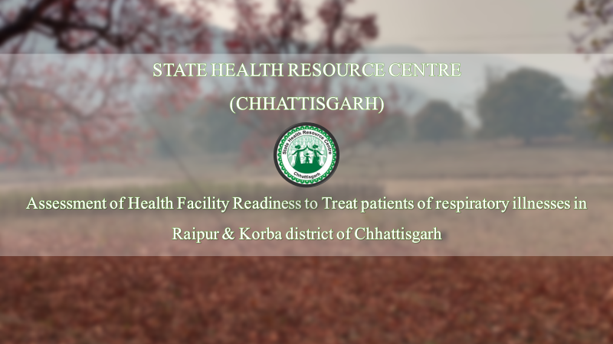
Guided By
Dr Pankaj Talreja
Miss Punita Kumar

Slide 2
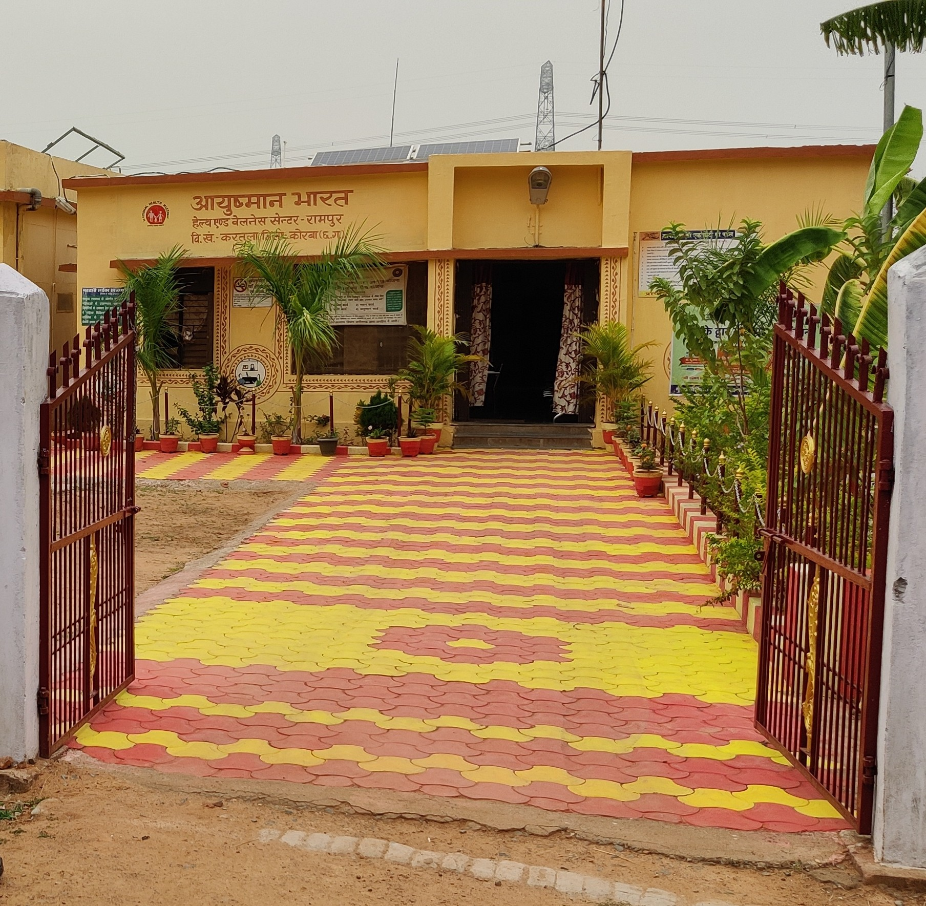
Background
Global situation analysis
There are 3.2 million deaths due to COPD and 495,000 deaths due to asthma. Overall, prevalent cases of CRDs were 545 million about 50% for COPD and 50% for asthma incident.
- According to global burden of disease study
Situation analysis of India
COPD and asthma were responsible for 75% and 20% of the chronic respiratory disease DALYs, Respectively I India in 2016
- According to Lancet study
Situation analysis of Korba and Raipur
Korba was ranked fifth in the 'critically polluted environment' category among 88 industrial clusters in a 2009 study conducted by the Central Pollution Control Board (CPCB).
According to the World Health Organization (WHO), 37 Indian cities are among the top 100 cities in the world with the worst PM10 and 2.5 pollution, with Delhi, Raipur, Gwalior, and Lucknow among the top ten

Slide 3
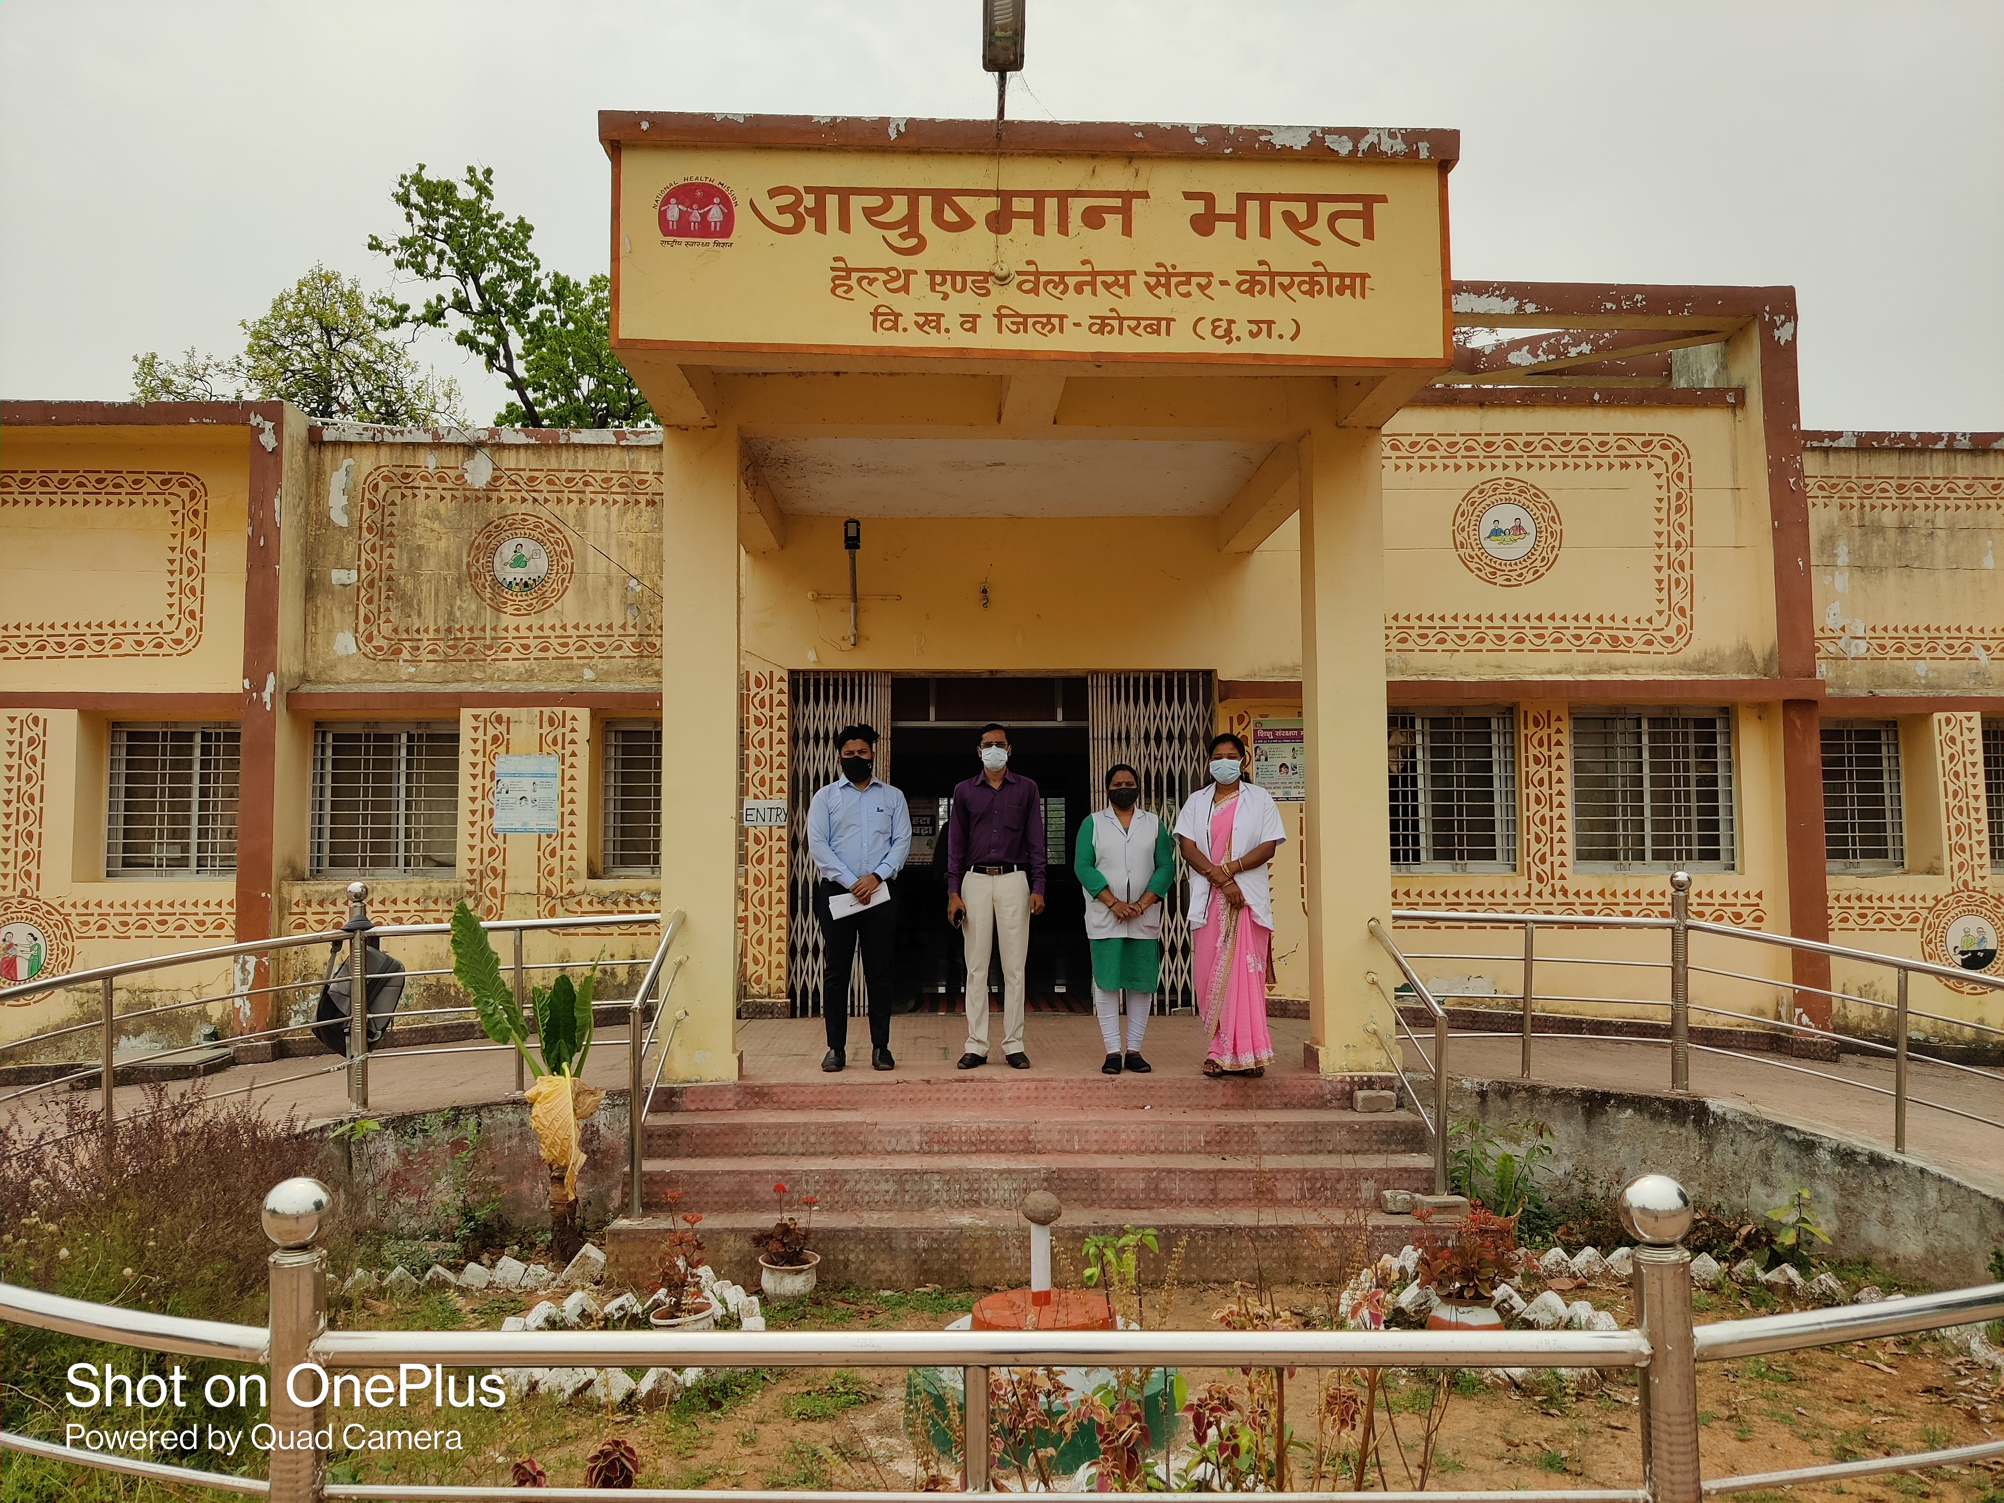

State Health Resource Centre,
First Floor, Health Training Centre Building, Bijli Chowk, Kalibadi, Raipur 492001, Chhattisgarh
Vision Statement
To facilitate attainment of ‘Peoples health in Peoples hands’
Mission Statement
To empower communities, specially women, to
exercise their right to health and health care
To facilitate effective health sector
strengthening with focus on community processes,
decentralization and quality of care
To facilitate networking of state and civil society
organizations and inter-sectoral convergence
The assessment is permitted by State Health Resource Centre, Chhattisgarh
State Health Resource Centre, Raipur under Ministry of Health and Family Welfare of Chhattisgarh.
SHRC work as a collaboration between Government and civil society in order to provide necessary technical support to the health department for designing and implementing health sector reforms in the state including community-based health programme.

Slide 4
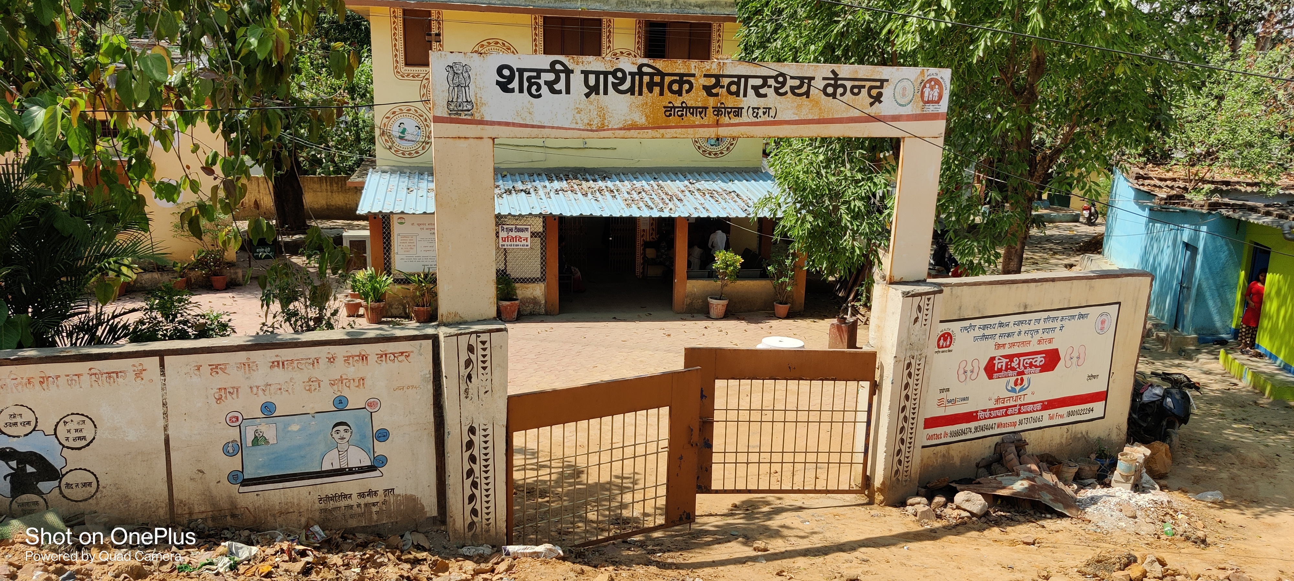
To Assess the Public health facility readiness to treat patients of respiratory emergencies in Raipur and Korba district of Chhattisgarh
AIM–
OBJECTIVES –
To assess the availability of Drugs, Equipment's and Diagnostic facility to handle respiratory emergencies.
To assess the availability of human resources in association with respiratory health.
To assess community awareness program or training of the staff and community on Respiratory Illnesses

Slide 5
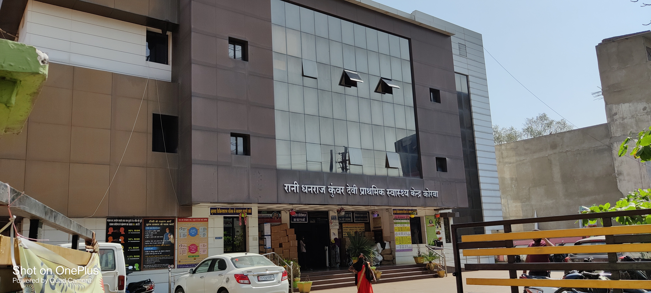
MATERIALS & METHODOLOGY -
Place of study – Korba, and Raipur (Chhattisgarh)
Duration of study- 3 months (March to June)
Study design – Cross-sectional study
Data collection –
Primary data – from PHCs, CHCs, District Hospitals and Medical college
Total = 56 Public Health Facility.
Secondary data – from Research paper, Govt Reports and Books.
The material used – Kobo collect an Android-based Mobile Application tool to collect Answers with a GPS location tracker from the respondents.

Slide 6
Checklist for assessment at Public Health Centre
DRUGS | HUMAN RESOURCE | EQUIPMENTS | DIAGNOSTIC FACILITY
Salbutamol inhaler | MBBS doctor | Oxygen cylinder | Blood Test
Beclomethasone inhaler | ECG technician | Ventilators | X-ray chest
Hydrocortisone injection | Radiographer (X-ray tech) | Nebulizers | ECG
Epinephrine injectable | Lab technician | Spirometers | ECHO
Rota haler / Rota caps | Doctor who is able to do PFT | Spacer | PFT MACHINE
AR blockers | MD doctor | Pulse oximeter | SPUTUM TEST
ACE inhibitor / Calcium channel blocker |  | IEC MATERIAL
Diuretic's / Aspirin |  | Tracheostomy kit

Slide 9
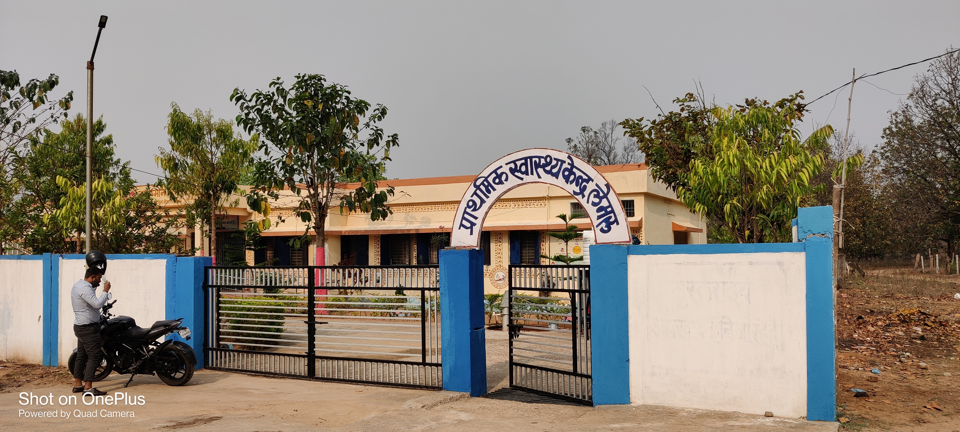
Findings–
There is a shortage of Human resource at PHCs and CHCs
There is also a shortage of Respiratory and cardiovascular emergency medications in PHCs only.
Diagnostics facility is also not properly available at PHCs and CHCs
Spacers, spirometer, and IEC material, in particular, are in short supply.
There is a need for health workers to be trained in how to deal with respiratory emergencies.
There is need of community awareness activities related to air pollution.

Slide 10
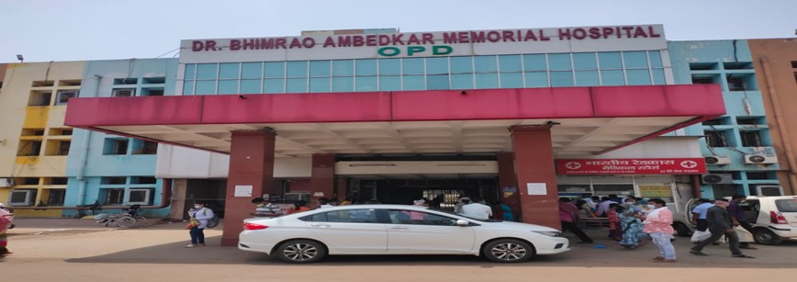
Recommendations.
Manual PFT should be made available at the PHC and Digital spirometer at CHCs and District hospitals for early screening of illnesses.
IEC materials should be distributed to all the Public health facilities.
Trainings related to air pollution should be given to Healthcare staff for the early diagnosis of respiratory diseases.
There should be regular screening of respiratory illnesses.

Slide 11
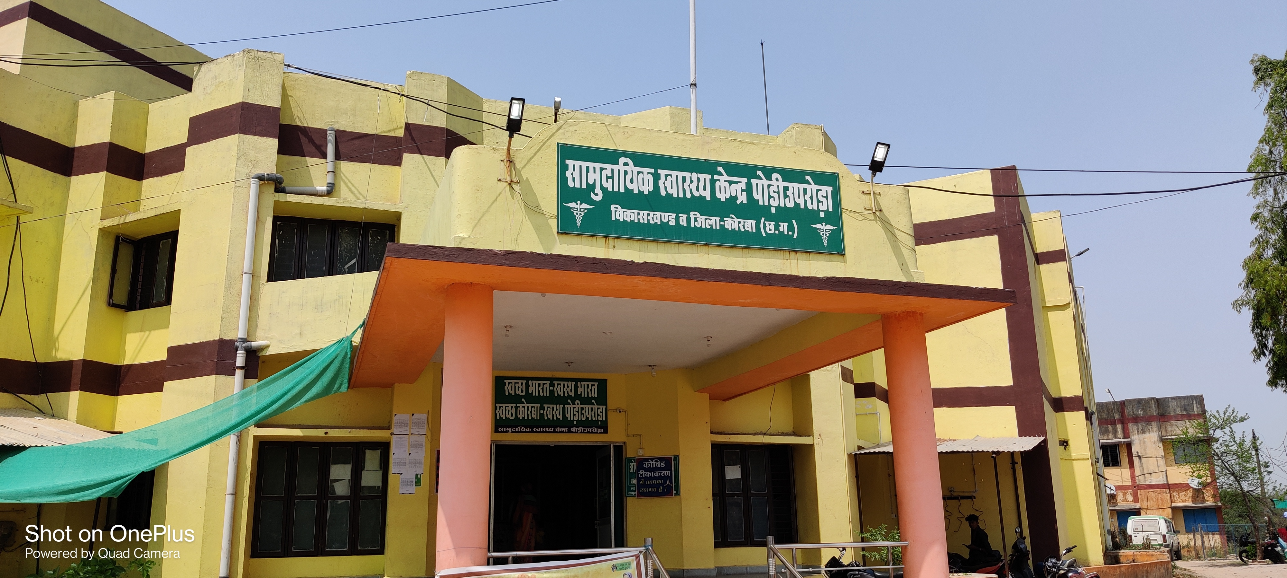
2Program Outcomes (rate how your course addresses the POs by giving a score of 1,2,3- 1: Slight (Low) 2: Moderate (Medium) 3: Substantial (High)
1. Internalize the concepts of management such as healthcare delivery system, strategic planning, HR, marketing, finance and operations | 2. Apply knowledge of research and management techniques and functions in an integrated manner in healthcare set up | 3. Use appropriate skills to support healthcare organizations to take informed decision in planning, building and managing healthcare organizations | 4. Utilize learning acquired from trainings and practical exposures in real time situations.
3 | 2 | 3 | 3

Slide 12
