Slide 1


Assessment of Denial management: Thumbay University Hospital , United Arab Emirates
Report By:- Dr Divakar
Mentor:- Dr Anuradha Bhardwaj
IIHMR DELHI

Slide 2
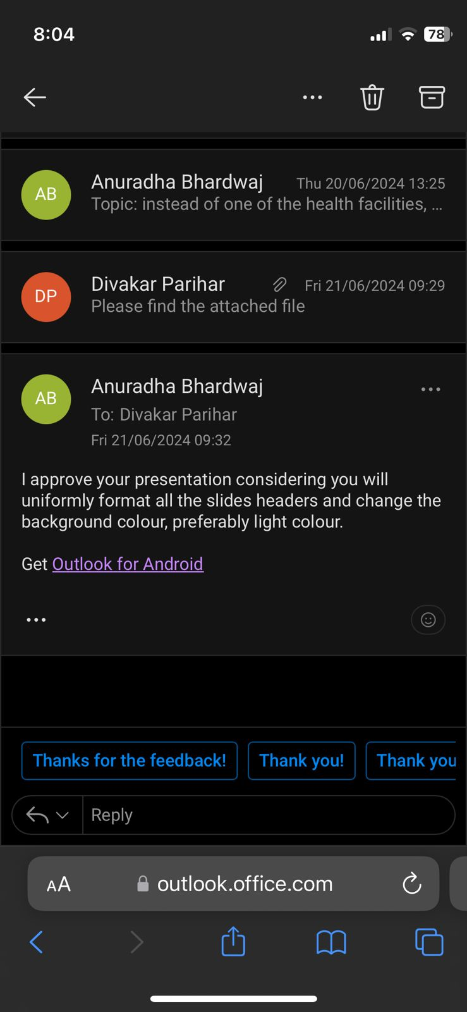
MENTOR APPROVAL

Slide 3

INTRODUCTION
Healthcare Reforms in
United Arab Emirates
Expenditure on healthcare can reach to a catastrophic state which may pose a serious challenge in minimizing the out of pocket expense on individuals (1). With the market value of $10.51 billion in 2024 and with the various reforms in healthcare sector UAE is expecting the growth of $18.83 billion in year 2029 resulting in more reformed healthcare delivery system in the entire nation. The federal structure of UAE allows the emirates to have their own programs along with the national level. Covid-19 has contributed to a potential way in awareness people about the importance of health insurance(2). In an attempt to achieve the target of reducing the economic burden due to heavy investment in the health sector by the individual UAE in all its emirates have strengthen the reforms in accessible and affordable healthcare system through an integrated public-private partnership(3).
With the union of the seven emirates that formed UAE in 1971 the various reforms in healthcare has allowed the private insurance to boom the health sector throughout the emirates(4).

Slide 4
Provider Model and Revenue Cycle Management
Revenue cycle management is the system that is implemented in the health facility to track the revenue status against the service provided to the patient. It is a complex system that starts with the patient appointment to the eligibility if the patient falls under the covered benefits, receiving the care, discharge transfer and final payment. It is the integral part of the provider model of healthcare that accumulate the data at various stages about the revenue that has be to be generated against the health service rendered by the provider or facility. With the introduction of the coding system (ICD-10) the cycle has become more efficient and productive(5).
The lifecycle of a RCM are as follows: -
Registration of the patient that deals to register patient to the facility and collecting the information about the insurance
Pre-authorization refers to the approval by the payer towards certain services
Coding refers to the assignment of special alphanumeric character against the disease and procedures rendered to the patients
Chargeables means that all the bills will be finally captured against the services codes
Submission means that the coded services are sent in a documented for called clims to the payer in electronic or paper format
Account receivable Management (AR) these referred to as the process of managing the payment and taking follow-ups on the outstanding balance from the payers and patients
Denial Management: involves the management of the denied claims due to error like duplication, non-approvals or coding issues that are manages(6).

Slide 5



Thumbay Healthcare Group
Thumbay group with chain of three tertiary care health facilities along with 6 operational clinics, 1 day care centre ,1 Dental Hospital and 1 Physiotherapy and rehabilitative hospital spread across all the seven emirates catering the workforce from 20 nationalities rendering the healthcare and medical education(7).

Slide 6
Objectives
Primary Objective:
The assessment of the denials of health claims rendered against the health services provided to all the facilities for the active payers empanelled with the Organization.
Secondary Objective:
Assessment of the frequency of the type of denial codes for the health claims rendered against the services in the most rejected payer.
Categorization of the types denials that are OP or IP rejected against the health claims for the most rejected payer.

Slide 7
Methodology
Study Design
A retrospective Cross-sectional study conducted to assess the denials of all the active empanelled payers, the frequency of various denial codes and type of rejection of claims and pathway of claim errors.
Study Population
The total patient population of 3 months for 2024 was evaluated, these are the services provided against the monitory coverage rendered by the insurance Payer for its specific beneficiary.
There no sampling rather total enumerations data is captured for all the insured patient of year 2024.
Site
The study will be done at the Head Office of RCM for Thumbay Group located Thumbay University Hospital Complex at Jurf, Ajman, UAE that caters the central team of RCM which manages the Denials of across all the facilities of Thumbay group.

Slide 8
Duration of the study
The initial review of literature was started in has already started the study took place from 15 th May to 15 th June
Inclusion Criteria
All the active payers are included in the study that are empanelled.
Rejection from all the tertiary care, clinics and daycare centre.
Only three month data is included in the study.
Data of the health Insured patients are included.
Exclusion Criteria
Travel health insurance and medical tourism patient are excluded from the study

Slide 9
Data Collection Method
Secondary system generated data be collected through the HIMS of facility in the form of rejection report in an encrypted excel. Direct observation, record review and interview will be taken from the executives at all level for the data triangulation and understanding the barriers and enablers for a smooth claim processing.
The data will be collected in English language.
Data Collection Tool
The data collected will be in the form of excel tool named rejection report which will have various indicators that are: -

Slide 10
Statistical analysis
The IBN SPSS version 2.2.2 and MS-Excel 2019 were used to analyse the data. The variables used described using the frequencies, proportions, mean, Standard deviation and range.
EXPECTED OUTCOME
The RCM plays a very Important role in the revenue generation in the tertiary care facility, in a long run the providers tends to generate more revenue often miss out the important STGs which may result in losses, understanding the details of rejection and denials will aid in the development of a strong STG that has to be followed while attending the patient so it wont hamper the profit and may result in the patient satisfaction and reduce the TAT of the insurance. The detailed study will also help us to know the area of focus which needs to be improved at any stage of revenue cycle. The study will give all the stakeholders a holistic approach to work in their field for the improvement so there is less rejection.

Slide 11
RESULTS

Slide 12
Identification of denials against the active payers

Slide 13
Insurance Company | Denial Count
DAMAN INSURANCE COMPANY | 5262
ALMADALLAH INSURANCE | 4811
NAS INSURANCE | 8682
NEXTCARE INSURANCE | 5621
ADNIC INSURANCE | 1531
MEDNET INSURANCE | 2070
ALICO INSURANCE | 601
AAFIYA Medical Billing | 925
HEALTHNET BASIC NETWORK | 963
NEURON INSURANCE - ENAYA | 1153
AXA INSURANCE | 549
FMC GN Network | 444
INAYAH TPA (LLC) | 228
LIFE LINE INSURANCE | 1
The given data outlines the distribution of insurance claims among various insurance companies, with a total of 37,591 recorded instances. The largest share of claims is attributed to DAMAN INSURANCE COMPANY, which covers 12.8% of the total. Close behind is SUKOON (OMAN) INSURANCE with 12.6%. Other significant contributors include NAS with 11.6% and ALMADALLAH at 11.8%. Smaller portions are held by companies such as ADNIC Insurance (3.1%), MEDNET (3.8%), and NEXTCARE (2.6%). The remaining insurers, including AXA INSURANCE and HEALTHNET, contribute lesser proportions, mostly under 2%. The data reflects a broad and diverse insurance landscape with a few major players dominating the market.

Slide 14
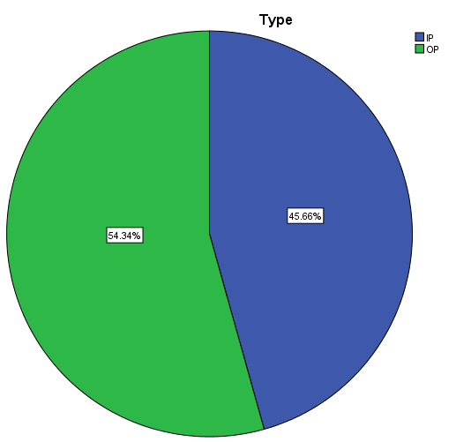
Category of type of Denial
The data provided categorizes insurance claims based on the type of service: Inpatient (IP) and Outpatient (OP). Out of a total of 37,591 claims, 54.3% are for outpatient services, accounting for 20,428 rejected claims. Inpatient services constitute the remaining 45.7%, with 17,163 rejected claims. This indicates that a majority of the claims are for outpatient services which are rejected and need to be more focused
.

Slide 15
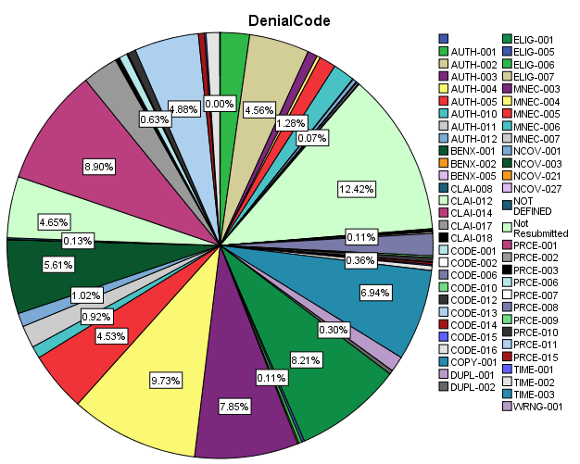
Frequency of Type of Denial Code
The data set details 37,591 insurance claim denials, categorized by specific denial codes. The most common denial code is CLAI-012, accounting for 12.4% of denials. Other frequent codes include MNEC-004 (9.7%), PRCE-001 (8.9%), and ELIG-001 (8.2%).
Authorization issues, represented by AUTH-002 and AUTH-001, account for 4.6% and 2.2% of denials, respectively. Medical necessity denials (e.g., MNEC-003) are at 7.8%, and pricing denials (e.g., PRCE-001) are at 8.9%.
Less frequent codes include DUPL-001 (1.2%), CODE-006 (1.7%), and NCOV-003 (5.6%). The data highlights varied reasons for denials, such as eligibility, duplicate claims, and incorrect coding.

Slide 16
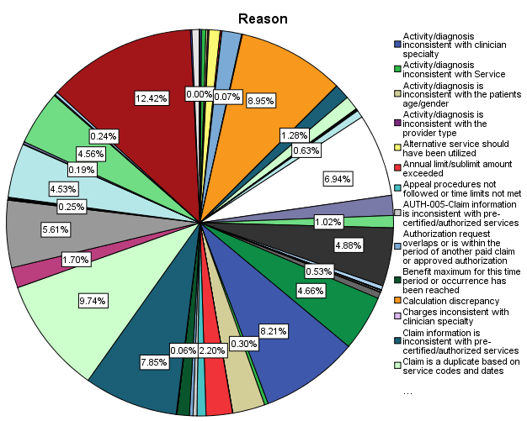
The data details 37,591 insurance claim denials, highlighting various reasons.
The most frequent reason, at 12.4%, is "Submission not compliant with contractual agreement between provider & payer." Other common reasons include "Service is not clinically indicated without additional documentation" (9.7%), "Calculation discrepancy" (8.9%), and "Patient is not a covered member" (8.2%). Significant reasons also include "Service not clinically indicated" (7.8%) and "Deductible/co-pay not collected" (6.9%).
Less common reasons involve "Authorization request overlaps" (1.6%), "Diagnosis inconsistent with procedure" (1.7%), and "Requested additional information not received on time" (1.0%). This data illustrates the varied and complex nature of insurance claim denials.
Tables and figures

Slide 17
Discussion
Revenue cycle Management is one of the major department in the payer-provider model, especially in the facility where the insurance and other third parties constitute more than the 75% of the total revenue , thus a major factor in the healthcare financing.
While the people are more concern about the monitory aspect of the healthcare to reduce the burden on the annual income more towards the insurance aspect.
Countries like USA and UAE have adopted the system of the billing through the medical coding which is an alpha numeric/ numeric unique codes assigned to the diagnosis and the services that are billed against the patient.
The payers in return approve or reject the services against the special codes called denial codes which elaborates the reason for the rejection of the medical services in term with the agreement of the facility .
The denial management is the most important and integral aspect of the healthcare payer=provider model as it analyses how much revenue is been approved and how much is rejected and the strategies designing the way to retrieve those revenues.
A Denial management process first analyses the active payer and the frequency the rejection as in our case Daman Insurance was the highest with 12.8 % rejection while the Sukoon with 12.6% securing the second most rejection rate.
It is necessary to identify the payers as we need to understand the nature of the rejection they provide, it also help to strategies how to plan next slot of submission

Slide 18
There are different approaches in out patient services and In-patient services like lack of approval needed, dental claims going for in-patient services, mandatory approval for special cases , the denial categorization in IPD and OPD helps us to understand, what approaches we need to modify and understand the gap in patient OP services, admission and discharges.
Type of denial code is the most important part in the Revenue Cycle assessment and denial management. This stage helps us to understand which services whether medical, technical or billing is been rejected most thus helping us to analyzed whether we are over investigation to generate revenue, there is billing issue or the technical issues like wrong Post-Office submission’ further we can also analyze the stage of the claim which could have been bypassed.
The reason of the rejection is processed against the denial codes while here there was approx. 12% rejection was done due non-resubmittable services. While calculation discrepancy contributing to 8.5%. Thus requiring an immediate attention towards the current billing issues in the facility

Slide 19
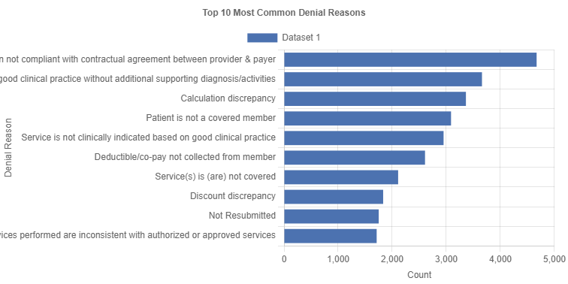

Slide 20
Conclusion
It is very mandatory that the provider should take serious concern in a payer associated revenue model that all the aspects must be assessed from the commencements of the cycle to the end of the cycle.
As we know that the global burden due too NCD is a major health concern even in the developed countries like UAE which has significantly moved towards the insurance model to get secured against the financial crisis during any healthcare problems, this has led to change in the behaviour for the payers as the global burden due to NCD is rising and they have become very significant and critical towards medical services provided by the provider, through this study finding suggestive that the provider aspect must be secured in all technical justified medical investigation and treatment and billing aspects for a better healthcare delivery system.
The analysis of the given data reveals that it is characterized by a total of 37,591 recorded insurance claims denials. The largest share of denial claims is attributed to Daman Insurance Company, covering 12.8% of the total, closely followed by Sukoon (Oman) Insurance with 12.6%. Other significant contributors include NAS Insurance at 11.6% and Almadallah Insurance - Govt & Dubai Police at 11.8%. Smaller portions are held by insurers such as ADNIC Insurance (3.1%), Mednet (3.8%), and Nextcare GN & GN Plus Network (2.6%). Various other insurers, including AXA Insurance and Healthnet, contribute lesser

Slide 21
The data outlines the distribution of 37,591 insurance claim denials, highlighting key reasons and their respective codes. The most common denial code, CLAI-012, accounts for 12.4% of denials. Significant reasons include calculation discrepancies (8.9%), clinical inappropriateness without documentation (9.7%), and patient ineligibility (8.2%). Authorization issues, represented by AUTH-002 and AUTH-001, contribute to 4.6% and 2.2% of denials, respectively.
The data underscores the complexity of the insurance claim process, with varied denial reasons, emphasizing the critical role of denial management in healthcare financing. Identifying high-frequency denial reasons helps in strategizing and improving the revenue cycle, particularly in facilities where insurance constitutes over 75% of total revenue.
Effective denial management involves analyzing payer patterns and refining submission processes, especially for outpatient and inpatient services, to address gaps and reduce revenue loss due to billing and technical issues.

Slide 22
RECOMMENDATIONS
INTRODUCTION OF KPIs - Implementation must be done to assess the compliance related to rejections wrong submissions , spelling mistakes , and submission of same comments , TAT, ETC , should be implemented check on indicators , revert queries.
Transaction managemnet system rather than hims. integrated system for payer provider model - we have single portal for all things , u can track path of claims , stores data, retrieve data at all levels. ( artificial intelligence (ai)) which is absent in HIMS.
Regular audits at all levels - billing audits as per insurance needed ,denial managers , billing audits ,mrd audits, admision audits. ( To deal with billing errors )
AUTOFLAGGING OF HIGH PAYMENT CLAIMS must be auto reminder for users before submsion ( Flagging System ) these flags alert practice staff to proceed with caution ( To deal with High Payment Claims)
Timely checking/ verification of pt. insurance on each visits to avoid later denial or if there is change in the persons insurance .

Slide 23
Scope of the Study
The thorough study of the denial management helps the healthcare facility as they are the revenue generating domain of the healthcare system.
The scope extends from the public aided schemes like AB-PMJAY to the private players, all these that brings revenue to the facility and system are the part of RCM.
The Denial management is the integral and most important part as at this stage only we can decide whether our revenue is going to be a good show for the facility, understand the burden of the disease in that facility and monetary coverage provided against it while profitable or not.
“Revenue Is not always a Profit”

Slide 24
Referencing
1. Erlangga D, Suhrcke M, Ali S, Bloor K. The impact of public health insurance on health care utilisation, financial protection and health status in low- And middle-income countries: A systematic review. PLOS ONE. 2019 Aug 28;14:e0219731.
2. ltd R and M. UAE Health and Medical Insurance - Market Share Analysis, Industry Trends & Statistics, Growth Forecasts 2020 - 2029 [Internet]. [cited 2024 May 8]. Available from: https://www.researchandmarkets.com/reports/4771674/uae-health-and-medical-insurance-market-share
3. Malaviya S, Bishai D, Soni MM, Suliman ED. Socioeconomic disparities in healthcare utilization under universal health coverage: evidence from Dubai household health survey. Int J Equity Health. 2022 Jun 25;21:90.
4. Koornneef E, Robben P, Blair I. Progress and outcomes of health systems reform in the United Arab Emirates: a systematic review. BMC Health Serv Res. 2017 Sep 20;17:672.
5. Alradhi Z, Alanazi A. The Road Ahead and Challenges of Revenue Cycle Management in Saudi Governmental Hospitals. Healthcare. 2023 Oct 12;11(20):2716.
6. Mastering Revenue Cycle Management: A Guide for Independent and Direct Primary Care Physicians [Internet]. 2023 [cited 2024 May 9]. Available from: https://www.elationhealth.com/resources/blogs/mastering-revenue
7. Thumbay Healthcare – Thumbay Chain of Hospitals [Internet]. 2024 [cited 2024 May 9]. Available from: https://thumbayhospital.com/

Slide 25
THANK YOU

