Slide 1

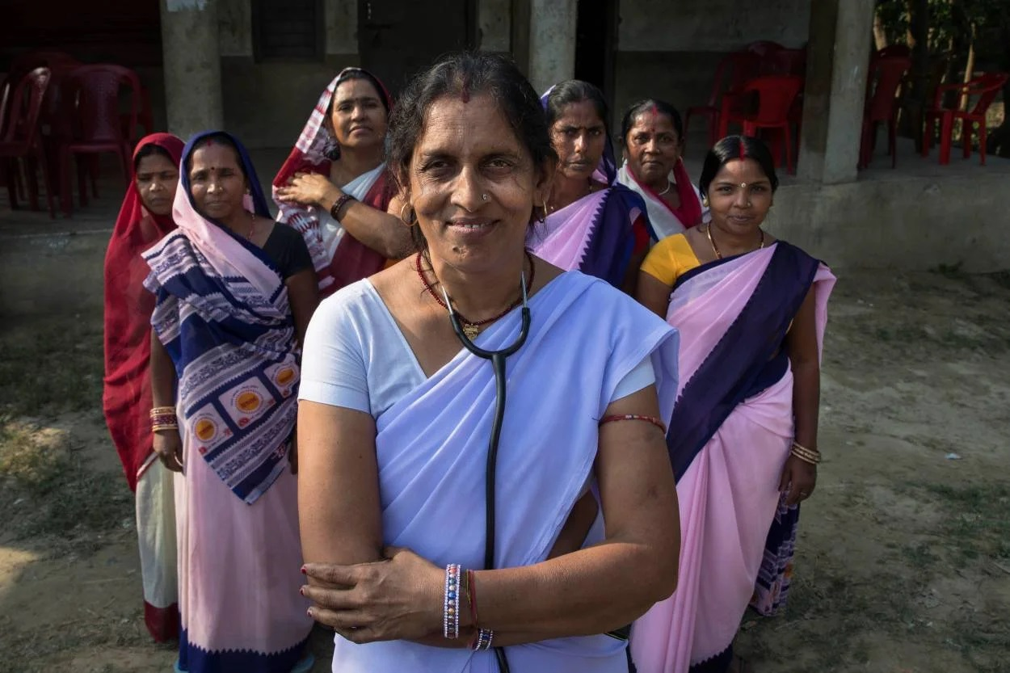

Influencers and Modifiers of Family Planning at Community level, Family level, and Individual level:
a qualitative deep dive
Presented by-Aradhana Singh
Guided by-Dr. Sidharth Sekhar Mishra
IIHMR, Delhi

Slide 2
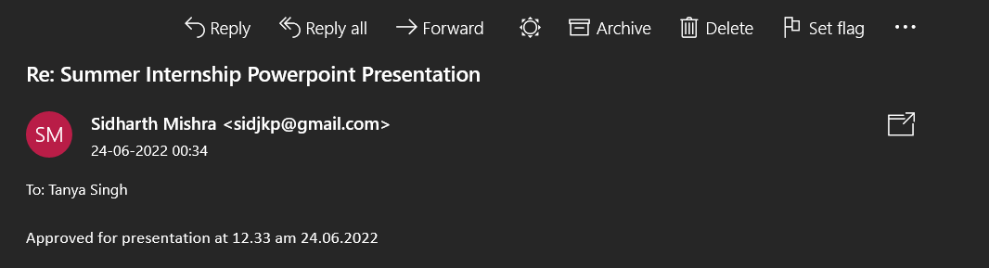
Screenshot of Approval

Slide 3


Background
In high-income countries, fertility rates for women of all age groups have declined since 1950; in low-income countries, fertility rates are steadily declining for all age groups.
India is projected to have the greatest absolute increase in population size of any country between 2021 and 2050.
Bihar is India's third most populous and fifth poorest state with the highest total fertility rate (TFR) of 3.0 children per woman.
The use of modern methods of contraception has increased across most Indian states in the last five years with Bihar showing the most improvement, according to the latest National Family Health Survey (NFHS-5).
This indicates the state has made headway in its family-planning endeavour. This can help prevent high-risk pregnancies and enhance child health.
Community health worker (CHW) programs can increase use of contraception, particularly where unmet need is high, access is low, and geographic or social barriers to use existing services.
Still ,the TFR of Bihar is high, this study was conducted to understand the intricacies of FP practises and its influencers at various levels.
https://sdg.iisd.org/news/2021-population-data-sheet-highlights-declining-fertility-rates/
https://www.downtoearth.org.in/blog/health/use-of-contraceptives-in-bihar-doubles-in-5-years-nfhs-5-75394
https://www.fphighimpactpractices.org/briefs/community-health-workers/

Slide 4
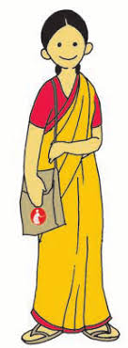
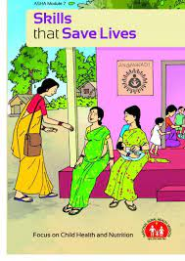

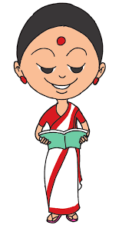
Community Health Workers
The Accredited Social Health Activist (ASHA) is a community health worker. Depending on the area covered by the sub- centre, each Auxiliary Nurse Midwives(ANMs) is supported by four or five ASHAs. With the Anganwadi Worker (AWW), the ANMs acts as a resource person for the training of ASHAs.
The CHWs have also been instrumental in many developing countries reducing unmet need for contraception.
The CHWs have been continuously involved in, ongoing reproductive and child healthcare programs over the last few decades including FP; though little is known about the extent of their outreach in providing FP messages and services.
The role of CHWs in increasing the utilization of maternal, newborn and child health services has been widely acknowledged
There is limited evidence whether or not the CHWs outreach increases demand for contraception in the community.
In India, CHWs are mostly comprised of Auxiliary Nurse Midwives (ANMs), Accredited Social Health Activists (ASHAs) and Anganwadi workers.
https://bmcpublichealth.biomedcentral.com/articles/10.1186/s12889-020-09061-1
Notes:
The ASHA is expected to work in close coordination with the ANM and the Anganwadi worker while all three have their own responsibilities, some are
The ASHA is expected to work in close coordination with the ANM and the Anganwadi worker while all three have their own responsibilities, some are
overlapping. There are five major activities at the community level where such overlap is likely, but each has her own roles as discussed below.

Slide 5

'Why'—why individuals use or don't use current approaches, what affects their decisions, and who influences them

Slide 6
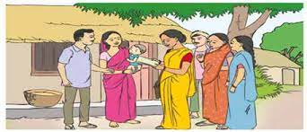
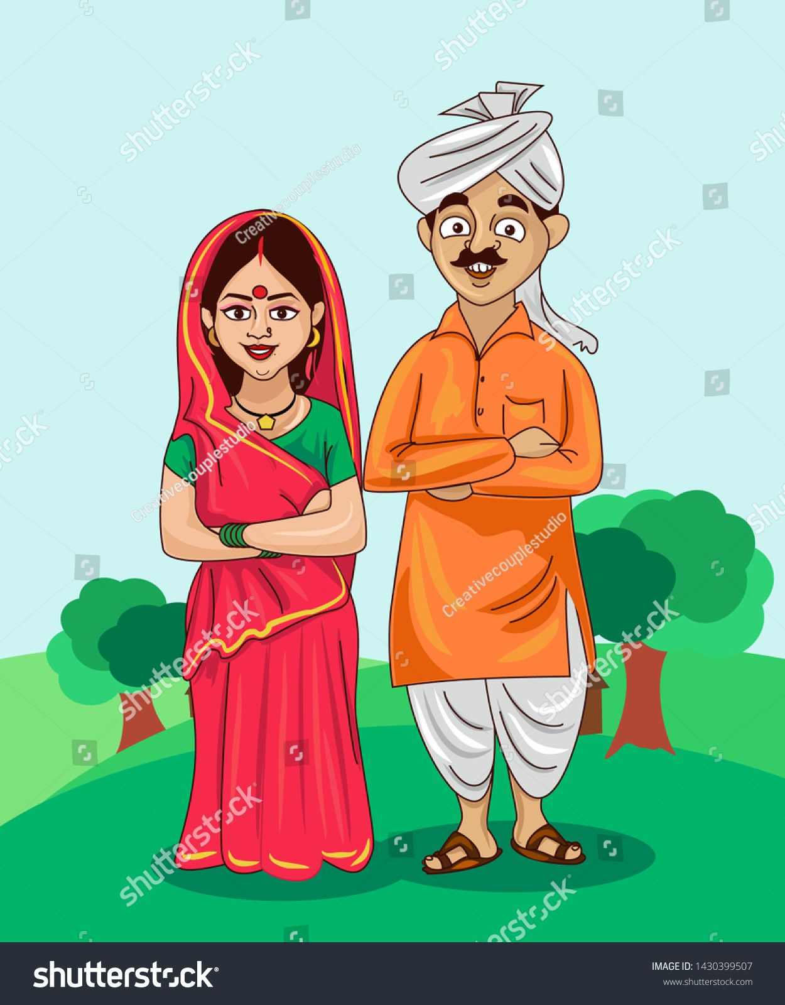
Objectives
To understand awareness, attitude, perception and practises about FP in the community.
To understand ASHAs/ANMs knowledge, attitude and practises for FP related services and delivery Platforms.
To explore the barriers and enablers faced by CHW (particularly ASHA’s/ANM’s) for the delivery of FP services.

Slide 7
Methodology
Study Design- Exploratory study.
Study Setting- Arwal ,Patna, and Vaishali districts were selected based on operational and logistic feasibility. Further 4 blocks were selected in each district, and ASHAs were selected randomly from AWC.
Sampling Method-Three-stage random sampling was employed to reach the sample for interview conduction.
Study Population-
In-depth interview (IDIs) of 24 ASHA’s/ANM’s (12 each) were interviewed in May 2022
.
Sample Selection
West Champaran
Inclusion Criteria: - ASHAs/ANMs having upto 5 years of experience.
- ASHA’s/ANM’s having more than 5 years of experience.
Exclusion Criteria: -ASHAs/ANMs who are not available at AWC.
-ASHAs/ANMs who refuses to provide consent or record their interview.
-
:
East Champaran
Sheohar
Sitamarhi
Gopalganj
Madhubani
Siwan
Muzaffarpur
Supaul
Araria
Kishanganj
Darbhanga
Saran
Vaishali
Samastipur
Saharsa
Madhepura
Purnia
Following the thematic approach, qualitative guides were prepared based on different themes after literature review and discussion with program team members/subject experts
Buxar
Bhojpur
Patna
Begusarai
Khagaria
Katihar
Arwal
Nalanda
Sheikhpura
Lakhisarai
Munger
Bhagalpur
Lakhisarai
Rohtas
Jehanabad
Lakhisarai
Rohtas
Rohtas
Analysis
Bhabua
Rohtas
Interviews were recorded, transcripted and coded for analysis in Atlas.ti 7.5 software
Aurangabad
Nawada
Jamui
Banka
Gaya

Slide 8
Sampling Frame
Bihar
Patna (Bikram)
Arwal (Karpi)
Arwal (Kaler)
Vaishali (Desri)
AWC- DATIANA
AWC- KOCHAHASA
AWC-Pahelja
AWC-Sakri Khurd
AWC-Uphraul
AWC-Jahangirpur
AWC-
Aajampur
ASHA/ANM(1)
ASHA/ANM-(6)
ASHA/ANM-(1)
ASHA/ANM-(1)
ASHA/ANM-(1)
ASHA/ANM-(1)
ASHA/ANM-(1)

Slide 9
THEMATIC APPROACH EXTRACTION
Community FP Profile and Perspective
“ab bolte hain MC aa gaya toh ladki jawaan ho gaya unn logoan ka kehna hain ,toh shaadi kar detein hai MC ke baad mein aur unko yeh lagta hain didi , shaadi hua jaldi bacha ho jaye ,jitna jaldi ho bacha ho jayein”_ASHA,Arwal
Profile of beneficiaries –(18 to 30)
Aware of ASHA/ANM roles and responsibilities
Communities anticipate deliverables like……
Prenatal, Postnatal care and Immnunisation
Ideal age of marriage varies for communities
Awareness of Interval between children is there but practise does not.
Decision maker-Mother-In-Laws(MIL’s) and Family
Factors influence decision- Presence of Male child
CHW’S have lack knowledge about fertility cycle
“voh didi jaise do ladki hain abhi tak ladka nahi hua hain,toh ladka ke chakar mein ho jaata”_ASHA_ Arwal
“samudayein yeh hi kehta hain didi ,ek go ladka huive kara toh vansh aur buniyaad chalve karega na ,agar vansh buniyaaad khatam ho gayi toh kaise kya hoyi”_ASHA,Arwal
“Mochi Tha Uski Patni Abhi hi Death Kar Gai Usko 4 Bacche The Main Boli Ki Aap Opretion Karwa Lijiye Nahi Toa Mahila Karane Layak Nahi Thi Kyunki Usko damma Tha Toa Wo Kya Bola Se Nahi Kono Hum Bhumiyar Hai Ki Jo 4 Hi Baccha Rakhege Ya 5 Hi Baccha Rakhenge Humko Jitna Man Hai Hum Utna Rakhenge”_ASHA,Patna
“hum toh khud hi bolte hai ek beta ho jae uske baad operation kara lijye”(ANM, Arwal District
“aap nahi jaante hai yaha jiska ek bhi beta nahi hota hai uska samaaj me koi ijjat nahi rehta hai”_ANM, Vaishali District

Slide 10
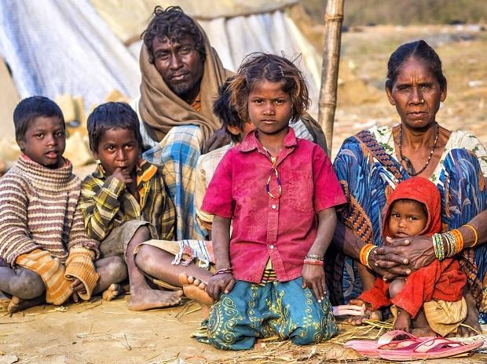
THEMATIC APPROACH EXTRACTION
Community Contraceptive Perception and Practises
Fear of Side effects
Preferences-Chhaya,Mala-N,Condoms, Antara,Sterilisation
Inaccurate information of side effects from peers
God is responsible for providing children
Women do not have adequate autonomy
Couples don’t have accurate information about traditional methods
Follow-up services through phone , home visits
Leads to unwanted pregnancy
Education is an essential key
“Antara didi ,par koi koi toh yeh bhi nahi lagana chahta hain ,kyuinki bleeding hota hain na ,phir dard hota hain,aur nirodh hain par uske liye bhi bole prabhavh hi naa padhta hain aacha nahi lagta hain toh naa lagayi purush toh manata nahi hain,toh mahila hi antara leti hain ,chhaya khati hain,”_ASHA,Arwal
“Nahi phir nahi aapnayi ,boli ab operation karwala raha ,aur kehte hain ab goli boli nayi khayenge nirodh apna li hain,aur hum toh bole esthayi operation karwa lo ek bacha aur ek bachi hain”_ASHA,Arwal
“Antara sui se bahut pareshaani hua sabko ,antara devai na 6-7 mahina bleeding nahi aaya usko ,band ho gay bleeding aana toh madam se sujhabh liye ki antara dilaya tha 6-7 mahina ho gaya hain bleeding nahi ho raha hain ,uska pura body mein sujhan aa gaya tha”_ASHA,Arwal
“hm btate hai ki jab pati-patni sath rahe toh sambhog ke dauran beej ko mahila me giraane ki jagah bahar hi nastt kar de, ya fir pati-patni ek dusre se doori banake rakkhe”ANM, Vaishali District

Slide 11
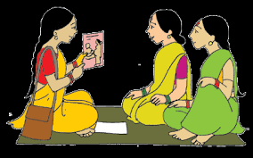
THEMATIC APPROACH EXTRACTION
Client Provider Interaction
Availability of Contraceptives in facilities
Only Women encountered issues with side effects
Joint counselling preferable over individual counselling
Couples have intention but worry about judged by others
Lack of information leads to lack of participation
CHW’s do not provide counselling to young men and couples
“Didi pati ke sath batayenge toh jaise mahila dawa khana bhul gayi toh pati yaad dila detein hain par jab akele baat karti hain toh kabhi mahila bhul na jaaye toh hame yaad dilwana hota hain”_ASHA,Arwal
“ usko jaise nahi chahiye bacha toh hume chupke se bolegi toh hum de detein hain na usko condom ,yaha aayegi toh sabko pata chal jayega ,agar ladka bhi rahega toh bolega chachi yeh hain samnva toh hum log de detein hain”_ASHA,Arwal
“Main sab chiz hai counselling ke upar, yadi hm acche se counselling karte hai toh log samjhte hai agr counselling sahi se nahi hoga toh sab bolega are kya bakar bakar kar rahi hai”_ANM, Vaishali District

Slide 12
THEMATIC APPROACH EXTRACTION
Male Engagement
“ Nahi didi mahila hi aati hain tikakaran mein bhi ,pakhwada mein bhi,purush ka yogdaan na ke barabar hain,jaise maan lijiye 100 hua ya 50 go operation hua hain usme se mushkil se 5 go purush karayein hain ,nahi toh mahila hi karati hain”_ASHA,Arwal
FP services is made available for women not for men.
Men do not seek information on FP
CHW’s focus their attention on counselling women
Condoms can reduce sexual pleasure for men
Vasectomy considered as a loss of masculinity ,so men decide against it.
Majority of them aware of male specific training for FP, but still gap is present.
“ Kehte hain Bhabhi hum use karte hain par santhusthi nahi milti”
“ didi jitna joh sahe voh sab mahila sehti hain ,Boltein hain na didi hum toh humse bolte hain hume kaam karna hain,bora uthana hain ,baahar jaana hain,ikko kya karana hain ghar par baithkar khana hi toh banana hain aur khana hain”_ASHA,Arwal

Slide 13
THEMATIC APPROACH EXTRACTION
Social Analysis and Action
Service Provision
The ASHAs confessed that they now comfortably and freely introduce and explain FP to women and face less inhibitions as compared to earlier times. (reference period 2-3 years back when first sensitised through SAA)
Women now seek FP related advice to the ASHAs, even on phones, if they are unable to meet physically
ASHAs serve as a mobiliser in community outreach event as VHSND and facility based Fortnight and ANMs acts as a resource person for the training of ASHAs
Able to provide counselling for management for side effects to bring beneficiaries to the ANM
Counselling is provided on determining family size, spacing, methods of FP etc.
“ Parivartan hai na didi pahale hamko ye sab chij ke bare me kya pata tha pata jaise yahan par aye meeting hota hai “
“To usme me didi log batati hai”
“ Sir hai ye sab batate hai “ASHA,Arwal
“didi jinka baccha ho gaya hain aur unko baccha nahi chahiye toh kehte hain esthayi operation karane ko,aur jiska baccha 6 mahine ya 8 mahine baad teher jaa raha hain usko batatein hain ,Antara ,Copper-t,jab bacha hua usse turant copper-t lagwa diye ,aur nahi lagwatein hain toh nirodh ka salah detein hain,baccha thoda bada ho jayega deh vikas ho jayega ,phir toh waise bhi hum teen shaal ke baad ki salah detein hain”_ASHA,Arwal

Slide 14
THEMATIC APPROACH EXTRACTION
Provider Motivation and Improvement
Support for Ongoing Work
Lack of supportive supervision & timely incentives leads to de-motivation and lack of accountability
Training on FP is clearly lacking and is required to instil confidence to increase awareness about FP
Training on digital literacy was relatively low with training preceding provisioning of Android phones for FPLMIS usage.
The ANMs were identified as constant source of support as they provide hand-holding support in day-to-day activities
There was a lack of formal feed-back and constructive support or feedback from senior public health professionals
“ANM didi se ,raam raam didi yeh ANM didi hain hamare liye baghwaan hain yeh hi hamara register maintain karti hain”_ASHA,Arwal
“hum sarkaar ka kaam karte hain online ka apne paise se,karja managate hain ,ek mahina mein kitna ASHA diwas hua hain,kitna tikaran hua,sab hame online paise dena hota hain,ASHA facilitator kyuin banayein hain unlgoan ko hamari madad karni chahiye na ,100 rupayein dena hota hain,ASHA facilitator kuch nahi sunati”_ASHA,Arwal
“ ASHA ban ke didi aacha lag raha hain samaj ka seva kar rahe hain khush hain ,lekin ek hi baat se naraz hain sarkar joh hain toh hum jono hisab se kaam kar rahe hai uss hisab se vetan nahi mil raha hain”_ASHA,Vaishali

Slide 15



THEMATIC APPROACH EXTRACTION
Social Norms
Lack of Knowledge about Ideal age of Marriage and Pregnancy
Male Engagement
Beneficiaries Provider Interaction
Knowledge-Perception-Intention
Community Level
2
Family level
Peer Influence
Partner and Family Influence
Spousal communication
Male child preference
Spousal Support
Decision Making
Decision Involvement
Fecundity
Knowledge
Beliefs and Values
Autonomy
Agency
Education
Fear of Side effects
Emotions
Perceived Norms
Attitude
Health Concern
Age
Gender
Individual Level

Slide 16
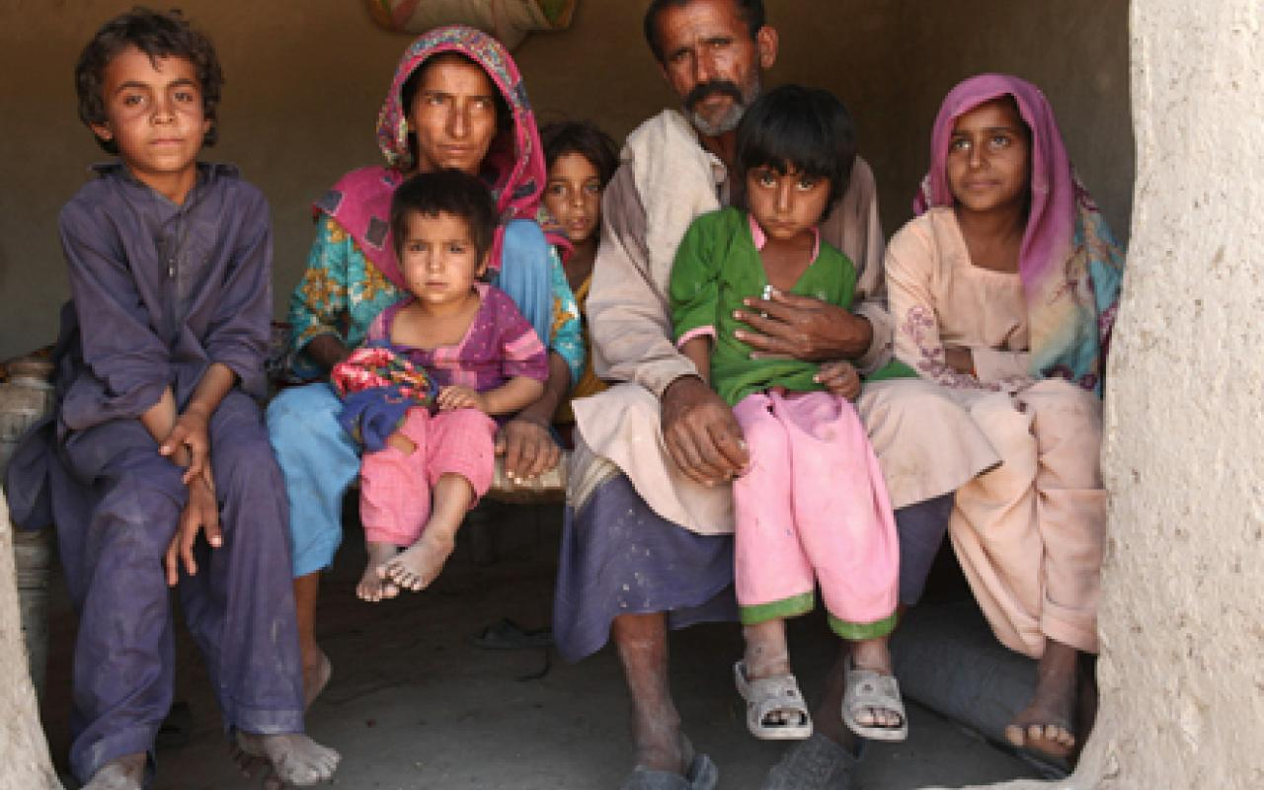
DISCUSSION
In particular, rural communities their attitude about family planning practises and contraception use are neither assertive nor inclusive.
It is critical that ASHAs/ANMs receive sufficient training in order to break down social & communication barriers surrounding contraception and promote family planning information.
As the Indian society is extremely divided, with urban, slum, and rural populations all having their own distinct identities.

Slide 17
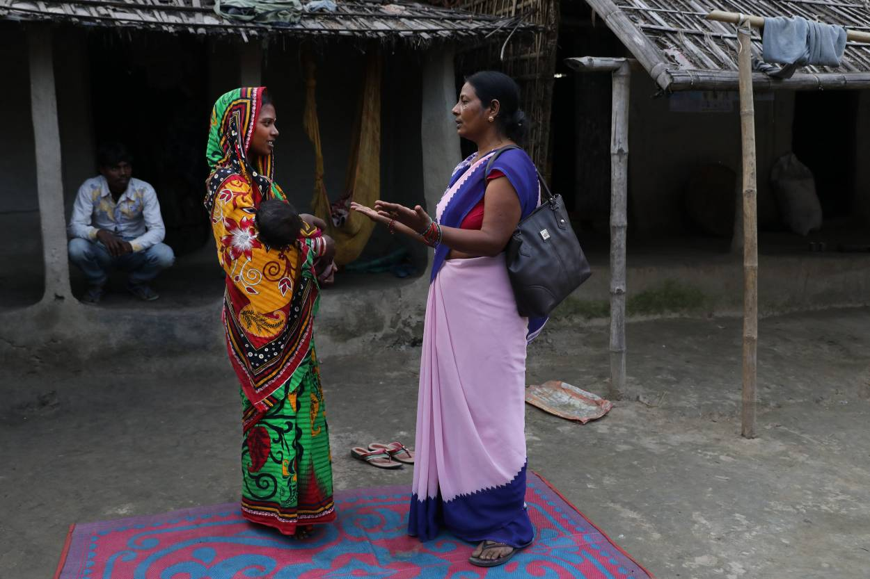
DISCUSSION
ASHAs reported that they do not get a fixed income and that their incentive is erratic and inconsistent
Incentives are largely oriented toward permanent and long-acting contraceptive techniques; training is inadequate and lacks in-depth instruction on spacing choices
There is a dearth of education on FP as a concept, the cycle, and its relationship to pregnancy.
ASHAs' work is invariably hampered by social and cultural factors

Slide 18
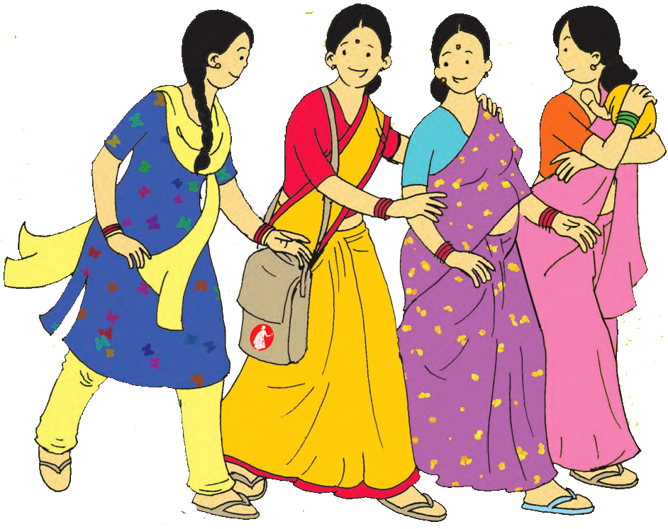
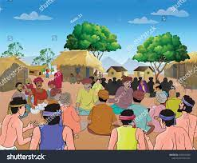
Limitations of Study
Social Desirability Bias
Generalizability of the findings

Slide 19

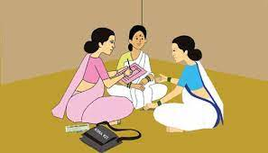
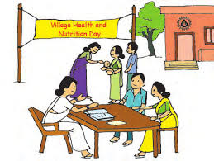
WAY FORWARD
ASHAs are highly dissatisfied with their remuneration and feel that they should be paid a set remuneration on a monthly basis.
Institutionalising acknowledgment ASHAs work and performance for exceptional field work or service delivery.
Periodic trainings on counselling strategies to enable ASHAs/ANMs to break down socio-cultural communication barriers in the community, in addition to the technical components.
State-level development partners to be made responsible for supportive supervision, execution, and assessment and capacity building of the ASHAs/ANMs.
The distribution of smartphones and digital literacy to ASHAs in order to facilitate effective communication and counselling.
Male community health workers, like ASHAs/ANMs, are required in the community to involve and engage men as partners and beneficiaries in Family Planning services.
Joint counselling (spousal counselling) should be promoted more to develop better understanding about family planning practises among couples.
A day or platform should be set aside for couples (especially recipients of Adarsh Dampati Yojna) to discuss their experiences with contraception and family planning techniques with other couples.

Slide 20
REFERENCES
1.Țarcă V, Țarcă E, Luca F-A, editors. The Impact of the Main Negative Socio-Economic Factors on Female Fertility. Healthcare; 2022: Multidisciplinary Digital Publishing Institute.
2.International Institute of Population Science. National Family Health Survey India 2015–2016: Bihar fact sheet.[INTERNET].Available from: http://rchiips.org/nfhs/bihar.shtml
3.International Institute of Population Science. National Family Health Survey India 2015–2016: Bihar fact sheet.[INTERNET].Available from: http://rchiips.org/nfhs/bihar.shtml
4.Shakya HB, Dasgupta A, Ghule M, Battala M, Saggurti N, Donta B, et al. Spousal discordance on reports of contraceptive communication, contraceptive use, and ideal family size in rural India: a cross-sectional study. BMC Women's Health. 2018;18(1):147.
5.Jain M, Caplan Y, Ramesh BM, Isac S, Anand P, Engl E, et al. Understanding drivers of family planning in rural northern India: An integrated mixed-methods approach. PloS one. 2021;16(1):e0243854.
6.Role of Key Influencers in shaping FP decisions and choices of young women in Uttar Pradesh and Bihar: A social network study.[INTERNET].Available from: https://ipc2021.popconf.org/uploads/211187
7.Kumar A, Jain AK, Ram F, Acharya R, Shukla A, Mozumdar A, et al. Health workers’ outreach and intention to use contraceptives among married women in India. BMC Public Health. 2020;20(1):1041.
8.Ranjan M, Mozumdar A, Acharya R, Mondal SK, Saggurti N. Intrahousehold influence on contraceptive use among married Indian women: Evidence from the National Family Health Survey 2015-16. SSM - population health. 2020;11:100603.
9.Wagner AL, Porth JM, Bettampadi D, Boulton ML. Have community health workers increased the delivery of maternal and child healthcare in India? Journal of Public Health. 2017;40(2):e164-e70.
10.The Role of ASHAs in the Delivery of Contraceptive Information and Services.[INTERNET].Availabllefrom: https://hrln.org/uploads/2018/02/HRLN-The-Role-of-ASHAs-in-the-Delivery-of-CIS.pdf
11.Shukla A, Acharya R, Kumar A, Mozumdar A, Aruldas K, Saggurti N. Client-provider interaction: understanding client experience with family planning service providers through the mystery client approach in India. Sexual and reproductive health matters. 2020;28(1):1822492.
12.Bertozzi E, Bertozzi-Villa A, Kulkarni P, Sridhar A. Collecting family planning intentions and providing reproductive health information using a tablet-based video game in India. Gates open research. 2018;2:20.
13.Anukriti S, Herrera-Almanza C, Pathak P. Curse of the Mummy-ji: The Influence of Mothers-in-Law on Women's Social Networks, Mobility, and Reproductive Health in India. 2019.
14.Rammohan A, Goli S, Saroj SK, Jaleel CPA. Does engagement with frontline health workers improve maternal and child healthcare utilisation and outcomes in India? Human resources for health. 2021;19(1):45.
15.Dehingia N, Dixit A, Averbach S, Choudhry V, Dey A, Chandurkar D, et al. Family planning counseling and its associations with modern contraceptive use, initiation, and continuation in rural Uttar Pradesh, India. Reproductive Health. 2019;16(1):178.
16.Dey AK, Acharya R, Tomar S, Silverman JG, Raj A. How does the sex composition of children affect men's higher ideal family size preference relative to women and contraceptive use patterns among couples? A cross-sectional analysis of dyadic couple's data in India. SSM - population health. 2021;15:100835.
17.Char A, Saavala M, Kulmala T. Influence of mothers-in-law on young couples' family planning decisions in rural India. Reproductive health matters. 2010;18(35):154-62.
18.Kumar A, Bordone V, Muttarak R. Like Mother(-in-Law) Like Daughter? Influence of the Older Generation's Fertility Behaviours on Women's Desired Family Size in Bihar, India. European journal of population = Revue europeenne de demographie. 2016;32(5):629-60.
19.Dey AK, Averbach S, Dixit A, Chakraverty A, Dehingia N, Chandurkar D, et al. Measuring quality of family planning counselling and its effects on uptake of contraceptives in public health facilities in Uttar Pradesh, India: A cross-sectional analysis. PloS one. 2021;16(5):e0239565.
20.Aengst JC, Harrington EK, Bahulekar P, Shivkumar P, Jensen JT, Garg BS. Perceptions of nonsurgical permanent contraception among potential users, providers, and influencers in Wardha district and New Delhi, India: Exploratory research. Indian journal of public health. 2017;61(1):3-8.
21.Sebastian MP, Khan ME, Roychowdhury S. Promoting healthy spacing between pregnancies in India: Need for differential education campaigns. Patient Education and Counseling. 2010;81(3):395-401.
22.Mandal M, Muralidharan A, Pappa S. A review of measures of women’s empowerment and related gender constructs in family planning and maternal health program evaluations in low- and middle-income countries. BMC Pregnancy and Childbirth. 2017;17(2):342.
23.Lalchandani K, Gupta A, Srivastava A, Usmanova G, Maadam A, Sood B. Role of financial incentives in family planning services in India: a qualitative study. BMC Health Services Research. 2021;21(1):905.
24.Yadav B, Pandey S. Study of knowledge, attitude, and practice regarding birth spacing and methods available for spacing in rural Haryana, India. International Journal of Reproduction, Contraception, Obstetrics and Gynecology. 2018;7:1389+.
25.Bahuguna M, Das S, Shende S, Manjrekar S, Pantvaidya S, Fernandez A, et al. TO USE OR NOT TO USE: A MIXED METHODS STUDY EXPLORING FACTORS INFLUENCING MODERN CONTRACEPTIVE USE IN INFORMAL SETTLEMENTS OF MUMBAI. 2021.
26.Yadav K, Agarwal M, Shukla M, Singh JV, Singh VK. Unmet need for family planning services among young married women (15–24 years) living in urban slums of India. BMC Women's Health. 2020;20(1):187.
27.Parsekar SS, Hoogar P, Dhyani VS, Yadav UN. The voice of Indian women on family planning: A qualitative systematic review. Clinical Epidemiology and Global Health. 2021;12:100906.

Slide 21
Influencers and Modifiers of Family Planning at Community level, Family level and Individual level
Presented By- Aradhana Singh Guided By- Dr. Siddharth Sekhar Mishra
International Institute of Health Management and Research, IIHMR, Delhi
INTRODUCTION
OBJECTIVES
RESULTS
CONCLUSION
The Accredited Social Health Activist (ASHA) is a community health worker. Depending on the area covered by the sub- centre, each ANMs is supported by four or five ASHAs. With the Anganwadi Worker (AWW), the ANMs acts as a resource person for the training of ASHAs.
The CHWs have also been instrumental in in many developing countries reducing unmet need for contraception.
The CHWs have been continuously involved in, ongoing reproductive and child healthcare programs over the last few decades including FP; though little is known about the extent of their outreach in providing FP messages and services.
The role of CHWs in increasing the utilization of maternal, newborn and child health services has been widely acknowledged
There is limited evidence whether or not the CHWs outreach increases demand for contraception in the community
To understand awareness, attitude, perception and practises about FP in the
community.
To understand ASHAs/ANMs knowledge, attitude and practises for FP related services and delivery platforms.
To explore the barriers and enablers faced by CHW (particularly ASHAs/ANMs) for the delivery of FP services.
Barriers at Individual Level-
Lack of Knowledge
Lack of Autonomy
Lack of Agency
Lack of Education
Fear of Side effects
Perceived Norms
Given the importance of the family planning services they provide, they require comprehensive, continuous training and hand-holding support
To ensure that they are delivering accurate information about FP methods for their clients to make an informed choice.
An ASHA's counselling to a single person or a couple might make a crucial difference between an undesired pregnancy and a successful birth spacing
Attitude
Health Concern
Age
Gender
Emotions
Barriers at Family Level-
Peer Influence
Partner and Family Influence
Lack of Spousal communication
Male child preference
Lack of Spousal Support
Lack of participation in Decision Making
Lack of Participation in Decision Involvement
Fecundity
Barriers at Community Level-
Social Norms
Lack of Knowledge about Ideal age of Marriage and Pregnancy
Male Engagement
Beneficiaries Provider Interaction
Knowledge-Perception-Intention
Enablers at Community level-
For ASHAs–ANMs provide handholding
support in their work
For ANMs-
Head of the village and and other community members
Supportive supervision by supervisors(MOIC,BHM,BCM) to provide technical training on FP issues.
METHODOLOGY
REFERENCES
Three-stage random sampling was employed to reach the sample for interview conduction.
In-depth interview (IDIs) of 24 ASHA’s/ANM’s (12 each) were interviewed in May 2022.
Arwal ,Patna, and Vaishali districts were selected based on operational and logistic feasibility. Further 5 blocks were selected in each district, and ASHAs were selected randomly from AWC
Inclusion Criteria: - ASHA’s/ANM’s having upto 5 years of experience.
ASHA’s/ANM’s having more than 5 years of experience.
Exclusion Criteria: -ASHA’s/ANM’s who are not available at AWC.
-ASHAs/ANMs who refuses to provide consent or record their interview.
Jain M, Caplan Y, Ramesh BM, Isac S, Anand P, Engl E, et al. Understanding drivers of family planning in rural northern India: An integrated mixedmethods approach. PloS one. 2021;16(1):e0243854.
Role of Key Influencers in shaping FP decisions and choices of young women in Uttar Pradesh and Bihar: A social network study.[INTERNET].Available from: https://ipc2021.popconf.org/uploads/211187
.International Institute of Population Science. National Family Health Survey India 2015–2016: Bihar fact sheet.[INTERNET].Available from: http://rchiips.org/nfhs/bihar.shtml
.International Institute of Population Science. National Family Health Survey India 2015–2016: Bihar fact sheet.[INTERNET].Available from: http://rchiips.org/nfhs/bihar.shtml
The Role of ASHAs in the Delivery of Contraceptive Information and Services.[INTERNET].Availabllefrom: https://hrln.org/uploads/2018/02/HRLN-The-Role-of-ASHAs-in-the-Delivery-of-CIS.pdf
Kumar A, Jain AK, Ram F, Acharya R, Shukla A, Mozumdar A, et al. Health workers’ outreach and intention to use contraceptives among married women in India. BMC Public Health. 2020;20(1):1041.

Slide 22
INTERNSHIP EXPERIENCES
Literature review, themes and sub themes, comprehensive thematic mapping, tool development, data collection, data management and analysis of study topic: Influencers and Modifiers of family planning (with a special emphasis on role of ASHAs/ANMs)-at Community, Family and Individual level-a qualitative deep dive..
Conducting In-Depth Interviews (IDIs) among the eligible participants regarding the mentioned topic of interest and allied factors in three districts of Bihar (Arwal, Vaishali & Patna).
Transcribing the In-Depth Interviews (IDIs) within 24 hours of interview maintaining accuracy and sanctity as well as cross-checking other colleagues’ transcriptions against the audio recording.
Coding of In-depth Interviews done through Atlas-Ti software.
Writing the comprehensive Internship report and made a Power-Point presentation by contextualization of the analytical findings with the summary of the literature review.
Presentation editing and compilation of district stories depicting the progression of health and nutrition related indicators in Bihar from 2014-2021.
Presentation editing for Health And Nutritional Situation Assessment (HANSA) project.
Literature review of Spacing Methods.
Worked with the team, got exposed to Data management, Data cleaning and analysis Using SAS and MS-Excel. Learnt the Basics of & worked on MS-word/Power-point/Excel, and EndNote.
Attended training Sessions on Qualitative study tool development and study conduct
This Summer Internship Program at Care India was an enlightening research experience that gave me a new perspective on the realities of public health and how it plays an important role in rural lives.
This program taught me the most valuable lesson in Public health, finding cures and ways to make life better for our generation to come.
This experience made me realize that there are people working behind the scenes to save lives... Like BMLEs, ANMs, ASHAs and many more.
Our partners were great people who made work fun during the field visits and proved to us that “Teamwork makes the Dream work”.

Slide 23
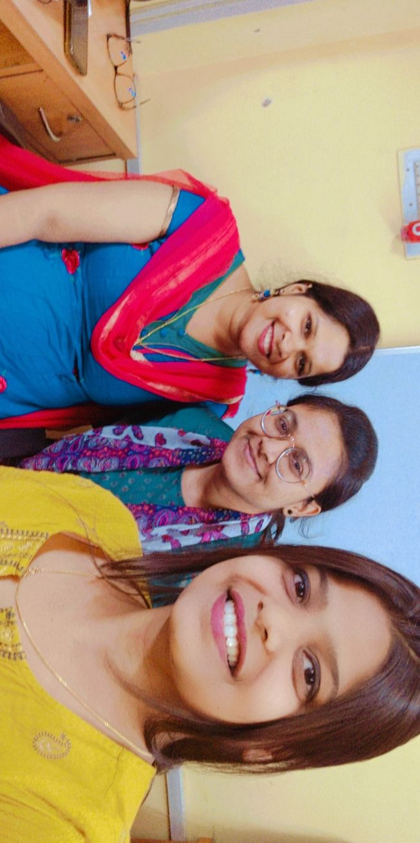
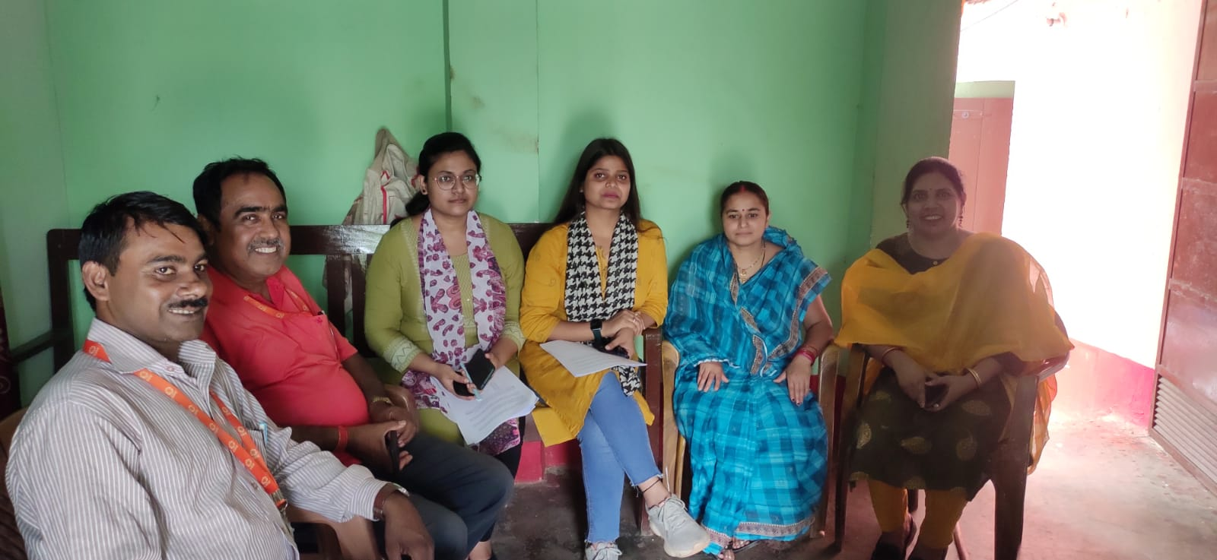
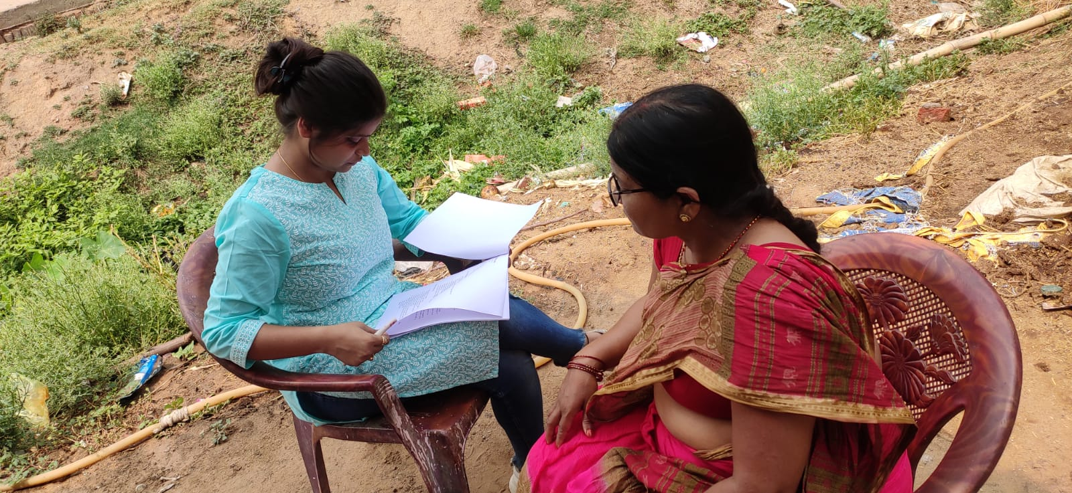
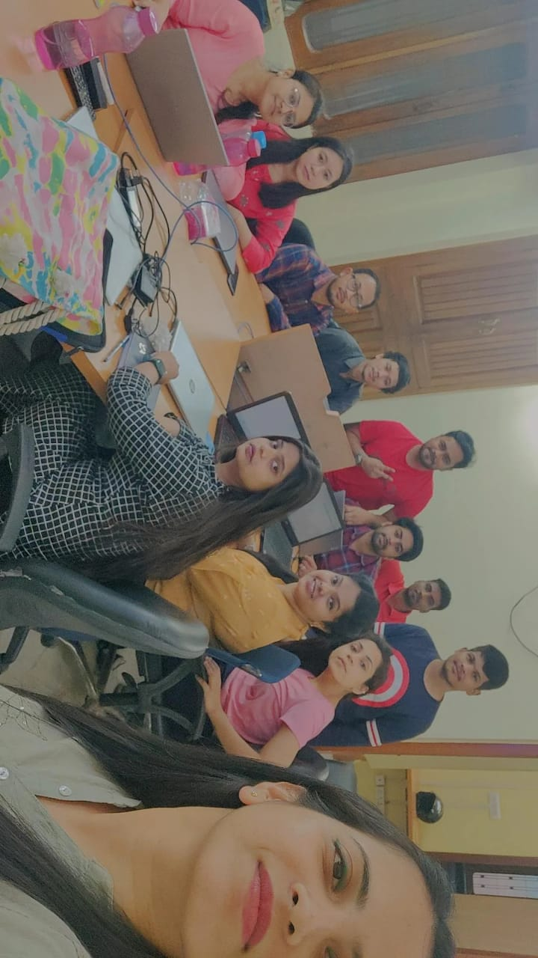
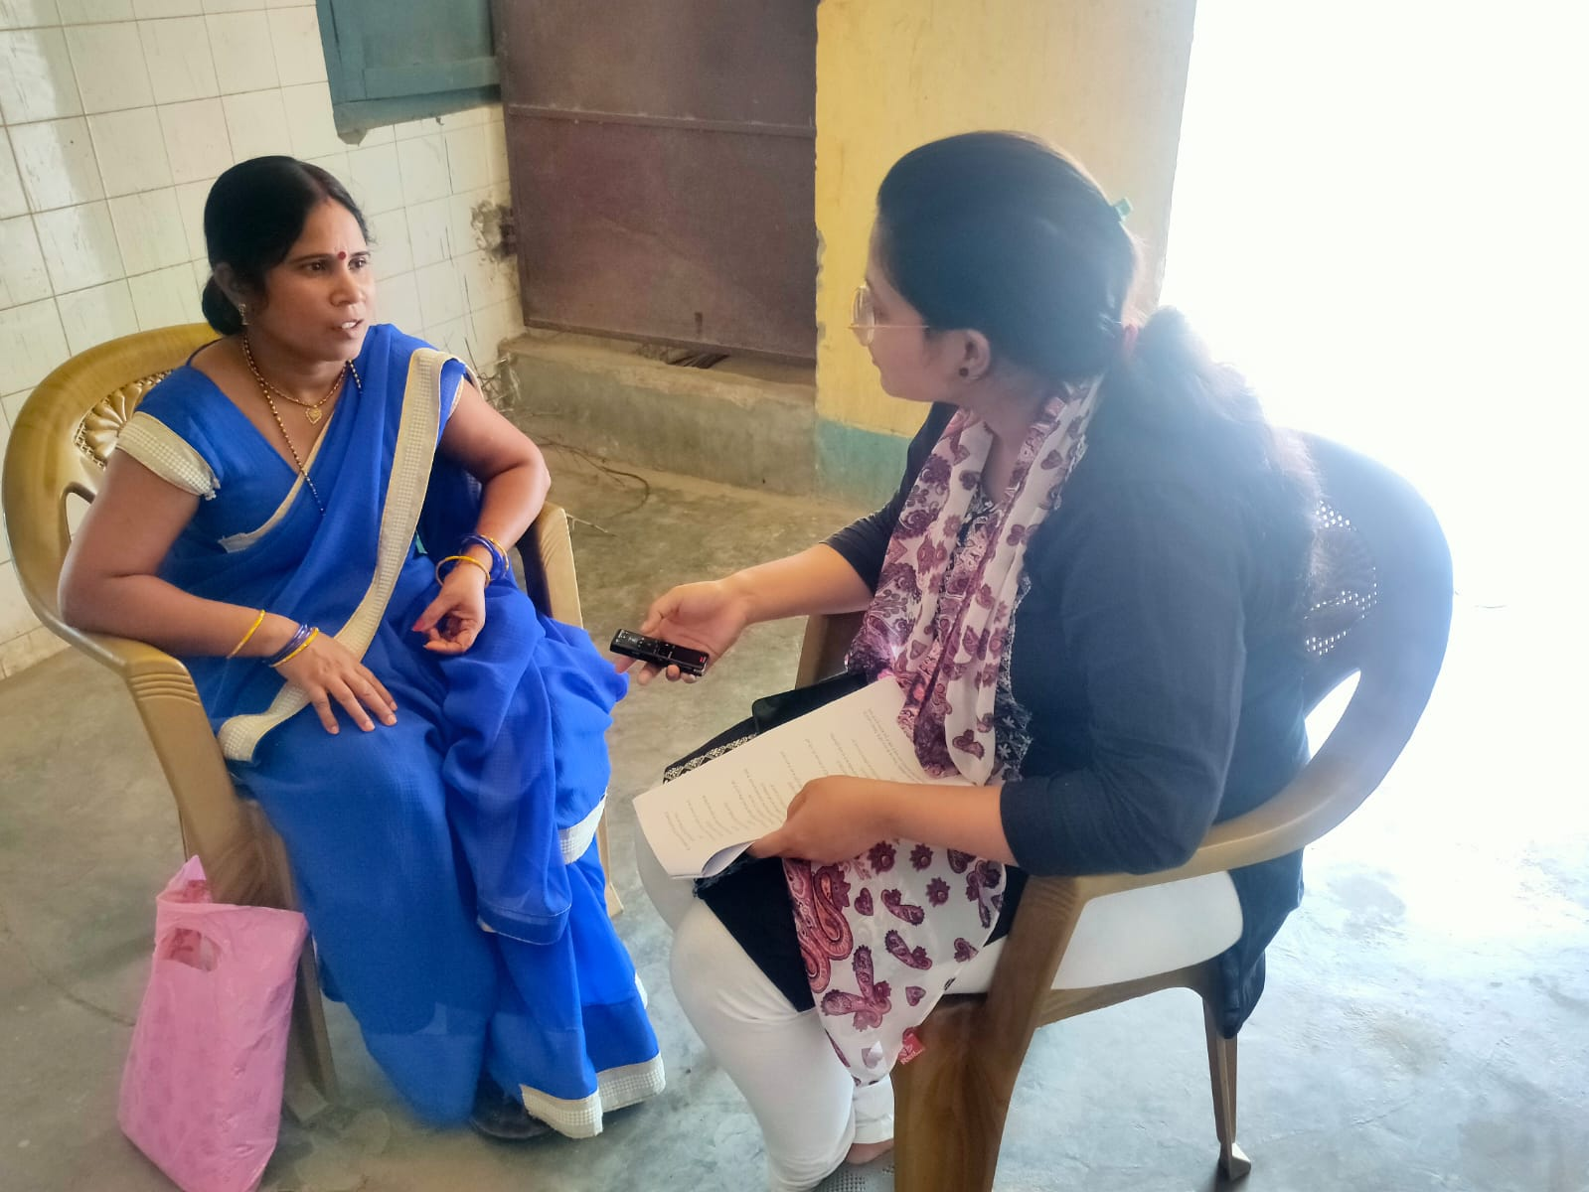
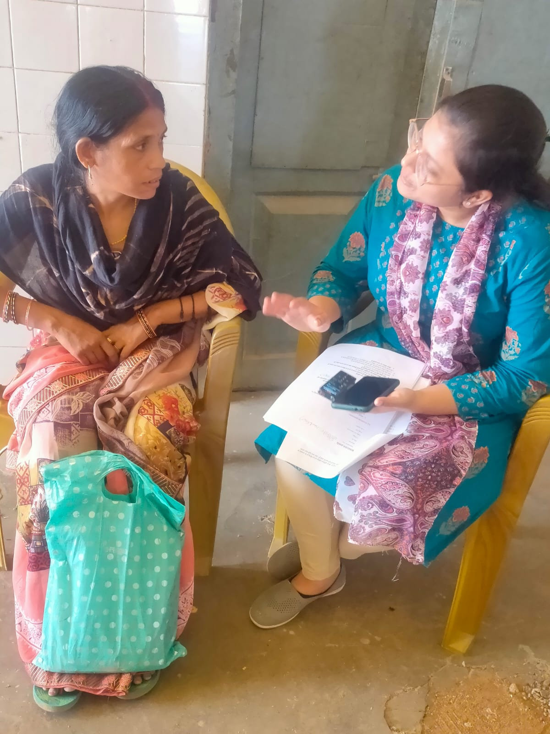
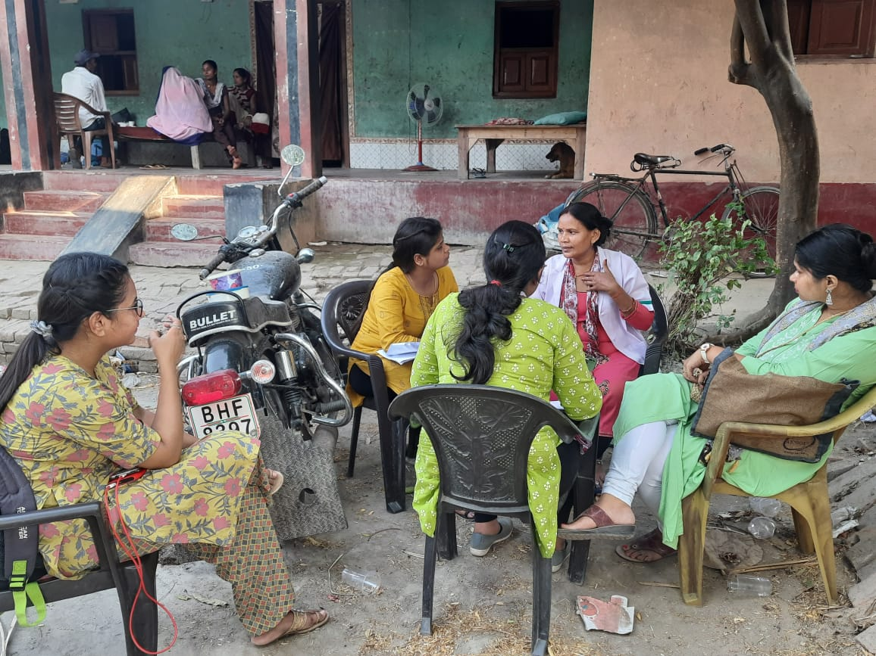
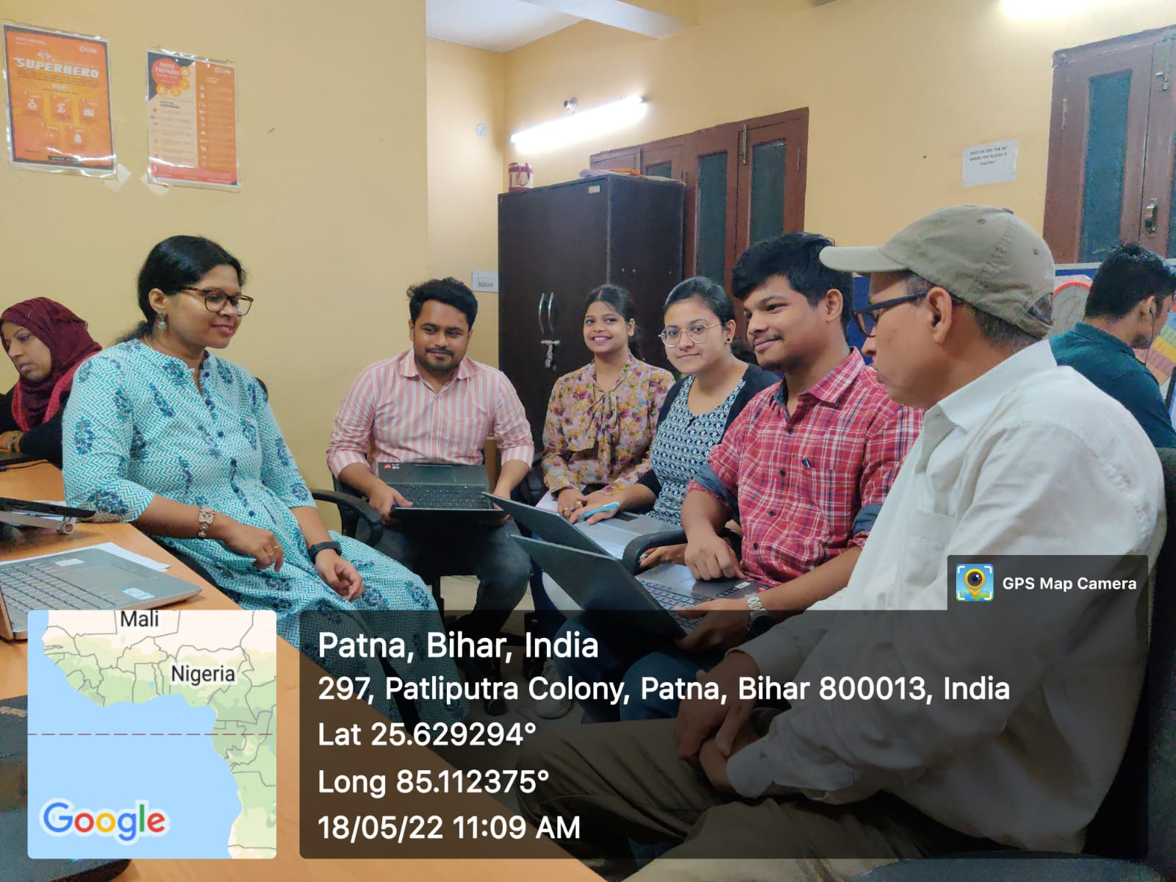
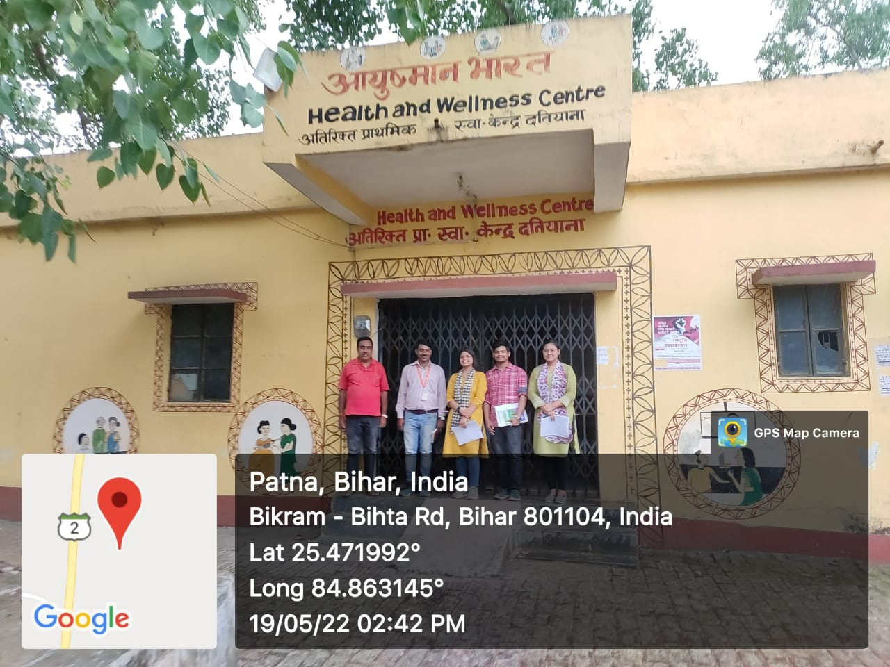
PICTORIAL JOURNEY

Slide 24
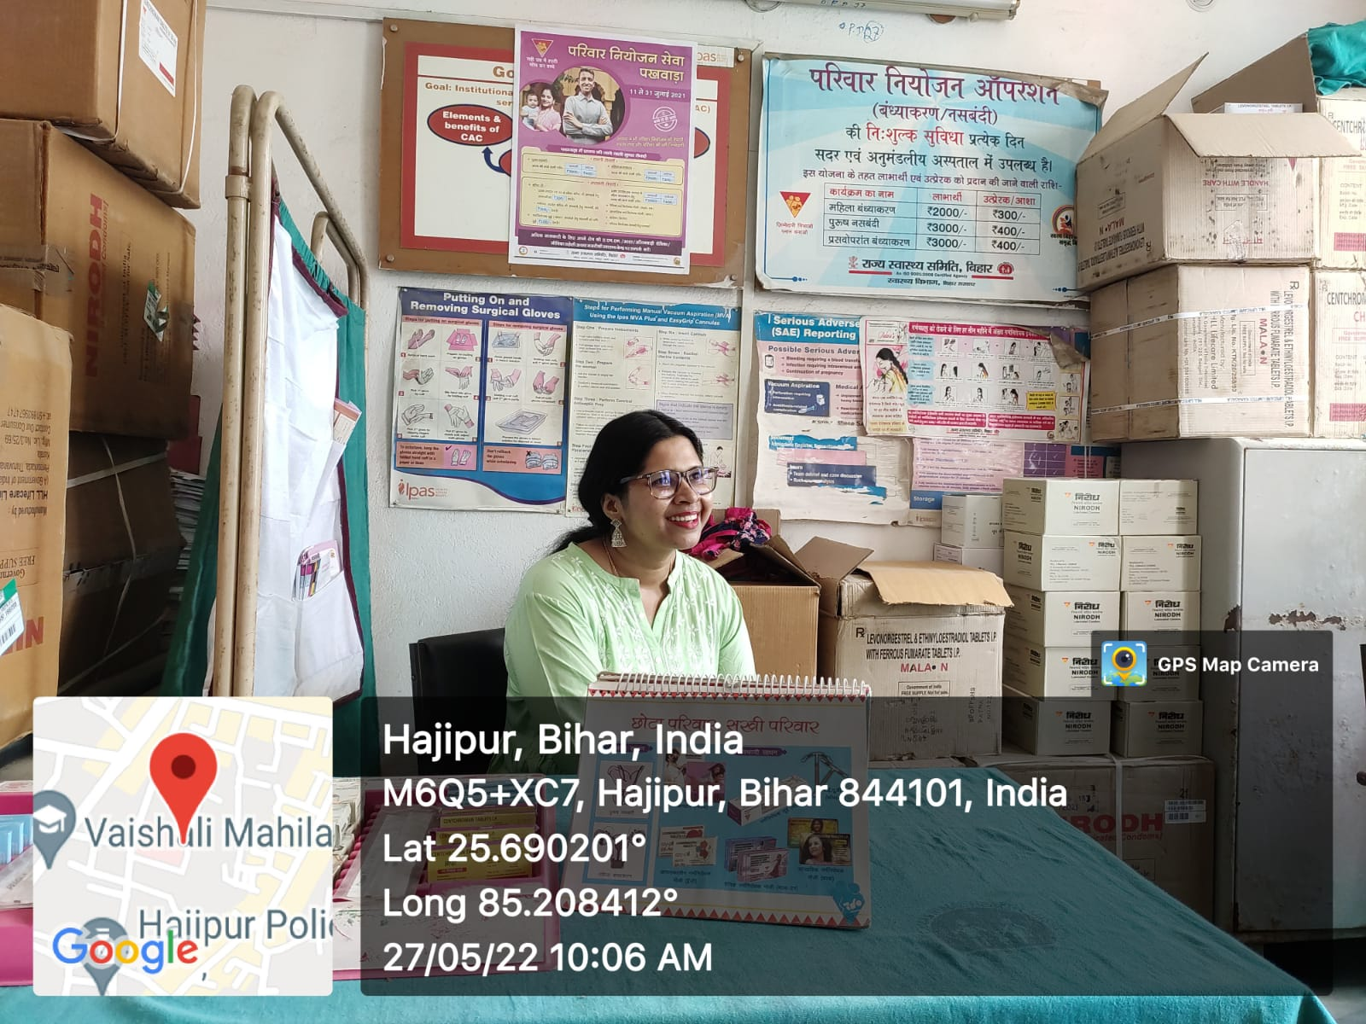
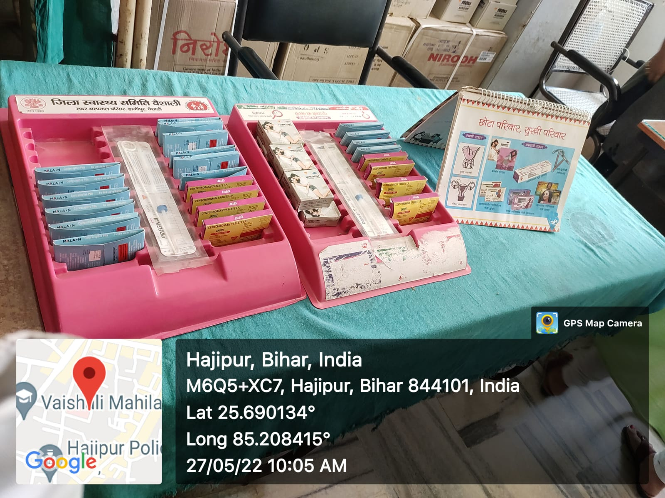
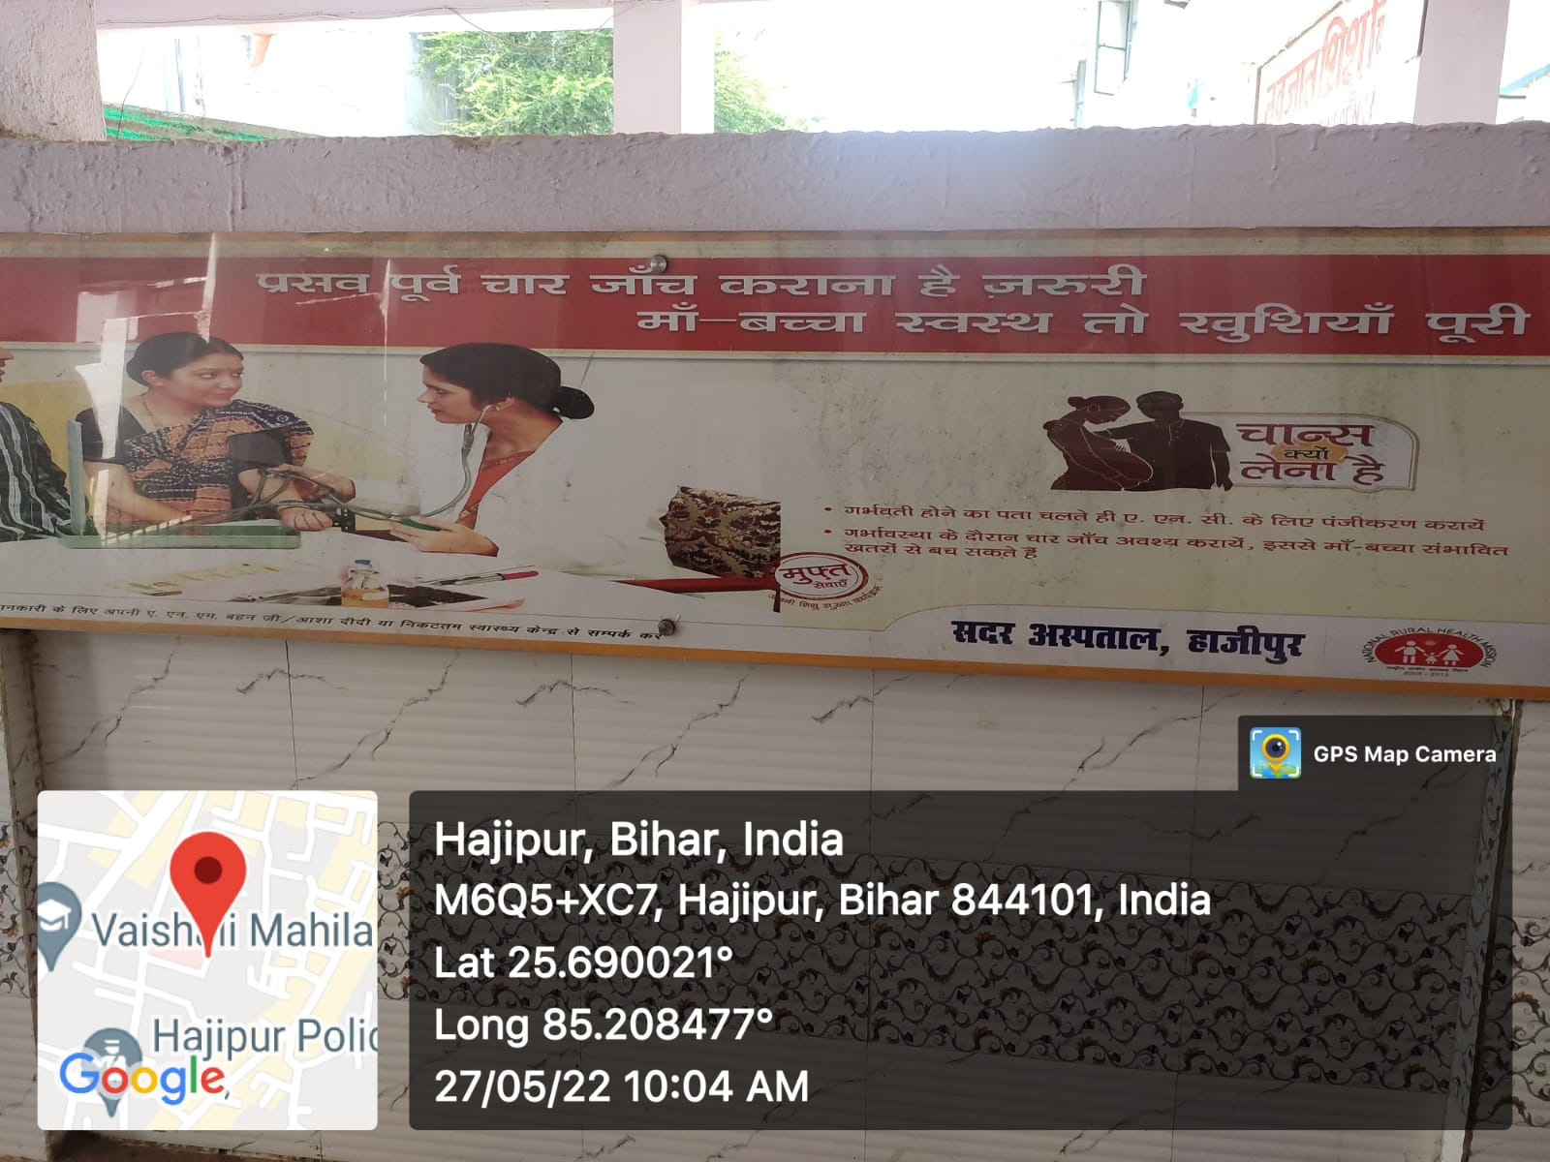
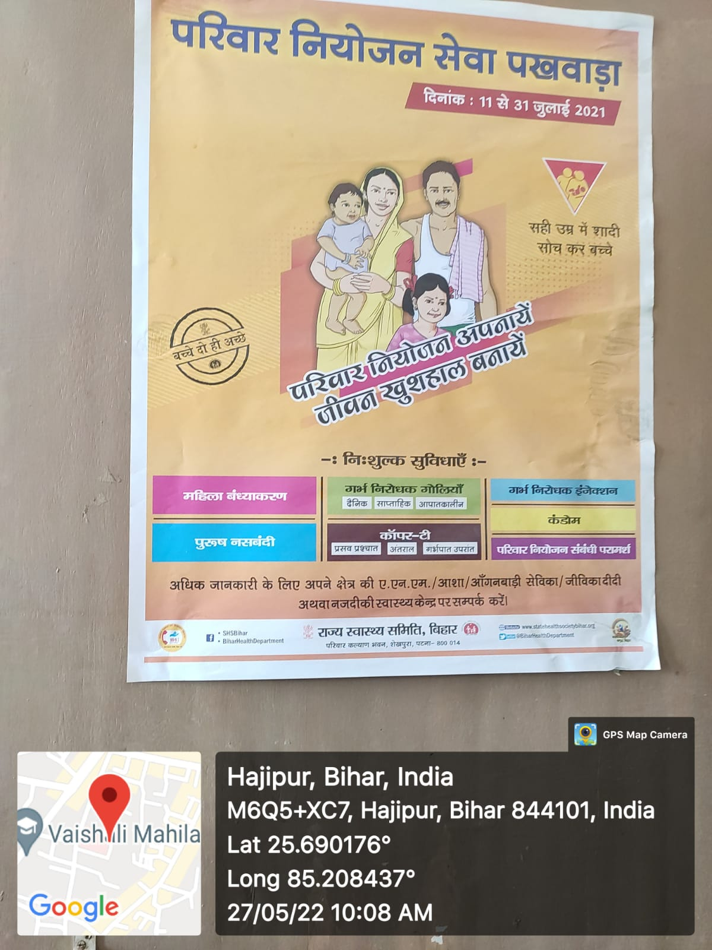
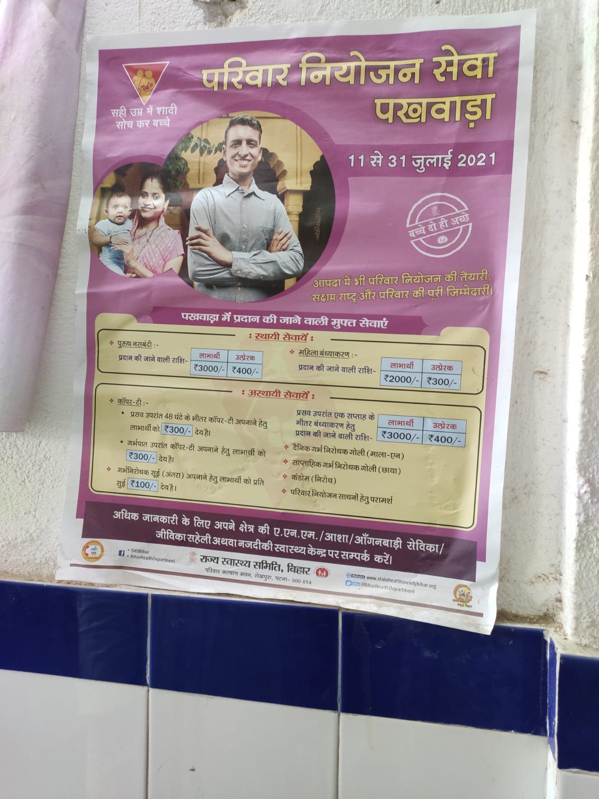
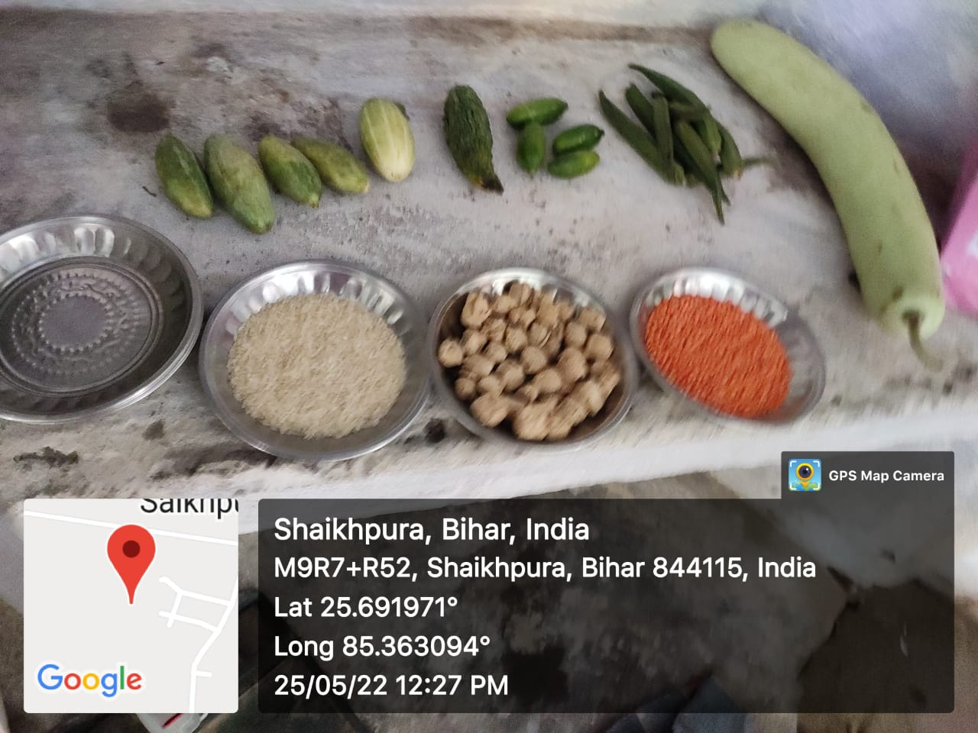
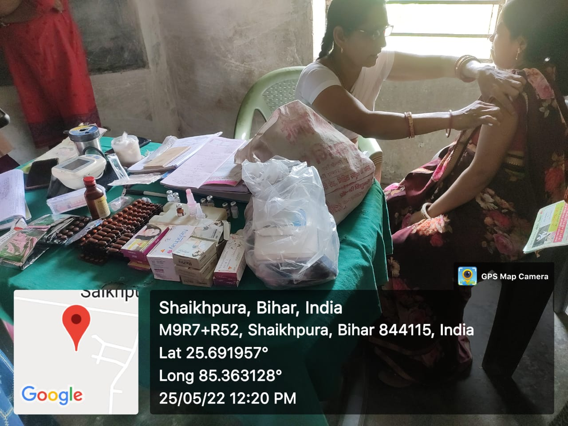
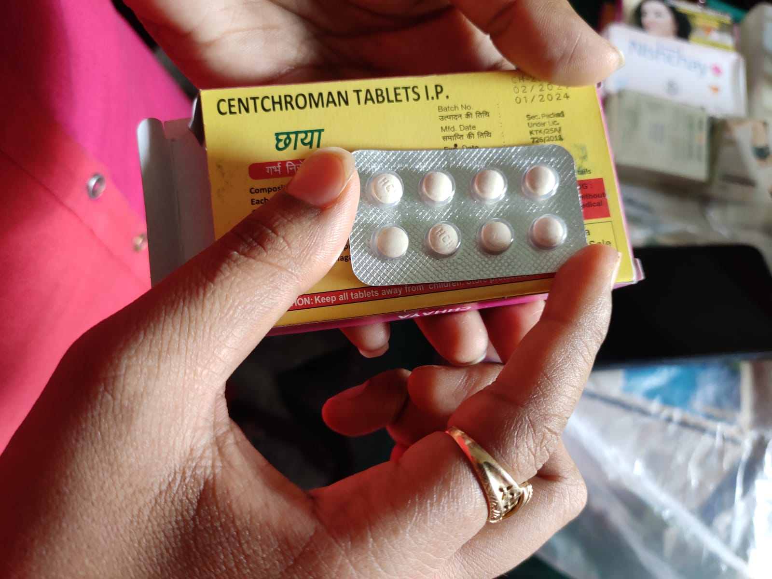
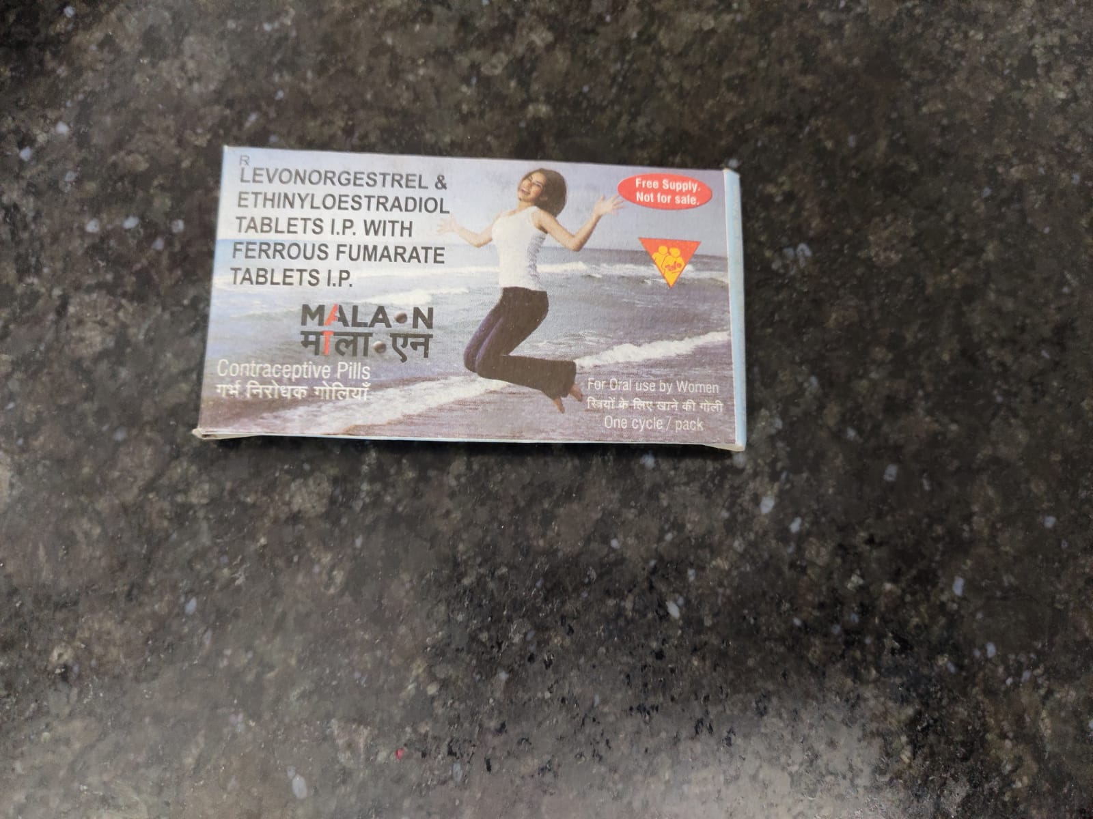
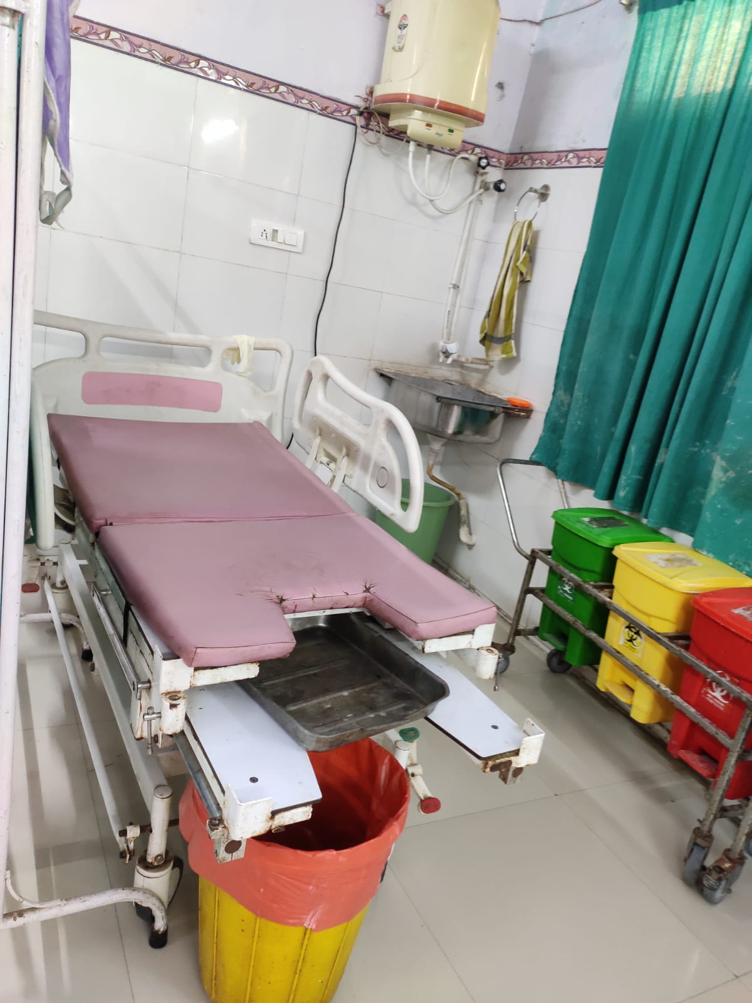
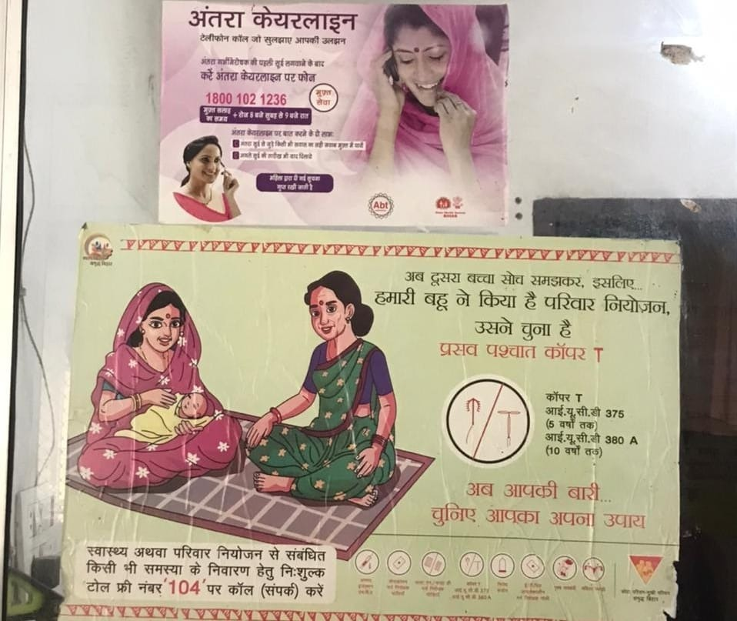
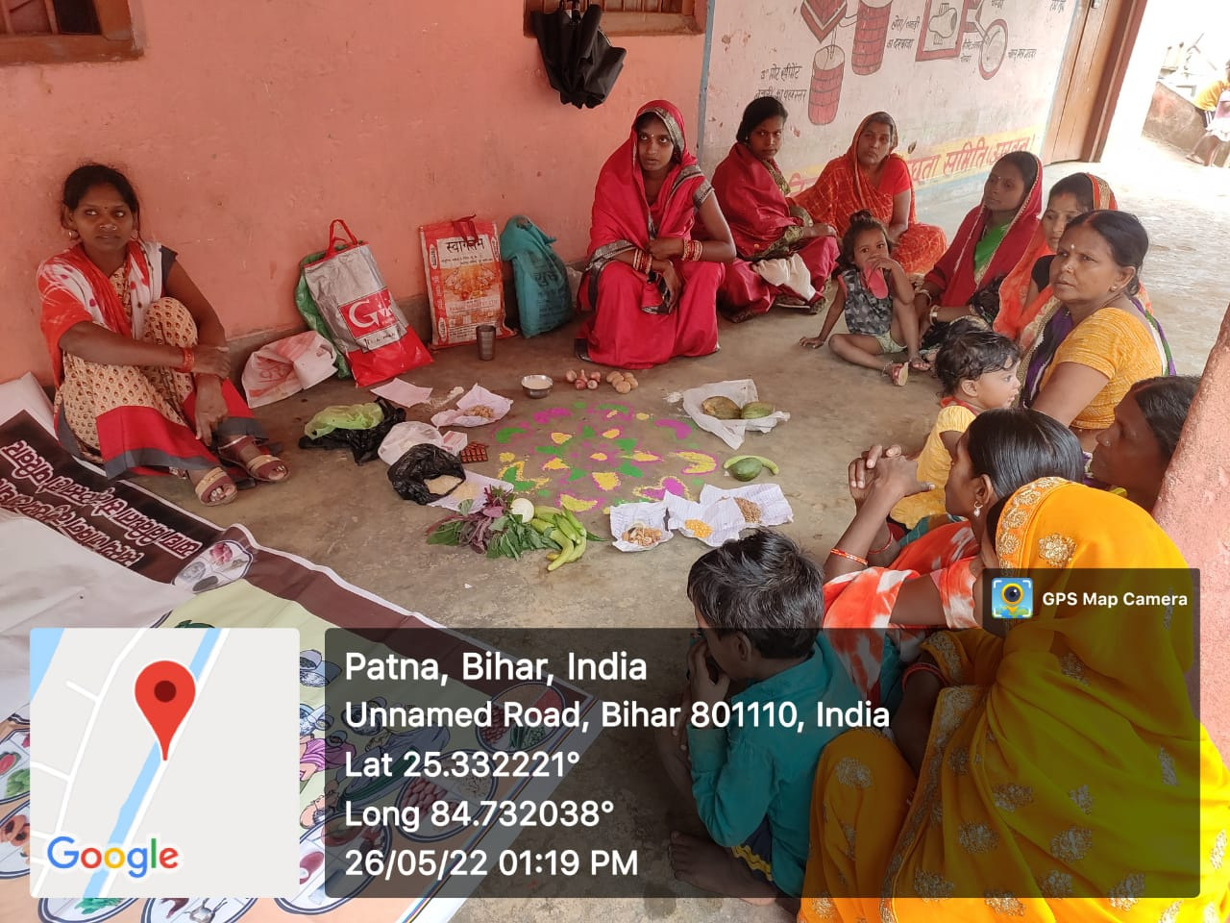
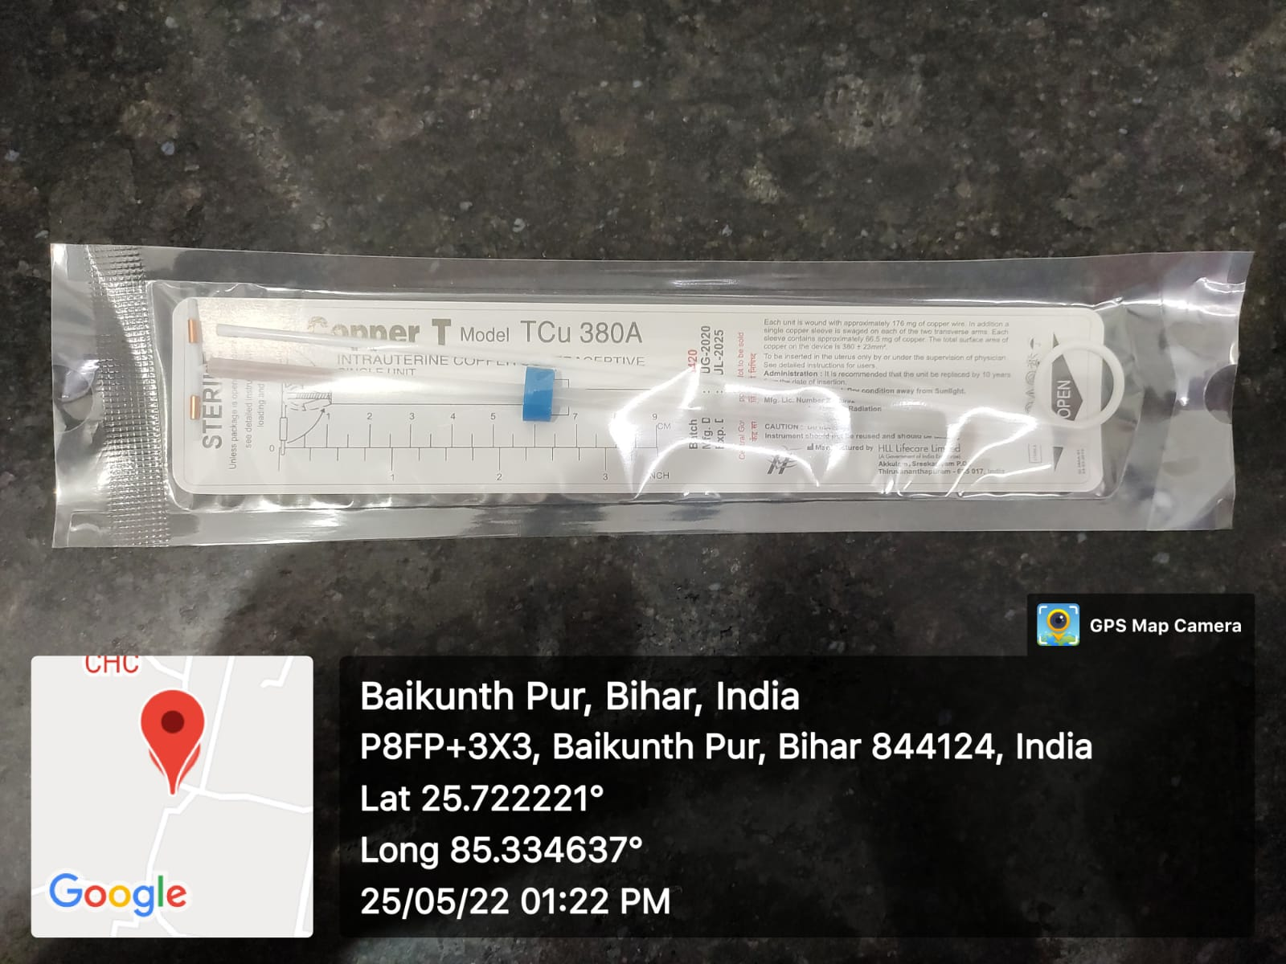
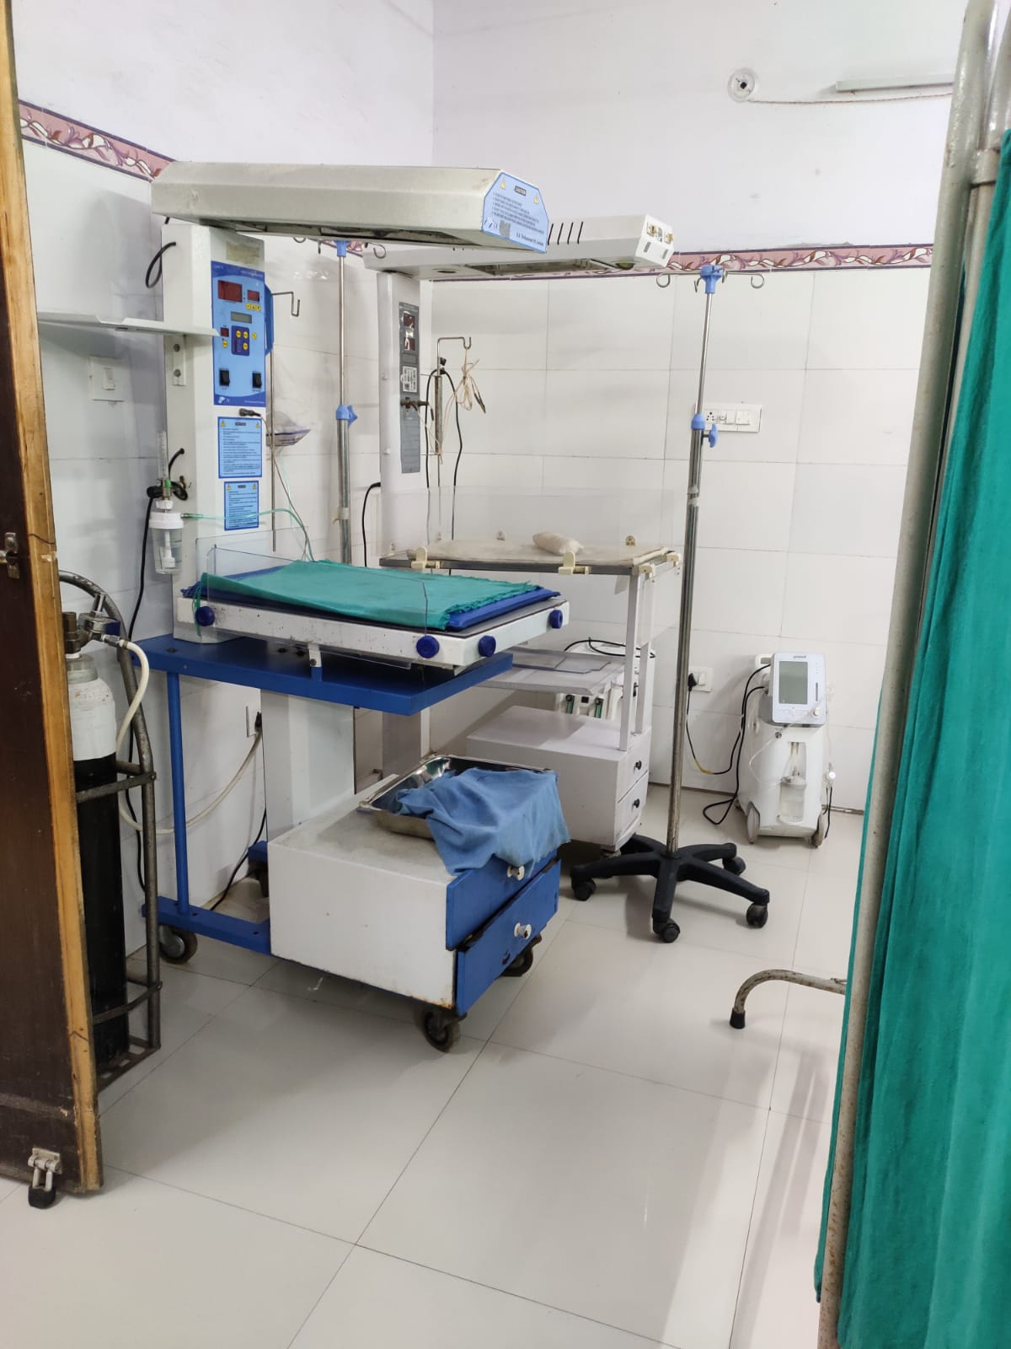
PICTORIAL JOURNEY

Slide 25
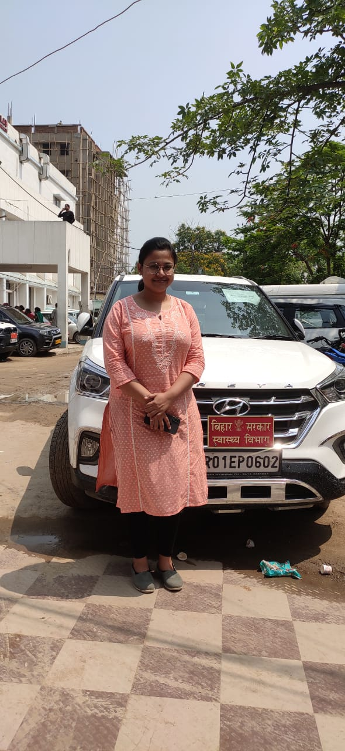
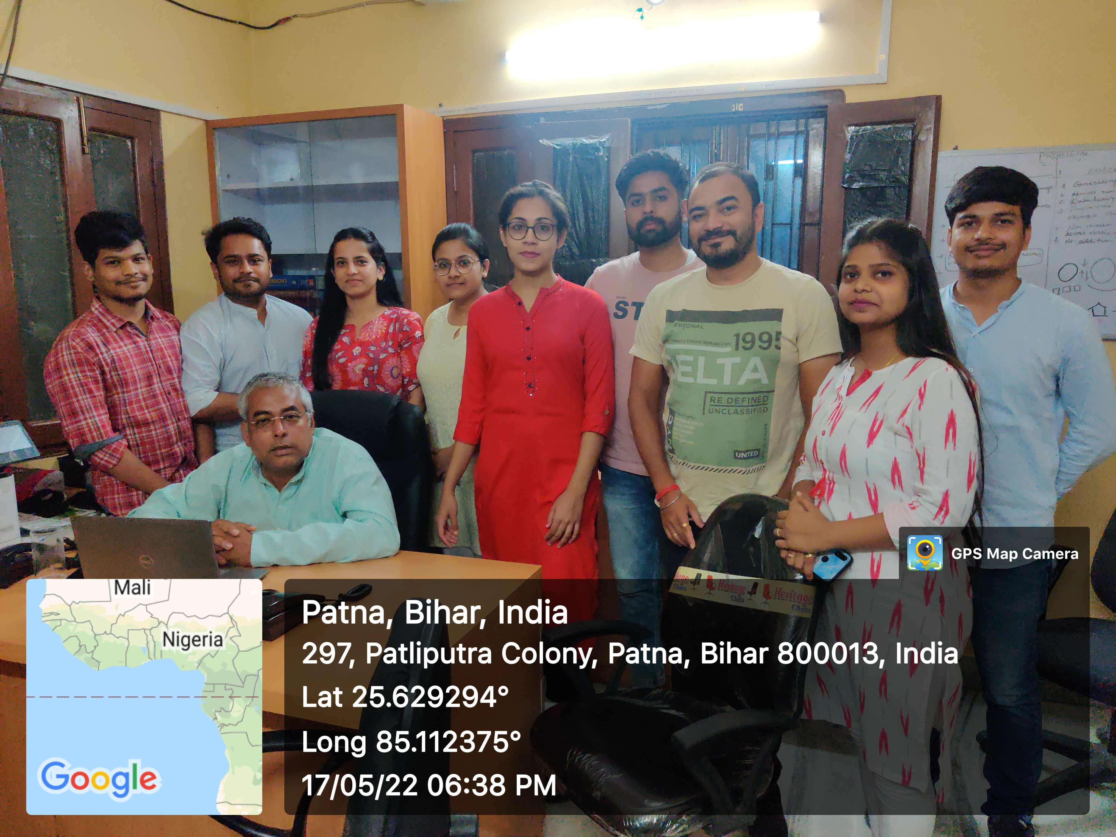
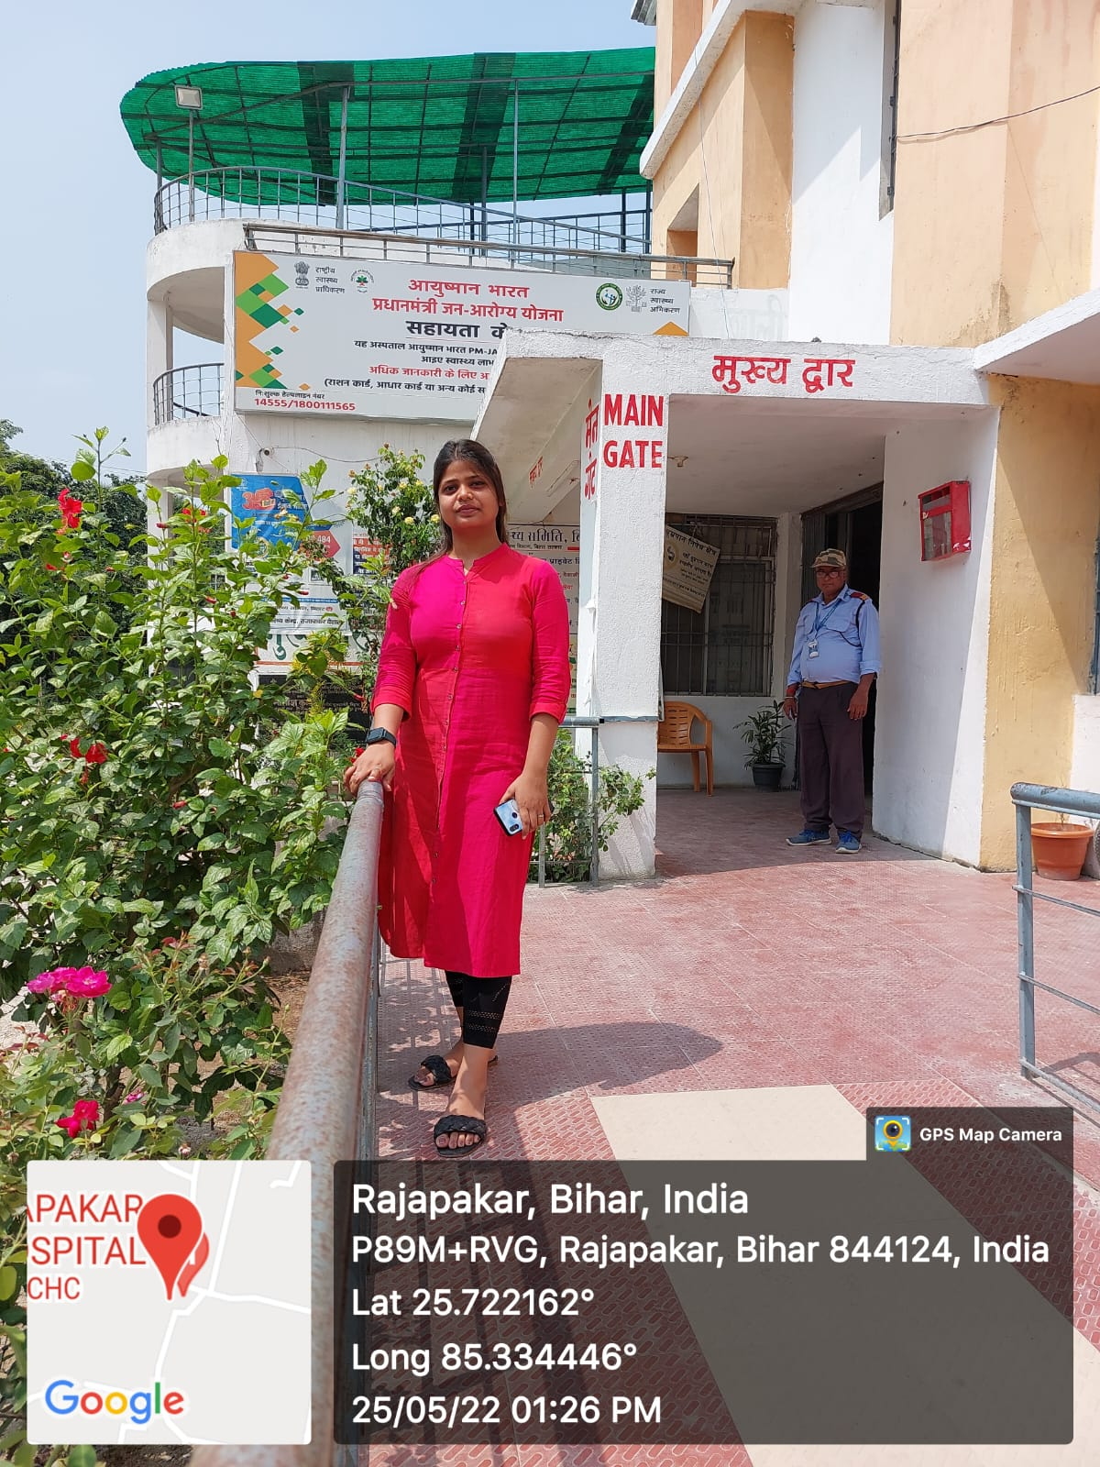
PICTORIAL JOURNEY

Slide 26
Thank You
Any Questions

