Slide 1
@
Dell Services
Interning
Presented By:
Harshita Vijh
PG/11/030
IIHMR – New Delhi

Slide 2



Internship Report
Dissertation Report
Case Study

Slide 3

ORGANIZATIONAL PROFILE

Slide 4
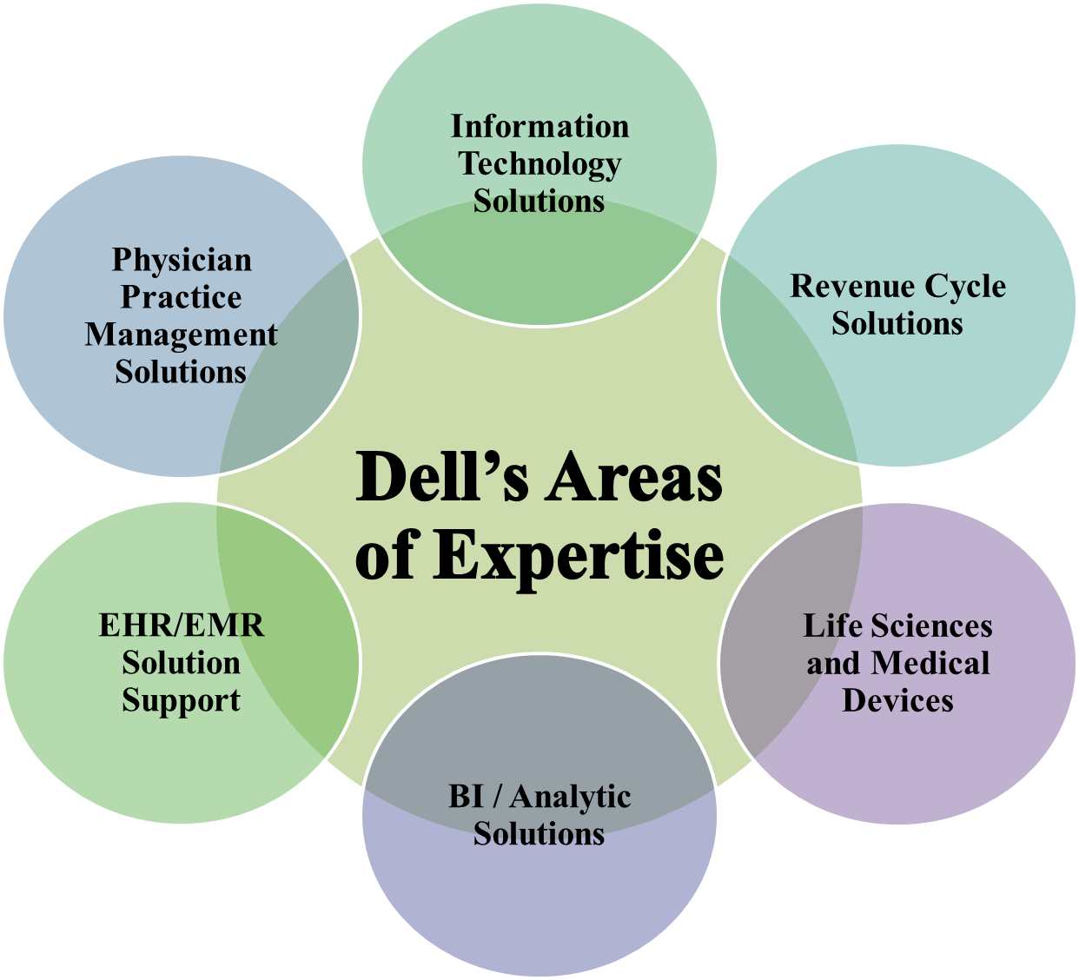
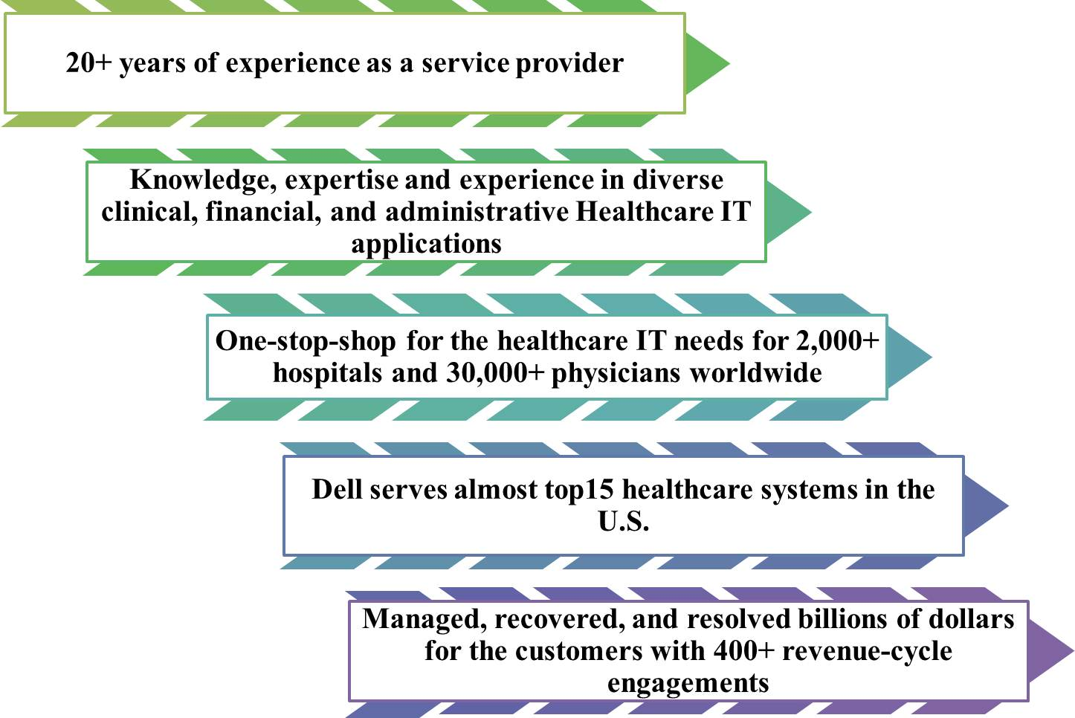
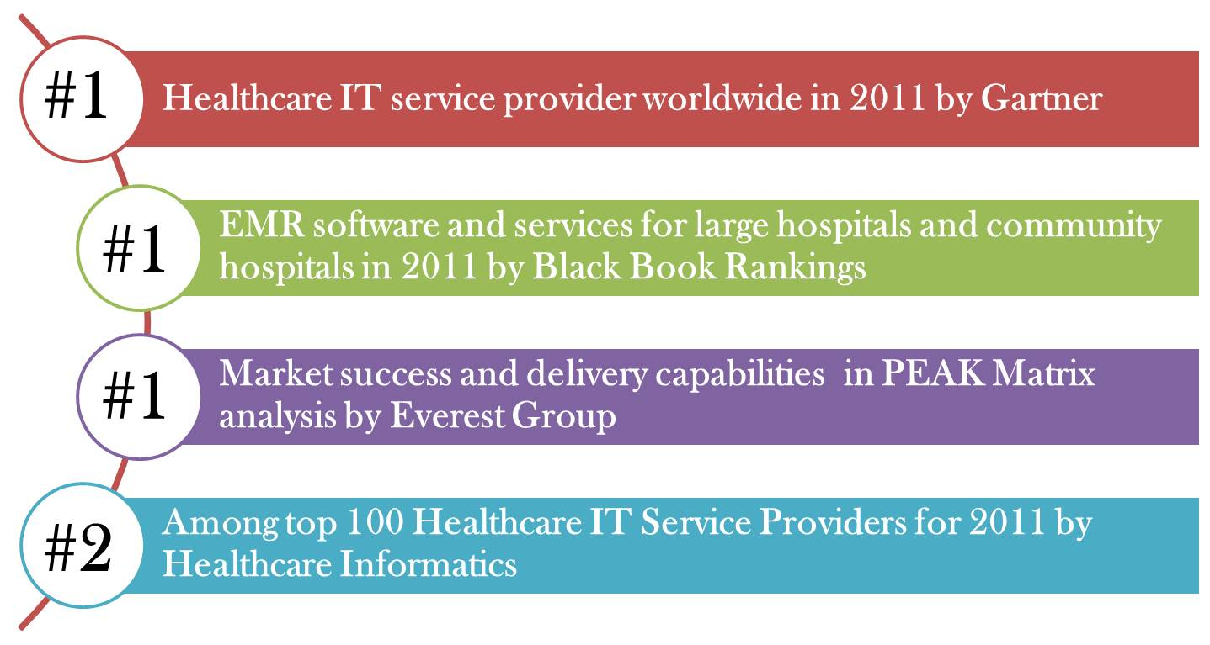
Dell Services
Dell Services the No. 1 leaders for providing the healthcare information technology services in the world
The healthcare consultants and technologists at Dell Services are experienced in end-to-end hospital operations and understand how to develop, design and implement processes and technologies that bring about real provider transformation

Slide 5
Areas of Engagement
Was a part of the “Cerner Core Support Team” to provide offshore L2 support for Cerner EMR to the client in U.S.
Core Tasks
Validations
Audits

Slide 6

Key learning’s at Dell Services
Performed various types of monthly or quarterly core tasks
Learnt about various EHR/EMR and HIS solutions namely Meditech, McKesson and Cerner and their associated modules
Learnt about using the ticketing tool for Service management processes
DBA and Generic Accounts audits for Cerner EMR
Performed Validations of various modules associated with the Cerner EMR
Provided cross – trainings to the new interns on various core tasks
Learnt a brief about the various types of testing performed and upgrades

Slide 7
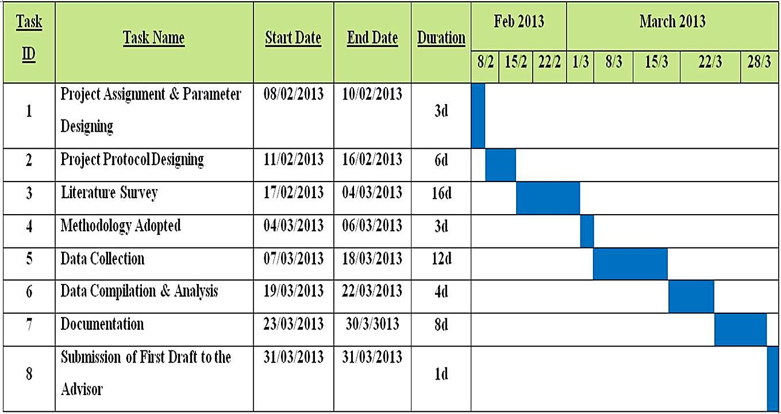
Project Work Plan

Slide 8

PHYSICIAN PRACTICE MANAGEMENT SYSTEMS (PPM)

Slide 9

PROJECT CONCEPT

Slide 10
Rationale of the Study
The main purpose of the report is to describes the extent to which the American physicians are using the practice management systems to improvise their medical practice to sustain in the U.S. healthcare market through 2011
The study majorly focuses on understanding the practice management solution, its adoption by the physician community, the U.S. PPM market trends and the future of PPM for the U.S. healthcare market

Slide 11

Objectives of the Study
General Objective
The main objective of the study is to do an Analysis of the Physician Practice Management System and its need
Specific Objectives
Understanding of the Physician Practice Management Systems and its need
Analyzing the current state of Ambulatory practice
Adoption rates and Market Analysis of the Medical Practice Management Solutions
Future prospects of PPM for the U.S. healthcare providers

Slide 12
Methodology
Research Design: Descriptive, Exploratory and Instrumental Qualitative study
    Pre – Requisite of the study: Understanding the workflows and information flow in an Ambulatory and Acute Care, impact of HIPAA, ARRA – HITECH and Meaningful Use Act
Type of Data
Literature available about Medical Practice Management solutions
PPM/PPMS brochures from the Vendors
Studies, surveys and Journals on PPM
Books, websites, etc.
Audio and Videos for PPM by Vendors
Sample Population: Independent American Physicians’
Notes:
Triangulation of the secondary data from various sources

Slide 13
Limitations of the Study
The study is purely qualitative and has been referenced from multiple secondary sources
The analysis is based on the latest available 2010’s and 2011’s data
The study concentrates more on the stand alone PPM solutions as compared to the integrated one’s
The subscription fee for the top four PPM products is in approximation and therefore, the actual cost of adapting the PPM system may differ than mentioned

Slide 14


INTRODUCTION

Slide 15

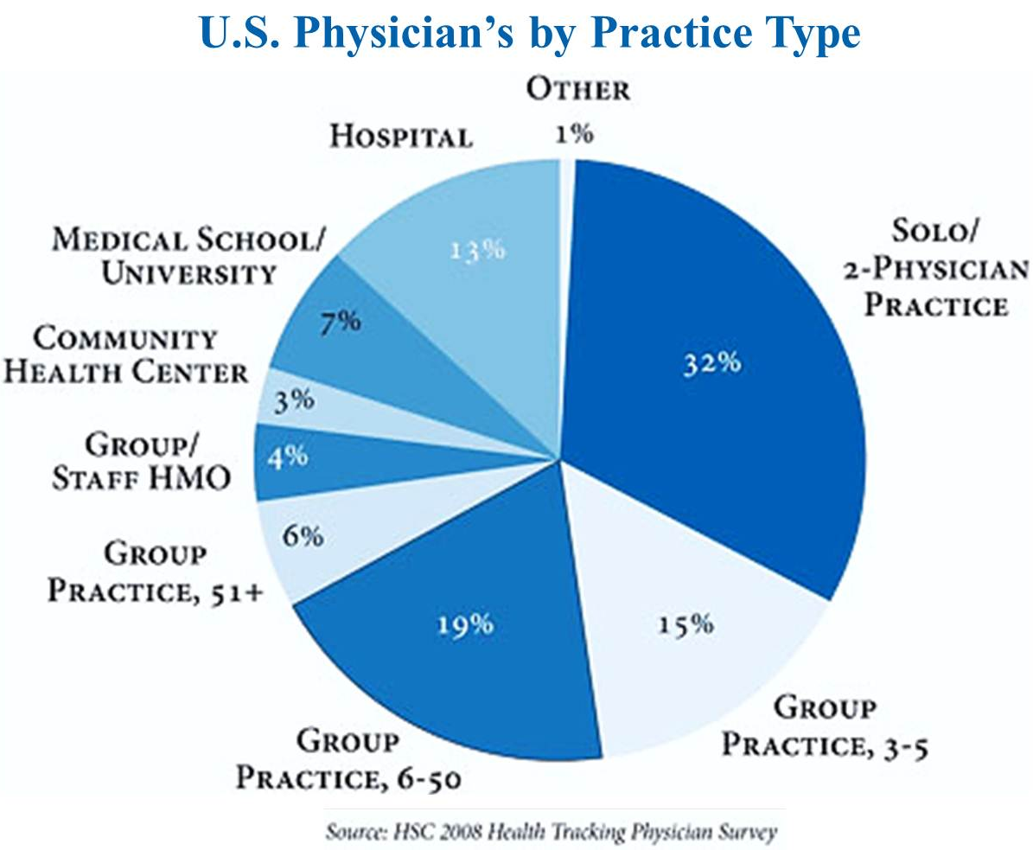
U.S. Healthcare Services
Ambulatory Surgery Centers
Birthing Centers
Industrial Health Clinics
Physician office practices
School Health clinics
Urgent Care Centers
Independent/ Free Standing Care Facilities
Ambulatory/ Outpatient Services
Hospital Based/Acute Care Facilities
Ambulatory Surgery
Clinics and Satellite clinics
Emergency Department
Observation Services
Partial Hospitalization
U.S. Healthcare Services
Contributes to almost 84% of patient’s care
This trend is expected to continue, with a projected of more than 20% by 2019
More than 26 percent of healthcare expenditures is related to ambulatory care
Major percentage of share for the care coordination falls under the free-standing (Ambulatory and Acute care setting) physicians of the U.S healthcare.
General Hospital
Specialty Hospital
Rehabilitation Hospital
Behavioral Health Hospital
Hospitals & Ancillary Care Facilities
Inpatient Services
Assisted Living Facility
Independent Living Facility
Nursing Care Facility
Residential Care Facility
Retirement Care Facility
Long Term Care Facilities

Slide 16
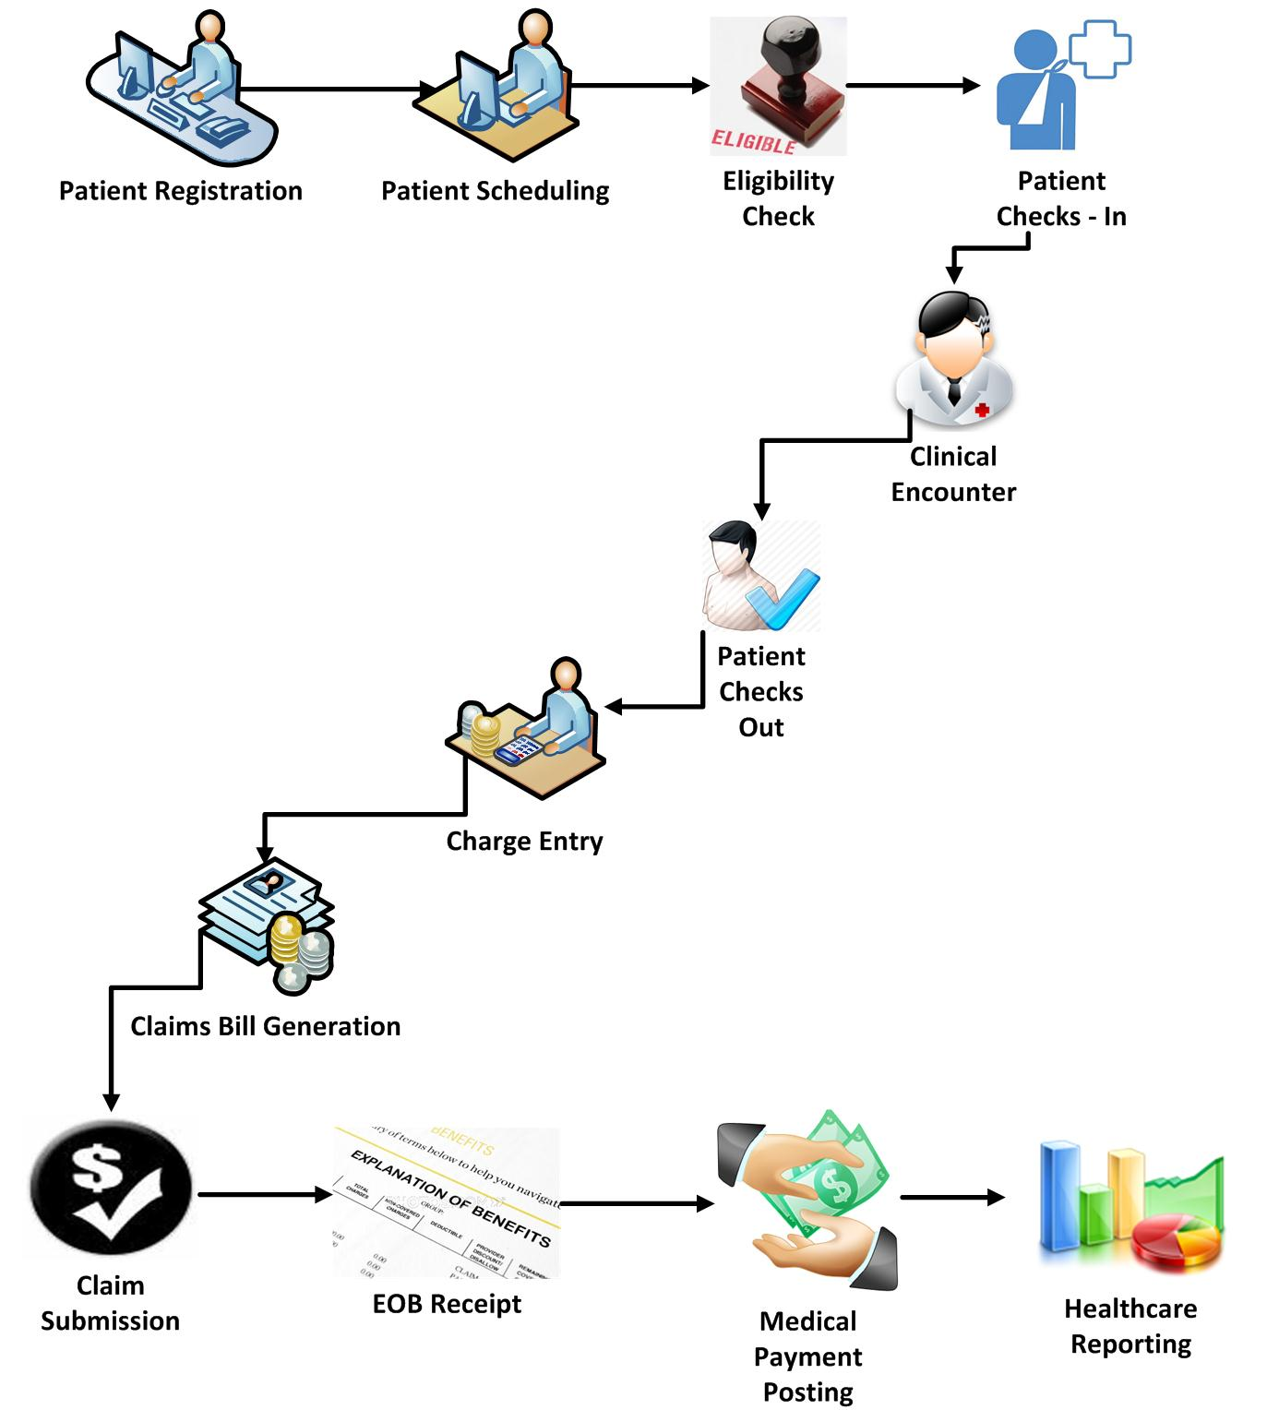
Administrative & Clinical Workflows in a Physician’s Office

Slide 17

ARRA – HITECH ACT
American Recovery and Reinvestment Act (ARRA)
includes
Health Information Technology for Economic and Clinical Health (HITECH) Act
implemented in
CMS Rule
alignment
ONC Rule
Defines the Meaningful Use (MU) criteria
Establishes incentive payments and penalties for MU criteria
Establishes Certification Criteria for EHR and related technologies
outcomes
Quality Enhancement
Cost Reduction
Standardization
Stimulus Incentives

Slide 18

Physician Practice Management Systems
Healthcare IT solution designed to assists the independent physician practices in dealing with the day to day operations of the medical practice
Easy-to-use, intuitive solution to streamline their practice functions and to enhance the quality of care
Associated with the independent physicians, general practitioners or practice managers

Slide 19
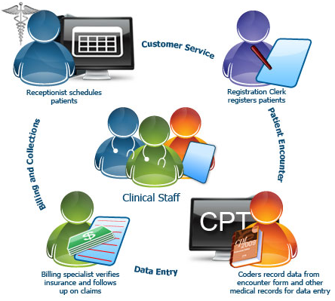
Core Functionalities of PPM System
Appointment Scheduling
Patient Registration
Billing & Claims Statements
Coding & Reporting

Slide 20
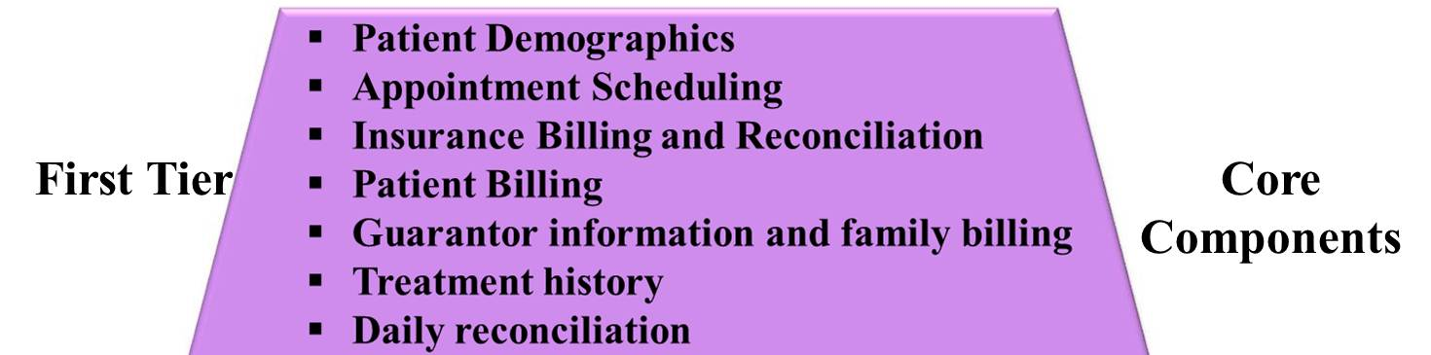
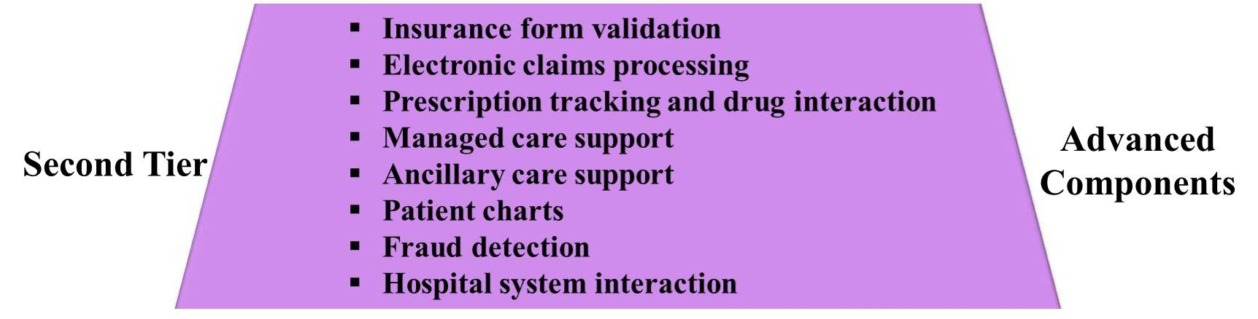
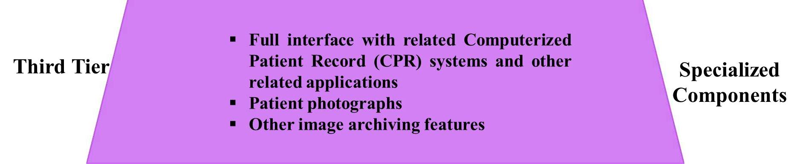
Components Of PPM System

Slide 21
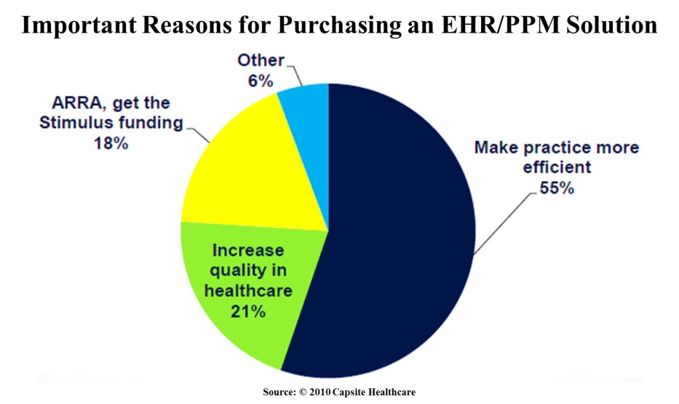
Driving Factors
ARRA Incentives
Driving Factors for PPM Adoption
Quality Enhancement
e – claims Submission

Slide 22

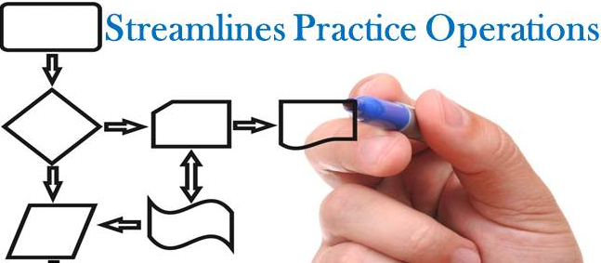









Why PPM??

Slide 23

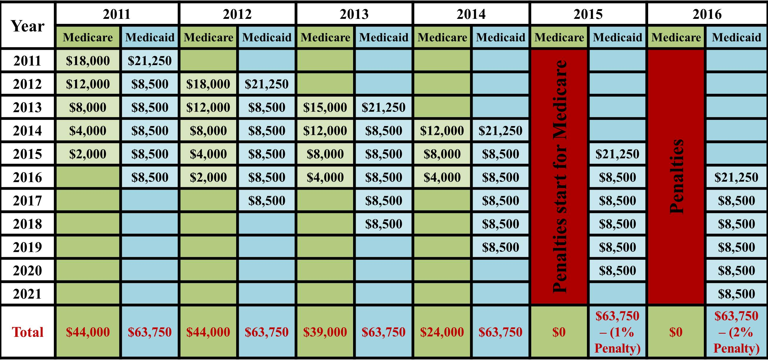
ARRA – HITECH Incentives For Eligible Professionals

Slide 24


RESULTS
AND
DISCUSSION

Slide 25

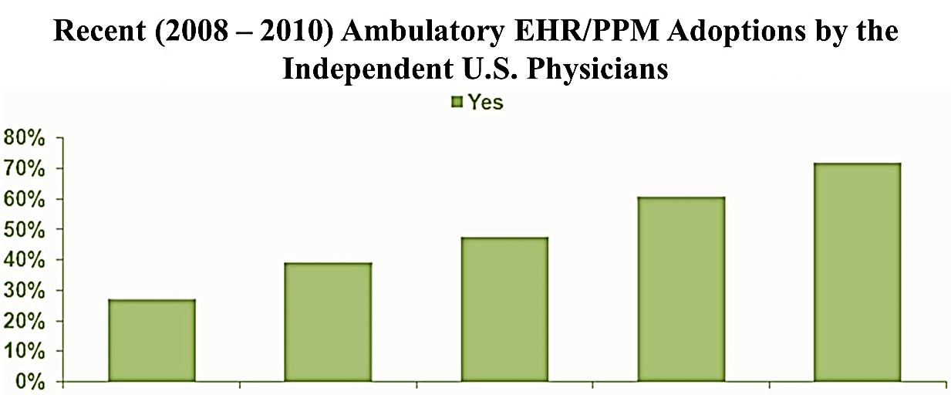
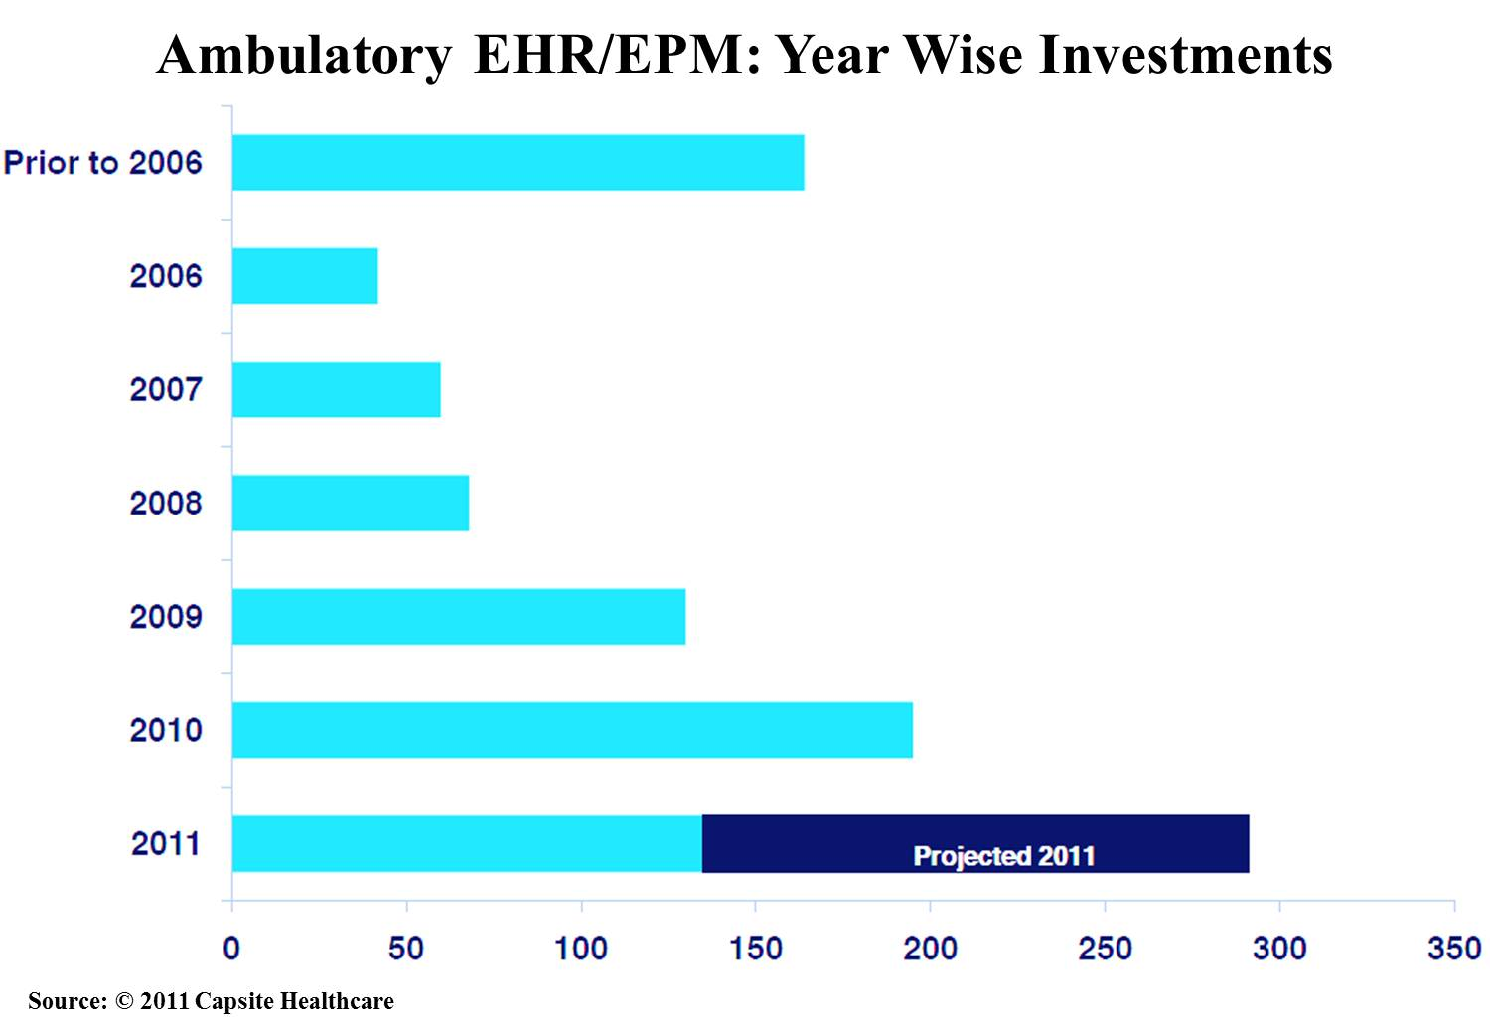
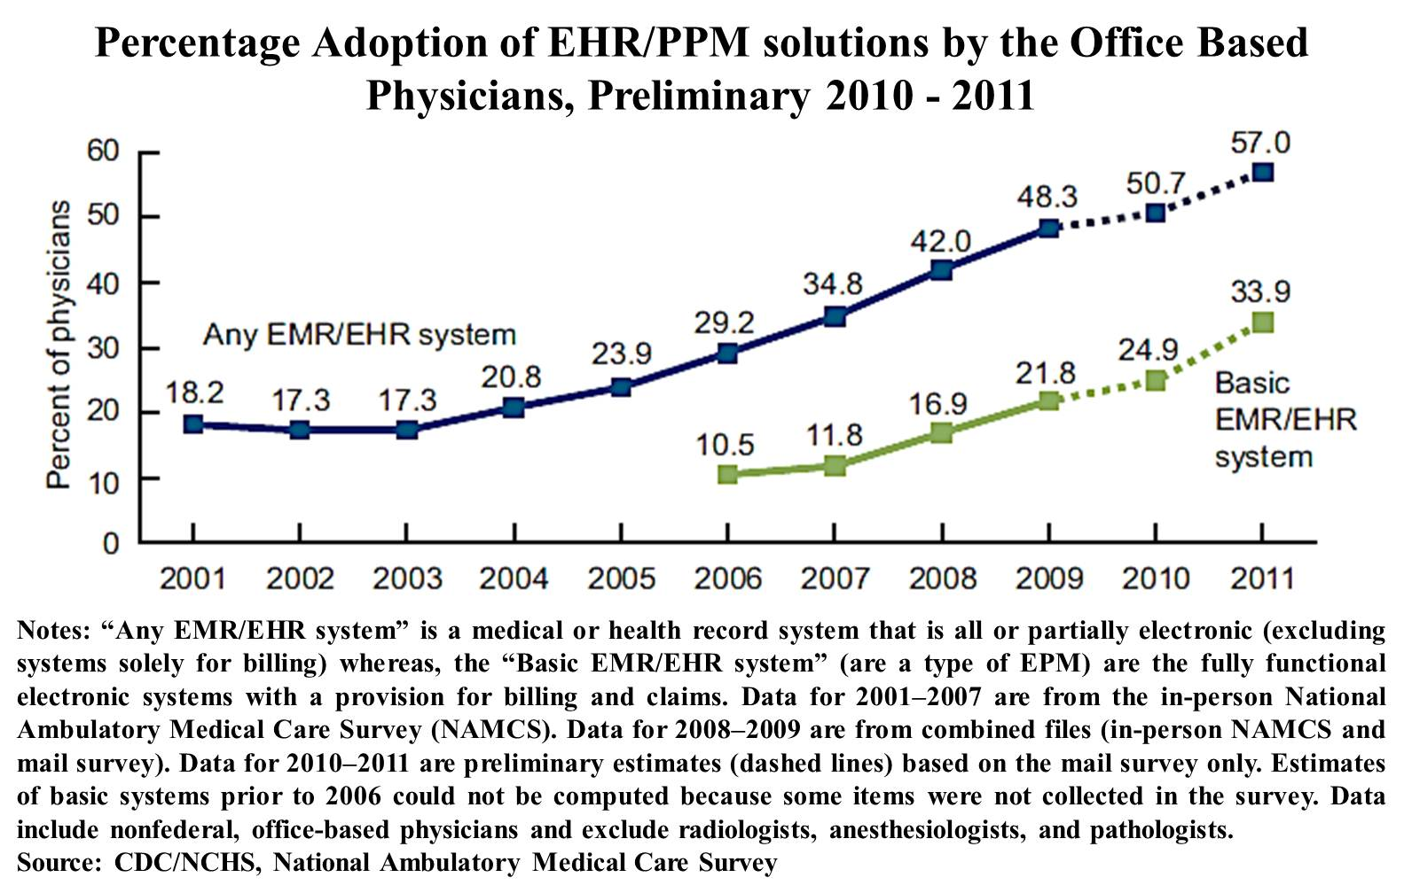
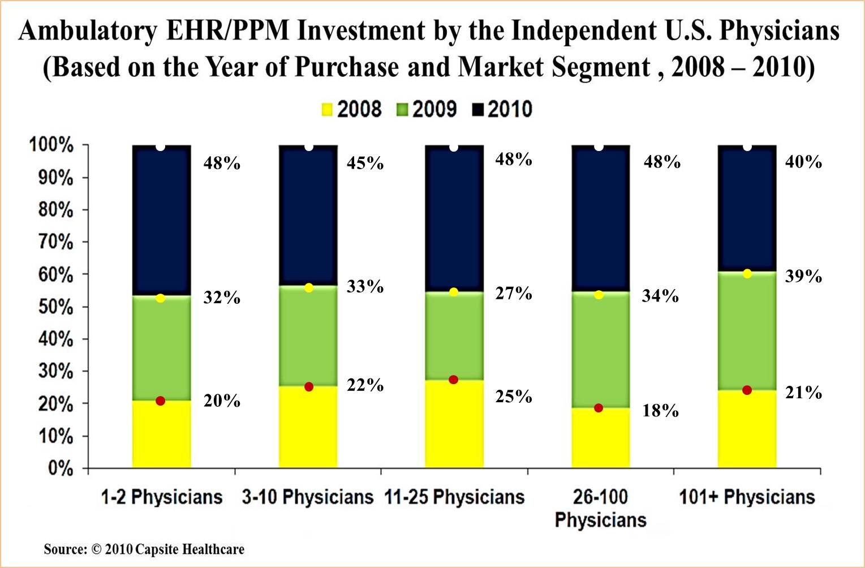
EHR/PPM Adoption Trends
An increase of about 36% in 2011 as compared to the 25% in 2010

Slide 26

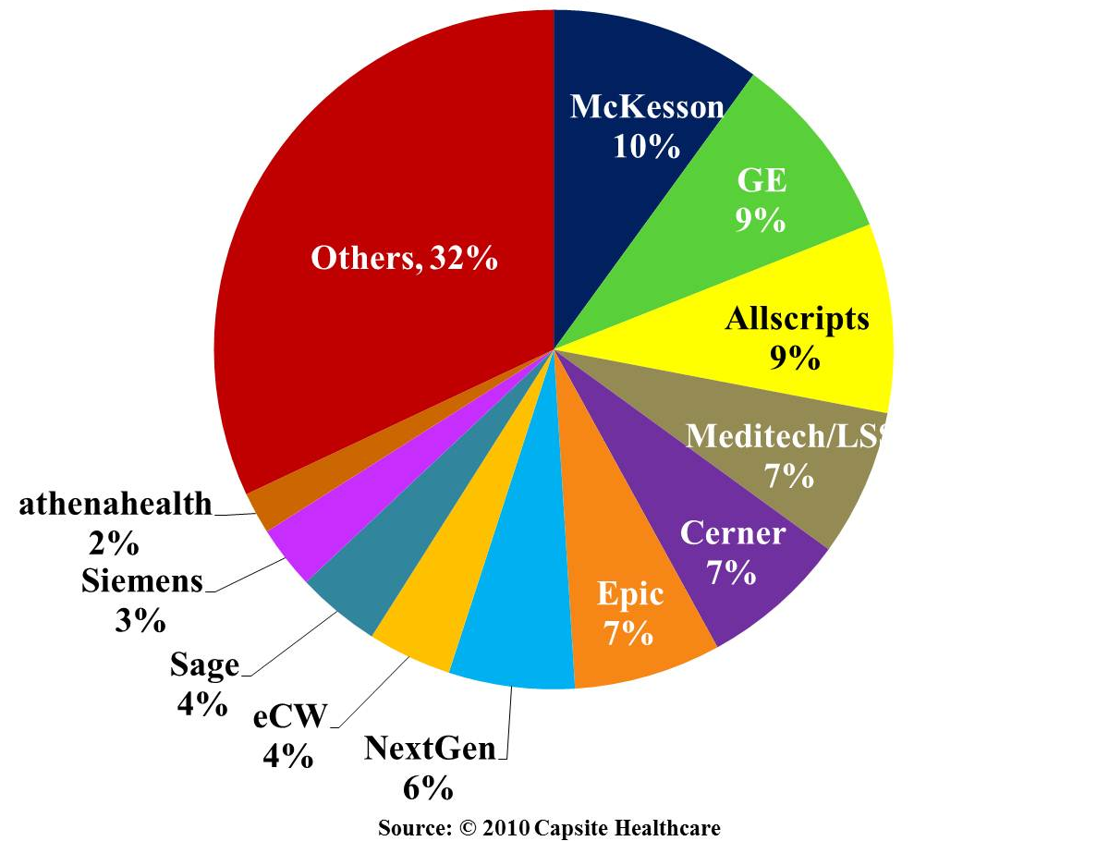
PPM Vendor Market Share

Slide 27
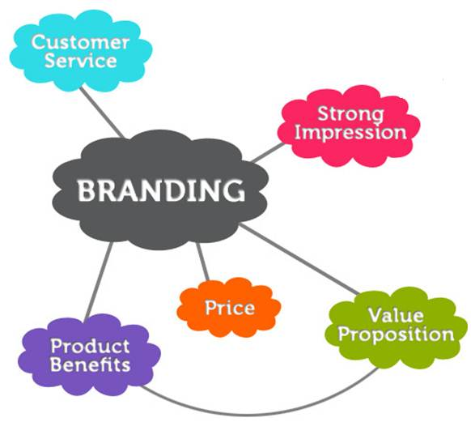
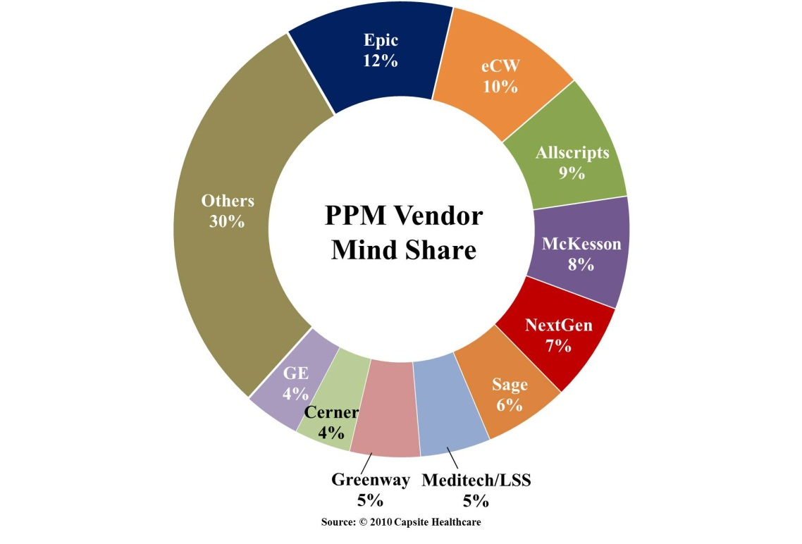

Slide 28
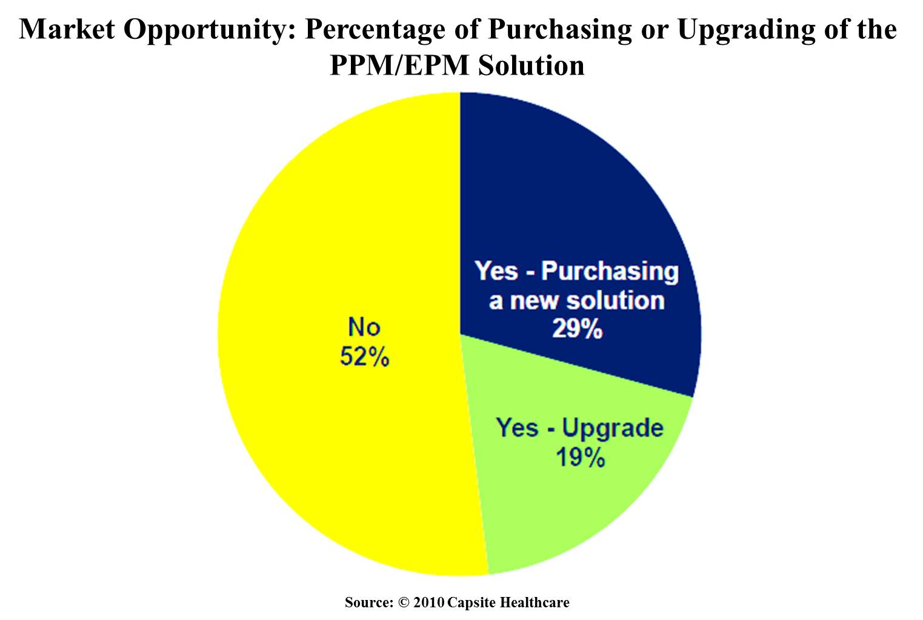
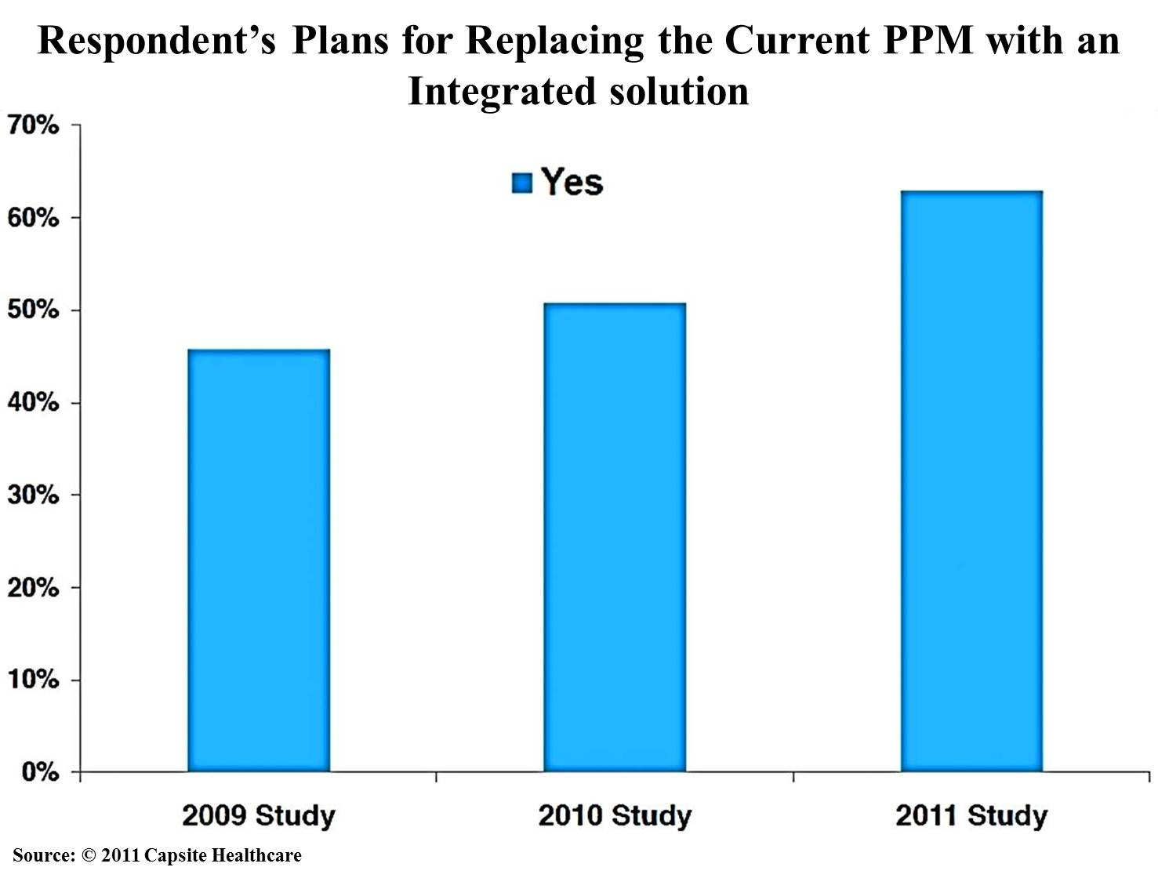
PPM/EPM Vendor Market Opportunities

Slide 29

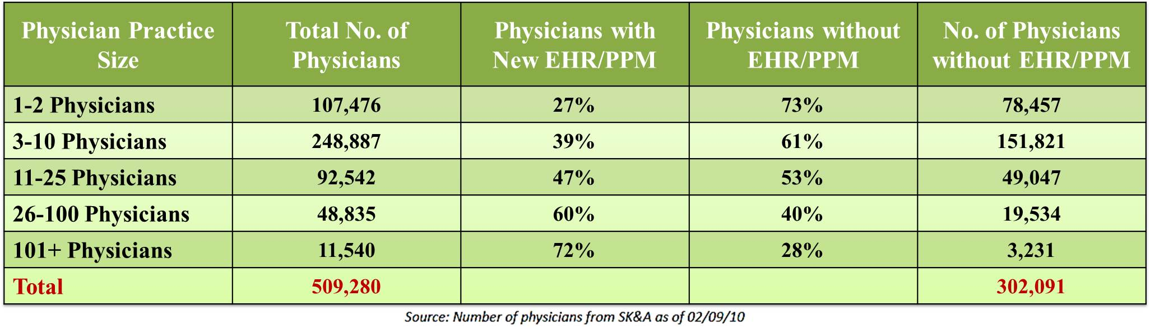
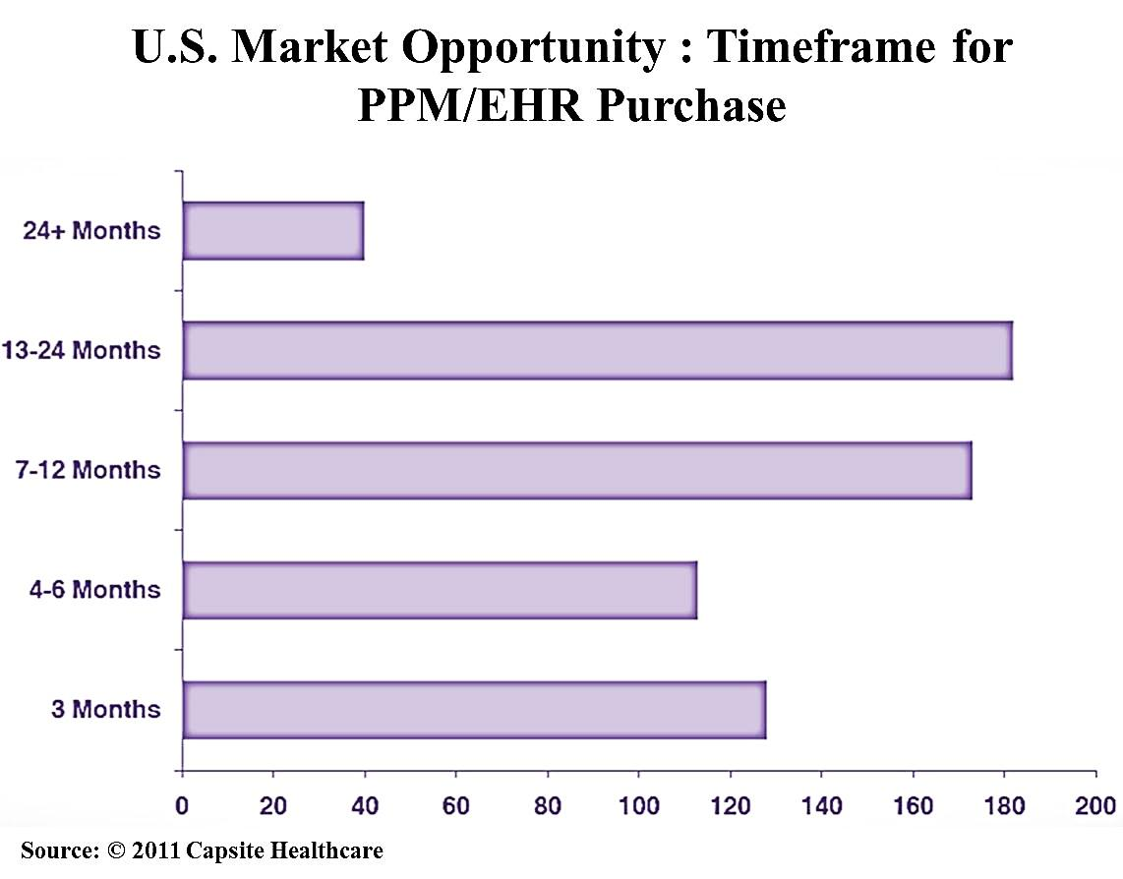
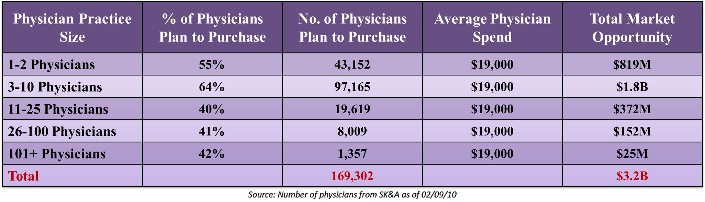
PPM/EPM Vendor Market Opportunities

Slide 30


OPPORTUNITIES FOR HEALTHCARE SERVICE ORGANIZATIONS

Slide 31


PPM Vendor & Healthcare Service Organizations
PPM systems vendors entering into strategic partnerships with healthcare services organizations
Reasons for Partnerships:
Insufficient capabilities to provide service and support to the customer directly
Lack of domain experience and expertise
Total enterprise support including the integration with other Healthcare IT solutions
Cost

Slide 32
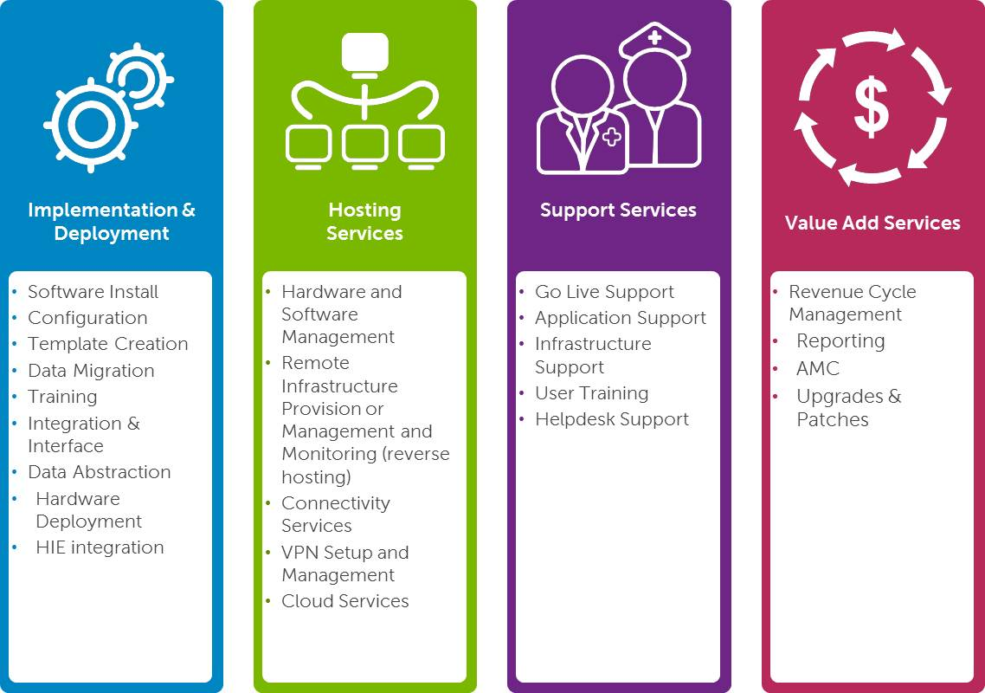
Support Areas for PPM
Implementation & Deployment
Hosting
Services
Support Services
Value Add Services
$
Software Install
Configuration
Template Creation
Data Migration
Training
Integration & Interface
Data Abstraction
Hardware Deployment
HIE integration
Hardware and Software Management
Remote Infrastructure Provision or Management and Monitoring
Connectivity Services
VPN Setup and Management
Cloud Services
Go Live Support
Application Support
Infrastructure Support
User Training
Helpdesk Support
Revenue Cycle Management
Reporting
AMC
Upgrades & Patches

Slide 33



Conclusion

Slide 34
Case Study
Analysis of Stress Levels &
Use of Information Technology among the IT Professionals of Bangalore

Slide 35

Objectives of the Study
Case study is based on the analysis of the occupational stress levels and the use of Information Technology to overcome its consequences by the IT Professionals of Bangalore
The primary objectives of the study are:
To analyze the level of occupational stress among the IT Professionals of Bangalore
To study the relationship between the demographic characteristics (Gender, Age and Work Experience) and the level of occupational stress among the IT Professionals
To analyze and determine the possibility of using Information Technology to reduce the levels of stress

Slide 36
Problem Statement
Stress levels among the IT professionals has increased in the last few years. The increased stress is due to the fact that they are more integral part of the overall business and like other business people, feel the pressures of quick product cycles, major changes in organization structure, and decreased downtime
There is clearly a need for organizations and IT professionals to pay attention to and manage the occupational stress of IT professionals. Organizations that fail to do so are likely to have dissatisfied employees and high staff turnover. IT professionals who fail to effectively manage their stress may end up with a variety of health problems

Slide 37

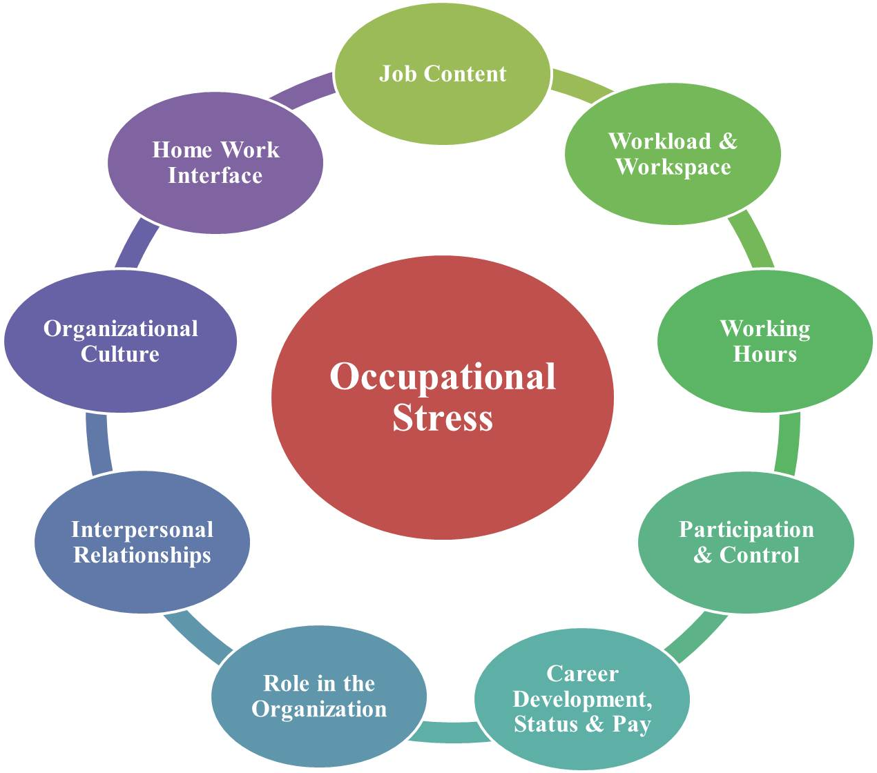
Occupational Stress & its Impact
Occupational stress -also called work stress, job stress or stress in organizations- “is a condition wherein job-related factors interact with the worker to change, either disrupt or enhance, his or her psychological or physiological conditions such that the individual's mind and/or body are forced to deviate from normal functioning.”

Slide 38
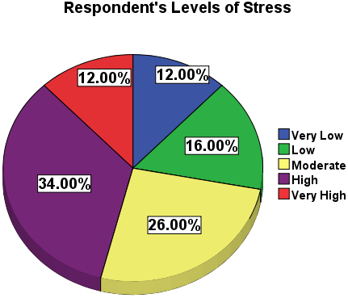
Results & Discussion
Results of Research Hypothesis
Hypothesis | Pearson Correlation | Sig. (2 – Tailed) | Result | N = 50
H₁0 (Gender) | 0.069 | 0.635 | Null Hypothesis Rejected
H₂0 (Age) | -0.240 | 0.616 | Null Hypothesis Rejected
H₃0 (Work Experience) | -0.195 | 0.047 | Null Hypothesis Accepted
H₄0 (Marital Status) | -0.52 | 0.718 | Null Hypothesis Rejected
H₅0 (Use of IT for Stress Management) | 0.390 | 0.13 | Null Hypothesis Accepted
Notes:
H0₁: There is no significant relationship between gender and the level of occupational stress
H0₂: There is significant relationship between Age of the Respondent’s and the level of occupational stress
H0₃: There is no significant relationship between the Work Experience and the level of occupational stress
H0₄: There is no significant relationship between the Marital Status and the level of occupational stress
H0₅: The use of Information Technology can be helpful in managing the levels of stress

Slide 39
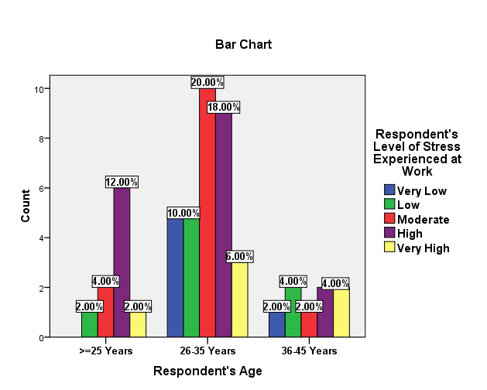
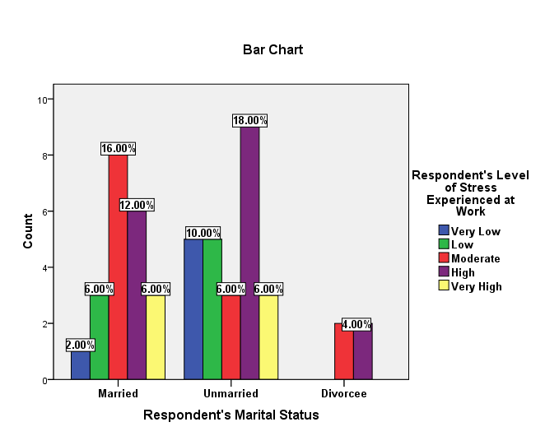
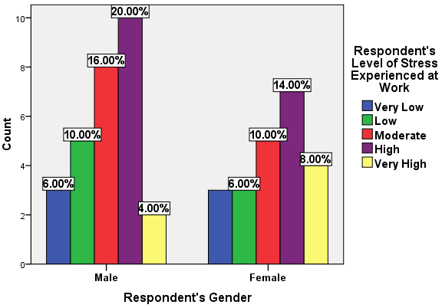
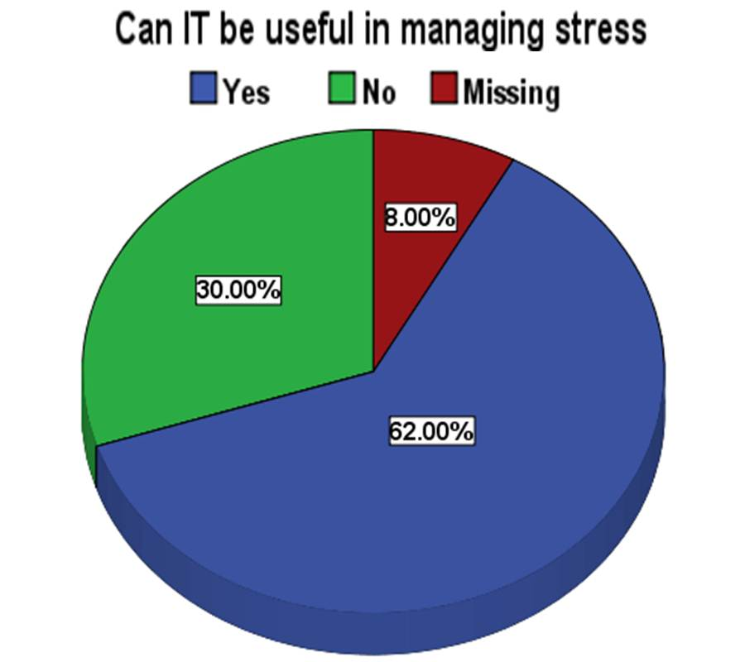

Slide 40

Conclusion
Higher levels of occupational stress is affecting the quality of life of the majority of the respondents
Demographic variables influence the level of job stress and quality of life of IT professionals It is clear that the demographic profiles with which people enter employer organizations ultimately affect the IT such companies’ profitability and effectiveness indirectly by impacting on the employees’ job stress and job satisfaction

Slide 41

Recommendations
Enterprises should ensure that there should be adequate scope for individual customization of work content, performance reward structures and characteristics of the work environment
Moreover, the adaption of internet based stress management (ISM) solutions like the online relaxation practice materials, strategies to help cope with life’s stressors, stress assessments programs, and daily topics to inspire participants to continue the meditation and relaxation techniques

Slide 42

References
        Healthcare Informatics, “Ambulatory EHR and Practice Management System Demand, 2011”, http://www.healthcare-informatics.com/Rising_Demand_for_Ambulatory_EMR_Systems.pdf
        Esther Hing and Sayeedha Uddin, “Visits to Primary Care Delivery Sites: United States, 2008,” Centers for Disease Control and Prevention, National Center for Health Statistics, NCHS Data Brief, No. 47, October 2010, http://www.cdc.gov/nchs/data/databriefs/db47.htm
        U.S. Census Bureau, Industry Statistics Sampler, NAICS 62111, “Offices of Physicians”, http://www.census.gov/econ/industry/hierarchy/i62111.htm
        Peter Berman , “Organization of ambulatory care provision: a critical determinant of health system performance in developing countries, 2000”, Bulletin of the World Health Organization, 2000, Ref. No. 00-0592, World Health Organization
        KLAS Research, Reports on EHR/PPM vendors and product, http://www.KLASresearch.com
        Capsite for Healthcare, “2010 and 2011 U.S. Ambulatory EHR PM Study” http://www.CapSite.com

Slide 43



