Slide 1

Pilot Study on the Cardiovascular status among Health Employees : An Observational Study
Researcher: Monica Chettri | Roll No: PG/23/066 | Institution Mentor: Dr. Sukesh Bhardwaj

Slide 2
Background - Rationale and Development of the Study
Growing Global Concern: Cardiovascular diseases (CVDs) remain the leading cause of death worldwide, with an increasing trend observed even in younger, working-age populations.
Workplace as a Critical Factor: The modern work environment, particularly in corporate settings, introduces unique stressors and lifestyle patterns that significantly elevate CVD risk. Long working hours, high job demands, and limited control contribute to this increased risk.
IT Sector Vulnerability: IT professionals face specific challenges, including sedentary behavior, prolonged sitting, and high-pressure work environments, making them a particularly vulnerable group.
Follow-Up Care Neglect: Despite the known risks and the importance of early detection and management, there is a concerning lack of timely medical follow-up among employees with early risk markers or those advised for routine screening.
Research Gap and Study Focus: Existing research has not fully addressed the impact of missed follow-ups in the workplace, particularly in relation to occupational stress and lifestyle factors. This study aims to fill this gap by examining how neglecting medical follow-up interacts with workplace and lifestyle factors to influence cardiovascular health in corporate employees.

Slide 3
Problem Statement
Escalating CVD Risk: Corporate employees, particularly in the IT sector, face an alarming rise in CVD risk, driven by occupational stress and unhealthy lifestyles.
Critical Adherence Gap: A central, underexplored problem is the insufficient adherence to medical follow-up among these employees, even when advised for routine screening or identified with risk factors.
Barriers to Proactive Care: This non-adherence stems from perceived obstacles like time constraints, a low sense of urgency when asymptomatic, and work-related barriers.
Unmitigated Risk Progression: This behavioral gap directly prevents IT employees from effectively avoiding or mitigating the progression of CVD risk that could be managed through timely medical attention.
Literature Deficit: Existing research significantly lacks focus on the specific impact of this follow-up non-adherence within corporate workplace contexts and its interaction with lifestyle and stress factors.
Study's Core Inquiry: This study seeks to determine the extent to which IT employees' adherence to medical follow-up influences their ability to successfully avoid or reduce their cardiovascular disease risk.

Slide 4
Literature Review
Workplace Stress & CVD:
High job demands, low control, and inadequate recognition (JDC, ERI models) significantly increase cardiovascular risk.
Prolonged work stress is a major contributor, with men in high-stress jobs showing double the risk.
Lifestyle & Corporate Culture:
Sedentary behavior, unhealthy diet, poor sleep, and substance use are prevalent among corporate employees.
These habits, often exacerbated by corporate culture, are independently linked to increased CVD risk.
Critical Gap:
Despite known risk factors and preventive strategies, research highlights a significant, underexplored behavioral gap in adherence to medical follow-up.
This lack of consistent follow-up, particularly concerning stress and lifestyle risks within the corporate context, remains insufficiently addressed.
Gender-Specific Impacts:
CVD risk and outcomes can vary by gender, necessitating consideration of these differences in health management and follow-up.

Slide 5
Research Objectives
General Objective: To investigate the impact of medical follow-up adherence on cardiovascular health outcomes among corporate employees, with the ultimate goal of informing targeted interventions to mitigate long-term cardiovascular risk within workplace health systems.
Specific Objectives:
To quantify the prevalence and specific patterns of missed or delayed medical follow-up among corporate employees aged 25 to 45 who have known cardiovascular risk factors or have received prior health advisories.
To evaluate the comprehensive relationship between non-adherence to follow-up care and measurable cardiovascular health indicators, including but not limited to blood pressure, lipid profile, body mass index (BMI), and self-reported cardiac symptoms.
To investigate the influence of key occupational stressors and prevalent lifestyle behaviors—such as physical inactivity, dietary habits, sleep quality, and substance use—on both follow-up compliance and overall cardiovascular risk.
To identify the specific perceived and systemic barriers that impede timely medical follow-up among corporate professionals, encompassing factors like organizational culture, excessive workload, or challenges in accessing appropriate care.
To propose evidence-informed, actionable strategies aimed at substantially improving medical follow-up adherence and effectively reducing long-term cardiovascular risk within established corporate health frameworks.

Slide 6
Methodology
1. Study Design
This study will utilize a cross-sectional quantitative design to investigate the impact of missed medical follow-ups and lifestyle factors on cardiovascular health among IT professionals.
2. Study Population
Target group: Employees aged 25 to 45 years working in Information Technology (IT) companies.
Inclusion criteria:
  Currently employed in an IT organization.
  No prior clinical diagnosis of cardiovascular disease.
  Consent to participate voluntarily.
Exclusion criteria:
  Diagnosed cardiovascular conditions or currently under cardiac treatment.
  Pregnant employees.
3. Sampling Technique and Sample Size
Sampling method: Convenience sampling via known IT employees who will distribute the survey within their professional networks and colleagues.
Sample size: Target of 100

Slide 7
Methodology
. 4. Data Collection Tool
A structured questionnaire hosted on a Google Form is used.
The questionnaire covers:
  Demographics (age, gender, job role, working hours)
  Medical follow-up adherence and reasons for missed appointments
  Lifestyle habits (diet, exercise, sleep, smoking, alcohol use)
  Work-related stress measured by a validated scale (e.g., Perceived Stress Scale)
  Self-reported cardiovascular health indicators (blood pressure, cholesterol, BMI, palpitation and other related symptoms)
5. Data Collection Procedure
The Google Form link was shared via trusted IT professionals who disseminated it within their companies and professional circles.
Participants got anan electronic informed consent section within the form, explaining:
  Study purpose
  Voluntary participation
  Confidentiality and anonymity assurances
  Right to withdraw at any point before submitting responses
The form will be set not to collect email addresses or personal identifiers.
Data collection will occur over a predetermined period until the sample size is reached.

Slide 8
Methodology
6. Data Analysis
Descriptive statistics will summarize participant characteristics and key variables.
Analysis will be performed using statistical tools in Excel.

Slide 9
Analytical Approach
  The analysis was carried out using Microsoft Excel, applying the following methods:
Descriptive Statistics
  Calculation of frequencies and percentages for each response.
  Identification of dominant trends (e.g., most common reasons for missing follow-ups, most affected age group).
Cross-tabulation
  Responses were grouped and compared across age groups, gender, and work experience to understand patterns.
  For example: comparison between age and frequency of missed follow-ups.
Visualization Techniques
  Pie charts, bar graphs, and column graphs were used to present:
    Distribution of missed follow-up reasons
    Stress levels across age groups
    Gender-based comparison of health practices

Slide 10
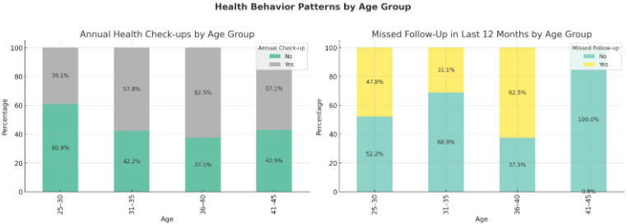
Results

Slide 11
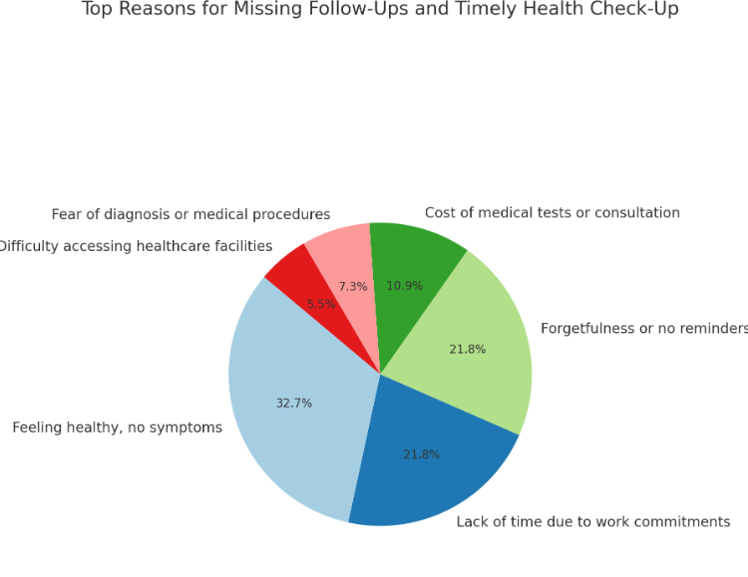
Results

Slide 12
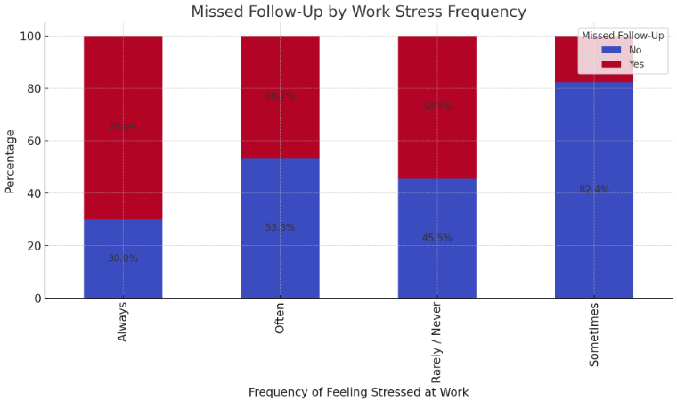
Results

Slide 13
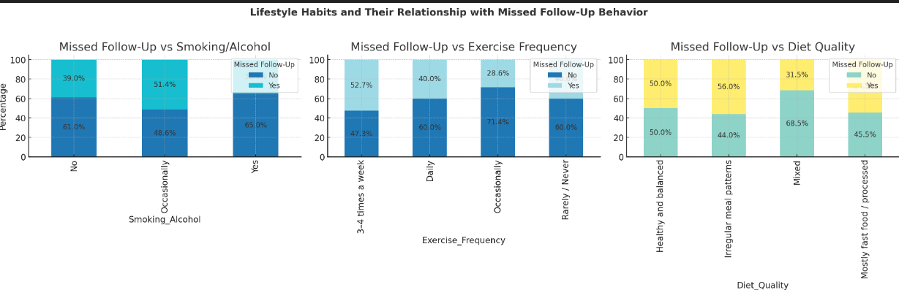
Results

Slide 14
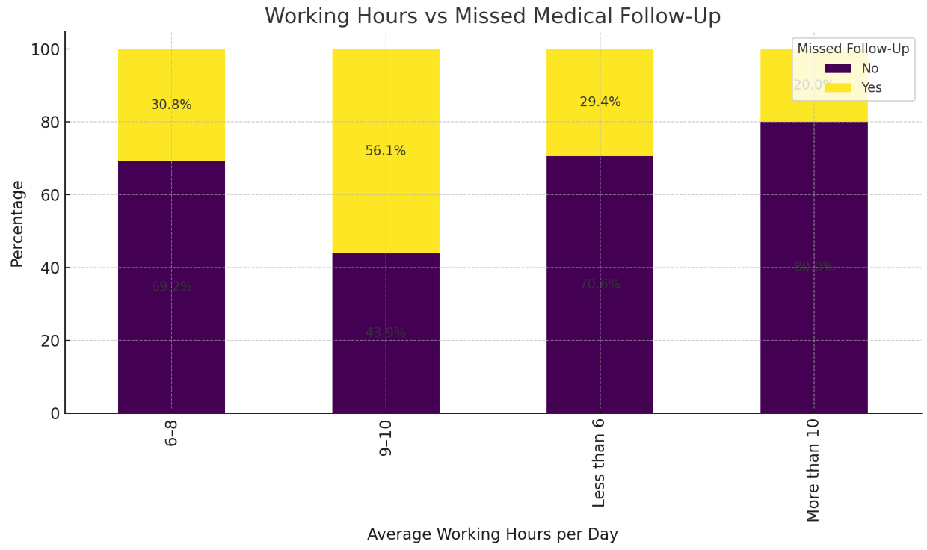
Results

Slide 15
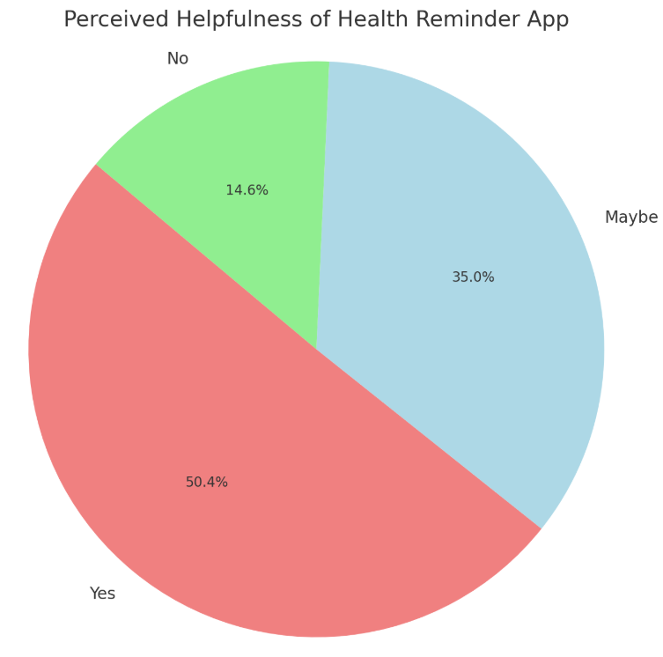
Results

Slide 16
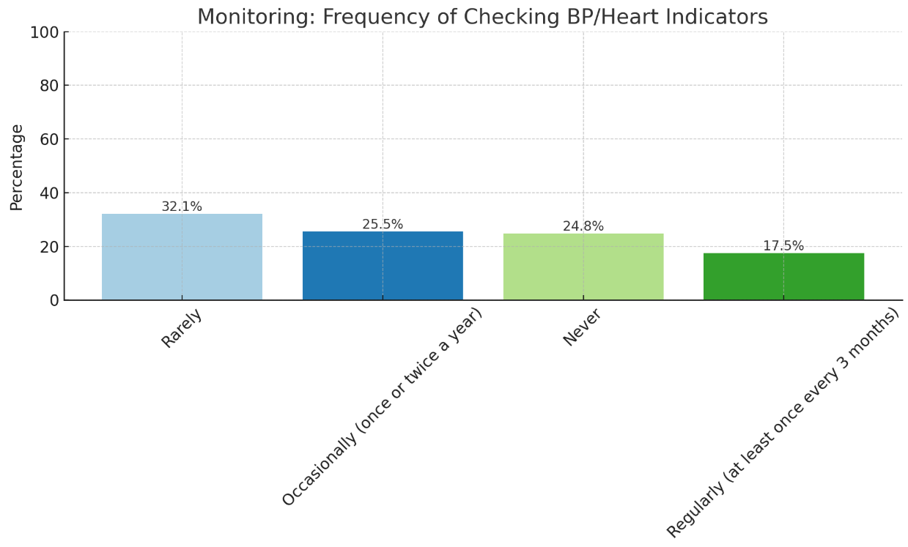
Results

Slide 17
Discussion
Alarming Awareness-Action Gap
  While a significant number of respondents were aware of cardiovascular health risks, there was a clear gap between awareness and action—with many failing to attend regular medical follow-ups.
  This suggests a disconnect between knowledge and behavior, likely driven by factors such as work culture, perceived healthiness, or lack of immediate symptoms.
‘No Time’ — A Recurring Theme
  A dominant reason for missed follow-ups was “lack of time”, highlighting the intense work pressures faced by corporate employees, particularly in the IT sector.
  This calls for organizational reforms such as flexible schedules and health-focused HR policies.

Slide 18
Discussion
Younger Employees Neglecting Preventive Care
  Respondents aged 25–30 showed the highest percentage of missed medical follow-ups.
  This points to a low perceived vulnerability, where younger employees may ignore early warning signs or delay routine check-ups.
Gendered Health Behavior
  Men reported higher instances of neglecting follow-ups than women.
  This could reflect gender norms around health-seeking behavior, where men often underprioritize self-care or perceive medical attention as unnecessary unless symptoms are severe.

Slide 19
Discussion
Stress as a Critical Health Obstacle
  High reported stress levels correlated with low adherence to medical follow-ups.
  This reflects a vicious cycle, where work-related stress not only increases cardiovascular risk but also discourages proper management and monitoring.
Need for Targeted Interventions
  The findings underscore the importance of:
    Workplace wellness initiatives
    Mandatory annual check-ups
    Digital follow-up reminders
    Education on asymptomatic risk factors
Potential for Technological Solutions
  As many participants expressed interest in tech-based reminders or easier booking systems, digital health platforms could bridge the gap between awareness and consistent care.

Slide 20
Recommendations
Promote Workplace Health Awareness
  Organize corporate wellness programs focused on cardiovascular health education.
  Include seminars on stress management, lifestyle diseases, and the importance of regular medical follow-ups.
Integrate Regular Health Screenings at Work
  Collaborate with healthcare providers to conduct on-site annual screenings.
  Make participation easy, time-efficient, and scheduled during work hours to reduce “no time” excuses.

Slide 21
Recommendations
Implement Follow-Up Reminder Systems
  Encourage the use of digital health platforms or mobile apps that send personalized medical follow-up reminders.
  Use email/text alerts integrated with employee health check-up data.
Encourage Management Support
  Train managers and team leaders to recognize stress and promote health-seeking behavior.
  Develop a workplace culture where taking time for health is normalized and encouraged.
Customize Interventions by Demographics
  Create age-specific and gender-sensitive strategies to improve follow-up adherence:
    Young employees: Gamify health goals or provide incentives.
    Male employees: Use peer-based motivation or mentor health campaigns.

Slide 22
Recommendations
Flexible Work Arrangements
  Advocate for flexible work hours or health leave policies that allow employees to attend check-ups and follow-ups without compromising productivity.
Stress Management Initiatives
  Introduce mindfulness programs, counseling access, and recreational breaks to reduce chronic work stress that discourages follow-up.
Policy-Level Interventions
  Companies should consider making annual follow-ups mandatory, with HR tracking compliance as part of performance health audits.
Enhance Accessibility to Care
  Tie up with nearby hospitals or telemedicine services to make follow-ups less time-consuming and more accessible, especially for high-risk employees.
Use of Technology for Monitoring
  Encourage employees to use wearables or apps for monitoring blood pressure, heart rate, and other vitals—especially for those with family history or previous conditions.

Slide 23
Conclusion
Cardiovascular health remains a growing concern among corporate employees, especially in high-stress environments like the IT sector.
The study revealed a significant gap between awareness and consistent medical follow-up, with “lack of time” being the most cited reason.
Younger employees (25–30) and male participants were found to be the most likely to skip follow-ups, indicating the need for targeted health interventions.
Workplace stress and sedentary lifestyles further compound cardiovascular risk and act as barriers to preventive care.
These findings highlight the urgent need for workplace-based health solutions, digital reminders, and flexible policies to promote timely health check-ups and reduce long-term cardiovascular risk.

Slide 24
Annexure
Annexure 1: Structured Questionnaire: Comprehensive details of all questions across Sections 1-9, covering demographics, medical follow-up adherence, lifestyle habits, work stress, and cardiovascular indicators, as described in the methodology.
Annexure 2: Electronic Informed Consent Form Language: The exact wording and structure of the informed consent section presented to participants within the Google Form, outlining study purpose, voluntary participation, confidentiality, and participant rights.

Slide 25
Ethical Considerations
Institutional Review Board (IRB) Approval: Formal ethical approval has been diligently sought from an institutional ethics committee prior to the commencement of any data collection activities.
Informed Consent: Electronic informed consent was obtained from every participant via the Google Form, ensuring full comprehension and voluntary agreement.
Anonymity & Confidentiality: No personally identifiable information was collected, guaranteeing complete anonymity. All collected data was securely stored and accessible only to the authorized research team, thereby maintaining strict confidentiality.
Voluntary Participation & Right to Withdraw: Participation was entirely voluntary, and participants retain the absolute right to opt out at any stage simply by not submitting the form.
Adherence to Guidelines: The study will strictly adhere to the ethical guidelines stipulated in the Declaration of Helsinki and all relevant national and international data protection laws.

Slide 26
References
Steptoe, A., & Kivimäki, M. (2016). Stress and cardiovascular disease. Nature Reviews Cardiology, 13(4), 230–238. https://doi.org/10.1038/nrcardio.2015.183
Medical News Today. (2023). A stressful job could double the risk of heart disease — especially for men. https://www.medicalnewstoday.com/articles/a-stressful-job-could-double-the-risk-of-heart-disease-especially-for-men
Loef, B., van Oostrom, S. H., van Mechelen, W., & Proper, K. I. (2018). The mediating role of lifestyle, health, and work in the association between socioeconomic position and sickness absence. IJERPH, 15(9), 1952. https://www.mdpi.com/1660-4601/15/9/1952
Chau, J. Y., et al. (2020). Sedentary behavior and risk of mortality and cardiovascular disease. Preventive Medicine, 141, 106291. https://doi.org/10.1016/j.ypmed.2020.106291
World Heart Federation. WORLD HEART REPORT 2023
CDC. About Work-related Heart Disease - CDC
Occupational Cardiovascular Disease - Wikipedia. Occupational cardiovascular disease - Wikipedia
2 out of 3 IT professionals at risk for diabetes, heart disease: Study | Pune News - Times of India. 2 out of 3 IT professionals at risk for diabetes, heart disease: Study | Pune News
Unearthing Gaps in the Heart Failure Ecosystem: An Asian Pacific Society of Cardiology Online Survey. Unearthing Gaps in the Heart Failure Ecosystem: An Asian Pacific Society of Cardiology Online Survey

Slide 27
Thank You!

