Slide 1

The impact of community outreach programs on the brand image and reputation of the hospital.
Organization – Mumbai-Based Superspecialty Hospital
Name – Ms. Ketaki Kokate: PG.21.047
Faculty Mentor – Dr. Altaf Yousuf
International Institute of Hospital and Health Management Research, New Delhi

Slide 2
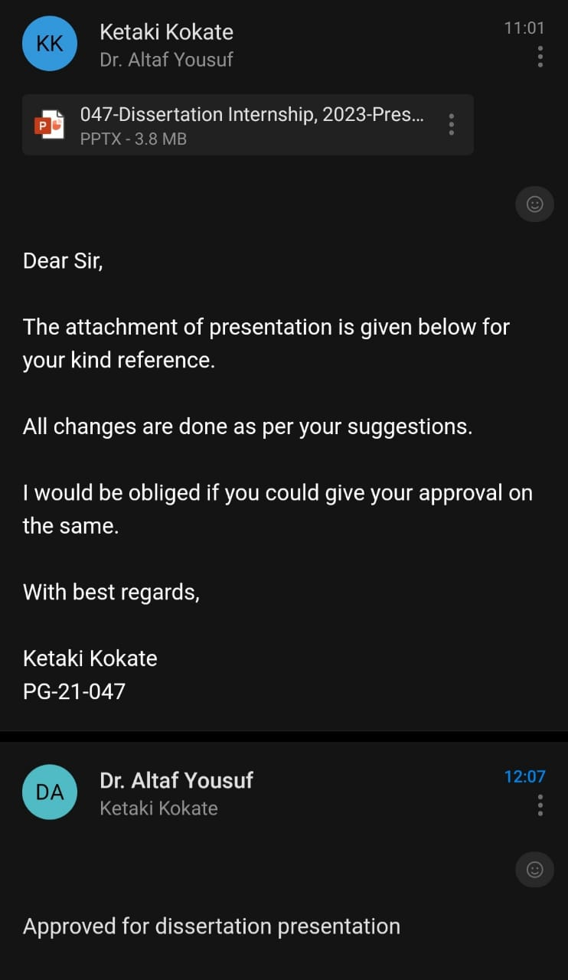
MENTOR’S APPROVAL

Slide 3
01
02
03
04
AGENDA
Introduction
Objectives of the study
Methodology
Results
05
Discussion
06
Conclusion

Slide 4

INTRODUCTION (1/2)
Community based marketing in hospitals focuses on establishing strong connections and building relationships between healthcare institutions and their local communities.
By engaging in targeted marketing strategies tailored to community needs, hospitals can enhance their reputation, increase brand loyalty, and ultimately improve patient satisfaction.
Community outreach programs can take various forms, including free health check ups, health talks, health clinics, vaccination drives, and partnerships with local organizations.

Slide 5
INTRODUCTION (2/2)
Community outreach programs establish trust and credibility by addressing community needs and concerns, engaging with the local community, offering valuable services, education.
In this study, we will get to the importance of community outreach programs on and community members’ opinion towards it.
We are going to discuss which community outreach programs do they find most valuable and what improvements should we make to its community outreach programs to enhance.

Slide 6
OBJECTIVES OF THE STUDY
Objectives of the study
To determine how community outreach programs influence the choice of a healthcare facility for receiving services.
To gather community members' satisfaction levels with the hospital's community outreach programs
To identify the most effective approaches to improve hospital brand image and reputation through community outreach programs.

Slide 7
METHODOLOGY (1/2)
Study Design: A cross-sectional descriptive method.
Study Setting: Mumbai based hospital.
Study Duration: Three months.
Study Population: Community members.
Inclusive Criteria: Community members who have participated in or have knowledge of the hospital's community outreach programs.
Exclusive Criteria: Individuals who have no knowledge or involvement in the hospital's community outreach programs.

Slide 8
METHODOLOGY (2/2)
Sample Size: 344. (Community members).
Study Tool: A questionnaire will be developed to collect data from the study population. The questionnaire will consist close-ended questions that will have a structured format with consent attached.
Sampling Method: A simple random sampling method will be used to select the study population.
Methods of Data Collection: The study will use Primary, Quantitative data and will be collected through the questionnaire in google form from community members.
Data Analysis: All the data will be stored in Microsoft Excel spreadsheet and was analysed using descriptive analysis (Bar graph, Pie chart, Pareto Graph).

Slide 9
RESULTS (1/7)
Demographic details -

Slide 10
RESULTS (2/7)

Slide 11
RESULTS (3/7)

Slide 12
RESULTS (4/7)

Slide 13
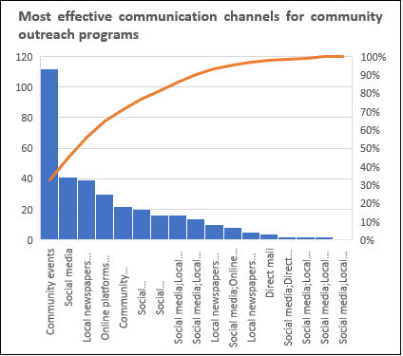
RESULTS (5/7)

Slide 14
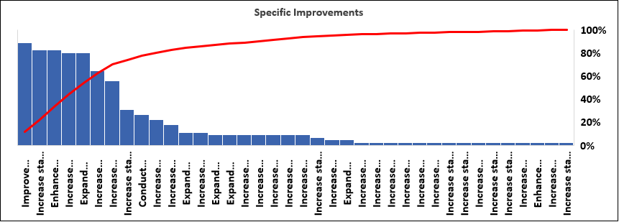
RESULTS (6/7)

Slide 15
RESULTS (7/7)
Paediatric Cardiac OPDs in Remote areas
The hospital organizes Paediatric Cardiac OPDs in remote areas for the children between 3-5 years of age. They mostly have tie ups with NGOs.
Rotatory clubs
Rotatory clubs gives the hospital funds to do CSR activities.

Slide 16
Health Check-ups
Blood Donation Camps
Health Talks
Housing Societies - OPDs
Target audience – From middle class group, societies.
Impact – More than 100 people participate if, the target audience is more than 150 each in 20 camps.
Target audience – From middle class group, societies, institutes.
Impact – More than 70 people participate if, the target audience is more than 150 each in 20 camps.
Target audience – General public, Patient communities, Workplace and organizations, Community Organizations.
Impact – More than 30 people attend, if the target audience is more than 70 each.
Target audience – Upper middle class societies.
Impact – Increase accessibility, efficient and time saving, improved preventive care, community engagement, strengthened reputation, economic benefits.
Free/Discounted Health Screenings
Target audience – General public, High-Risk Populations, Elderly Individuals, Specific Health Conditions, Workplace.
Impact – The impact of this is low as compared to those of other community programs.

Slide 17
DISCUSSION
Community outreach programs have a significant impact on the brand image and reputation of hospitals.
Its very important to meet expectations and satisfaction level of community members.
There are several factors that influence the success and effectiveness of community outreach programs.
The factors include: Community needs, Resources and budget, staff engagement, evaluation and feedback, communication level.
Most valuable programs which should be included as per the analysis are healthcare education and awareness programs and free health screenings which can enhance community engagement which will increase the impact of community outreach programs which will eventually lead to brand image and reputation of the hospital.
Its very important to meet specific needs of the people.
Community members should be satisfied by the overall quality of the hospital.

Slide 18
CONCEPTUAL FRAMEWORK
Market research and analysis and target auidience identification
Cultivating relationships with community leaders
Leveraging digital marketing platforms
Patient feedback and satisfaction, tracking and evaluation.
Community needs assessment
Service development
Collaboration with community organizations, Community education and outreach

Slide 19
CONCLUSION
Hospitals are recognized not only for delivering quality medical services but also for their reputation and brand image within the community.
The perception of the hospital by the community outreach programs can impact its patient base, its ability to attract the patients, retain staff, and its financial performance.
Community outreach programs have been identified as a potential strategy for enhancing positive brand image and reputation in the community.
It is one of the best tool for any organization to reach the community to enhance community engagement, build trust and trust and credibility by addressing community needs and concerns.
Community outreach programs may include tangible and intangible profits.
From my study, we conclude that yes, there is an impact of community outreach programs on the brand image an reputation of the hospital.

Slide 20
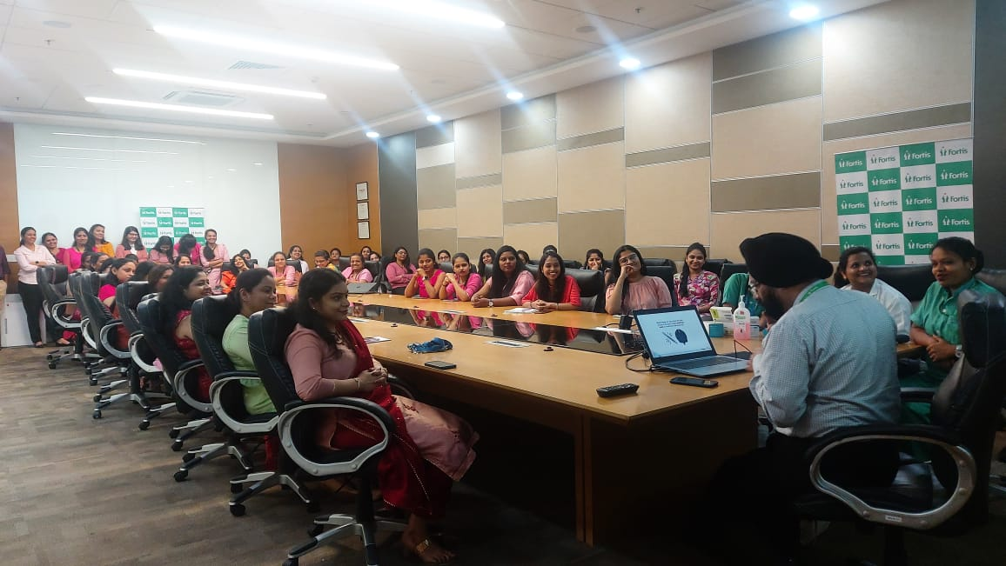

PICTORIAL JOURNEY (1/2)

Slide 21
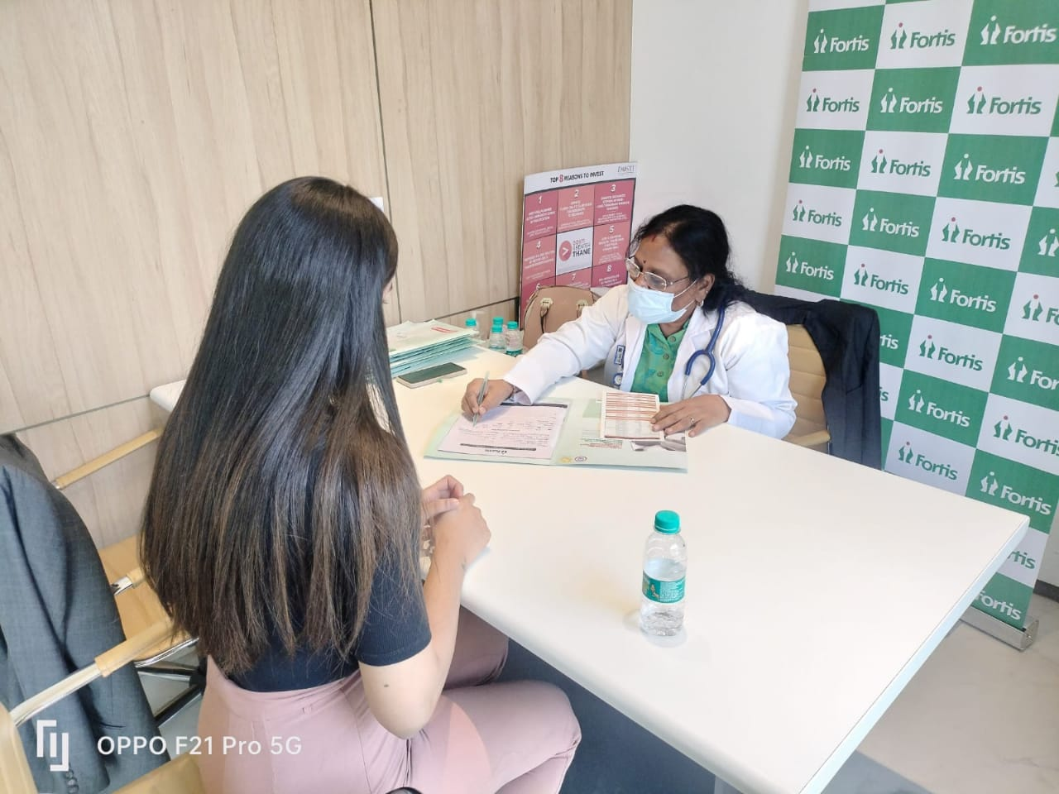
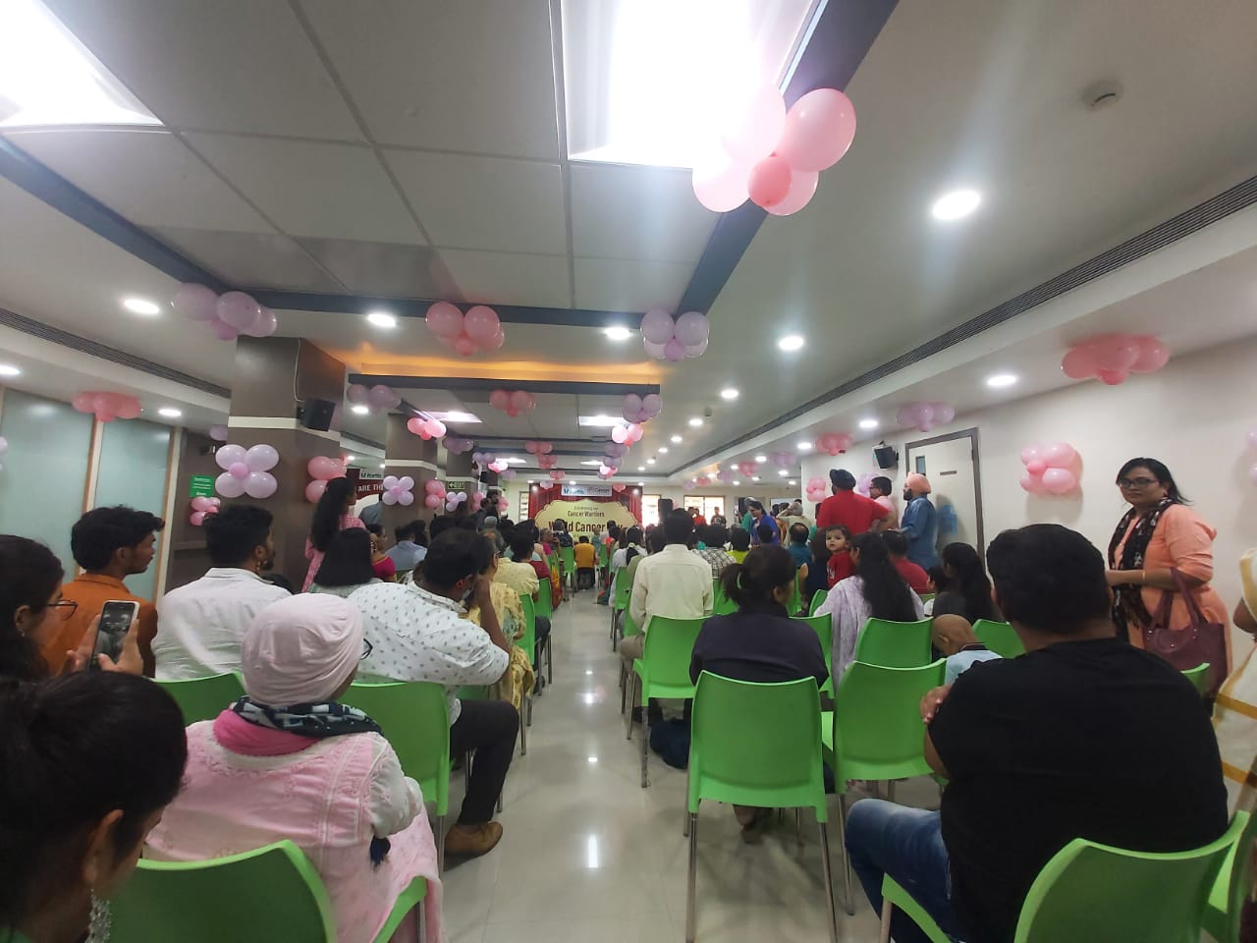
PICTORIAL JOURNEY (2/2)

Slide 22
REFERENCES
1. | Choyke KL, Cronin CE, Rodriguez V, Gran BC, Franz B. An Organization’s role in anchoring community health: How for-profit hospitals’ balance corporate and social responsibility. SSM Qual Res Health [Internet]. 2022;2(100037):100037. Available from: https://www.sciencedirect.com/science/article/pii/S2667321521000378
2. | Anderson V. Hospital laboratory outreach: benefits and planning. Clin Lab Med [Internet]. 2007;27(4):791–805, vi. Available from: https://www.sciencedirect.com/science/article/pii/S027227120700087X
3. | Researchgate.net. [cited 2023 Jun 16]. Available from: https://www.researchgate.net/publication/267793568_The_impact_of_hospital_brand_image_on_service_quality_patient_satisfaction_and_loyalty/citation/download
4. | Long S. The importance of community education and outreach for people, the planet and business [Internet]. Green Business Bureau. 2022 [cited 2023 Jun 16]. Available from: https://greenbusinessbureau.com/green-practices/communiity/the-importance-of-community-education-and-outreach-for-people-the-planet-and-business/
5. | Huffpost.com. [cited 2023 Jun 16]. Available from: https://www.huffpost.com/entry/community-outreach-programs-make-a-big-impact-on-the_b_59836f21e4b0bd823202961
6. | Benefits of community outreach programs for businesses [Internet]. Clubunioncomercio.com. 2021 [cited 2023 Jun 16]. Available from: https://clubunioncomercio.com/benefits-of-community-outreach-programs-for-businesses/

Slide 23
Thank you

