Slide 1
Internship Presentation
by:
Sumit Gupta

Slide 2
Areas covered during Internship
Empanelment
Eye camp/Talk show
Relationship management
Awareness campaigns
Communication skills
Perseverance and commitment

Slide 3
Medical Tourism in India & Strategies to increase flow of International Patients at Centre For Sight
Long waiting lists, rising healthcare cost, inadequate insurance cover and poor follow-up care.
Thailand, Malaysia, Singapore, have emerged as big healthcare destinations in Asia
Costa Rica, Cuba, Mexico, Brazil, South Africa, Jordan
Low cost/Availability of competent doctors
Negligible Waiting Time/ World class services and infrastructure/No Language Barrier

Slide 4
Cost Comparison
Procedure | US | UK | Thailand | India | Singapore
Angioplasty | 30000 | 21000-27000 | 4000 - 5000 | 4000 - 5000 | 5000
Angiography | 2500 - 3000 | 2000 | 1100 | 400 | 800
Hip replacement | 19000 | 13000-16000 | 7000 | 6000 | 6600
Knee replacement | 27000-32000 | 16000-18000 | 7000 | 6000 | 7000
CABG | 30000 | 20000 | 7500 | 6400 | 9600
Lasik | 4000 | 2500-3000 | 700 | 700 | 800

Slide 5
India in Medical Tourism – SWOT Analysis
Strength Quality service at affordable cost. Availability of excellent skill set. Global recognition of Doctors and Hospitals Strong presence in advanced healthcare Diversity of tourism destinations and experiences. Increasing number of healthcare facilities with Indian and International accreditation. Adoption of cutting edge technology. | Weakness Lack of aggressive government initiative. Lack of coordination between stakeholders of medical tourism namely transportation, hospitality and hospitals.
Opportunity Increased demand for healthcare services from countries with aging population. Fast-paced lifestyle increases demand for wellness tourism and alternative system of healthcare. Long waiting periods in National Health systems in countries like UK and Canada. Demand from countries with underdeveloped healthcare facilities. Recognition of Indian facilities as a cost effective alternative by US insurance and employers. Accreditation initiatives in India. | Threat Unsynchronized efforts of various stakeholders. Still lacks in infrastructural support. Strong competition from countries like Thailand, Malaysia and Singapore. Under-investment in health infrastructure.

Slide 6
Objectives of the Study
General Objective
To study factors affecting medical tourism in Centre for Sight.
Specific Objectives
To study cost difference in Ophthalmic procedures in US/UK/compared to India.
To suggest strategies to increase flow of International patients at Centre For Sight.

Slide 7
Cost Difference in Opthalmic Procedures
PROCEDURE | USA ($) | UK ($) | INDIA ($)
Vision Correction | 4000 | 2500-3000 | 700
Cataract (Phaco) | 4000-5000 per eye | 3500-5000 per eye | 500 per eye
Retinal Detachment | 3500-4500 per sitting | 3000-4000 per sitting | 600-1000 per sitting
Ptosis | 2900-3600 | 3500-4500 | 750-1000

Slide 8
Research Methodology
TOOLS OF DATA COLLECTION:
Primary Research:
This has been conducted through a questionnaire .
Sample size – 70 patients.
Time Taken – 1 month
Secondary Research:
Internet websites.
Past evaluations and research
Periodical articles (refer to magazines, journals, and
newspapers)
Statistical sources

Slide 9
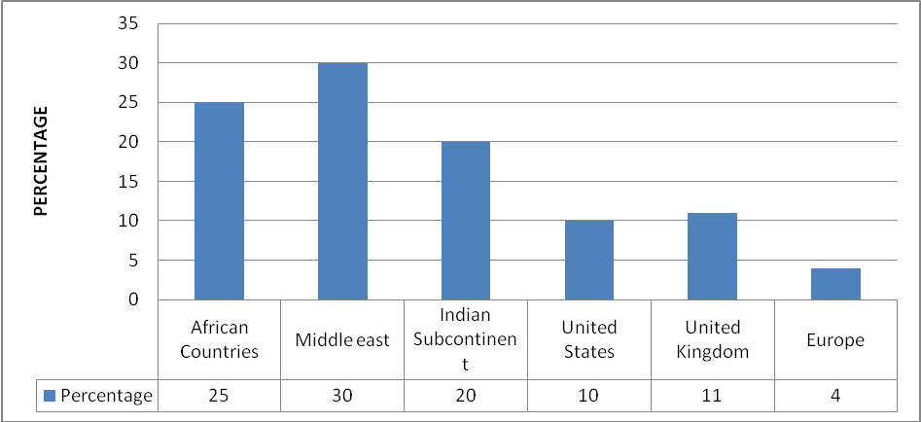
Study findings
A1. Most patients coming into India are from the Middle East and African Countries

Slide 10
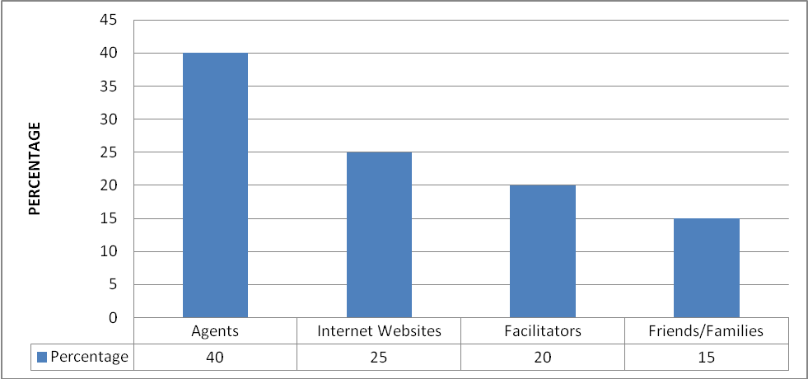
A2. The Most popular source of information for patients are the Agents.
Break up of Information sources

Slide 11
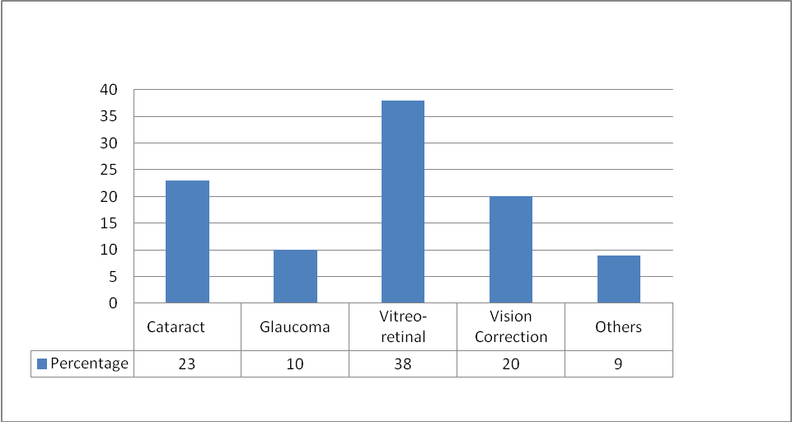
A3. Maximum patients came for Vitreo-retinal procedures
Most popular procedures

Slide 12
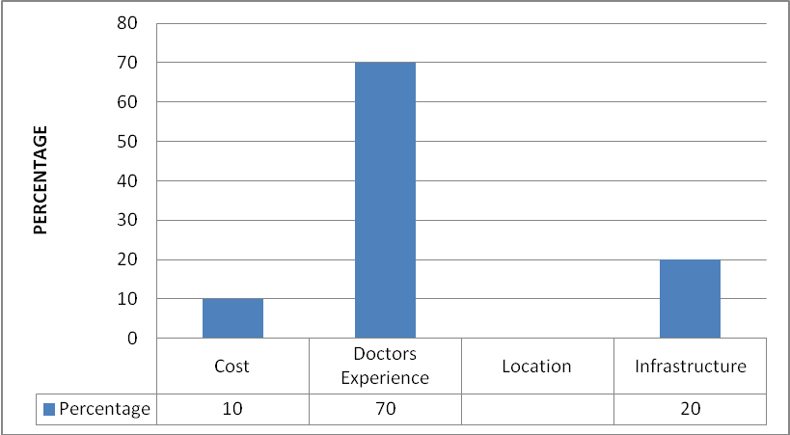
A4. Doctors experience was the most important factor for patients.
Important factors before seeking treatment

Slide 13
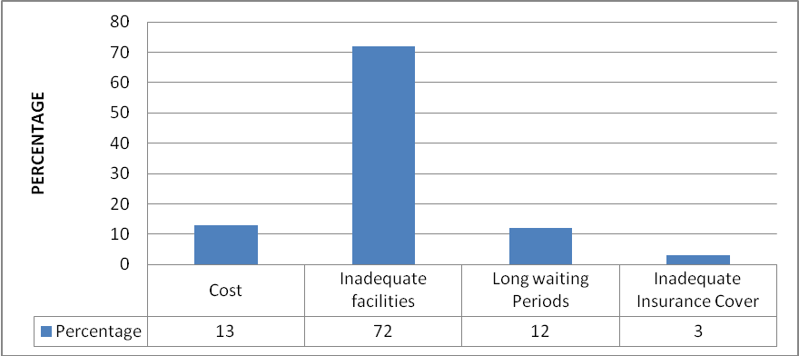
A5. Inadequate healthcare facilities in home country was the leading cause for patient s seeking treatment at Centre for Sight.
Other factors for seeking treatment abroad

Slide 14
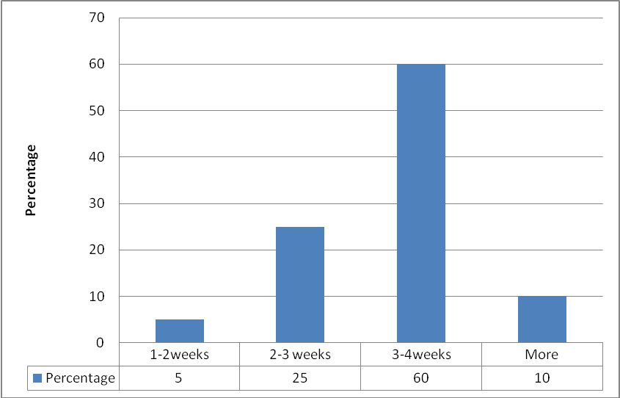
A6) For majority of the patients it took 3-4 weeks to get the visa.
Time taken to Procure Visa

Slide 15
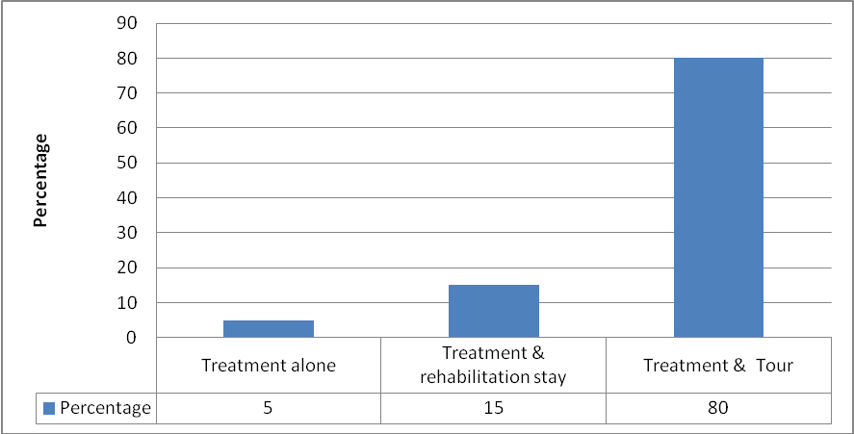
A7.Majority of the patients preferred touring after treatment

Slide 16
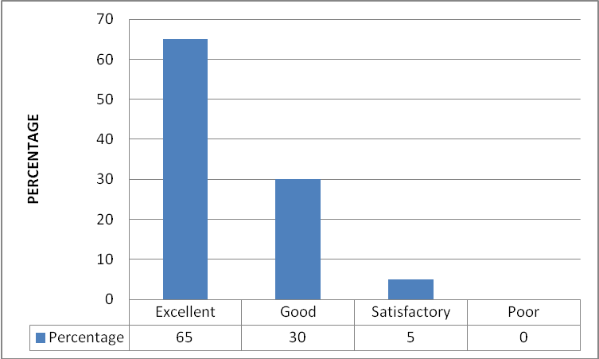
Rating of Areas:
RECEPTION/HELP DESK

Slide 17
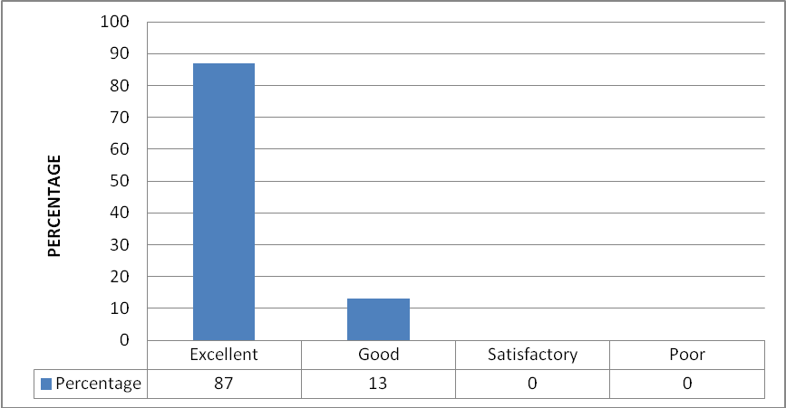
International Patient Coordinators

Slide 18
Doctors

Slide 19
Technicians

Slide 20
Counselling

Slide 21
Billing

Slide 22
Categories of Patients
Group I – Non-Residential Indians (NRIs)
Group II - Patients from Countries with underdeveloped facilities
Group III - Patients from developed countries with state owned healthcare system.
Group IV - Patients from developed countries with private healthcare system

Slide 23
Future Strategies for Centre for Sight
Tie up with Medical Tourism Facilitators
Advertise in International Print Media catering to NRIs
Use Website as a marketing tool
Tie-ups with Foreign Insurance Companies
Tie-ups with Corporates in other countries.
International Help Desk
Target NRI Population
Tie-ups with International NGO’s

Slide 24
SWOT ANALYSIS FOR CENTRE FOR SIGHT
Strength Backed by a team of renowned Ophthalmologists. Cutting edge technology at par with global standards. State of the art infrastructure. First eye hospital in to get ISO certification. Value for money as compared to developed countries. | Weakness Lack of Synchronised efforts for a targeting patients on alarge scale Low awareness of the brand in the International market.
Oppurtunity Collaboration with medical tourism facilitators. Increasing initiatives from private players to promote Indian medical tourism leading to awareness on Indian healthcare. Increase in use of internet to seek information on healthcare. | Threat Apprehension among foreign clients to seek services. Established eye centres like Shroffeye care Upcoming eye hospitals in north like Vasan Eye/Medfort.

Slide 25
Specific Recommendations
Presently number of patients from US/UK/Europe is less and hence strategies to increase their flow must be implemented.
Majority of the patients visiting are through the agents/brokers. Other sources listed earlier to get patients must be implemented
Centre for Sight is presentlynot advertising in any foreign publications/media. This should be done to target both the international and NRI population

Slide 26
Specific Recommendations
Since 70% of the patients rate doctors expertise as the most important factor for coming for treatments it is equally important to promote doctors expertise. This will build a positive brand image of the hospital.
Most middle eastern and African countries have a patriarchal society. We can promote women health and educate them on eye care to raise awareness among them about the hospital services.
As per the analysis counseling areas needs more attention. We can increase the number of counselors to reduce the waiting time of the patients.

Slide 27
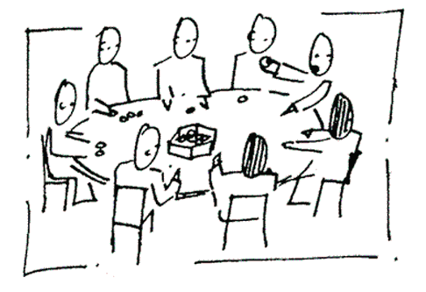
Thank you for your time

