Slide 1
ASSESSMENT OF PATIENT SATISFACTION IN THE OUTPATIENT DEPARTMENT OF CGHS MATERNITY & GYNAE HOSPITAL, NEW DELHI
Mentor : Dr. A K Khokhar, Prof. & Dean Training
Guidance : Dr. Sangeeta Malhotra, Medical Superintendent
APPROVAL : DR. D C JOSHI, DIRECTOR, CGHS
Duration : Feb 2017 to May 2017

Slide 2



Slide 3
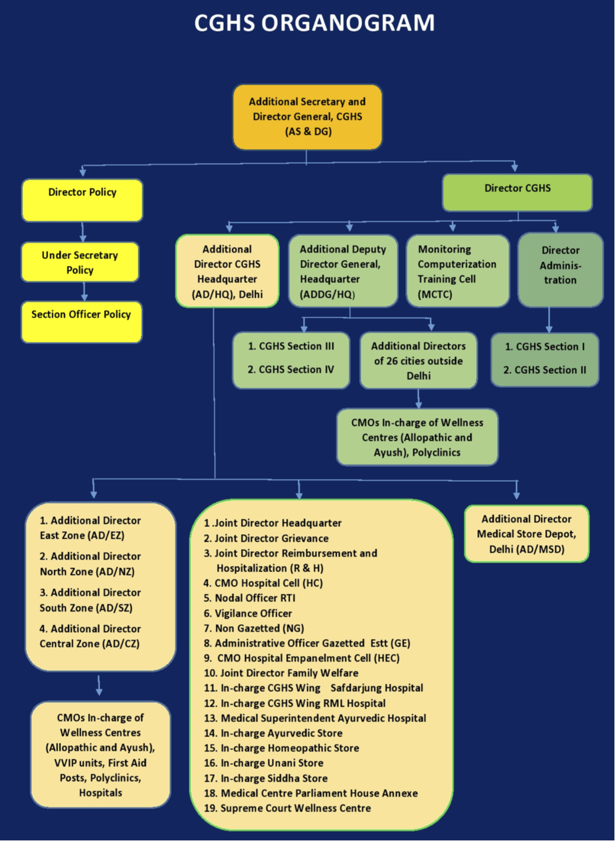
CGHS Maternity & Gynae Hospital
40 bed
Comprehensive medical care facilities of Maternity & Gynaecology and Paediatrics
Patients referred from Wellness centres in Delhi / NCR
Maximum patients from the serving class of CGHS employees or their entitled dependents
Wellness
Centres
92
EZ - 17
NZ - 25
SZ - 34
CZ - 16

Slide 4
INTRODUCTION
What is Patient Satisfaction?
Patient satisfaction is one of the important indicators for determination of Quality in health care.
Important means of measuring the effectiveness of health care delivery
Offer practitioners and staff valuable information and data on which to build improvement efforts
What is the CGHS Scheme?
It is providing comprehensive medical care to the Central Government employees and pensioners enrolled under the scheme
Wellness Centres / dispensary is the backbone of the scheme

Slide 5
INTRODUCTION
CGHS Maternity & Gynae Hospital
40 bed
Comprehensive medical care facilities of Maternity & Gynaecology and Paediatrics
Patients are referred to the hospital from their respective CGHS Wellness centres in Delhi / NCR
Maximum of the patients are from the serving class of CGHS employees or their entitled dependents

Slide 6
REVIEW OF LITERATURE
Aday and Anderson (1974) in the study of peoples satisfaction with health care delivery in the United States of America pointed out six principles focusing on patient satisfaction:
  Satisfaction with convenience of care.
  Satisfaction with coordination.
  Satisfaction with cost.
  Satisfaction with courtesy shown by providers.
  Satisfaction with information given to patient about his illness.
  Judgment as to quality of care received.

Slide 7
RESEARCH DESIGN &
METHODOLOGY
General Objective
To assess the level of patient satisfaction with the health care services provided by the Outpatient Department (OPD) of CGHS Maternity & Gynae Hospital, New Delhi.
Specific Objectives
To assess the level of patient satisfaction with OPD services focusing on waiting time, registration services, laboratory facilities, physical facilities, soft skills of physicians, nurse & staff and satisfaction with physician consultation process.
To find the possible relationships between patient satisfaction levels and other variables.

Slide 8
RESEARCH DESIGN &
METHODOLOGY
Study Design
A cross-sectional study
predesigned and pretested questionnaire
statements regarding services of physical facilities, registration staff, doctor, nurse, laboratory and waiting time
response to these statements in yes / no / not sure
Waiting time was expressed in four time blocks of minutes
Data was entered and analyzed using the software SPSS version 16
responses were expressed in proportions
Chi square test was used to find out if any association existed taking p ≤ 0.05 as the statistically significant level
Sample Size and Sampling Technique
sample consists of 100 patients who attended the OPD
systematic random sampling

Slide 9
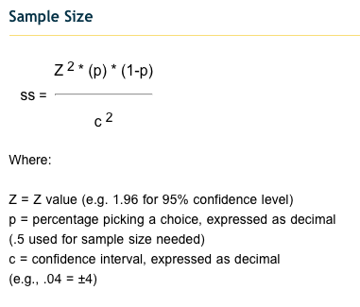

Slide 10

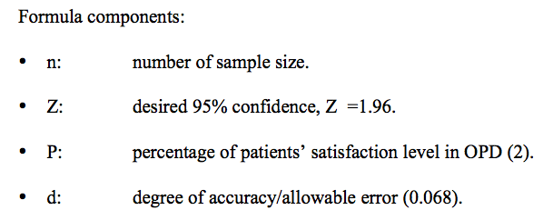

Slide 11
RESEARCH DESIGN &
METHODOLOGY
Inclusion Criteria
A patient attending the OPD and having age above 18 years was included in the study.
As the paediatric OPD patients were much below 18 years of age, their accompanying guardians formed part of the interview process.
The patients who were willing to give consent.
Exclusion Criteria
Patients who needed emergency attention.
Patients who had not finished the interview process.
Patients not willing to participate.

Slide 12
RESULTS
Independent variables
  Age
  Gender
  Marital status
  Education level
  No. of visits to OPD
Dependent variables
  Physical facilities
  Doctors services
  Nursing services
  Laboratory services
  Registration services
  Courtesy
  Waiting time

Slide 13
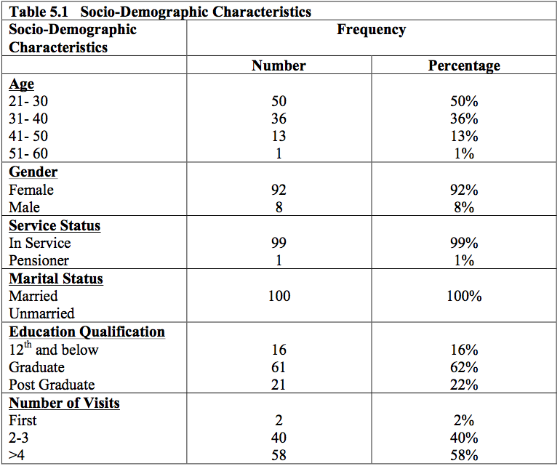

Slide 14
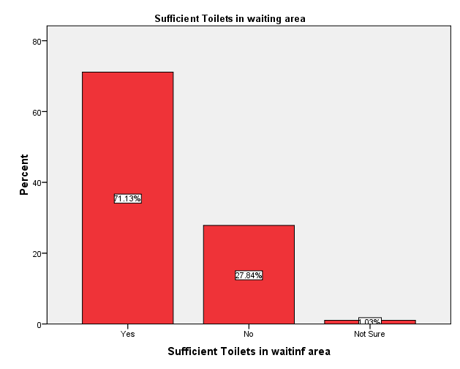
Physical Facilities

Slide 15
Courtesy

Slide 16
Lab Services

Slide 17
Registration
Consultation

Slide 18
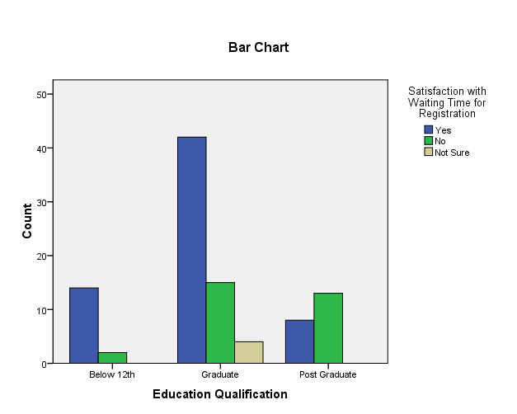
Relationship - Variables

Slide 19
Overall Satisfaction

Slide 20
DISCUSSION
To summarize the respondents had positive high satisfaction levels in the following: -
Finding the hospital neat and clean.
Availability of adequate sitting chairs in the waiting area.
Availability of lab reports in time.
Overall satisfaction in the consultation process with doctor – provision of information,
privacy and time allotted.
Overall experience in hospital.
Some issues of dissatisfaction which need to be looked into for resolution are: -
Waiting time for registration.
Waiting time for consultation.
Provision of all required lab test facilities.
Courtesy / soft skill improvement of nursing staff, registration staff and lab staff.

Slide 21
Recommendations
Registration process be digitised and integration with referal Wellness centres.
Digitisation of data / records thereby resulting in reduction in time at registration.
Token number display facility outside doctors room for the waiting patients.
The ANC cases are routine follow up cases. Therefore allotting block consultation time in advance
Increase in number of OPD days of ANC will reduce the waiting time at both
Registration and consultation.
Provision of additional toilets for ladies and regular schedule of cleaning and upkeep
The drinking water aspect needs to be looked into and assessed further.
Educating the patients on the test facilities available at the hospital
Soft skill training of registration staff, nursing staff and lab staff to reflect positive vision and attitude of the hospital.

Slide 22
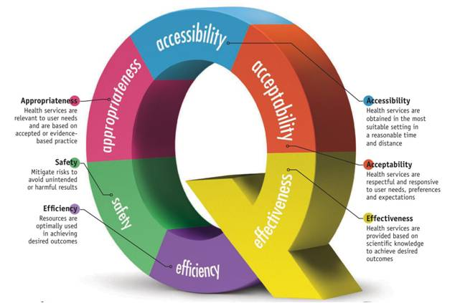

Slide 23


Slide 24
Thank you

