Slide 1


Assessment of the State initiative scheme for X-Ray and Ultrasound for Patients of Government Hospitals (DH, SDH & CHC) of Punjab
Department of Health and Family Welfare
National Health Mission(NHM), Punjab
Aditi Sinha
Dr. Anandhi Ramachandran
IIHMR Delhi

Slide 2

Screenshot of Approval

Slide 3
Introduction (1/2)
India, despite its substantial economic progress, remains a lower-middle-income country with significant socioeconomic and health disparities. Over 20% of the population lives in poverty, and the nation faces a "triple burden of disease," which includes persistent communicable diseases, a growing prevalence of non-communicable diseases, and injuries. The Indian healthcare system is challenged by the need to serve its 1.4 billion citizens, with the private sector handling around 70% of healthcare needs. However, private providers are often small, unregulated, and concentrated in urban areas, leaving many underprivileged populations without proper care. Public hospitals, on the other hand, are overwhelmed by insufficient funding, a lack of skilled health professionals, inconsistent drug and equipment supplies, and overcrowding (1). In mixed healthcare systems like India's, private practitioners play a crucial role in providing healthcare, especially where public systems are overburdened. The private sector's involvement is significant in settings where public healthcare faces challenges in providing universal and timely access to medical services. Outsourcing has been identified as an effective strategy that can increase personnel, client, and stakeholder satisfaction, as well as reduce costs and improve benefits for the public sector. (2)
Access to universal healthcare (UHC) is increasingly recognised as a fundamental right worldwide. Healthcare disparities include inequitable differences in health coverage, access to care, and quality of care received. Addressing these disparities is critical for achieving equitable healthcare outcomes. (8) Large inequities in access to healthcare services persist across rural and urban areas and within communities in India. These are driven by factors such as population distribution, historical inequities, socioeconomic status, and unequal provision and availability of health services. (9) (10). These are reflected in terms of a lack of infrastructure, human resources, supplies, low bed-to-population ratios and disparities in the spatial distribution of health institutions. Public-private partnerships (PPP) are seen as a viable solution to making UHC a reality by leveraging the private sector to address the healthcare disparities.
Hospitals in developing countries allocate 5-15% of their expenditure to purchasing advanced diagnostic equipment.
However, the World Health Organization (WHO) reports that over 38% of medical equipment is out of service, primarily due to poor user expertise and improper maintenance. The PPP approach has been shown to significantly enhance the efficiency and quality of healthcare services, making it a key strategy for improving service quality and reducing resource wastage. (6) The primary reasons for outsourcing in healthcare include improving customer service, reducing costs, enabling healthcare organisations to focus on core activities, and increasing flexibility to meet changing market needs. (7)

Slide 4
Introduction (2/2)
India's health spending is significantly lower than that of OECD countries, highlighting the need for private sector investment to bridge the funding gap and improve service delivery efficiency. (4) (5). The PPPs in the hospital sector in India are evolving from simple contracts to the use of private finance and differing governance and accountability structures. This restructuring of the public sector hospitals is emerging as new sites of competition for the private sector. Simultaneously, the rolling back of the public sector from certain services leads to a greater reliance on the private sector for patients. (11)
The Department of Health & Family Welfare, Government of Punjab, has launched an initiative to augment and improve diagnostic services for the public in government hospitals, including District Hospitals (DH), Sub-Divisional Hospitals (SDH), and Community Health Centers (CHC). To address the persistent service gaps in diagnostic services, especially in radiological investigations, the Punjab government has decided to collaborate with private diagnostic centres. By empanelling diagnostic centres at Central Government Health Scheme (CGHS) package rates, the government aims to mitigate challenges such as equipment breakdowns, staff shortages, and other operational hurdles. This partnership allows for seamless continuity of services, ensuring that patients receive necessary diagnostic care without delays. The initiative ensures that patients at government hospitals receive X-ray and ultrasound services at nominal charges, regardless of whether the services are provided in-house or referred to empanelled centres. This approach aligns with the government's objective of making essential healthcare services accessible and affordable for all, particularly the underprivileged.
By ensuring continuous availability of essential diagnostic services, the scheme aims to improve patient outcomes through timely and accurate diagnoses. The scheme's design prioritises the utilization of in-house diagnostic facilities before referring patients to empanelled centers. Evaluating the efficiency of this prioritisation will highlight areas where resource utilisation can be optimised, ensuring that government hospitals make the best use of available equipment and personnel. The current study is proposed to evaluate whether the scheme achieves its goal of reducing delays and improving the quality of care received by patients.

Slide 5
Objectives of Your Study
To evaluate the effectiveness of the State Initiative Scheme for X-ray and Ultrasound in government hospitals across Punjab.
To assess how collaboration with empanelled diagnostic centres addresses the service gaps and enhances diagnostic service delivery to the patients.

Slide 6
Methodology (1/2)
Study Design: Descriptive Study
Study population: Patients coming to government health facilities and empaneled centers in Punjab who were prescribed USG or X-ray.
Inclusion criteria: All government health facilities and privately empaneled centres in Punjab
Exclusion criteria: All other non-government and non-empaneled health facilities.
Data Type: Secondary Data
Data Collection Source & Tool
  Live Google Sheet that reports daily OPD visits, X-ray and ultrasonography prescriptions, tests performed at in-house facilities, and tests done via outsourcing, HMIS and Punjab Health Systems Corporation (PHSC) Data.

Slide 7
Methodology (2/2)
Data Collection Period: January to May 2023 and January to May 2024.
Data Analysis Method & Tool: Descriptive statistics and trend patterns ( in-house service utilization, referral trends) through Microsoft Excel
Ethical Clearance: Obtained from Institute Student Review Board

Slide 8
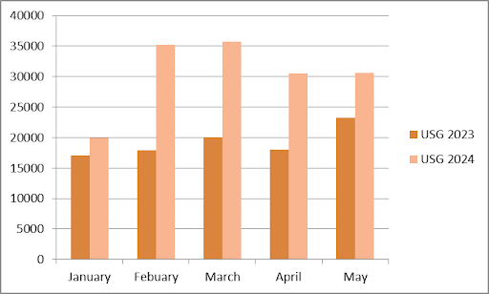
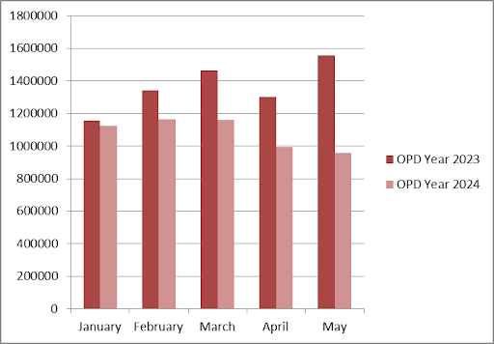
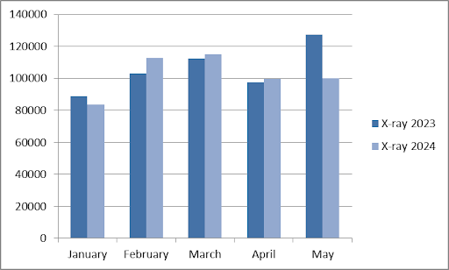
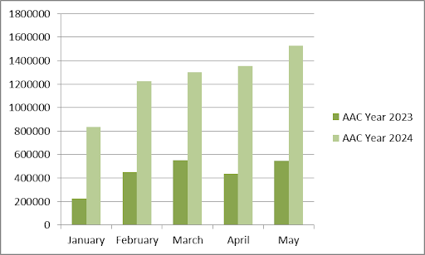
Data Analysis
% Increment
17.12%
96.83%
77.91%
68.98%
31.69%
OPD | AAC
-2.61% | 270.44%
-13.33% | 173.33%
-20.68% | 134.73%
-23.62% | 209.30%
-38.58% | 180.67%
Fig 1: Increment in USG services done in 2024 as compared to 2023.
Fig 3: Reduction in OPD patient footfall
% Increment/Reduction
-5.80%
9.37%
2.32%
2.22%
-21.45%
Fig 2: Increment/Reduction of X-ray Services in 2024 as compared to 2023
Fig 4: Increment in Aam Aadmi Clinics patient footfall

Slide 9
Results (1/3)
Below are the findings of the study:
1. There are a total of 202 empanelled centers for X-ray and 389 for Ultrasound.
2. Out of a total OPD visits of 3,479,927; 111,790 USG (ultrasound) were prescribed, constituting 3.21% of the total OPD.
3. 64.2% of USGs were done in-house, 30.2% at empanelled centers, while 6.4% of patients did not avail USG services either in-house or at empanelled centers.
4. A total of 7,176 patients who were prescribed USGs did not get the investigation done. The highest number of such patients was 756 cases.
5. Empanelled centers conducted 1,101 additional USGs that were not referred from government health facilities.
6. 38 health facilities reported more patients investigated than prescribed. Five facilities reported more than 50 extra patients each, with 391 extra patients being the highest number.
7. Seventeen health facilities did not prescribe any USGs during the study period, with seven of these being from a single district.
8. There was a 6.37% increase in USG referrals from February to March 2024, followed by a 21.73% reduction from March to April 2024 .
9. Five districts saw significant reductions in EC referrals for USGs between March and April .

Slide 10
Results (2/3)
10. Out of a total OPD visits of 3,479,927; 345,747 X-rays were prescribed, making up 10% of the total OPD.
11. 100.2% of X-rays were completed in-house, 0.5% at empanelled centers, and 0.9% of patients did not get X-rays done either in-house or at empanelled centers.
12. Government health facilities conducted 8,881 extra X-rays, resulting in a 0.2% increase in the overall percentage.
13. 1,034 patients did not get their prescribed X-rays, with the highest number of missing patients being 496.
14. Nine health facilities did not prescribe any X-rays during the study period.
15. The highest number of patients referred to empanelled centers for X-rays was 210 patients.
16. The highest in-house USG was 94%.
17. There was a 22% reduction in referrals to empanelled centers for X-rays from February (771 referrals) to April (503 referrals).
19. 38 health facilities reported more USG patients investigated than prescribed.
20. 5 health facilities reported more than 50 extra USG patients investigated by empanelled centers.

Slide 11
Results (3/3)
21. X-Ray Prescription and Completion:
- 10% of the total OPD visits were prescribed X-Rays.
- 100.2% of prescribed X-Rays were completed in-house, indicating some facilities exceeded their prescribed number.
- 0.56% of X-Rays were done at empanelled centers.
- 0.9% of patients did not avail X-Ray services either in-house or at empanelled centers.
- 8881 extra patients were investigated for X-Ray by government health facilities, contributing to a 0.2% increase in overall completion percentage.
22. 5 health facilities accounted for 36% of total referrals to empanelled centers for X-Rays.
23. Nine health facilities did not prescribe any X-rays during the study period.
24. The reasons shared by the concerned authorities of the health facilities for the high number of missing USG patients included JSSK data not being reported for both in-house and empanelled centers and referrals being made to nearby health facilities.
These findings illustrate the performance, gaps, and discrepancies in the implementation of the radiological investigation scheme, highlighting areas for improvement in operational efficiency and patient outcomes within Punjab's public healthcare system.

Slide 12
Discussion (1/2)
This research aimed to analyze the impact of new healthcare schemes on the utilization of services in Punjab's government hospitals, focusing on in-house and referral services. The findings, supported by various tables and graphs, reveal significant insights and trends. Despite India's economic progress, healthcare disparities remain pronounced. With over 20% of the population living in poverty, the healthcare system is strained by a triple burden of communicable diseases, non-communicable diseases, and injuries. The public sector is often underfunded and overburdened, while the private sector, though crucial, is mostly unregulated and concentrated in urban areas, leaving rural populations underserved.
The research highlights the importance of the private sector in bridging gaps where public healthcare is insufficient. Public-private partnerships (PPPs) have shown the potential to increase satisfaction among personnel, clients, and stakeholders while reducing costs and improving public sector benefits. This is particularly relevant in mixed healthcare systems like India's, where the public sector alone cannot meet the population's healthcare demands.
The findings reveal several important insights into the effectiveness of the State Initiative Scheme for X-ray and Ultrasound for Patients of Government Hospitals in Punjab. The implementation of a substantial network of empanelled centres (202 for X-ray and 389 for ultrasound) indicates a robust effort to supplement in-house diagnostic capabilities and address service gaps. However, the data highlights mixed results in terms of service utilisation and accessibility. The OPD data shows that out of 3,479,927 total OPD visits, 3.21% resulted in ultrasound prescriptions and 10% in X-ray prescriptions. The high proportion of X-rays compared to ultrasounds underscores the critical role of radiological services in patient care. While 64.2% of ultrasounds were conducted in-house and 30.2% at empanelled centers, 6.4% of patients did not receive the prescribed USG services, pointing to potential barriers in accessing these diagnostics. Similarly, the X-ray services were exceptionally high at 100.2% in-house, suggesting efficient in-house facilities as well as minimal reliance on empanelled centers (0.5%). Notably, 0.9% of patients did not avail themselves of X-ray services, indicating a need for better follow-up and coordination.

Slide 13
Discussion (2/2)
A concerning finding is the significant number of patients who did not undergo prescribed USG investigations, totalling 7,176. Additionally, the fluctuations in USG referrals, including a 6.37% increase from February to March 2024 and a subsequent 21.73% decrease from March to April, suggest variability in demand and possible improvements in in-house service provision over time. The reduction in USG referrals in five districts reflects enhanced in-house capabilities.
The USG data show a significant increase in 2024, particularly a 96.83% rise in February. This surge can be attributed to enhanced access of patients to diagnostic services in either in-house facilities or empanelled centers, reflecting a positive impact of the healthcare schemes on the provision of diagnostic services. Conversely, X-ray services displayed mixed results. While January and May 2024 saw a decrease in X-rays compared to 2023, February, March, and April showed slight increases. These findings suggest that the scheme's impact on X-ray services varies across different periods, influenced by factors such as scheme awareness and better in-house capabilities.
The data from the study also reveal significant impacts of new healthcare schemes on OPD visits, ultrasound (USG) services, and X-ray services in Punjab's government hospitals. There was a notable reduction in OPD visits in 2024 compared to 2023, with a marked -38.58% decrease in May. This suggests improved diagnostic services and healthcare efficiency, potentially reducing the need for repeated visits. Additionally, the introduction and expansion of Aam Aadmi Clinics (AACs) have shifted patient preferences from traditional OPD services to AACs, evident from the consistent decline in OPD visits and a substantial increase in AAC visits, such as the 270.44% rise in January 2024. This shift indicates that AACs are becoming a preferred choice for patients due to their better accessibility, affordability, and improved service quality.
Overall, the new healthcare schemes, including establishing AACs and integrating empanelled diagnostic centres, have significantly impacted healthcare delivery in Punjab. The reduction in OPD visits and the increase in diagnostic services like USG highlight the schemes' effectiveness in enhancing healthcare access and efficiency. However, the mixed results for X-ray services highlight the ability of in-house facilities to conduct radiological investigations and future changes in the scheme if applicable. These insights are crucial for informing future policy enhancements and optimising the implementation of healthcare initiatives to improve patient outcomes and reduce healthcare inequities in Punjab's public healthcare system.

Slide 14
Limitations of Study
The study is still in it’s primary stage and has a long way to go. Deep root cause analysis can be performed for many aspects like why in house facilities are preferable than empanelled for the X-ray patients and what are the ways in which in house facilities can be used to the best of its capabilities.

Slide 15
Conclusion
In conclusion, the assessment of the State Initiative Scheme for X-ray and Ultrasound for patients of government hospitals in Punjab reveals a significant impact on healthcare service delivery. The establishment of a substantial network of empanelled centers has supplemented in-house diagnostic capabilities, improving access to essential diagnostic services. The notable reduction in OPD visits and the increase in ultrasound services indicate enhanced healthcare efficiency and accessibility. However, the study also highlights areas needing improvement, such as better tracking of service utilisation, addressing barriers to access, and ensuring consistent service provision across all health facilities. The mixed results for X-ray services highlight the ability of in-house facilities to conduct radiological investigations and future changes in the scheme if applicable. These findings are critical for informing policy enhancements and optimising healthcare initiatives, ultimately aiming to improve patient outcomes and reduce healthcare inequities in Punjab's public healthcare system.

Slide 16
References (Only Vancouver Style)
1. Grewal H, Sharma P, Dhillon G, et al. Universal Health Care System in India: An In-Depth Examination of the Ayushman Bharat Initiative. Cureus. 2023 Jun 21;15(6):e40733. DOI: 10.7759/cureus.40733.
2. Khan IA, Priyanka N, Mitra SK, Lahariya AU, Vaz RP, Lahariya C. The Role of Private Practitioners in Bridging the Healthcare Gap and Achieving Universal Health Coverage in India. Preventive Medicine Research & Reviews. 2024 Apr 18; DOI: 10.4103/PMRR.PMRR_26_23.
3. Barati O, Najibi M, Yusefi AR, et al. Outsourcing in Shiraz University of Medical Sciences; a before and after study. J Egypt Public Health Assoc. 2019;94:13. DOI: 10.1186/s42506-019-0010-0.
4. Ganapathy K, Reddy S. Technology Enabled Remote Healthcare in Public Private Partnership Mode: A Story from India. In: Latifi R, Doarn CR, Merrell RC, editors. Telemedicine, Telehealth and Telepresence. Springer Cham; 2021. DOI: 10.1007/978-3-030-56917-4_14.
5. Khan AM, Mir MS. Contracting In Healthcare. Biomed J Sci Tech Res. 2021;36(3):5846. DOI: 10.26717/BJSTR.2021.36.005846.
6. Baniasadi A, Sari EA, Jaafaripooyan M, Rahimi Foroushani A. Real-Life Incentives Driving Public-Private Partnership in Diagnostic Services. Ethiop J Health Sci. 2020;30(3):409. DOI: 10.4314/ejhs.v30i3.12.
7. Khan AM, Mir MS, Kumar S. Recent Advances in Hospital Administration. Scripown Publications.
8. Wasserman J, Palmer RC, Gomez MM, Berzon R, Ibrahim SA, Ayanian JZ. Advancing Health Services Research to Eliminate Health Care Disparities. Am J Public Health. 2019;109(S1):S64-S69. DOI: 10.2105/AJPH.2018.304922.
9. DeBenedectis CM, Spalluto LB, Americo L, et al. Health Care Disparities in Radiology—A Review of the Current Literature. J Am Coll Radiol. 2022;19(1):101-111. DOI: 10.1016/j.jacr.2021.08.024.
10. Sivakumar I, Manimekalai K, Ranjithkumar A. Accessing Public Health Facilities: Rural and Urban Disparities. J Crit Rev. DOI: 10.31838/jcr.07.03.73.
11. Roy, B. (2017). How reforms are reorienting public sector hospitals in India. How Reforms are Reorienting Public Sector Hospitals in India. https://www.ippapublicpolicy.org/file/paper/593bbc3046ba8.pdf

Slide 17
Final Poster of Internship Presentation
Another presentation

Slide 18
Thank You
Any Questions

Slide 19
Internship Experiences
What did you learn (skill/ topic)?
Overall self comments on Internship
Advanced Microsoft Excel
Data analysis using Excel
Making minutes of meetings
Data representation using Excel
Data interpretation
The internship was a very fruitful experience for me. I got to learn so many new skills and things. I got deep insight of how a health program is actually managed at its headquarters. The experience of how people sitting in a room can take decisions of lives of common people was very surreal for me. Overall, the internship was worth remembering for a lifetime.

Slide 20
Suggestions Given to Organization
For the broad impact of the scheme, it is important to regularly audit its effectiveness.
It is also important to increase the manpower and diagnostic and radiological tools and equipment.
It is also necessary to spread awareness regarding the scheme, so that maximum number of people can avail benefit out of it.

Slide 21


Pictorial Journey (1/2)

Slide 22
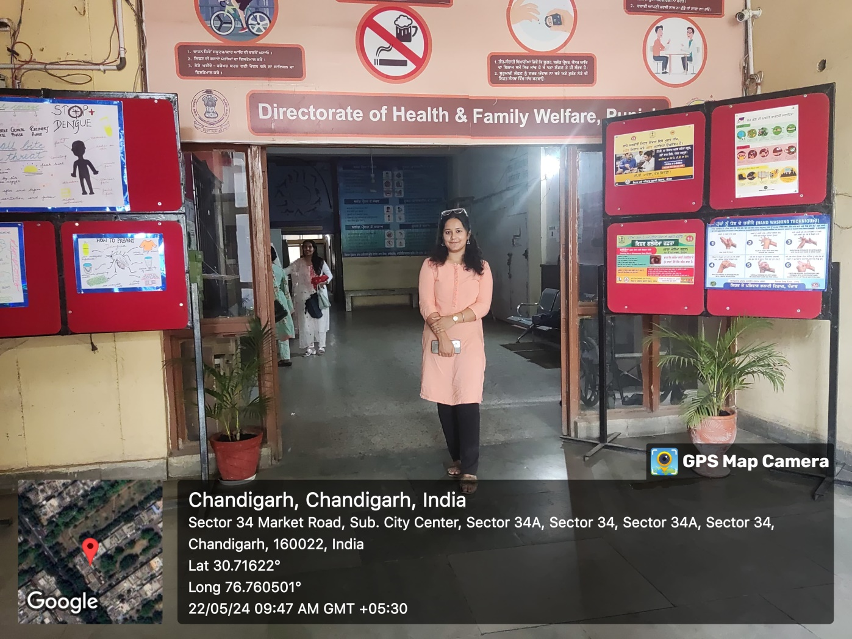
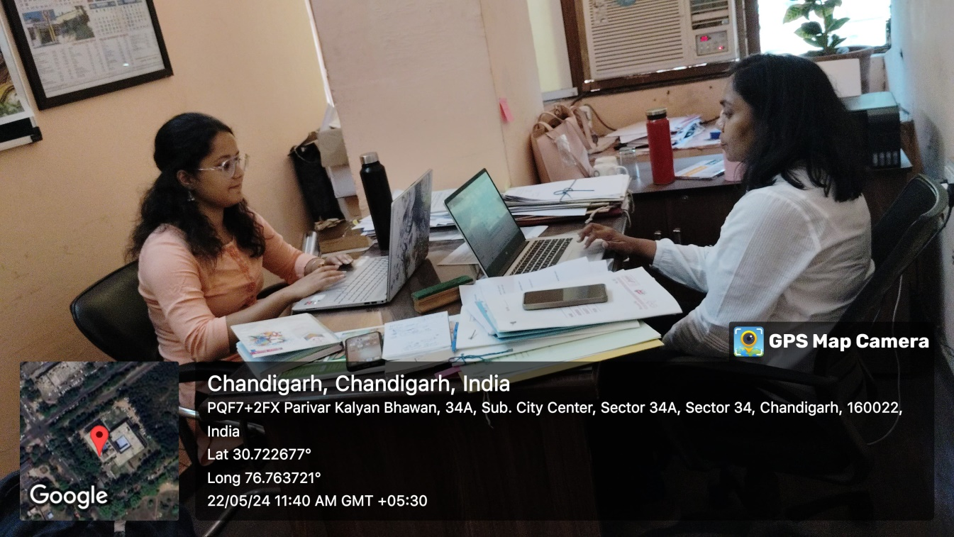
Pictorial Journey (2/2)

Slide 23
SANGATPURA HEALTH AND WELLNESS CENTER
1. Introduction:
The Sangatpura Health and Wellness Centre (HWC) is located in the rural area of Punjab. This report provides a detailed overview of the infrastructure, patient footfall, human resources, and services offered at the centre based on recent observations.
2. Infrastructure:
The Sangatpura HWC lacks several basic infrastructural facilities:
Boundary Walls: The centre does not have basic boundary walls, which raises concerns about security and privacy for both patients and staff.
Drinking Water: There is no provision for drinking water, which is a critical need for patients and staff, especially during the hot summer months.
Toilets: The absence of toilets is a significant issue, affecting both staff and patients, particularly impacting women's comfort and health.

Slide 24
3. Patient Footfall:
Daily Footfall: The centre receives approximately 15-20 patients daily.
Monthly Footfall: On a monthly basis, the footfall ranges between 40-50 patients. This indicates that while the daily footfall is relatively steady, there is variability in monthly visits, possibly due to seasonal diseases or specific health campaigns.
4. Human Resources:
The centre is staffed with a diverse team that manages various health services:
Community Health Officer (CHO): The CHO, holding a B.Sc in Nursing, plays a crucial role in managing diverse outpatient department (OPD) functions, non-communicable disease (NCD) screening and follow-ups, tuberculosis (TB) screening and follow-ups, and the identification and follow-up of high-risk pregnancies.
Female Worker (FW): The FW focuses on Reproductive and Child Health (RCH), delivery registrations, antenatal checkups, immunizations, home visits, and the school health and wellness program.
ASHA Workers: There are 5-6 Accredited Social Health Activist (ASHA) workers who assist with community outreach and various health programs.
Auxiliary Nurse Midwife (ANM): The ANM supports maternal and child health services, immunization programs, and other primary healthcare activities.
Male Health Worker: Currently on deputation, this worker specializes in dengue and malaria testing, including slide formation for accurate diagnosis.

Slide 25
5. Diagnostic Services:
Out of the 14 free diagnostic tests mandated under the free diagnostic service initiative for HWCs/sub-centers, Sangatpura HWC offers more than 7. This indicates partial compliance with the initiative, although there is room for improvement to ensure comprehensive diagnostic services are available.
6. Essential Medicines:
The centre has a good supply of medicines from the essential drug list, including:
- Antibiotics like Amoxyclav and Azithromycin
- Cardiovascular drugs like Atenolol
- Diabetes management drugs like Metformin
- Anti-infective agents like Ofloxacin
Nutritional supplements like Calcium and Vitamin D3
- And many more
This availability ensures that basic and essential treatments can be administered effectively.
7. Training and Support:
Training for cervical cancer screening has been provided by Homi Bhabha Cancer Hospital, which is a positive step towards enhancing the skill set of the healthcare providers. However, there is no logistic support for the implementation of this screening, which limits the practical application of the training.

Slide 26
8. Conclusion:
The Sangatpura Health and Wellness Centre is providing essential health services to the local community despite facing significant infrastructural challenges. The dedication of the health staff, including the CHO, ANM, and ASHA workers, is commendable. To enhance the effectiveness and efficiency of the HWC, it is imperative to address the infrastructural deficiencies, expand diagnostic services, and provide logistic support for newly introduced health initiatives. Improving these areas will ensure better health outcomes for the community served by the Sangatpura HWC.
9. Recommendation:
Basic facilities like boundary walls and toilets should be immediately made.

Slide 27
