Slide 1
Reducing Turnaround Time (TAT)
in
Reimbursement Claims Processing
Dr. RUCHI KUKRETI
PG/13/057
IIHMR, Delhi

Slide 2
ORGANIZATIONAL PROFILE
Vipul MedCorps TPA is headquartered in Gurgaon with branch offices in New Delhi, Noida, Faridabad, Jaipur, Mumbai, Kolkata, Bangalore, and Chennai & Cochin.
Wide Medical Network of over 2000 + hospitals, Diagnostic Centre. Operates a 24/7 Assistance Centre.
Tailor-made software developed in-house with full web-based access for Claims Tracking, On-Line Access and Querying.
Dedicated Panel of Doctors, enable to render Second Medical Opinion, Case Management and Medical Procedure Audit.
Mission:
To continually deliver top quality healthcare to all across the globe so as to promote wellness, with the highest value for all concerned.
Vision:
To create and deliver quality healthcare services & products at affordable cost consistently and to become the industry leader in healthcare facilitation across the globe.

Slide 3
INTRODUCTION
Vipul MedCorp TPA Pvt. Ltd, is in the role of a healthcare facilitator in India for over 8 years and are rated among the top 5 TPAs (Third Party Administrators) in the country. Vipul MedCorp is currently managing over 5.4 Million lives across India and the rest of Asia.
Vipul MedCorp Third Party Administration services
Claims Handling, Management & Back office operations
HealthCare Assistance Services
Outpatient HealthCare facilitation & Management
Second Medical Opinion
Cost Containment Services
Preferred Service Provider (PSP) Networks

Slide 4
OBJECTIVES
This observational study is carried out to with the following objectives:
To understand Third-party administrator (TPA) Work Environment
To understand Claim Reimbursement Process
To understand Turnaround Time(TAT) in Claim Reimbursement and its importance
Based on Observational study, recommendation to “Reduce Turnaround time (TAT) in reimbursement claims processing” is summarized

Slide 5
METHODOLOGY
This observational study is carried out to study procedures and steps involved in reimbursement claims and measure total time taken to settle reimbursement claims.
Time taken to settle reimbursement claims at TPA end is commonly referred as Turnaround time (TAT) which indicate efficiency of process.
Sample size- Total 76 claims
Sampling Method- Convenience
Period - The data is collected for reimbursement claims from 15th Feb to 30th April.
Number of query raised is also taken in account to understand delay in claim processing.
Based on these key parameter recommendation to all stakeholders to “Reduce Turnaround time (TAT) in reimbursement claims processing” is summarized

Slide 6
RESULTS
Goals for Third-party administrator
Faster and focused claims management
Lower overhead cost and reduced cost of claim management
Immediate access to highly trained claim administrators
Improved control over claims outcomes
Provision of cashless services at much ease
Safeguarding of customer relationships
Protection of brand reputation.
Control of possible frauds by the private healthcare providers

Slide 7
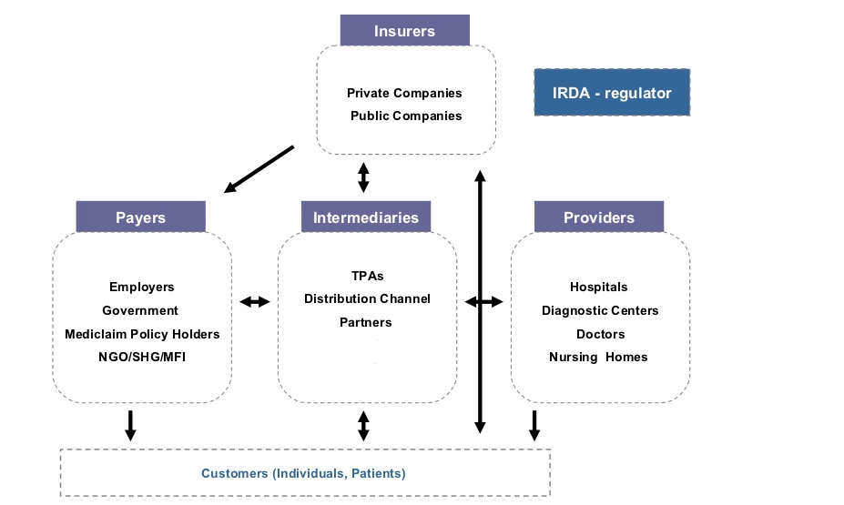
Third-party administrator (TPA) Work Environment

Slide 8
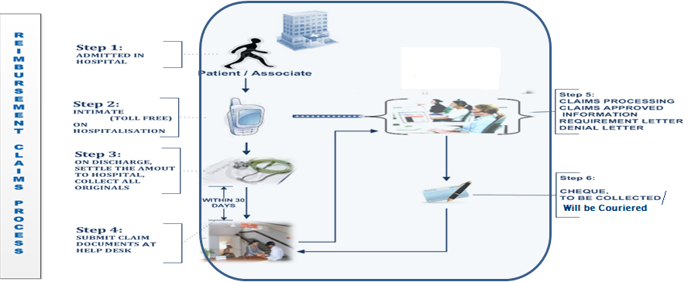
Procedure for Reimbursement Claims
Step 1: Patient get admitted in hospital for his/her illness.
Step 2: Intimation to Vipul Medcorp TPA
Step 3: Patient discharged from hospital with all original bill and discharge summary
Step 4: Patient needs to submit original bills to Regional Helpdesk including discharge summary, breakup of bill and claim form.
Step 5: Claim processing for Approval, Rejection or Investigation
Step 6:Dispatch of Cheque or Electronic fund transfer
VIPUL

Slide 9
TURNAROUND TIME (TAT) measured between step 4 and step 6 is very important parameter to measure performance of TPA among different TPAs. TAT is one of the major parameters in Service level Agreement with corporates in this study TAT of 15 days is taken as reference to compare level of service delivered
Performance of Vipul MedCorp TPA 2007-2011
Year | Total Claims | Settled in 1-3 Month | Settled in 3-6 Month
2007-2008 | 57784 | 22785(39.4%) | 7130(12.3%)
2008-2009 | 109119 | 37960(34.7%) | 8338(7.6%)
2009-2010 | 248790 | 11484(4.6%) | 906(.36%)
20010-2011 | 240582 | 20121(8.3%) | 2814(1.1%)

Slide 10
Key statistics of reimbursements claims (February)
Sample size of claims | 26
Number of claim approved in 15 days | 7(27%)
Number of query raised | 9(35%)
Delay more than 20 days without Query | 4(15%)

Slide 11
Key statistics of reimbursements claims (March)
Sample size of claims | 25
Number of claim approved in 15 days | 9(36 %)
Number of query raised | 12(48 %)
Delay more than 20 days without Query | 2(8%)

Slide 12
Key statistics of reimbursement claims (April)
Sample size of claims | 25
Number of claim approved in 15 days | 12(48 %)
Number of query raised | 6(25 %)
Delay more than 20 days without Query | 1(4 %)

Slide 13
Challenges Observed In Reimbursement Claims
Submitting document without claim form
Quoting wrong claim amount on claim form
Enclosing certificate from doctor instead of detailed discharge summary
Not attaching original cash paid receipts and submitting details on prescription / hospital letter head instead of proper numbered receipt
Incomplete documents: non submission of Lab reports, breakup for bills and medicine prescriptions
Not providing Bank Account Details for effective settlement of claims through EFT mode
Providing Bank Account Details of a beneficiary instead of Employee Bank Account
Claim Documents submitted after 30 days of Discharge for Main Hospitalization and beyond 7 days for Post Hospitalization Expenses.
Lack of training of TPA helpdesk team

Slide 14
RECOMMENDATIONS
Recommendation for Hospitals
Use of software based summarized bill generation which can be imported to TPA software can resolve bulk of Data entry at TPA end
Use of mobile application or cloud based application for maintenance of patient records such as discharge summary and bills which can easily accessed by patient
Standardization of final bill among care providers
Checklist to ensure all original documents are provided to patient on discharge

Slide 15
Recommendation for TPA
Mobile based application to generate intimation
Automatic SMS based reminder to patient to collect original document on discharge
Automatic SMS based reminder to patient to submit missing document for claims
Checklist and Medical officer at helpdesk to ensure all relevant document as available for claim processing this with reduce number of query generated
MIS to keep track number of query generated from each corporate clients
Training of helpdesk staff of TPA to ensure collection of all original document required for claim processing

Slide 16
Recommendation for Claim processing Software
Application to process final bill to generate automatic data entry
Feature for data validation between scanned final bill and data entry
Feature for automatic Co-pay deduction , Corporate specific deduction
Accurate post and pre hospitalization details on date and time of admission and discharge

Slide 17
Thank You

