Slide 1
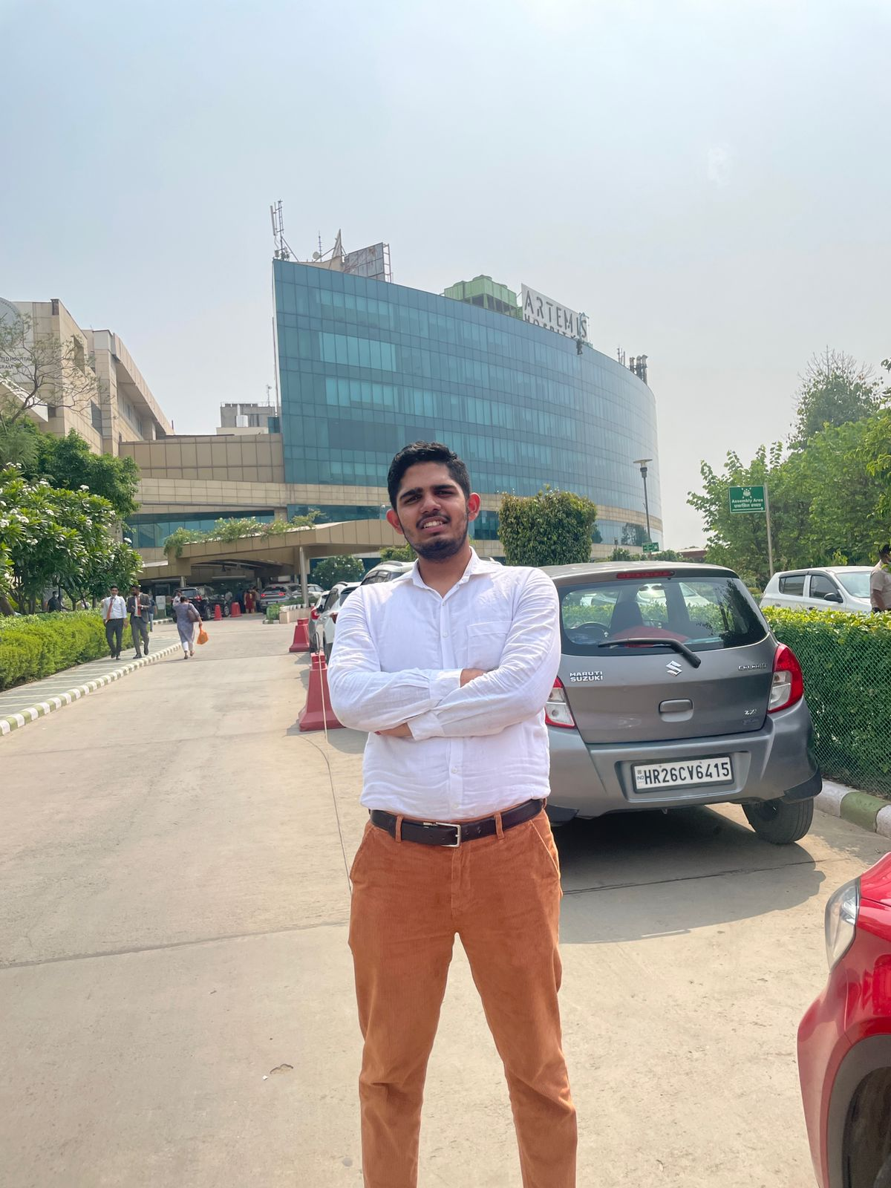
A Study of HIS integrated Artemis Connect MD applications: Challenges and opportunities.
By- ABHIMANYU DABAS PG/21/142 Guided by Dr. Sumant Swain
Notes:
Line spacing + Page numbers

Slide 2


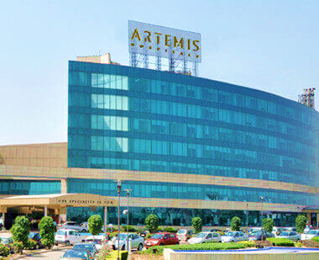

Internship Overview
Internship Organization-
Artemis Hospitals, Gurugram
Topic of Project –
A Study of HIS integrated Artemis Connect MD applications: Challenges and opportunities.

Slide 3


Introduction to the Artemis
Artemis Hospital, established in 2007, spread across 9 acres, is a 600 plus bed [450+ operational, 150 under construction]; state-of-the-art multi- specialty hospital located in Gurgaon, India. Artemis Hospital is the first JCI and NABH accredited Hospital in Gurgaon.
Artemis is the name of the Greek goddess of fertility, nature, childbirth. She is also the twin sibling of the Greek god Apollo, God of Youth, Masculinity and healing.

Slide 4
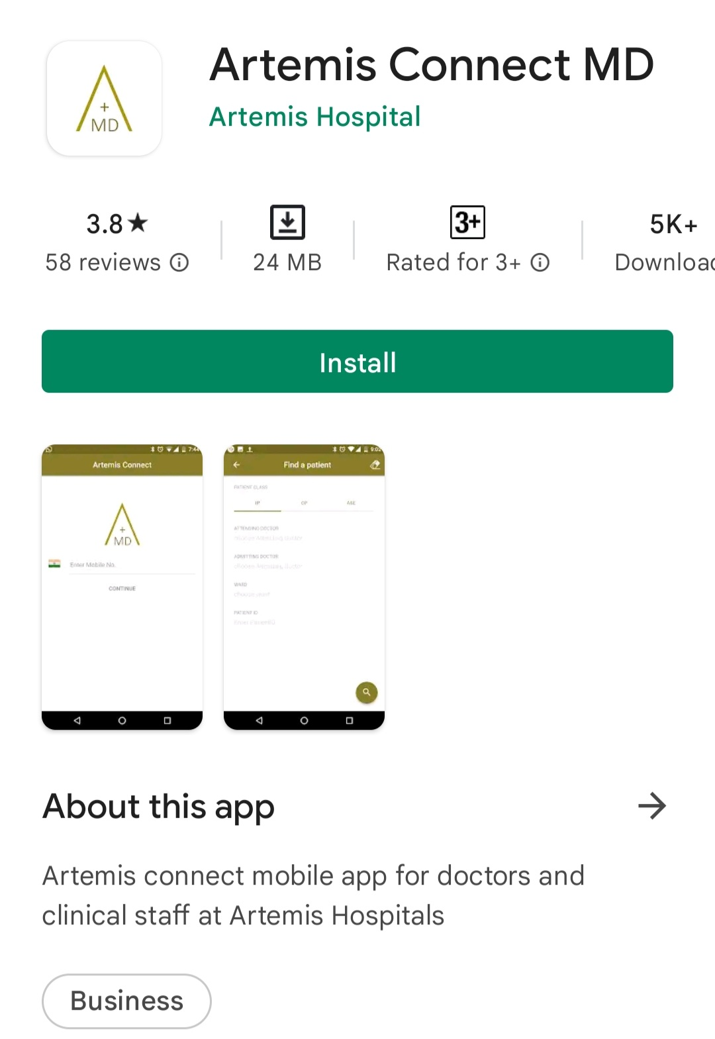
Introduction to the project
Topic- A Study of HIS integrated Artemis Connect MD applications: Challenges and opportunities.
Hospital Information system (HIS) is one of the most advance and sophisticated implementations within healthcare industry.
Even further development of HIS and its integration within the portable Smartphones and Tablets, took this system from the admission counters to the patient’s bedside.
Artemis Connect MD app is the step in this direction. It allows the HCPs to use various features to help with their day to-day activities.
The feature under considerations are;
Patient Tagging Ordering drug or Prescription Referral feature Document Upload feature

Slide 5
Objectives of the study
OBJECTIVE-
To find out the satisfaction level of HCPs at Artemis Hospital, Gurugram using the HIS integrated Artemis Connect MD application.
  SPECIFIC OBJECTIVES-
  To find out whether the integration of HIS into a mobile device has changed the perception of HCPs towards it.
  To Analyse the level of adaptability of healthcare industry towards Information Technology.

Slide 6
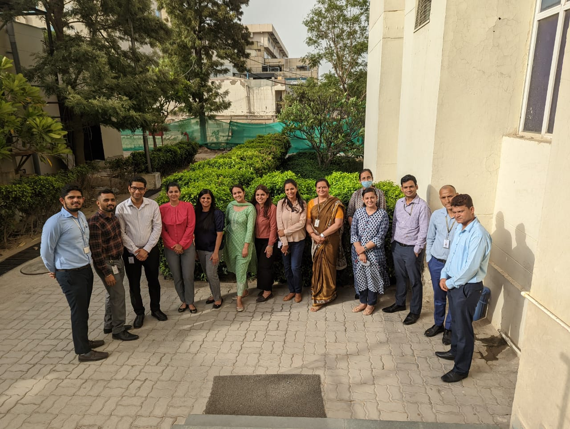
STUDY DESIGN- Cross-Sectional Study
STUDY TYPE- Quantitative
SAMPLING METHODOLOGY- Convenient Sampling
LOCATION OF THE STUDY- Artemis Hospital, Gurugram
TARGETED GROUP- The users of the Artemis Connect MD application
TYPE OF DATA- Primary Data
METHODOLOGY

Slide 7
In continuation…
DATA COLLECTION-
In order to collect data a Microsoft Form was created and circulated among the prospective candidates which includes Doctors, Nursing Staff and Coordinators who are the daily users of the application. Mode of Data collection was ‘Primary’ and was tracked using MS Excel.
SAMPLE SIZE-
The sample were collected in the month of May and June. The sample size was kept to be 50 and was analysed after the data was collected.

Slide 8
Data Analysis
During the process of making ourselves familiar with the application, we are able to see that the applications offer the user with several facilities and tools which were making work more and more efficient, out of all the features few were found out to be used in a large number and were directly involved in both the patients and doctor day to-day work.

Slide 9
Result

Slide 10
Result….

Slide 11
Discussion
After a thorough study, one can easily reflect upon the fact that the Hospital Information System (HIS) was a truly pathbreaking discovery when it comes to the healthcare industry, and now developing it even further to integrate it into the handy mobile system is the new era’s welcoming amendment into this discovery.
As discussed earlier, this is an era of instantaneity and not industry today can afford to remain untouched by this. And in healthcare time is everything.

Slide 12
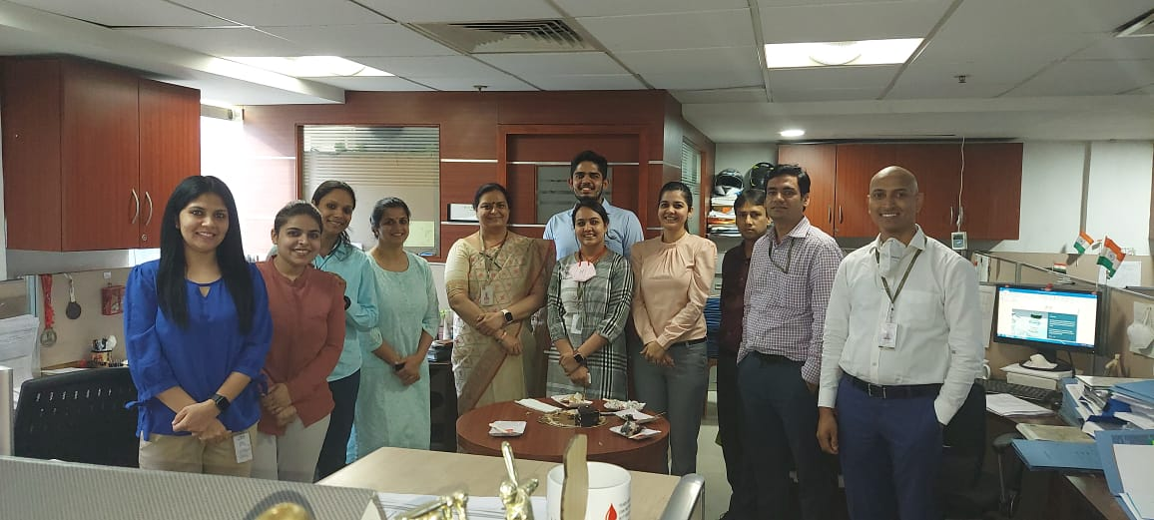
In Continuation
After going through the responses given by the candidates of the questionnaire one thing is clear, this change is being welcomed. Integration of HIS within an application was a very thought after change.
Clearly there are few problems that the app user might face in the starting just like we observed in the Referral Feature and Online ordering feature. These few glitches can be explained as to networking issues and or lack of awareness or knowledge about the application.

Slide 13
Limitation of the Study
Click to enter

Slide 14
Conclusion

Slide 15
References

Slide 16
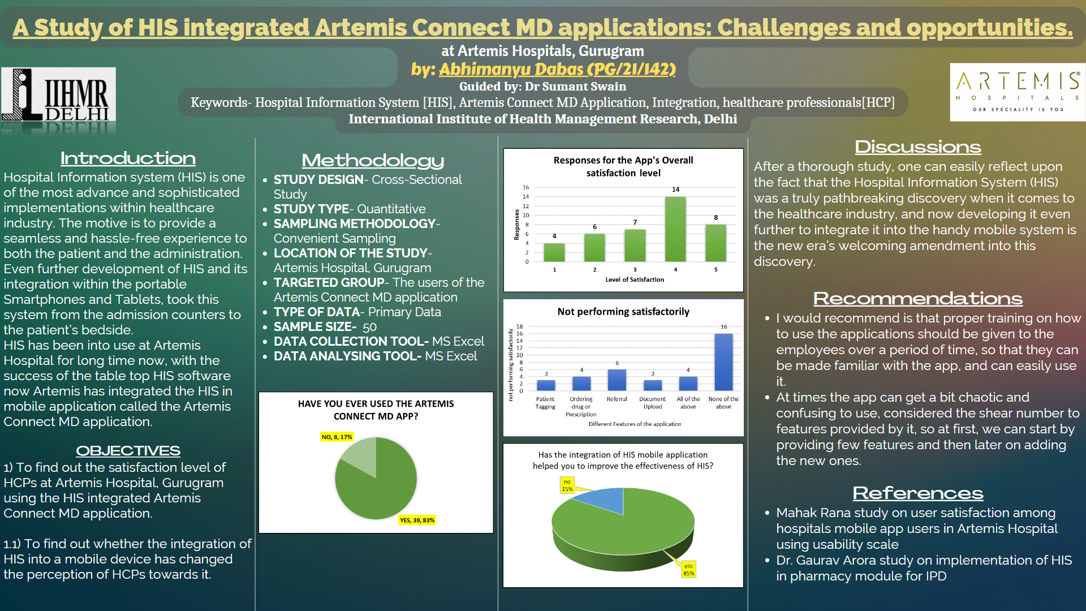

Slide 17
Thank You

Slide 18
Internship Experience
Skills Learned-
Self Comments on Internship

Slide 19
Suggestions given to the organization

Slide 20
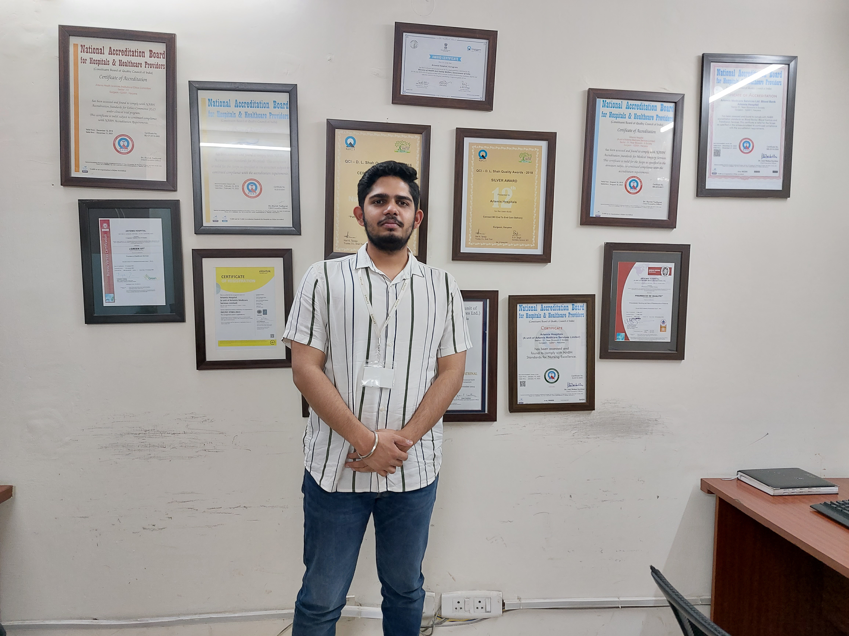
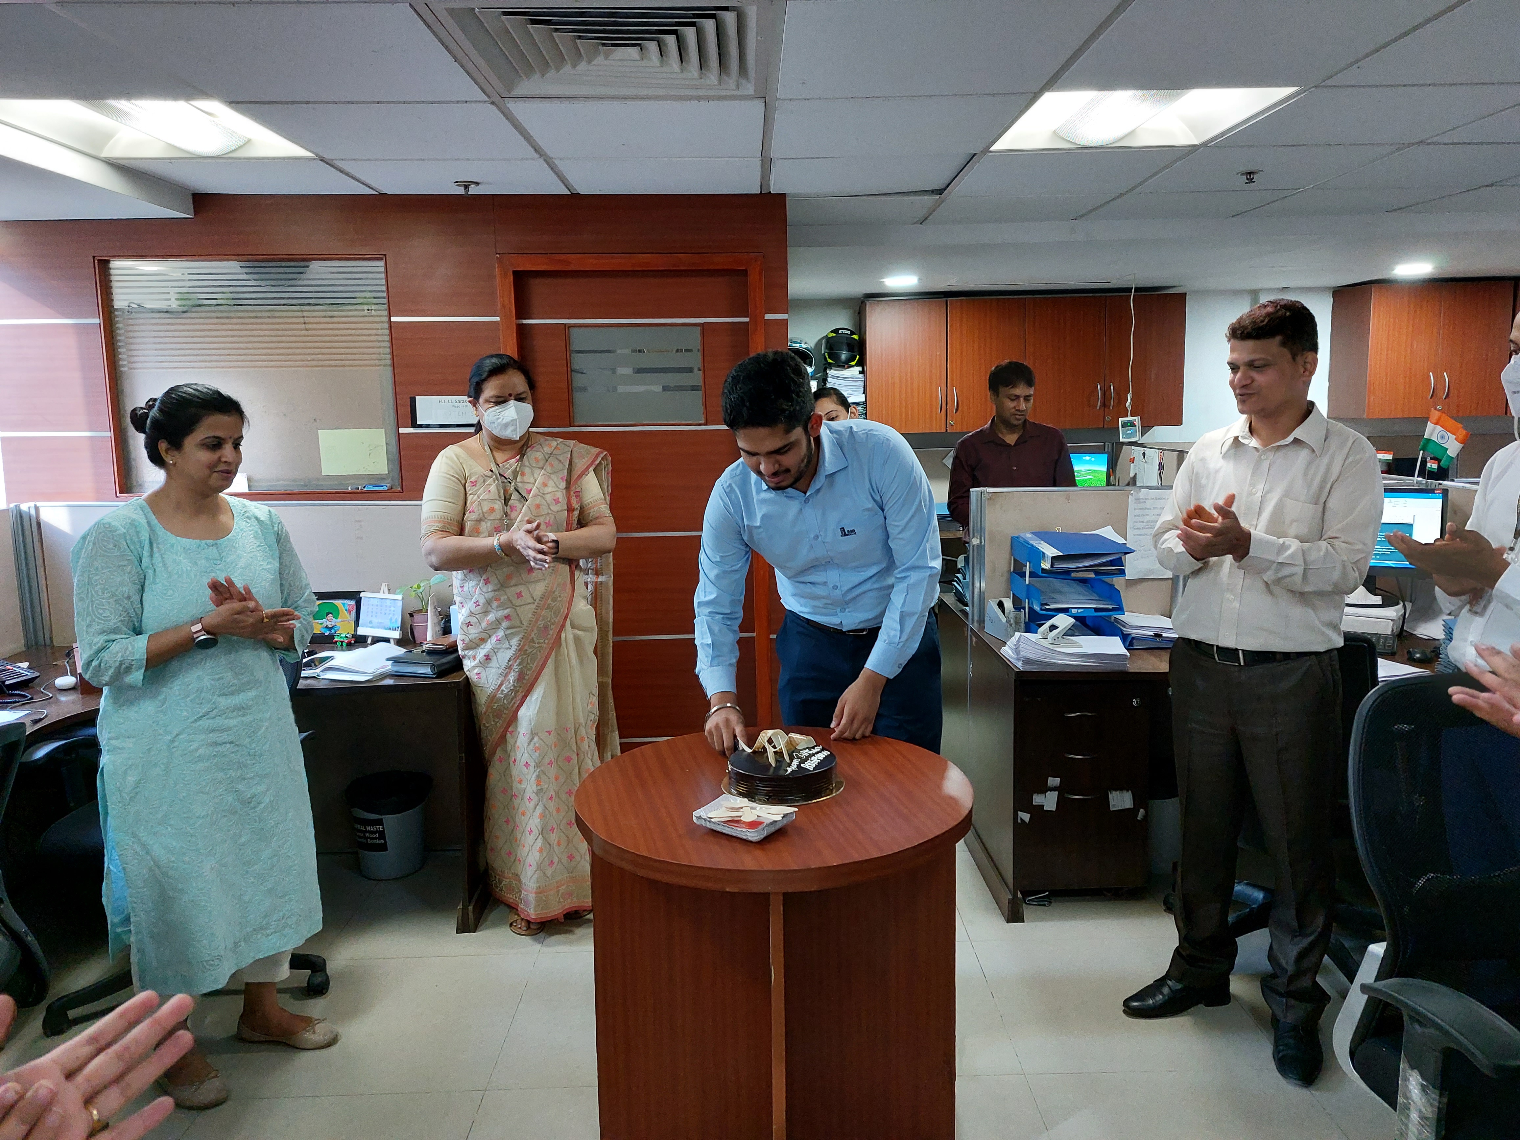

Slide 21
