Slide 1

Topic - Profile of Clients Availing Services from Silver Genie Pvt Ltd.
Silver Genie Pvt Ltd.
Guided By - Dr Ekta Saroha
IIHMR Delhi
Submitted By- Dr Nikita Dubey

Slide 2
Mentor Approval

Slide 3
Introduction
Global Aging Phenomenon: The aging population is a worldwide trend with major social and economic effects, prompting a need for specialized elder care services.
In India, the increase in the elderly population has heightened the demand for elder care services, with Silver Genie Private Limited emerging as a key provider in this sector.
This study seeks to analyze the sociodemographic profile of clients using Silver Genie's services, using a quantitative approach with univariate analysis to summarize data through measures like mean, standard deviation, median, and range.

Slide 4
Objectives of Your Study
1. To describe the sociodemographic characteristics of clients using Silver Genie's services.
2. To quantify the central tendencies of key sociodemographic variables.
3. To identify patterns and trends within the client data that may inform service provision and policy development.

Slide 5
Methodology
Study Design: Quantitative study using univariate analysis and survey methodology.
Study Area: Clients of Silver Genie Pvt Ltd across India.
Study Population: Clients who have availed services from Silver Genie over the past year.
Study Variables
Demographic Variables: Age, gender, Location, etc.
Sociodemographic Variables: Health Status, Disability Status, Employment status, etc.
Data Collection Tools and Techniques
Secondary Data Collection: Total 150 client’s data extracted from Silver Genie's records, focusing on age, gender, location, services, and health status.

Slide 6
Methodology
Timelines – 3 Months
Inclusion Criteria: Clients of Silver Genie: Participants must have availed services from Silver Genie Pvt Ltd. within the past year.
Exclusion Criteria: Non-clients: Individuals who have not utilized services from Silver Genie within the past year.

Slide 7
Results
Analysis of age distribution - Mean, Standard deviation
 | MEAN | 76.65
 | STANDARD DEVIATION | 8.94
RANGE 37
MINIMUM AGE 60
MAXIMUM AGE 97

Slide 8
Results
MALE | 59 | 39.30%
FEMALE | 91 | 60.60%
GURGAON | 30 | 20%
DELHI | 60 | 40%
KOLKATA | 32 | 21.33%
NOIDA | 28 | 18.66%
ENGLISH | 73 | 48.60%
HINDI | 62 | 41.30%
BENGALI | 15 | 10%
Frequency and percentage distribution of male and female individuals.
Frequency and percentage distribution of primary languages spoken.
Frequency and percentage distribution of Location

Slide 9
Results
UNEMPLOYED | 28 | 18%
EMPLOYED | 0 | 0%
RETIRED | 122 | 81.33%
WITH DISABILITY | 59 | 39.33%
WITHOUT DISABILITY | 91 | 60.66%
SEVERE | 53 | 35.33%
MODERATE | 63 | 42%
MILD | 32 | 21.33%
Frequency and percentage distribution of employment Status.
Frequency and percentage distribution of individuals with physical or mental disabilities.
Frequency and percentage distribution of health conditions.

Slide 10
Discussion
Mean age of clients: 76.7 years (Standard Deviation = 8.94), indicating predominantly older adults.
Gender distribution: 60.6% females, 39.3% males, reflecting global longevity trends.
Geographic distribution: Primarily urban areas—Delhi (40%), Kolkata (21.3%), Gurgaon (20%), Noida (18.66%).
Employment status: Majority (81.3%) are retired, highlighting support for the aging population.
Language diversity: English (48.6%), Hindi (41.3%), Bengali (10%); reflects regional and cultural variations.
Disability prevalence: 39.3% report disabilities, indicating the need for tailored care services.
Health status: Varied distribution—35.3% severe, 42% moderate, 21.3% mild—underscoring diverse health care needs.

Slide 11
Conclusion
In conclusion, this study will provide valuable insights into the sociodemographic characteristics and needs of clients using elder homecare services. By employing rigorous quantitative methods and a well-structured survey, the research aims to produce reliable and actionable findings that can benefit both Silver Genie and the broader elder care sector.
In conclusion, this dissertation contributes valuable insights that can guide Silver Genie Pvt Ltd. in improving service provision and policy formulation to better meet the evolving needs of India's aging population

Slide 12
References
Scala MA, Mayberry PS, Kunkel SR. Consumer-directed home care: client profiles and service challenges. PubMed. 1992. Available from: https://pubmed.ncbi.nlm.nih.gov/9257623/
Mah JC, Stevens SJ, Keefe JM, Rockwood K, Andrew MK. Social factors influencing utilization of home care in community-dwelling older adults: a scoping review. BMC Geriatr. 2021;21(1):169. Available from: https://bmcgeriatr.biomedcentral.com/articles/10.1186/s12877-021-02069-1
Low LF, Yap M, Brodaty H. A systematic review of different models of home and community care services for older persons. BMC Health Serv Res. 2011;11:93. Available from: https://bmchealthservres.biomedcentral.com/articles/10.1186/1472-6963-11-93
Hokenstad MC, Johansson L. Eldercare in Sweden: issues in service provision and case management. J Nurs Manag. 2008;16(2):169-177. PMID: 18269547. doi:10.1111/j.1365-2834.2007.00841.x
Tullett M, Neno R. Approaches to long-term conditions management and care for older people: similarities or differences? J Nurs Manag. 2008;16(2):178-187. PMID: 18269547. doi:10.1111/j.1365-2834.2007.00841.x
Davies S, Goodman C. Supporting quality improvement in care homes for older people: the contribution of primary care nurses. J Nurs Manag. 2008;16(2):188-196. PMID: 18269540. doi:10.1111/j.1365-2834.2007.00838.x
Clarfield AM, Bergman H, Kane R. Fragmentation of care for frail older people—an international problem. Experience from three countries: Israel, Canada, and the United States. J Am Geriatr Soc. 2001;49(12):1714-1721. Available from: https://doi.org/10.1046/j.1532-5415.2001.49285.x

Slide 13
Thank You
Any Questions

Slide 14
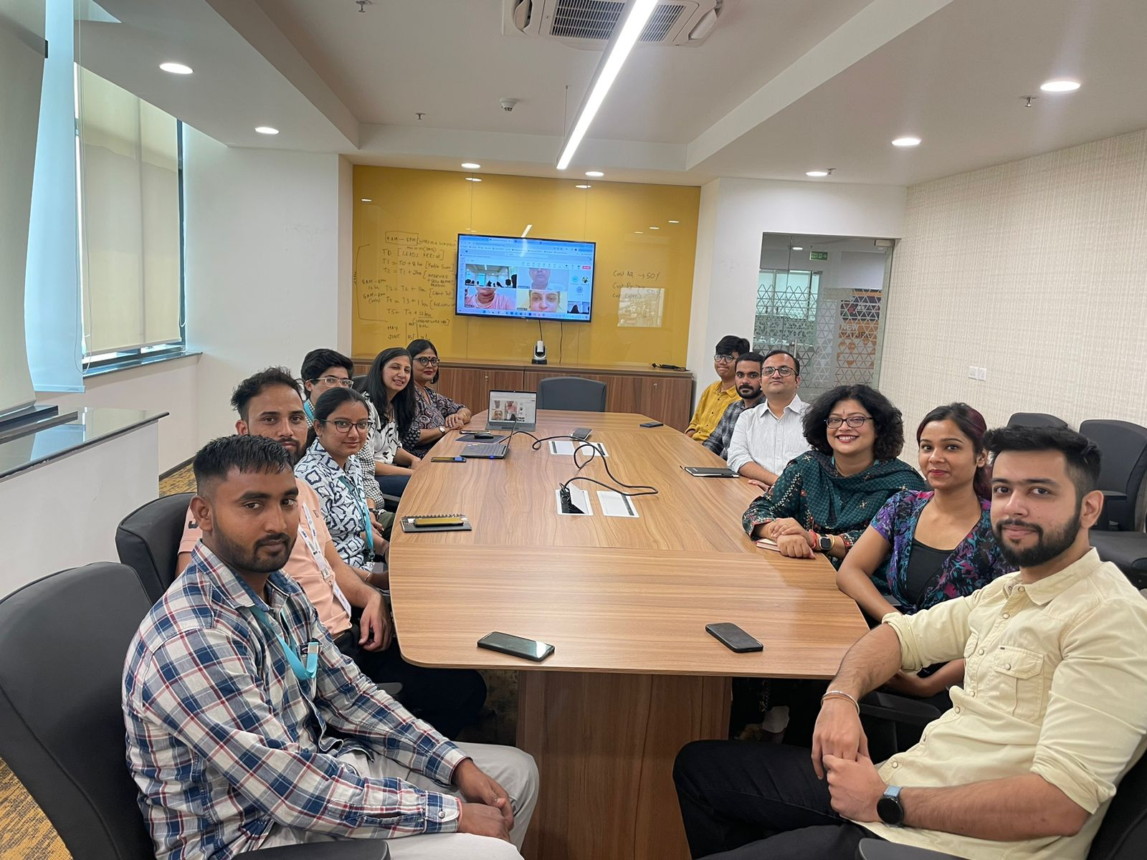
Pictorial Journey

