Slide 1

A Study on Employee Motivation at Artemis Hospital, Gurugram
BY
Dr. MITALI YADAV
PG/21/61
UNDER THE GUIDANCE OF
Dr. EKTA SAROHA & Dr. Punit Yadav
PGDM (Hospital & Health )
2021-23

Slide 2
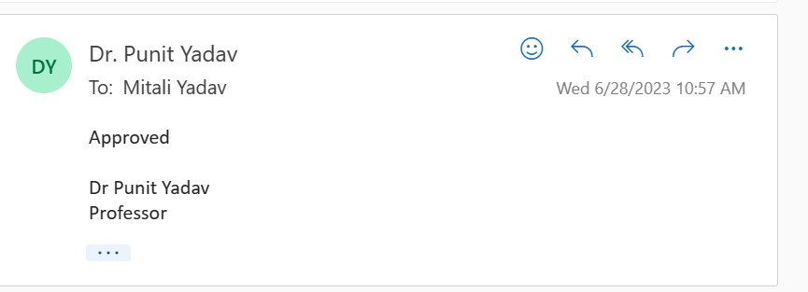
Mentor Approval

Slide 3
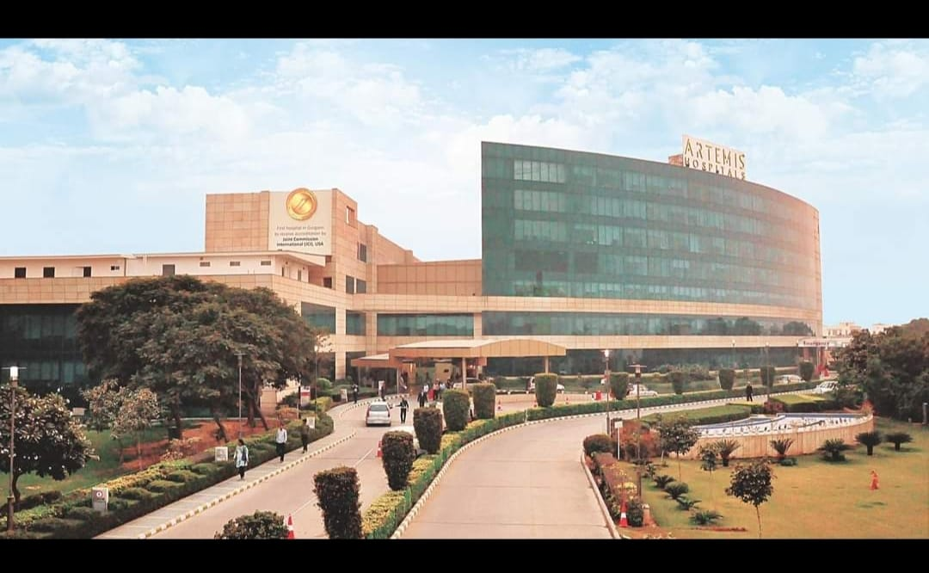
ABOUT HOSPITAL
Artemis Hospital, established in 2007, spread across 9 acres, is a 600-plus bed; state-of-the-art multi-specialty hospital located in Gurgaon, India.
Artemis Hospital is the first JCI and NABH accredited Hospital in Gurgaon.
Designed as one of the most advanced hospitals in India, Artemis provides a depth of expertise in the spectrum of advanced medical & surgical interventions, a comprehensive mix of inpatient and outpatient services.

Slide 4
Introduction
Employee motivation directly impacts individual performance, job satisfaction, and commitment, leading to higher productivity levels and improved organizational outcomes.
Motivated employees are more likely to exhibit discretionary effort, creativity, and innovation, resulting in competitive advantages for the organization.
A motivated workforce leads to lower turnover rates, reduced absenteeism, and enhanced employee retention, saving recruitment and training costs.

Slide 5
Objective
Primary Objective-
To find the employee motivation techniques adopted in Artemis Hospital Gurugram.
Secondary Objectives:
To analyse the job involvement of employees in an organization.
To study about growth needs of employees
To find whether organizational health is being given to employees by the company or organization
To study the effect of Job promotion on employees

Slide 6
Methodology
Study design: The study type is cross-sectional and descriptive in nature.
Study location: Artemis Hospital.
Study population: Random Working Employees at Artemis Hospital Gurgaon.
Duration of study: 3 Months i.e. 25th February to 31st May.
Sample size: 100
Sampling technique: Convenience sampling.
Method of data collection: Structured Questionnaire.
Methods for data analysis: Microsoft Excel.

Slide 7
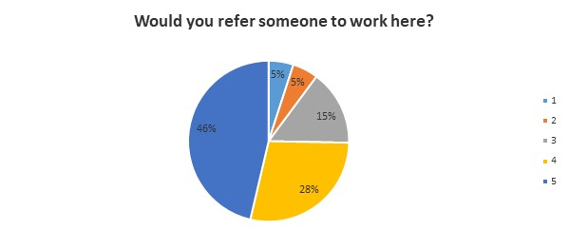
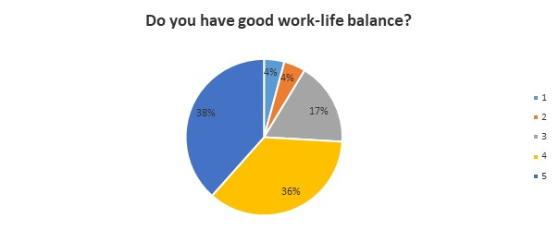
Results
Figure 1 Figure 2

Slide 8
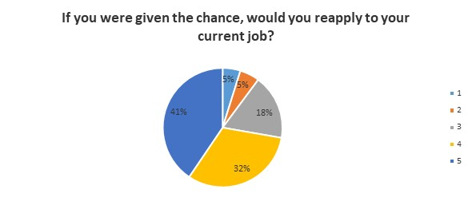
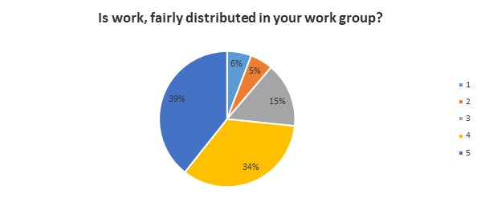
Figure 3 Figure 4

Slide 9
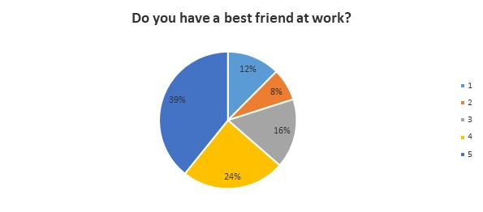
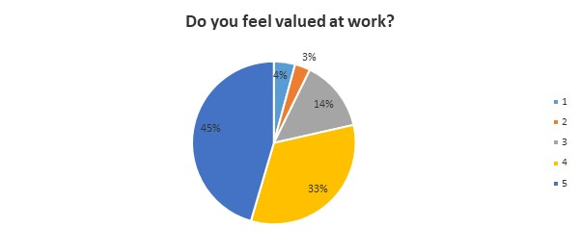
Figure 5 Figure 6

Slide 10
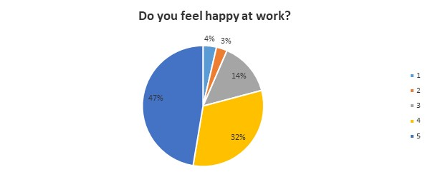
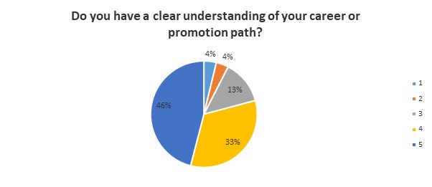
Figure 7 Figure 8

Slide 11
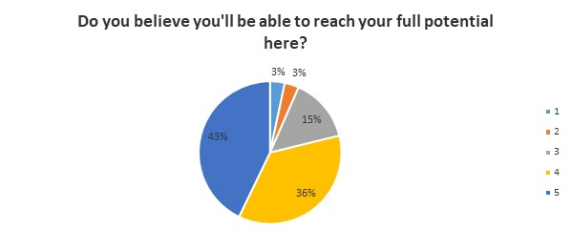
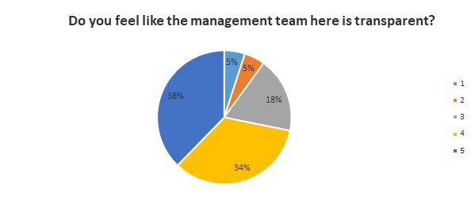
Figure 9 Figure 10

Slide 12
Discussion
Employees are highly inclined to refer someone to work at the company, demonstrating a strong endorsement of the workplace.
Employees say they have a good work-life balance, indicating that the organisation values employee well-being and places a premium on work-life integration.
Employees want to reapply for their existing job, demonstrating a high level of satisfaction and contentment with their current position.
Employees say that work is fairly distributed in their work group, reflecting a sense of justice and equity in workload distribution.
Employees have a best buddy at work, demonstrating the presence of healthy social relationships and a supportive work environment.

Slide 13
6. Employees believe they are valued at work, reflecting the company's efforts to recognise and reward employee contributions.
7. Employees say they are satisfied at work, indicating a positive work environment and job satisfaction among the workforce.
8. Employees have a clear grasp of their career or advancement route, demonstrating strong management communication and transparency.
9. Employees believe they will be able to maximise their potential at the organisation, suggesting a strong sense of personal growth and development chances.
10. Employees consider the management team to be transparent, reflecting open communication and trust between employees and leadership.

Slide 14
Conclusion
The majority of employees are highly inclined to refer someone to work at the organisation, reflecting a positive workplace view.
A sizable percentage of employees say they have a good work-life balance, indicating a pleasant work environment that prioritises employee well-being.
The vast majority of employees indicate a strong desire to reapply for their current position, suggesting job happiness and contentment.

Slide 15
A sizable proportion of employees say that work is distributed equitably within their work group, indicating a view of fairness and equitable practises.
While the majority of employees report having a best friend at work, a significant minority do not, highlighting the need for more focus to build better social interactions among employees.
The vast majority of employees believe they are valued at work, indicating a healthy business culture that recognises and values employee contributions.

Slide 16
References (Only Vancouver Style)
https://www.google.com/
https://en.wikipedia.org/wiki/Human_resources
https://www.questionpro.com/blog/employee-motivation/
https://www.inc.com/encyclopedia/employee-motivation.html
https://www.entrepreneur.com/topic/employee-motivation

Slide 17
Thank You
Any Questions

