Slide 1


EFFECTIVENESS AND SUSTAINABILITY OF INTERMITTENT FASTING AMONG ADULTS: A SYSTEMATIC REVIEW AND META ANALYSIS
Guided by
Dr Sai Ram Challa , Scientist E, ICMR-NIN
&
Dr Anandhi Ramachandran – Professor , IIHMR Delhi
Presented by
Dr Palla Gayatri
PG/22/143

Slide 2
INTRODUCTION
Intermittent fasting, a common dietary intervention adapted by humans for weight loss. Intermittent fasting (IF) is a dietary regimen that alternates between designated periods of fasting and eating. IF emphasizes the timing of food intake. This approach aims to improve metabolic health and facilitate weight loss through various structured fasting schedules
AIM-The primary objective of this study is to conduct a systematic review and meta – analysis to understand the effectiveness of intermittent fasting as compared to normal diet in overweight or obese adults.
Another objective is to understand the sustainability of intermittent fasting.

Slide 3
A systematic search on PubMed, Google scholar and Scopus was done independently by two reviewers. The terms used in the literature search are “Intermittent fasting” “Time restricted feeding” “Alternate day fasting” “Body mass index” “Weight loss” “Metabolic syndrome” “Metabolic health markers” “randomized controlled trials” “cohort studies” “case-control studies” “qualitative studies” “Longevity” “Effectiveness”. The mentioned keywords were combined with “OR” / “AND” for the search strategy
METHODOLOGY

Slide 4
METHODOLOGY(CONTD..)
Inclusion criteria
The intervention group included studies of intermittent fasting and the types- Alternate day fasting, 5:2, Time restricted feeding. The control group included normal eating or no other dietary intervention. Overweight and obese adults
Exclusion criteria
Ramadan or any other type of religious fasting
if the comparison group included any other type of dietary intervention.
The research individual was not human.
The full text of the article was not in English.
The literature was duplicated
If the data was not available.

Slide 5
PRISMA FLOW DIAGRAM
Record identified through database searching - 317
PubMed n=39, Scopus n=119, Google scholar n=159
Identification
Records screened and excluded after screening of title and abstract – 254
PubMed – 26; Scopus n=97; Google scholar n=131
Full text articles assessed PubMed – 13
Scopus n=22
Google scholar n=28
Duplicates removed – 3
Screening
Reports excluded – not English language, control group not matching with our study, wrong outcome measure
PubMed – 12; Scopus n=19; Google scholar n=22
Studies included in quantitative synthesis /meta-analysis – 6
Studies included in qualitative synthesis -4
Included

Slide 6
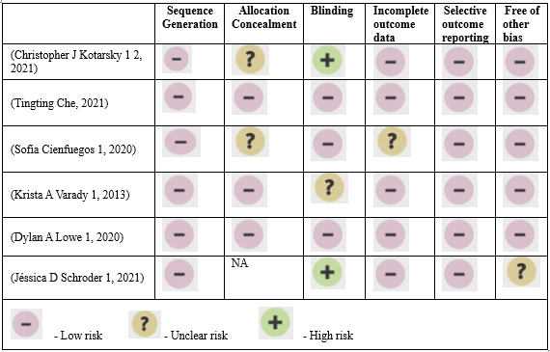
RISK OF BIAS

Slide 7
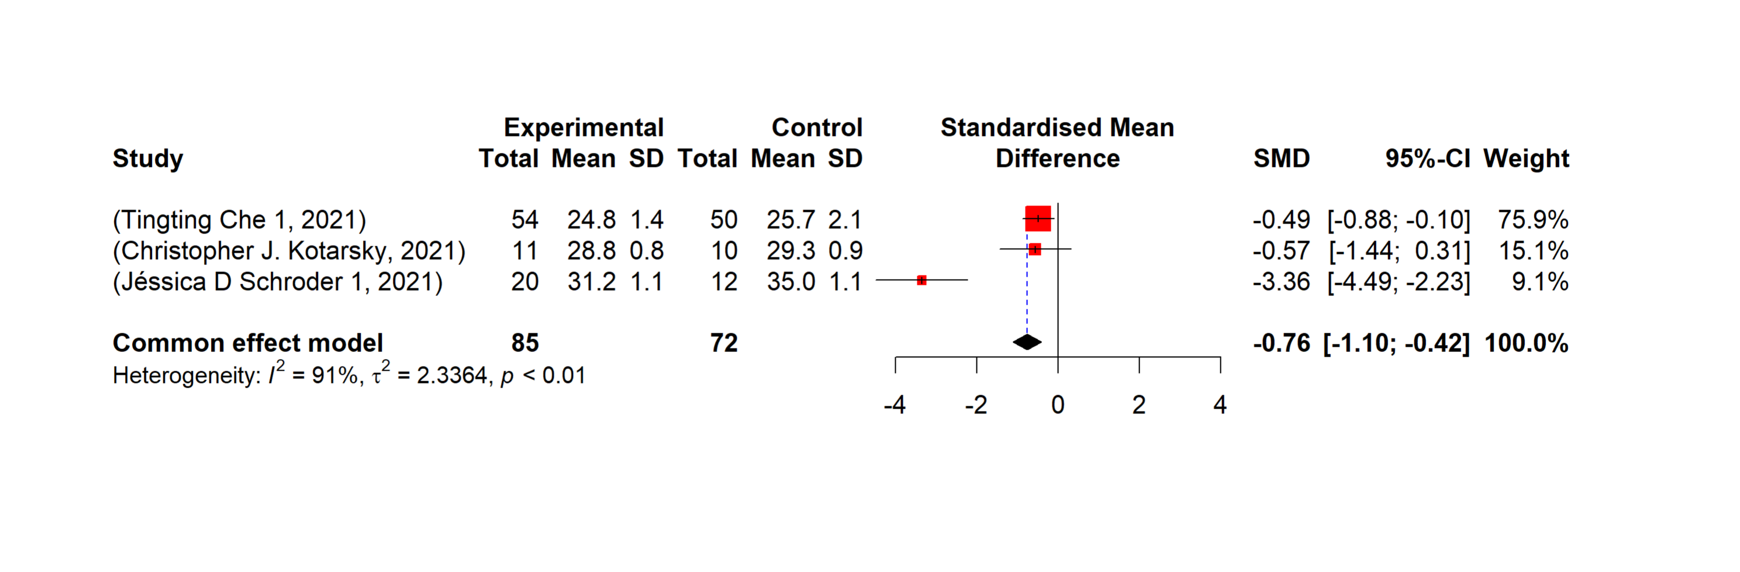
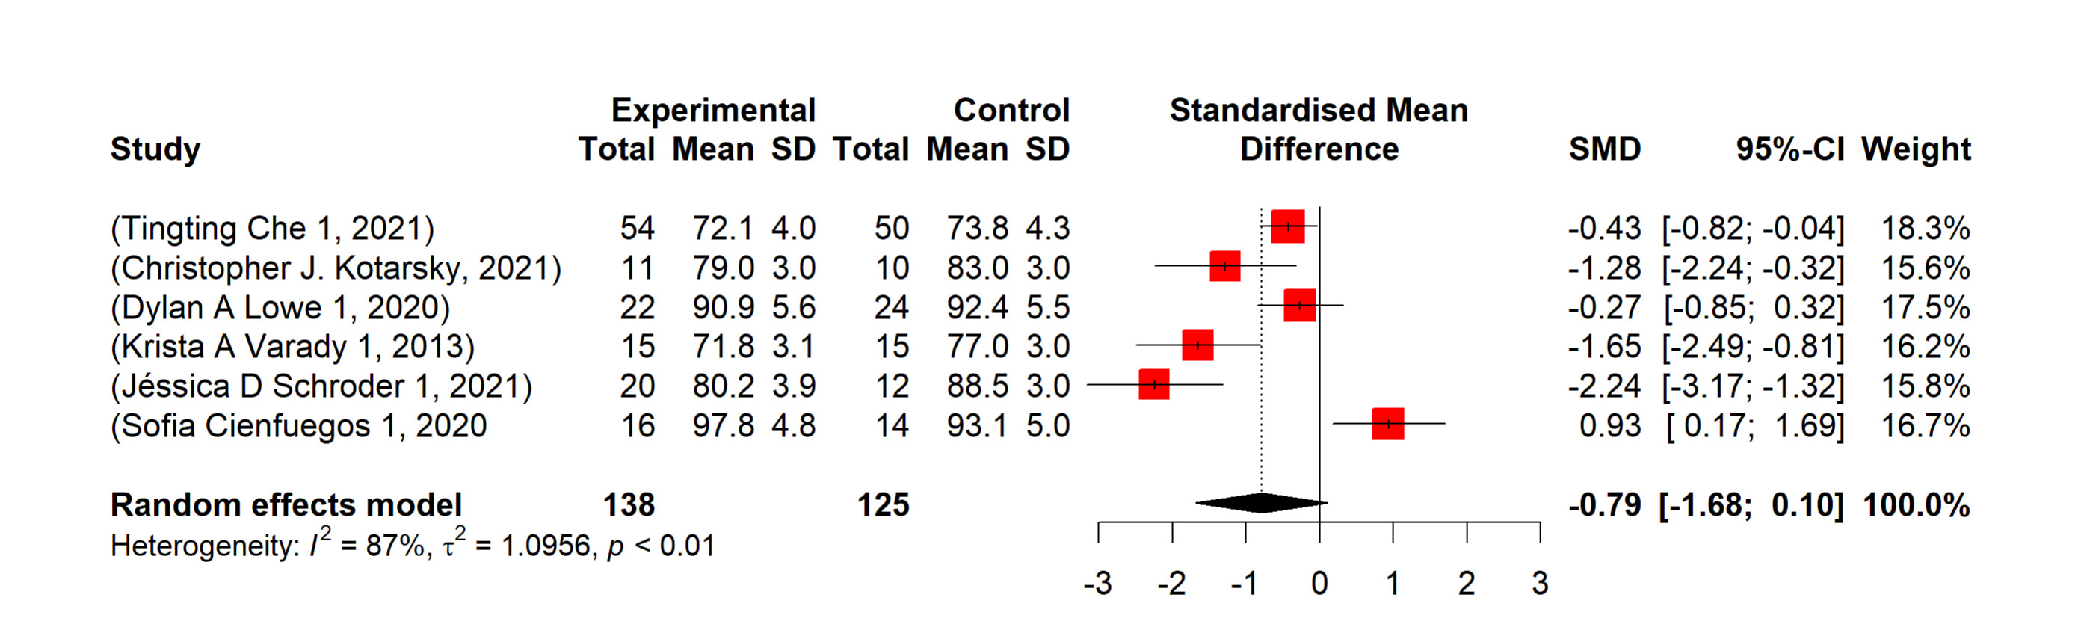
META-ANALYSIS
Effectiveness of Intermittent fasting on BMI
Effectiveness of Intermittent fasting on Weight

Slide 8
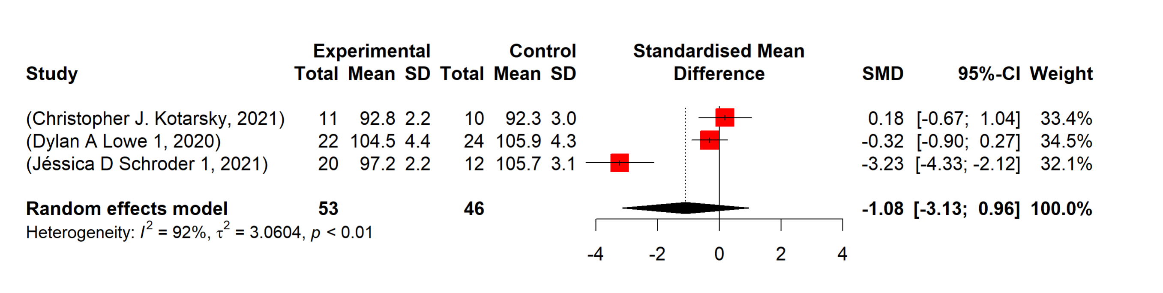
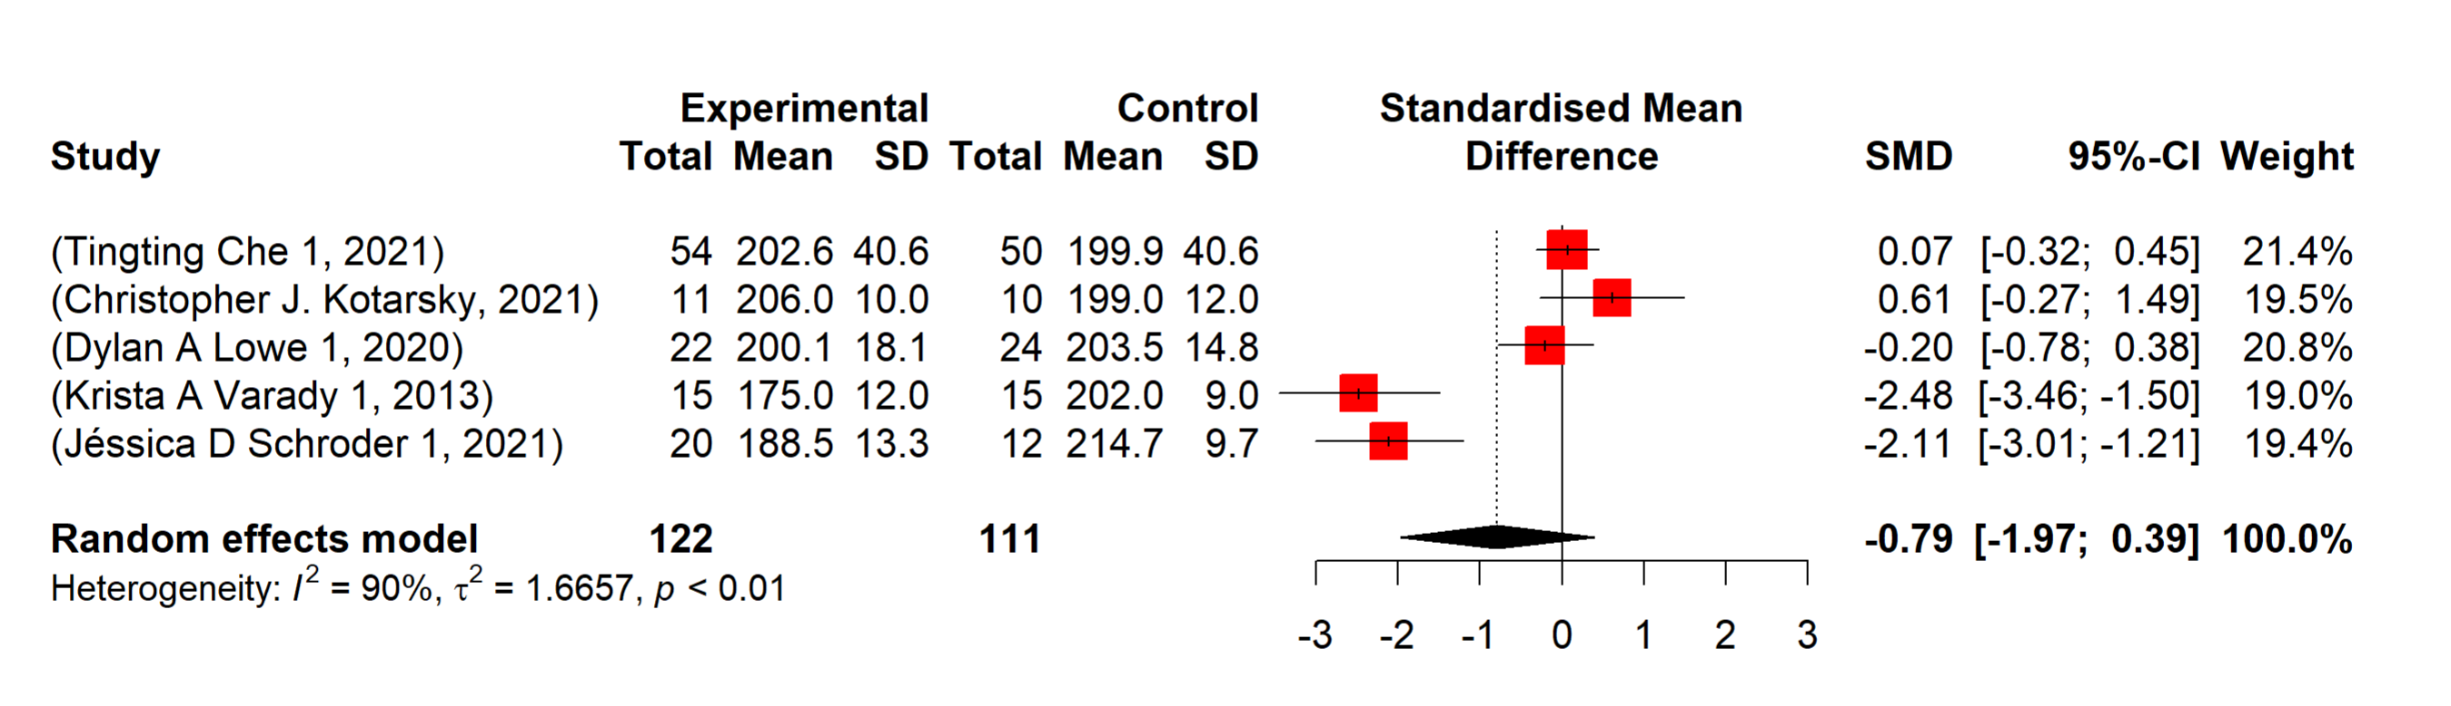
META-ANALYSIS(CONTD..)
Effectiveness of Intermittent fasting on waist circumference
Effectiveness of Intermittent fasting on total cholesterol

Slide 9
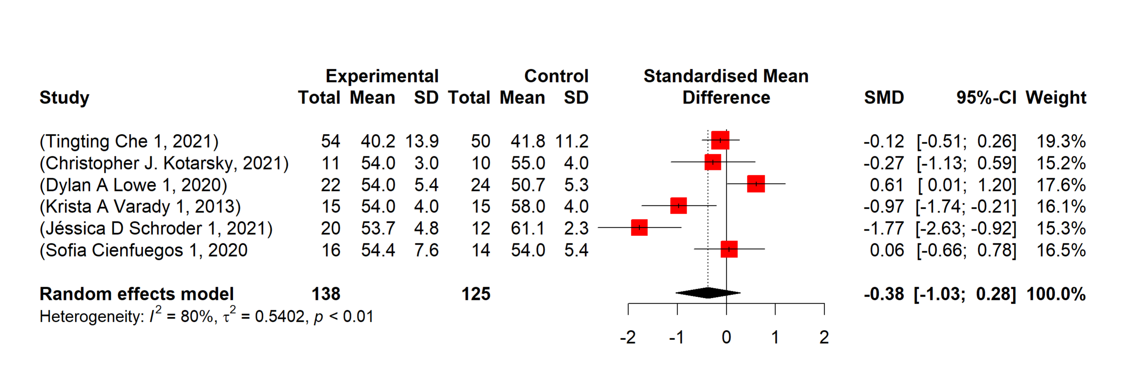
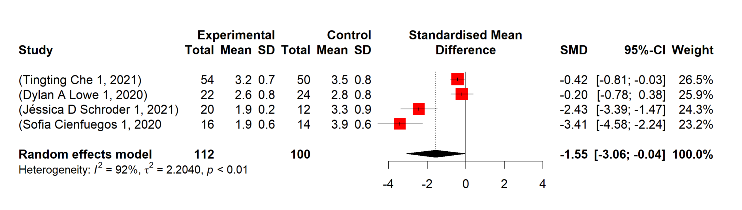
META-ANALYSIS(CONTD..)
Effectiveness of Intermittent fasting on High density Lipoprotein (HDL
Effectiveness of Intermittent fasting on Homeostatic Model Assessment for Insulin Resistance

Slide 10
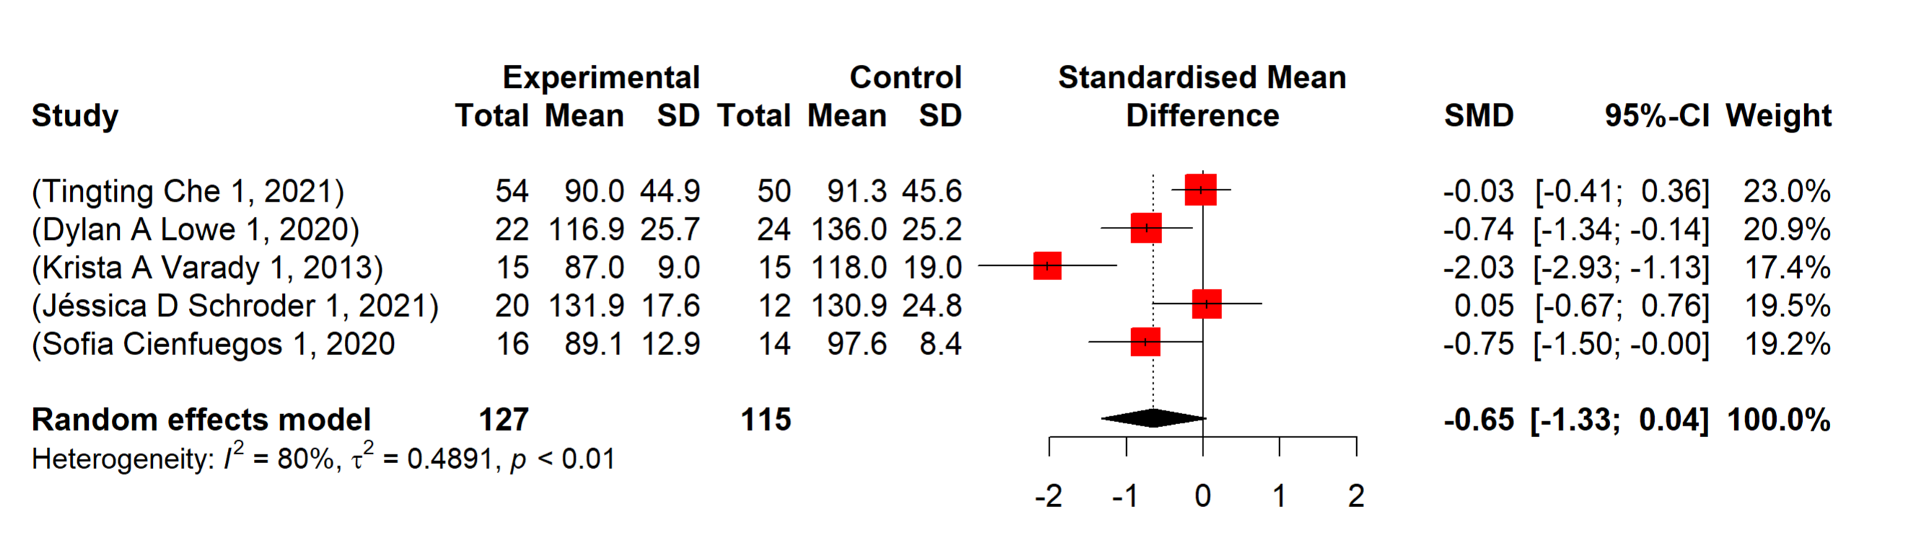
META-ANALYSIS(CONTD..)
Effectiveness of Intermittent fasting on triglycerides

Slide 11
QUALITATIVE SYNTHESIS
Parameter | Mean difference of all studies
Weight Loss (kg) | -4.80 kg
BMI Reduction (kg/m²) | -1.8 kg/m²
Waist Circumference Reduction (cm) | -5.06 cm
Systolic BP Reduction (mmHg) | -9.67mmHg
Diastolic BP Reduction (mmHg | -8.36 mmHg
Total Cholesterol Reduction (mg/dL) | -13.06 mg/dL
Triglycerides Reduction (mg/dL) | -16.6 mg/dL
LDL Cholesterol Reduction (mg/dL) | -18.16 mg/dL
HDL Cholesterol Increase (mg/dL) | -8.26 mg/dL
Fasting Blood Sugar Reduction (mg/dL) | -6 mg/dL

Slide 12
CONCLUSION
In conclusion, intermittent fasting (IF) significantly reduces body weight, BMI, waist circumference, and improves metabolic health markers which proves that intermittent fasting is an effective dietary strategy.

Slide 13
LIMITATIONS
In the context of obesity research, BMI is a crucial metric for evaluating pre- and post-intervention changes. However, only three studies within our meta-analysis included BMI as a measured outcome, highlighting a significant gap in the current literature.
We did not find any studies that followed up with patients for a year or longer to assess the long-term effects of intermittent fasting.
Another notable gap in the current literature is the short duration of the interventions in the selected studies, which ranged from 5 weeks to 3 months. This limited timeframe restricts our ability to assess the long-term sustainability and maintenance of the observed changes.
The intervention group included various types of interventions, resulting in high heterogeneity in the meta-analysis. Despite this diversity, conducting a subgroup analysis was not feasible due to the insufficient number of studies. Furthermore, This study focused exclusively on refined studies with a control group that had either ad libitum or no dietary intervention.

Slide 14


