Slide 1
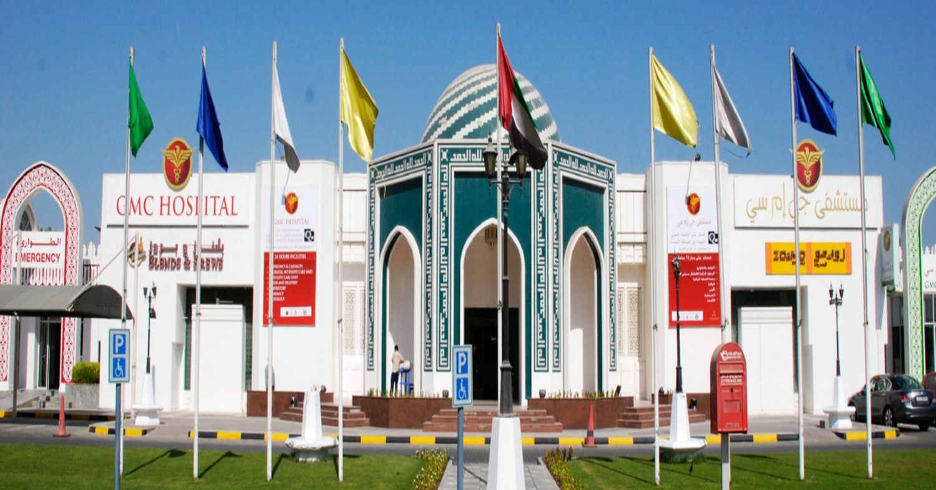
Dissertation Report
Dipstick Survey to determine People’s Perception regarding GMC Hospitals
By: Suvendu Sekhar Panda
PG/12/094

Slide 2
Hospital Profile

Slide 3
GMC Hospital, Ajman, UAE was inaugurated on 17th October,2002 by H.H Sheikh Humaid Bin Rashid Al Nuaimi - Member of Supreme Council, U.A.E and Ruler of Ajman.
Key Highlights –
The First Private University Teaching Hospital in U.A.E.
GMC Hospital and Research Centre affiliated to Gulf Medical University became operational on 17th October 2002.
Capacity of 117 beds, and serves patients from more than 150 nationalities.
GMC Hospital conducts the highest number of deliveries in the private sector in U.A.E.
Affordable prices and caters to population from all the Emirates.

Slide 4
Accreditations – Memberships - Affiliations
Joint Commission International (JCI)
Ministry of Health, UAE
Member - Medical tourism Association
International Hospital Federation
Tresmos, International Board of Medicine and Surgery
Temos Dental certification
Asian Hospital Federation

Slide 5
Task Done
5.Analyzing the result and Developing Competitive Pricing Strategy
4.Conducting the survey in 3 prominent Malls to different Nationalities
2.Contacting the responsible persons to seek permission for survey
3.Designing a semi structured questionnaire
6.Report Filing and Suggestion
1. Mapping the survey sites in and around GMC Dubai Hospital

Slide 6
Key Learning
There is a tremendous potential for the healthcare industry in Middle East especially in Dubai.
The brand GMC HOSPITAL is well known in the Middle East and there is a great potential to capture the “floating population” in Dubai.
There is a perceived likeliness for Indian Doctors and hospital marketing (Domestic and International )is a whole different ball game.
The survey conducted was really helpful for the hospital to plan out the launching activities in a more precise way.

Slide 7
Limitations of Marketing in Ajman and Dubai
Language barrier
Every pamphlet, poster, flyer, brochure designed ,requires Ministry of Health approval(with a time period of a month)
Free, bulk sms and Discount offers of Hospital are prohibited by Law.
Permission from Department of Economics and Ministry of Health for each Health related promotion, event or survey in shopping malls and then a NOC followed by contract signing from the shopping malls.
Actual footfalls in shopping mall seen in only weekdays (Friday and Saturday) and evening considering extreme weather conditions.
Compromisation of visa status

Slide 8
Introduction
Gulf Medical College Hospital Group of UAE, an enterprise of Thumbay Group of Companies and affiliated to Gulf Medical University has been successfully providing healthcare services in UAE since 1998. After successfully establishing itself as a Hospital brand that provides quality treatment at affordable prices through its Hospitals at Ajman, Sharjah and Fujairah, the group now intends to establish itself in Dubai.

Slide 9
Rationale
GMC Hospital is a leading healthcare provider in Ajman, Sharjah and Fujairah continually growing in scope and technologies to meet the diverse needs of families of the region. It offers a wide range of inpatient medical and surgical devices with particular expertise in Obs and Gyn, Neurosurgery, Orthopedics and General Surgery.
Patient have access to sophisticated diagnostic testing including CT Scanning ,MRI etc. Catering to the needs and demands of the people ,the hospital wants to open up a 150 bedded sister hospital in Dubai in three months from now..
However, there has been increasing competitors in Dubai. In order to cater to the needs of the people and brand image of the hospital ,strong marketing strategy, research ,robust marketing techniques is required which will help in pinpointing the exact healthcare problems and demands of the customer and a favorite hospital to avail treatment and consultation.

Slide 10
Cont..
Considering the limitations of marketing
In order to determine all the important variables organizations frequently need quick, quality consumer feedback on a range of things …..Advertising ideas, business issues, specific opinions, brand values, service elements, usage and attitude etc.
Dip-Stick delivers this at a highly competitive fee.

Slide 11
Project Summary
The survey was aimed to gather information regarding Brand awareness and Satisfaction levels of people with GMC Hospitals. Information was also gathered about other aspects of health seeking behaviour of people like source of information about medical treatment, treatment charges and preference for language and nationality of Doctors.
Semi structured Questionnaires were utilized to gather information from more than one thousand respondents randomly selected at prominent malls in Al Qusais area of Dubai and Sharjah. Findings of data analysis are presented hereby. On the basis of findings, Marketing Strategies are suggested for effective marketing of Gulf Medical College Hospital, Dubai.

Slide 12
Objectives

Slide 13
General Objective
To determine the customer perception of brand awareness and service utilization of GMC Hospitals and based on the findings develop a marketing strategy for the upcoming hospital in Dubai.
Specific Objectives
To determine the level of awareness regarding Gulf Medical College Hospitals among people of Al Qusais area of Dubai.
To determine the level of satisfaction from the services of GMC Hospitals, among people of Al Qusais area of Dubai.
To determine the current ‘Hospital Services Utilization Pattern’, in terms of source of information on medical treatment, charges paid for specialist consultation and choice of facility in medical emergency, among people of Al Qusais area of Dubai.
To determine the preference for language and nationality of treating Doctor, among people of Al Qusais area of Dubai.

Slide 14
Review of Literature

Slide 15
Percy, Larry; Rossiter, John (1992). "A model of brand awareness and brand attitude advertising strategies". Psychology & Marketing.
Thumbay Group Brochure, GMC Ajman Brochure and Marketing Department Records (For Hospital Related information)
Mc-kinsey Report on GCC Healthcare markets, Health Systems Profile UAE –Regional health systems observatory – WHO- 2006 and DHA Annual report 2012 (To know the demand and scope of a new hospital in Dubai)
www.raygain.com ( To know what is Dip Stick Survey and how it is conducted)
http://www.businessdictionary.com/definition/brand-awareness.html (On how to create BRAND AWARNESS)
Keller, Kevin (1993). "Conceptualizing, measuring, and managing customer-based brand equity". The Journal of Marketing 1 (22)( On how to recognize and quantify Brand).

Slide 16
Methodology

Slide 17
Study area: Al-Qusais ,Dubai
Study design: Cross-Sectional
Study duration: 75 Days (April 1st to 20th May)
Study population: 3 Shopping malls-Lulu Hypermarket, Al-Mullah Plaza and Ansar Mall (To cater the residents of the Sub-Continent ,Middle East and Western population in the locality)
Tools and techniques: Semi-Structured Questionnaire
Sample: 1017
Sampling method: Simple Random Sampling

Slide 18
Findings

Slide 19
Demographic Profile of Respondents (age-groups)

Slide 20
Q1 Brand Awareness of GMC Hospitals

Slide 21
Q2 Satisfaction with GMC Hospital Services
LULU HYPERMARKET
AL MULLA PLAZA
Not Satisfied (2.1 %)
Very satisfied (5.9%)
Satisfied (14.4%)
Never Experienced (77.3 %)
Not Satisfied (1.3 %)
Very satisfied (3.9 %)
Satisfied (14.2 %)
Never Experienced (80.6 %)
ANSAR MALL
OVER ALL
Not Satisfied (1.5 %)
Very satisfied (6.5 %)
Satisfied (21 %)
Never Experienced (71%)
Not Satisfied (1.7 %)
Very satisfied (5.8 %)
Satisfied (17.6 %)
Never Experienced (74.9 %)

Slide 22
Q3 Awareness of GMC Hospital, Dubai

Slide 23
Q4 Consultation Charges for Specialist

Slide 24
Q5 Source of Information about Medical Treatment
(percentages)
Internet 45% Doctors 32% Friends & Relatives 31% Newspapers 14%

Slide 25
Q6 Preferred Nationality of Doctor
Indian 49% Arabic 15% No Preference 19%

Slide 26
Q6 Preferred Language of Doctor
(percentages)
English 57% Hindi 18% Arabic 18% Malayalam 12%

Slide 27
Q7 Preferred Medical Facility in Emergency
Private hospital 42% nearby clinic 31% govt hospital 24%

Slide 28
Conclusion and Recommendation

Slide 29
Conclusion
First thing that becomes clear from this exercise is that Gulf Medical College Hospitals is a known brand in Dubai. But, awareness needs to be generated among the masses regarding its latest venture, that is, upcoming Gulf Medical College Hospital in Al Quasais area of Dubai.
Secondly, the consultation charges that people are paying currently for a specialist in Dubai are in the range of 200-250 AED, in case of self-paying patients. We have further corroborated this finding by doing a ‘Price Study’ of hospitals in Dubai. In case of Insured patients, the co-payment part of charges is Below 200 AED (mostly being 30 to 50 AED)

Slide 30
Cont..
Thirdly, it can be concluded that Indian Doctors who communicate with patients in English are most preferred by our prospective patients. Knowledge of Hindi, Arabic or Malayalam is an added advantage.
Fourthly, Internet is the most important source of information on medical treatment. This is followed by ‘Doctors’ and ‘Friends and Relatives’. We need to focus on these three areas for effective Hospital Marketing Communication.
An Impressive Interactive Website, Referral Marketing and Offers & Events targeting friends and relatives of existing patients are important for marketing of our new hospital in Dubai.

Slide 31
Cont..
Lastly, results indicate that most preferred choice of medical facility in an emergency is ‘Private Hospital Emergency Department’ and second is ‘Nearby Clinic’. This presents us with an opportunity to market 24-7 Medical Emergency Services. Also, we need to emphasise more and more on Referral Marketing at nearby clinics of Al Qusais area to bring in more and more new patients to our hospital.

Slide 32
Extra Information Gathered
Majority of respondents currently visit NMC Hospital, Zulekha Hospital, and Dubai Hospital
People confuse GMC Hospital with GMC Poly-Clinic located at Al Bada
Comments on experience with GMC Hospital–
“Prices keep changing very frequently”
“Why did you revise prices three times in a year”
“Your OBG department is very good”
“Indian doctors are very professional and very good in clinical skills”
“Information related to new job opening in GMC Hospitals”

Slide 33
Marketing Strategies (Pre Launch of the Hospital )
Above the Line Marketing
Below the Line Marketing
Through the Line Marketing
Gifting Health
Take Care Cards
Health @ Coffee Table
Patient Involvement Activities
Loyalty Cards
Differentiated Marketing
Quality-Academics Association
GMC Mascot
Dentist of Star

Slide 34
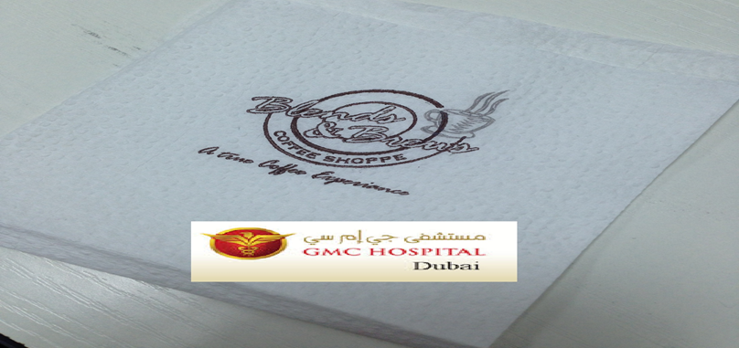
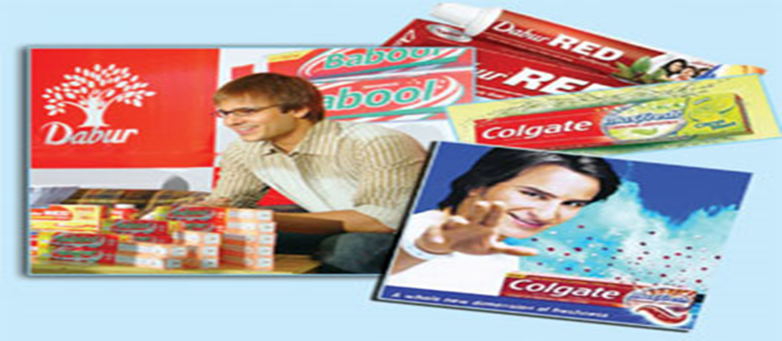
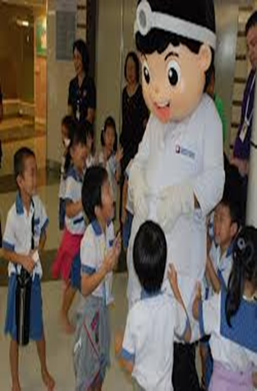
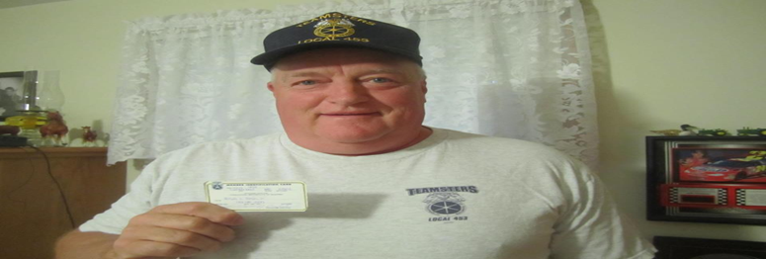
IMAGES

Slide 35
References
Thumbay Group Brochure ,GMC Ajman Brochure ,Records of Marketing Department assessed on 1st of April,2014.
Mckinsey Report on GCC Healthcare markets(http://middleeasthospital.com/GCC%20HEALTHCARE%20CHALLENGE.pdf) assessed on 5th of April,2014
Health Systems Profile UAE –Regional health systems observatory – WHO- 2006 and DHA Annual report 2012(http://www.dha.gov.ae/EN/SectorsDirectorates/Directorates/HealthRegulation/Reports/Pages/HRDAnnualReport.aspx) assessed on 12th April,2014
Building Brand Awareness (www.raygain.com) assesed on 11th of April,2014.
Building and quantifying brand (http://www.businessdictionary.com/definition/brand-awareness.html) assessed on 13th of April,2014.
Keller, Kevin (1993). "Conceptualizing, measuring, and managing customer-based brand equity". The Journal of Marketing 1 (22).
Percy, Larry; Rossiter, John (1992). "A model of brand awareness and brand attitude advertising strategies". Psychology & Marketing 9 (4): 263–274.

Slide 36
Thank You

